Slide 1
The Virginia Literacy Act
Virginia Board of Education Work Session

Slide 2
Objective and Agenda
Today’s presentation will provide an overview of the Virginia Literacy Act (VLA).
The Need: Current State of Literacy in Virginia
Background: Science of Reading
Overview of the VLA
Big Picture: What Success Looks Like
High Level Timeline: What to Expect When
Role of Virginia Literacy Partnerships
Opportunities for Engagement

Slide 3
The Need: Current State of Literacy

Slide 4





Why We Need the VLA
To reverse the trend in literacy levels
To address learning loss from the pandemic
To ensure all children read at benchmark in K-3
To provide support for increasing
numbers of at-risk readers
To provide teachers with evidence-based instructional strategies and curricula

Slide 5
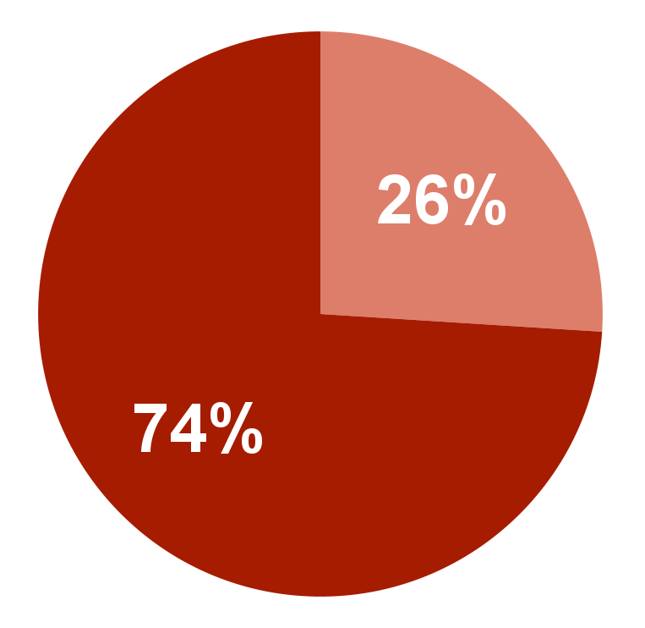
Overall K-2 Literacy Results
Recent Virginia data reveals concerning trends in literacy with historically high numbers of K-2 students at risk of reading difficulties.
29%
  Spring 2022 percentage of K-2 students scoring below benchmark.
  74% of K-2 students fall in the high-risk and medium-risk groups for reading difficulties. Only 26% are considered low-risk.

Slide 6
Disparities in K-2 Literacy
Historically marginalized populations are more likely to be at risk of reading difficulties on the PALS relative to the overall student population.
Rate at which Sub-groups Score At Risk Compared with Overall Grade Level
Sub-Group | K | 1st Grade | 2nd Grade
Black | 1.4x | 1.4x | 1.3x
Hispanic | 1.6x | 1.5x | 1.4x
ESL | 1.9x | 1.6x | 1.4x
Economically-Disadvantaged | 1.4x | 1.4x | 1.3x
Disabilities | 1.9x | 1.7x | 1.7x

Slide 7
Grade 3 Reading SOL Trends
  The third grade passage rate on the Reading SOL has continued to fall over the last decade and has dropped to historic lows during the pandemic.

Slide 8
Significant Drops in NAEP Reading
  Virginia experienced one of the largest drops in 4th Grade Reading in the nation.
NAEP Grade-4 Reading: Percent Proficient or Above
44
43
43
43
Percent At or Above Proficient
42
40
39
38
38
36
34
35
35
34
34
32*
32
32
2011 2013 2015 2017
32
30
2019
2022
National
Virginia

Slide 9
Comparing Virginia to the Nation
Virginia experienced a 13.6 point decrease in average score since 2017.
NAEP Grade-4 Reading: Change in Average Scale Score 2017-2022
5
4
3
2
1
0
-1
-2
-3
-4
-5
-6
-7
-8
-9
-10
-11
-12
-13
-14
-15
AZ
DD LA
MS HI
SC
Change in Average Scale Score
NJ
VT MO CT MN IN MA
KS ME OK NY
ID NC KY OR
OH DC WA NH
RI PA MI NM NE
TN NP
AR UT ND GA
IA SD MT
FL NV
AK AL
IL WI WY
CO
CA TX
VA
DE MD WV

Slide 10
NAEP Reading and Subgroups
4th graders from these sub-groups in Virginia have fared worse compared to peers.
Virginia Grade-4 Reading Proficiency Levels Across Student Groups
50
41
40
32
17
16
All Students
Asian
Two or More Races
White
Black
Hispanic

Slide 11
Why Early Literacy Matters
Third grade is the final year children are learning to read, rather than “reading to learn.” If they are not proficient readers when they begin fourth grade, as much as half of curriculum will be incomprehensible.
Three quarters of students who are poor readers in third grade will remain poor readers in high school; data shows they are more likely to have social and behavioral problems and to be retained.
Students who are not proficient in reading by the end of third grade are four times more likely to drop out of high school than proficient readers.
Low achievement in reading has long-term consequences for individual earning potential, global competitiveness, and general productivity.
https://assets.aecf.org/m/resourcedoc/AECF-Early_Warning_Full_Report-2010.pdf

Slide 12
Background: Science of Reading

Slide 13
The Science of Reading
Converging evidence, from multiple fields of study, over many decades has established the scientific evidence base
Explains how reading develops (neurologically and behaviorally), and why some people struggle to learn how to read and write
Informs evidence based early reading assessment and instruction to prevent reading difficulties

Slide 14
Science and Reading Development
Reading is not the same as language development- reading is not natural
When individuals are skilled readers, they automatically recognize words, but, this is not how early readers process words
Reading comprehension requires both adequate word reading (decoding) and linguistic or language comprehension
Explicit and systematic instruction of foundational reading skills (phonics, phonological awareness, orthographic mapping, etc.) with simultaneous high-quality language and meaning based instruction

Slide 15
The Simple View of Reading
Decoding
Linguistic Comprehension
=
Reading
Comprehension
X

Slide 16
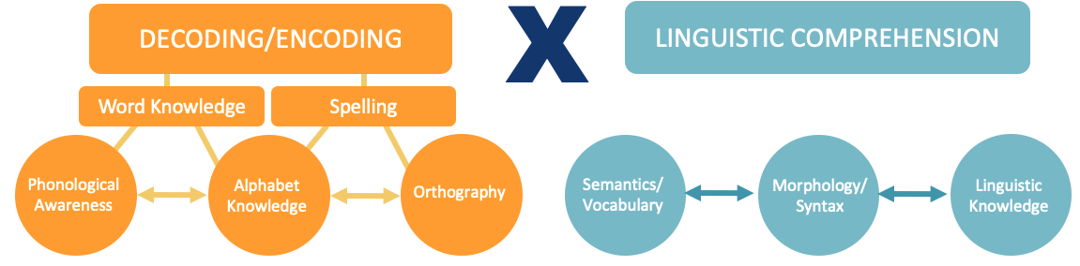
With More Detail
READING COMPREHENSION
FLUENCY
Prosody
Accuracy
Rate

Slide 17
Skilled Reading
Background knowledge
SKILLED
READING:
Fluent execution and coordination of word recognition and text comprehension
Vocabulary
Increasingly strategic
LANGUAGE COMPREHENSION
Language structures
Verbal reasoning
Literacy Knowledge
Phonological awareness
WORD RECOGNITION
Decoding- alphabetic principle, spelling-sound correspondences
Sight recognition–
of familiar words
Increasingly automatic
Scarborough, 2001

Slide 18
Overview of the VLA

Slide 19
What is the Virginia Literacy Act?
The Virginia Literacy Act (VLA) is a comprehensive, multi-pronged approach for ensuring evidence-based literacy instruction is implemented in all K-3 classrooms.
House Bill 319 (Coyner) and Senate Bill 616 (Lucas), both known as the Virginia Literacy Act, passed unanimously out of the 2022 General Assembly.
There is state funding to address the costs of these new initiatives.
VLA provisions become effective beginning with the 2024-2025 school year.*
Delegate Delaney’s HB418 and HB419 are both complements to the Act and address the allowable uses of Early Intervention Reading Initiative funds as well as the audit and approval of educator preparation programs.
*Staffing ratios for reading specialists go into effect for 2023-2024, with funding to support this goal and flexibility in who can meet this requirement.

Slide 20
How the VLA Will Improve Literacy
Virginia is taking the lead nationwide to reverse these trends and improve early literacy outcomes for the Commonwealth’s youngest learners.
Prepare Teachers
Align Curricula, Screening & Intervention Methods
Science-Based Reading Research
Evidence-Based
Literacy
Instruction
The Virginia Literacy Act
Partner with Families
Require Continuing Professional Development

Slide 21
Key Components of the VLA (1 of 2)
Defines Key Terms
Establishes the definition of evidence-based literacy instruction and science-based reading instruction.
Aligns Core Curricula, Screening and Intervention Methods
Requires both the core instructional, supplemental and intervention programs in grades K-3 be aligned with science-based reading research, as set out in a division-wide literacy plan.
Maintains the current screening model to identify students in need of intervention, and requires the development of reading plans for students below the benchmark.
Adds a division-wide staffing ratio of one reading specialist per 550 students in K-3.
Requires Continuing Professional Development and Training
Requires principals, teachers and reading specialists be provided with professional development in science-based reading research and evidence-based literacy instruction.

Slide 22
Key Components of the VLA (2 of 2)
Partners with Families
Ensures parents are engaged in the development of student reading plans and have access to resources to support literacy development at home.
Aligns Educator Preparation and Licensure
Requires certain educator preparation programs to ensure candidates have a program of coursework and demonstrate mastery in science-based reading research and evidence-based literacy instruction.
Stipulates that the literacy assessment for licensure or alternate route to licensure with certain endorsements include a test of science-based reading research and evidence-based literacy instruction.
Requires every person seeking initial licensure with certain endorsements complete study in science-based reading research and evidence-based literacy instruction.
Establishes a microcredential program for earning an add-on reading specialist endorsement (when needed).

Slide 23
Big Picture: What Success Looks Like

Slide 24







Who Will Benefit?
Teachers and Reading Specialists
Families
School Divisions
Higher Education
Students

Slide 25
Every K-3 Student…
Receives core literacy instruction from an evidence-based literacy curriculum for the entire literacy block
Receives additional evidence-based instruction and intervention, as outlined in a student reading plan, if they do not meet literacy benchmarks

Slide 26

Every K-3 Teacher…
Uses evidence-based literacy curriculum for the entire literacy block
Assesses student learning using approved literacy screeners routinely throughout the year
Uses student-level data to inform both whole group instruction and individualized instruction and intervention
Participates in pre-service preparation and/or in-service training in evidence-based literacy instruction

Slide 27
Every K-3 Reading Specialist…
Coordinates intervention services for students not meeting literacy benchmarks
Develops, oversees implementation of, and monitors student progress on student reading plans, in collaboration with teachers and families

Slide 28
Every School Division…
Develops a division-wide literacy plan
Ensures all kindergarten through grade 3 teachers have and use evidence-based literacy curriculum
Staffs at least one reading specialist for every 550 students in kindergarten through grade 3
Provides professional development in evidence-based literacy instruction to teachers, reading specialists and principals
Receives coaching and support from regional literacy coaches

Slide 29
Every Family of a K-3 Student…
Has access to free online evidence-based literacy instruction resources to support their child’s literacy development at home
Can participate in the development of their child’s student reading plan, if they do not meet literacy benchmarks

Slide 30
Every K-3 Educator Prep Program
Requires aspiring teachers and reading specialists to complete coursework in and demonstrate a mastery of evidence-based literacy instruction

Slide 31


VLA = Comprehensive Supports for All
Working together we can improve literacy for all students in Virginia.
Policymakers
Partners
Division Leaders
Reading Specialists
Teachers
Families
Students
Higher Education

Slide 32
Timeline: What to Expect When

Slide 33
Key Activities for the VDOE in 22-23
In 2022-2023, the VDOE will support divisions to prepare for VLA implementation by:
Building and running a rigorous, multi-phase process that engages Virginia experts/educators to identify best-in-class K-3 core curriculum, supplemental and intervention materials and professional development providers.
Developing guidelines and tools for supporting students who have not yet met reading benchmarks using a student-specific reading plan.
Providing statewide training for reading specialists, beginning in Summer 2023.
Developing guidance and tools for divisions to build literacy plans.

Slide 34
Key Activities for the Board in 22-23
In 2022-2023, the VBOE will be asked to:
Become familiar with the VLA and key timelines and activities.
Begin to approve best-in-class K-3 core literacy curriculum (Recommended Core Instructional Program Guide).
Begin to approve certain knowledge-based professional development vendors.
Approve guidance for student-specific reading plans and division-wide literacy plans.
Note: It is expected that there will be multiple rounds of reviews for core, supplemental and intervention materials with each requiring Board approval.

Slide 35
Key Activities for Divisions in 22-23
In 2022-2023, school divisions can prepare by:
Building awareness of the VLA and why evidence-based literacy instruction matters for students, focusing on principals, reading specialists and K-3 educators.
Submitting curricula or ensuring curriculum vendors submit their materials for review.
Evaluating which students are not yet meeting reading benchmarks and introduce the concept of using student specific reading plans.
Calculating reading specialist ratios and adding staff if needed.
Ensuring that reading specialists can participate in statewide training beginning in Summer 2023.

Slide 36
High Level Timeline for 2023-2024
In 2023-2024, the VDOE and divisions will take additional steps to prepare for full implementation of the VLA by 2024-2025.
There will be additional rounds to identify best-in-class literacy instructional materials focused on supplemental and intervention materials.
Statewide training options in evidence-based literacy instruction and science based reading research will be available for teachers and principals, beginning Summer 2024.
VDOE will release templates, tools and guidance for literacy plans and student-specific reading plans along with a proposed calendar for annual VLA data collection and reporting.
VDOE will also work closely with educator preparation programs to begin to institute the shifts required by the VLA.

Slide 37
Role of Virginia Literacy Partnerships

Slide 38
Role of Virginia Literacy Partnerships
In partnership with VDOE, the Virginia Literacy Partnerships (VLP) at UVA will:
Develop a process for vetting K-3 core literacy curricula, supplemental instruction practices and programs, intervention programs, knowledge-building professional development, and curriculum-embedded professional development
Develop and execute a statewide training series available to all reading specialists and K-3 teachers, special education teachers, and principals.
Develop a template for a student reading plan and provide technical assistance to divisions.
Hire and supervise literacy coaches who will support all training and implementation efforts, primarily through collaboration with reading specialists.
Produce a list of aligned literacy resources for families that are culturally-responsive and available in multiple formats (e.g., online, paper).
Note: VLP will also continue to support the state’s universal literacy screener, including developing a new and improved screener with a parallel screener in Spanish.

Slide 39
Opportunities for Engagement

Slide 40
Opportunities for Engagement
Implementing the VLA successfully will require building partnerships, securing buy-in and ensuring the perspectives of leaders, educators, experts and families are fully included. Here are key ways in which the VDOE will engage stakeholders:
Launch a Virginia Literacy Act Advisory Work Group that will include a broad set of stakeholders and will meet quarterly to provide insights and feedback.
Engage Virginia literacy experts and educators through the instructional materials review process.
Continue to engage a separate taskforce that is advising the pilot of Virginia’s New Literacy Screener.
Conducting outreach within existing structures including conferences, webinars, regional meetings and other events and activities.

Slide 41
Questions

