Slide 1
Summer Food Service Program (SFSP)
Application for Participation
Training Module
Office of School Nutrition Programs
April 2018
Notes:
Welcome to the webinar training for the Summer Food Service Program module in SNPWeb. My name is Courtney Jones and I am the Child Nutrition Programs Supervisor at the Virginia Department of Education. This webinar will walk participants through the new SFSP application module and will be recorded. The line will be muted for all participants so please use the chat box to ask any questions you may have. At the webinar’s conclusion, I will review the questions that have been asked.

Slide 2
Accessing SNPWeb
Notes:
VDOE has a log-on portal called Single Sign-On for Web Systems, often referred to as SSWS, where all organizations will log in to access the SNPWeb modules.
Each school division has an assigned ERA that determines who within your division has access to SSWS. You will need to contact this individual to get access to the SFSP module prior to the application opening Monday, April 16.
Non-school sponsors will be sent the login instructions as well as information regarding their username via email Tuesday, April 10. Friday, April 13, non-school sponsors will be sent a temporary password. It’s very important that you go in and reset the password immediately upon receipt of the temporary password, as the account access will expire within 20 hours.
The application packet itself will open on April 16, 2018.

Slide 3
SFSP Module Overview
Software screens
Navigation
System notifications
Application
Sponsor Application
Management Plan*
Food Production Facility
Site Applications
Budget*
Checklist Items
*To be completed by non-school sponsors only
Notes:
Along with discussing the software screens and basic navigation, I will walk through each component of the SFSP application. Please note that this webinar is intended for all sponsor types, so there are certain sections that will not be applicable to school divisions, and I will point those out as we go along.

Slide 4
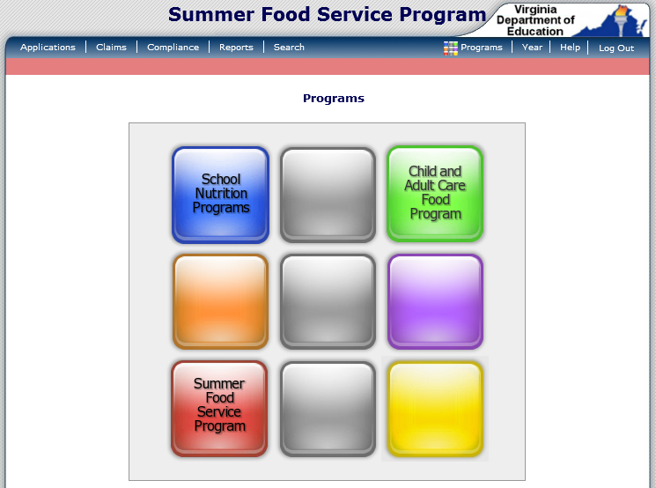
Program Module Selection
Notes:
Upon login to SSWS, if your organization participates in multiple programs, you will first see the landing screen with tiles to select which program module you want to access. If your organization only participates in the Summer Food Service Program, you will bypass this screen and go directly to the SFSP module. This training will focus on the Summer Food Service Program module, and you will see the red tile to take you to that module in the bottom left hand corner of the screen.

Slide 5
Summer Food Service Program
Main Menu Options
Applications
Claims
Compliance
Search
Notes:
After choosing the program module you want to work in, you will reach a landing page where you will see messages from the state agency. The message board will be updated throughout the program season with important reminders and dates.
The main menu for the SFSP module contains various tabs that have different functions for the program (applications, claims, compliance, search). Which menu items appear in your SFSP module are determined by security rights, which are set by VDOE. For the purpose of today’s training, we will be focusing on the Applications tab.

Slide 6
Common Menu Tools
The following menu options are available from every screen:
Programs
Displays Program Selection screen if the organization participates in multiple programs
Allows users to switch to a different program
Year
Allows user to switch the Program Year to use in the software
Help
Opens Help screen – electronic version of the module’s User Manual
Logout
Notes:
There are various menu tools on the top right of the screen. The Programs button will allow you to select which program module you want to work in, if your organizations participates in multiple programs. Program Year allows you to navigate between different program years, if your organization has participated in more than one program year. Should you have any questions about how to operate the software, the Help button will take you to a user manual on the SFSP module. Lastly, the Logout button will log you out of SNPWeb completely.

Slide 7
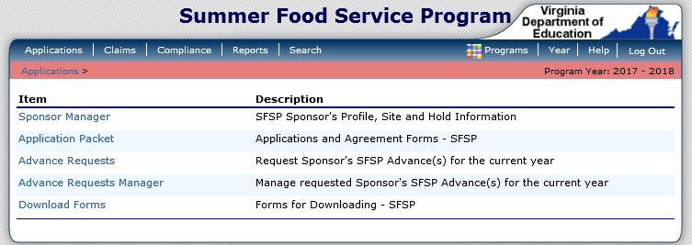
Navigation
Red Menu Bar denotes user is in the SFSP
Breadcrumb Navigation
Click link to go to that software screen
Displays the active Program Year
Notes:
There are a few tools in SNPWeb that make navigating the system easy. The colored menu bar gives a visual que to the user which program they are working in. If you recall from the login screen, the SFSP tile displays as red, and so does this navigation bar when you are in the SFSP module. This menu bar also contains a breadcrumb navigation so users can access previous screens rather than using the browser’s back button. The program year is also viewable within the menu bar.

Slide 8
Screen Modes
Many screens have different modes depending on the user’s security rights.
View
Modify
Delete
Notes:
Users with multiple security rights can change the mode in which they are working with the application from the upper right corner of the screen. Based on your security rights, you will be able to View, Modify, and Delete information on the application forms. Only authorized state agency users will be able to work in the Internal Use Only mode.

Slide 9
Errors and Warnings
Business rule checks have levels of severity that indicate whether the data entered is considered an Error or a Warning.
Notes:
When you save information or proceed to a new page, the software checks for input errors and performs business rule checks. Business rule checks are used to ensure that data entered on a form conforms to state-defined guidelines and federal regulations. You may encounter Errors and Warnings as you are working through the application. Errors appear in red and must be corrected before the form can be submitted. Warnings appear in blue and indicate an “out of the ordinary” data value. Warnings do not need to be corrected prior to the form submission but should be reviewed to ensure the accuracy of the application.

Slide 10
Application Menu Items
Application Packet
Advance Requests
Download Forms
Notes:
You access the Application Packet by clicking on Applications in the upper left hand corner. The Application Packet is where the SFSP application will be completed. If you plan on requesting an advance once your application has been submitted, you will also be accessing the Advance Requests screen here. All SFSP forms that you will need for the application and throughout the summer can be accessed by clicking on Download Forms, located at the bottom of the list.

Slide 11
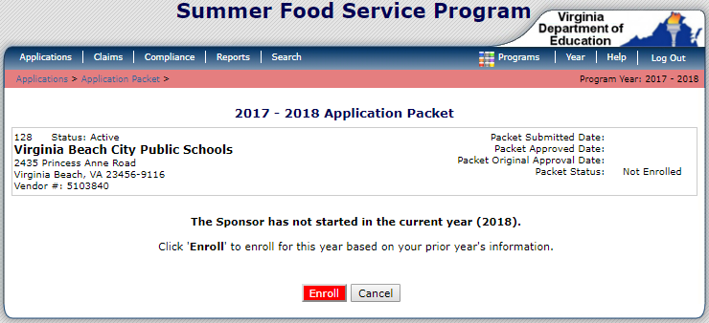
Returning Sponsors
Select the Enroll button
This will enroll the sponsor for the current program year and rollover the appropriate data into the Application Packet forms
Notes:
When the application is opened on April 16, 2018 (and October 1 of each subsequent year for the beginnings of the fiscal year), sponsors will need to enroll. Simply click on the Enroll button and data from the previously approved application will rollover into the new fiscal year’s application. You will then be able to review and update the application packet forms, which I will discuss next.

Slide 12
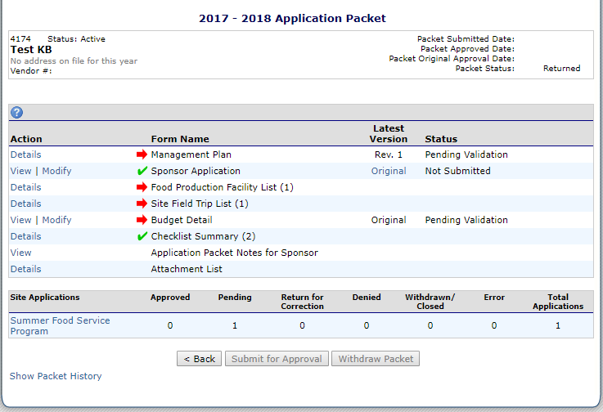
SFSP Application Packet Components
The following components are part of the Application Packet:
Sponsor Information
Packet Details
Tooltip
Forms
Packet History
Notes:
The main application packet screen is where you can view all of the items required for the completion of the SFSP application.
Sponsor information: in the top left corner you will see information about your organization. Please confirm that this information is correct when you first open your application packet. If not, please contact your specialist for assistance.
In the top right corner you will see information about the status of your application, such as when the application was originally submitted, when it was originally approved, and if it is currently approved or submitted for approval.
Directly below your organization’s information is a circle with a question mark inside of it. This is called a tool tip. If you hover your mouse over the tool tip, a box with helpful information will appear. This tool tip provides information about which order the application components should be completed in.
In the middle of the screen you will see all of the forms that must be completed in order to submit your application packet. In a few moments we will review the order in which you should complete these forms.
Toward the bottom, left side of the screen you will see a link that says “Summer Food Service Program” under the gray header that reads “Site Applications”. You will click on this link when it’s time to complete your site applications.
Finally, at the bottom left corner of the screen you will see a link that says “Show Packet History”. If you click on this link, the screen will extend to show you the history of your application packet, including when changes were made and by which user.

Slide 13
SFSP Application Packet Functions
Action column allows user access/navigation to a particular form
Action settings are controlled by security rights
Forms requiring completion and/or contain errors display a Red Arrow
Forms display a Green Checkmark when completed and are error-free
Notes:
The action column will allow you to decide if you want to view or edit certain forms. Depending on your security rights, you may be allowed to only view some forms. Beside the form names you will see red arrows and green check marks. A red arrow indicates that the form is incomplete and must be completed before submitting the application packet. A green check mark means the form is complete without any errors.

Slide 14
SFSP Application Packet Overview
Application Required Forms
Management Plan*
Sponsor Application
Food Production Facility List
Site Application(s)
Budget Detail*
Checklist Summary
*To be completed by non-school sponsors only
Optional Forms/Tools
Site Field Trips
Attachment List
Notes:
The required forms of the SFSP application are located on the main Application Packet screen. School sponsors are not required to complete a Management Plan or a Budget, so these will not appear on their screens. Forms required for all organizations include the Sponsor Application, Food Production Facility List, Site Applications, and Checklist Summary. Other form names you will see on the screen include Site Field Trips and Attachment List. When a state agency user returns an application for corrections, you will also see a section named Application Packet Notes for Sponsor. This is where your CNP or SNP Specialist will leave you instructions for completing your SFSP application.

Slide 15
Order of Completing Application Forms
Sponsor Application
Management Plan
Food Production Facility
Site Applications
Checklist Items
Budget
The recommended order for completing application forms
Certain data is necessary in order to be available for use in the next form
Notes:
When completing your SFSP application, you should first fill out the Sponsor Application. If you are a non-school sponsor, you will then move on to the Management Plan. Remember, if you are a school sponsor, the Management Plan will not be a component of your application. Both sponsor types will then complete the Food Production Facility form. It is important to complete the Food Production Facility form prior to completing Site Applications, as information entered into the Food Production Facility form feeds into the Site Applications. Once the Food Production Facility form has been completed, you should move onto the Site Applications. After Site Applications have been completed, non-school sponsors will complete the Budget section. It is important to complete the Budget after the Site Applications because information from the Site Applications is pulled into the Budget. School sponsors are not required to submit a Budget. Next, all sponsor types will be prompted to upload any required documents into the Checklist. I will now discuss each section of the application in detail.

Slide 16
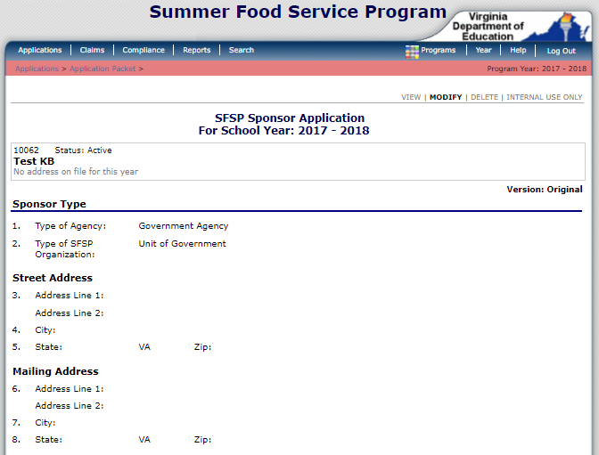
Sponsor Application
Collects the following information:
Addresses
Contacts
Training
Ethnicity/Racial Data
General Questions
Some information will populate from the VDOE database
Notes:
Now that we have discussed the basic navigation of the Application Packet screen, I will go in to each form and review the content and requirements. The Sponsor Application, which should be completed first, collects contact information, information about training, ethnic and racial reporting, and general questions about your organization and summer program. Certain information is being pulled from the VDOE database to populate the address and contact information fields. If any of the populated information is not correct, let your CNP or SNP Specialist know immediately. Data will also rollover from the applications you submitted in CHAAMPS, the application system used at the Virginia Department of Health. Please review any information that rolled over and update that information when necessary.

Slide 17
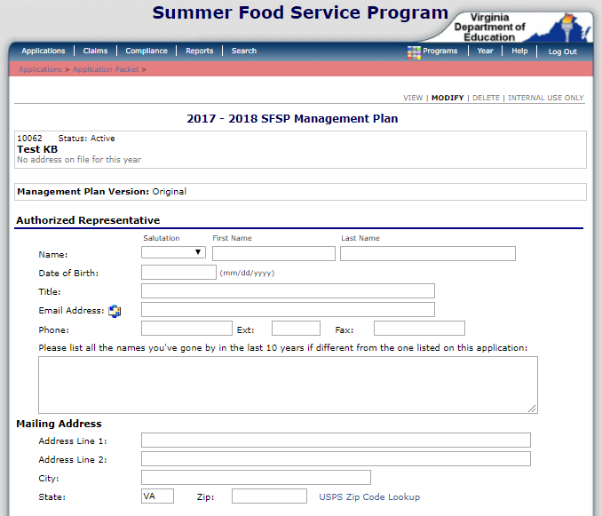
Management Plan*
Collects the following information:
Authorized Representative
Administrative Staff/Training
Administrative and Operational Personnel
Monitoring Plan
*To be completed by non-school sponsors only
Notes:
Non-school sponsors should next complete their Management Plan. The purpose of this form is to collect information on the organization’s administrative and operational staff that will have responsibilities in the SFSP. The form will also collect the dates that you plan to train your staff. Toward the bottom of the form you will enter information about your monitoring plan, so the state agency can ensure your organization will have adequate oversight of the sites you plan to sponsor.

Slide 18
Food Production Facility List
Food Production Facilities must be entered prior to completing the Site Applications
A Food Production Facility is the location where the meals served to children are prepared
Central Kitchen
Vended
Notes:
Before moving on to your Site Applications, both school and non-school sponsors must first complete the Food Production Facility List. A form should be completed for all vended meal companies your organization may contract with and for all central kitchens used for preparation of SFSP meals. It is important to ensure that you enter all facilities that are preparing food, because for all sites that are not self-preparation you will be asked to indicate the facility where the food is coming from in the Site Application. As mentioned previously, this information from the Food Production Facility List will feed into the Site Applications, to help you answer that question. Please note that when completing information for a vended meals facility, a Checklist item will be triggered to upload a copy of your vended meals contract.

Slide 19
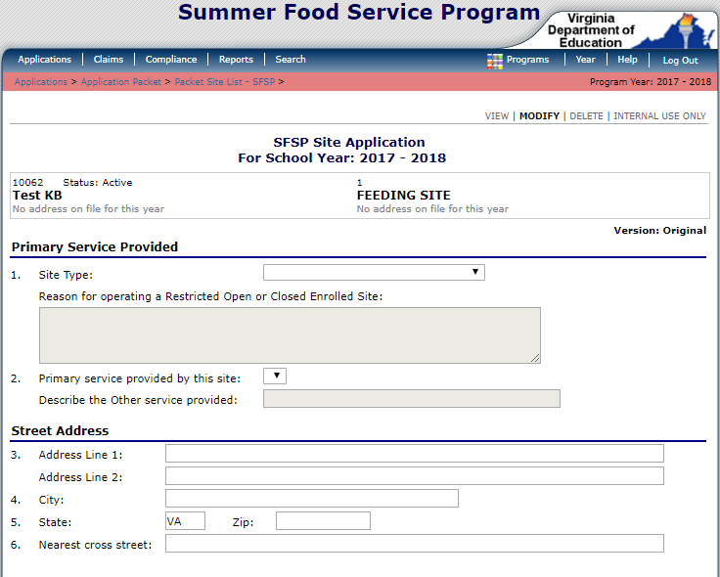
Site Application(s)
Collects the following information:
Site Type
Addresses
Contacts
General Info
Site Eligibility
Site Operation
Meal Type
Food Production
Outreach
Notes:
After the Food Production Facilities are completed, you should complete all of the site applications. This form will collect all information about the delivery of the program including site type and contact information, site eligibility, and general site information such as dates of operation and meal types and times. The Site Application will also collect information on how the site will communicate with the sponsor and also information on health and sanitation, such as how the site will appropriately store food between delivery and meal service. We understand that Site Applications are lengthy, and that completing one for each site when you sponsor several sites can take time. Keep in mind that information from CHAAMPS will be rolling over into SNPWeb, so applications for returning sites will contain information from last summer that will just need updating. Lastly, school sponsors should note that addresses for sites located in schools will pull from the VDOE database and will not be editable. If the addresses are incorrect, please let your SNP Specialist know.

Slide 20
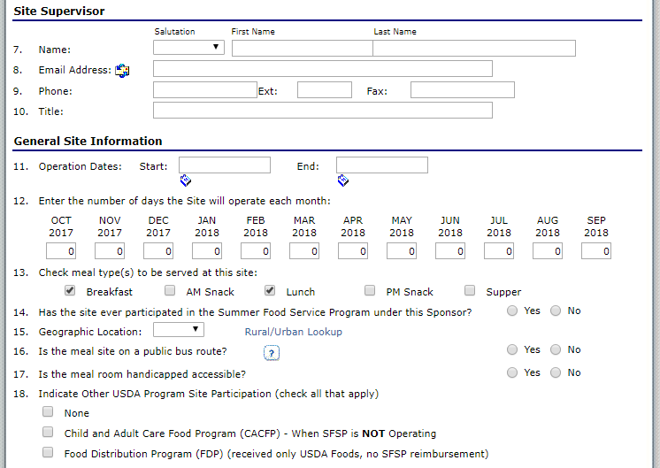
Site Application(s) – General Site Information
This section of the form collects the following information:
Contact information for the site supervisor
The site’s dates of operation and the meals
Location and accessibility
Notes:
As noted in the previous slide, the site application collects all information regarding site operation. Questions 7-10 collect contact information of the site supervisor. Each site must have a designated individual who is responsible for overseeing the entire meal service. The General Site Information section of the Site Application form collects data such as the site dates of operation, the total number of days the site will plan to operate each month, and the meals the site will serve. It is important to note that the number of operating days must be accurate for claiming purposes. Please verify that you’ve entered the appropriate number of days, especially for July. We typically see errors in July due to closures for the July 4 holiday.
This section also collects information about the location and accessibility of the site. Please note that each site application must have the appropriate designation in terms of rural and urban, as it is linked to the reimbursement rate for meals served at the site. There is a link for Rural/Urban Lookup to obtain the proper designation.

Slide 21
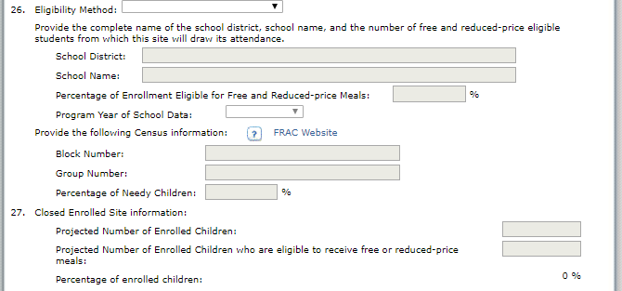
Site Application(s) – Site Type and Eligibility
Indicate the applicable Site Type:
Open
Restricted Open
Closed Enrolled
Camp
National Youth Sports Program
Notes:
The software will enable or disable fields in this section based upon the responses entered. Please know that any sites operating as restricted open must have supporting documentation of a prior specific event that compromised space, security, safety, or control. Please upload the doucmentation in the Attachments section in order for the Site Application to be considered for approval. If the site is operating as open or restricted open, you will use school or Census data to qualify the site as area eligible. For the purpose of streamlining your SFSP operation with your At-Risk operation (if you have one), VDOE recommends first trying to qualify sites using school data, as sites that participate in the At-Risk program can only qualify through school data. If the site is a closed enrolled site or a camp, different fields will be available for you to enter qualifying information.

Slide 22
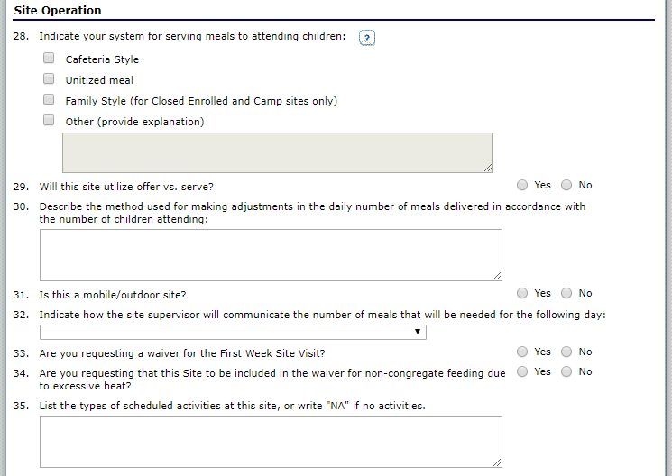
Site Application(s) - Operation
This section collects the following information:
Meal delivery system
Offer vs Serve
Communication process
Waiver requests
Notes:
This section of the Site Application collects information relative to the site operation, which includes how meals are served, if offer vs. serve will be utilized, the process the site will follow for communicating to the sponsor fluctuations in attendance, and waiver requests. Sponsors may request a First Week Site Visit waiver if the site operated in the previous year without any operational deficiencies. There is also a waiver to request non-congregate feeding due to excessive heat. If approved, the site must maintain documentation of days in which the National Weather Service issued warnings of excessive heat for the area the site is located in.

Slide 23
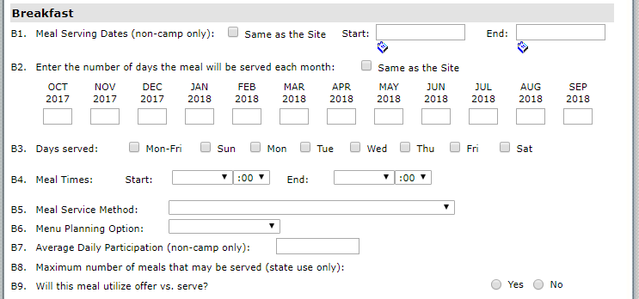
Site Application(s) - Meals
Breakfast, Lunch, Snack, and Supper sections share the same basic questions
Meal sections are dynamically displayed
Notes:
There are certain sections of the site application that impact anticipated reimbursement, which will be reflected in the Budget for non-school sponsors. These sections will also effect the claiming section edit checks for all sponsor types. These sections include the number of operating days entered, and Average Daily Participation. The state agency determines the maximum number of meals that may be served in the Internal Use Only section, and you will see the approved number when the site application is approved. It’s important to keep the ADP updated throughout the season so that you don’t run into problems when attempting to enter a claim for reimbursement later.

Slide 24
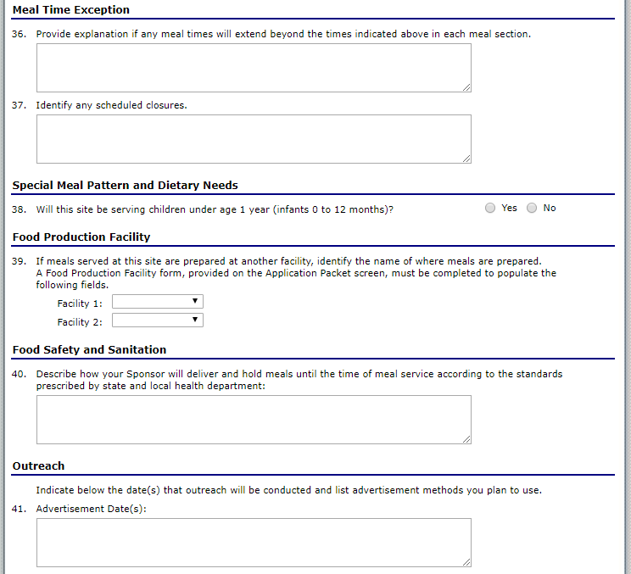
Site Application(s) – Other Considerations
These sections collect the following information:
Meal time exceptions
Scheduled closures
Special meal pattern
Food production facilities
Food safety practices
Outreach
Notes:
The final sections of the Site Application collect various information about the site. The sponsor must note any meal time exceptions that will affect the meal service, such as variations in meal time and identified closures. The July 4th holiday is a common date for sites to be closed, so please indicate that in question #37. The next section asks the sponsor to identify if the site will be serving children under the age of 1 year, and if so, the Child and Adult Care Food Program meal pattern may be used to serve those infants. Question #39 collects information on where meals are obtained from, such as a central kitchen or a vendor. The next section asks sponsors to describe the process and procedure used to ensure that all meals are held at appropriate temperatures until the time of meal service. Finally, the sponsor is asked to identify the dates that outreach was conducted and the advertisement methods used. The sponsor will then certify that the information entered is correct and save the site application form.

Slide 25
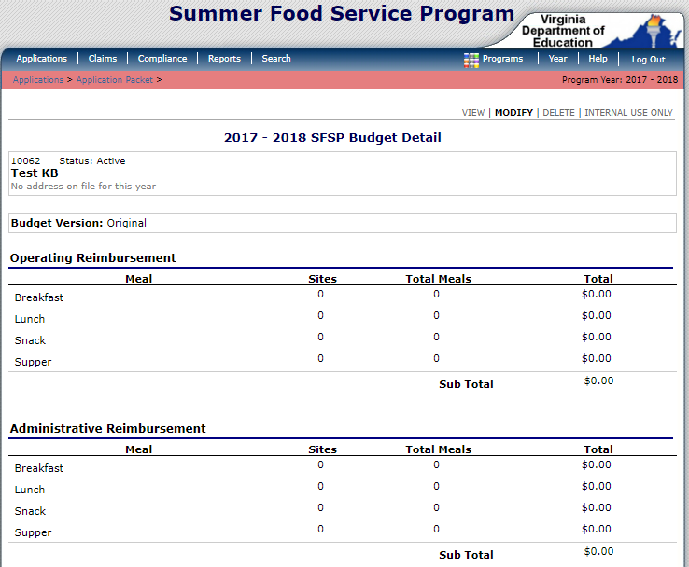
Budget Detail Part 1
The Budget Detail is a required form for Non-School SFSP Sponsors
Budgets must be completed after all Site Applications are completed
Notes:
Non-school sponsors will complete the Budget Detail after all site applications are complete. The top portion of the budget is a projection of your organization’s operating and administrative reimbursement. This projection is calculated by the system and is based off information entered into your site applications. This section allows you to estimate what your SFSP reimbursement may be, if the information you entered into your site applications is a reasonable estimate for your upcoming summer operation.
By meal type, the software calculates the following:
Sites = Total # of sites with applications
Total Meals = Total number of operating days * Average Daily Participation
Total = Operating Reimbursement Rate * Total Meals
-AND- Administrative Reimbursement Rate * Total Meals

Slide 26
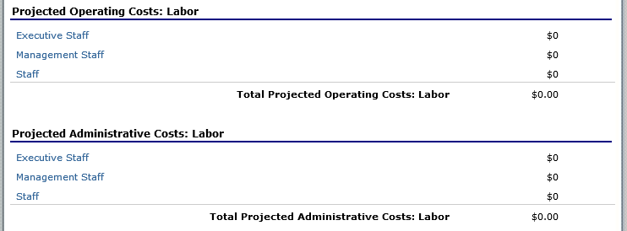
Budget Detail Part 2
Click Add Rows link to add additional rows
Click on Additional Costs and/or Benefits link to view/edit Benefits Calculator items
To exit Projected Costs screen, press the Save button
Notes:
The main budget screen displays Projected Operating and Administrative Costs sections where labor is calculated. There are subsections within each that contain space for tracking Executive Staff, Management Staff, and Staff labor costs. When you choose a category, a screen will display where the name of the employee and duties can be entered. You will enter the employees base annual salary, additional costs and/or benefits, number of hours worked daily, number of hours spent performing food service duties, and the portion you are paying the staff from the food service account. The software will calculate the Total Base Annual Salary plus benefits. The portion paid from food service account should be based on the proportion of hours spent performing SFSP duties compared to the total hours worked daily. For example, if a staff member works 8 hours per day and half of that time is spent on the SFSP, half of their salary plus benefits can be attributed to the food service account. In other words, since labor is an allowable cost in SFSP, half of their salary would be counted toward SFSP expenses, and you can then use SFSP funds to pay that portion of their salary.

Slide 27
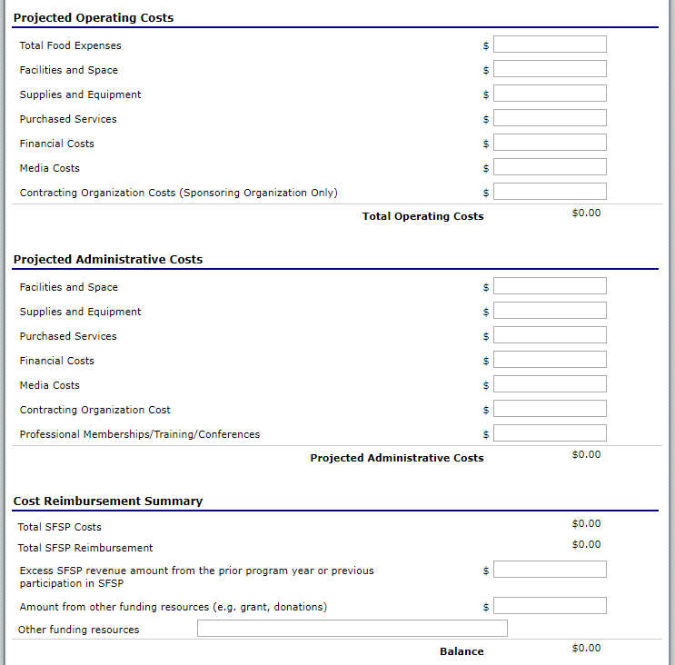
Budget Detail Part 3
Sponsors will detail Operating and Administrative Costs to demonstrate to the state agency that they are financially able to administer the SFSP
The system will calculate the total SFSP costs
Balance cannot be <$0.00
Notes:
When labor expenses are entered, the system navigates you to a new screen in which to enter the information. Upon completing and saving the information, the system will run its edit checks which look at the overall form. It’s unlikely the entire budget will be completed before entering labor costs. Because sections may be blank, you may receive a red error message. Once the blank fields are completed and the form is saved, those error messages will go away.
You will then list the Projected Operating and Administrative Costs for the program. These include total food costs, facilities and space, supplies and equipment, purchased services, financial costs, media costs, and contracting organization costs. There are two important take-aways about this section.
First, items entered under both operating and administrative costs must be prorated to reflect accurate allocations to program. For example, if the kitchen and administrative office are in the same building that is owned or leased, the space must be prorated to reflect accurate distribution of program utilization. You might allocate 75% of the expense of the space to the operating costs and 25% of the expense of the space to administrative costs.
Second, most of these items require submission of supplemental documentation to show proper allocation. Facilities and space will require submission of a lease or similar documentation to validate the cost indicated, purchased services will require submission of documentation to show what services are contracted, and contracting organization costs will also require supplemental documentation.
One last point to make about the Budget Detail is that the system will automatically calculate the Total SFSP Costs and the Balance based on the Total Anticipated SFSP Reimbursement. The balance cannot be less than $0.00. Please be aware that the Budget Detail is used to verify the sponsor’s financial viability to run the program. The amount of funding from other sources must be indicated to account for any deficit of program revenue.

Slide 28
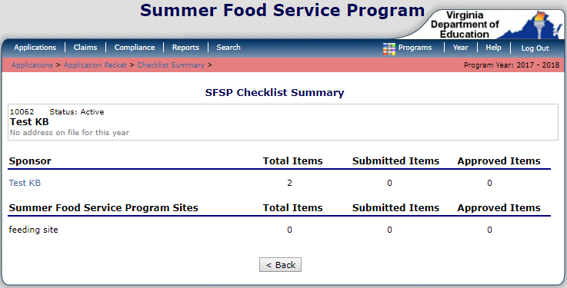
Checklist Items
Items are generated by the system based on answers in the Sponsor and Site Applications
Sponsors must attach the required documents
Notes:
The Checklist Items are the last component of the SFSP application that must be completed. Checklist Items are generated based on the answers provided by the sponsor in the application forms.

Slide 29
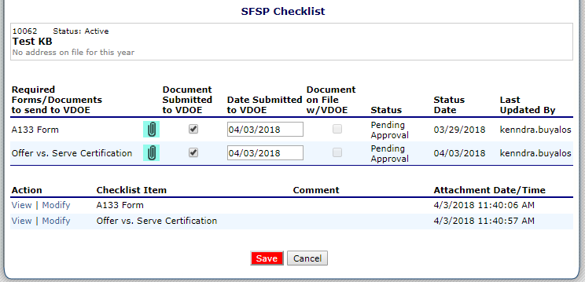
Checklist Items (cont.)
Click the paper clip icon to attach documents
Then click the browse button to select the appropriate file, enter a comment if applicable, and press Save button
Notes:
Underneath of “Required Forms/Documents to send to VDOE” click on the paper clip icon that corresponds with the document you are ready to attach to the Checklist. You will be taken to another screen where you’ll browse and the select the file you wish to upload. When you’re ready to submit the document, press the Save button. Then, you’ll need to check the box to the right of the paper clip underneath “Document Submitted to VDOE”. The box reading “Date submitted to VDOE” will automatically populate with the date the document is uploaded and the box checked. You will be able to view and modify your uploaded attachment under the Action column on the Checklist screen.

Slide 30
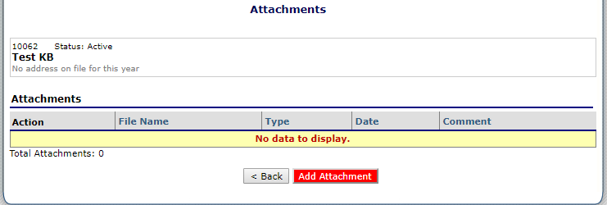
Attachments
Allows sponsors to add additional documentation to the Application Packet
Documents are added the same way as Checklist Items
Add Attachment
Browse to find the appropriate file
Save
Notes:
This section will be used to upload any relevant documents that need to be collected for the completion of the application. Later this week, Dr. Curwood will be sending out a SFSP Addendum to the Permanent Agreement for School Divisions. This will need to be completed by the Superintendent and uploaded into the Attachments section. Non-school sponsors will be sent a new Permanent Agreement to have completed. It should also be uploaded into the Attachments section.
Additionally, if one of your sites is restricted open, you would upload documentation verifying an incident that compromised safety or security. This is also where you would upload the Right of First Refusal and health inspections for every site, except for sites that are located inside of schools. You may also need to upload supporting documentation for your Budget here.

Slide 31
Attachments (cont.)
Other documents to be updated in Attachments:
Permanent Agreement (non-schools only) or Addendum to the Permanent Agreement (schools)
IRS Documentation*
Free and Reduced-Price Policy Statement
Certification Regarding Lobbying*
Notes:
The following documents need to be uploaded to the Attachments section. Those documents include:
-Permanent Agreements: since the SFSP transferred to VDOE, all non-school sponsors will be required to enter into a new Permanent Agreement with VDOE. School divisions will complete and submit an Addendum to their existing Permanent Agreement.
-All sponsor types must upload the following: Free and Reduced Price Policy Statement
-Non-school sponsors should upload their IRS documentation and their Certification Regarding Lobbying
All of these forms will be available to download under the Download Forms section of the Applications tab.

Slide 32
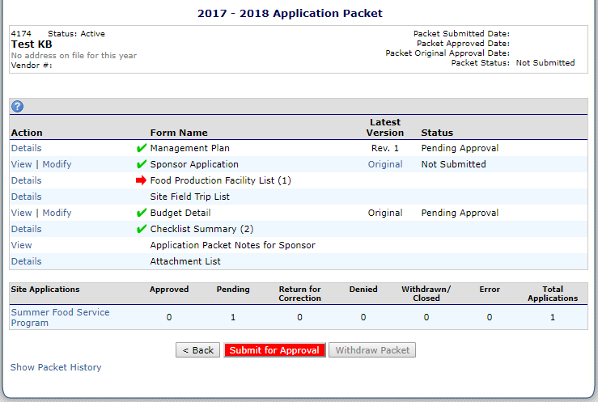
Submitting the Packet for Approval Part 1
All forms have green checkmarks
No site applications have errors
Submit for Approval button is enabled
Notes:
After all the forms of the Application Packet have been completed and are error-free, the Submit for Approval button will be enabled at the bottom of the Application Packet Screen. Please note that all sections should have green checkmarks indicating the forms are submitted without error, except for the Food Production Facility List. This section will always show a red arrow.

Slide 33
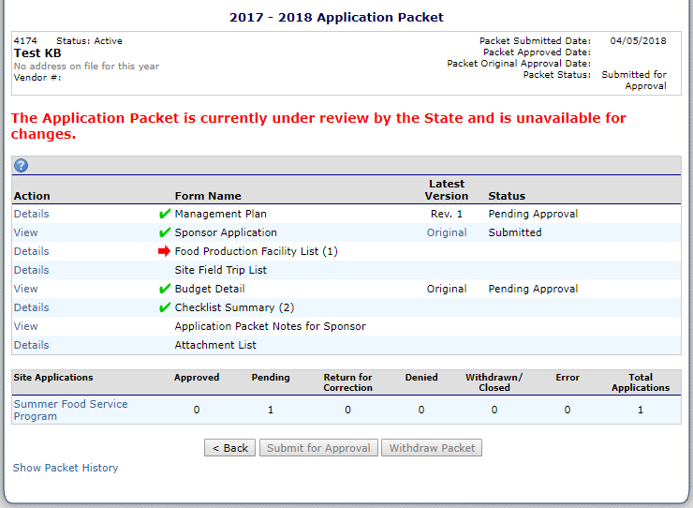
Submitting the Packet for Approval Part 2
SFSP contact receives automatic email notification of packet submission
Packet Status displays “submitted for approval”
Message displays alerting the user the Application Packet is under review
Forms are now view-only to the sponsor
SFSP contact will receive an automatic email confirmation if packet is Approved or Returned for Correction by the state agency
Notes:
After a sponsor has submitted the application for approval, the SFSP contact will receive an automatic email generated from the system that verifies the packet submission. The Application Packet status will display “submitted for approval” and with the date it was submitted, and a message will be visible at the top of the screen alerting the user that the Application Packet is under review and is unavailable for changes. The user will notice that the modify mode is disabled under the Action column, which will continue until the state agency has either approved or returned the Application Packet for corrections.

Slide 34
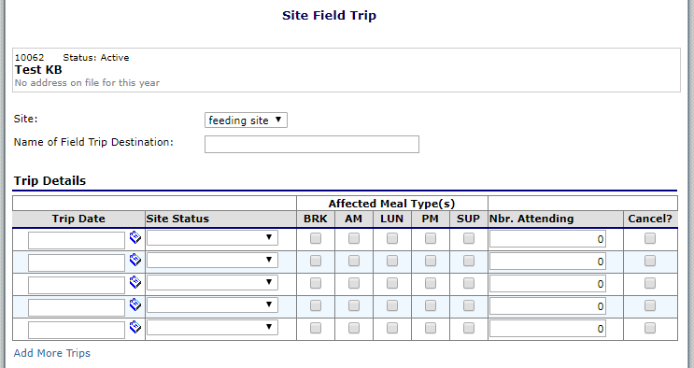
Site Field Trips
All field trips that affect a meal service must be entered after the application packet has been approved
Site field trips will be automatically approved by the system
Notes:
After the Application Packet has been approved by the state agency, the sponsor can submit Site Field Trip information. SFSP regulations require that sponsors notify the state agency of any field trips that affect the meal service at a site. Site fields trips that are entered by a sponsor will be automatically approved by the system. However, field trips cannot be entered on the day that the field trip will occur. Please remember that it is best practice to submit field trips 24-48 hours in advance of when they will occur.

Slide 35
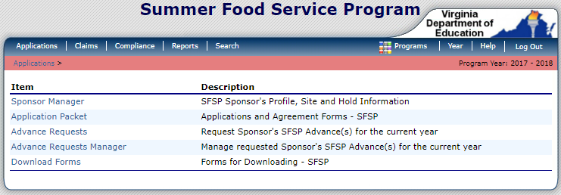
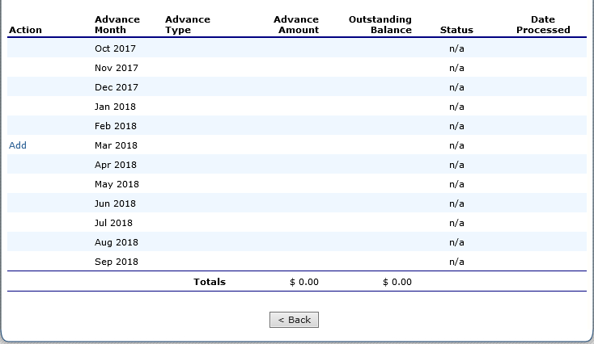
Advance Requests
Requests for advances in payment may be made after approval of the Application Packet is granted
Deadlines for Advances
May 2 for a June 1 advance
June 15 for a July 15 advance
July 16 for a August 15 advance
Notes:
Like site field trips, advance requests cannot be submitted until an organization has an approved application. However, after approval is granted, submitting the request for an advance is straightforward. Any advances approved by the state agency will be recovered from future claims for reimbursement until the full amount of the advance is recuperated. School divisions will be required to submit a Statement of Financial Need if the division wishes to seek advances in payment. This statement can be uploaded in the Attachments section.
If the organization is requesting an advance, click on the Applications tab in the main menu, and underneath you will see Advance Requests. A screen will display that indicates all months the sponsor operates for 10 days or more. Click the Add button and enter a request for Operational and/or Administrative advance payment. The state agency will be notified and the request will be evaluated based on previous year’s participation, anticipated reimbursement, and other factors.
The deadlines for Advances are:
May 2 for a June 1 advance
June 15 for a July 15 advance
July 16 for an August 15 advance

Slide 36
Questions?
Notes:
At this time I’m going to open the floor for questions related to what I have discussed today regarding the Summer Food Service Program application in SNPWeb.

Slide 37
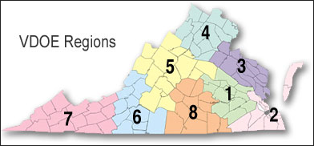
Contact Information for School Sponsors
 | SNP Specialist | Phone | Email
Region 1 | Denise Clark | (804) 786-7055 | Denise.clark@doe.virginia.gov
Region 2 | Susie Wood | (804) 225-2695 | Susanne.wood@doe.virginia.gov
Region 3 | Suzie Kollaja | (804) 225-2662 | Suzie.kollaja@doe.virginia.gov
Region 4 | Karen Howard | (804) 371-2337 | Karen.howard@doe.virginia.gov
Region 5 | Casey Dickenson | (804) 786-2695 | Casey.dickenson@doe.virginia.gov
Region 6 | Tom Patrick | (804) 225-2081 | Thomas.patrick@doe.virginia.gov
Region 7 | Tom Patrick | (804) 225-2081 | Thomas.patrick@doe.virginia.gov
Region 8 | Rasa Lakas | (804) 225-2433 | Rasa.lakas@doe.virginia.gov
Notes:
This concludes our webinar training on the Summer Food Service Program applications module.
Please contact your assigned regional specialist if you have any questions regarding the Summer Food Service Program. School divisions should contact the School Nutrition Program Specialist assigned to their region.

Slide 38
Contact Information for Non-School Sponsors
 | CNP Specialist | Phone | Email
Region 1 | Brandon Archer | (804) 786-1136 | Brandon.archer@doe.virginia.gov
Region 2 | Kenndra Buyalos | (804) 225-3342 | Kenndra.buyalos@doe.virginia.gov
Region 3 | Kenndra Buyalos | (804) 225-3342 | Kenndra.buyalos@doe.virginia.gov
Region 4 | Maggie Parker | (804) 786-1147 | Maggie.parker@doe.virginia.gov
Region 5 | Maggie Parker | (804) 786-1147 | Maggie.parker@doe.virginia.gov
Region 6 | Courtney Jones (until May 1) | (804) 786-0178 | Courtney.jones@doe.virginia.gov
Region 7 | Courtney Jones (until May 1) | (804) 786-0178 | Courtney.jones@doe.virginia.gov
Region 8 | Brandon Archer | (804) 786-1136 | Brandon.archer@doe.virginia.gov
Notes:
Non-school sponsors should contact the Child Nutrition Programs Specialist assigned to their region.

