Slide 1
High-Quality Instructional Materials - Primary Instructional Materials Identification
Presentation to the Virginia Board of Education
January 26, 2022

Slide 2
Statutory Authority

Slide 3
Virginia Constitution, Article VIII, § 5 (d)
It [the Board of Education] shall have authority to approve textbooks and instructional aids and materials for use in courses in the public schools of the Commonwealth.
Code of Virginia, § 22.1-238
The Board of Education shall have the authority to approve textbooks suitable for use in the public schools and shall have authority to approve instructional aids and materials for use in the public schools. The Board shall publish a list of all approved textbooks on its website and shall list the publisher and the current lowest wholesale price of such textbooks.
Any school board may use textbooks not approved by the Board provided the school board selects such books in accordance with regulations promulgated by the Board.
For the purposes of this chapter, the term "textbooks" means print or electronic media for student use that serve as the primary curriculum basis for a grade-level subject or course.

Slide 4
Regulations Governing Local School Boards and School Divisions
8 VAC 20-720-170. Textbooks
Textbook approval
The Board of Education shall have the authority to approve textbooks for use in the public schools of Virginia.
In approving basal textbooks for reading in kindergarten and first grade, the Board shall report to local school boards those textbooks with a minimum decodability standard based on words that students can correctly read by properly attaching speech sounds to each letter to formulate the word at 70 percent or above for such textbooks, in accordance with § 22.1-239 of the Code of Virginia.
Any local school board may use textbooks not approved by the Board provided the school board selects such books in accordance with this chapter.
Contracts and purchase orders with publishers of textbooks approved by the Board for use in grades 6-12 shall allow for the purchase of printed textbooks, printed textbooks with electronic files, or electronic textbooks separate and apart from printed versions of the same textbook. Each school board shall have the authority to purchase an assortment of textbooks in any of the three forms listed above.

Slide 5
The Board of Education has the authority to approve textbooks and other instructional materials as prescribed in the Virginia Constitution and in the Code of Virginia.
The Code of Virginia, § 22.1-238 states that “the term ‘textbooks’ means print or electronic media for student use that serve as the primary curriculum basis for a grade-level subject or course.”
High-Quality Instructional Materials - Primary Instructional Materials (HQIM - PIM), such as textbooks, are instructional resources that serve as the primary curriculum basis for a grade-level subject or course, and meet expectations in the following areas:
Alignment to the Virginia Standards of Learning
Alignment to the Profile of a Virginia Graduate
Instructional Design
Student Experience

Slide 6
Background, Stakeholders, and Development Process

Slide 7
Background
Virginia develops Standards of Learning (SOL) and Curriculum Frameworks (CF), which define the student expectations for learning and inform the development of statewide assessments.
School divisions develop their local curricula that are aligned with state SOL and CF.
School divisions then select and purchase textbooks as primary instructional materials that are aligned to the local curricula and state standards. School divisions may select a textbook from the approved textbook list after following the review process with their community or select another based on a local selection process similar to the Board’s process.

Slide 8
Why the Shift to HQIM?
Since the last Textbook Adoption Process revision in 2011:
Virginia teachers have progressively moved from textbooks to utilizing broader instructional materials, especially web-based resources.
Many school divisions have used allocated textbook funding to procure instructional resources rather than physical textbooks.
In a spring 2021 survey, teachers indicated the need to review primary materials for: Alignment to the Standards of Learning; Support for Virginia 5 C’s; Clarity for subject matter; Accessibility for all students; Representation of diverse experiences and perspectives; and Inclusion of content that represents, validates, and affirms diverse groups.
Identifying HQIM is important for two main reasons: to improve student achievement and reduce the burden on school divisions and teachers.
Nearly one out of three Virginia teachers reported spending nine or more hours per week searching for high quality instructional materials.

Slide 9
Research
Communicated with Department of Education Staff in Maryland, Massachusetts, Nebraska, and Louisiana
HQIM Review/Approval Tools
Identification Process
Other Services and Support
Communicated with EdReports

Slide 10
Timeline
December 2020-February 2021: Surveyed teachers
April, May, September 2021: Stakeholder Meetings
Summer 2021: Content Specific Small Group Work
September 2021: Publisher Meeting
October 2021: VDOE Staff Practicing with the HQIM - PIM Review Framework

Slide 11
HQIM - PIM Stakeholders
Teachers
Teachers of the Year
Division Curriculum and Instruction Leaders
Elementary and Secondary Principals
VDOE Staff - Content Area Representatives, Instructional Directors, Special Education, CTE, Assessment, and the Office of Equity
Superintendents
Virginia Board of Education member
VaSCL, VASCD, and Commonwealth Learning Partnership

Slide 12
Stakeholder Meetings
April 2021: Defined HQIM - PIM, leading to four Performance Criteria
May 2021: Defined Performance Indicators for each Performance Criteria
September 2021: Provided feedback on the Content Specific Indicators

Slide 13
Content Specific Workgroups
Summer 2021
Four Content Area Workgroups
Developed Instructional Design and Student Experience Content Specific Indicators
October 2021
Using the draft HQIM - PIM Review Framework Tools and Descriptions in “practice” reviews

Slide 14
Publisher Meeting: September 2021
Attendees
Saavas, BFW Publishers, O’Brien Associates, Achieve 3000, McGraw Hill, Five Ponds Press, Discovery Education, Benchmark Education
Purpose
Seek Input and Feedback
Draft HQIM - PIM Review Framework Tools
Identification Process
Feedback and Recommendations

Slide 15
HQIM - Primary Instructional Materials
Review Framework

Slide 16
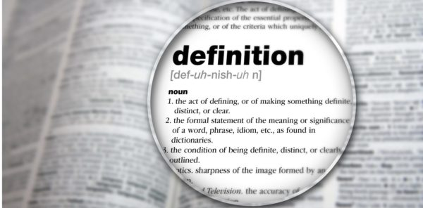
High-Quality Instructional Materials - Primary Instructional Materials (HQIM - PIM), such as textbooks, are instructional resources that serve as the primary curriculum basis for a grade-level subject or course, and meet expectations in the following areas:
Alignment to the Virginia Standards of Learning
Alignment to the Profile of a Virginia Graduate
Instructional Design
Student Experience

Slide 17
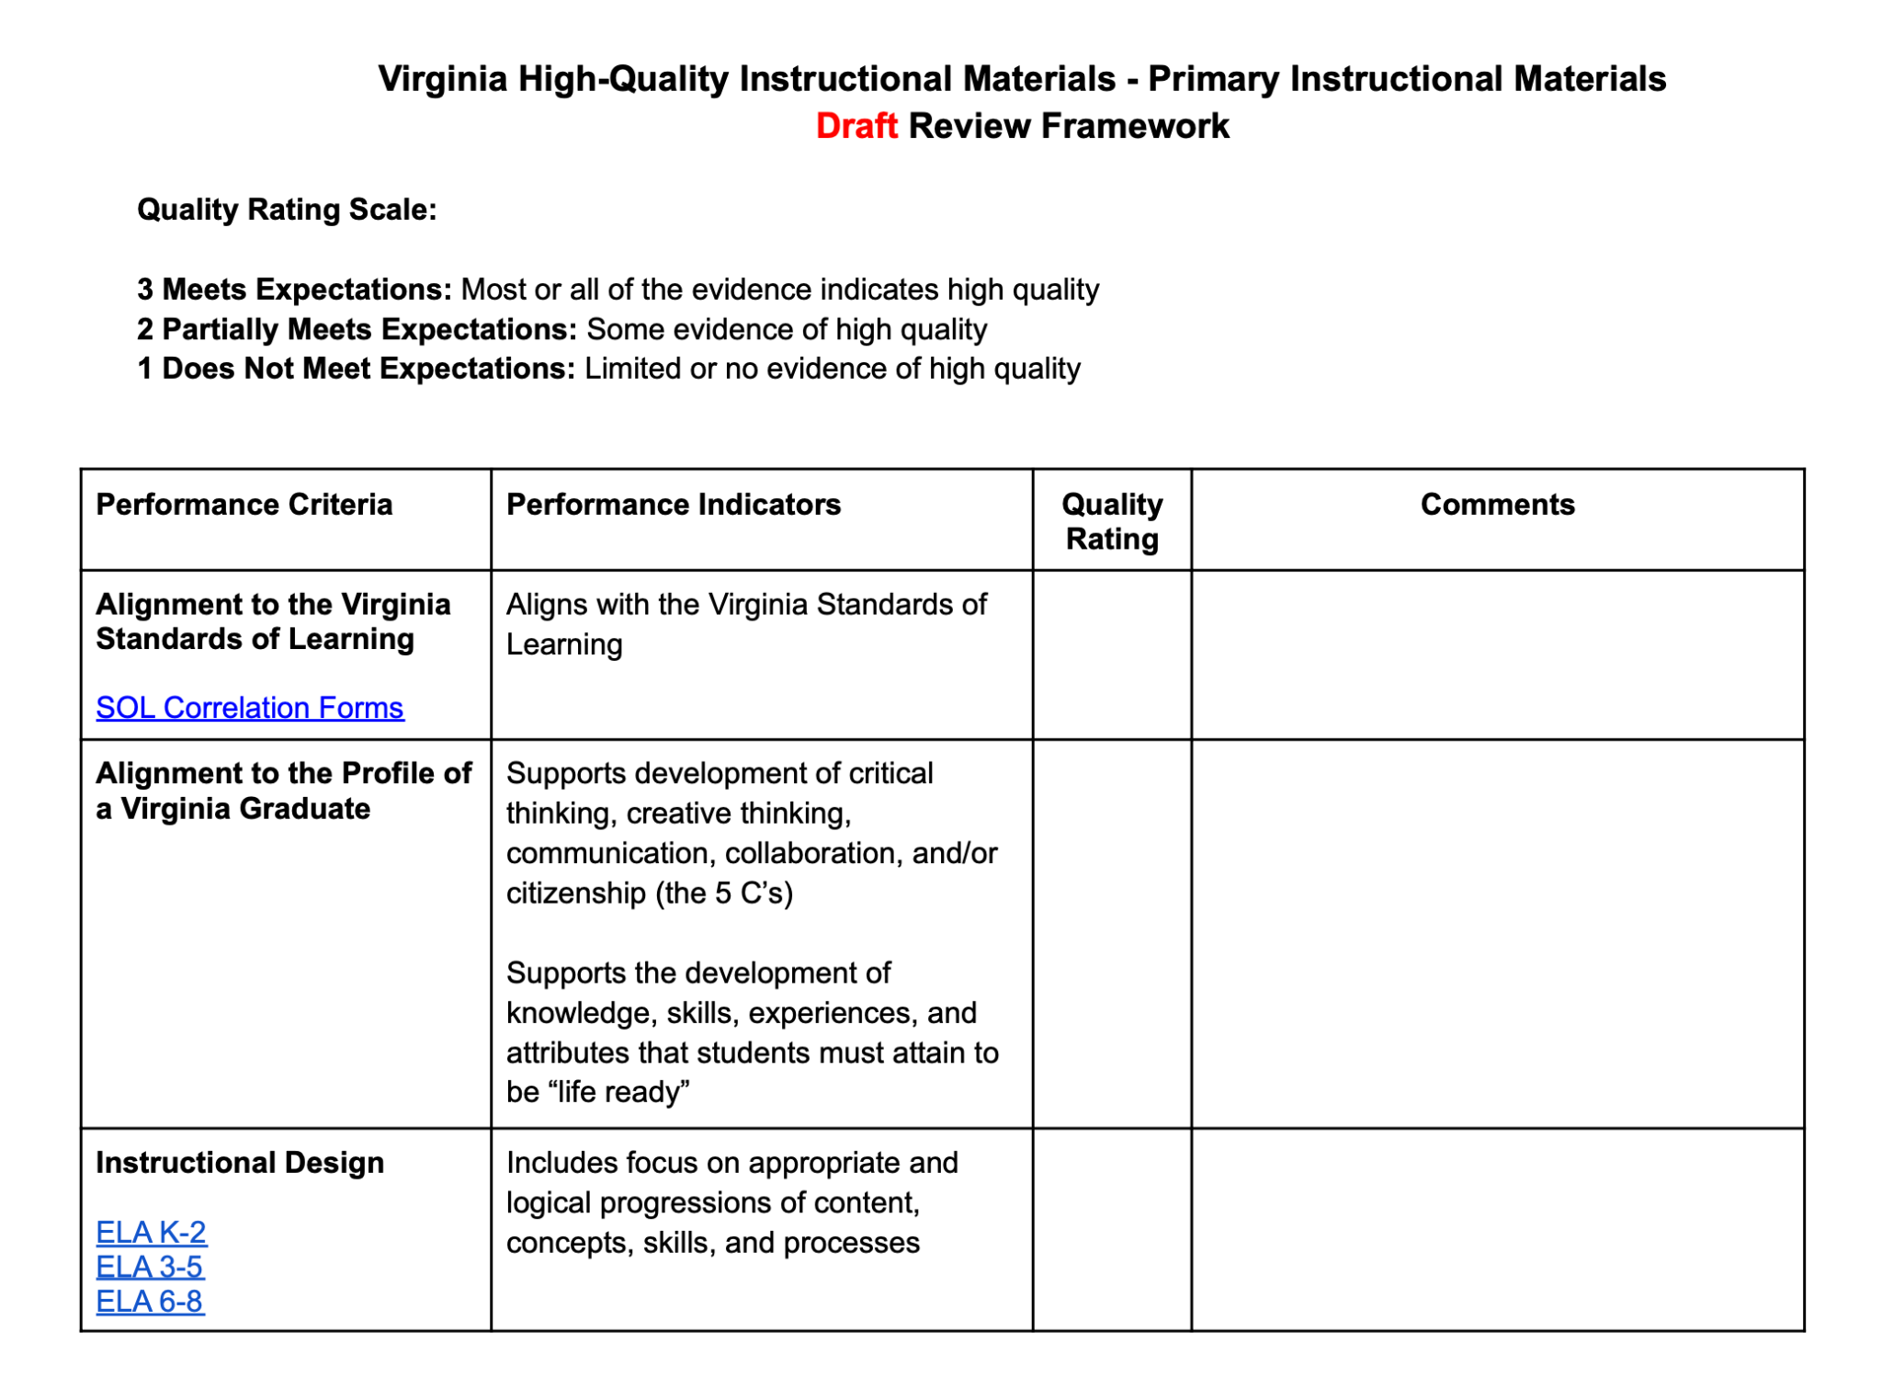
Performance Criteria

Slide 18
Performance Criteria
Alignment to the Virginia Standards of Learning
Aligns with the Virginia Standards of Learning

Slide 19
Performance Criteria
Alignment to the Profile of a Virginia Graduate
Supports development of critical thinking, creative thinking, communication, collaboration, and/or citizenship (the 5 C’s)
Supports the development of knowledge, skills, experiences, and attributes that students must attain to be “life ready”

Slide 20
Performance Criteria
Instructional Design
Includes focus on appropriate and logical progressions of content, concepts, skills, and processes
Explains the subject matter with clarity
Represents diverse experiences and perspectives with respect to student cultures and backgrounds
Supports evidence-based teaching and learning practices
Supports connections within and between disciplines and authentic applications
Supports opportunities for differentiation of instruction
Supports teachers in planning and instructional delivery
Notes:
Content Specific Indicators?

Slide 21
Performance Criteria
Instructional Design - Mathematics Specific Indicators
Includes focus on appropriate and logical progressions of content, concepts, skills, and processes
Supports the progression of mathematical learning through concrete, representational, and abstract connections
Embeds mathematics processes throughout lessons and activities (mathematical problem solving, mathematical communication, mathematical reasoning, mathematical connections, and using mathematical representations to model and interpret practical situations)
Explains the subject matter with clarity
Provides clarity through a variety of representations (i.e., concrete models and manipulatives, pictorial representations, and abstract representations) as appropriate for the content and grade level

Slide 22
Performance Criteria
Student Experience
Supports accessibility for all students
Supports student agency
Supports information processing
Supports student engagement through relevant learning experiences

Slide 23
HQIM Primary Instructional Materials
Review and Identification Process

Slide 24
 | Current Process | Proposed Changes
Evaluation Criteria | Alignment to the Virginia Standards of Learning Instructional Design & Support https://www.doe.virginia.gov/instruction/textbooks/review_process/evaluation_criteria.pdf | Four Performance Criteria: Alignment to the Virginia Standards of Learning Alignment to the Profile of a Virginia Graduate Instructional Design Student Experience
Rating Scale | Adequate, Limited, No Evidence | Meets Expectations, Partially Meets Expectations, Does Not Meet Expectations Each of the Performance Criteria must rate Meets Expectations to be recommended to the Virginia Board of Education to be included on the approved HQIM - PIM list.

Slide 25
 | Current Process | Proposed Changes
Format | Hard Copies In-Person Meetings & Review of Materials | Digital/Web-based
Review Committee Selection | Nominations Selection of various expertise and representation from across the state | Remains the same
Review Process | Review Committee members individually evaluate materials Review Committee meets and comes to consensus on ratings | Remains the same, except for conduct electronically

Slide 26
 | Current Process | Proposed Changes
Publisher Certifications & Assurances | Certify that textbooks submitted for approval have been thoroughly examined and reviewed by qualified content experts for factual accuracy and must list all authors/editors and their credentials. List the professional credentials for at least three content review experts who have thoroughly examined each textbook for content accuracy. Certify that each textbook has been thoroughly examined and reviewed by qualified editors for typographical errors and errors in grammar, written expression, spelling, formatting and other substantive elements that may affect student learning. Sign an agreement that if factual or editing errors are identified in a publisher’s textbook, the publisher must submit a corrective action plan to VDOE for review and approval by the Board of Education. All corrective action plans must be approved by the Board of Education, or the Board may delegate the approval of action plans to the superintendent of public instruction. Execute corrective action plans at their own expense. | Remain the same, except in digital format.

Slide 27
 | Current Process | Proposed Changes
Publisher Submissions | Hard Copy Submissions Specific Alignment to the Virginia Standards of Learning | Digital Submissions Specific Alignment to the Virginia Standards of Learning (as now) Template for narratives with links to provide evidence for the other three Performance Criteria May provide a five minute video to provide an overview and layout of materials
Review Cycle | Following Standards of Learning Revisions (every seven years) | Remain the same School divisions could use HQIM - PIM Review Framework & Tools between state level reviews
Public Examination of Materials | Provide in various locations across the state | Digitally/Web-based

Slide 28
Recommendations for HQIM-PIM Approval
HQIM-PIM that are recommended for Board of Education approval will be those that have met expectations (score of 3) in each of the four Performance Criteria areas.
Alignment to the Virginia Standards of Learning
Alignment to the Profile of a Virginia Graduate
Instructional Design
Student Experience

Slide 29
Possible Other Uses of the Framework:
Framework and Tools for Local Textbook Adoptions
Beyond the Four Content Areas - CTE, Fine Arts, etc.
Modified for HQIM - Instructional Materials and Resources
Use of HQIM-PIM in identified low-performing school divisions

Slide 30
Next Steps:
February 2022
Seek input from parents and the community
March 2022
Proposal to Virginia Board of Education for First Review
June 2022
Proposal to Virginia Board of Education for Final Review

Slide 31
Next Steps:
Spring/Summer 2022
Development of Professional Development Materials for Review Committee Members, School Divisions, and other Stakeholders
Digital Platform Development
Fall 2022
Implementation of HQIM - PIM Identification Process
Development of HQIM Review Process for Instructional Materials and Resources

Slide 32
Questions, Feedback, and Input from the Board

Slide 33
Potential Discussion
Would the Board want to consider a requirement for school divisions needing extensive support through a memorandum of understanding to select materials exclusively from the Board’s listing of identified High Quality Instructional Materials?

