Slide 1
VDOE 2018 Mathematics Institute Algebra I/Geometry/Algebra II

Slide 2
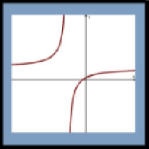
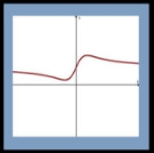
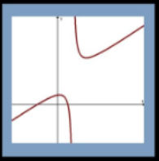
Which One Doesn’t Belong?
A
B
C
D

Slide 3
Agenda
Welcome and Introductions
Facilitate Meaningful Discourse
Mathematical Community
Pose Purposeful Questions
Building a Playground Task
What Can I Buy? Task
Lunch at 12:00
Elicit/Use Evidence of Student Thinking
Exponential Regression Activity
Taking Action – Next Steps

Slide 4
Parking Lot

Slide 5
Strategy Catcher
Instructional strategies used during today’s session will be recorded on chart paper
At the end of each module, we review any strategies incorporated
Participants will discuss other ways these strategies can be used in the classroom

Slide 6
Norms
Devices away when you hear the phrase “Courtesy Close”
Respect the views and opinions of others
Actively engage and participate in activities and discourse
Attend to your own needs
Notes:
Attend to your own needs - bathroom breaks will be on your own as you need

Slide 7
I: Teaching Practice: Facilitate Mathematical Discourse

Slide 8
Facilitating Discourse
A
B
C
D
Notes:
Discuss why this type of activity is linked to the concept of facilitating discourse.

Slide 9
Resources for building mathematics community:
Which one doesn't belong
Dot images
Table Talk Math
Number Talk Real World Images
Would you rather math
Estimation 180
101 Questions
Notes:
Check availability of these links in your division

Slide 10
I. Essential Questions
What elements must be in place to support meaningful mathematical discourse?
In what ways can teachers promote equitable teaching practices in mathematics classrooms?

Slide 11
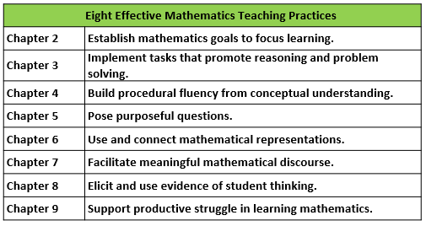
Eight Effective Mathematics Teaching Practices
Read the description of each practice in
your Taking Action book – page 5
Adapted from Leinwand, S. et al. (2014) Principles to Actions – Ensuring Mathematical Success for All, National Council of Teachers of Mathematics.

Slide 12
Mathematics Process Goals for Students
“The content of the mathematics standards is intended to support the five process goals for students” - 2009 and 2016 Mathematics Standards of Learning
Communication
Connections
Representations
Problem Solving
Mathematical Understanding
Reasoning

Slide 13
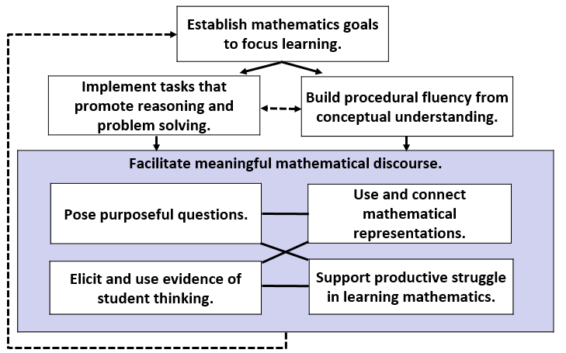
Teaching Framework for Mathematics
Taking Action book – page 215
Adapted from Smith, M. et al. (2017) Taking Action – Implementing Effective Mathematics Teaching Practices Series, National Council of Teachers of Mathematics.

Slide 14
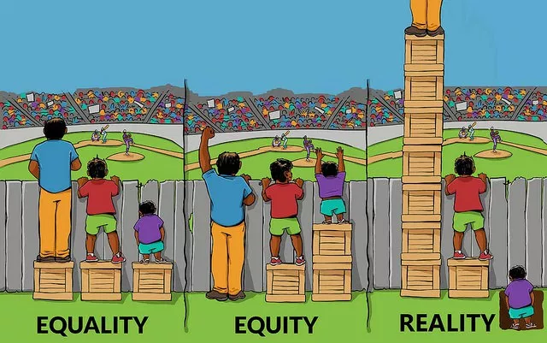
Equality, Equity and Reality
Introduce yourself to a shoulder partner.
What connections can you make to this image?
http://interactioninstitute.org/illustrating-equality-vs-equity/

Slide 15
Mathematical Discourse – Card Sort
Rich classroom discourse is a necessity. This rubric lets you consider where your classroom is on the continuum.
There are five headings (shaded cards) and level rating cards 0-3.
Sort the cards under each heading so that “0” is the least and “3” is most advanced.
After your sort is complete, take a picture to capture your current thinking (Pre-Assessment)

Slide 16
I. Reflect on the Essential Questions
What elements must be in place to support meaningful mathematical discourse?
In what ways can teachers promote equitable teaching practices in mathematics classrooms?

Slide 17
II. Teaching Practice: Pose Purposeful Questions

Slide 18
II. Essential Questions
How can posing purposeful questions be used to assess student understanding and inform instruction?
How does posing purposeful questions support the development of mathematical identity and a student’s sense of agency?

Slide 19
Posing Purposeful Questions
Effective teaching of mathematics uses purposeful questions to assess and advance students’ reasoning and sense making about important mathematical ideas and relationships.

Slide 20
The Building a New Playground Task
With a partner, solve the Building a New Playground Task on p. 91
Discuss your strategies and other strategies that students might use with the colleagues at your table

Slide 21
Video - Playground Task
As you watch the video, jot down 3-5 questions asked by the teacher, use a sticky note per question.
Notes:
Video length: 4:36
Playground Task
We may have to log on separately to access this video and enlarge the screen to 250%. It would help to open and enlarge the screen prior to the presentation

Slide 22
Video -- Playground Task
As a table group, sort your questions by type and/or purpose.
Prepare to share out your major headings/groupings.

Slide 23
Gathering Information Probing Thinking Making the Mathematics Visible Encouraging Reflection and Justification
Questions
Assessing
Advancing
Taking Action book – pages 76 & 83

Slide 24
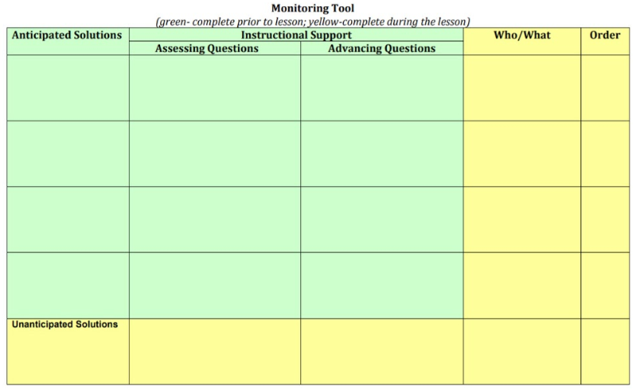
Monitoring Tool
Adapted from Smith, M. et al. (2017) Taking Action – Implementing Effective Mathematics Teaching Practices Series, National Council of Teachers of Mathematics.

Slide 25
Review the Monitoring Tool
Here is an example of the monitoring tool, completed for the lesson you just saw
Check for understanding:
What distinguishes Assessing Questions from Advancing Questions?
Taking Action book – page 239

Slide 26
Playground Task
Reasoning, Lines & Transformations
G.3 & G.4
Polygons & Circles
G.9
Planning for purposeful questions helps maintain the rigor and develops conceptual understanding for all students. The Curriculum Framework can be used to guide planning.

Slide 27
Revisit Module II Essential Questions
How can posing purposeful questions be used to assess student understanding and inform instruction?
How does posing purposeful questions support the development of mathematical identity and a student’s sense of agency?

Slide 28
Burger Task
Adapted from VDOE Mathematics Instructional Plans, Algebra I, Graphing Systems of Linear Inequalities in Two Variables

Slide 29
Burger Task – Problem Solving
Individually, solve the Burger Task
Discuss your strategies and other strategies that students might use with the colleagues at your table
Adapted from VDOE Mathematics Instructional Plans, Algebra I, Graphing Systems of Linear Inequalities in Two Variables

Slide 30
Burger Task - Strategies
Thinking about the different strategies that were/could be used, fill out the blank “Task Monitoring Tool” for the Burger Task
Be ready to share out one Assessing and one Advancing question from your table
Adapted from VDOE Mathematics Instructional Plans, Algebra I, Graphing Systems of Linear Inequalities in Two Variables

Slide 31
Lunch

Slide 32
Desmos Polygraph Activity

Slide 33
Teacher View in Desmos
Teacher Dashboard

Slide 34
Desmos Demo
How can we use Desmos to enhance the teaching and learning in the Burger Task we started before lunch?

Slide 35
Burger Task
Equations & Inequalities
A.4, A.5, A.7f
Planning for purposeful questions helps maintain the rigor and develops conceptual understanding for all students. The Curriculum Framework can be used to guide planning.
Adapted from VDOE Mathematics Instructional Plans, Algebra I, Graphing Systems of Linear Inequalities in Two Variables

Slide 36
Equitable Teaching:
Posing Purposeful Questions
Students know that their thinking is valued and makes sense.
Mark students’ ideas as interesting or identify an important aspect of students’ strategies to position them as competent.
Support the student’s development of a positive mathematical identity and sense of agency.
Adapted from Smith, M. et al. (2017) Taking Action – Implementing Effective Mathematics Teaching Practices Series, National Council of Teachers of Mathematics.

Slide 37
II. Reflect on Essential Questions
How can posing purposeful questions be used to assess student understanding and inform instruction?
How does posing purposeful questions support the development of mathematical identity and a student’s sense of agency?

Slide 38
III. Teaching Practice: Elicit and Use Evidence of Student Thinking
Notes:
Use Verdana font for all slides

Slide 39
III. Essential Questions
What can teachers to do elicit and use evidence of student thinking?
How does eliciting and using evidence of student thinking promote student agency and identity?

Slide 40
Elicit and Use Evidence of Student Thinking
Effective teaching of mathematics use evidence of student thinking to assess progress toward mathematical understanding and to adjust instruction continually in ways that support and extend learning.

Slide 41
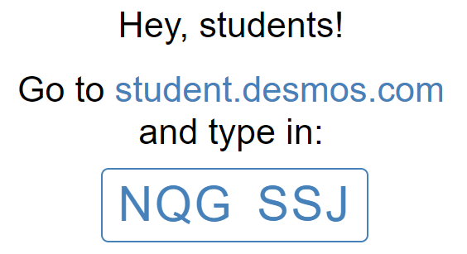
Exponential Regression

Slide 42
Using evidence of student thinking – student responses
Consider the sample student responses to the Desmos activity:
What mathematical understanding do these responses reveal?
What misconceptions do these responses reveal?

Slide 43
Using evidence of student thinking - share
Back at your table group:
Round robin share the understandings/misconception of your student to get full class picture

Slide 44
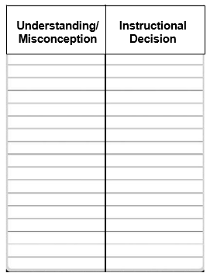
Next Steps
What instructional decisions might you make based on the understanding and misconceptions that you noticed?

Slide 45
Gallery Walk
Look at the plans of the other groups
Identify one idea that your group could add to your plan
Notes:
Move as a group to discuss each of the other instructional plans

Slide 46
Desmos Activity - Exponential Regression
Functions AII.7
Statistics AII.9
Eliciting and using evidence of student thinking drives instructional decisions. The Curriculum Framework can be used to guide planning.
Notes:
New 2016:Continuity

Slide 47
Equitable Teaching: Elicit and Use Evidence of Student Thinking
Sends positive messages about student identity.
Elevates the student’s position in the discussion to identify his/her idea as worthy.
Broadens range of participation and promote a culture where mistakes and errors are viewed as opportunities.
Taking Action, p.179

Slide 48
III. Reflect on Essential Questions
What can teachers to do elicit and use evidence of student thinking?
How does eliciting and using evidence of student thinking promote student agency and identity?

Slide 49
IV. Taking Action – Next Steps
Notes:
Use Verdana font for all slides

Slide 50
IV. Essential Questions
How will you plan to facilitate meaningful mathematical discourse?
How will you share this information with others?

Slide 51
Revisit classroom discussion rubric
Let’s go back to the Levels of Discourse sort we did at the beginning.
Where did you see evidence of or opportunities for higher levels of discourse in the modules shown today?

Slide 52
Summarize Our Learning
Climate for discourse
Use of technology
Equity
Planning for purposeful questioning
Eliciting and using evidence of student thinking
Strategy catcher
Notes:
Facilitator: Share this quick summary on what we have discussed during the day.

Slide 53
Teaching Framework – Another Look
Taking Action book – page 215
Adapted from Smith, M. et al. (2017) Taking Action – Implementing Effective Mathematics Teaching Practices Series, National Council of Teachers of Mathematics.
Notes:
We focused on posing purposeful questions and eliciting and using evidence of student thinking, but there are additional ways to facilitate meaningful mathematical discourse.

Slide 54
2016 Mathematics Standards of Learning - Instructional Resources
Currently Available
2016 Mathematics Standards of Learning
2016 Mathematics Standards Curriculum Frameworks
2009 to 2016 Crosswalk (summary of revisions) documents
Narrated Crosswalk Presentations
Test Blueprints for SOL Assessments
2017 SOL Mathematics Institutes PD Resources – includes progressions for select 2016 content
Sample K-3 Mathematics Achievement Records
Vocabulary Word Wall Cards – 2016 SOL
Mathematics Instructional Plans (formerly Enhanced Scope and Sequence) correlated to 2016 SOL
Mathematics Instructional Videos

Slide 55
Parking Lot/Final Q&A
What questions might you still have?

Slide 56
Reflect on Essential Questions
How will you plan to facilitate meaningful mathematical discourse?
How will you share this information with others?

Slide 57
Please contact us
The VDOE Mathematics Team at
Mathematics@doe.virginia.gov

