Slide 1
Virginia Learning Advisory Committee
Thursday, February 27, 2020

Slide 2
Introductions
Division Superintendents
VDOE
VSBA
VASS
WHRO
Virtual VA
REL
Office of Secretary of Education

Slide 3
Virginia Department of Education
Dr. James Lane, State Superintendent of Public Instruction
Mr. Michael Bolling, Assistant Superintendent for Dept. of Learning & Innovation
Dr. Tina Manglicmot, Director for Office of STEM & Innovation
Dr. Meg Foley, Virtual Learning Specialist
Mr. Reggie Fox, Virtual Learning Specialist
Dr. Jen Piver-Renna, Director Office of Research
Ms. Jean Weller, Educational Technology Specialist
Ms. Cynthia Evans, Support Staff
Ms. Maggie Clemmons, Coordinator of Organizational Development & Advancement

Slide 4
Division Superintendents
Dr. Mervin B. Daughtery, Region I, Chesterfield County Schools (Mr. Ernest Longworth)
Dr. Jeffrey Smith, Region II, Hampton City Schools
Dr. James G. Smith, Region III, Richmond County Public Schools
Dr. Kevin Newman, Region IV, Manassas City Public Schools (Dr. Catherine Magouyrk)
Dr. Garett Smith, Region V, Staunton Public Schools
Ms. Jeanette Day Warwick, Region VI, Craig County Schools
Dr. Kevin Siers, Region VII, Pulaski County Public Schools (Mr. Lincoln Whitaker)
Mr. Robbie W. Mason, Region VIII, Charlotte County Public Schools

Slide 5
Organizations & Agencies
Dr. Gina Patterson, Executive Director, Virginia School Boards Association
Dr. Ben Kiser, Executive Director, Virginia Association of School Superintendents
Mr. Bert Schmidt, President & Chief Executive Officer, WHRO Public Television
Dr. Brian Mott, Executive Director of Virtual VA, Charlotte County Public Schools
Ms. Holly Coy, Deputy Secretary of Education, Office of the Secretary of Education
Dr. Jessica Mislevy, Director of Digital Learning & Technology Policy, SRI/REL
Dr. Jaunelle Pratt-Williams, Education Researcher & REL Appalachia Project Lead, SRI

Slide 6

Virginia is for Learners

Slide 7
Training K-12 Students to Go Deeper
Students in every grade level will experience a new approach to instruction that focuses on key skills for success in a modern world – Virginia’s 5 C’s: critical thinking, creative thinking, communication, collaboration, and citizenship skills. This approach will prepare every student with the content knowledge they need and the skills they need to apply it successfully after graduation.

Slide 8
Making Student Success the Highest Standard for Every School
Virginia is changing how the Commonwealth evaluates and accredits schools across the state.
These changes, in combination with a new approach to the Virginia Standards of Learning (SOLs):
Provide a more comprehensive view of school quality;
Place increased emphasis on racial and economic equity;
Recognize schools that demonstrate continuous improvement; and
Increase expectations that schools prepare students to succeed in college and the workforce after graduation.

Slide 9
Preparing Virginia Graduates for What Comes Next
Virginia high school graduation requirements have been revised to incorporate the Profile of a Virginia Graduate, ensuring graduates have the knowledge, skills, attributes, and experiences identified by employers and educators as critical for future success.
For the first time, all Virginia graduates will also leave high school with life changing work-based learning experiences that put them on the path for a good career and economic advancement.

Slide 10
Equity
Vision for Educational Equity:
The commitment to eliminating the predictability of student outcomes based on race, gender, zip code, ability, socio-economic status or languages spoken at home
Focus on teaching and leading
Use an equity lens on school funding
Ensure all students have access to high-quality curricula and programs, including gifted programs

Slide 11
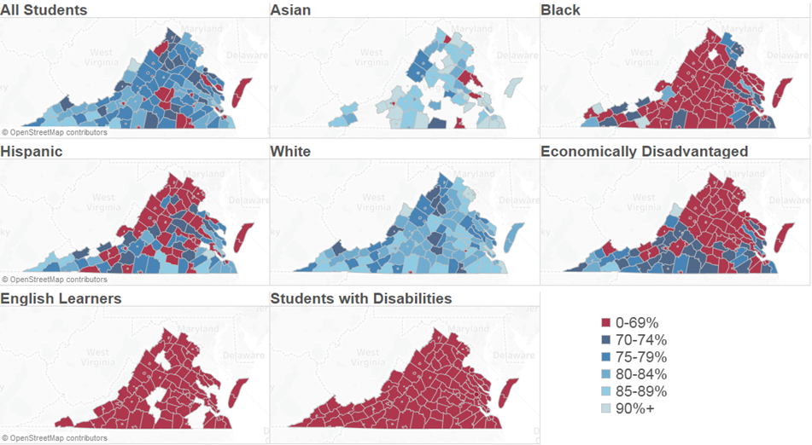
2018-2019 SOL Reading Pass Rate

Slide 12
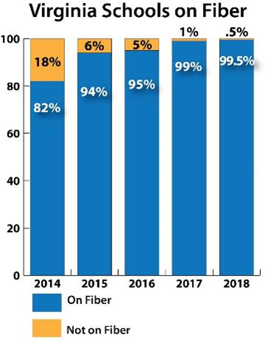
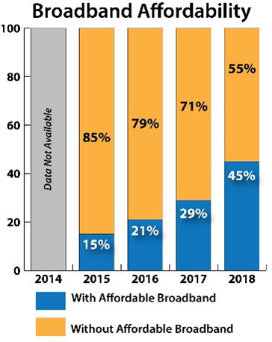

Digital Equity

Slide 13

Upcoming Work at VDOE
Possible Future Enhancements in VVa:
African-American History course
Synchronous and asynchronous models
Credit recovery
Blended learning
Professional development
Expansion to K-5
Enhanced rate structure to support more student enrollments
Vetted content and procured resources
Outcomes:
Guaranteed curriculum in every community
High quality instructional materials
Access to certified teachers

Slide 14

#GoOpenVA and OER
This cloud-based platform will provide:
Equitable Access to Open Resources
Collaborative Platform to Support Deeper Learning
Develop High Quality Curriculum Materials

Slide 15
VA LEAP
Virginia Learners Equitable Access Platform (LEAP): The introduced budget provides state funding to create the Virginia Learner Equitable Access Platform (VA LEAP), a statewide learning management system. This system will serve as a central location or virtual hub where teachers, students, and families have access to a wide variety of instructional tools and resources. The introduced budget provides $7.1 million in FY 2021 and $6.1 million in FY 2022. It will provide:
Equitable Cost-Effective Access Collaborative Teacher Support
Quality Curriculum Development Family Engagement Tools

Slide 16



Connect with Dr. Lane
James.Lane@doe.virginia.gov
Twitter: @DrJamesLane
#VAis4Learners #EdEquityVA

Slide 17
Agenda
Breakfast
Welcome, Introductions
Remarks – Dr. Lane
Committee Purpose, Role, Term
Virtual VA Updates
VVA Program Evaluation
Break
REL Cost Feasibility
MOP Update
GoOpenVA
Next Steps

Slide 18
Purpose, Role & Term
Advisory group: online courses, in-service training and digital instructional resources necessary for school divisions to meet graduation requirements.
Strategic planning to expand blended and online learning opportunities in Virginia public schools, training, content and digital resources.
Important role sharing experience, expertise & resources.
3-year commitment meeting twice annually.

Slide 19
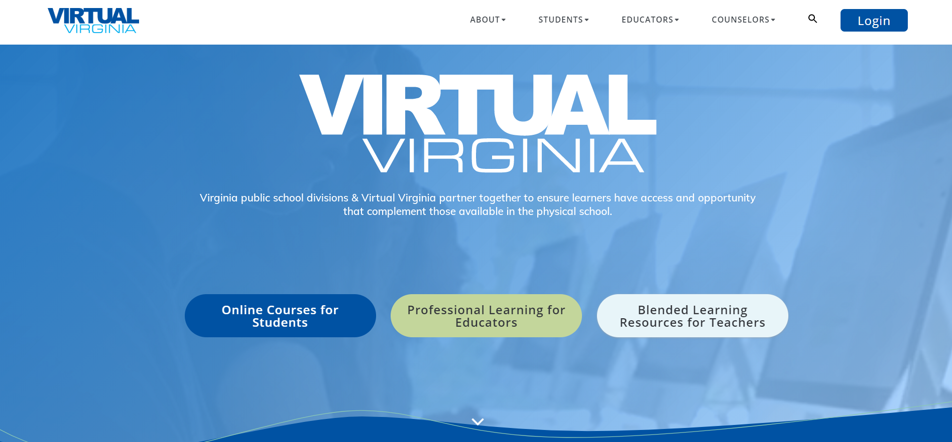
Virtual VA Updates
Program Overview
Update
Outlook

Slide 20

Dr. Brian Mott
Executive Director
brian.mott@virtualva.org
(866) 650-0025
www.virtualvirginia.org

Slide 21
The Virginia Department of Education’s Virtual Virginia Program (VVA) offers online courses, professional learning opportunities, and digital content to schools, students, and educators across the Commonwealth.

Slide 22
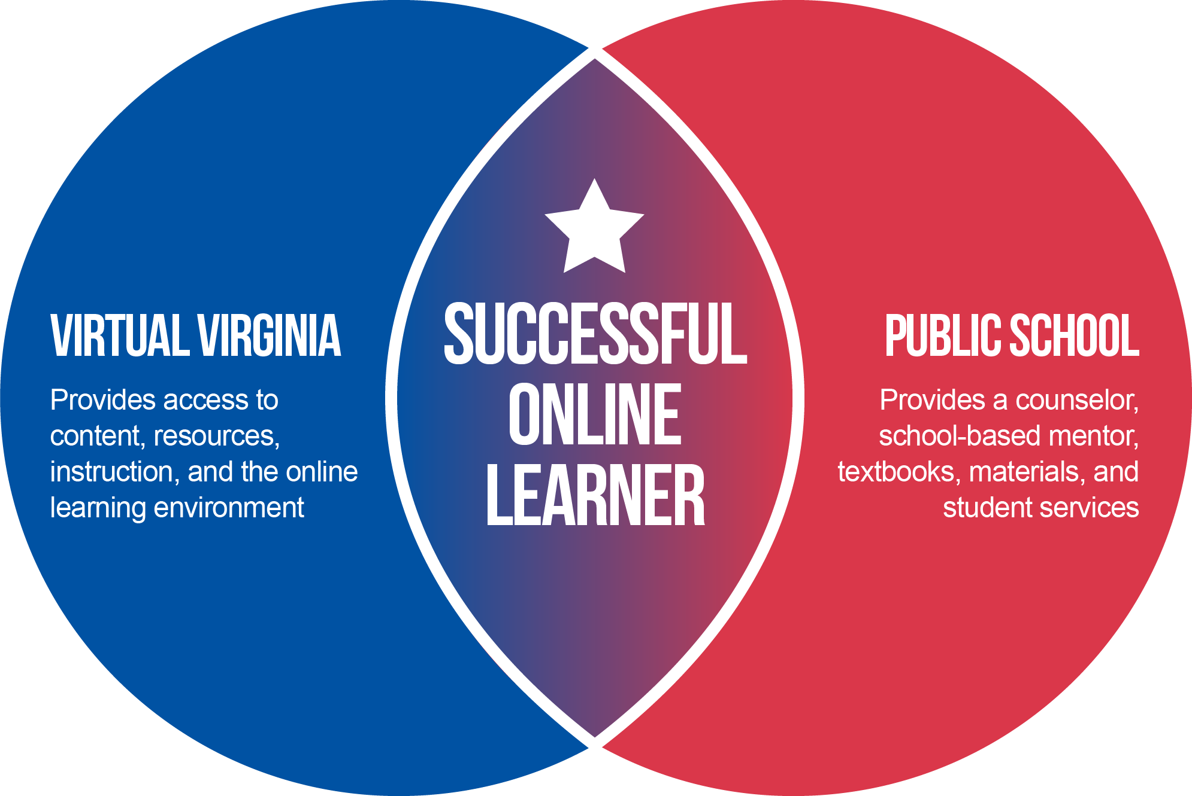
Partnership
Virginia public school divisions & Virtual Virginia partner together to ensure learners have access and opportunity that complement those available in the physical school.

Slide 23
Public Schools & Virtual Virginia
A history of collaboration & partnership for more than 25 years.

Slide 24
Products & Services
Complementary Program
81
AP, core, Word Language and elective courses taught by Virginia educators.
Outreach Program
14
blended learning resources available to public school teachers and their students—at no cost.
Professional Learning
11
PL options in blended learning facilitation, OER resources, and online teaching available to public school teachers —at no cost.
Summer Session
51
core, WL, and elective courses offered in Summer Session 2019, available to all Virginia students.

Slide 25
Expanded Enrollment
Regular
Enrollment
A school may enroll up to 15 enrollments per course (pending space availability) on a first-come, first-served basis.
Expanded
Enrollment
A school has unlimited enrollment beyond the free-enrollment allocation on a per-student, per-course fee schedule.

Slide 26
Complementary Program
VVA courses are instructed by Virginia public educators
VVA courses are developed by Virginia public educators
Instruction is both synchronous and asynchronous
Each student is offered a minimum of 2 live instructional sessions per week

Slide 27
Outreach Program
SOL-aligned content is developed and annually updated by Virginia public educators
Content includes Instructor Guides, fully developed lessons with interactive practice and assessments, and SOL question banks
Local school teachers are enrolled in a statewide PLN for each subject area
Local school teachers may participate in Professional Learning workshops and monthly statewide webinars

Slide 28
Summer Session
Courses are instructed by Virginia public educators
Courses are developed by Virginia public educators
Instruction is both synchronous and asynchronous
Each student is offered a minimum of 2 live instructional sessions per week

Slide 29
Professional Learning
VVA offers PL in online learning best practices, blended learning facilitation, subject-area online tools, and #GoOpenVA
VVA PL offerings are offered at no cost to Virginia public educators
PL offerings are developed by Virginia public educators
Complement to projects and innovations

Slide 30
Let’s Review
Big Concept
Virtual Virginia offers online courses, digital content, and professional learning opportunities.
Partnership
Virtual Virginia and school divisions work together to ensure learners have opportunity and access.
Access
Virtual Virginia is accessible anywhere and at any time.
Evolution
As schools and learners change, Virtual Virginia can provide solutions tailored to evolving needs.
Unlimited
Expanded Enrollment offers unlimited enrollment in Virtual Virginia courses.
Summer Session
51 courses offered in Summer Session 2019.

Slide 31
Virtual Virginia Program Evaluation Overview

Slide 32
Evaluation Purpose
The Virginia Joint Legislative Audit and Review Commission (JLARC) recommended that the state:
  Conduct ongoing analysis of student outcomes in online programs compared with place-based schools
  Develop a methodology for estimating costs of fully online programs
This information is of particular policy relevance as the state continues expanding virtual learning opportunities in Virginia

Slide 33
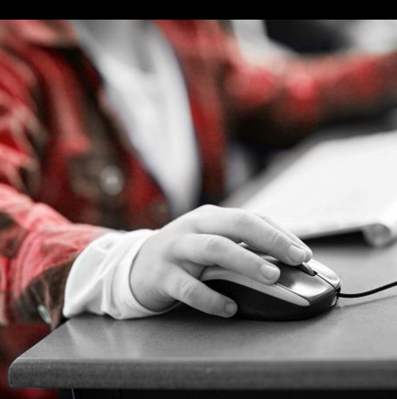
Three Evaluation Components
Student, Parent, and Staff Surveys
Cost Methodology
Student Outcomes Study

Slide 34
2018-2019 Survey Content and Administration
Student Survey: Participant experiences and satisfaction (n = 1,990)
Parent Survey: Interactions with course and perceptions of instructional quality (n = 857)
Staff Survey: Implementation experience and satisfaction (n = 97 divisions)

Slide 35
Why do students take Virtual Virginia courses?
 | Students say… | Parents say… | Staff say…
Course not offered at school | 48% | 42% | 86%
To get ahead | 44% | 47% | --
Prefer/interest in virtual courses | 31% | 23% | 74%
Scheduling conflict | 24% | 27% | --
To catch up | 7% | 9% | --
To raise a previous grade | 3% | 5% | --

Slide 36
Are students prepared for virtual instruction?
Nearly 90% of students agreed that they had the skills necessary to be successful in the course
Staff identified students’ skills with virtual learning and use of technology as the most difficult aspects of implementation

Slide 37
What is the quality of instruction?
90% of parents agreed their child was appropriately challenged by the course
93% of staff were satisfied with the rigor of course content

Slide 38
Do students feel supported?
78% of students agreed that their mentor checked on their progress regularly
87% of parents agreed communication with the instructor met their child’s needs
89% of staff were satisfied with the support the program offered to students

Slide 39
Would students participate again?
84% of students reported interest in taking another online course
84% of parents would enroll their child in the program again
92% of staff agree that the program creates positive attitudes toward virtual learning

Slide 40
Next Steps
Release findings from student outcomes study
Revisit survey content and methods to increase participation for 2020-2021 school year

Slide 41
REL Cost Feasibility
Introduction to REL Appalachia & virtual learning work with VDOE
Overview of cost analysis
Orientation to Cost Feasibility Analysis (CFA) Toolkit
Potential application for CFA Toolkit

Slide 42
Assessing the costs of online learning programs: The Cost-Feasibility Analysis Toolkit
Jessica Mislevy
SRI International
Jaunelle Pratt-Williams
SRI International

Slide 43
Meet your presenters
Jessica Mislevy, Ph.D.,
REL Appalachia @ SRI International (REL AP)
Jaunelle Pratt-Williams, Ph.D., REL Appalachia @ SRI International

Slide 44
Introduction to REL Appalachia and our virtual learning work with VDOE

Slide 45
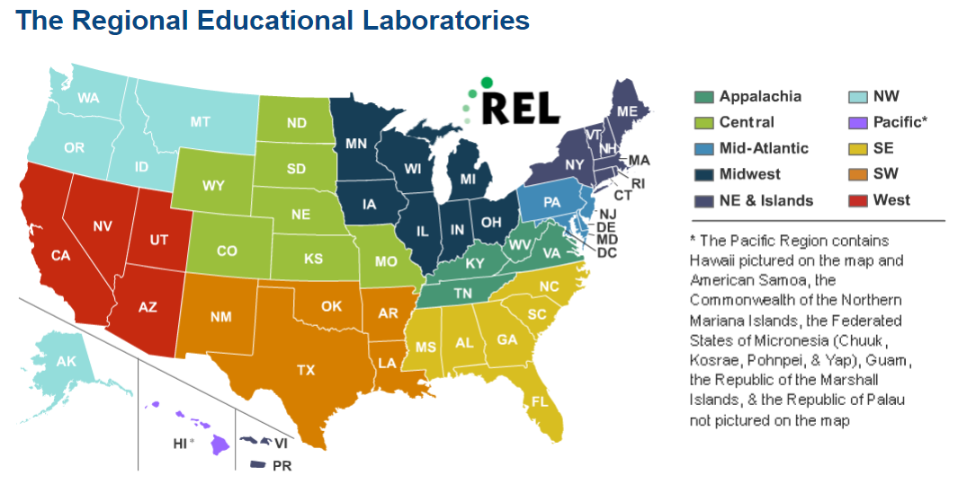
The 10 Regional Educational Laboratories (RELs) work in partnership with stakeholders to conduct applied research and training.
The REL mission is to support a more evidence-based education system.
Administered by the U.S. Department of Education, Institute of Education Sciences (IES)

Slide 46

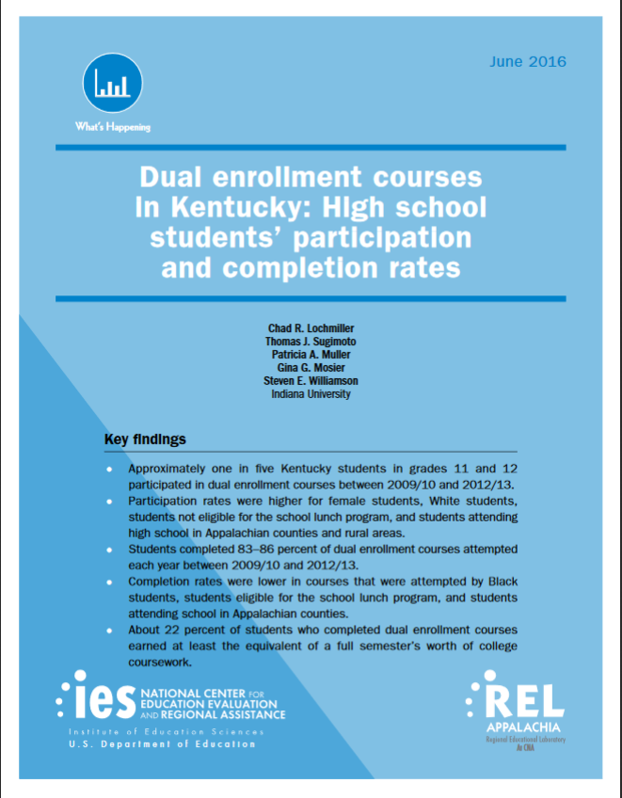
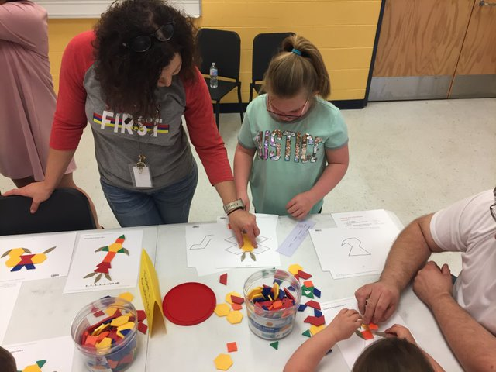
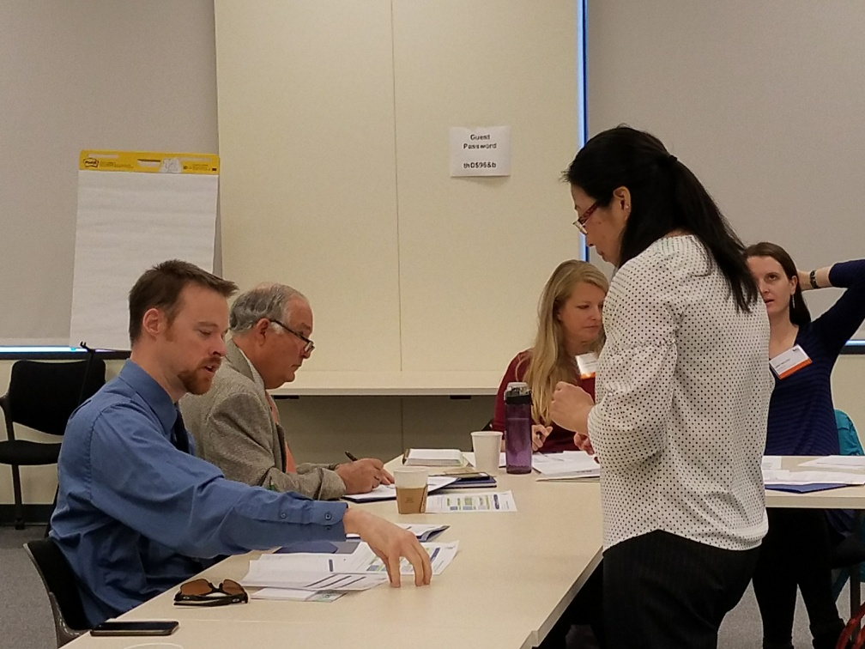
Applied Research
Dissemination
Training, Coaching,
and Technical Support

Slide 47
REL AP’s virtual learning support activities
Student Outcomes
Program Costs
Implementation Conditions
  Providing VDOE with in-depth coaching and consultation to codesign a comprehensive plan to evaluate the implementation, outcomes, and costs of virtual learning programs and initiatives, including Virtual Virginia (VVA) and GoOpenVA.
  Conducting a secondary analysis to compare the academic achievement of students in VVA courses with that of their peers in face-to-face courses.

Slide 48

Goals for the VDOE/REL AP cost analysis collaboration
  Build VDOE staff capacity to conduct cost analyses for online learning programs.
  Develop a cost feasibility methodology that the VDOE can implement.
  Better understand the local resources needed to implement online learning programs like VVA.

Slide 49
Cost feasibility analysis for virtual learning programs

Slide 50

What is a cost analysis?
  A cost analysis is an economic evaluation of resources.
  There are four types of cost analysis.
    Cost-feasibility
    Cost-effectiveness
    Cost-benefit (also referred to as benefit-cost)
    Cost-utility
  Each type of analysis uses the same initial approach to assess the resource costs but answers different questions.
  This initial approach entails calculating the cost of resources, which includes personnel, facilities, materials, and any other items necessary for implementation, using the ingredients method.

Slide 51
Questions cost analysis can answer
Cost analysis type | Cost questions this type of analysis answers
Cost-feasibility | Are there adequate resources to implement a new policy or program or scale up an existing one?
Cost-effectiveness | Which of several policies or programs produce the desired outcome for the lowest cost? or Which maximizes the desired outcome for a given cost?
Cost-benefit | Are the economic benefits of a policy or program greater than the costs?
Cost-utility | Is the usefulness of a policy or program valued by stakeholders compared with the costs?

Slide 52

The ingredients method
Let’s use a brownies recipe as an example …
A detailed list of all the resources needed to initiate and carry out a program or intervention
Levin, H. M., McEwan, P. J., Belfield, C. R., Bowden, A. B., & Shand, R. D. (2017). Economic evaluation in education: Cost-effectiveness and benefit-cost analysis (3rd ed.). Thousand Oaks, CA: Sage.

Slide 53

Costing with the ingredients method
  Itemizes resources needed for program replication.
  Makes an effort to understand value of resources regardless of price.
  Is inclusive of all payers (or is explicit about particular purchasers).
  Relies on budgets as one but not the only data source.
  Provides techniques for spreading out cost of investments over the life of the program.

Slide 54
Stages of a cost-feasibility analysis

Slide 55
Orientation to the Cost Feasibility Analysis (Virginia CFA) Toolkit

Slide 56

Virginia CFA Toolkit Components
  The Virginia CFA toolkit has four main components:
    User’s guide: detailed guide on how to use each component of the Virginia CFA toolkit.
    Resource list: detailed list of the potential resources needed to implement an online learning program and to maintain it annually.
    Interview protocols: guides for conversations with school division staff.
    CFA estimator: data-collection tool designed using Microsoft Excel.
  Each component of the Virginia CFA toolkit helps facilitate one or more stages of a cost-feasibility analysis.

Slide 57
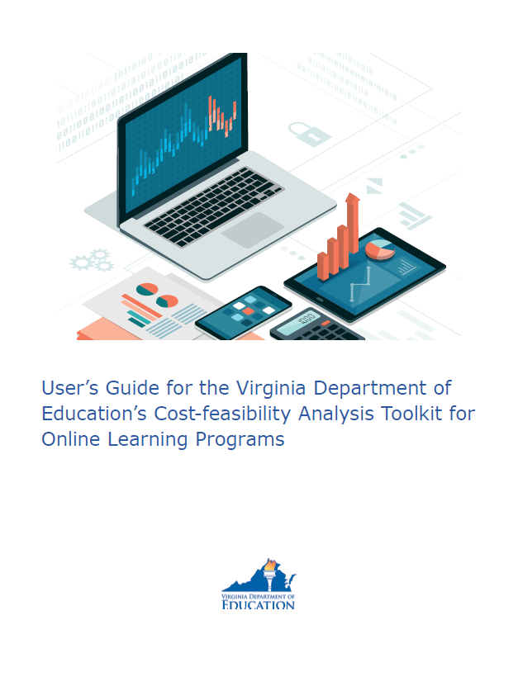
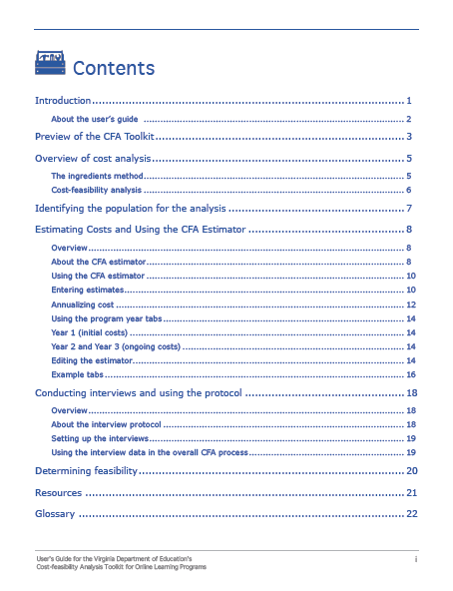
User’s guide
  Detailed guide on how to use each component of the Virginia CFA toolkit.

Slide 58
Resource list
  Detailed list of the potential resources needed to implement an online learning program and to maintain it annually.

Slide 59
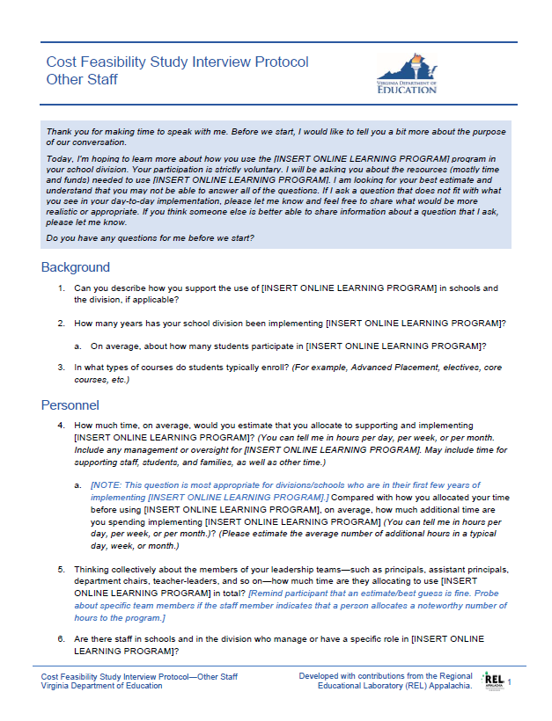
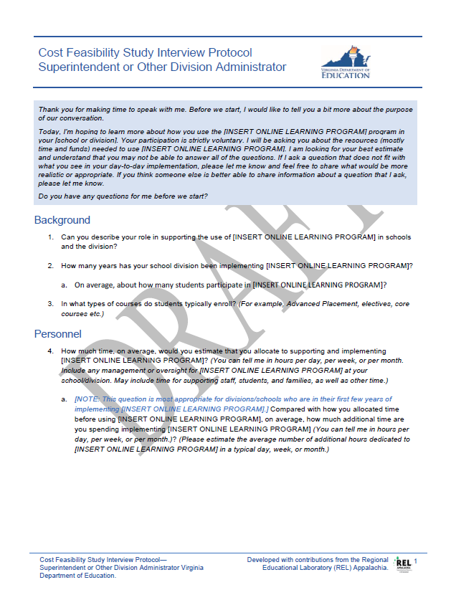
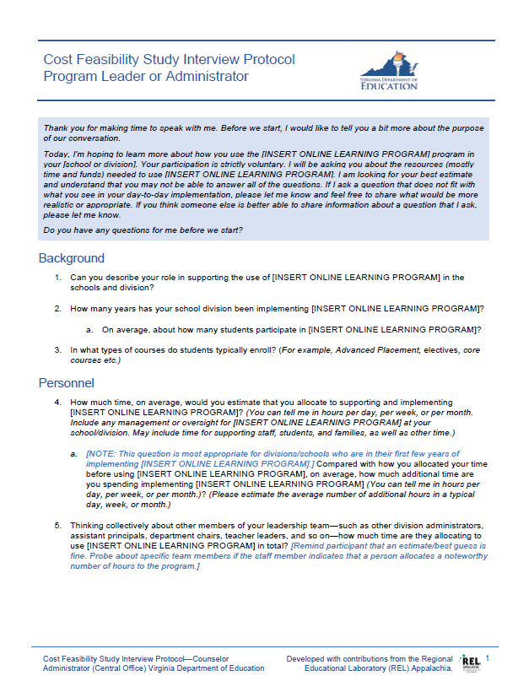
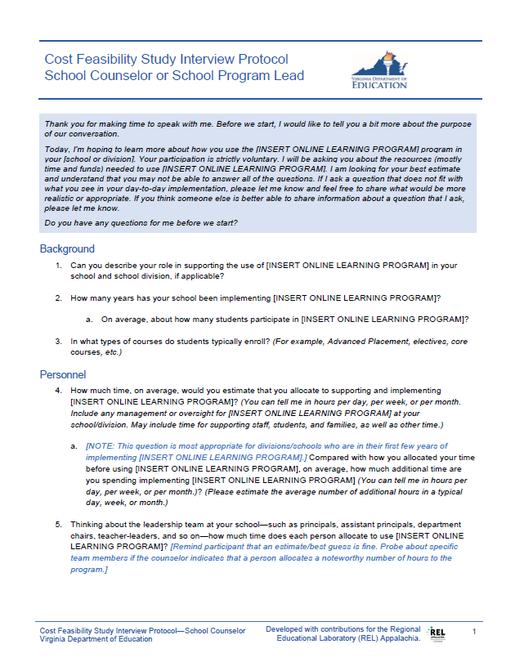
Interview protocols
  Guides for conversations with selected school division staff to understand time and resources required to implement a program.

Slide 60
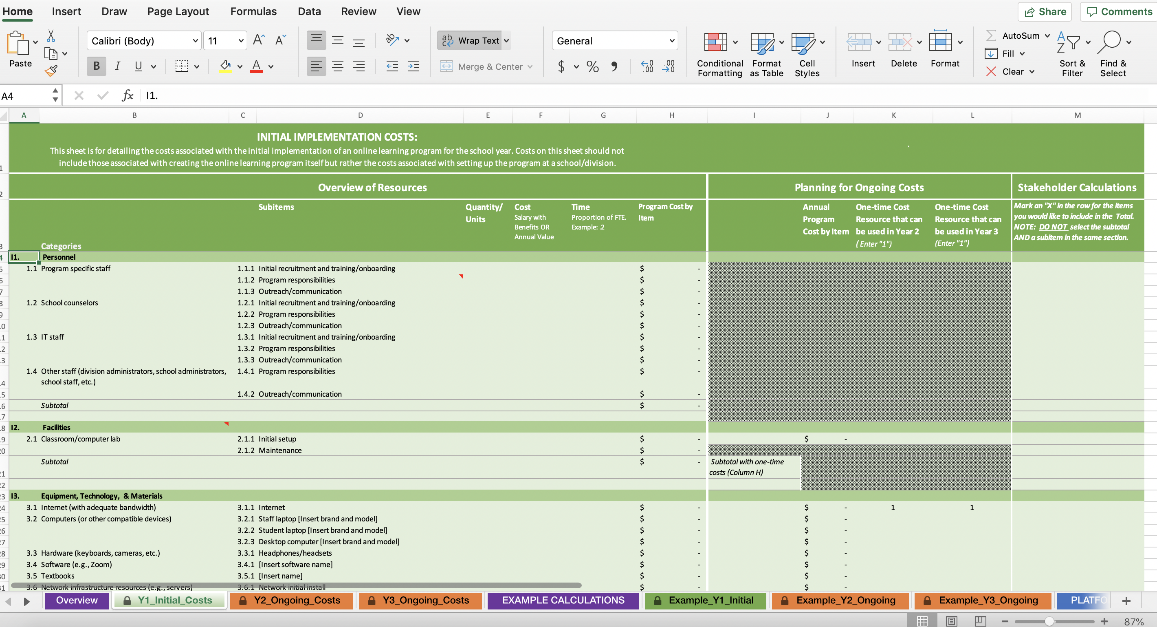
CFA estimator
  Microsoft Excel data-collection tool designed to estimate the cost of resources to implement and maintain an online learning program.

Slide 61

Virginia CFA Toolkit’s user-friendly design
All analysis documents are in Microsoft Office formats (MS Word or MS Excel) to:
  Promote ease of sharing with leaders and educators in Virginia.
  Allow for changes and modifications to the format or to the content.
The User’s Guide:
  Uses language that is approachable for a range of audiences, with clear explanations of technical elements.
  Allows users to navigate to the sections they need via page jump links.
The goal is to enable a broad range of users to conduct the cost-feasibility, even those who are not familiar with cost analysis.

Slide 62


Potential applications for the Virginia CFA Toolkit
VDOE and Virginia schools/school divisions could use the toolkit to:
Assess the costs and cost feasibility of supplemental online programs, such as VVA or Multidivision Online Provider Programs (MOPs)… | Assess the costs and cost feasibility of other types of virtual learning programs, such as fully-online schools... | Assess the costs and cost feasibility of other types of programs beyond virtual learning...
As is/with little modification. | With some modification. | With further modification.

Slide 63
Why a MOP Program?
As specified in § 22.1-212.24.A & B, the Superintendent of Public Instruction will develop, and the Board of Education will approve, the criteria for approving multidivision online providers, including those specified in these sections.

Slide 64
What is a MOP?
A Multidivision Online Provider (MOP) is a local school board or a private or nonprofit organization that provides online courses or programs to students in multiple public school divisions in Virginia.

Slide 65
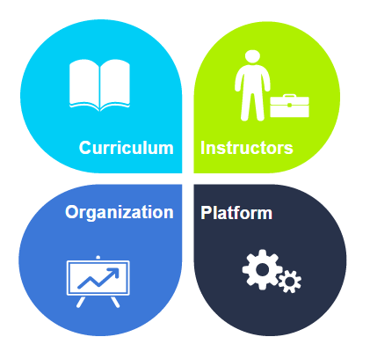
MOP Application Criteria

Slide 66

Annual MOP Processes

Slide 67
Current MOP Information
19 active MOPs
146 courses submitted
51 SOL, 28 CTE, & 67 electives
118 approved, 28 in approval process

Slide 68
Automation & Streamlining Efforts
Updated and simplified MOP related websites and documents
Created spreadsheet templates for course submissions
Incorporated phone interview questions into the annual Monitoring report
Streamlined and automated renewal process

Slide 69
MOP Renewal
Automation
Questionnaire & Monitoring Report
12 MOPs renewed
Courses
Alignment with SOL, new competencies
3-year cycle

Slide 70

#GoOpenVA: An Introduction
Jean Weller
Virginia Department of Education
2/27/2020
VLAC
#GoOpenVA presentation by #GoOpenVA is licensed under a Creative Commons Attribution 4.0 International License.

Slide 71
#GoOpenVA
A cloud-based platform built exclusively for Virginia educators allows for creation, distribution and collaboration of OER (openly-licensed education resources).
  Digital resources for deeper learning
  Equitable distribution
  Collaborative community

Slide 72
What are OER?
Free
Generally digital (much can be printed locally, as needed)
Copyright licensing is key
    Provides permissions upfront
    Removes burden from teachers
    Encourages sharing and remixing

Slide 73
Not just a repository
#GoOpenVA
GoOpenVA is a repository of openly-licensed educational resources
BUT
it is also a community of people who create, curate, and share.
THIS is it’s most important role in supporting equity, deeper learning, and student-focused education

Slide 74
Designed for Teachers
Digital Resources
Address components of deeper learning
Support personalized learning
Search engine uses several fields to help teachers find the most helpful resources, including drop-down menus for Virginia SOL
Community
Multiple ways to participate based on YOUR passions and needs
Openly-licensed materials lead to creative remixing
Open Author is built-in; easy tool for creation, with lots of help and support
Communication tools for collaborating

Slide 75
Deeper Learning Support
Virginia is for Learners: focus on K-12 education is to ensure that every student is ready to succeed when they graduate
5 C’s
  Critical thinking
  Creative thinking
  Collaboration
  Communication
  Citizenship
Support for teachers implementing personalized learning
  materials that fit the needs of many different students at different times and in different ways
  flexibility that is not available with most traditional classroom materials

Slide 76
#GoOpenVA and OER
#GoOpenVA is one component of a coordinated system for providing digital learning materials and opportunities for Virginia’s students.
#GoOpenVA role is to provide the creative space where educators in all areas of the state can share and develop resources.

Slide 77
How do resources get to #GoOpenVA?
Initial and continued sharing from other repositories
Teachers and Educator teams adding original resources they have created or remixed
Teachers and Educator teams adding curated resources links from around the Web
WE’RE JUST GETTING STARTED!

Slide 78
Who vettes the resources? Everyone!
Levels of initial vetting
    School Divisions
    Educator teams
    Individuals
Guidelines and other tools help creators and curators to self-evaluate
#GoOpenVA includes star rating system, evaluation rubrics, and areas to add comments

Slide 79
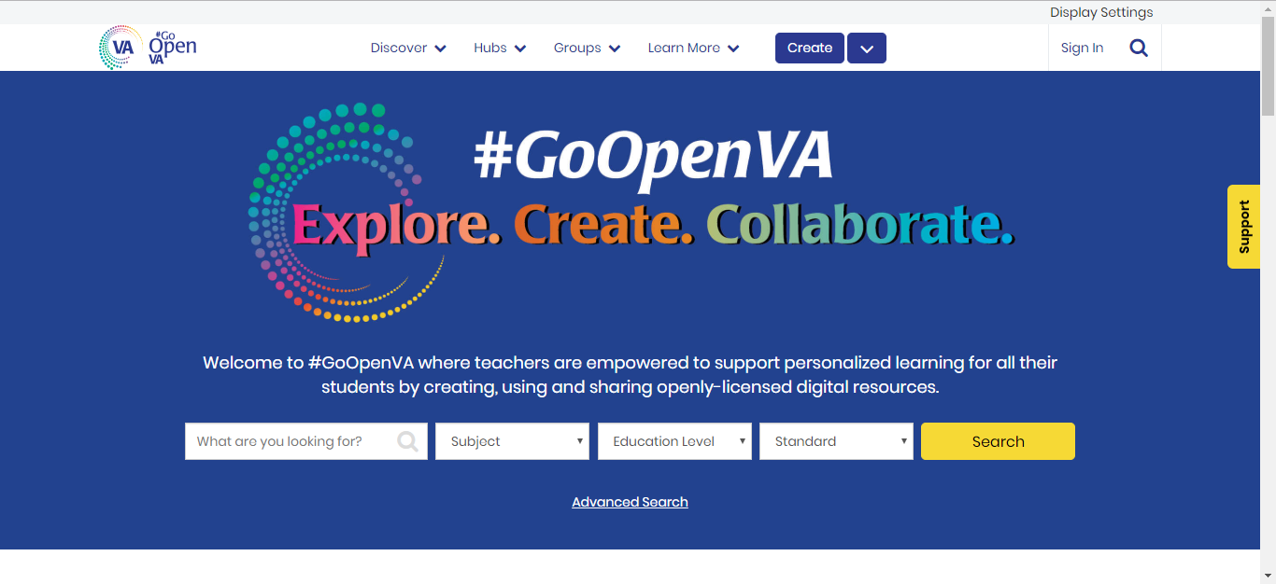
#GoOpenVA Website

Slide 80
#GoOpenVA Contact Information
jean.weller@doe.virginia.gov
Twitter: @VDOE_News
Facebook: @VDOENews
#VAis4Learners #EdEquityVA

Slide 81
Summary
Questions
Discussion
Establish next meeting date

Slide 82
.
Thank you for your work on this advisory committee

Slide 83
Contact Information
Meg Foley
meg.foley@doe.virginia.gov
Reginald Fox
reginald.fox@doe.virginia.gov
Twitter: @VDOE_News
Facebook: @VDOENews
#VAis4Learners #EdEquityVA

