Slide 1
Virginia Learning Advisory Committee
Thursday, September 24, 2020
Notes:
Welcome
Excited about opportunity for this committee to meet
Appreciative of the presenters taking time from their busy schedules to share important information with you
____________________________________________
Everyone should have a folder with the agenda and VA is for Learners paraphernalia.
Full agenda which Dr. Manglicmot will review, and we will commit to addressing all questions while maintaining our schedule.
Restrooms are located in the hallway.
We understand that you may need to take a call – you may use the area at the end of the hallway to have a private conversation.

Slide 2
Zoom Protocols & Public Comment
To avoid feedback we will keep our microphones muted until speaking.
Committee members may use the raise hand feature to get the facilitators’ attention.
Committee members are invited to post questions or comments in the chat box.
If you are using the phone, use *6 to mute and unmute and *9 to raise your hand.
Public viewing on the VDOE YouTube channel may email questions/comments to the mailbox until October 8: virtualprograms@doe.virginia.gov.

Slide 3
Introductions
Division Superintendents
VDOE
VSBA
VASS
WHRO
Virtual VA
Notes:
Representatives from VDOE, Superintendents from all regions in the Commonwealth, and representatives from organizations and agencies

Slide 4
Virginia Department of Education
Dr. James Lane, State Superintendent of Public Instruction
Mr. Michael Bolling, Assistant Superintendent for Dept. of Learning & Innovation
Ms. Holly Coy, Assistant Superintendent, Department of Policy, Equity & Communications
Dr. John Hendron, Coordinator of Organizational Development & Advancement
Dr. Meg Foley, Virtual Learning Specialist
Mr. Reggie Fox, Virtual Learning Specialist
Dr. Jen Piver-Renna, Director Office of Research
Dr. Susan Clair, Learning Infrastructure Coordinator
Ms. Jean Weller, Educational Technology Specialist
Ms. Cynthia Evans, Support Staff
Notes:
Thank Cynthia Evans for preparation and setup

Slide 5
Division Superintendents
Dr. Mervin B. Daughtery, Region I, Chesterfield County Schools (Mr. Ernest Longworth)
Dr. Jeffrey Smith, Region II, Hampton City Schools
Dr. James G. Smith, Region III, Richmond County Public Schools
Dr. Kevin Newman, Region IV, Manassas City Public Schools (Mr. Dave Lyon)
Dr. Garett Smith, Region V, Staunton Public Schools (Mr. Tom Lundquist)
Ms. Jeanette Day Warwick, Region VI, Craig County Schools
Dr. Kevin Siers, Region VII, Pulaski County Public Schools (Mr. Lincoln Whitaker)
Mr. Robbie W. Mason, Region VIII, Charlotte County Public Schools

Slide 6
Organizations & Agencies
Dr. Gina Patterson, Executive Director, Virginia School Boards Association
Dr. Ben Kiser, Executive Director, Virginia Association of School Superintendents
Mr. Bert Schmidt, President & Chief Executive Officer, WHRO
(Mitzi Fehl-Seward, Vice President of Digital Learning, WHRO)
Dr. Brian Mott, Executive Director of Virtual VA, Charlotte County Public Schools
Notes:
Dr. Patterson emailed and apologized for not being able to attend

Slide 7
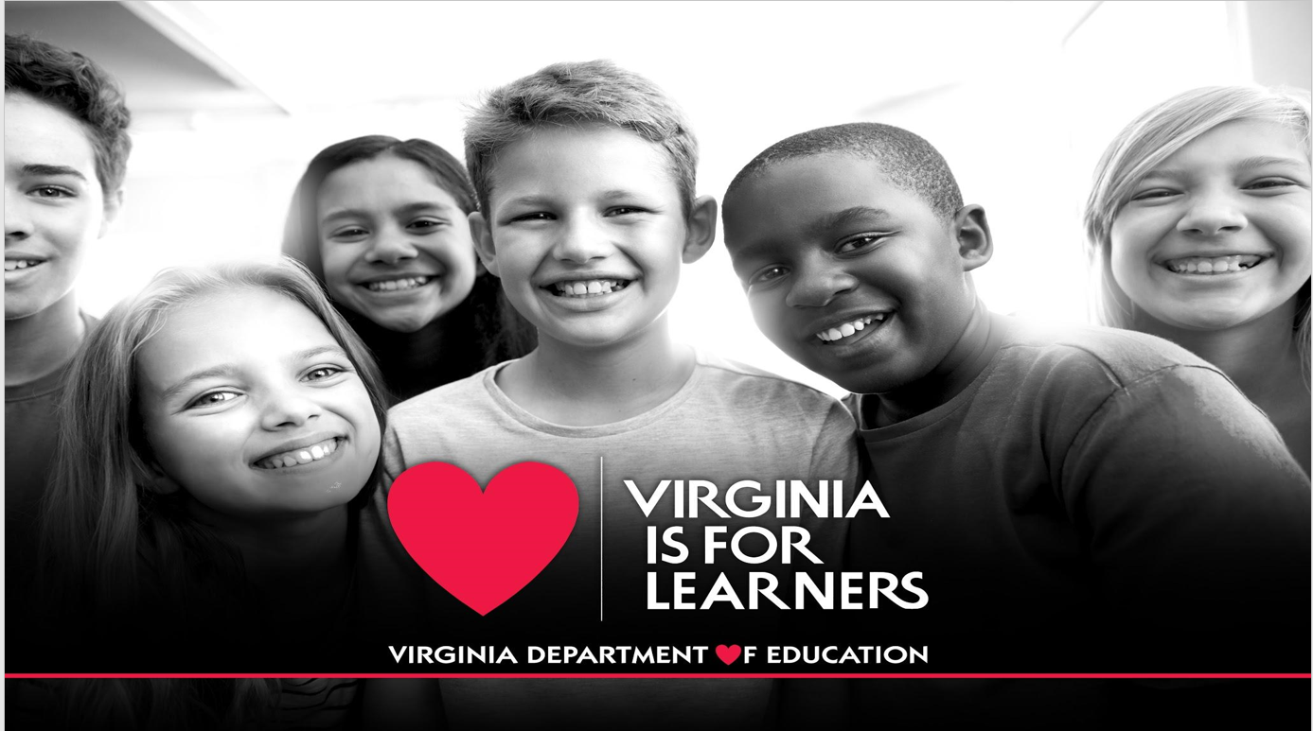
VA is for Lovers

Slide 8

Innovating around Virtual Learning
James F. Lane, Ed.D.,
Virginia Superintendent of Public Instruction
Notes:
VLAC Meeting 9/24/2020

Slide 9
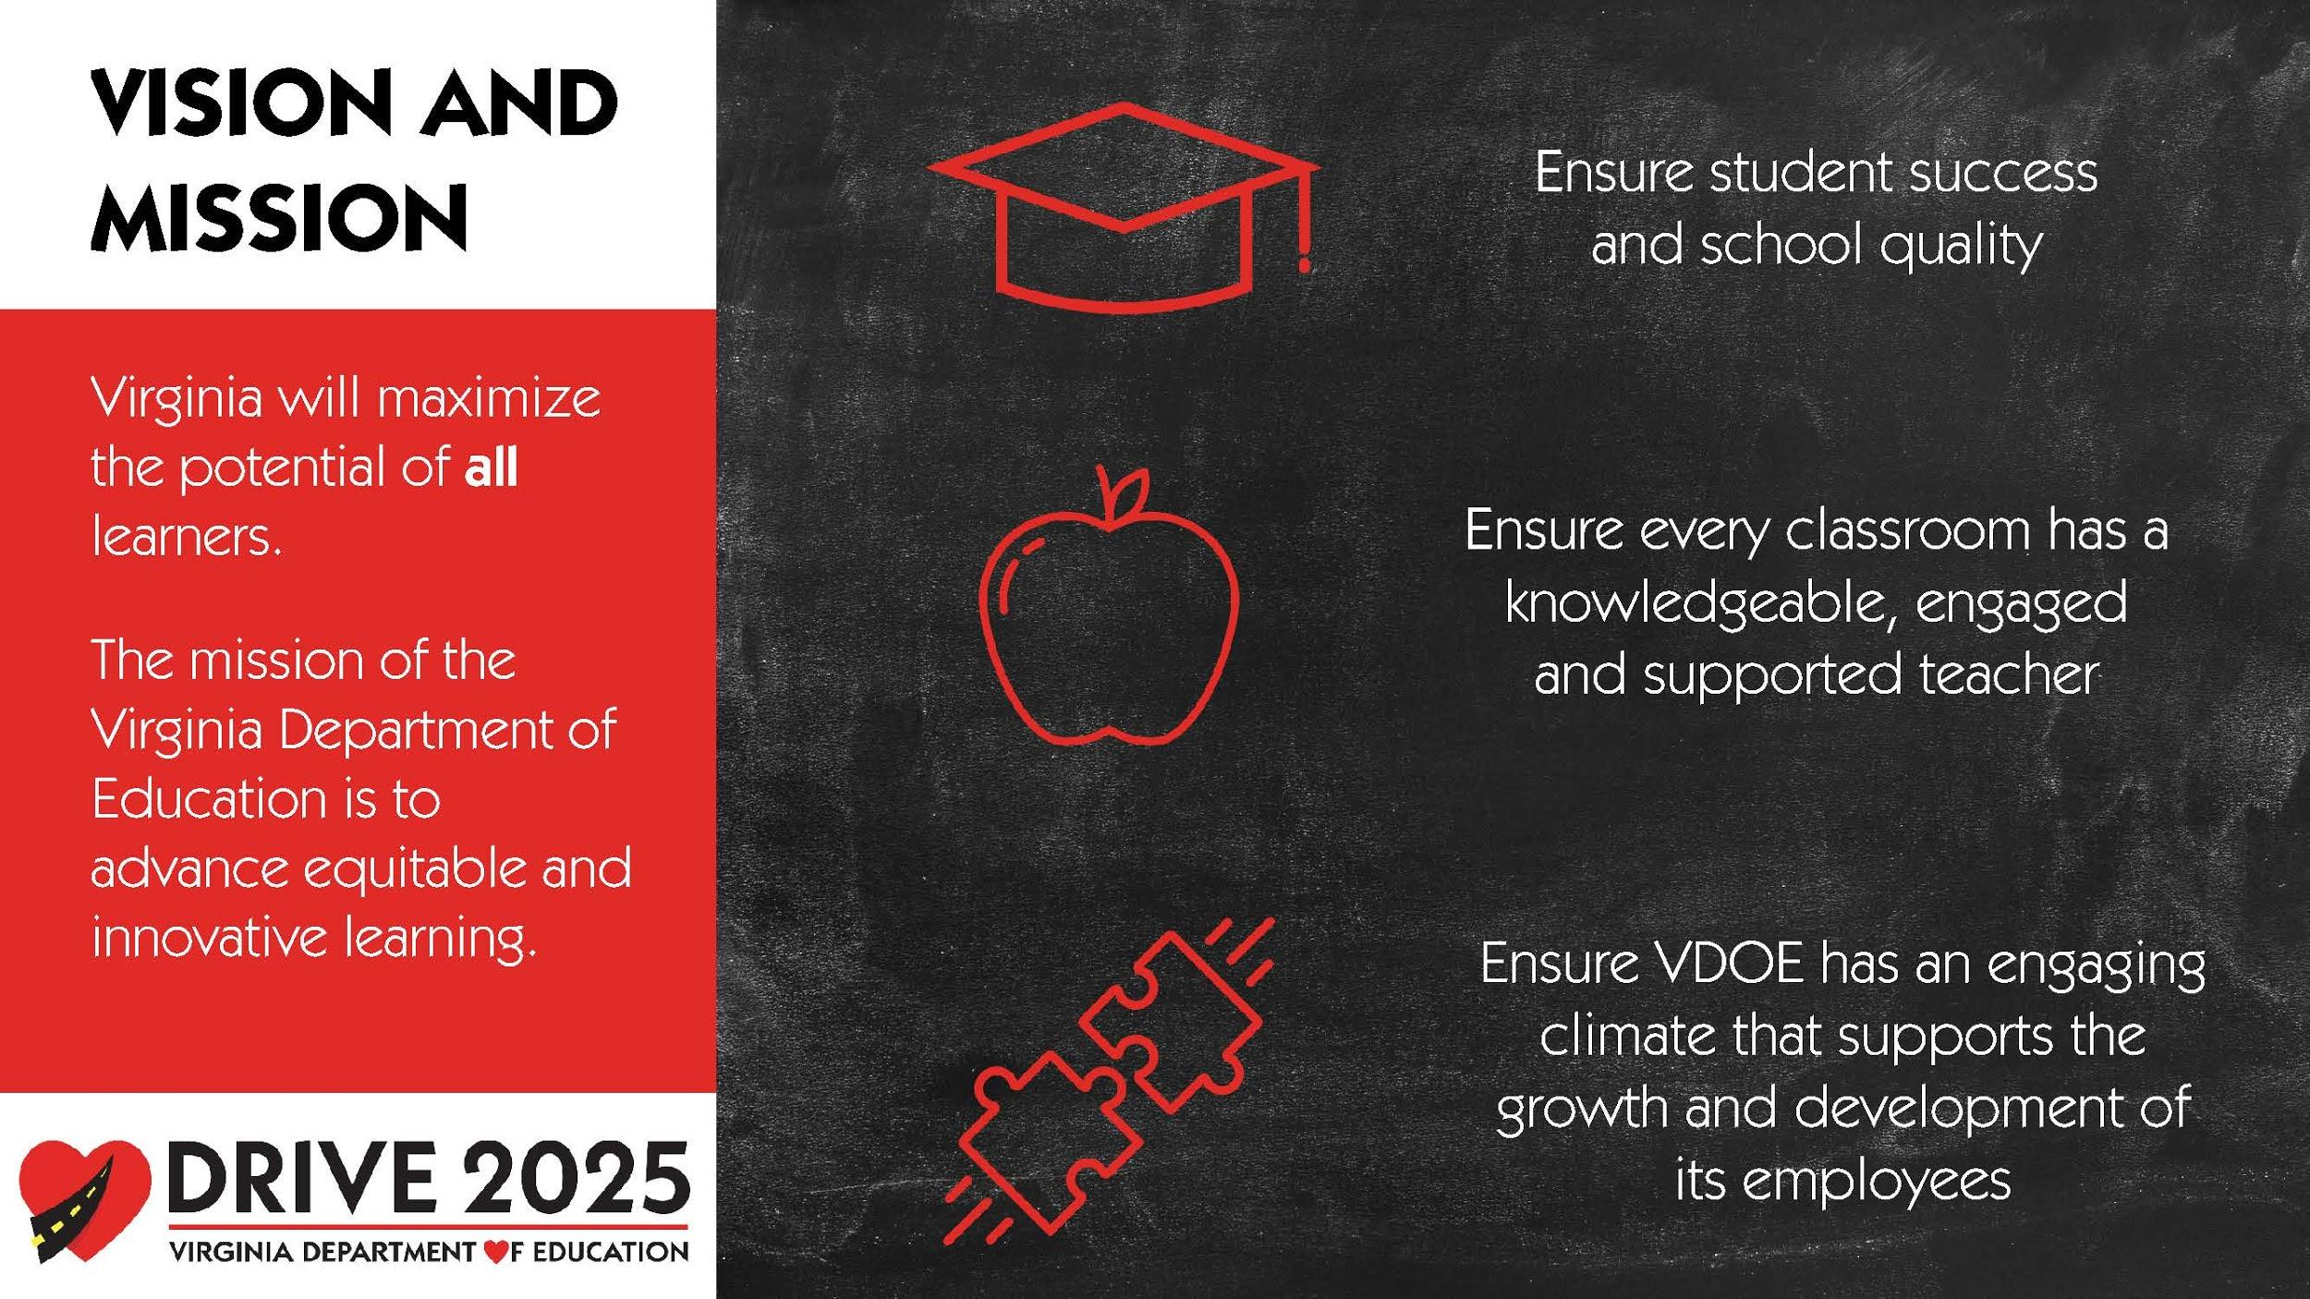
Vision and Mission

Slide 10


Innovation is critical in addressing
all of today’s challenges in education.

Slide 11

VA is for Lovers

Slide 12

Yet we still face big challenges.
The pandemic has highlighted the need
for real focus for equity in education.

Slide 13
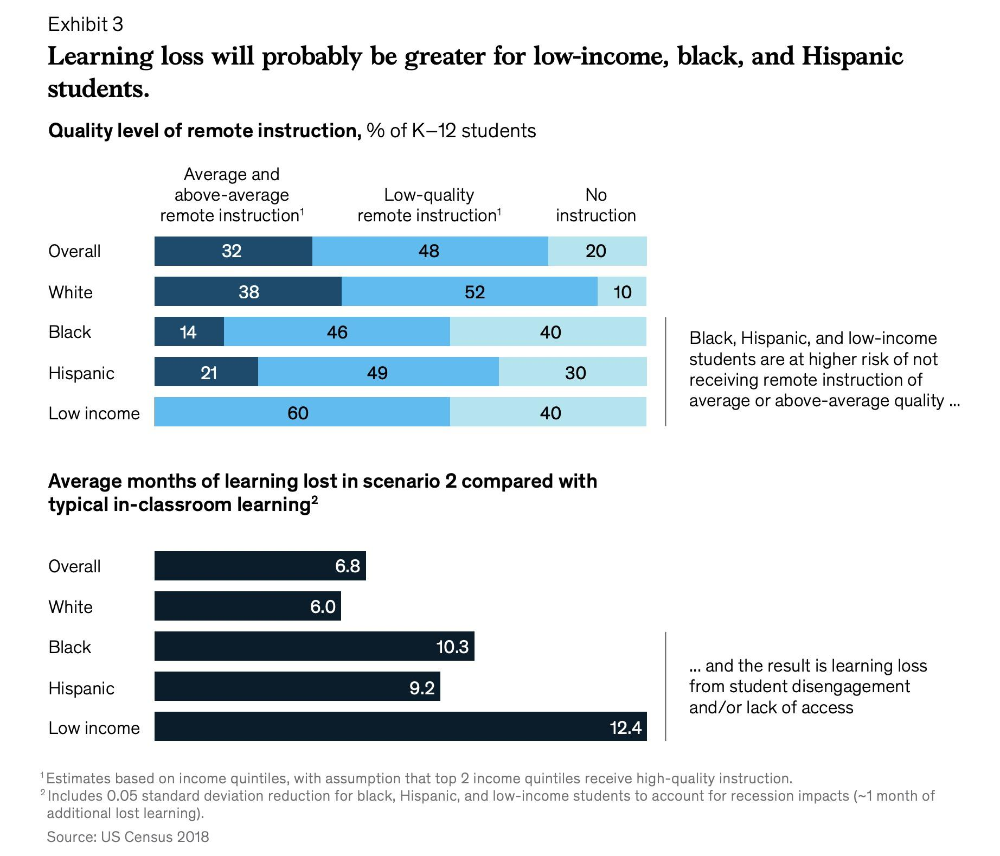
Learning Loss Chart
https://fresnostate.edu/kremen/about/centers-projects/weltycenter/documents/COVID-19-and-student-learning-in-the-United-States-FINAL.pdf

Slide 14
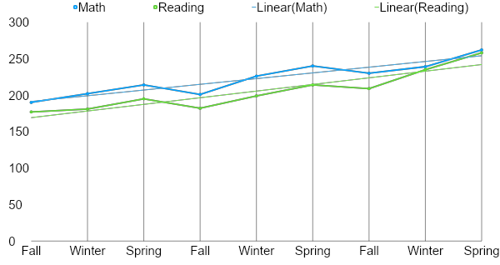
Annual Student Growth
Annual Student Growth
TIME

Slide 15
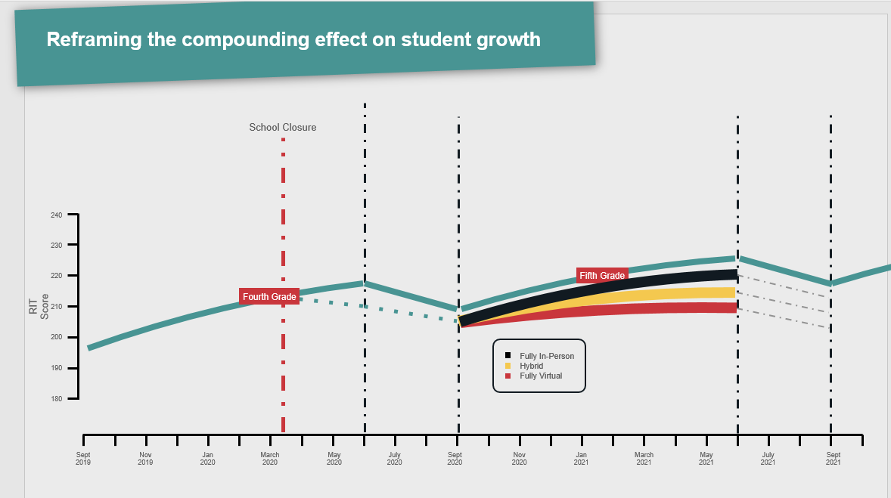
Reframing Compounding Effect

Slide 16
Compounded learning loss is an equity issue.
Providing the support that’s required when it’s needed to those who need it.

Slide 17

Investing in Virtual Virginia
We invested in VVA this summer to increase capacity and to
provide divisions with virtual support beyond our middle and high school courses.

Slide 18
Investing in Virtual Virginia
90% of school divisions participating
We invested in VVA this summer to increase capacity and to
provide divisions with virtual support beyond our middle and high school courses.
We provided educators across Virginia a learning management system (Canvas) at no cost.
Expanded course content for K-12 - core content for free
By December we will have asynchronous courses available for K-12
Invested ~$1M to increase number of VVA teacher-led courses beyond the former 15/high school to 12,000 total enrollments
  School divisions can still pay if they need additional teacher-monitored virtual instruction

Slide 19

A Quote from William Pollard
“Learning and innovation go hand in hand. The arrogance of success is to think that what you did yesterday will be sufficient for tomorrow.”

Slide 20

Virginia is for Learners

Slide 21
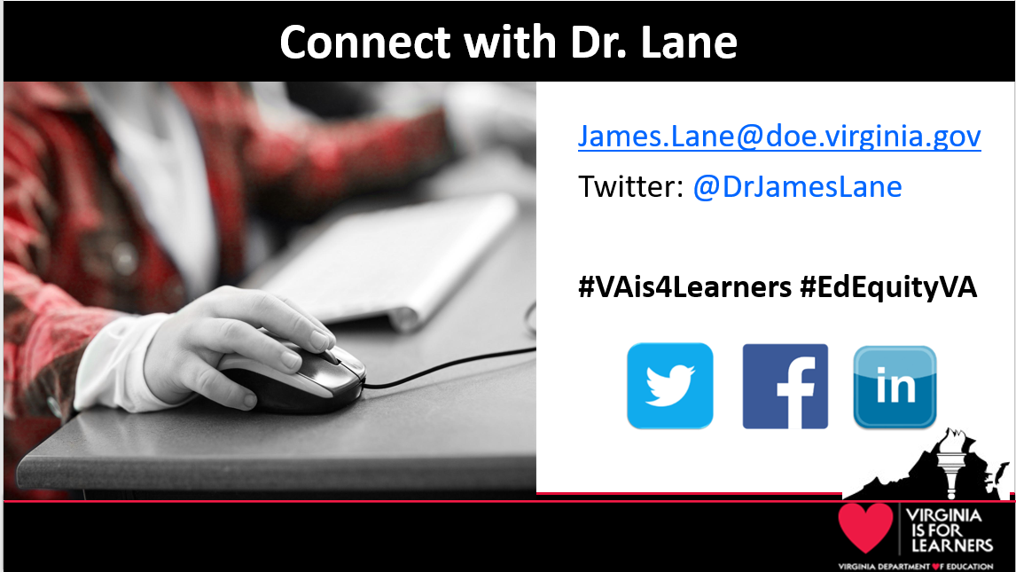
Dr. James Lane

Slide 22

Agenda
Welcome, Introductions
Remarks – Dr. Lane
Committee Purpose, Role, Term
Virtual VA Updates
VVA Program Evaluation
Virtual Teaching & Learning Update
Virtual Learning Website & HUB
MOP Update
Technology State Updates & Grants
GoOpenVA: Supporting Hybrid & Virtual Learning
Break-out Session
Next Steps

Slide 23
Purpose, Role & Term
Advisory group: online courses, in-service training and digital instructional resources necessary for school divisions to meet graduation requirements.
Strategic planning to expand blended and online learning opportunities in Virginia public schools, training, content and digital resources.
Important role sharing experience, expertise & resources.
3-year commitment meeting twice annually.

Slide 24
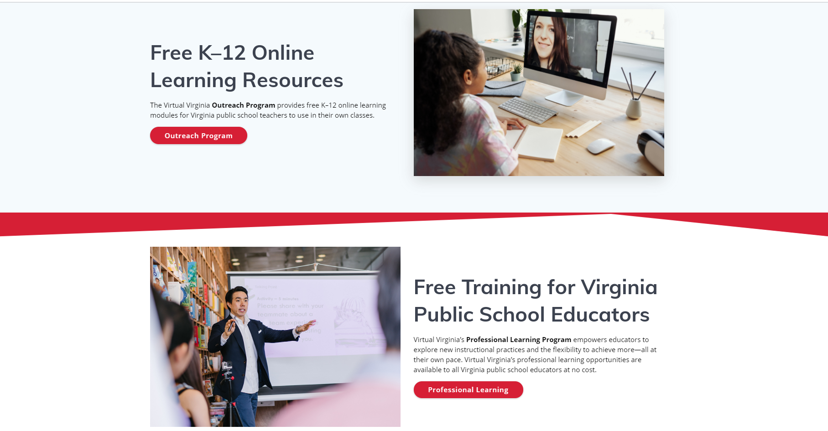
Virtual VA Updates
Program Overview
Update
Outlook

Slide 25
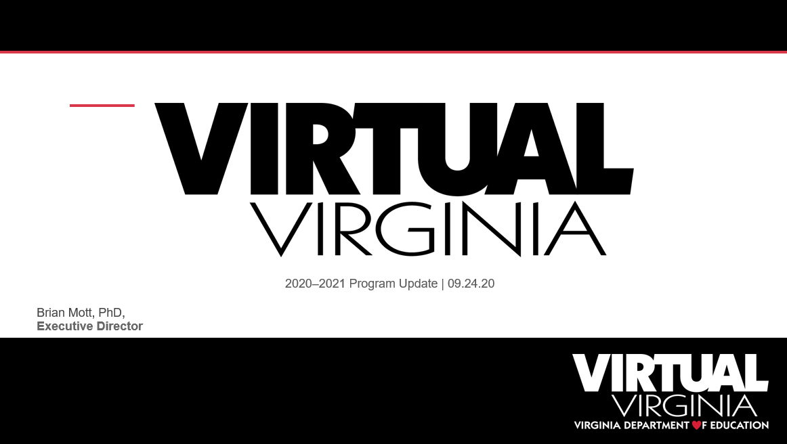
Virtual VA

Slide 26
Virtual VA
The Virginia Department of Education’s Virtual Virginia Program (VVA) offers online courses, professional learning opportunities, and digital content to schools, students, and educators across the Commonwealth.

Slide 27
Expanded Access in 2020-2021
Increased — from 6,000 to 12,000 — the number of free student enrollments available to divisions in Virtual Virginia-instructed courses in 2020–2021
Virginia Public school divisions can integrate with the Virtual Virginia learning management system to roster classes and transfer grades
The creation of digital content for grades K–12
A dedicated space within the platform for school divisions to curate, create, edit, and share course content and instructional materials
The expanded access to Virtual Virginia is available at no cost to school divisions through support from the federal Coronavirus Aid, Relief, and Economic Security Act, also known as the CARES Act

Slide 28
2019-2020 VVA Program Summary
Complementary Program
81
Courses offered in grades 6–12 taught by Virtual Virginia educators.
Outreach Program
107
Courses & learning modules in grades K–12 available to public school divisions—at no cost.
Professional Learning
26
PL offerings available to public school educators at no cost.
Summer Session
52
Courses offered in Summer Session 2020 to learners across the Commonwealth.
Notes:
Goal of the 2020-2021 Outreach Program - partner with and support each public school division as they establish and maintain a virtual learning program, all at no cost to the division

Slide 29
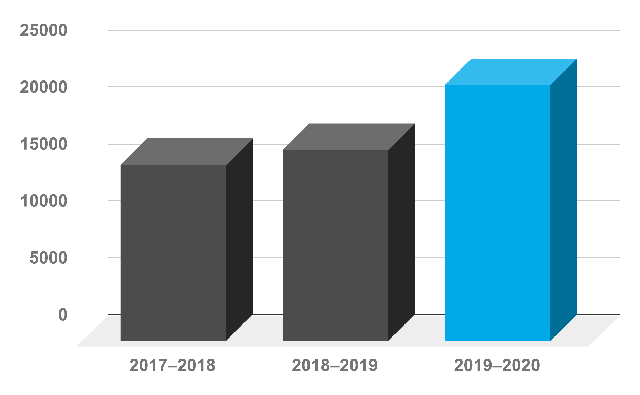
VVA Complementary Program
VVA courses are instructed by Virginia public educators
VVA courses are developed by Virginia public educators
Instruction is both synchronous and asynchronous modalities
Each student is offered a minimum of 4 group synchronous instructional sessions per week in addition to 1:1 and small group instruction
Sem Enrollment

Slide 30
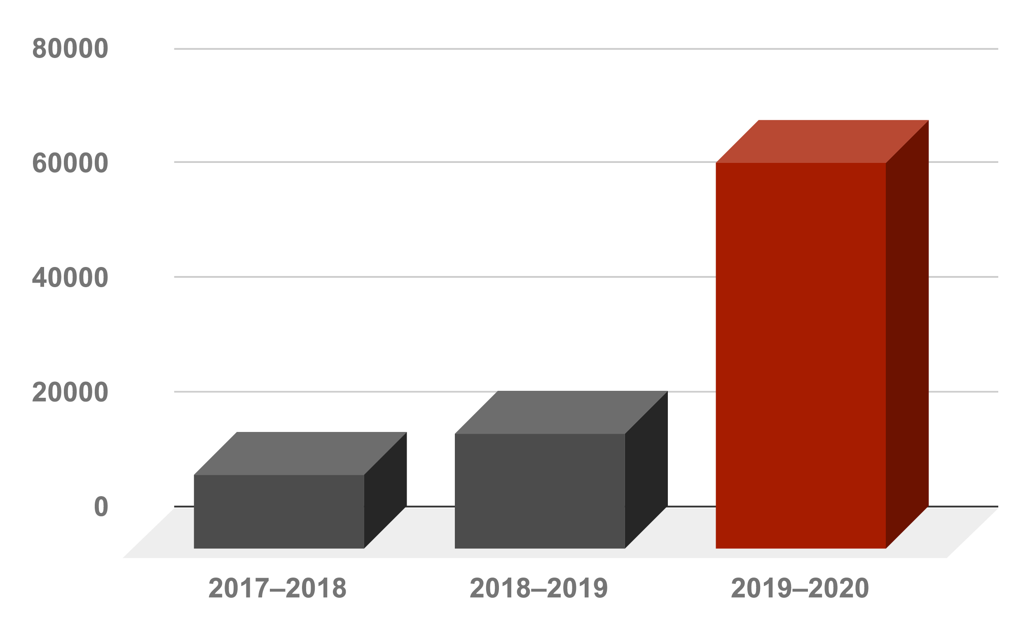
VVA Outreach Program
SOL-aligned content is developed and annually updated by Virginia public educators
Content includes Instructor Guides, fully developed lessons with interactive practice and assessments, and question banks
Local school teachers are enrolled in a statewide PLN
Local school teachers may participate in workshops and statewide webinars
Sem Enrollment

Slide 31
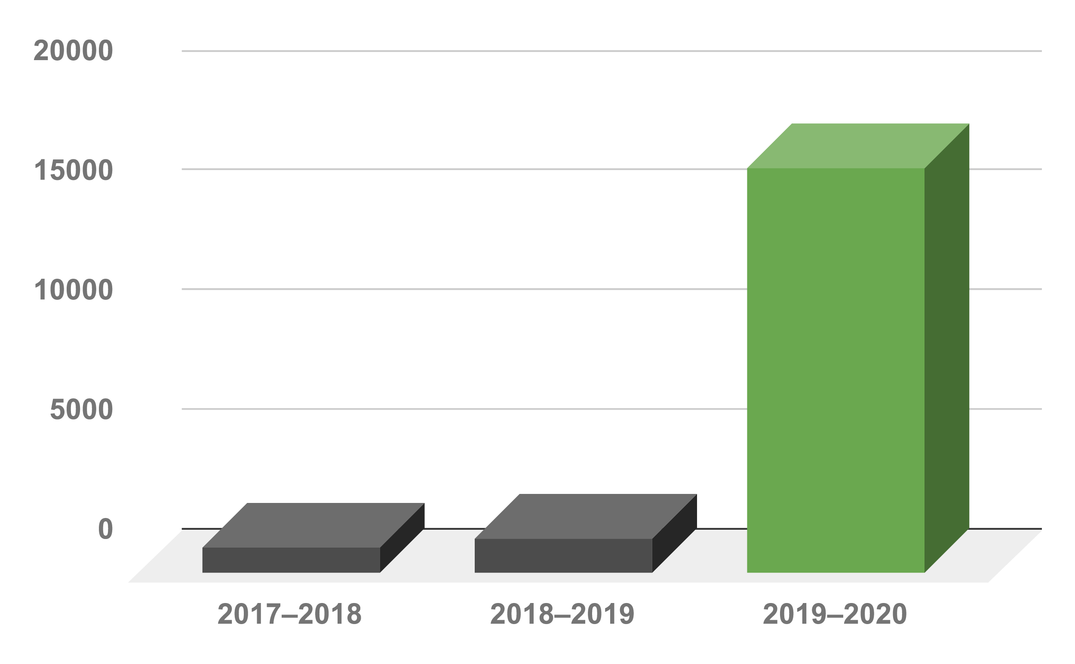
VVA Professional Learning Program
VVA offers PL in online learning best practices, blended learning facilitation, subject-area support and #GoOpenVA
VVA PL offerings are offered at no cost to Virginia public educators
PL offerings are developed by Virginia public educators
Complement to projects and innovations
Enrollment

Slide 32
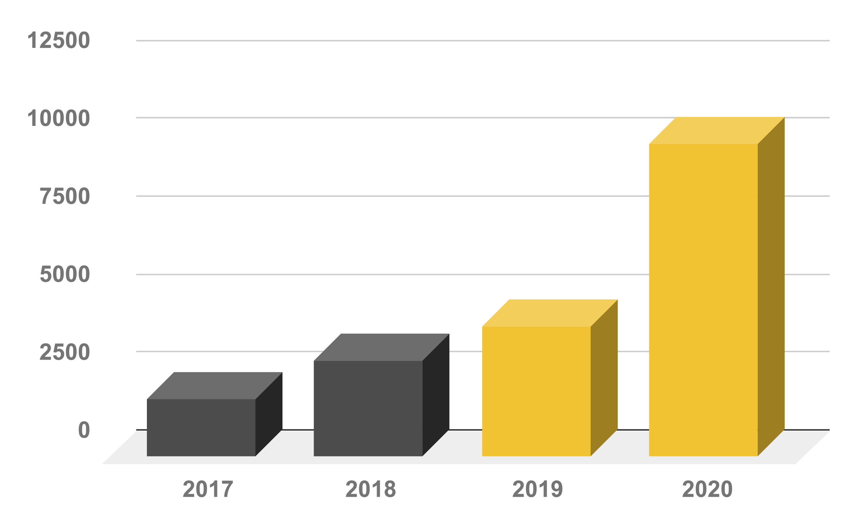
VVA Summer Session Program
Courses are instructed by Virginia public educators
Courses are developed by Virginia public educators
Instruction is both synchronous and asynchronous
Offered to all learners across the Commonwealth
Sem Enrollment

Slide 33
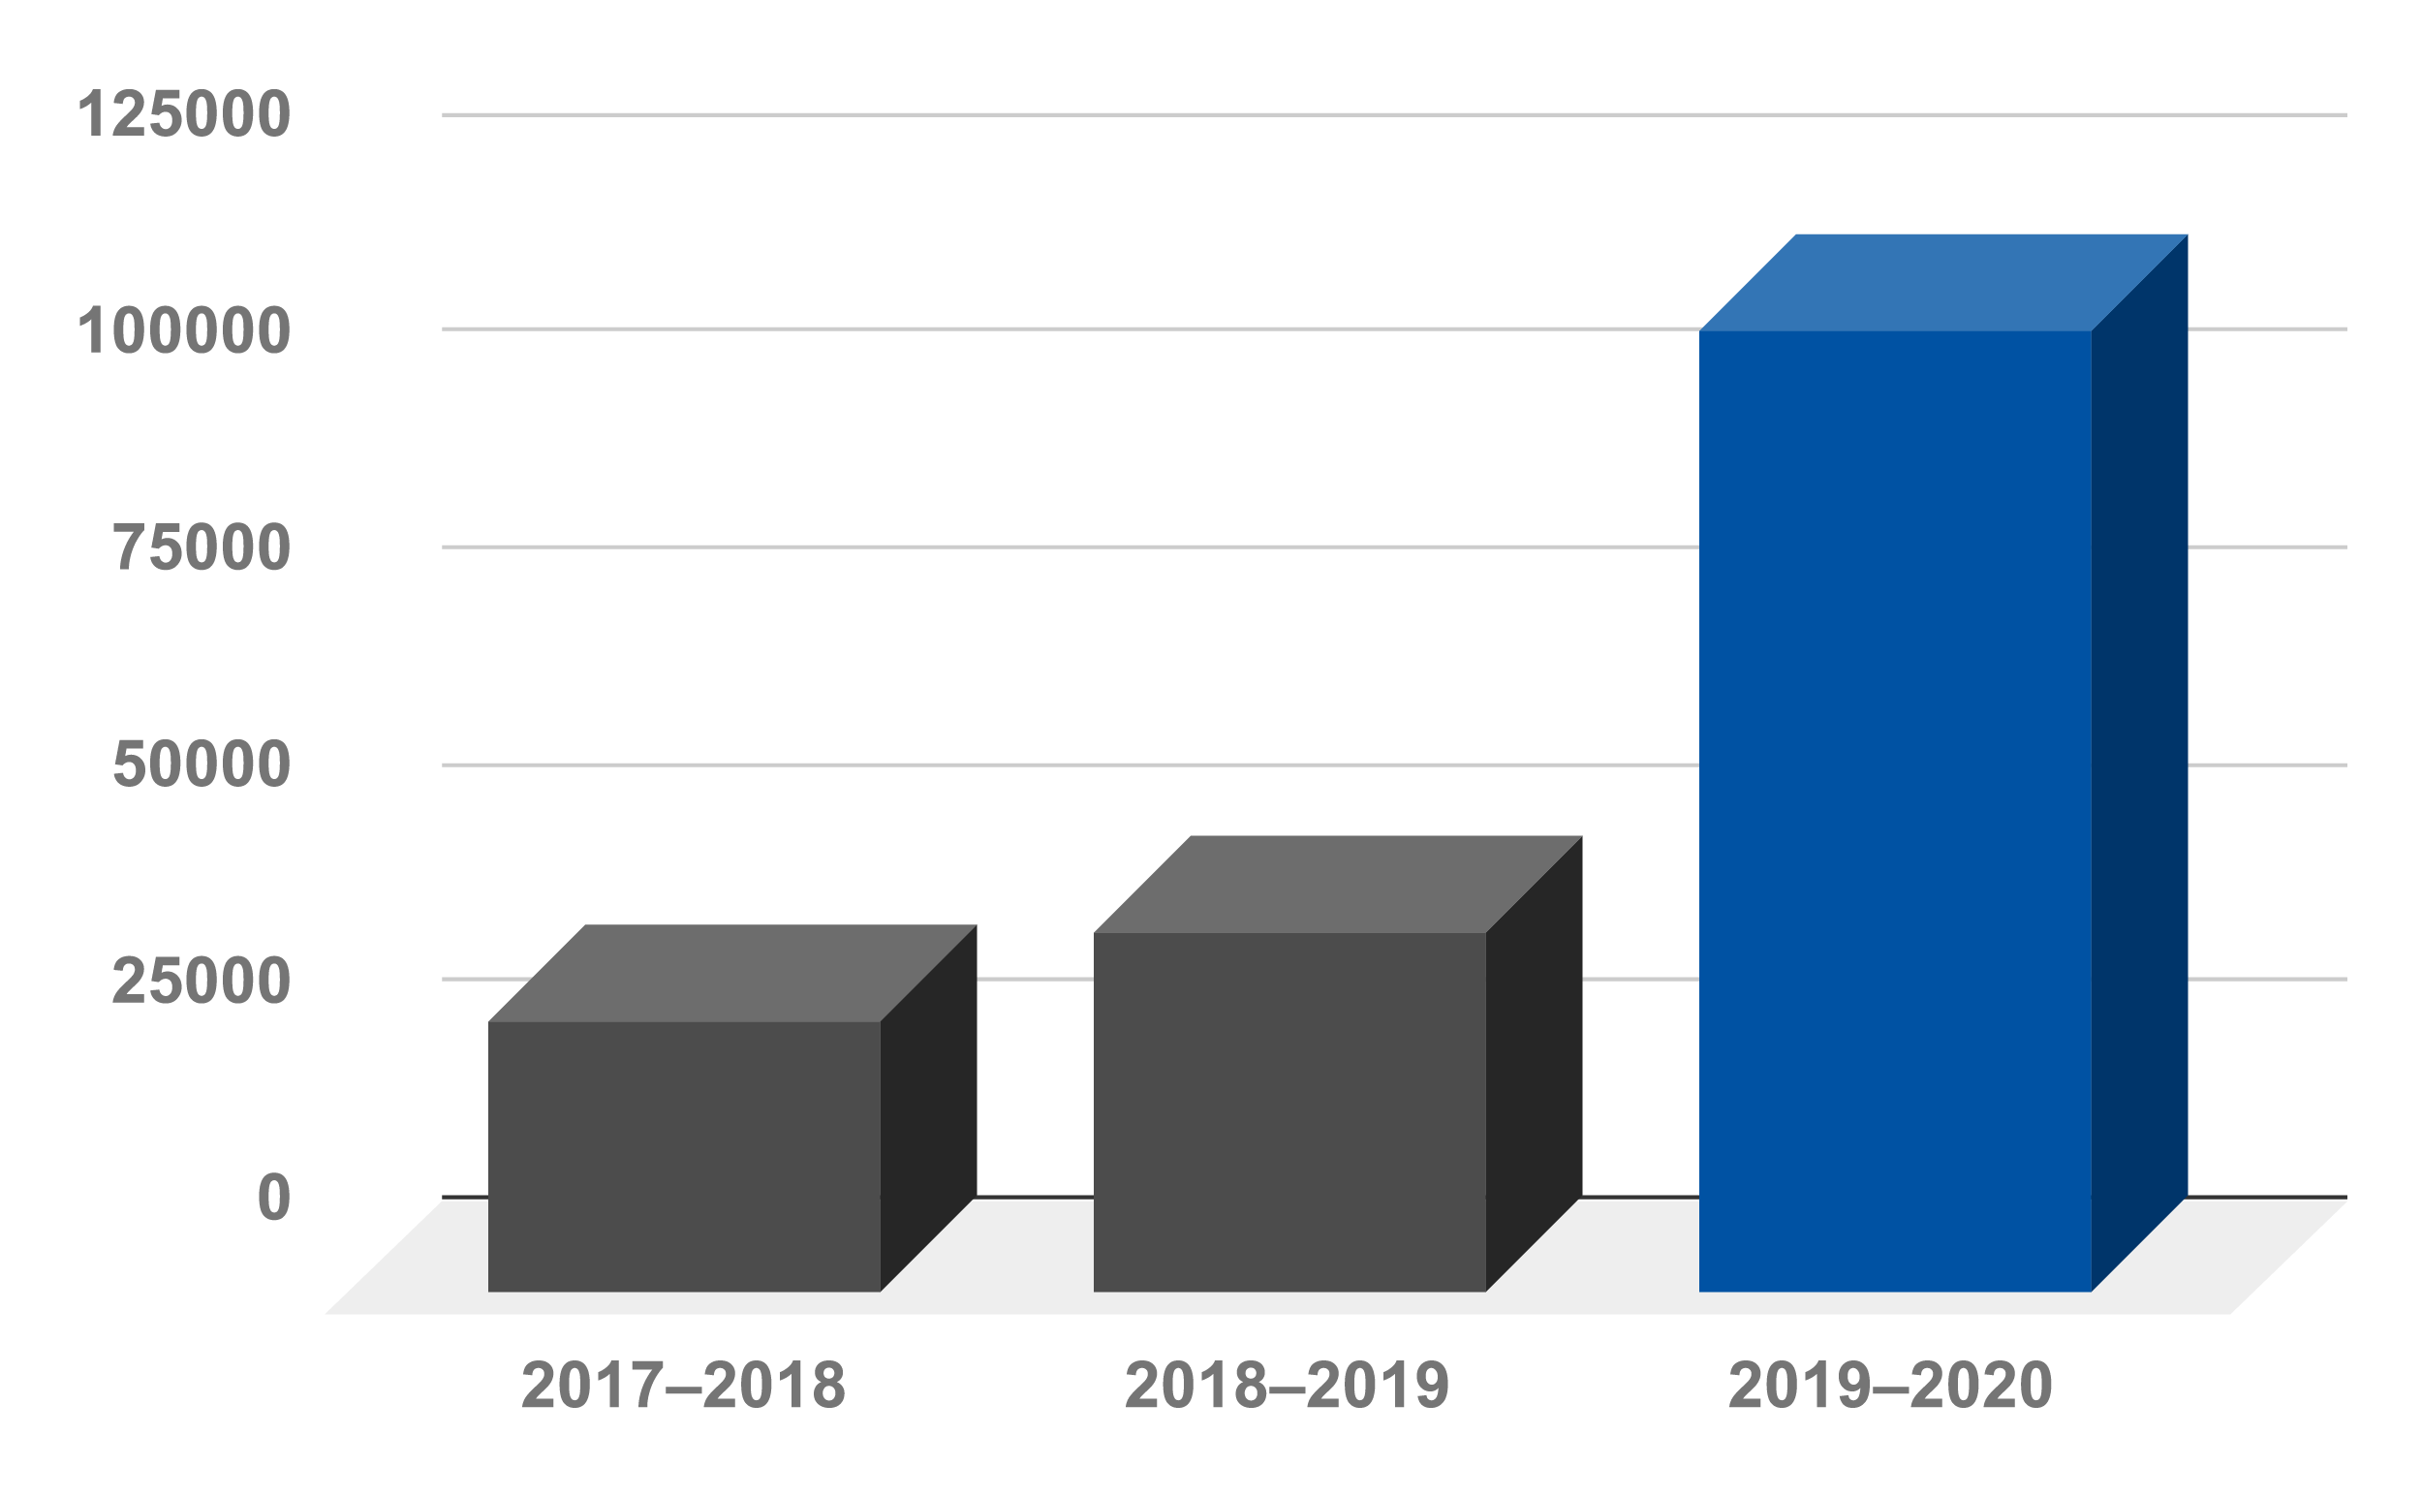
2019-2020 Enrollment Summary

Slide 34
2020-2021 VVA Program Update
Complementary Program
104
Courses offered in grades 6–12 taught by Virtual Virginia educators.
Outreach Program
107
Courses & learning modules in grades K–12 available to public school divisions—at no cost.
Professional Learning
125+
PL offerings available to public school educators at no cost.
Summer Session
52
Courses offered in Summer Session 2020 to learners across the Commonwealth.
Notes:
Goal of the 2020-2021 Outreach Program - partner with and support each public school division as they establish and maintain a virtual/online learning program, all at no cost to the division

Slide 35
VVA Outreach Program Components
LMS
Support
Content
Training
Support Teams
Content
Training
Learning Management System
Virginia public school divisions have access to their own instance of the VVA LMS at no cost.
Virginia public school divisions have access to VVA and LMS support teams at no cost.
Virginia public school divisions can import K–12 VVA content to the LMS at no cost.
Division educators have access to training and professional learning via VVA at no cost.
Notes:
All 4 components are on-going

Slide 36
VVA LMS Implementation
All in for Fall 2020
Phase In
Multi-platform approach
Use the VVA LMS along with an existing solution and making a decision at a later time
Implement now and planned deployment in 2021–2022
In 2020-2021, Virtual Virginia exceeded
22,000+
unique course downloads in the LMS!

Slide 37
Additional 2020-2021 Projects
Credit Recovery
Credit Recovery content development in Grades 7–12, available via the Outreach Program
Asynchronous Courses
Additional self-paced content and assessments are scheduled for initial release in early October for Grades 3–6
Expanded Offerings
Additional Outreach and Complementary Courses in preparation for Summer 2021
Professional Learning
The 2020–2021 VVA PLN will be expanded to include more educators across the Commonwealth

Slide 38

Dr. Brian Mott
Executive Director
brian.mott@virtualva.org
(866) 650-0025
www.virtualvirginia.org

Slide 39
Virtual Virginia Survey Results: 2019-20
Report provided by Dr. Jennifer Piver-Renna

Slide 40
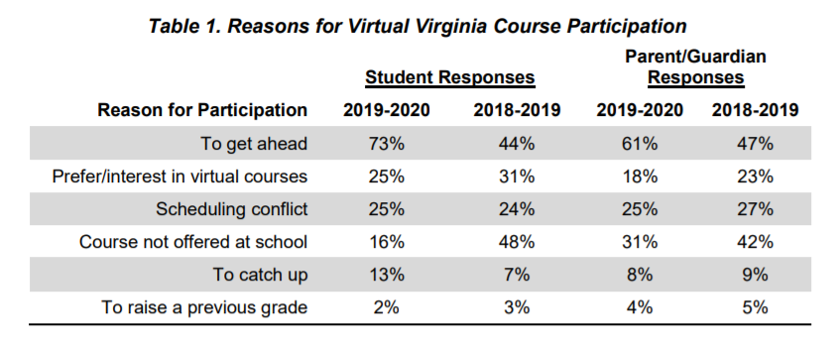
Reasons for Participating in Virtual VA

Slide 41
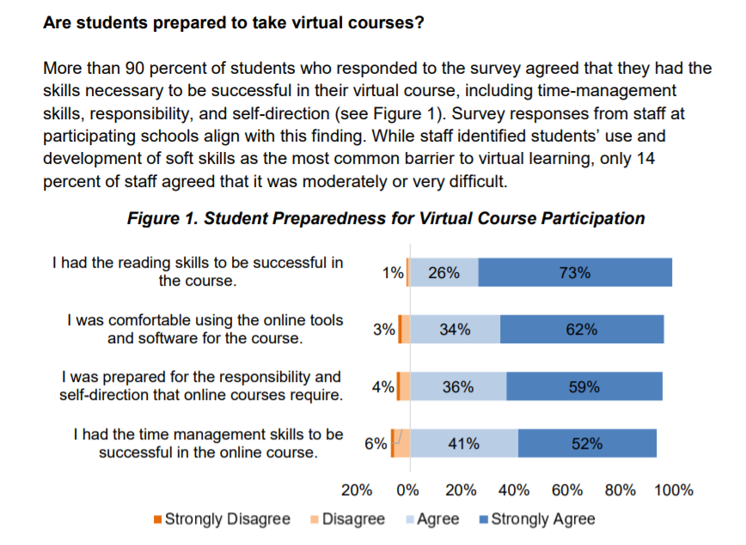
Virtual VA: Student Preparedness

Slide 42
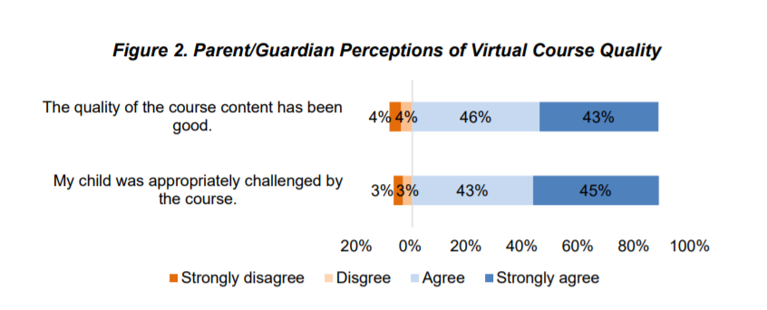
Virtual Course Quality: online & F2F

Slide 43
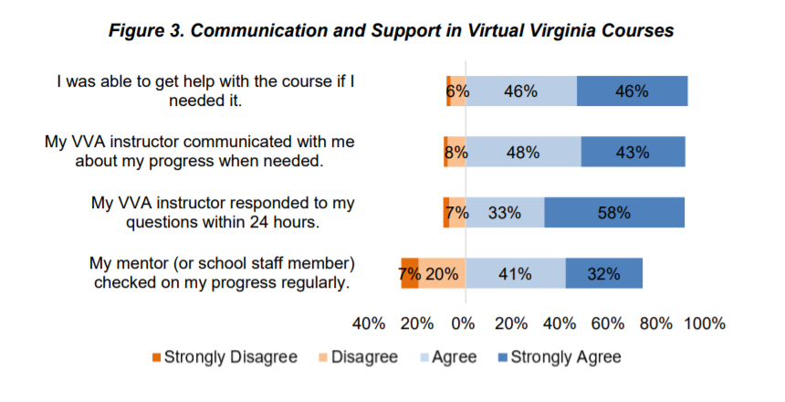
Communication & Support

Slide 44
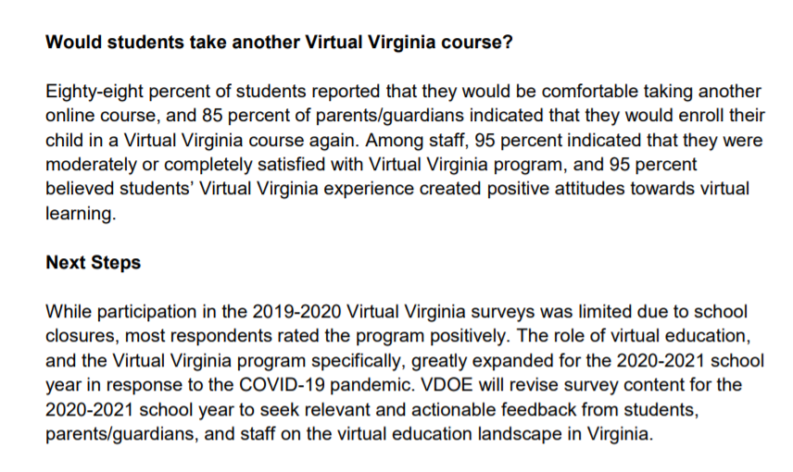
More online learning…
88% of students stated that they would take another online course.
95% of staff indicated that they were satisfied with the Virtual VA program which created a positive online experience.

Slide 45


Virtual Teaching & Learning Updates
Michael Bolling
Virtual Teaching & Learning Updates
michael.bolling@doe.virginia.gov

Slide 46
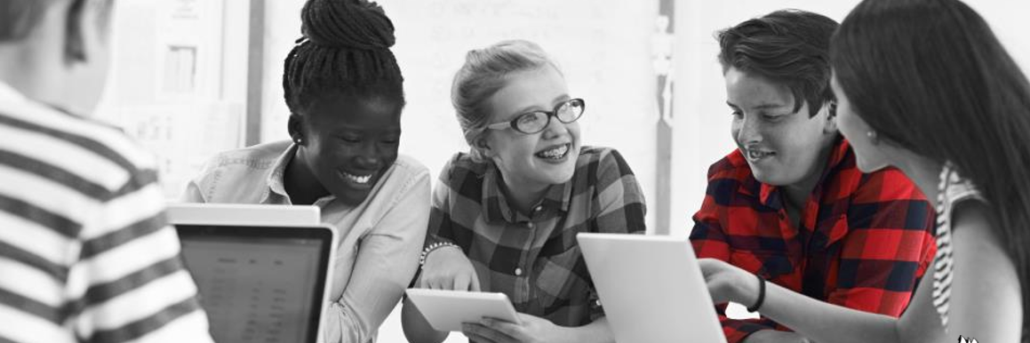


Virtual Teaching & Learning Updates
VDOE Updates
Virtual Learning Support
Grant Funding
Professional Development

Slide 47
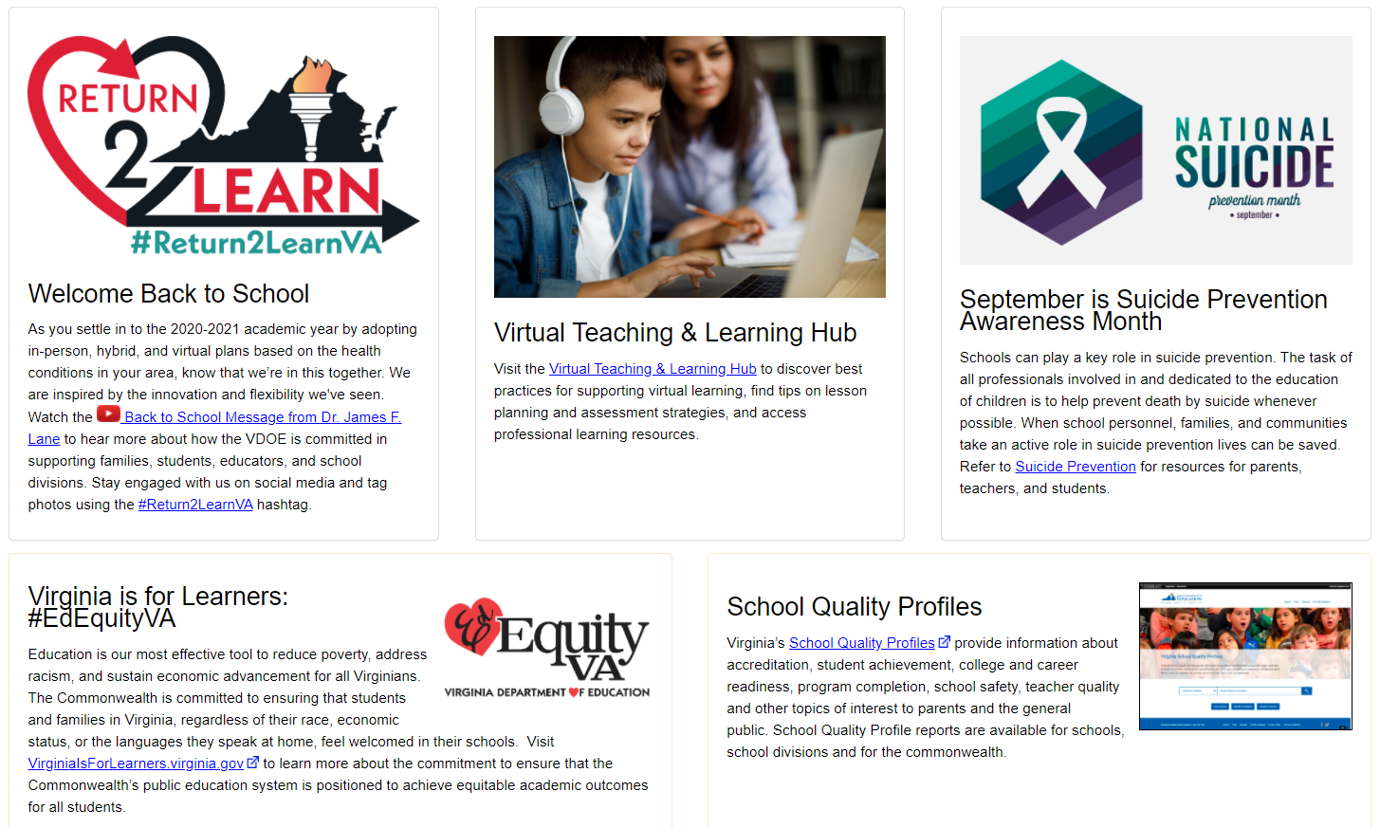
What’s New with Virtual Learning?

Slide 48
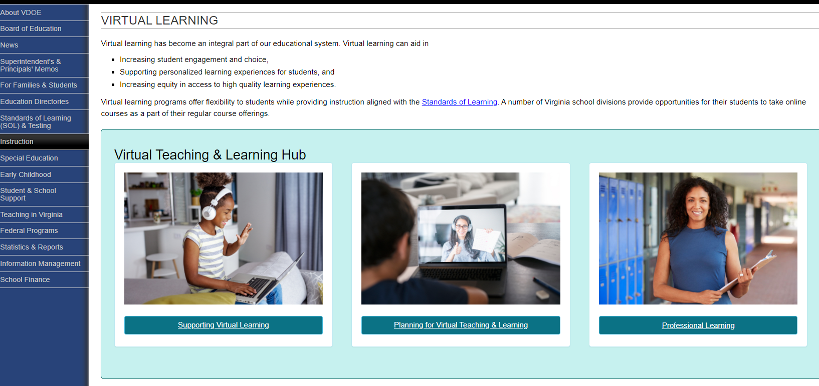
What’s New with Virtual Learning?

Slide 49
Why a MOP Program?
As specified in § 22.1-212.24.A & B, the Superintendent of Public Instruction will develop, and the Board of Education will approve, the criteria for approving multidivision online providers, including those specified in these sections.

Slide 50
What is a MOP?
A Multidivision Online Provider (MOP) is a local school board or a private or nonprofit organization that provides online courses or programs to students in multiple public school divisions in Virginia.

Slide 51

MOP Application Criteria

Slide 52
Current MOP Information
19 active MOPs
165 courses submitted
52 SOL, 24 CTE, & 89 electives
159 approved

Slide 53



Contact Information
meg.foley@doe.virginia.gov
reginald.fox@doe.virginia.gov
VDOE Website
Twitter: @VDOE_News
Facebook: @VDOENews
#VAis4Learners #EdEquityVA

Slide 54
Technology Updates & Grants
Dr. Susan Clair
Virginia Initiative to Support Internet Outside of school Networks (VISION)

Slide 55
Virginia Initiative to Support Internet Outside of school Networks (VISION)
GEERS grant funds (Governor’s Emergency Education Relief Funds) , Supt’s Memo awards on Oct. 2, 2020
Little less than $18 million available for divisions
Competitive grants
Eligible technologies: computing devices, LTE mobile data plans, hotspots, filtering, device management, other technologies that expand WiFi into the community.

Slide 56
Virginia Initiative to Support Internet Outside of school Networks (VISION)
Impact on education & virtual learning:
Students will get computing devices that never had one to take home –moves divisions to 1:1
Students will get LTE mobile carrier access to the Internet via a hotspot
Students /families will have access to low cost Internet programs to the home
Expansion of WiFi into areas of the community
Beyond Covid-19 benefits- support for hybrid, blended, snow day instruction

Slide 57
Contact Information
susan.clair@doe.virginia.gov
Twitter: @VDOE_News
Facebook: @VDOENews
#VAis4Learners #EdEquityVA

Slide 58

#GoOpenVA: Supporting Hybrid & Virtual Instruction
Jean Weller
Virginia Department of Education
VLAC
#GoOpenVA presentation by #GoOpenVA is licensed under a Creative Commons Attribution 4.0 International License.
Notes:
#GoOpenVA is a collaboration between Virginia educators, educational entities, and other stakeholders to create, provide and share quality digital instructional materials that can be used by all educators and learners to support deeper learning. A cloud-based platform built exclusively for Virginia educators allows for creation, distribution and collaboration.

Slide 59
OER and Hybrid/Virtual Learning
The VDOE is serious about supporting teachers to provide student-centered, culturally-responsive teaching, no matter the medium used
Openly-licensed resources provide a means for teachers to do this easily and quickly
  Easy editing allows on-the-fly adjustments
  Digital (can be shared through Internet, downloaded for sharing on USB drives, or printed)
  Lessons provided need not be the same for each student or group of students
  New recommended resources can be pushed out to a group immediately
  No concern about restrictions on flexibility

Slide 60
#GoOpenVA Capabilities
Access through single-sign on or direct login
Access through LTI connections with local LMS and/or Virtual Virginia’s Canvas
Provision of spaces for sharing and collaborating (large or small groups)
Encouragement of “mentor mentality” among teachers to share what they know with other teachers, helping all with continual growth and exploration of new skills
Important Note: #GoOpenVA is teacher-facing, meaning it is intended to be used directly by teachers. Although there are student-facing resources linked, and students can access these, it is not designed as a student-facing system.

Slide 61
#GoOpenVA Contact Information
jean.weller@doe.virginia.gov
Twitter: @VDOE_News
Facebook: @VDOENews
#VAis4Learners #EdEquityVA

Slide 62
Breakout Session
10 minutes for break-out groups; Livestream on YouTube (break)
Discuss and answer questions
  What advice would you give about your blended and/or virtual learning based on your experiences with opening the school year?
  What additional technologies and instructional support would you need to continue blended and/or virtual learning?
Facilitators: Michael Bolling, John Hendron, Meg Foley, Reggie Fox – identify someone to report back to the group.
Set a timer and be prepared to report back to the full committee

Slide 63
Breakout Session Discussion
Share group discussion
Identify common threads
Addressing needs
Sharing across the Commonwealth

Slide 64
Have a safe & successful year!
    Next steps
    Next meeting (March)
    Public viewing on the VDOE YouTube channel may email questions/comments to the mailbox until October 8: virtualprograms@doe.virginia.gov.
Thank you for your work on this advisory committee

