Slide 1
Virginia Learning Advisory Committee
Monday, March 15, 2021 (9:00 a.m.)

Slide 2
Zoom Protocols & Public Comment
To avoid feedback we will keep our microphones muted until speaking.
Committee members may use the raise hand feature to get the facilitators’ attention.
Committee members are invited to post questions or comments in the chat box.
If you are using the phone, use *6 to mute and unmute and *9 to raise your hand.
Public viewing on the VDOE YouTube channel may email questions/comments to the mailbox until March 25: virtualprograms@doe.virginia.gov.

Slide 3
Introductions
Division Superintendents
VDOE
VSBA
VASS
WHRO
Virtual VA
Notes:
Representatives from VDOE, Superintendents from all regions in the Commonwealth, and representatives from organizations and agencies

Slide 4
Virginia Department of Education
Dr. James Lane, State Superintendent of Public Instruction
Mr. Michael Bolling, Assistant Superintendent for Dept. of Learning & Innovation
Dr. Brendon Albon, Director of STEM & Innovation
Dr. John Hendron, Coordinator of Organizational Development & Advancement
Dr. Meg Foley, Coordinator of Virtual Learning
Mr. Reggie Fox, Virtual Learning Specialist
Mr. Mark Saunders, Instructional Technology Coordinator
Dr. Susan Clair, Learning Infrastructure Coordinator
Ms. Jean Weller, Educational Technology Specialist
Notes:
Thank Cynthia Evans for preparation and setup

Slide 5
Division Superintendents
Dr. Mervin B. Daughtery, Region I, Chesterfield County Schools (Mr. Ernest Longworth)
Dr. Jeffrey Smith, Region II, Hampton City Schools
Dr. James G. Smith, Region III, Richmond County Public Schools
Dr. Kevin Newman, Region IV, Manassas City Public Schools (Mr. Dave Lyon)
Dr. Garett Smith, Region V, Staunton Public Schools (Mr. Tom Lundquist)
Ms. Jeanette Day Warwick, Region VI, Craig County Schools
Dr. Kevin Siers, Region VII, Pulaski County Public Schools (Mr. Lincoln Whitaker)
Mr. Robbie W. Mason, Region VIII, Charlotte County Public Schools

Slide 6
Organizations & Agencies
Dr. Gina Patterson, Executive Director, Virginia School Boards Association
(Rodney Jordan, Virginia School Boards Association)
Dr. Ben Kiser, Executive Director, Virginia Association of School Superintendents
Mr. Bert Schmidt, President & Chief Executive Officer, WHRO
(Mitzi Fehl-Seward, Vice President of Digital Learning, WHRO)
Dr. Brian Mott, Executive Director of Virtual VA, Charlotte County Public Schools

Slide 7
Agenda
Welcome, Introductions
Committee Purpose, Role, Term
Virtual VA Updates
Virtual Teaching & Learning Update
Multidivision Online Provider (MOP) Update
Digital Learning Integration Standards
Technology State Updates & Grants
GoOpenVA: Supporting Hybrid & Virtual Learning
Discussion Virtual School Regulations
Next Steps

Slide 8
Purpose, Role & Term
Advisory group: online courses, in-service training and digital instructional resources necessary for school divisions to meet graduation requirements.
Strategic planning to expand blended and online learning opportunities in Virginia public schools, training, content and digital resources.
Important role sharing experience, expertise & resources.
3-year commitment meeting twice annually.

Slide 9
Virtual Virginia Program Update
Virtual Learning Advisory Committee
March 15, 2021

Slide 10
Dr. Brian Mott
Executive Director

Slide 11
Program Goals: Spring 2021
Expand options for learners across the Commonwealth
Support each school division in establishing its digital ecosystem
Provide professional learning opportunities to engage and support educators
?
How can we further support school divisions in 2021–2022?

Slide 12
Agenda
Summer Session 2021
Complementary Program: 2021–2022 K–12 Instruction
Outreach Program: Statewide LMS Expansion
Professional Learning Program

Slide 13
Enrollment Now Open!

Slide 14
Summer Session 2021
72 online courses, grades 6–12 (core, world language, and elective courses)
Registration: Now through June 15 via the VVA SIS (Genius)
Courses: June 15 through July 28
Enrollment Fee: $375 per student, per course (students may be enrolled in more than one course)
Notes:
Share flyer here: https://www.virtualvirginia.org/wp-content/uploads/2021/02/summer-21-flyer.pdf
Summer Session Website link:
All Summer Session fees are paid via cc

Slide 15
VVA Complementary Program: K–12 Instruction
K–12 course enrollment opens March 15
Each student enrolled in VVA courses remains affiliated with their enrolling school division’s ADM
Students may be enrolled full time or part time as a complement to the local school’s academic offerings
The availability of no-cost secondary public school enrollments in grades 6–12 will be 6,000 in 2021–2022
Synchronous and asynchronous instruction with Virginia-licensed educators
Notes:
Add website link:

Slide 16
K–5 Enrollment Fees
K–5 Elementary Program Enrollment Fees, 2021–2022 (Per Student)
 | Band I | Band II | Band III | Band IV*
2020–2022 LCI | 0.0001–0.3700 | 0.3701–0.5000 | 0.5001–0.8000 | N/A
Semester | $1,325 | $1,800 | $2,275 | $2,750
Year | $2,650 | $3,600 | $4,550 | $5,500
*Virginia private school, homeschooled, out-of-state, and international enrollments

Slide 17
6–12 Enrollment Fees
Grades 6–12 Semester Enrollment Fees (Per Student, Per Course)
 | Band I | Band II | Band III | Band IV*
2020–2022 LCI | 0.0001–0.3700 | 0.3701–0.5000 | 0.5001–0.8000 | N/A
Semester (0.5cr) | $125 | $175 | $225 | $275
Year | $250 | $350 | $450 | $550
*Virginia private school, homeschooled, out-of-state, and international enrollments

Slide 18
VVA Enrollment Process
Virginia public schools must create a Virtual Virginia account. To ensure your school has an existing account or to create a new school account, please contact the VVA Registrar.
Course Enrollment
The enrolling school/division counselor of record creates a VVA student account if the student is new to VVA.
The enrolling school/division counselor of record enrolls the student in the VVA course(s).
Payment (for Fee-Based Enrollments Only)
The enrolling school/division counselor of record makes applicable enrollment fee payment via credit card or requests invoice for fee-based enrollments.
Based on the method of payment in Step 3, VVA automatically generates:
An electronic receipt of payment for credit card payments, or
A digital Invoice for invoice payments.
VVA processes enrollment, and school/division enrollments are rostered in VVA courses.
Notes:
Share Enrollment process one-pager in chat here: https://www.virtualvirginia.org/enrollment-process/

Slide 19
VVA Complementary Program Dates
Enrollment windows
Fall Semester enrollment: March 15 — July 15, 2021
Spring Semester enrollment: March 15 — December 15, 2021
VVA cohort start dates support varying school calendars
Fee-based enrollments may be paid via invoice or credit card.
Fall semester enrollments
Initial invoices to divisions: July 15, 2021
Credit card payments: Through August 2, 2021
Spring semester enrollments
Initial invoices to divisions: December 15, 2021
Credit card payments: Through January 3, 2022
Notes:
Calendar: https://www.virtualvirginia.org/calendar/

Slide 20
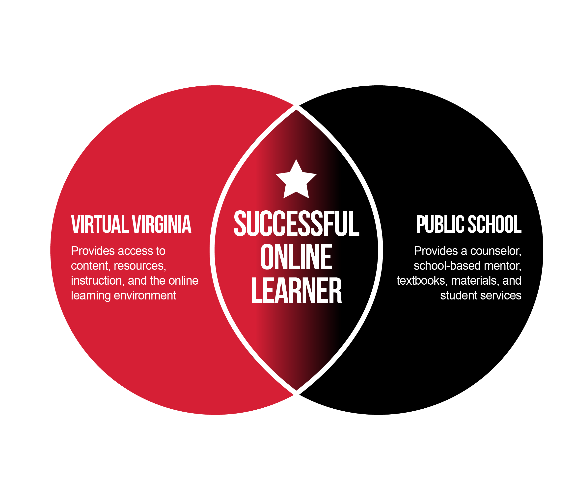
Virtual Virginia School Support & Partnership Meetings
Every other Tuesday at 10 a.m.
Biweekly Information & Support Sessions for public school administrators, counselors, and mentors
Provide regular opportunities for school personnel to learn about VVA's partnership with public schools and to interact with the VVA school support team.
Please encourage your staff to attend.

Slide 21
Outreach Program
Virtual Virginia provides a statewide LMS at no cost to school divisions.
Why an LMS?
Automation
Interoperability
Organization & security: all in one place
Unlimited access for learners
Easily accessible data: track progress & performance
Saves on cost: printing, travel, professional learning, etc.
Expands the division profile: more options for learners and educators
Division’s Digital Ecosystem: a 2021 solution to a 2021 problem
Blended learning and personalized education
Transparency for parents/guardians

Slide 22
Outreach Program Update
Each Virginia public school division has access to their own instance of a Learning Management System (LMS) at no cost, plus access to VVA and LMS support teams.
Public school divisions can import K–12 courses & learning modules at no cost.
Virginia and national standards-aligned content is developed and annually updated by Virginia educators.
Content includes instructor documents, fully developed lessons with interactive practice and assessments, rubrics, and question banks.
Divisions may create their own content and easily share within the division or with others across the state.
Divisions may add procured or free content to their LMS at any time.
Notes:
(Sarah, Stephanie, Nate, & Chris)

Slide 23
Outreach Program Components
Support Teams
Content
Training
Learning Management System
Virginia public school divisions have access to their own instance of the VVA LMS at no cost.
Virginia public school divisions have access to VVA & LMS support teams at no cost.
Virginia public school divisions can access and use K–12 VVA Outreach content at no cost.
Division educators have access to training and professional learning via VVA at no cost.
Notes:
All 4 components are on-going

Slide 24
Outreach Program Sneak Peek
92,000+ unique Outreach Program course downloads in 2020–2021!
What’s next?
Additional Outreach Program content is scheduled for release in 2021–2022:
Credit recovery, grades 6–12
Updated asynchronous content, grades K–12
Enrichment content, grades K–12

Slide 25
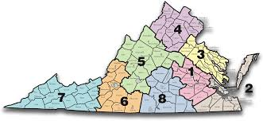
March Regional LMS Monthly Meeting Dates
Region 1: Tuesday, March 16, at 11 a.m.
Region 2: Tuesday, March 16, at 2 p.m.
Region 3: Wednesday, March 17, at 11 a.m.
Region 4: Wednesday, March 17, at 2 p.m.
Region 5: Thursday, March 18, at 11 a.m.
Region 6: Thursday, March 18, at 2 p.m.
Region 7: Friday, March 19, at 11 a.m.
Region 8: Friday, March 19, at 2 p. m.
Notes:
Divisions from each region will share information during each meeting.

Slide 26
Professional Learning (PL)
Synchronous and asynchronous PL workshops and courses in a variety of areas, including online learning best practices, blended learning facilitation, LMS training, subject-area support, and the #GoOpenVA platform
Offered at no cost to Virginia public educators
Developed by Virginia public educators, often in partnership with professional organizations (e.g., VSTE, VASCD, CodeVA, and the Virginia Museum of Fine Arts)
The Fast and the Curious Webinar series: VVA, VSTE, and Canvas present this series of 30-minute webinars highlighting best practices in synchronous, asynchronous, and hybrid/concurrent instruction.
Blending Learning: Mixing Up Your Digital Pedagogy: A free, one-day virtual conference for Virginia public school educators. Registration and more info coming soon.
Summer 2021 Virtual Virginia Professional Learning Program
Notes:
Share Survey link in Chat here

Slide 27
Professional Learning Network
Public school educators are enrolled in the statewide Virtual Virginia Professional Learning Network (PLN) and may participate in workshops and statewide webinars.
45,000 current participants
Provides LMS support, professional best practice resources, and a shared space where educators can learn from each other
Offers 21 unique user groups (content, grade level, and tech-specific)
Professional Learning Portal
17,000 current enrollments via the VVA PL Portal
Canvas-specific courses (Growing with Canvas, Be the Hero, and Passport to Canvas)
Special-topics courses: Foundations in Online Learning, Teaching with Virtual Virginia, Champions (synchronous, asynchronous, and hybrid/concurrent strategies)
VASCD partnership courses to strengthen face-to-face and online teaching practice

Slide 28
Program Summary
Complementary
Summer Session 2021 Registration is open
2021–2022 K–12 Registration opens on March 15
School Support Meetings biweekly Tuesdays at 10 a.m.
Outreach
VVA LMS available to all school divisions
K–12 content available via the LMS for local use
Increased offerings and resources will be available in 2021–2022
Monthly Regional LMS Support Meetings
Professional Learning
2020–2021 PLN expanded to support more educators
Summer 2021 professional learning offerings
Professional Learning Portal

Slide 29
VVA Contact Info
Main Office:
Debbie Staughton
(866) 650-0025
Registrar:
Tavy Young
(804) 226-2217
Technology Support Supervisor:
Chris Wyatt
(757) 598-1517
School Support Coordinator:
Stephanie Shea
(855) 679-4748
Professional Learning Coordinator:
Steven Sproles
(866) 605-4495
VVA HelpDesk:
Technology Support Team
(866) 650-0027
Notes:
Add email addresses in chat

Slide 30
V
Michael Bolling
Virtual Teaching & Learning Updates
michael.bolling@doe.virginia.gov

Slide 31
Proposed Revisions to the Approval Process for Multidivision Online Providers in Virginia
Dr. Meg Foley, Coordinator of Virtual Learning
Mr. Reginald Fox, Virtual Learning Specialist March 15, 2021

Slide 32
Factors impacting Review and Revision
The 2010 General Assembly directed the Board of Education to establish criteria for the approval of virtual school programs that provide instruction to students in multiple school divisions.
The application process for Multidivision Online Providers (MOP) was last approved by the Board in November 2010.
Factors for review and revision
Changes in the virtual learning environment
Increases in number of students served virtually statewide
Increases in the number of full-time elementary students served
Changes to data, reporting, security

Slide 33
Proposed Revisions
Topic | Original | Recommended Change
Processes | Requirement of Multidivision Online Providers (MOP) to have a Full Review every 3 years for approval. | MOP will be reviewed annually using the Monitoring Report and other documentation for approval. (Aligned requirements from revised application and monitoring report)
Staffing | Provide at least one FTE teacher at a reasonable ratio to students based on grade and subject being taught, but not exceeding 150 students per FTE teacher (secondary focus). | Staffing has been expanded to include elementary, middle and high school and must conform to the staffing requirements set forth in Virginia’s Standards of Quality § 22.1-253.13:2c and Standards of Accreditation (SOA) 8VAC20-131-210-240.

Slide 34
Proposed Revisions
Topic | Original | Recommended Change
Data and Reporting | MOP must provide data to each division in which students are enrolled for the purposes of monitoring student participation and progress. | Expanded language to clarify data and class enrollment: Data and data management must meet state and federal testing and reporting requirements, to include, but not limited to FERPA, participation & achievement, state testing, enrollment and diploma achievement. Annual monitoring will require MOP to report student assessment and achievement data, in addition to data requested from school divisions.

Slide 35
Proposed Revisions
Topic | Original | Recommended Change
Accountability | MOP must ensure that students meet division participation requirements and make progress toward successful completion of the course. | Requiring MOP to provide evidence of student performance. Written policies and procedures for recording, monitoring, and reporting student participation, progress, written grading and reporting policies If applicant is a private company or nonprofit organization entering into a contract with a local school board(s), evidence that the multidivision online provider has the capacity to ensure appropriate administration of Virginia Standards of Learning tests as directed by the local school division.

Slide 36
Proposed Revisions
Topic | Original | Recommended Change
Equity | Original documents did not include language addressing equity. | New language: MOP are required to ensure representation of diverse experiences and perspectives including, but not limited to racial, ethnic, language, religions, and gender groups and inclusion of content that represents, validates, and affirms diverse groups from different rings of culture.

Slide 37
Proposed Revisions
Topic | Original | Recommended Change
Student Services | Students with special needs, including students with disabilities, students with limited English proficiency, students with financial limitations, students from traditionally underrepresented groups, and others, are not excluded from participating in courses provided by the multidivision online provider. | Expanded language: While the responsible school division is required to provide services and counseling for special populations, including students with disabilities, English Learners, gifted, minorities, and/or economically disadvantaged, the provider must work collaboratively with the school division in order to provide these services. Provision of services for these and all students must be clearly stated in the contract between the MOP and the contracting school division. Students shall not be excluded from participating in courses provided by the MOP. The provider must ensure equity-related policies and practices in the Commonwealth of Virginia for providing access to all students.

Slide 38
Proposed Revisions
Topic | Original | Recommended Change
Technology | Technology is used to support course delivery and management. | MOP will provide written documentation to support course delivery, management, system data and reporting, response time, and staffing. Timely and consistent technical support, at a minimum of regular business hours, is available for students, parents/guardians, and school divisions and contact information shall be communicated to stakeholders and posted publicly.

Slide 39
Proposed Revisions
Topic | Original | Recommended Change
Course Submission and Alignment | Course alignment with Virginia Standards of Learning (SOL) and competencies | Course content objectives should meet or exceed the Virginia SOL, competencies, and the SOA (90%+ on all strands, objectives, concepts, competencies, and skills). The VDOE may review and verify course correlations provided by MOP. Based on the results of reviews, MOP may be required to provide updates to ensure alignment with the SOL or competencies to maintain approval. Approved MOP agree to provide VDOE course access upon request to review curricular materials and observe instruction.

Slide 40
Contact Information
Link to email Meg Foley
Link to email Reggie Fox
Link to VDOE website
Twitter: @VDOE_News Facebook: @VDOENews
#VAis4Learners #EdEquityVA

Slide 41
Technology Updates
Digital Learning Integration Standards
Mr. Mark Saunders
mark.saunders@doe.virginia.gov

Slide 42
Digital Learning Integration
Standards of Learning (SOL)
Replace Computer Technology SOL
What is digital learning?
What are the components
Implementation support
What can schools do?

Slide 43
Digital Learning Integration
Standards of Learning (SOL)
What is digital learning?
The use of digital technology resources that contribute to a deeper learning experience for students by empowering students as learners to improve their functional literacy as digital citizens capable of constructing knowledge, designing innovative works, thinking computationally, creatively communicating, and collaborating with others locally, regionally, and globally.

Slide 44
Digital Learning Integration
Standards of Learning
The Components:
Standard Statement
Learning Priority & Relevant 5 Cs Connection
Grade Band Performance Indicator

Slide 45
Digital Learning Integration Standards of Learning
Potential Guidance and Resources:
Computer Science alignment
Cross-curricular alignment
Glossary
Rubrics
Tech integration level or models
TPACK; SAMR

Slide 46
Digital Learning Integration Standards of Learning
What can schools do?
Make educators aware of the standards
Properly use ITRTs
Provide support

Slide 47
Technology Updates & Grants
Dr. Susan Clair
susan.clair@doe.virginia.gov
Learning Infrastructure Coordinator

Slide 48
#GoOpenVA: Supporting Hybrid & Virtual Instruction
Jean Weller
Virginia Department of Education
VLAC
#GoOpenVA presentation by #GoOpenVA is licensed under a Creative Commons Attribution 4.0 International License.
Notes:
#GoOpenVA is a collaboration between Virginia educators, educational entities, and other stakeholders to create, provide and share quality digital instructional materials that can be used by all educators and learners to support deeper learning. A cloud-based platform built exclusively for Virginia educators allows for creation, distribution and collaboration.

Slide 49
#GoOpenVA Since Launch
Launched 1/24/2020; COVID helped and hindered roll-out
Over the last year:
Page Views: 583,329
Searches: 20,727
Users: 14,640
Content Added: 5,605 resources

Slide 50
New Providers
Carnegie Hall
Census 2019
Dan Meyer Three-Act Mathematics
EL Education
eMediaVA (VA TV project)
Encyclopedia of Life
Engage NY
Eureka (Great Minds)
Georgia Virtual
Match Fishtank
New American History (Ed Ayers/UR)
VCU (STEM)
VDOE
Virginia Geographic Alliance
Virginia Public Media (VPM)
Virginia STEM Pipeline (Loudoun & Chesapeake)
Virginia Tech

Slide 51
Upcoming for #GoOpenVA
Ten division mini-grants completed (April)
AAH materials from Carter G. Woodson Cooperative project
Small-museum pilot with Virginia Association of Museums
Continuation of VDOE materials uploaded
High Quality Instructional Materials evaluative process
Culturally Responsive Teaching tutorials
Professional learning opportunities to focus on mutual mentoring by teachers

Slide 52
#GoOpenVA Contact Information
jean.weller@doe.virginia.gov
Twitter: @VDOE_News Facebook: @VDOENews
#VAis4Learners #EdEquityVA

Slide 53
Discussion Activity
Respond to 3 questions
Respond initially by typing in the chat
Post topics/themes on a slide
Opportunity for open discussion

Slide 54
Discussion Activity
Question 1:
What are some considerations for Special Regulations regarding virtual learning/schools in Virginia, including accreditation for virtual schools?

Slide 55
Discussion Activity
What are some considerations for Special Regulations regarding virtual learning/schools in Virginia, including accreditation for virtual schools?
Seat time
ADM flow of basic aid
Attendance
Quality
Pedagogical approach should be stated by the MOP
Elementary class sizes
Have there been discussions about digital inclusion and how to support socioeconomically diverse learning environments as we strive in buildings? Are there regulations for that?
To expand on requiring information about pedagogical approach, divisions often want to find a MOP who matches their own larger goals. Having the MOP address this would help divisions make better decisions.

Slide 56
Discussion Activity
Question 2:
What is one thing that you have learned this year related to virtual learning that will help you better address a hybrid, blended or virtual model next year? New technologies, strategies or professional development models?

Slide 57
Discussion Activity
What is one thing that you have learned this year related to virtual learning that will help you better address a hybrid, blended or virtual model next year? New technologies, strategies or professional development models?
Getting good data – school divisions could student achievement, participation rates, etc.
In our Region V group, we have been talking about how if a virtual component is required next year, we need some "teeth" in it. For example, students need to actually turn their cameras on to receive credit for work and attendance.
Virtual learning requires different skills for teachers, students, and administrators. This needs to be recognized to reduce frustration and increase successful learning.
Clear expectations for attendance and participation. Providing support to families that need help navigating an LMS and general understanding of computers and wireless technology.
I think you have a great point about too much regulation will hamper innovation. This is a different world and a different type of "school" and we need to consider that.

Slide 58
Discussion Activity
Question 3:
How is your division/region addressing mitigation strategies to work towards face to face instruction this school year and have you discussed plans for next school year?

Slide 59
Discussion Activity
How is your division/region addressing mitigation strategies to work towards face to face instruction this school year and have you discussed plans for next school year?
Time did not permit noting responses to this question.

Slide 60
Stay safe!
Next steps
Next meeting (September)
Public viewing on the VDOE YouTube channel may email questions/comments to the mailbox until March 25th: virtualprograms@doe.virginia.gov.
Thank you for your work on this advisory committee

