Slide 1
Utilizing Data to Maximize Literacy Instruction in the 2021-2022 Academic Year
Fall 2021

Slide 2
Agenda
Growth Assessment Reports
Stacking Skills to Maximize Instruction
Stacking Skills in Texts to Maximize Instruction
Planning for Instruction
Stay Connected!

Slide 3
Growth Assessment Reports
Office of Student Assessment

Slide 4
Purpose: News Release-September 3, 2021 (1 of 2)
“These new assessments are timely in that they will provide teachers and other educators with baseline data showing exactly where students are in reading and mathematics as they return to school after the disruptions to learning caused by the pandemic,” Superintendent of Public Instruction James Lane said. “Teachers will use performance data from the fall tests to craft instruction that meets the individual needs of every student, with the goal of achieving proficiency or significant growth by the end of the year.”
Notes:
A news release was published on September 3, 2021 describing the purpose of the Growth Assessments for fall 2021. Dr. Lane, Superintendent of Public Instruction indicated “Teachers will use performance data from the fall tests to craft instruction that meets the individual needs of every student, with the goal of achieving proficiency or significant growth by the end of the year.”

Slide 5
Purpose: News Release-September 3, 2021 (2 of 2)
“The focus of growth assessments is on identifying what students have already learned, as well as the skills they may need additional help with during this school year. As the purpose of the fall growth assessments is to establish a baseline for measuring student growth, the tests will not have a minimum passing score, and VDOE will not report aggregate growth results for schools and divisions.”
Notes:
The focus of the data is to identify where students are and what they may need additional help with this year.

Slide 6
Instructional Focus: News Release-August 26, 2021
“In addressing unfinished learning from the pandemic, VDOE and school divisions are emphasizing acceleration, not remediation. Acceleration maintains advancement trajectories for students by combining grade-level content with the teaching of skills and concepts not mastered during 2019-2020 and 2020-2021.”
NOTE: Acceleration in this context does not mean that content should be skipped or that teachers should move beyond content when students may not be ready.
Notes:
It is important to note that in the news releases acceleration was mentioned. Acceleration in this context does not mean that content should be skipped. It means that instruction should include the combination of teaching on-grade level content with the teaching of skills and concepts that may have not been previously mastered.

Slide 7
Analyzing and Using SDBQ Reports for Growth Assessments
“We have given the growth assessment, so what’s next?”

Slide 8
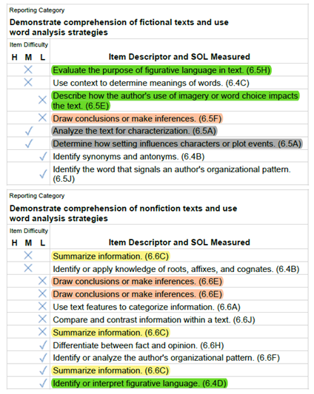
SDBQ Reporting Category Details (1 of 2)
Each reporting category has its own section
Item descriptors will reflect every test item completed by the student
Notes:
This is an example SDBQ from a student who took the grade 7 reading Fall 2021 Growth Assessment. There are a few things I would like to bring to your attention. Each reporting category on the SDBQ report will have its own section. There will be an item descriptor to reflect each test item received by the student.

Slide 9
SDBQ Reporting Category Details (2 of 2)
SOL content standard number will be included after the item descriptor
Item descriptors will be sorted from incorrect items, highest level difficulty to lowest level, to correct items, highest level difficulty to lowest
Notes:
Each item descriptor will have an associated SOL. Please note the SOL on this SDBQ are from grade 6 since the grade 7 growth assessment assessed prior grade level content. In addition, when the report is provided, the descriptors will be sorted by listing incorrect items first from highest to lowest difficulty levels, then the correct items will be listed from highest to lowest difficulty.
In this report we have highlighted certain item descriptors. The highlighted descriptors and standards have course connections or are the same standard. You can also see where some skills are reflected in both fiction and nonfiction. For example: “draw conclusions or make inferences” appears in both fiction and nonfiction reporting categories.
We often receive the question of “Why can’t the descriptors be more specific?” We have to walk a fine line, so that these descriptors provide enough information about the item without compromising the item.

Slide 10
Additional Item Descriptor Information
Item descriptors are not unique to a single item.
An existing item descriptor may be applied to newly developed test items if the content and skills measured are a good fit.
The same item descriptor can be used for different test items with varying levels of difficulty.
Every SDBQ item descriptor will not be used on every Growth Assessment or SOL assessment.
Notes:
The item descriptors also do not indicate the format of the test item, multiple choice or technology-enhanced items.
Unlike released test items, the item descriptors are not taken out of circulation once the item they are assigned to is released.
Item descriptors may not describe everything a student must understand and be able to do. Item descriptors give you the gist of a skill or concept an item assesses (like a quick sketch would give), but they don’t give you all of the details (like a full color portrait would give). For example, one item descriptor in reading is: Draw conclusions or make inferences. The word "or" tells us that either the student had to draw a conclusion or make an inference but not both. This is because drawing a conclusion or making an inference have course connections and it is important that students understand the relationship.

Slide 11
Understanding the Item Descriptor
Consider the descriptor, “drawing conclusions and making inferences.” It is important to reflect on how this skill could be assessed. For example, the item might not always have the word “conclusion” or “inference.”
The author wrote this text most likely to--
Why did [insert character] [insert something that happened in the text]?
What is the purpose of the [article/website]?
Test questions are used to assess what students know in a variety of ways.
Notes:
Let’s continue to think about the item descriptor: draw conclusions or make inferences. It is important for us to think about how students might be assessed on this skill. Drawing conclusions and making inferences may be assessed without using the words “conclusion” or “inference.” It is important that students are exposed to a variety of questions throughout instruction.
Another example: What may the reader infer from [insert paragraph/heading].

Slide 12
Different Purpose, Different Focus (1 of 2)
● SDBQ reports for SOL tests are traditionally used to prepare for expedited retakes after SOL testing.
○ Expedited Retakes: focus is on intervention or
remediation on skills and content already taught
Notes:
Previously, school divisions have used SDBQ data to remediate students in preparation for an expedited retake.

Slide 13
Different Purpose, Different Focus (2 of 2)
The approach to using fall growth SDBQ should differ from the approach to using spring SOL test SDBQ data to prepare for expedited retakes.
○ Fall Growth: focus is readiness and skills needed for current grade-level instruction yet to occur
Notes:
We are talking about using these data from the SDBQ to set the stage and prepare for units of instruction that have not yet been taught, not using these data to provide remediation for instruction that has already occurred.

Slide 14
Questions for Teachers to Consider when Using SDBQ Data for Planning Instruction
What data will provide additional information about your students’ understanding of previously taught skills and content?
What evidence will you look for that will show you that students have learned the grade level appropriate skills and content?
If evidence shows students are approaching proficiency but not there yet, how will you scaffold current grade-level instruction?
Notes:
It is important the SDBQ data is not used in isolation. Teachers and building level administrators should use the English Tracking Logs (links will be provided on upcoming slides) along with other formative and summative assessment data when planning instruction. As mentioned previously, it is essential we target on-grade level instruction while folding in prerequisite skills and content.

Slide 15
Cautions When Analyzing SDBQ Data
Important! These data cannot be used in isolation to determine mastery of content.
● Review the SOL the item measures in addition to the item descriptor. Review related SOL to provide a comprehensive approach to reading and mathematics instruction.
● Consider other assessment data (formative and summative) in conjunction with the SDBQ data.
Notes:
As mentioned earlier, item descriptors may not describe everything a student must understand and be able to do. It is essential to review the SOL the item measures along with related standards to provide a comprehensive approach to instruction. Other assessment data (formative and summative) should also be used to gauge students’ proficiency with content.

Slide 16
Reading Instruction (1 of 4)
As noted in the 2017 English Standards of Learning Curriculum Framework, “The concepts, skills, and content in English Language Arts spiral. Teachers should note each grade level builds skills that carry to the following grades.”
●This scaffolding provides opportunities for students to build concepts and apply comprehension skills to increasingly complex texts as they move through the grade and through grade levels.
Notes:
Many of you may be familiar with this statement in the 2017 English Standards of Learning Curriculum Framework. The goal is for students to build on their learning each year along with what they have learned previously. We have an example we will highlight in today’s presentation.

Slide 17
Reading Instruction (2 of 4)
Step One: Select Authentic Text
Ensure the passage(s) are grade-level appropriate, provide instructional scaffolding to introduce and review skills, and provide opportunities for formative and summative review.
Step Two: Examine the Content and Progression of Standards
Review the SOL in the grades before and after to ensure scaffolding of the targeted skills.
Notes:
Thus far we have talked about the data in the SDBQ and using the English Tracking Logs. Now let’s think about intentional planning for reading instruction using that information. The Office of Student Assessment collaborated with the Office of Humanities and provided an Assessment Supports Literacy Webinar Series about a year ago. In that series we discussed planning for reading instruction and the process that may be used to do so. We would like to request that you please share the link about this series with teachers in the event they have not seen the resource materials. There was a presentation for each grade level.
Step 1 when planning is selecting the text to be used with students.
When selecting a text to use for instruction, it is important to determine a purpose for reading the passage. Setting the purpose will focus on either:
– Identifying the skills that will be introduced or reviewed for reading comprehension and then ensuring the passage supports the identified skills; or
– Selecting a passage and then determining the skills that could be introduced or reviewed throughout the reading.
Every passage will be different and may not be used to support the introduction and review of all skills. The passage selection must be intentional.
Once the text has been selected, it is important to “set the stage” for students by giving them some background information and asking guiding questions. For example, consider telling the student that they are getting ready to read a nonfiction passage and who/what the passage is about, discussing what is known about nonfiction, and giving students some ideas of what to look for while reading the passage.
Step 2 in planning is to review and think about the content and progression of the standard you are targeting for instruction. Our Instruction friends will be sharing specific examples with you momentarily.

Slide 18
Reading Instruction (3 of 4)
Step Three: Sample Question Starters
Questions asked before, during, and after instruction should bring students back to the text and align with the progression of the skill, therefore supporting student mastery. These questions could be exemplified by having students write about what was read, answering questions, etc.
Notes:
The technique of asking questions is key throughout instruction. The questions used before, during, and after instruction should continuously refer students back to the text and align with the progression of the skill. It is encouraged that questions are planned prior to instruction occurring. If the questions have been thought out in advance, then it allows teachers to focus on the answers students are providing which will enable them to target next steps. Thinking of questions “in the moment” has the focus more on the question being asked than the student response.
See the Assessment Supports for 2020-2021 Literacy Webinar Series for more example question starters.
The questions provided are open-ended which allows for student discussion and for students to respond in writing. It is encouraged for the reading and writing connection to occur in English classrooms; students should write about what they read.

Slide 19
Reading Instruction (4 of 4)
Step Four: Exploring Instructional Resources
Select additional grade-level text that is engaging and varying in genre. Introduce new skills and spiral previously taught skills.
Notes:
The last step, and a very important step, in planning is to explore the instructional resources that are available. Select an additional grade-level text that is both engaging and varies in genre. Introduce new content with the text while spiraling the previously taught content in the standard.
The Comprehensive Literacy English Instructional plans were developed by teachers for teachers and are a great resource that may be used across various SOL.
The English Professional Development Packages are another resource that are great for new teachers, administrators or coaches to use in planning units of study or for an individual teacher who wishes to see ideas for new ways to teach content.
The Office of Student Assessment provided a Growth Assessment Training webinar on September 9th and 10th. In that training, we shared a process and method of using the SDBQ data and provided one example of how information from the SDBQ and English Tracking Logs can be used to provide support and scaffolding for student proficiency. There are many resources available for teachers and each teacher will use them differently. The important factor is that the focus should be on scaffolding skills and content to support student learning for on-grade-level instruction.

Slide 20
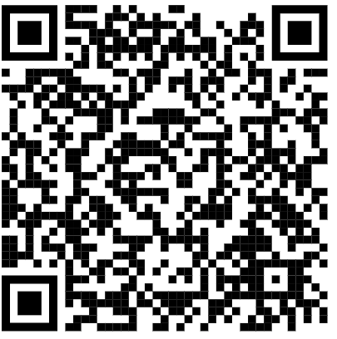
VDOE Assessment Supports Webinar Series

Slide 21
Stacking Skills to Maximize Instruction

Slide 22
What does “Stacking” Skills Mean?
Grouping skills and standards together to support students’ deeper comprehension of a text or set of texts.
Grouping skills and standards together in a way that leads students to greater understanding of text and maximizes instructional opportunities.

Slide 23
Considerations for Stacking Skills
Grade Level Skills
Vertical Progressions
Strand Integration
Authentic Text Based Stacks

Slide 24
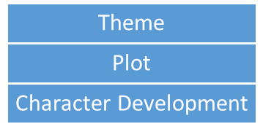
Grade Level Skills
Elementary (Grade 4 Example)
Secondary (Grade 7 Example)
Reading and Writing
Author’s Style
Written Expression
Literary Devices
Tone
Imagery/Figurative Language
Voice
Sentence Variety
Word Choice
Vivid and precise vocabulary

Slide 25
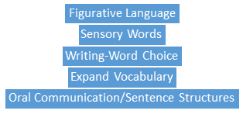
Vertical Progressions
Secondary
Elementary
Author’s Viewpoint
Compare/Contrast texts on the same topic
Organizational Patterns
Word Choice
Transition Words

Slide 26
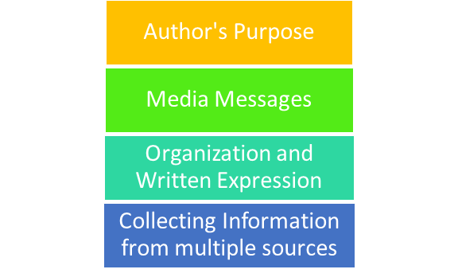
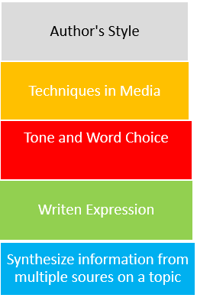
Strand Integration
Elementary
Secondary

Slide 27
Text Based Stacks
Select a text
Determine what skills are naturally evident in the text
Use your student data (formative/summative) to determine the best approach for stacking
Consider what skills can be reviewed
Consider what skills can be introduced
Identify the purpose for reading
Ensure the text supports the identified purpose for reading

Slide 28
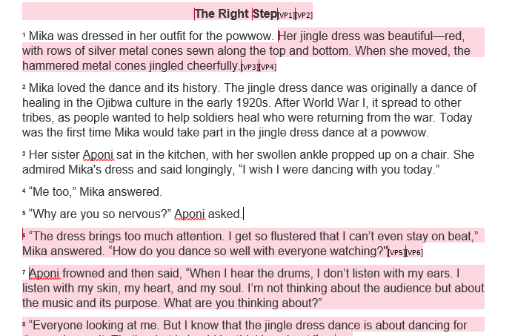
Text Based Stack 4th Grade (1 of 6)
Sample Assessment Question: What is the theme of the story? How does it connect with the lesson Mika learns?
STOP
& REFLECT
What standard is this question assessing?
Sample Assessment Question:What is the theme of the story? How does it connect with the lesson Mika learns??
4.5
b) Identify the theme(s).
identify the theme(s) of a text (e.g., friendship, survival, determination)
thematic topic
lessons learned

Slide 29
Text Based Stack 4th Grade (2 of 6)
Sample Assessment Question: What is the theme of the story? How does it connect with the lesson Mika learns?
STOP
& REFLECT
If a student answers this question incorrectly, what barriers might have prevented the student from determining the correct answer?

Slide 30
Text Based Stack 4th Grade (3 of 6)
The Right Step
¹ Mika was dressed in her outfit for the powwow. Her jingle dress was beautiful—red, with rows of silver metal cones sewn along the top and bottom. When she moved, the hammered metal cones jingled cheerfully.[VP3] [VP4]
² Mika loved the dance and its history. The jingle dress dance was originally a dance of healing in the Ojibwa culture in the early 1920s. After World War I, it spread to other tribes, as people wanted to help soldiers heal who were returning from the war. Today was the first time Mika would take part in the jingle dress dance at a powwow.
³ Her sister Aponi sat in the kitchen, with her swollen ankle propped up on a chair. She admired Mika's dress and said longingly, “I wish I were dancing with you today.”
⁴ “Me too,” Mika answered.
⁵ “Why are you so nervous?” Aponi asked.
⁶ “The dress brings too much attention. I get so flustered that I can’t even stay on beat,” Mika answered. “How do you dance so well with everyone watching?"
⁷ Aponi frowned and then said, “When I hear the drums, I don’t listen with my ears. I listen with my skin, my heart, and my soul. I’m not thinking about the audience but about the music and its purpose. What are you thinking about?”
Sample Assessment Question: What is the theme of the story? How does it connect with the lesson Mika learns?
If a student answers this question incorrectly, what barriers might have prevented the student from determining the correct answer?
Barrier
Identify conflict

Slide 31
Text Based Stack 4th Grade (4 of 6)
⁹ Aponi grabbed a small drum that was laying on the table. “Exactly. So close your eyes and listen.”
¹⁰ Aponi began to play. Mika could feel the rhythm. Her toes wanted to tap, but she held still, hands on her hips, as she had been taught.
¹¹ Then Aponi drummed faster. “Now begin. Step with one foot and follow it with the other. Respect the music, and let yourself be a part of it. You’re one more jingle in the song.”
¹² Mika began to move in a zig-zag pattern, one foot and then the other, lightly bouncing. Immediately, thoughts crowded into her mind: She looked silly. She would trip. People would laugh. She pushed them all away and let the drumming carry her feet up down, up down, right on the beat.
¹³ Her dress jingled exactly in time with the drum. Ching, Ching, Ching] . The sound was beautiful.
¹⁴ She stopped suddenly, eyes popping open. “I did it!”[VP2] [VP3]
¹⁵ “I knew you could do it once you danced to the music and not to your fears .”
Sample Assessment Question: What is the theme of the story? How does it connect with the lesson Mika learns?
If a student answers this question incorrectly, what barriers might have prevented the student from determining the correct answer?
Barrier
Identify the resolution

Slide 32
Text Based Stack 4th Grade (5 of 6)
The Right Step
¹ Mika was dressed in her outfit for the powwow. Her jingle dress was beautiful—red, with rows of silver metal cones sewn along the top and bottom. When she moved, the hammered metal cones jingled cheerfully.
² Mika loved the dance and its history. The jingle dress dance was originally a dance of healing in the Ojibwa culture in the early 1920s. After World War I, it spread to other tribes, as people wanted to help soldiers heal who were returning from the war. Today was the first time Mika would take part in the jingle dress dance at a powwow.
³ Her sister Aponi sat in the kitchen, with her swollen ankle propped up on a chair. She admired Mika's dress and said longingly, “I wish I were dancing with you today.”
⁴ “Me too,” Mika answered.
⁵ “Why are you so nervous?” Aponi asked.
⁶ “The dress brings too much attention. I get so flustered that I can’t even stay on beat,” Mika answered. “How do you dance so well with everyone watching?"
⁷ Aponi frowned and then said, “When I hear the drums, I don’t listen with my ears. I listen with my skin, my heart, and my soul. I’m not thinking about the audience but about the music and its purpose. What are you thinking about?”
Sample Assessment Question: What is the theme of the story? How does it connect with the lesson Mika learns?
If a student answers this question incorrectly, what barriers might have prevented the student from determining the correct answer?
Barrier
Summarizing the Plot

Slide 33
Text Based Stack 4th Grade (6 of 6)
Not all students need the same stack of skills.
Theme
Use your data to determine patterns in what your students are missing.
Select texts that naturally support the skills your students need to work on.
Stack skills using guiding questions.
Not all students have to work on the same stack of skills.
Student A
Conflict and Resolution
Summarize
Theme
Characterization
Student B
Comparing and Contrasting Details

Slide 34
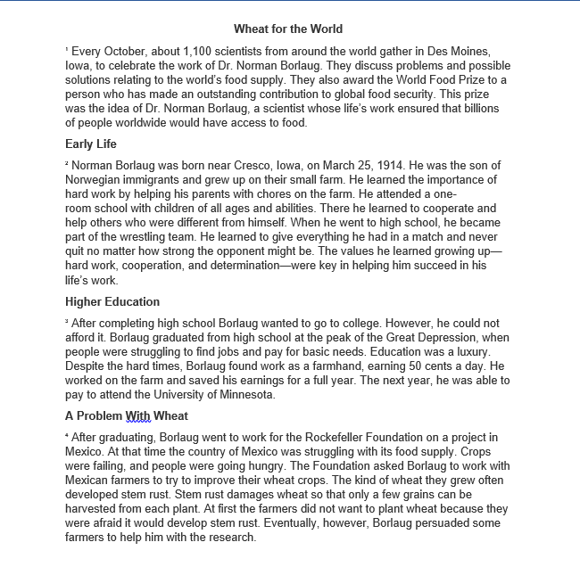
Text Based Stack 7th Grade (1 of 7)
Sample Assessment Question: In paragraph 2, what point does the author make when describing the values Borlaug learned growing up?
STOP
& REFLECT
What standard is this question assessing?
Sample Assessment Question: In paragraph 2, what point does the author make when describing the values Borlaug learned growing up?
7.6
e) Identify the source, viewpoint, and purpose of texts
f) Describe how word choice and language structure convey an author’s viewpoint

Slide 35
Text Based Stack 7th Grade (2 of 7)
Sample Assessment Question: In paragraph 2, what point does the author make when describing the values Borlaug learned growing up?
STOP
& REFLECT
If a student answers this question incorrectly, what barriers might have prevented the student from determining the correct answer?

Slide 36
Text Based Stack 7th Grade (3 of 7)
Wheat for the World
¹ Every October, about 1,100 scientists from around the world gather in Des Moines, Iowa, to celebrate the work of Dr. Norman Borlaug. They discuss problems and possible solutions relating to the world’s food supply. They also award the World Food Prize to a person who has made an outstanding contribution to global food security. This prize was the idea of Dr. Norman Borlaug, a scientist whose life’s work ensured that billions of people worldwide would have access to food.
Early Life ² Norman Borlaug was born near Cresco, Iowa, on March 25, 1914[VP4] . He was the son of Norwegian immigrants and grew up on their small farm. He learned the importance of hard work by helping his parents with chores on the farm. He attended a one-room school with children of all ages and abilities. There he learned to cooperate and help others who were different from himself. When he went to high school, he became part of the wrestling team. He learned to give everything he had in a match and never quit no matter how strong the opponent might be. The values he learned growing up—hard work, cooperation, and determination—were key in helping him succeed in his life’s work.
Sample Assessment Question: In paragraph 2, what point does the author make when describing the values Borlaug learned growing up?
If a student answers this question incorrectly, what barriers might have prevented the student from determining the correct answer?
Barrier
Identify supporting details

Slide 37
Text Based Stack 7th Grade (4 of 7)
Wheat for the World
¹ Every October, about 1,100 scientists from around the world gather in Des Moines, Iowa, to celebrate the work of Dr. Norman Borlaug. They discuss problems and possible solutions relating to the world’s food supply. They also award the World Food Prize to a person who has made an outstanding contribution to global food security. This prize was the idea of Dr. Norman Borlaug, a scientist whose life’s work ensured that billions of people worldwide would have access to food.
Early Life
² Norman Borlaug was born near Cresco, Iowa, on March 25, 1914[VP4] . He was the son of Norwegian immigrants and grew up on their small farm. He learned the importance of hard work by helping his parents with chores on the farm. He attended a one-room school with children of all ages and abilities. There he learned to cooperate and help others who were different from himself. When he went to high school, he became part of the wrestling team. He learned to give everything he had in a match and never quit no matter how strong the opponent might be. The values he learned growing up—hard work, cooperation, and determination—were key in helping him succeed in his life’s work.
Sample Assessment Question: In paragraph 2, what point does the author make when describing the values Borlaug learned growing up?
If a student answers this question incorrectly, what barriers might have prevented the student from determining the correct answer?
Barrier
Identify the main idea

Slide 38
Text Based Stack 7th Grade (5 of 7)
Wheat for the World
¹ Every October, about 1,100 scientists from around the world gather in Des Moines, Iowa, to celebrate the work of Dr. Norman Borlaug. They discuss problems and possible solutions relating to the world’s food supply. They also award the World Food Prize to a person who has made an outstanding contribution to global food security. This prize was the idea of Dr. Norman Borlaug, a scientist whose life’s work ensured that billions of people worldwide would have access to food.
Early Life
² Norman Borlaug was born near Cresco, Iowa, on March 25, 1914[VP4] . He was the son of Norwegian immigrants and grew up on their small farm. He learned the importance of hard work by helping his parents with chores on the farm. He attended a one-room school with children of all ages and abilities. There he learned to cooperate and help others who were different from himself. When he went to high school, he became part of the wrestling team. He learned to give everything he had in a match and never quit no matter how strong the opponent might be. The values he learned growing up—hard work, cooperation, and determination—were key in helping him succeed in his life’s work.
Sample Assessment Question: In paragraph 2, what point does the author make when describing the values Borlaug learned growing up?
If a student answers this question incorrectly, what barriers might have prevented the student from determining the correct answer?
Barrier
Differentiate between fact and opinion

Slide 39
Text Based Stack 7th Grade (6 of 7)
Wheat for the World
¹ Every October, about 1,100 scientists from around the world gather in Des Moines, Iowa, to celebrate the work of Dr. Norman Borlaug. They discuss problems and possible solutions relating to the world’s food supply. They also award the World Food Prize to a person who has made an outstanding contribution to global food security. This prize was the idea of Dr. Norman Borlaug, a scientist whose life’s work ensured that billions of people worldwide would have access to food.
Early Life
² Norman Borlaug was born near Cresco, Iowa, on March 25, 1914[VP4] . He was the son of Norwegian immigrants and grew up on their small farm. He learned the importance of hard work by helping his parents with chores on the farm. He attended a one-room school with children of all ages and abilities. There he learned to cooperate and help others who were different from himself. When he went to high school, he became part of the wrestling team. He learned to give everything he had in a match and never quit no matter how strong the opponent might be. The values he learned growing up—hard work, cooperation, and determination—were key in helping him succeed in his life’s work.
Sample Assessment Question: In paragraph 2, what point does the author make when describing the values Borlaug learned growing up?
If a student answers this question incorrectly, what barriers might have prevented the student from determining the correct answer?
Author’s Viewpoint

Slide 40
Text Based Stack 7th Grade (7 of 7)
Not all students have to work on the same stack of skills.
Author’s Viewpoint
Differentiate between fact and opinion
Use your data to determine patterns in what your students are missing.
Select texts that naturally support the skills your students need to work on.
Stack skills using guiding questions.
Not all students have to work on the same stack of skills.
Identify the main idea
Identify supporting details
Author’s Viewpoint
Differentiate between fact and opinion
Describe language structure
Word choice

Slide 41
Changing the Trajectory
Demonstrating Thinking
Showing Work

Slide 42
How Students “Show Work” in English
Highlighting evidence in texts
Annotating texts
Discussion
Writing

Slide 43
How Students Demonstrate Thinking in English
Think alouds
Annotating their thinking while reading
Discussing the “why”
Constructive responses in writing
Student audio recording of annotating their thinking
Conferencing about student thinking of a text
Reading is a metacognitive process.

Slide 44
Planning for Instruction

Slide 45
Considerations for Planning
Look for patterns across data points, including formative and summative assessments
Choose texts and create opportunities that will address skills that students may need based on your data
Plan experiences and opportunities around texts for all learners that support the vertical progression of skills

Slide 46
Reminders when Planning
Students need opportunities to experience different genres and writing styles
Students should be provided the opportunity to practice skill sets with complex texts that present rich examples
Selection of stacked skills is dependent on the text
Look across multiple sources of information for determining stacks
More than one text
All student data points
Progression charts and standards

Slide 47
Tools for Planning
Progression Charts
Tracker Logs
Curriculum Frameworks
Texts
English Instructional Plans
Assessment Supports Webinars

Slide 48
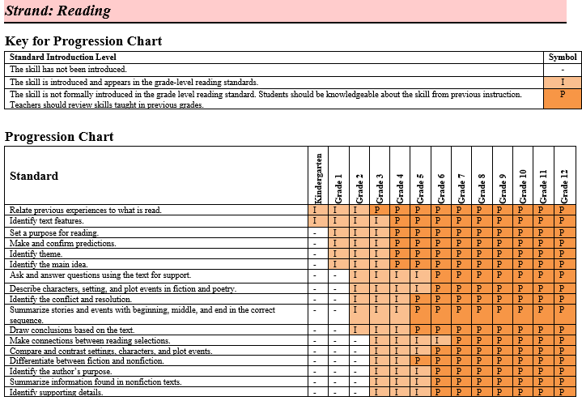
Tools for Planning: Progression Charts

Slide 49
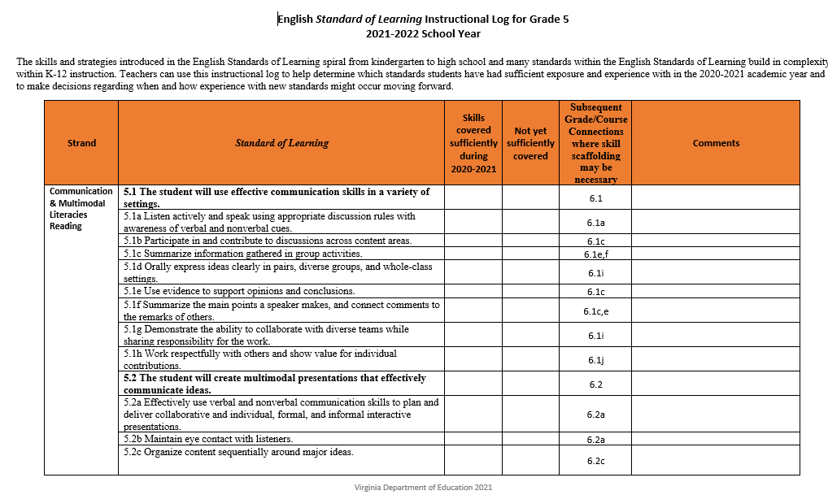
Tools for Planning: Tracker Logs

Slide 50
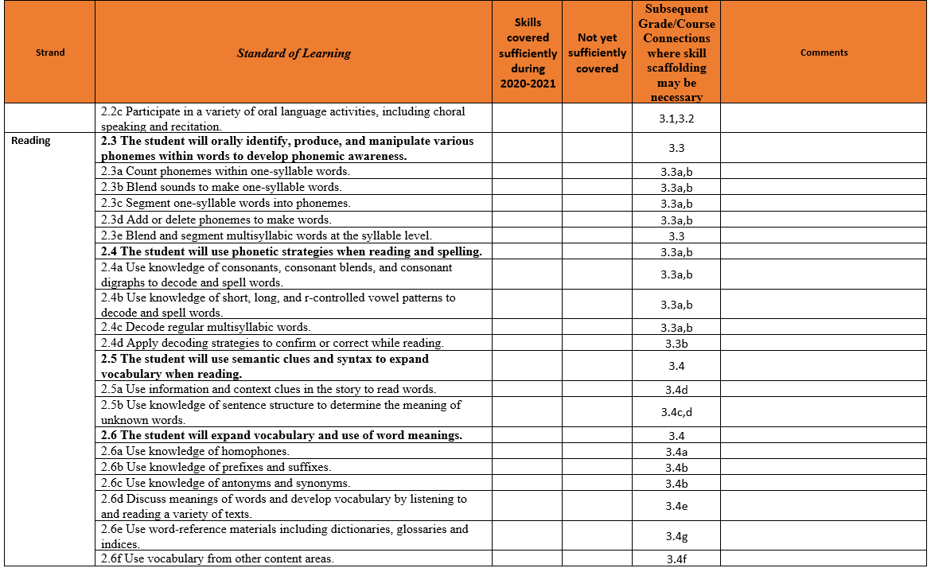
Addressing Unfinished Learning-Updated Logs

Slide 51
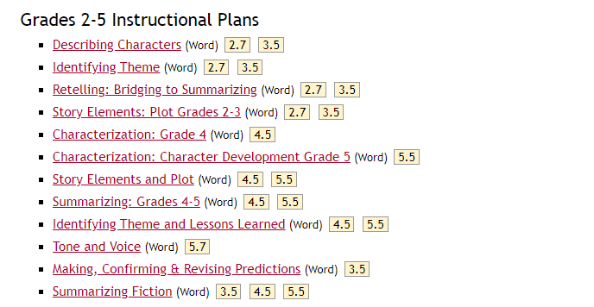
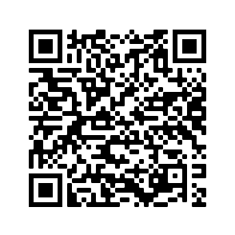
VDOE English Comprehensive Instructional Plans

Slide 52
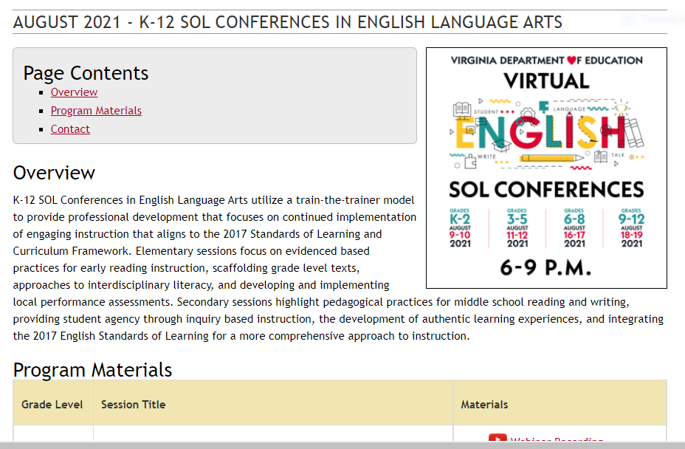
K-12 SOL Conferences In English Language Arts

Slide 53
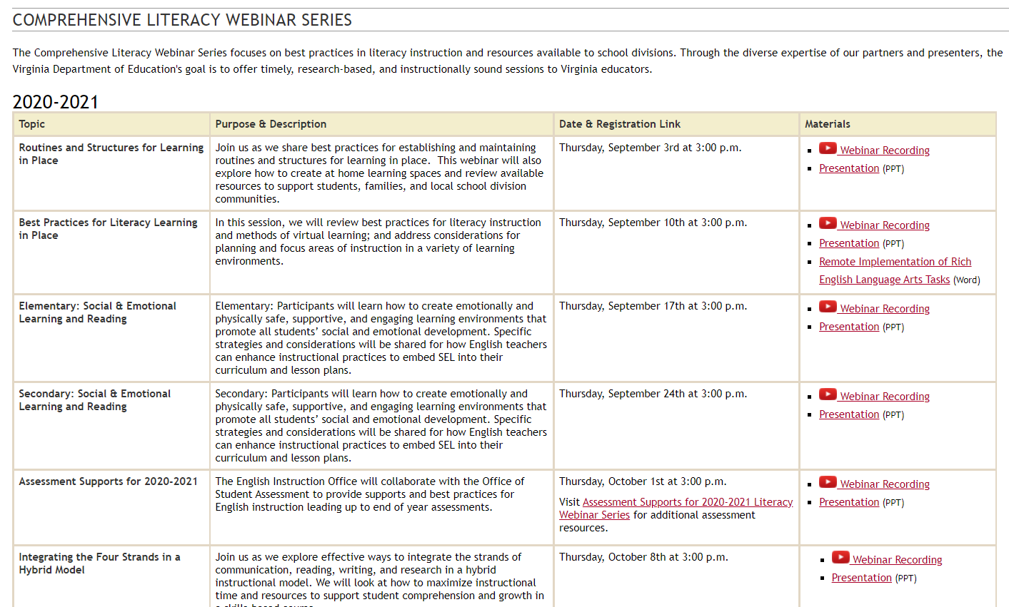
VDOE English Comprehensive Literacy Webinars

Slide 54
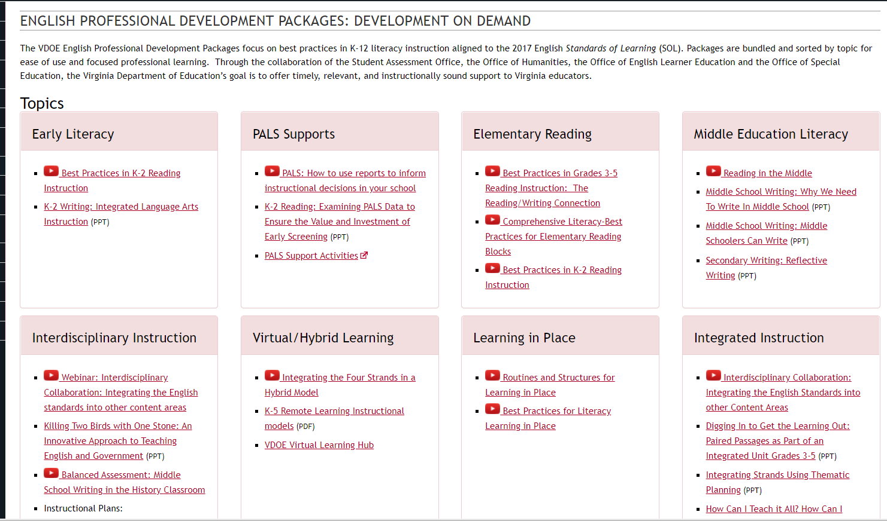
VDOE Professional Development on Demand

Slide 55
Final Thoughts:
Reading is a metacognitive process.
Get books and texts in the hands of kids.
Provide daily opportunities for students to read.
Prioritize literacy across contents.
Teaching skills in isolation is not authentic to real reading experiences.
From: Educator to Educator: Sharing Lessons Learned from School Divisions on Best Practices (Winter, 2019).

Slide 56
Thank You!

Slide 57
Stay Connected!
Jill Nogueras
K-12 English Coordinator
Jill.Nogueras@doe.virginia.gov
Carmen Kurek
Elementary English/Reading Specialist
Carmen.Kurek@doe.virginia.gov
Colleen Cassada
Middle School English Specialist
Colleen.Cassada@doe.virginia.gov
Assessment Office
student_assessment@doe.virginia.gov
#CommitToLitVA

