Slide 1
Assessment Supports for 2020-2021 (Grade 8)

Slide 2
Questions During the Webinar
Use the chat feature to pose any questions to the group that arise during the webinar.
Please send your questions to “All Attendees.”

Slide 3
Recover. Redesign. Restart. 2020 (1 of 2)
On June 9, 2020, Governor Northam announced a phased reopening plan for Virginia schools. During this press conference, Dr. Lane, Superintendent of Schools, shared the guidance document Recover, Redesign, Restart 2020.

Slide 4
Recover. Redesign. Restart. 2020 (2 of 2)
Teachers should seek to design and implement authentic learning experiences. Authentic learning is a term used to describe instructional strategies that are designed to connect the subjects students are taught in school to the real world. Authentic learning can: prepare students for the real world; help students make informed career choices; bridge skill gaps; enhance critical thinking; improve creativity; increase engagement; motivate students; boost retention of information; provide multiple perspectives on issues; and help build 21st Century skills.

Slide 5
Background (1 of 3)
In order to support instruction of the 2017 English Standards of Learning (SOL), this PowerPoint presentation has been developed to provide specific examples of SOL content and the progression of reading skills.
Some of the information in this PowerPoint originated from interviews with schools that maintained or went up in their 2018-2019 Standards of Learning (SOL) Reading data. Please refer to these webinar materials: Sharing With School Divisions Lessons Learned from Divisions on Best Instructional Practices.

Slide 6
Background (2 of 3)
It should be noted that the assessment questions in this presentation are not meant to mimic SOL test questions. Instead, they are intended to provide reading educators with further insight into the 2017 English Standards of Learning.

Slide 7
Background (3 of 3)
It is important to keep the content of this presentation in perspective. The information provided here should be used as supplemental information to support the implementation of the 2017 English Standards of Learning.
Instructional focus should remain on the standards as a whole, and the selection of authentic text should be used to support the introduction and review of skills.

Slide 8
Reading Instruction (1 of 3)
As noted in the 2017 English Standards of Learning Curriculum Framework, “The concepts, skills, and content in English Language Arts spiral. Teachers should note each grade level builds skills that carry to the following grades.” This presentation will support the spiraling, scaffolding, and progression of skills embedded in authentic text.

Slide 9
Reading Instruction (2 of 3)
Step One: Select Authentic Text
Ensure the passage(s) are grade-level appropriate, provide instructional scaffolding to introduce and review skills, and provide opportunities for formative and summative review.
Step Two: Examine the Content and Progression of Standards
Review the SOL in the grades before and after to ensure scaffolding of the targeted skills.

Slide 10
Reading Instruction (3 of 3)
Step Three: Sample Question Starters
Questions asked before, during, and after instruction should bring students back to the text and align with the progression of the skill, therefore supporting student mastery. These questions could be exemplified by having students write about what was read, answering questions, etc.
Step Four: Exploring Instructional Resources
Select additional grade-level text that is engaging and varying in genre. Introduce new skills and spiral previously taught skills.

Slide 11
Step 1: Select Authentic Text (1 of 7)
When selecting a text, it is important to:
Review to ensure it supports the identified purpose for reading the passage.
Setting the purpose will focus on either:
Identifying the skills that will be introduced or reviewed for reading comprehension and then ensuring the passage supports the identified skills.
Selecting a passage and then determining the skills that could be introduced or reviewed throughout the reading.
Read to locate examples of the skills that support the purpose identified.

Slide 12
Step 1: Select Authentic Text (2 of 7)
If the passage supports the identified purpose and includes examples that focus on the desired skills, the passage should be used for instruction.
If other reading comprehension skills are found within the passage, apart from the determined purpose, teachers should use these skills to support instruction and reading comprehension.
It is important to ensure the passage supports the use of guiding questions to provide the necessary background information to support student comprehension, engagement, and application of skills.

Slide 13
Step 1: Select Authentic Text (3 of 7)
If examples of the introduction or review of skills are not found:
A new passage should be selected to support the determined purpose, or
New skills should be identified to support a new purpose.

Slide 14
Step 1: Select Authentic Text (4 of 7)
Throughout the provided grade-level authentic passages, annotations (a note of commentary or explanation) that include discussion points and guiding questions have been provided to support the introduction and review of skills.

Slide 15
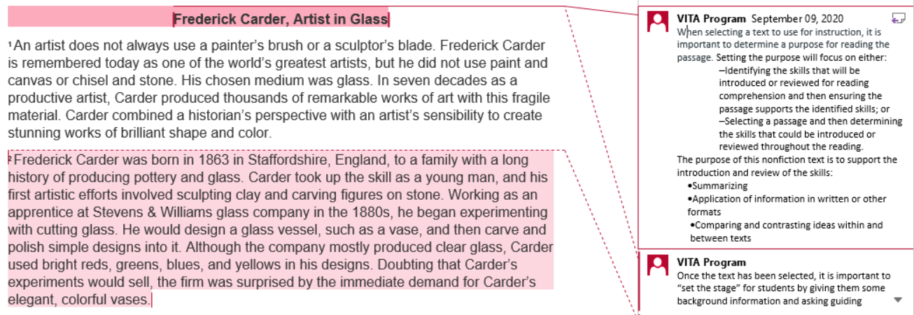
Step 1: Select Authentic Text (5 of 7)
Notes:
The annotations were created by Virginia Department of Education staff from the Office of Humanities and the Office of Student Assessment. VITA Program (Virginia Information Technologies Agency) is the author of the annotations.

Slide 16
Step 1: Select Authentic Text (6 of 7)
Article: “Frederick Carder, Artist in Glass”
Paired with
Poem: “Stampede”
This paired passage will be used to demonstrate how the selection of authentic text supports the introduction and review of specific skills.
Please see the annotated Word document for additional support.

Slide 17
Step 1: Select Authentic Text (7 of 7)
The selected article and poem* support the introduction and review of:
Symbols and figurative language
Inference
Summary
Application of information in other formats
Comparing and contrasting ideas within and between texts
*Please see the annotated Word document for additional support.

Slide 18
Step 2: Examine the Content and Progression of Standards for SOL 8.5D
7.5G- Describe the impact of word choice, imagery, and literary devices including figurative language in an author’s style.
8.5D- Explain the use of symbols and figurative language.
9.3E- Explain the meaning of literary and classical allusions and figurative language in text.

Slide 19
Step 2: Examine the Content and Progression of Standards for SOL 8.5E
7.5I- Make inferences and draw conclusions based on the text.
8.5E- Make inferences and draw conclusions based on explicit and implied information using references to the text for support.
9.4J- Make inferences and draw conclusions using references from the text(s) for support.

Slide 20
Step 2: Examine the Content and Progression of Standards for SOL 8.6I
7.6H- Summarize text identifying supporting details.
8.6I- Summarize the text identifying supporting details.
9.5E- Summarize, paraphrase, and synthesize ideas, while maintaining meaning and a logical sequence of events, within and between texts.

Slide 21
Step 2: Examine the Content and Progression of Standards for SOL 8.6K
7.6K- Organize and synthesize information for use in written and other formats.
8.6K- Evaluate, organize, and synthesize information for use in written and other formats.
9.5I- Analyze, organize, and synthesize information in order to solve problems, answer questions, complete a task, or create a product.

Slide 22
Step 2: Examine the Content and Progression of Standards for SOL 8.6L
7.6L- Analyze ideas within and between selections providing textual evidence.
8.6L- Analyze ideas within and between selections providing textual evidence.
9.5K- Analyze ideas within and between selections providing textual evidence.

Slide 23
Step 3: Sample Question Starters for SOL 8.5D (1 of 2)
Identify examples of figurative language in [insert title of text].
Why did the author include figurative language in [insert title of text]?
In [insert location or title of text], the author uses [insert figurative language] to help the reader-
In [insert location or title of text], the purpose of [insert figurative language] is to-

Slide 24
Step 3: Sample Question Starters for SOL 8.5D (2 of 2)
What idea does [insert symbol] symbolize?
The title symbolizes-
Explain how figurative language found in [insert title of text] supports the development of [insert statement about text]. Use specific details from the text to support your answer.

Slide 25
Step 3: Sample Question Starters for SOL 8.5E
What is an inference?
Based on [insert location or title of text], the reader can conclude that-
Which sentence from the story best supports [insert idea from text]?
Each of these details supports the idea that [insert idea from text] EXCEPT-
Which inference may best be drawn from the passage? [insert statements about the text]
After reading the passage, what inference can be made about [insert name, person, event, etc. from the text]. Use specific details from the text to support your answer.

Slide 26
Step 3: Sample Question Starters for SOL 8.6I
Which paragraph discusses [insert detail from text]?
Which question is NOT answered in the text?
Which of these is the best summary of the text?
Which detail is most important to include in a summary of the text?
Which detail should be added to the passage to support [insert idea from text]?
Write a summary of [insert title of text]. Use only details most relevant to a summary of the text.

Slide 27
Step 3: Sample Question Starters for SOL 8.6K
Information from this text could best be used as part of a [insert another format, i.e. report, presentation, visual aid, etc.] about-
Which paragraph would be most helpful for a [insert another format, i.e. report, presentation, visual aid, etc.] about [insert statement about text]?
The [insert location or title of text] would be most useful to someone who- [insert statements]
Based on [insert location or title of text], which alternate written or visual format could be used to support [insert idea from text]? Use specific details from the text to support your answer.

Slide 28
Step 3: Sample Question Starters for SOL 8.6L (1 of 2)
[Insert location] and [insert location] are similar because-
Based on the passages, which statement about [insert idea from text] is true?
How is [insert common idea from both texts] presented differently in the two passages?
The passages are alike because- [insert statements]

Slide 29
Step 3: Sample Question Starters for SOL 8.6L (2 of 2)
The passages are different because- [insert statements]
Which sentence expresses an idea shared by both authors? [inserts sentences about texts]
Explain how [insert common idea from first text] is similar/different from [insert common idea from second text]. Use specific details from the texts to support your answer.

Slide 30
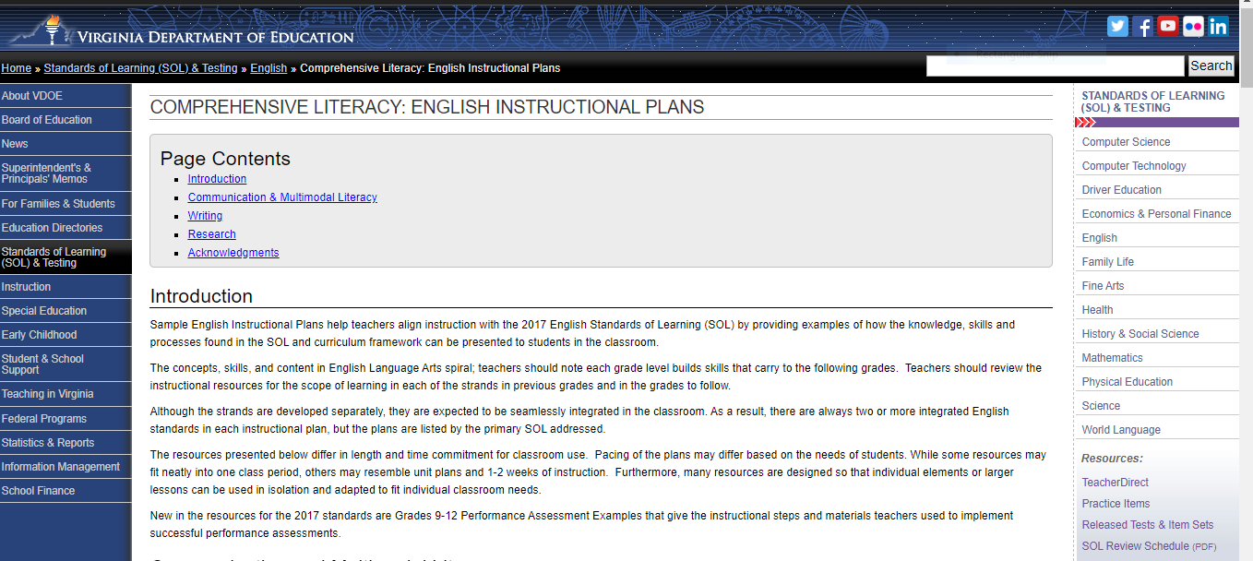
Step 4: Exploring Instructional Resources (1 of 7)
Comprehensive Literacy: English Instructional Plans

Slide 31
Step 4: Exploring Instructional Resources (2 of 7)

Slide 32
Step 4: Exploring Instructional Resources (3 of 7)

Slide 33
Step 4: Exploring Instructional Resources (4 of 7)
Comprehensive Literacy: English Instructional Plans
Word Choice in Paired Texts (8.5D)
This instructional plan was created by Virginia teachers to model how the skill can be introduced or reviewed.
Please note: text examples within the instructional plans can be changed based on grade level, genre, etc.
This plan models the use of figurative language; however, if the text supports the spiraling of additional skills, they should be implemented to support reading comprehension and skill application.

Slide 34
Step 4: Exploring Instructional Resources (5 of 7)
Comprehensive Literacy: English Instructional Plans
Making Inferences and Drawing Conclusions (8.5E)
This instructional plan was created by Virginia teachers to model how a skill can be introduced or reviewed.
Please note: text examples within the instructional plans can be changed based on grade level, genre, etc.
This plan models making inferences; however, if the text supports the spiraling of additional skills they should be implemented to support reading comprehension and skill application.

Slide 35
Step 4: Exploring Instructional Resources (6 of 7)
Comprehensive Literacy: English Instructional Plans
Using the GIST Method to Summarize (8.6I)
This instructional plan was created by Virginia teachers to model how the skill can be introduced or reviewed.
Please note: text examples within the instructional plans can be changed based on grade level, genre, etc.
This plan models summary and details; however, if the text supports the spiraling of additional skills, they should be implemented to support reading comprehension and skill application.

Slide 36
Step 4: Exploring Instructional Resources (7 of 7)
Comprehensive Literacy: English Instructional Plans
Compare and Contrast Paired Texts (8.6L)
This instructional plan was created by Virginia teachers to model how the skill can be introduced or reviewed.
Please note: text examples within the instructional plans can be changed based on grade level, genre, etc.
This plan models comparing and contrasting details within and between texts; however, if the text supports the spiraling of additional skills, they should be implemented to support reading comprehension and skill application.

Slide 37
Resources (1 of 3)
Virginia Department of Education: English
Grade 3 Reading Blueprint
Grade 4 Reading Blueprint
Grade 5 Reading Blueprint
Grade 6 Reading Blueprint
Grade 7 Reading Blueprint
Grade 8 Reading Blueprint
End-of-Course Reading Blueprint

Slide 38
Resources (2 of 3)
Reading Progression Charts
2017 Curriculum Framework
2017 Standards of Learning
Computer Adaptive Testing
Comparison of a Passage-Based CAT and a Traditional Test
Assessment Supports for 2020-2021 Literacy Webinar Series
Recover, Redesign, Restart 2020

Slide 39
Resources (3 of 3)
Frequently Asked Questions about Passage-Based CAT Testing
SOL Practice Items in TestNav 8
2019 English Deeper Learning Conferences
2018 English Standards of Learning (SOL) Institutes
Comprehensive Literacy: English Instructional Plans
Superintendent’s Memo 249-20: Update on New Standards of Learning Tests in Reading and History and Social Science

Slide 40
Stay Connected
Office of Student Assessment
student_assessment@doe.virginia.gov
(804) 225-2102
Department of Learning and Innovation
Jill Nogueras, K-12 English Coordinator,
jill.nogueras@doe.virginia.gov
Carmen Kurek, Elementary English Specialist,
carmen.kurek@doe.virginia.gov
Colleen Cassada, Middle School English Specialist,
colleen.cassada@doe.virginia.gov

Slide 41
Disclaimer
Reference within this presentation to any specific commercial or non-commercial product, process, or service by trade name, trademark, manufacturer or otherwise does not constitute or imply an endorsement, recommendation, or favoring by the Virginia Department of Education.

Slide 42
Copyright ©2020 by the Commonwealth of Virginia, Department of Education, P.O. Box 2120, Richmond, Virginia 23218-2120. All rights reserved. Except as permitted by law, this material may not be reproduced or used in any form or by any means, electronic or mechanical, including photocopying or recording, or by any information storage or retrieval system, without written permission from the copyright owner. Commonwealth of Virginia public school educators may reproduce any portion of these items for non-commercial educational purposes without requesting permission. All others should direct their written requests to the Virginia Department of Education at the above address or by e-mail to Student_Assessment@doe.virginia.gov.

