Slide 1
Teaching Math at a Distance
Theresa Wills, PhD, author of Teaching Math at a Distance and Assistant Professor at George Mason University, has taught online for a decade. In that time, Theresa has taught a variety of age groups including K&1, 3, middle school, young adult and and adult learners.
theresawills.com
@theresawills
youtube.com/theresawills

Slide 2
Find all of these templates at:
Find all recordings & slide decks at:
theresawills.com/templates
theresawills.com/mathurdays

Slide 3
Successes and Celebrations in Math or Personal Lives

Slide 5
Agenda:
Do the math
Do the discourse
Reimagine the opportunities online
Q&A about the teaching and tech

Slide 6
Notes:
National Council of Teachers of Mathematics. (2015). Principles to Actions: ensuring mathematical success for all. Reston, VA: National Council of Teachers of Mathematics.

Slide 8
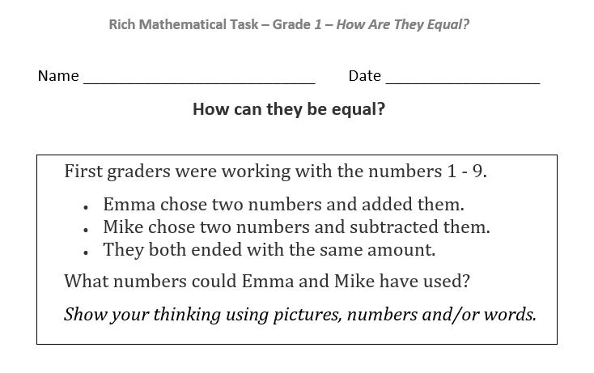
How are they equal?

Slide 9
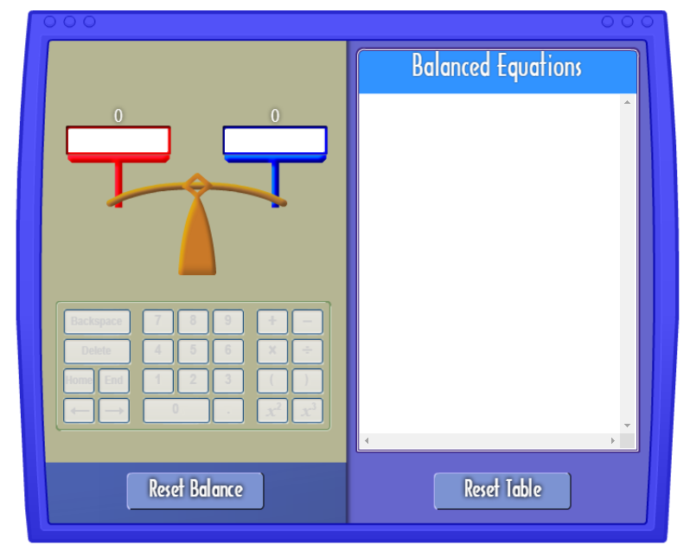
Show your thinking with these virtual manipulatives
CPM Tiles
Multiple shapes and colors for set models.
Interactive Number Line
Ability to “hop” on a linear model
Pan Balance
Place numbers on both sides to make it equal.
2 color counters
2 color model with ability to “flip” to change color
Unifix Cubes
Multi-color stackable cubes for a hybrid linear, set, and area model.
Notes:
Open middle

Slide 10
Group 1:
1+1= 2
5-3= 2
-
=
+
=

Slide 11
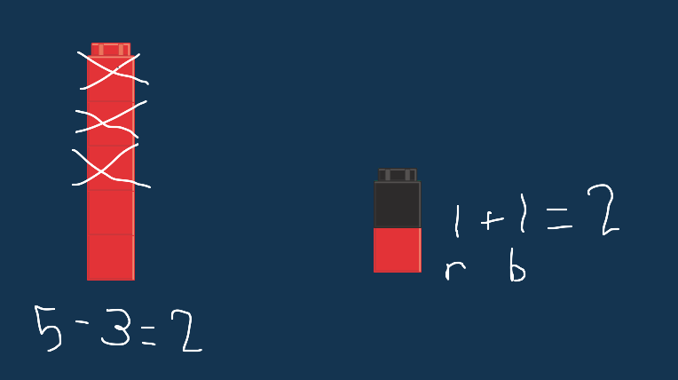
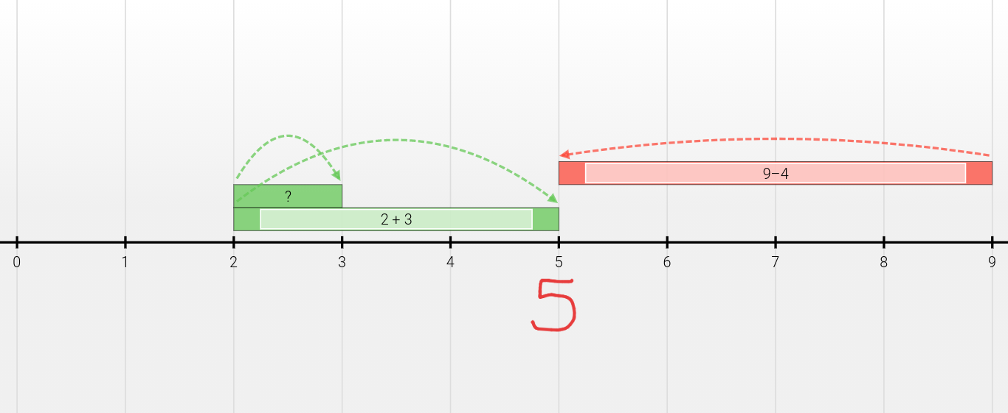
Group 2:

Slide 12
Group 3:

Slide 13
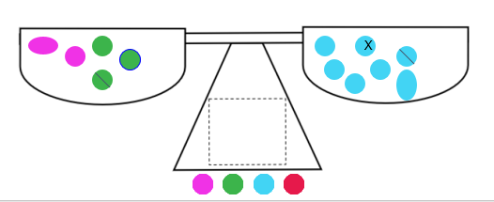
Group 4:

Slide 14
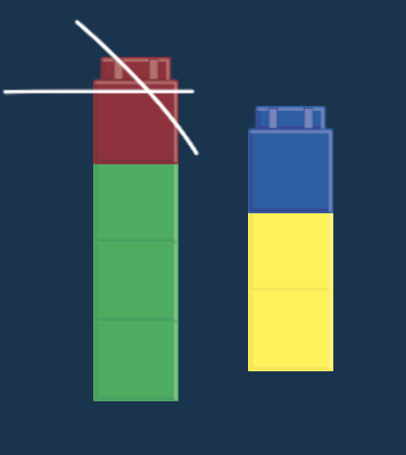
Group 5:
First graders were working with the numbers 1 - 9.
Emma chose two numbers and added them.
Mike chose two numbers and subtracted them.
They both ended with the same amount.
What numbers could Emma and Mike have used? Show your thinking using pictures, numbers and/or words.
4 - 1 = 3
2 + 1 = 3

Slide 15
Five Practices

Slide 16
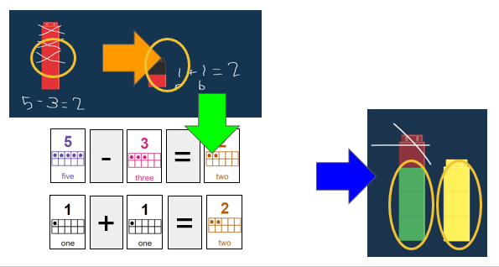
Select, Sequence, and Connect 1

Slide 17
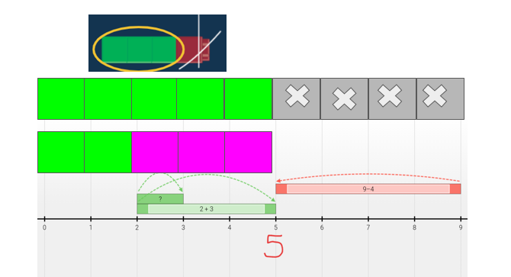
Select, Sequence, and Connect 2

Slide 18
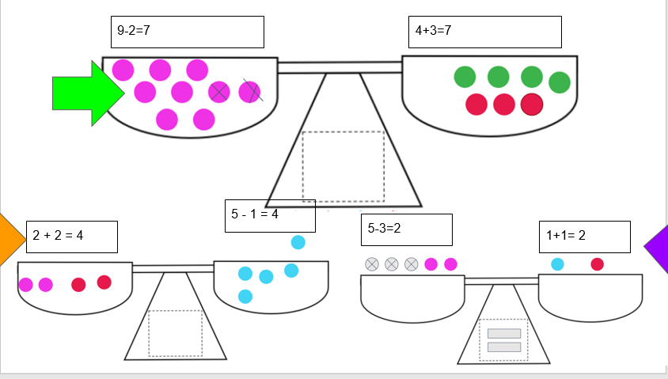
Select, Sequence, and Connect 3

Slide 19
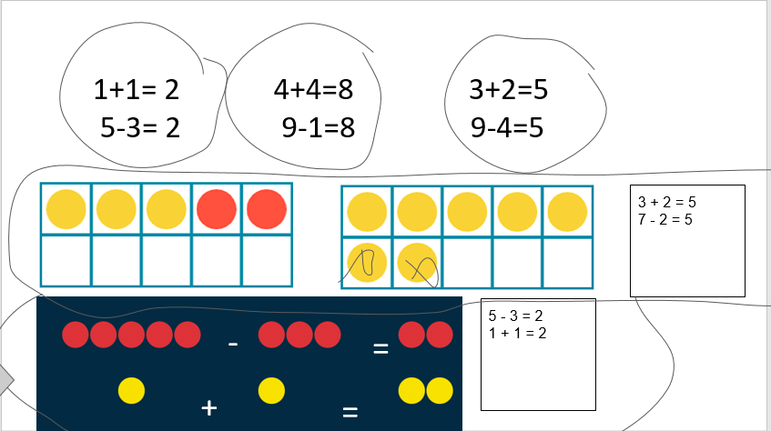
Select, Sequence, and Connect 4

Slide 20
Select, Sequence, and Connect 5

Slide 21
Discussion Prompts
What is similar and different about addition and subtraction?
How are different representations similar to each other?
How are fact families useful in this problem?
What are different ways to write equations?

Slide 22
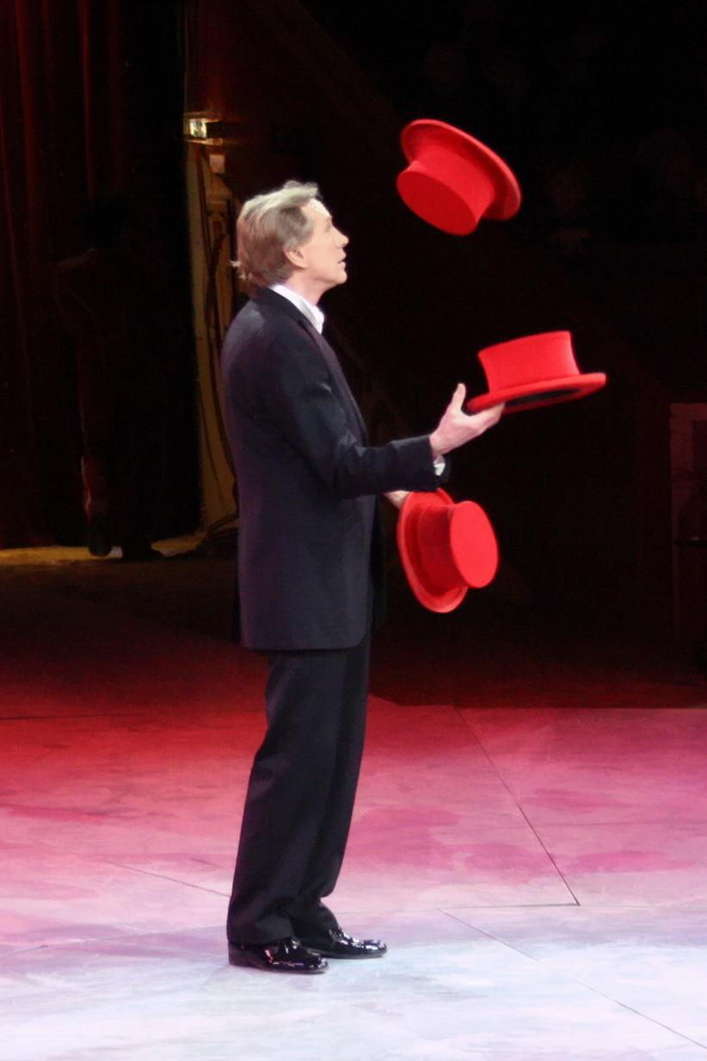
Teacher Hat
Rich tasks on VDOE website
This task
5 minutes independent think time

Slide 23
What opportunities were available because of the technology?
Quickly accessing multiple manipulatives
Collaborating and building off other’s good ideas
Exploration using manipulatives and the chance to model thinking
Manipulatives for everyone and a variety of to pick from
Online manipulatives
Variety of manipulatives to demonstrate thinking
We were able to see student thinking because we can scan and upload docs.
Students could collaborate and show a variety of representations for Prob Solv
Collaboration
Global collaboration!
Using virtual manipulative.
Variety of ways to ask deep thinking questions
Notes:
Please list grade level & topic.

Slide 24
SAMR (1 of 2)

Slide 25
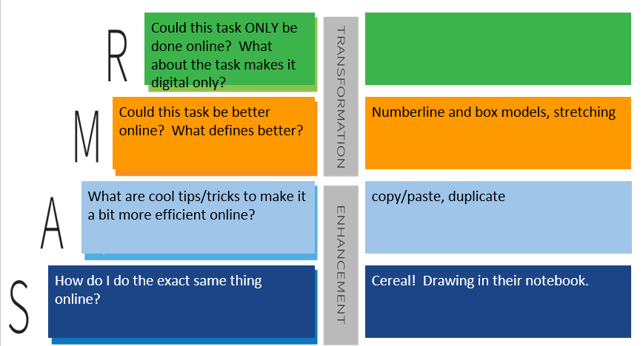
SAMR (2 of 2)

Slide 26
What are your biggest concerns about teaching online?
Skids with o utdent
Keeping students’ attention
Limitations regarding technology available to students/equity
Different types of technology across 65 elementary schools (we’re not a Google division!) theresawills@gmail.com
Internet access for all students
Not a google division...other similar tech??
Can’t get parents to show up for conferences or log kids on for assessments (kindergarten)
Unbalance of digital and nondigital
Monitoring student progress.
Too much time on screens.
Keeping students actively engaged
Too much parental interaction in K-2
Kids without internet
Students not knowing how to use the technology. (Testing in Schoology, but needed to open a new tab to open Star.)
Students K-2 use ipads- difficult to manipulate slides while on a zoom.
Reaching all students.
Notes:
Please list grade level & topic.

Slide 27
Scavenger Hunt: All About
Cover this with a clipart picture that shows what you do for fun.
Type your name
Take a photo (using phone or computer) and upload it. Cover this with the image.
Add a text box and tell us your age, then give it a new background color and change the outline color.
Cover this with a shape from the toolbar.
Color the bear using the SCRIBBLE tool under the line tool. Then delete this text box.
Add a comment that says “FINISHED” and turn this box red when you are done.

Slide 29
Frequently Asked Questions
How do I make Drag and Drop slides?
How do I clone objects, stack objects, or make them transparent?
How do I embed google translate to read my directions in english and other languages?
Why is my avatar an anonymous animal and how do I see my students’ names?
How do you teach students to move between zoom/BBcU/Meets/Mteams and google slides?
I can’t read the small print on the slides. How can I make it bigger?
How do I lock google slides so that students don’t move things?
How do I set up breakout rooms and move between them quickly? BBcU (more platforms to come)
How do I set up safety norms so that students can notify me instantly of problems in breakout rooms?
What if my students have an ipad, phone, or tablet?

Slide 30
Mathurdays- every Saturday at noon Eastern Time
FREE professional development
Engage in best practices for teaching math in remote K-12 classrooms.
Increase student participation
Access templates and lessons that are ready to use immediately.
theresawills.com
@theresawills
youtube.com/theresawills

