Slide 1
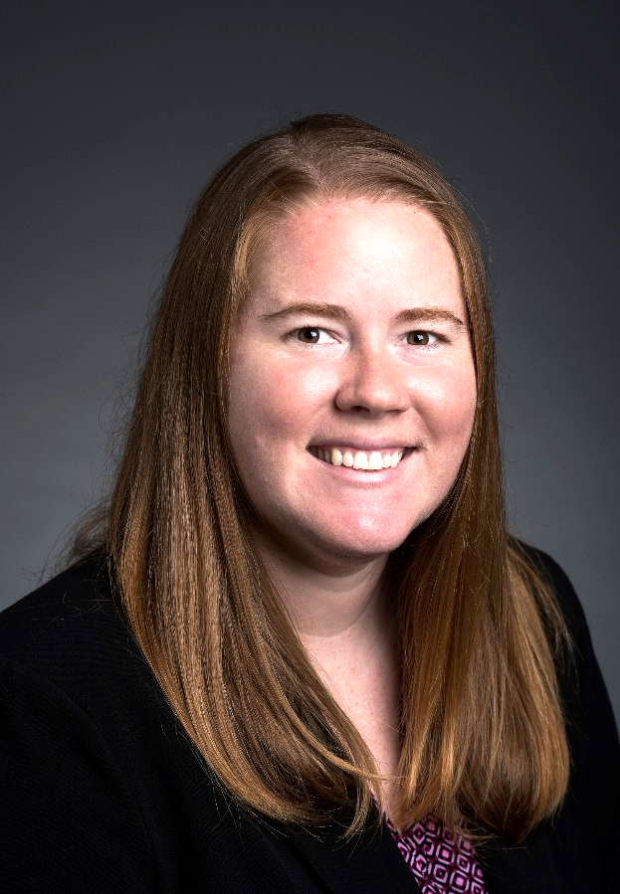
Teaching Math at a Distance
Theresa Wills, PhD, author of Teaching Math at a Distance and Assistant Professor at George Mason University, has taught online for a decade. In that time, Theresa has taught a variety of age groups including K&1, 3, middle school, young adult and and adult learners.
theresawills.com
@theresawills
youtube.com/theresawills

Slide 2
Find all of these templates at:
Find all recordings & slide decks at:
theresawills.com/templates
theresawills.com/mathurdays

Slide 3
Successes and Celebrations in Math or Personal Lives

Slide 5
Agenda:
Do the math
Do the discourse
Reimagine the opportunities online
Q&A about the teaching and tech

Slide 6
Notes:
National Council of Teachers of Mathematics. (2015). Principles to Actions: ensuring mathematical success for all. Reston, VA: National Council of Teachers of Mathematics.

Slide 8
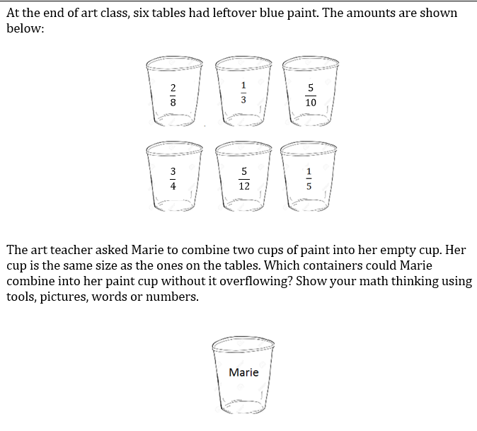
Task:

Slide 9
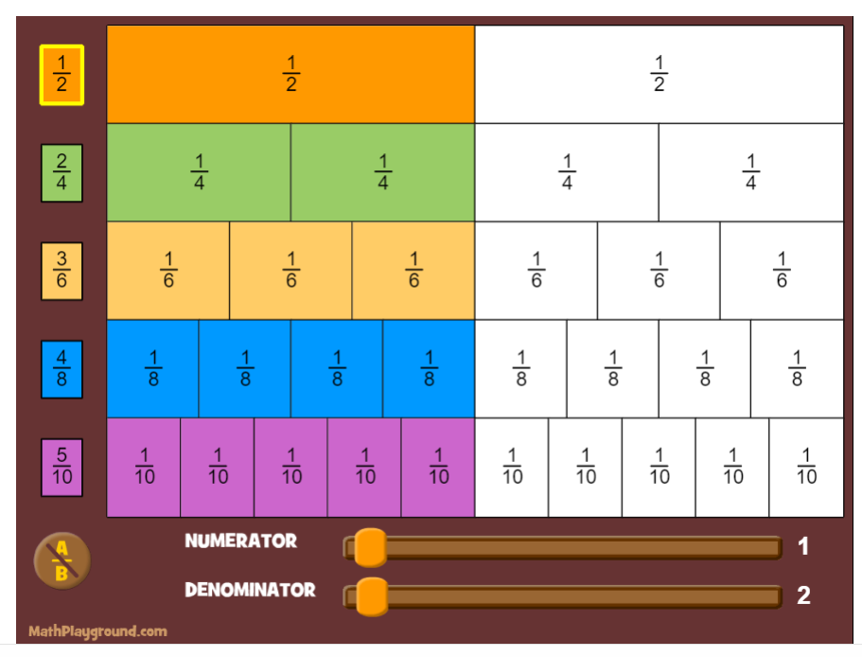
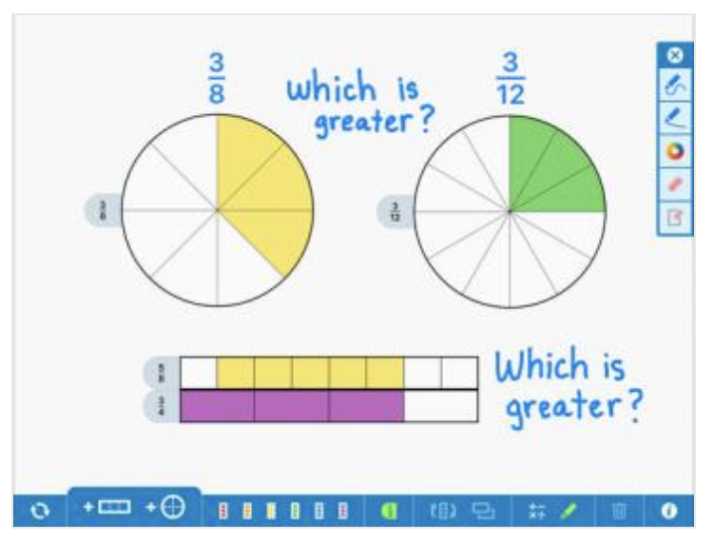
Show your thinking with these virtual manipulatives
Compare Fraction circles and bars
fractions
Interactive Number Line
Ability to “hop” on a linear model
Fraction Bars
Visualize fractions to compare
Cuisenaire Rods
“Locked” sizes for a compare model.
2 color counters
2 color model with ability to “flip” to change color
Notes:
Pouring paint

Slide 10
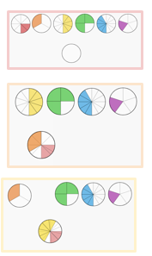
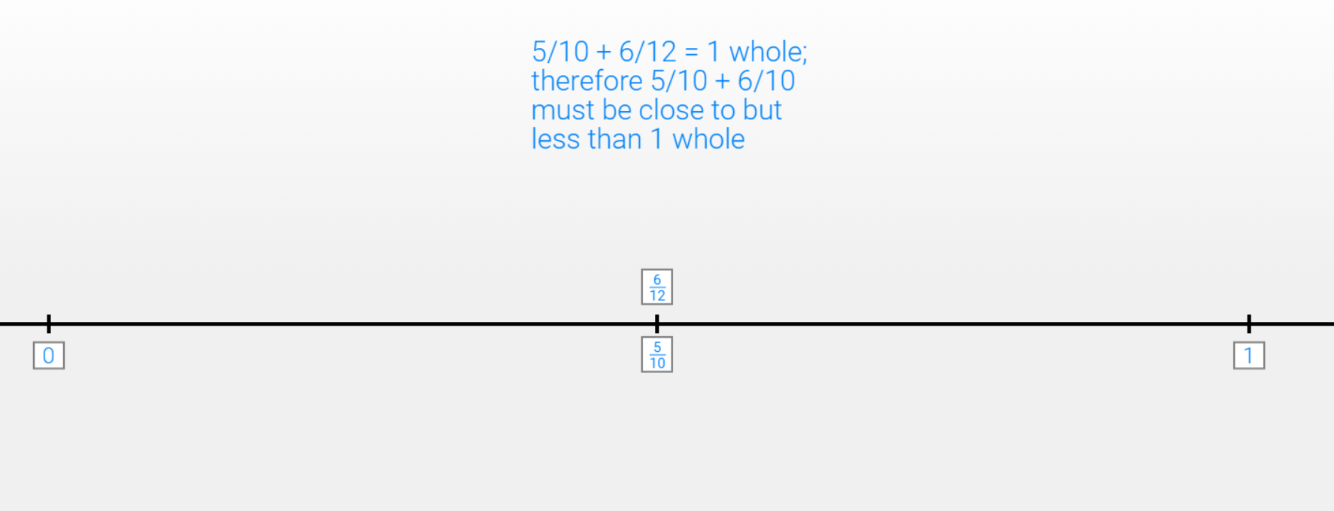
Group 1:
Oops! This should say 5/10 + 5/12 must be close to but less than 1 whole.

Slide 11
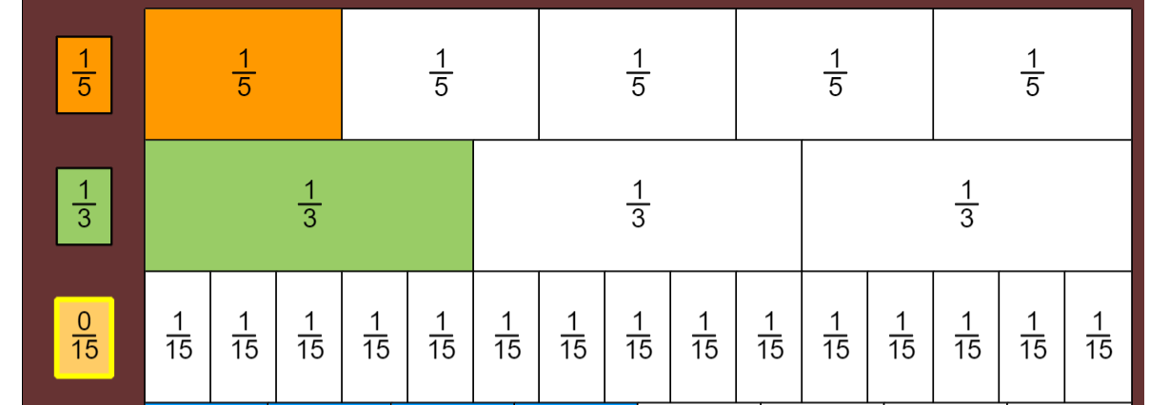
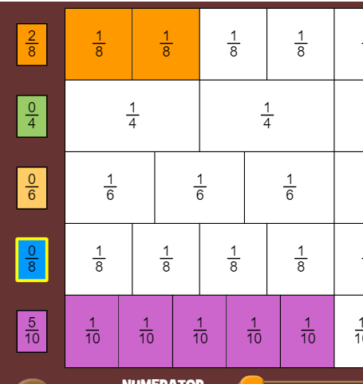
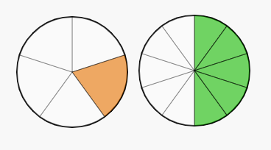
Group 2:
2/8 and 5/10 is smaller than 1 whole so it would fit
⅓ and ⅕ is less than one whole; we wanted to know how much it was...so, 3/15 + 5/15 = 8/15; more than half
⅕ and 5/10 because ⅕ is equivalent to 2/10 which would combine to 7/10 which is less than a whole

Slide 12
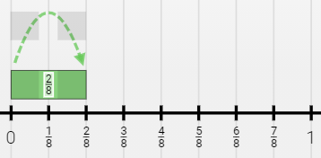
Group 2 Continued:
Both 5/12 and 2/8 are less than ½ so when you combine them the sum will be less than one whole

Slide 13
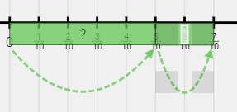
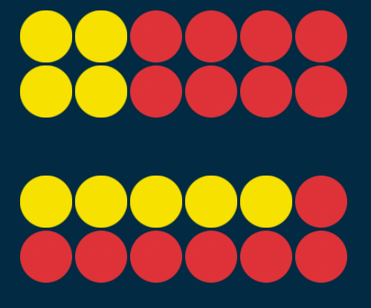
Group 3:
If we use a benchmark of a ½, 2/8, ⅓, 5/12, and ⅕ are all less than ½. 5/10 is equal to half, and ¾ is greater than ½. I looked at ones that I could NOT do: ex. 5/10 + ¾ would overflow. (½ plus more than ½ > 1.) ¾ + 5/12 would overflow. (almost ½ plus ¾ is also > 1)
We could also go 2/8 + ¾. This would be equal to 1, but I would worry that it would overflow when I put in a brush!
2/8 + ⅓
5/10 + 1/5
⅓ + 5/12

Slide 14
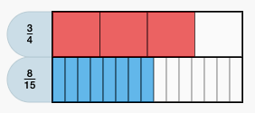
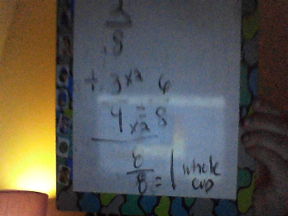
Group 4:
We know that the cup will hold ¾ of a cup. She can combine ⅓ and ⅕ and have less than ¾ of a cup.
She could combine 2/8 and 5/12 without going over 1 cup because 2/8 and 5/12 are both less than a half.
She could combine 5/12 and ⅓ because together they would equal less than one whole so the cup would not overflow.

Slide 15
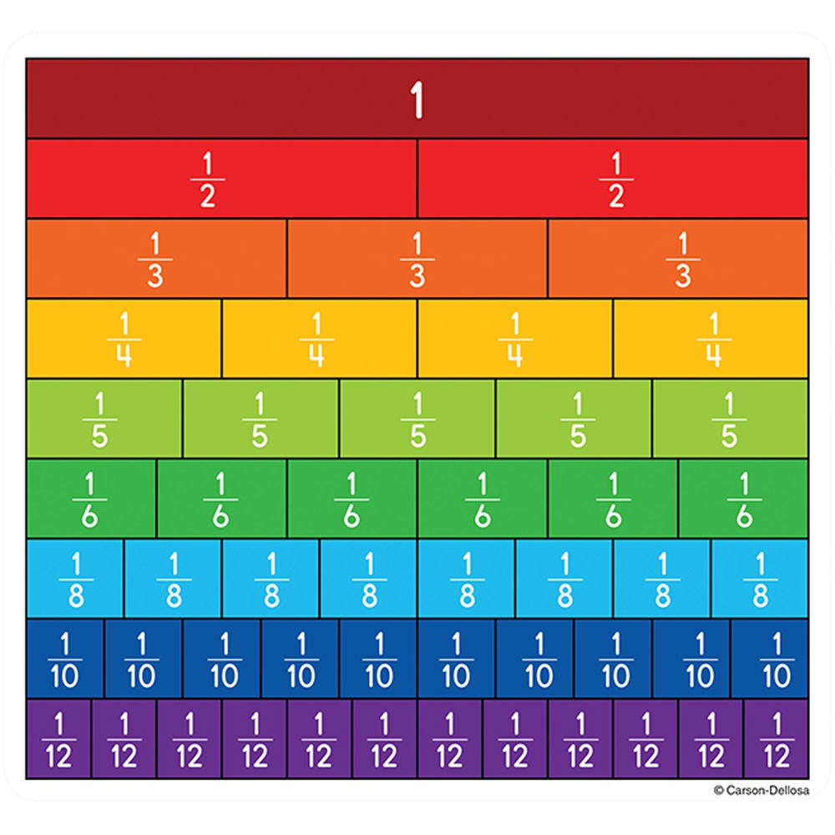
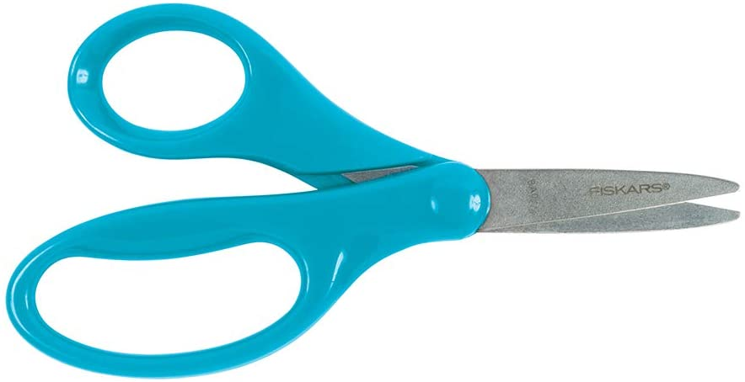
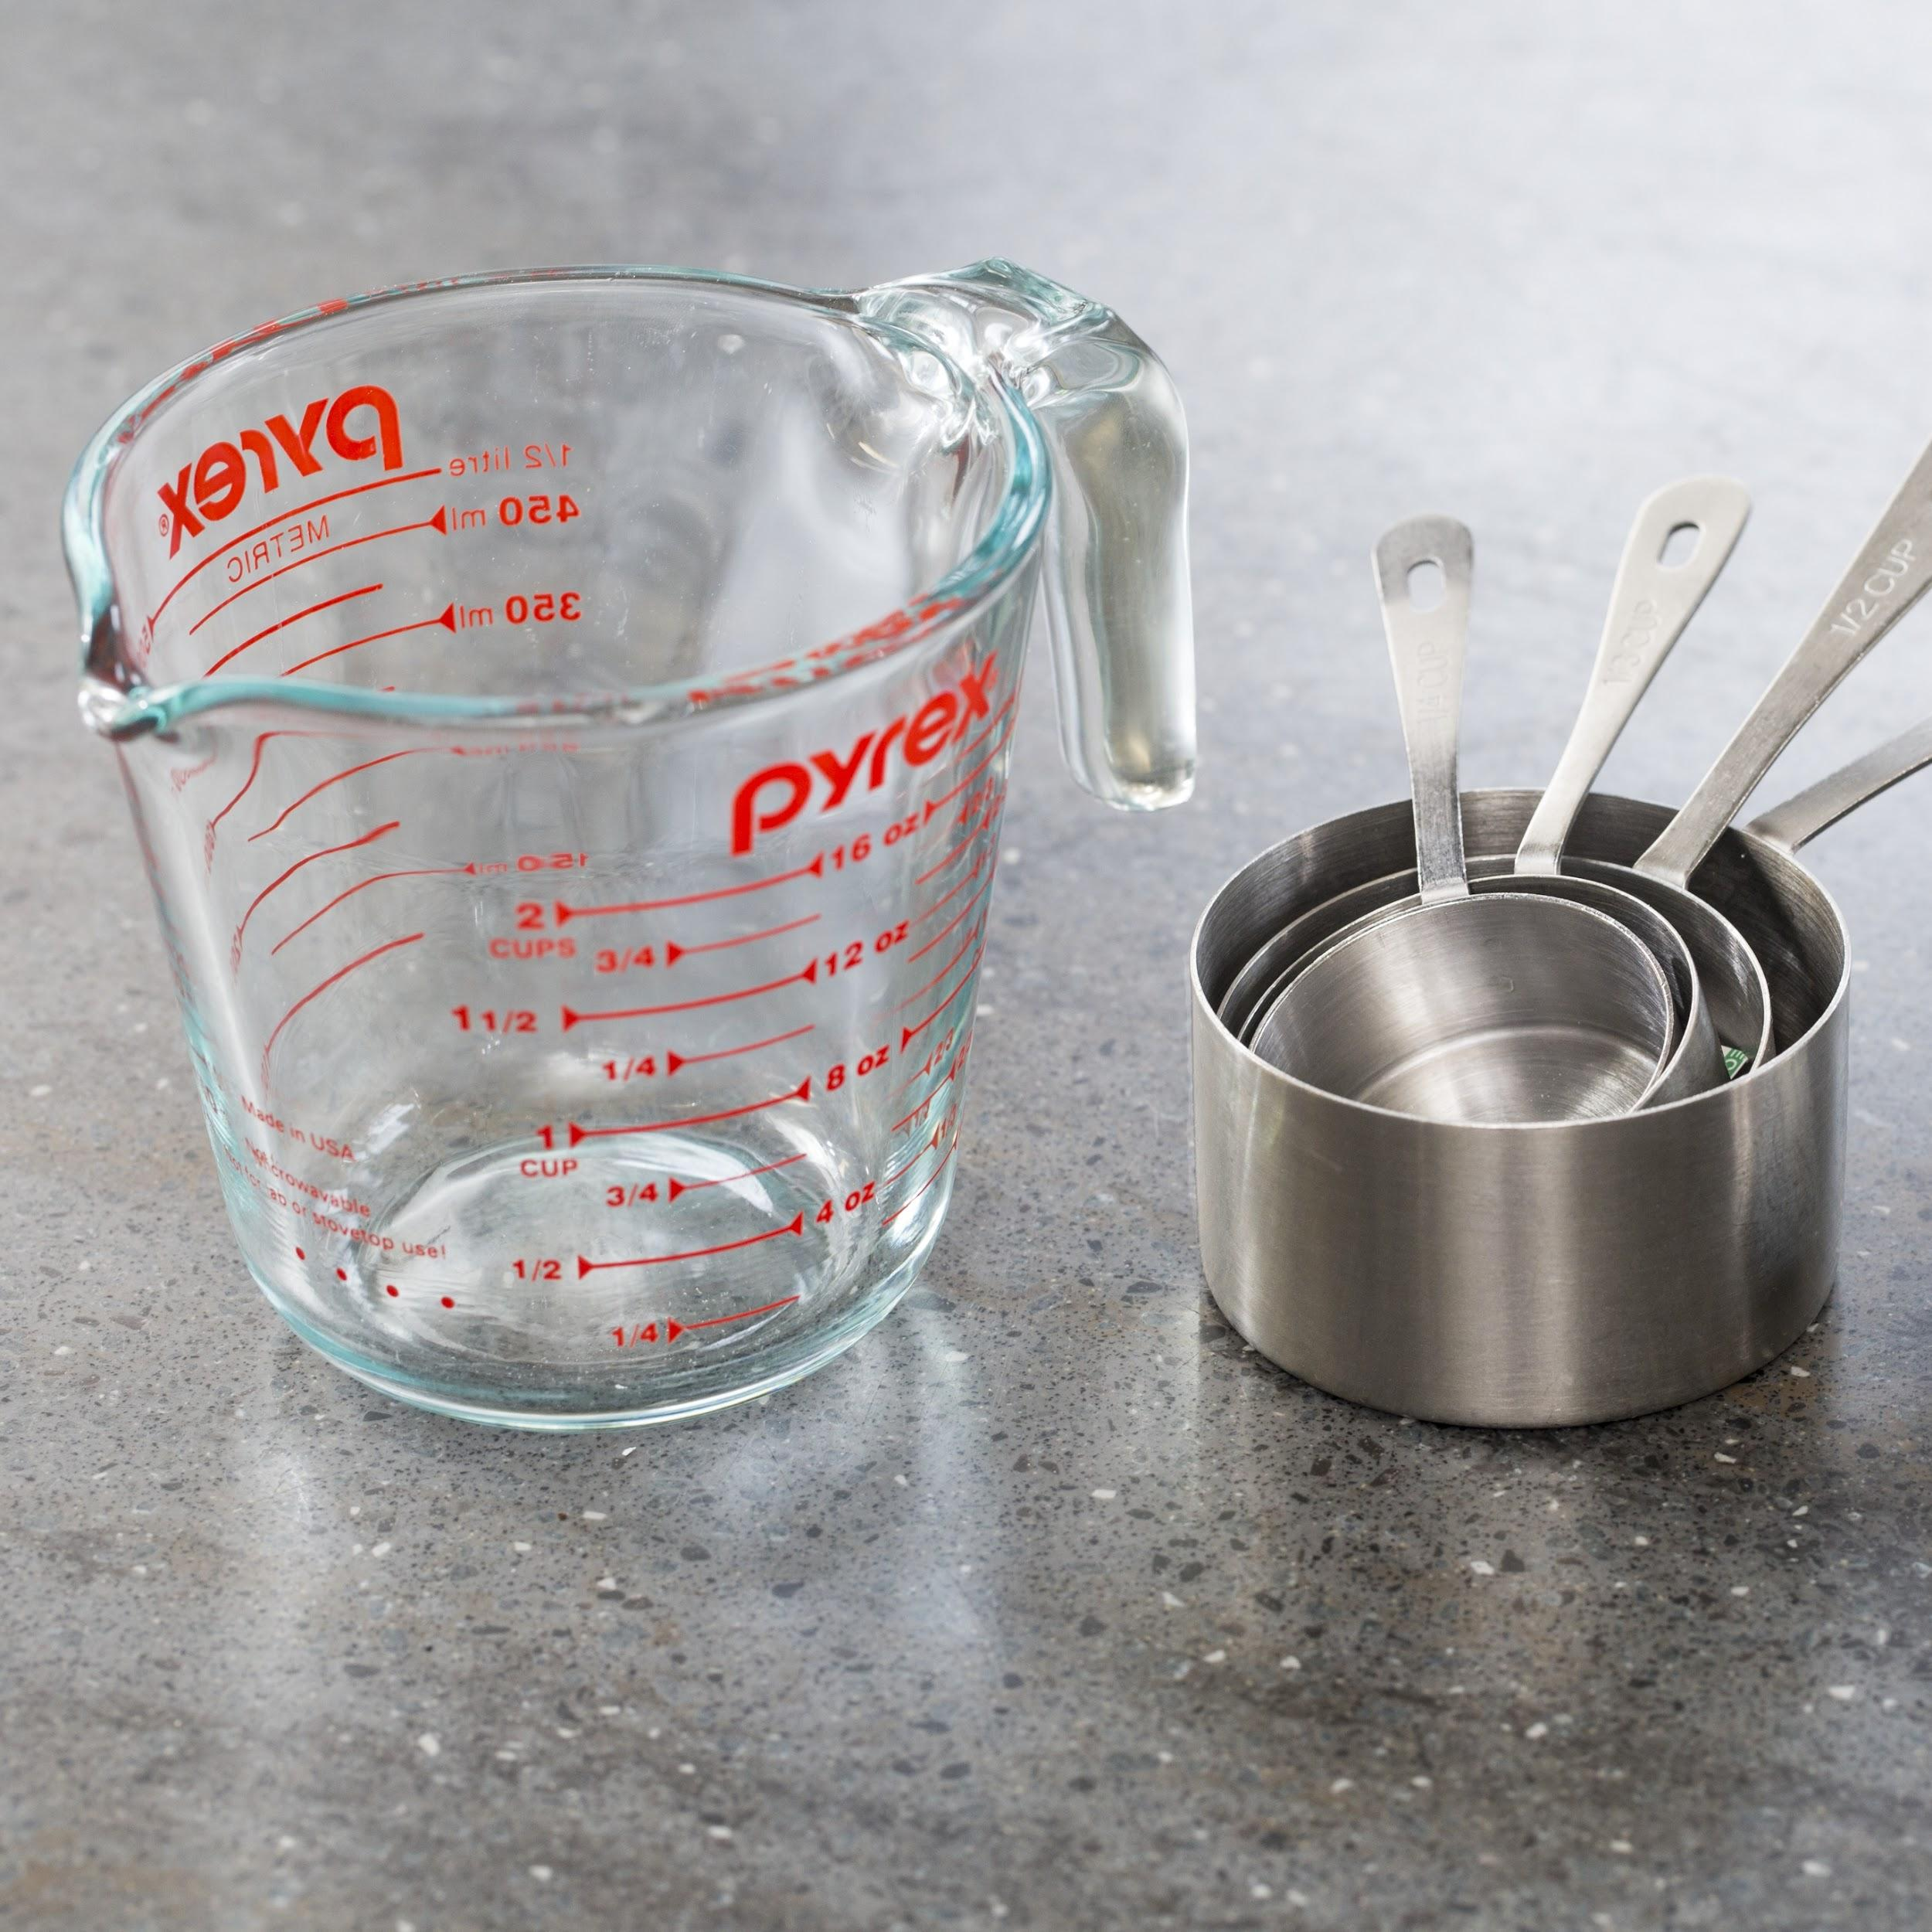
Group 5:
2/8 + 3/4 = 1 whole (Option 1 - LCD) 5/12 + 5/10 = 11/12 (Option 2 - use water/measuring cups) 3/4 + 1/5 = 19/20 (Option 3 - Fraction tiles) 1/3 + 5/10 = 5/6 (Option 4 - Cut a paper cup)

Slide 16
Five Practices

Slide 17
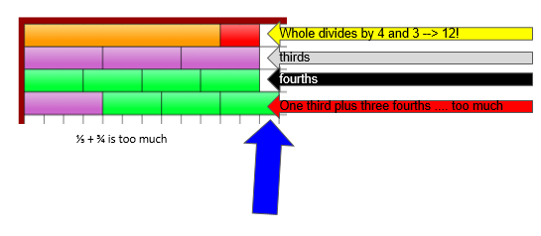
Select, Sequence, and Connect 1
5/10 is equal to ½. We know 5/12 is a little less than ½ because ½ would be 6/12. So we know if we combine 5/10 + 5/12, we have less than 1 whole cup.

Slide 18
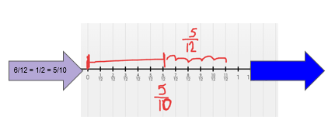
Select, Sequence, and Connect 2
2/8 + 3/4 = 1 whole (Option 1 - LCD) 5/12 + 5/10 = 11/12 3/4 + 1/5 = 19/20 1/3 + 5/10 =

Slide 19
Select, Sequence, and Connect 3

Slide 20
Select, Sequence, and Connect 4

Slide 21
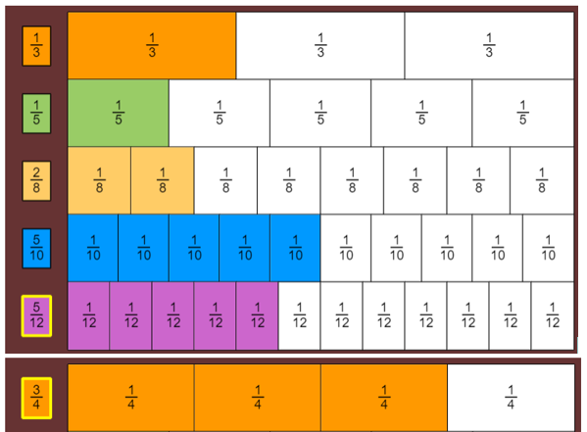
Select, Sequence, and Connect 5
Any two could be added together except ¾;
¾ can only be added to ⅕ and 2/8 (but it will be really full)
I wonder if you can add three cups together? I’ll think about it.

Slide 22
Discussion Prompts
What strategies allow for us to compare fractions?
Common denominator
Common numerator
Equivalent fractions
Benchmark
What strategies allow us to add fractions?

Slide 23
Teacher Hat
Rich tasks on VDOE website
This task
5 minutes independent think time

Slide 24
What opportunities were available because of the technology? (1 of 2)
Being able to use the manipulative of choice (a new one or the one you felt must comfortable with)
The use of manipulatives that students would otherwise not have access to.
Immediate Interactivity and collaboration.
I could show my thinking different ways using different tools
Work with people from other parts of the state!
Collaboration even with distance
Parents can be involved.
The chance to allow students to use the manipulatives.
Virtual manipulatives
“Hands On”, but with a virtual platform
Cool online manipulatives
No messy cleanup...and quiet!
I enjoyed collaborating with peers.
Comparing/using different manipulatives easily
FREE!
Notes:
Please list grade level & topic.

Slide 25
What opportunities were available because of the technology? (2 of 2)
We were able to show our thinking with models that were easy to adjust
Everyone can share and work at the same time using different web manipulatives
Letting everyone participate- didn’t limit it to a few vocal participants
The chance to use a variety of online manipulatives/representations
Quickly see multiple representations and strategies
The virtual manipulatives made it easy to represent without having to draw by hand
Choice with what manipulatives to use was easy
Unlimited manipulatives from virtual manipulatives.
Breakout rooms: quiet small groups
Opportunities to discuss with group and create multiple representations
Didn’t have to spend a lot of time “cleaning up” manipulatives =saved time!
Online manipulatives
Various tools that allow students to pick ones they are comfortable with.
It’s very easy for students to undo.
Notes:
Please list grade level & topic.

Slide 26
SAMR (1 of 2)

Slide 27
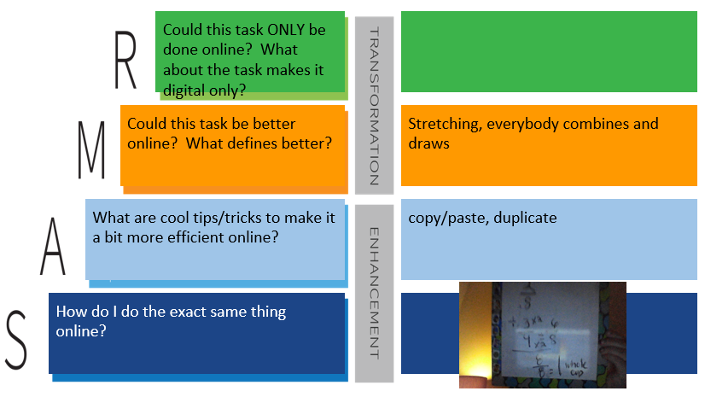
SAMR (2 of 2)

Slide 28
What are your biggest concerns about teaching online?
We are not allowed to put kids in break out rooms. How do I get them t0 particiipate more? It is always the same 5-6 kids participating.
Participation & Student Internet issues.
What I have heard from teachers -- how do I assess appropriately? How do I grade?
It’s difficult to see if they understand material individually.
We can’t require them to have camera on so they watch tv , go away, and are just “not there”
Students erasing slides and keeping them engaged
Motivation and participation
Keeping students engaged
Keeping engagement and avoiding “too much” screen time (giving screen breaks without loosing kiddos)
Keeping kids on task when I am in other rooms; yes I like that strategy!
Equity
Our Chromebooks do not allow for the kids to split their screens, so we can’t have them access another website while on Zoom with us. How do you teach students to move between zoom/BBcU/Meets/Mteams and google slides?
We can’t do breakout rooms at elem level
Students do not always attend.
Seeing and understanding students’ thinking in real time
Finding free resources in Spanish
Notes:
Please list grade level & topic.

Slide 29
Breakout Rooms for Distance Learning build:
@theresawills theresawills.com

Slide 30
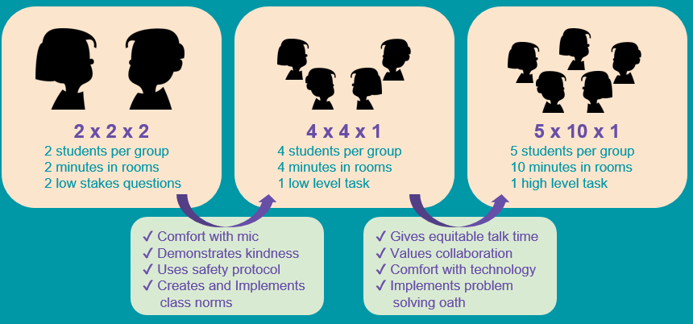
Breakout Room Phases
@theresawills theresawills.com

Slide 31
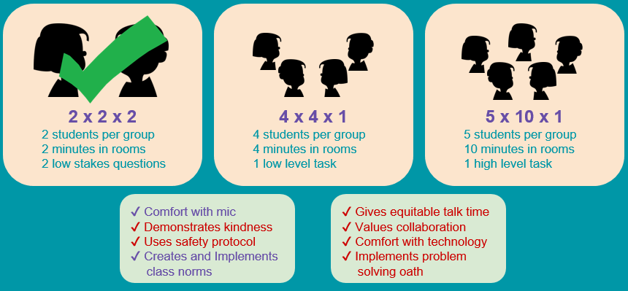
Breakout Room Phases 1
@theresawills theresawills.com

Slide 32
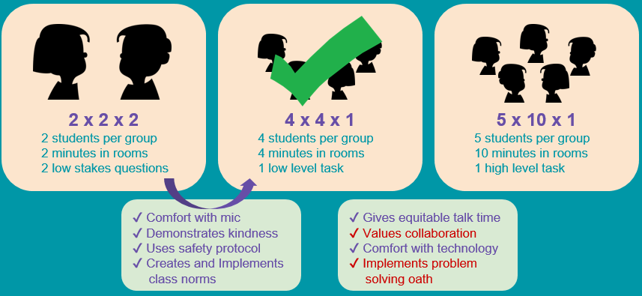
Breakout Room Phases 2
@theresawills theresawills.com

Slide 33
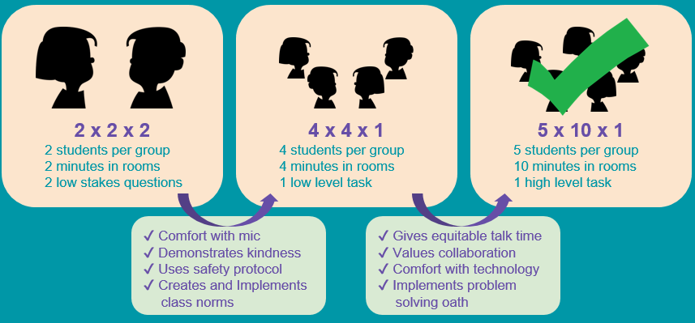
Breakout Room Phases 3
@theresawills theresawills.com

Slide 35
Scavenger Hunt: All About
Cover this with a clipart picture that shows what you do for fun.
Type your name
Take a photo (using phone or computer) and upload it. Cover this with the image.
Add a text box and tell us your age, then give it a new background color and change the outline color.
Cover this with a shape from the toolbar.
Color the bear using the SCRIBBLE tool under the line tool. Then delete this text box.
Add a comment that says “FINISHED” and turn this box red when you are done.

Slide 36
Frequently Asked Questions
How do I make Drag and Drop slides?
How do I clone objects, stack objects, or make them transparent?
How do I embed google translate to read my directions in english and other languages?
Why is my avatar an anonymous animal and how do I see my students’ names?
How do you teach students to move between zoom/BBcU/Meets/Mteams and google slides?
I can’t read the small print on the slides. How can I make it bigger?
How do I lock google slides so that students don’t move things?
How do I set up breakout rooms and move between them quickly? BBcU (more platforms to come)
How do I set up safety norms so that students can notify me instantly of problems in breakout rooms?
What if my students have an ipad, phone, or tablet?

Slide 37
Mathurdays- every Saturday at noon Eastern Time
FREE professional development
Engage in best practices for teaching math in remote K-12 classrooms.
Increase student participation
Access templates and lessons that are ready to use immediately.
theresawills.com
@theresawills
youtube.com/theresawills

