Slide 1
Social Emotional Learning
In Reading
Elementary School Educators
-September 2020-

Slide 2
Who Am I?
Sarah Bazemore
School Counseling Specialists,
and Student Assistance Systems Coordinator
Office of Student Services

Slide 3
In this session you will...
Build an understanding of Social Emotional Learning.
Learn how to create emotionally and physically safe, supportive, and engaging learning environments that promote all students’ social and emotional development.
Specific strategies and considerations will be shared for how English teachers can enhance instructional practices to embed SEL into their curriculum and lesson plans.

Slide 4
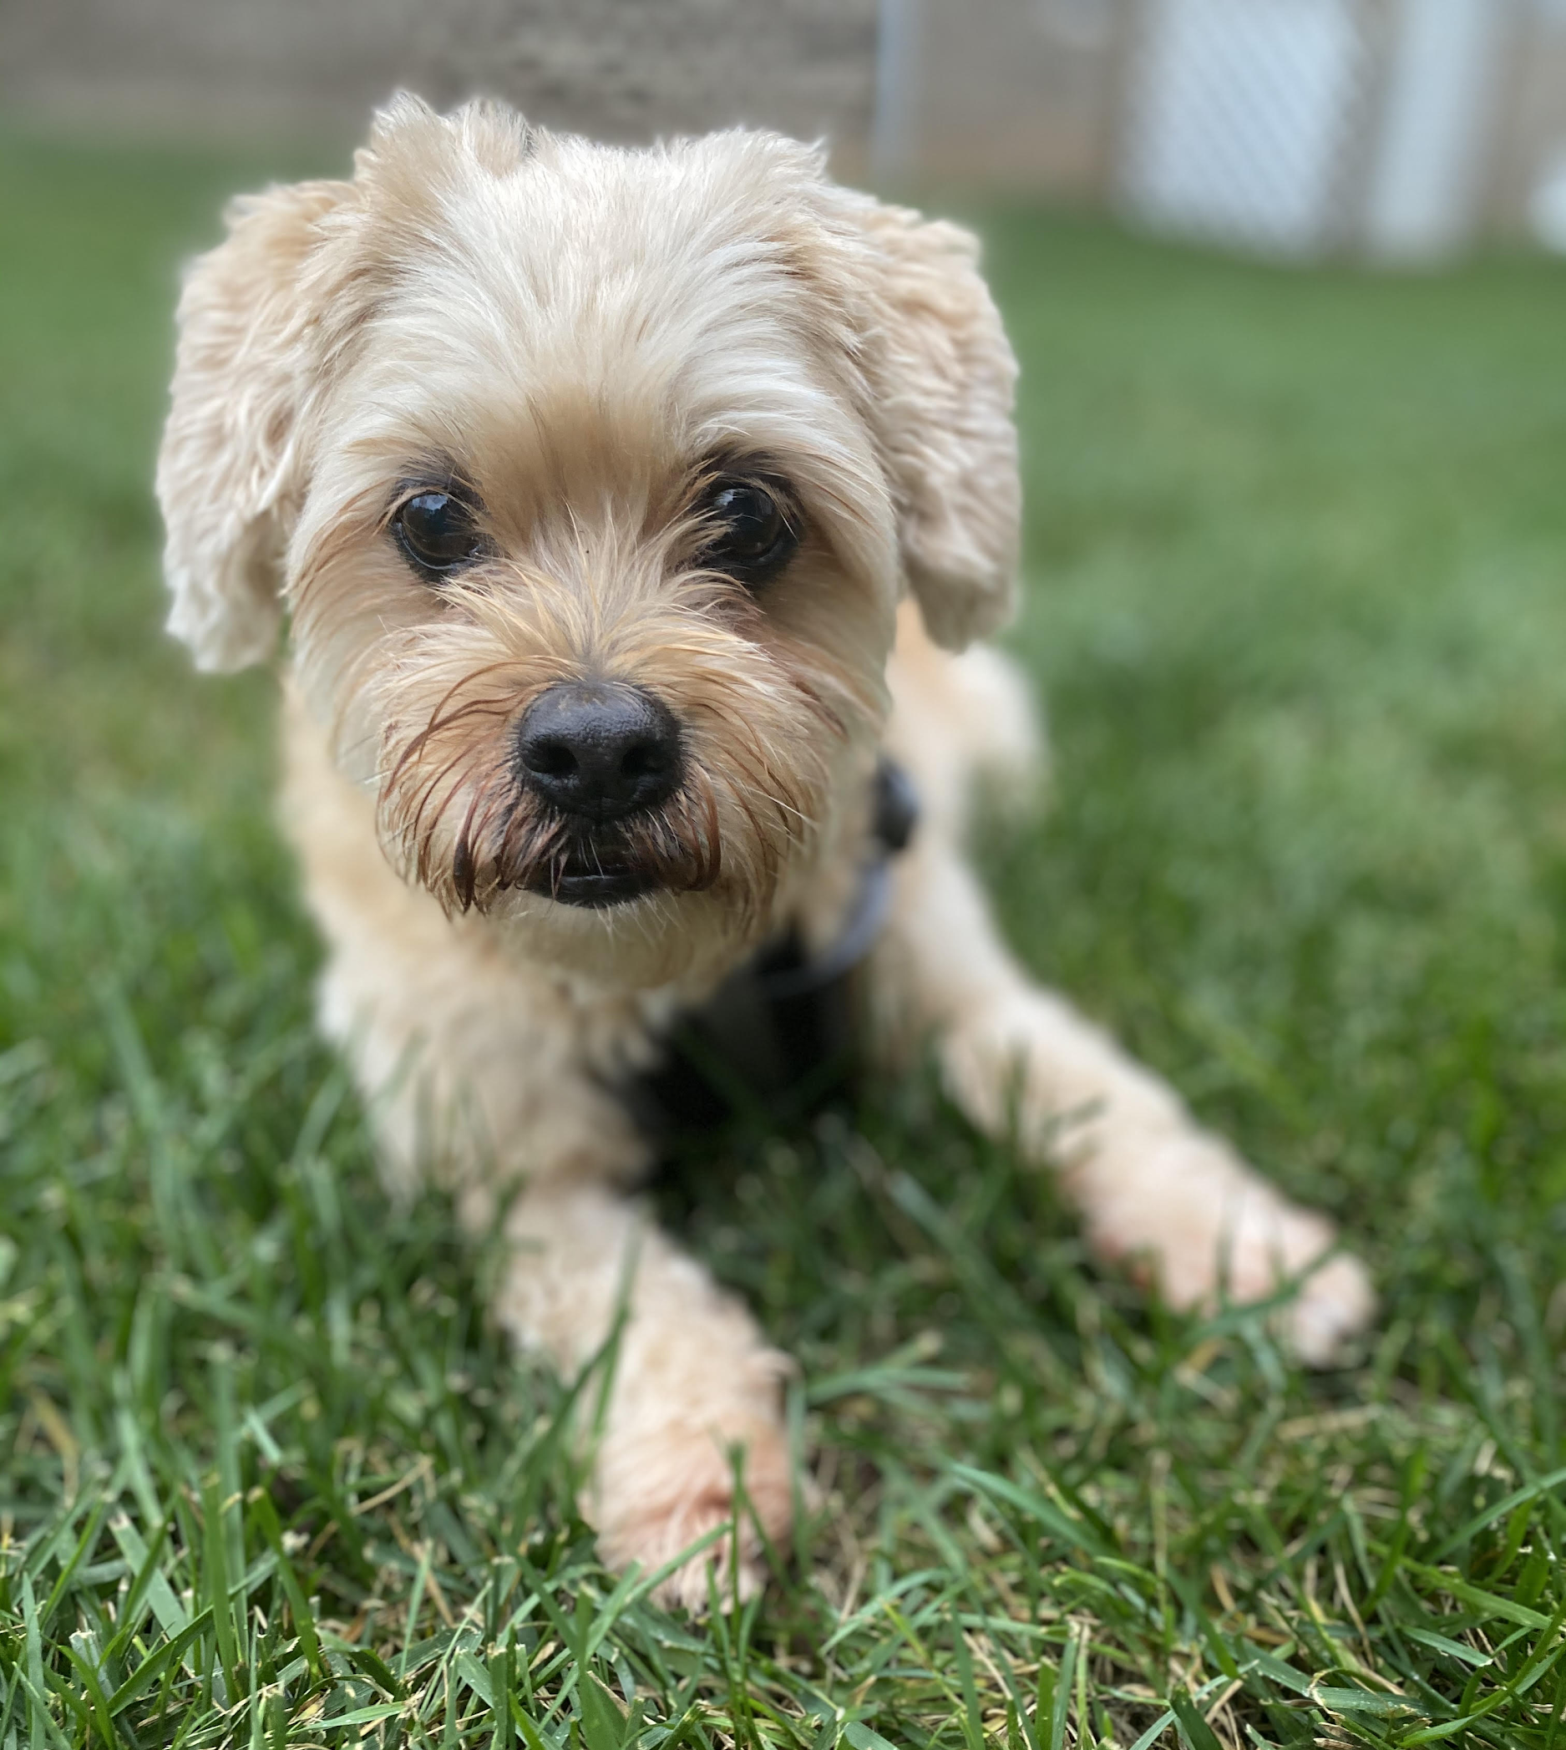
Housekeeping
Access to Presentation and Resources
Padlet: Sarah Bazemore
If I seem distracted…
Chat box

Slide 5
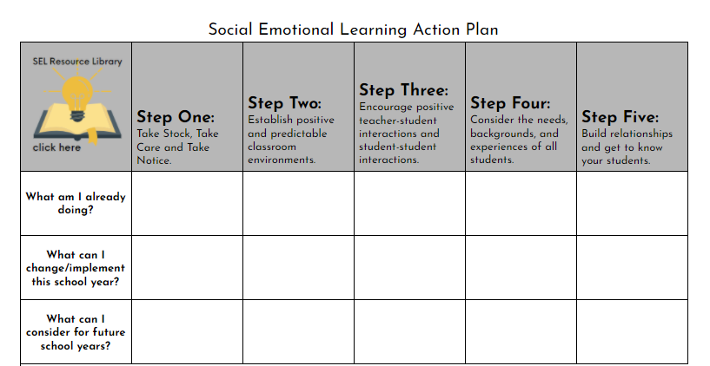
Note-taking Tip
You can access this sheet at: Social Emotional Learning Action Plan Link
Be sure to make a copy to edit!

Slide 6
What is Social Emotional Learning? (1 of 2)
Social and emotional learning (SEL) is the process through which children and adults understand and manage emotions, set and achieve positive goals, feel and show empathy for others, establish and maintain. positive relationships, and make responsible decisions.
-CASEL

Slide 7
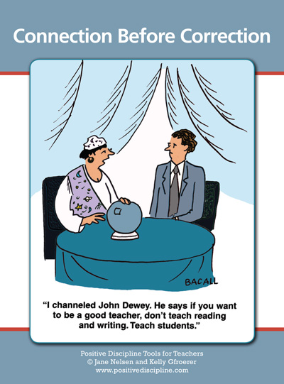
What is Social Emotional Learning? (2 of 2)

Slide 8
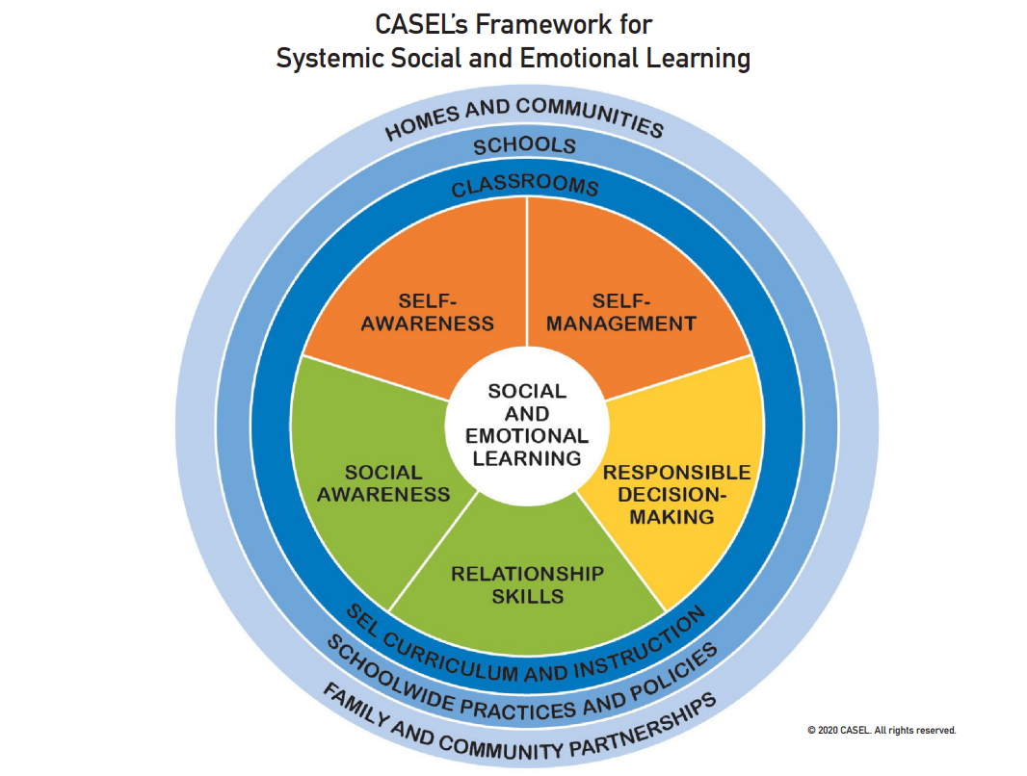
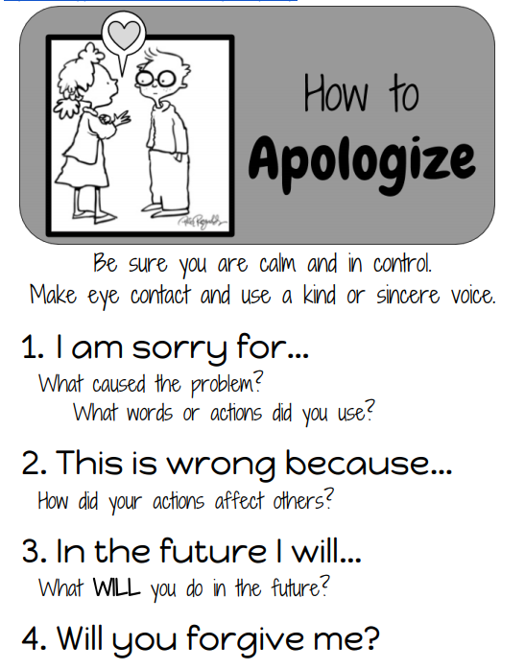
CASEL’s Framework for Systemic Social and Emotional Learning

Slide 9
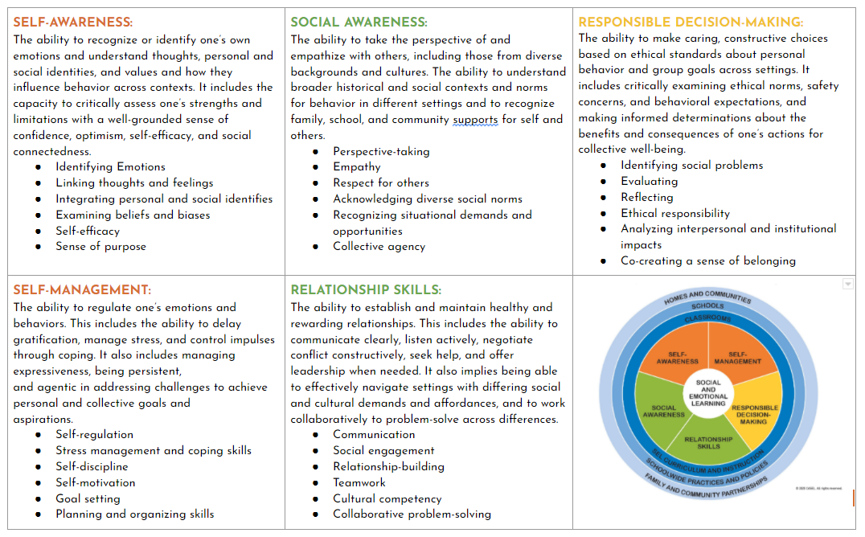
SEL Five Competencies

Slide 10
IMPACT ON STUDENTS
ATTITUDES | BEHAVIORS | SCHOOL PERFORMANCE
Better sense of community | More class participation | Improved math, literacy and social study skills
Higher academic motivation | Stronger pro-social skills | Higher achievement test scores (+14%) and higher grades (+11%)
Better understanding of consequences | Improved attendance | Improved metacognition skills
Better coping skills | Reduction in discipline referrals | Improved problem-solving, planning skills, and reasoning skills
Increased attitude toward school and learning | On track to graduate | Improvements in reading comprehension
Dvurlak, J. A., Weissberg, R. P., Dymnicki, A. B., Taylor, R. D. & Schellinger, K. B. (2011) The impact of enhancing students’ social and emotional learning: A meta-analysis of school-based universal interventions. Child Development, 82(a):405-432.

Slide 11
Impact on Teachers
IMPACT ON TEACHERS
Lower job related anxiety and depression (2)
Increased classroom student-teacher interactions (3)
Enhanced teacher engagement (4)
Increased perceived job control (5)
Reduction in teacher stress (6)
(2) Tyson, O., Roberts, C.9., & 0ane, R. (2009). Can implementation of a resilience program for primary school children enhance the mental health of teachers? Australian Journal of Guidance & Counselling, 19,116-130.
(3) Abry, T., Rimm-0aufman, S.E., Larsen, R.A., & Brewer, A.J. (2013). The influence of fidelity of implementation on teacher– student interaction quality in the context of a randomized controlled trial of the Responsive Classroom approach. Journal of School Psychology, 51,437-453.
(4) Castillo, R., Fernández-Berrocal, P., & Brackett, 9.A. (2013). Enhancing teacher effectiveness in Spain: A pilot study of The RULER approach to social and emotional learning. Journal of Education and Training Studies, 1(2).
(5) Zhai, F., Raver, C.C., Li-Grining, C.(2011). Classroom-based interventions and teachers’ perceived job stressors and confidence: Evidence from a randomized trial in Head Start settings. Early Childhood Research Quarterly, 26, 442-452.
(6) Greenberg, M. T., Weissberg, R. P., O’Brien, M. U., Zins, J. E., Fredericks, L., Resnik, H., & Elias, M. J. (2003). Enhancing school-based prevention and youth development through coordinated social, emotional, and academic learning. American Psychologist, 58(6&7), 466-474.

Slide 12
Nel Noddings Quote:
“At a time when the traditional structures of caring have deteriorated, schools must become places where teachers and students live together, talk with each other, and take delight in each other’s company.
My guess is that when schools focus on what really matters in life, the cognitive ends we now pursue so painfully and artificially will be achieved somewhat more naturally…
It is obvious that children will work harder and do things—even odd things like adding fractions—for people they love and trust."
~Nel Noddings

Slide 13
Creating an
Emotionally and Physically Safe, Supportive and Engaging Learning Environment
FIVE STEP APPROACH

Slide 14
Fostering Equity in the Classroom: Learning Environment
“Students have a right to grow in a space where they feel protected and encouraged. Learning happens through thoughtful inquiry, so in order to do this well, I must create a space where students know how to properly question and feel comfortable doing so. I model and explain clear classroom expectations: how we treat one another and the space in which we work; how we work effectively in groups; how we respond to someone when we disagree.
Without these first steps, it is difficult to have purposeful discussions during small group activities, Socratic seminars, or philosophical chairs. By the first quarter, students are responsible for our space and their learning, realizing that their voice matters and we must learn from one another and not simply the teacher.”
-Ayanna King

Slide 15
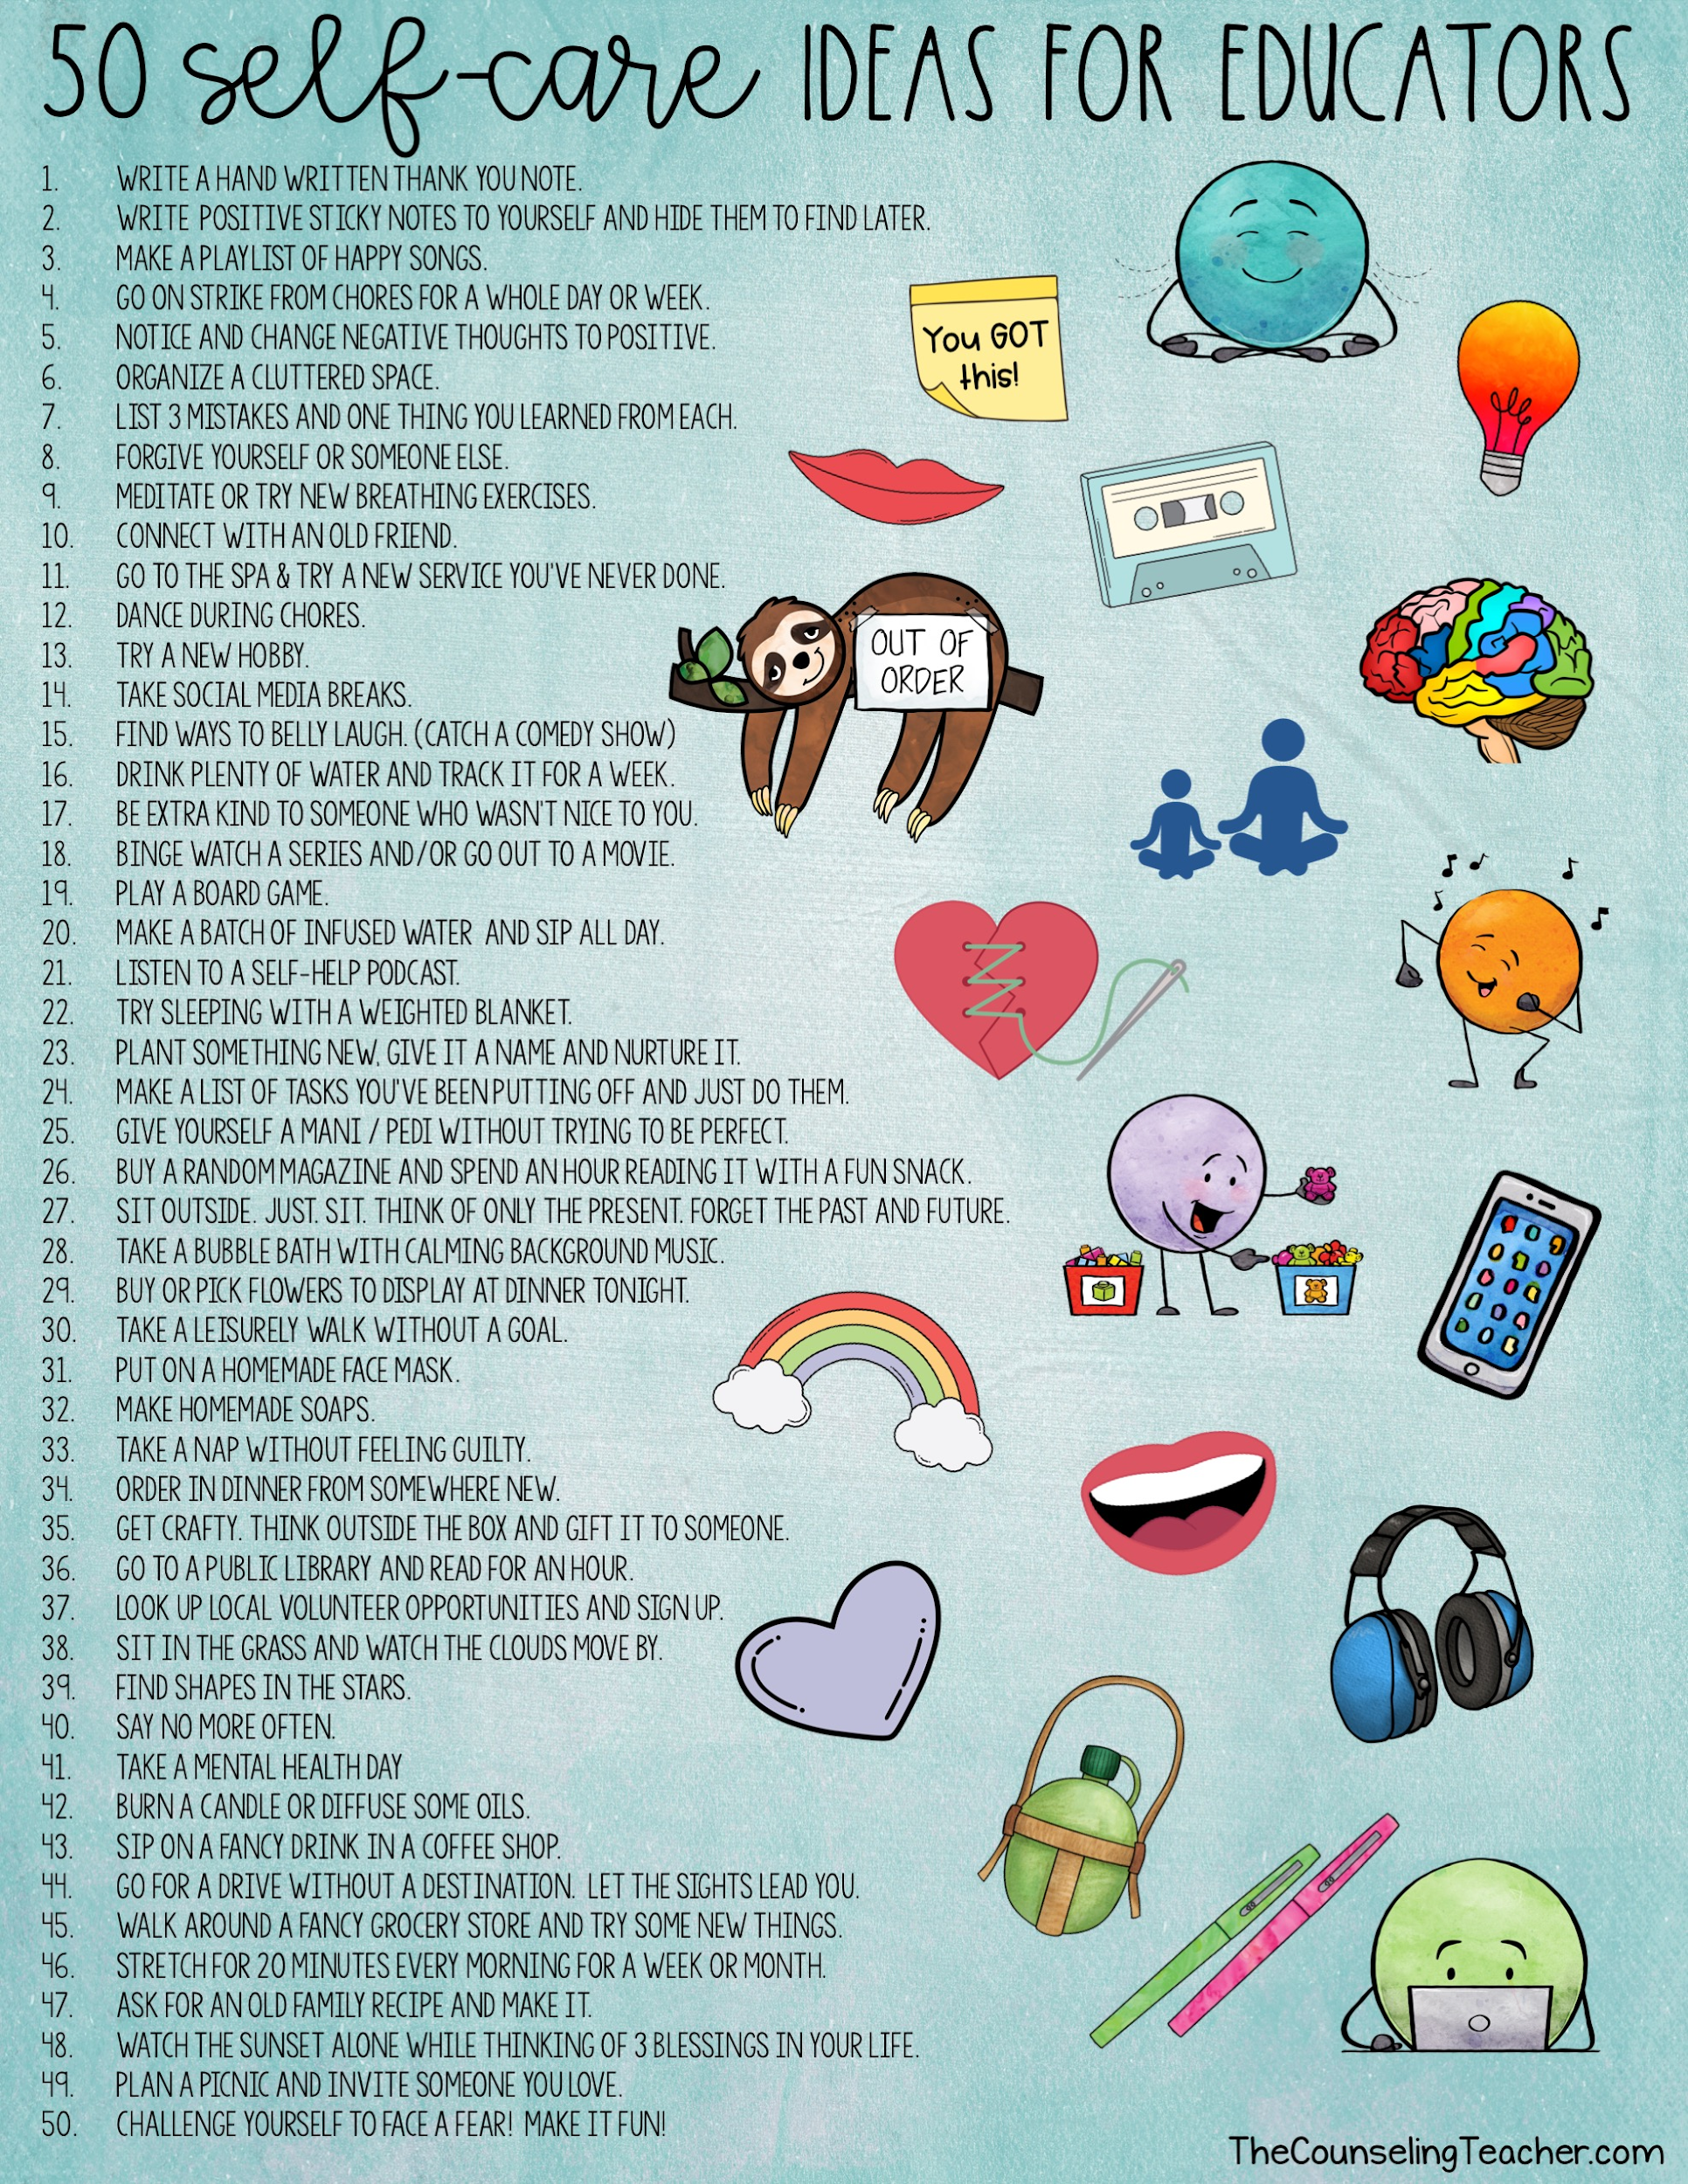
STEP #1:
Awareness
Take Care
Ask yourself:
How do I want to feel at school?
What do I need to be at my best for my students?

Slide 16
STEP #1:
Awareness
Take Stock,
“Simply put, if you want the kids to respect and use SEL, you can't just teach this stuff --
you have to live it."
- Dr. Maurice Elias
Self-Assessing SEL Instruction and Competencies- A Tool for Teachers
and/or
Empathy Self Assessment

Slide 17
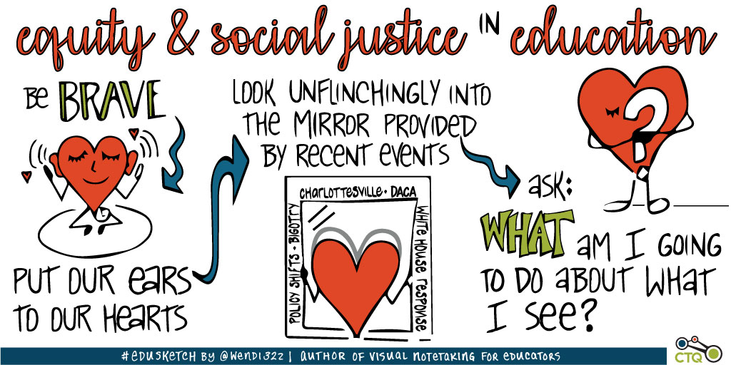
STEP #1: Awareness
Take Notice
5 Keys to Challenging Implicit Bias
CASEL:Guiding Questions for Educators: Promote Equity Using SEL
“The inside work is the hardest when the stakes are high and our habits of mind intractable.”
-Laurie Calvert
(I was a Racist Teacher and I Didn’t Even Know It)

Slide 18
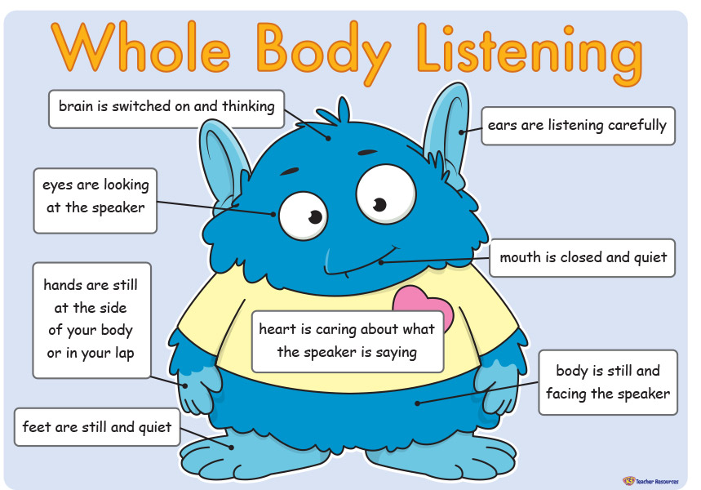
STEP # 2
Establish positive and predictable classroom environments.
Co-developed shared expectations or classroom routines that establish positive social norms
Example(s):
Use whole-body listening when someone is sharing with the class.
Digital Learning Agreement
K3 Teacher Resources

Slide 19
SLANT Listening
Video by Edutopia, George Lucas Educational Foundation

Slide 20
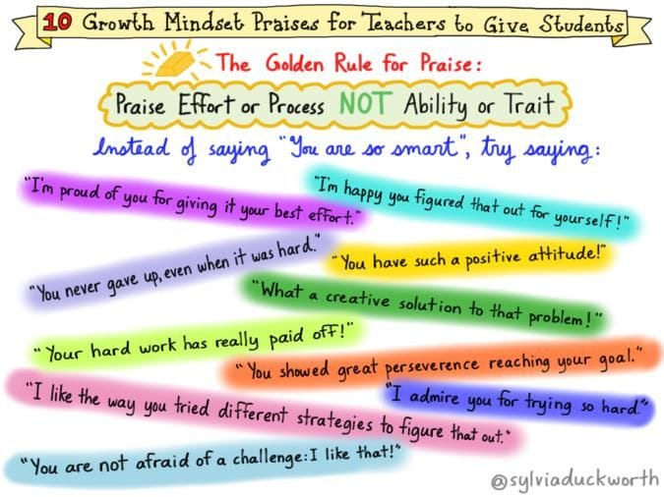
STEP # 2 (1 of 2)
Establish positive and predictable classroom environments.
Growth Mindset Practices…
Value: Effort
Persistence
Learning from Mistakes
Example:
Use process praise not person praise.

Slide 21
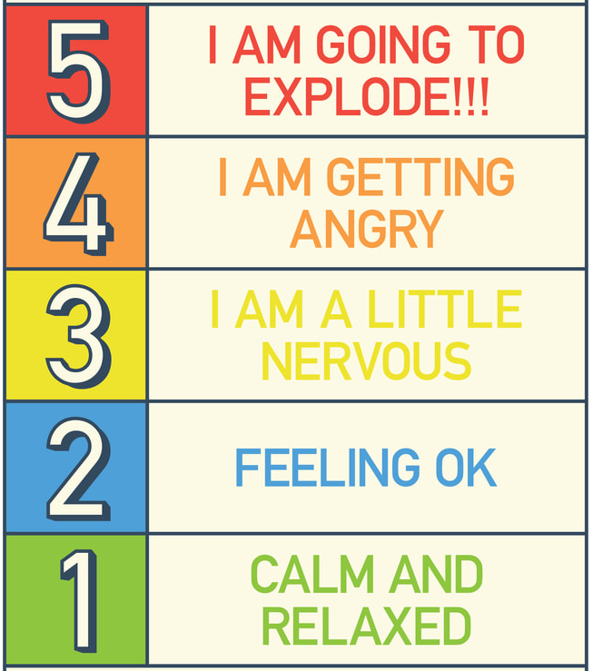
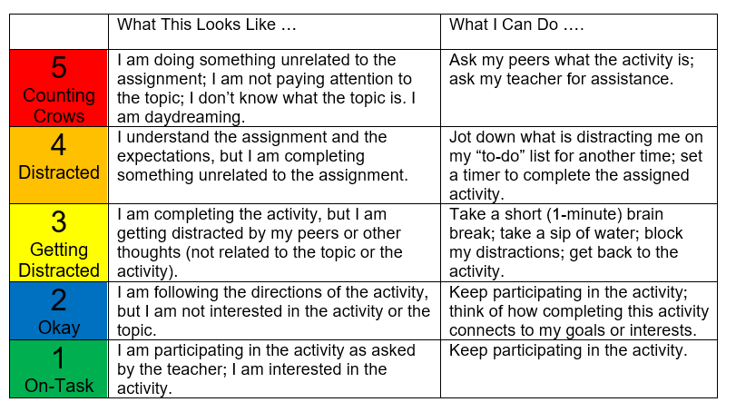
STEP # 2 (2 of 2)
Establish positive and predictable classroom environments.
Routines for Checking in Regularly with Students
Example:
The 5 Point Scale

Slide 22
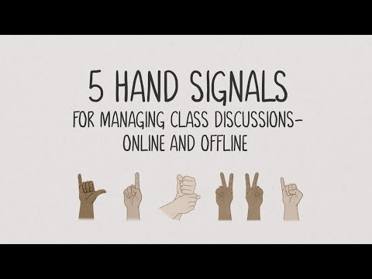
Hand Signals for More
Equitable Discussions
Video by Edutopia, George Lucas Educational Foundation

Slide 23
STEP # 3 (1 of 2)
Encourage positive teacher-student interactions and student-student interactions
Routines and regular opportunities for interactions that are taught and consistently used.
Example:
Greeting students by name as they enter the room.
-or-
Online Games to Get Your Class Engaged and Connected

Slide 24
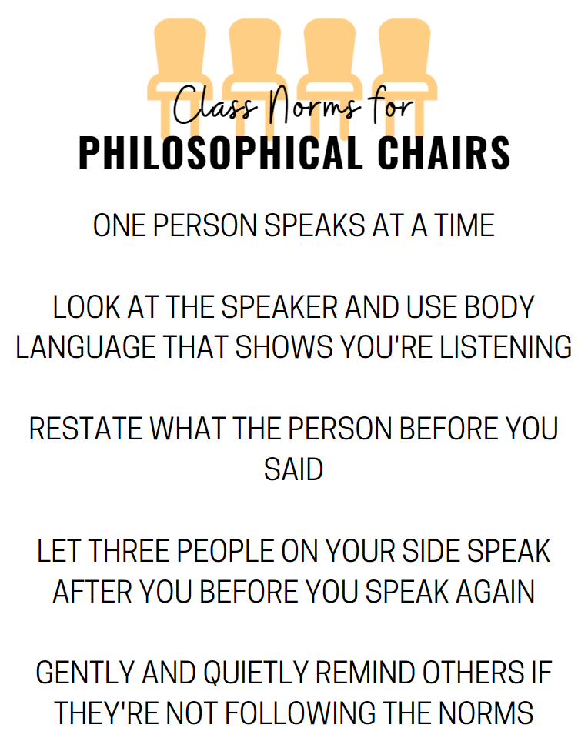
STEP # 3 (2 of 2)
Encourage positive teacher-student interactions and student-student interactions
Example:
Student Driven
Conversations
Philosophical Chairs
Socratic Seminar
(Newsela or CommonLit
is a great source for texts to drive conversations around current events or SEL)
Routines and regular opportunities for interactions that are taught and consistently used.

Slide 25
STEP # 4 (1 of 2)
Exclusive: Where did you go over Spring Break?
Inclusive: What was your favorite part of Spring Break?
Consider the needs, backgrounds, and experiences of all students.
Inclusive…
Questioning
Assignments
Statements
Visuals
Example:
Inclusive Questioning

Slide 26
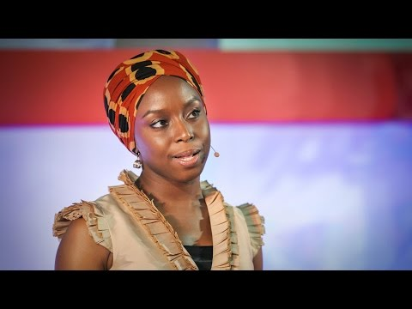
Ted Talk: Ideas Worth Spreading DANGER of a SINGLE STORY

Slide 27
STEP # 4 (2 of 2)
Consider the needs, backgrounds, and experiences of all students.
Take a close look at the texts you select.
Finding the courage to support queer youth
-Rich Ognibene

Slide 28
Use what you have
Using texts you may already have to address SEL topics

Slide 29
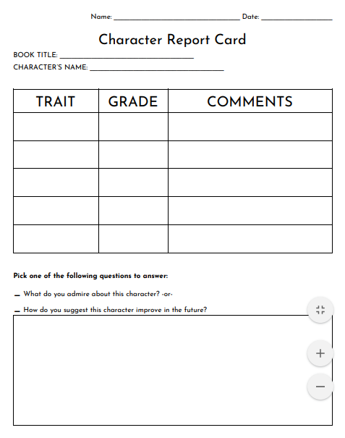
Character
Report Card

Slide 30
STEP # 5 (1 of 3)
Build relationships and get to
know your students.
What do they do in their free time?
What are their strengths?
Where do they live?
etc.
Example:
Learn about the apps they use.
Follow some of the same YouTubers they follow.
Create a class playlist (preview all requests) and play during transitions.
Notes:
Common Sense Media

Slide 31
STEP # 5 (2 of 3)
Build Relationships and
get to know your students!
What do they do in their free time?
What are their strengths?
Where do they live?
etc.
Example:
Focus on STRENGTHS.
Create an award for yourself assignment.

Slide 32
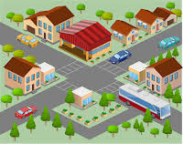
STEP # 5 (3 of 3)
Build Relationships and
get to know your students!
Incorporate elements of that community into the classroom.
Example:
Community Visits

Slide 33
Collaborate with your School Counselor
Ask them for their lesson plan topics so you can reinforce them afterwards.
If you notice a social/emotional need arising in your class ask for their help in addressing it.
If a lesson touches on a sensitive topic (either intentionally or accidentally) pull them in on how to best support students.

Slide 34
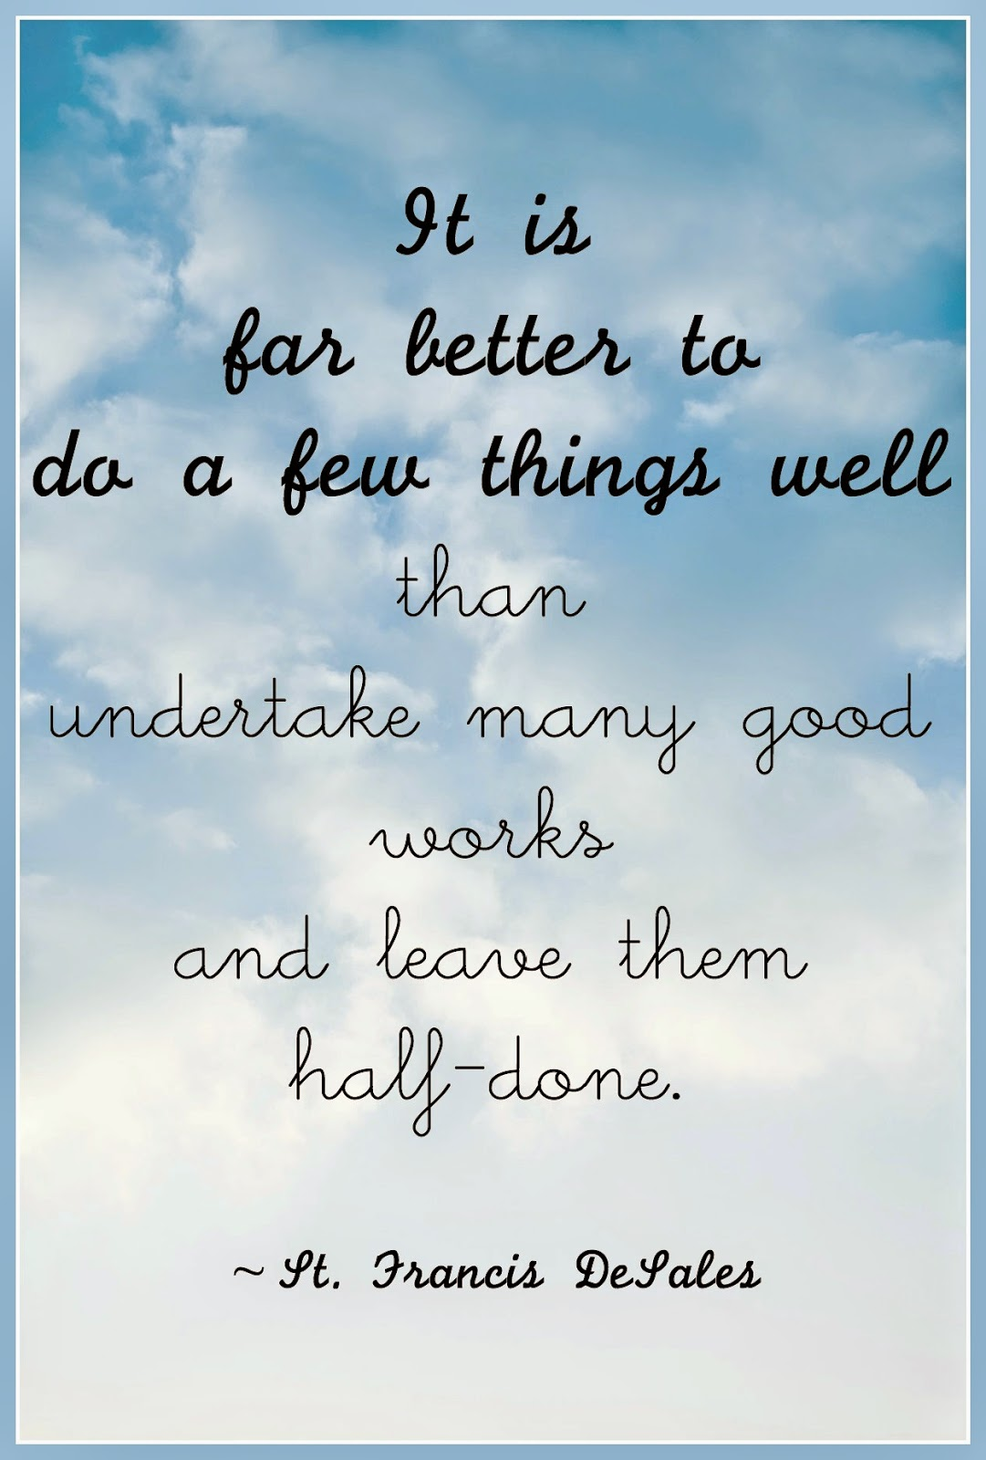
Closing Thoughts:

Slide 35
Padlet: Sarah Bazemore

Slide 36
Thank you!
I appreciate your feedback on the exit survey!
bit.ly/SELReadingFB1

Slide 37
Stay in Touch
Jill Nogueras
K-12 English Coordinator
Jill.Nogueras@doe.virginia.gov
Carmen Kurek
Elementary English/Reading Specialist
Carmen.Kurek@doe.virginia.gov
Colleen Cassada
Middle School English Specialist
Colleen.Cassada@doe.Virginia.gov

