Slide 1
Comprehensive Literacy Webinar Series
Reading in the Middle: Best Practices for 6-8

Slide 2
Questions from the Field
Chat Feature
Use the chat feature to pose any questions to the group.
We will collect these and add additional information as necessary to the presentation before slides are mailed out.

Slide 3
Agenda
Welcome and Introductions
National and State Focus Areas for Instruction
Practices that Support the 2017 English Standards of Learning
Instructional Resources

Slide 4
What Research Says- Best Practices for Success (1 of 3)
Incorporation of Disciplinary Literacy Instruction
Integration of Multiple and Social Literacies
Orchestration of Engagement and Motivation
Appreciation of Multicultural Perspectives and Cultures
A Call to Action: What We Know About Adolescent Literacy Instruction. (2018, July 17). Retrieved January 8, 2020, from https://ncte.org/statement/adolescentliteracy/.
Notes:
Academic reading requires specialized reading strategies to access complex texts. Teachers must model and show students how to read within different academic disciplines. When authors write for different audiences and purposes, their structures and styles change. It is important for content area teachers to model for students how to read and analyze text written for different content purposes.
Technology and social media has drastically changed the definition of literacy in the last few decades. “Text” comes in such a variety forms and we need to show students how to interact with all forms, to include bias, validity, credibility and also how to put different texts together to strengthen an argument or point.
Adolescent readers need sustained experiences with diverse texts in a variety of genres and structures. Opportunities for student choice and voice in independent reading and class reading increase motivation and engagement in text. This is something you will hear over and over again during today’s webinar- students need choice and voice in what they read in order to become lifelong readers.
Multicultural literacy is seeing, thinking, reading, writing, listening, and discussing in ways that critically confront and bridge social, cultural, and personal differences. Inclusion of culturally diverse texts allows for students to see themselves in text and embrace the similarities and differences of those around them. It is imperative that we offer students depth and breadth in their literacy development. Many of you have heard of the concept of texts as “mirrors, windows, and sliding glass doors.” How do students see themselves, identify and have empathy with others, and how can these texts act as bridges and doorways to access worlds that are different from our own?

Slide 5
What Research Says- Best Practices for Success (2 of 3)
What adolescent readers need:
Practice thinking critically about how they engage with texts to include
application of metacognitive strategies.
recognition of bias and high-quality sources.
argumentation with evidence.
Critical examination of texts that helps them to
recognize the purpose of text structure and how the writer uses it to create effect.
infer beyond literal interpretations.
question and investigate various social, political, and historical context.
understand multiple meanings and richness of texts and layers of complexity.
A Call to Action: What We Know About Adolescent Literacy Instruction. (2018, July 17). Retrieved January 8, 2020, from https://ncte.org/statement/adolescentliteracy/.
Notes:
Thinking about thinking- how often do we ask students to synthesize and determine which strategies will help them engage with and tackle a piece of text? We will only see this transfer happen when we ask students to think about a text on their own- not when their only experience with text is determined and dictated by the adults.
-To be successful community members, students need the space and time to learn how to recognize bias, credible sources, and how to determine when to believe what they read.
-text structure goes hand in hand with writing instruction. Again- writing instruction impacts reading comprehension.

Slide 6
What Research Says- Best Practices for Success (3 of 3)
Assessment that helps them to focus on
the larger purpose and big ideas of the curriculum, and on metacognitive strategies for thinking during literacy acts (Smith, 1991; Darling-Hammond & Falk, 1997; Langer, 2000).
preparation for assessment (from ongoing classroom measures to high-stakes tests) that should focus on the critical components of multicultural perspectives, motivation, multiple and social literacies, and shifting literacy demands.
Choice and volume of reading
Opportunities to read often from books of their own choosing
Access to a vast library of books and texts that vary in levels and text structures (Miller, 2009)
Dedicated time to read every day (Allington, 2009)
A Call to Action: What We Know About Adolescent Literacy Instruction. (2018, July 17). Retrieved January 8, 2020, from https://ncte.org/statement/adolescentliteracy/.
Notes:
-Access to books- at school, at home, in the community. What does this look like? What opportunities do we have to increase access or get the word out about the importance of access to books?
-Dedicated time to read in school every day. Donalyn Miller reminded us just this weekend that students are not going to go home and suddenly decide to read on their own if it isn’t something they are doing at school. We need to promote time for students to be in text of their choosing daily.

Slide 7
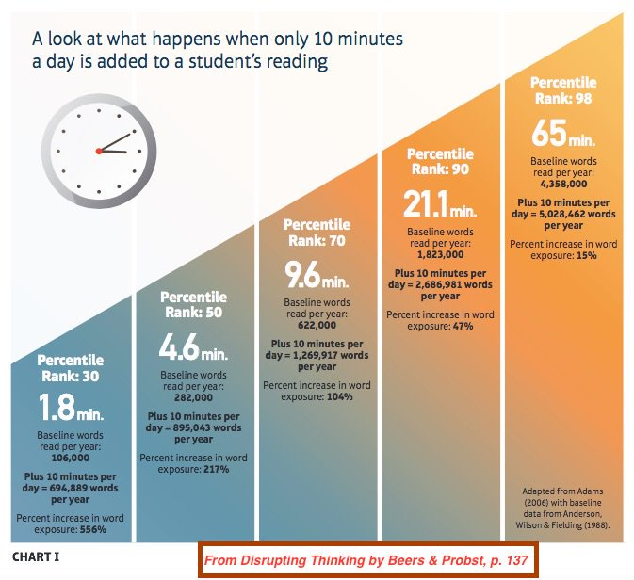
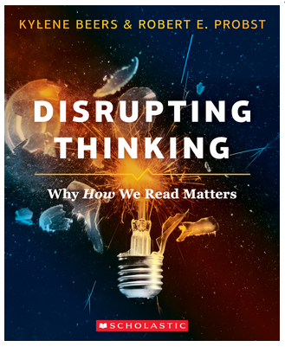
Impact of reading time on student performance

Slide 8
Building Relationships to Build Better Readers
Know your students, know their interests… engagement matters
Cognitive research indicates that the use of highly engaging texts selected to fit students’ interests aids comprehension and increases self-efficacy in reading because students learn more and comprehend better when they have the context that comes with interest in the text (Willingham, 2013).
Create a balance between whole group texts and student-selected
“Students need both content specific reading but also need the exploration of texts beyond the content. If a student enjoys to pleasure read graphic novels we should not dissuade that student from choosing them. Rather, we should support them while still exposing them to content specific passages and texts” (Fisher, Hattie & Frey, 2016).
Notes:
Skills based course- we have the opportunity to build units of study around essential questions that require students to critically think about a topic that resonates with them. They can learn to summarize, draw conclusions, analyze text structure, organization and author’s purpose from any text. Variety is the key- we can always include whole class selections- a poem, an article, a chunk of a book- but what are they in when they read independently in our classes and how can we tap into their natural curiosity to help scaffold and support their learning and independence?

Slide 9
Position Statement on the Value of Independent Reading in the School Library Program
The following position statement is currently under review to align with the National School Library Standards.
To become life-long readers, students must have . . .
access to current, quality, high interest, and extensive collections of books and other print materials in their school libraries, classrooms, and public libraries;
contact with adults who read regularly and widely and who serve as positive reading role models;
certified school librarians and classroom teachers who demonstrate their enthusiasm for reading by reading aloud and book talking;
time during the school day dedicated to reading for pleasure, information, and exploration;
opportunities specifically designed to engage young people in reading;
schools that create an environment where independent reading is valued, promoted, and encouraged; and
opportunities that involve care givers, parents and other family members in reading.
(adopted June 1994; revised July 1999, September 2010)

Slide 10
Best Practices
2017 English Standards of Learning

Slide 11
Summary of Changes in the 2017 English Standards of Learning
Alignment with the 5 Cs: Critical Thinking, Creative Thinking, Communication, Collaboration, and Citizenship
Alignment to the applicable VA Workplace Readiness Skills
Reorganization of K-3 to align with 4-12
Expansion of technical reading & writing in grades 9-12

Slide 12
Pairing Literary and Informational Nonfiction Texts- Grades 4 & 5
Creation of standards requiring students to compare/contrast details between literary fiction and informational nonfiction texts
Students will:
  Analyze similarities and differences between paired fiction and nonfiction texts
  Texts can be paired based on similar themes, topics, or patterns of events
  Pairings can include books, articles, poems, media, or graphics
Notes:
The opportunity for paired texts also provides the option to allow choice and voice with our required classroom readings.

Slide 13
Focus on the Writing Process (1 of 2)
Emphasis on ethical use of the Internet when gathering and using information (Grades 3-12)
Writing process increases in complexity and rigor as students progress through K-12
  Kindergarten = narrative and descriptive
  Grade 1 = narrative, descriptive, and opinion
  Grade 2 = narrative, descriptive, opinion, and expository
  Grade 3 = narrative, descriptive, opinion, and expository
  Grade 4 = narrative, descriptive, opinion, and expository
  Grade 5 = narrative, descriptive, expository, and persuasive

Slide 14
Focus on the Writing Process (2 of 2)
Introduction of a focus on a mode of writing at each grade level:
  6th- narrative & reflective
  7th & 8th – expository & persuasive
  9th & 10th – persuasive & analytical
  11th & 12th – persuasive & argumentative

Slide 15
Strands of the 2017 English Standards
The strands of the 2017 English Standards:
  Communication & Multimodal Literacies
  Reading
  Writing
  Research
  The goals are to teach students to read, write, research and communicate. The strands are developed separately, but expected to be seamlessly integrated in the classroom. Through the rigorous application of the English Standards of Learning, students become critical thinkers, effective contributors, and global citizens.

Slide 16
The Spiraling of Skills
The concepts, skills, and content in English Language Arts spiral; teachers should note each grade level builds skills that carry to the following grades. Each grade level within the English Curriculum Framework builds from kindergarten through grade 12, creating a comprehensive instructional tool, which prepares students for success in future postsecondary education and the workplace. Teachers should review the Curriculum Framework for the scope of learning in each of the strands in previous grades and in the grades to follow.

Slide 17
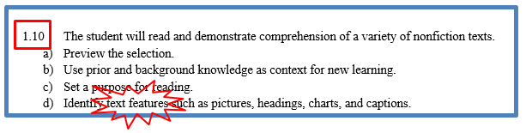
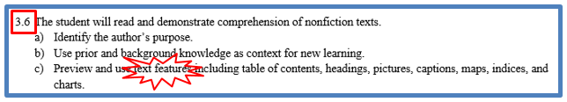




Vertical Articulation of Standards
Notes:
Nonfiction Example: Overarching standard- The student will read and demonstrate comprehension of a variety of nonfiction texts.
In 1st grade students must identify text features
In 3rd grade they must be able to identify but also use them to demonstrate comprehension of nonfiction text
By the time students are in 5th grade they should be able to use text features to predict and categorize information (This is a shift- we are using text features to do something else- the purpose has changed so we need to focus our attention on the second half of the standard. We are using our knowledge of text features to do something else)
10th grade continues to build on this and students must be able to analyze text features and organizational patterns to evaluate the meaning of text (think of knowledge of text features as one tool in a toolbox- we are pulling what we know about text feature to evaluate the text. We spend much of elementary school adding tools to the toolbox so that we may use those tools to do other things in secondary English)
Moving beyond the identifying and using text features stage is crucial for students to be successful with this skill as it spirals through elementary, middle, and high school.

Slide 18

Seamless Integration of
English Strands
Reading
Writing
Research
Communication/ Multimodal Literacies

Slide 19
Read! Read! Read!
Students need opportunities to read daily.
Students need to read extended pieces of text and grade level material.
All students need opportunities to read grade level text daily, including nonfiction and fiction pieces.
Schools should provide students with opportunities to read and compare paired passages (fiction and nonfiction) on the same topic as appropriate.
When students are analyzing ideas in two texts and searching for textual evidence to support their conclusions, they are engaging in deeper learning and thinking critically.

Slide 20
Successful English Instruction
Integrate the strands
  Reading
      Specific vocabulary from authentic texts
      Both fiction & nonfiction text
      Text-rich environment with variety of text and media
      Student choice whenever possible
  Writing
      Writing as a process for a variety of authentic purposes
      Regular writing conferences
      Use of writing portfolios
  Research
      Ongoing and embedded in the learning process (when applicable)
  Communication/Multimodal Literacies

Slide 21
Successful English Instruction
Best Practices
  Use of text-dependent questions
  Use of inference questions
  Use of text-based vocabulary
  Response to reading
  Writing components in every lesson
  Frequent research components

Slide 22
Paired Texts and Text Sets
Paired texts can include books, plays, articles, poems, functional text, graphics, or digital media
Focus on a common theme or topic that fits history and social science or science content
Compare and contrast texts to increase the level of thinking

Slide 23
Integration of Skills
Choose a theme or topic
Choose a variety of text and media options
Incorporate all strands during the unit
Select standards to introduce or review
Think about your students – What will interest them?
Provide opportunities for shared and independent reading
Model the writing process and meet with students for writing conferences

Slide 24
Unit Plan Reflection
* Did the materials thematically link genres and texts together for maximum impact?
* Did the experiences provide an opportunity for students to think critically?
* Were students given the opportunity to demonstrate their understanding of the material and apply the skills?
Hidden Camera Social Experiment Proves Most People Are Sheep

Slide 25
The Reading/Writing Connection
Use mentor texts to read like a writer and write like a reader
  Imitate an author’s style and structure
  Appreciate the author’s craft
Incorporate daily writing
  A warm-up prior to beginning a unit of study
  Incorporate writing into formative assessment
  After a thought provoking reading, discussion, or class experiment, students write their thoughts
Find authentic writing opportunities
  Blogging or social media connections
  Professional writing
Notes:
Writing can and should be integrated in all reading and all contents.

Slide 26
The Forgotten “R”
The elimination of the grade 5 Writing SOL assessment threatens writing/research instruction
Writing, like reading, is a life skill and should be included in all curricular areas.
How much writing does your job require?

Slide 27
Assigned vs. Taught
Students select their own topic, purpose, and audience
Teacher time is spent in class teaching writing skills and strategies
Students use models and strategies to complete each assignment
Students move through the recursive process
Students write only on teacher selected topic, purpose and audience
Students are given a task without the instruction on how to complete it successfully
Minimal improvement in writing
Students rewrite only to correct errors in usage and mechanics
Because Writing Matters by Carl Nagin
The National Writing Project
Notes:
There is a great difference between assigning writing and teaching writing. Although all students can write, direct instruction by the teacher is needed to develop an awareness of good writing and the skills needed to create it.
Direct instruction of concepts such as audience and purpose and skills such as revision can be followed by student choice and reflection. Then as the writing begins, the instruction continues with teacher modeling.

Slide 28
When writing is taught…
Teachers model by
  Writing with the students
  Revealing the hard work of writing
  Thinking aloud through revision of their writing
  Editing only after revision is complete
Notes:
Modeling is one of the most effective instructional strategies and that is true in writing as well as other areas. Teachers should write as students are writing and then model the steps in the writing process, fine tuning the modeling to meet the students’ needs. If composing is the weakest area then the teacher might conduct a think aloud through the process of selecting main ideas and developing organization and elaboration. If first drafts are generally solid but revision is lacking, then the teacher can model strategies such as developing sentence variety or replacing bland language for more vivid vocabulary.

Slide 29
Unit Layout Suggestion to create a flow between reading and writing
Writing:
Writing focus that connects with the SOL/objective, content and assessment.
Format of writing: Narrative, expository, informal or formal
Mentor text to use
How will you connect the text from reading?
Mini lessons
Reading:
Choose SOL strand, objective, content and assessment.
Choose resources: Novel, short stories, poems, nonfiction. Read aloud text.
Whole group, literature circles, small group, individual choice.
Mini lessons

Slide 30
Virginia Department of Education
Available English Resources

Slide 31
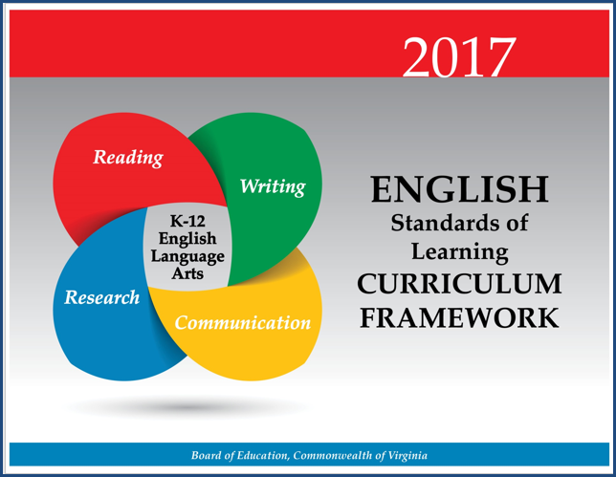
2017 English Curriculum Framework

Slide 32
2017 Curriculum Framework (1 of 4)
The 2017 English Standards of Learning are expanded by the Essential Knowledge, Skills, and Processes (EKSP) in the Curriculum Framework
  This is not meant to be an exhaustive list, nor one that limits what is taught in the classroom
  The EKSP is not a one-to-one match of the standards
  If the standard is self-explanatory, there will be no additional explanation

Slide 33
2017 Curriculum Framework (2 of 4)
Overview of strand on Strand Introduction page
Teacher Notes appear on Introduction page
Suggested Instructional Strategies and Best Practices are on Teacher Notes page
First column Understanding the Standard has been deleted and that information moved to introduction page
CF Columns: Essential Understandings & Essential Skills, Knowledge, and Processes

Slide 34
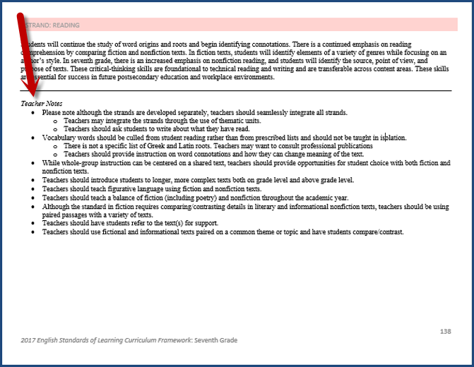
2017 Curriculum Framework (3 of 4)

Slide 35
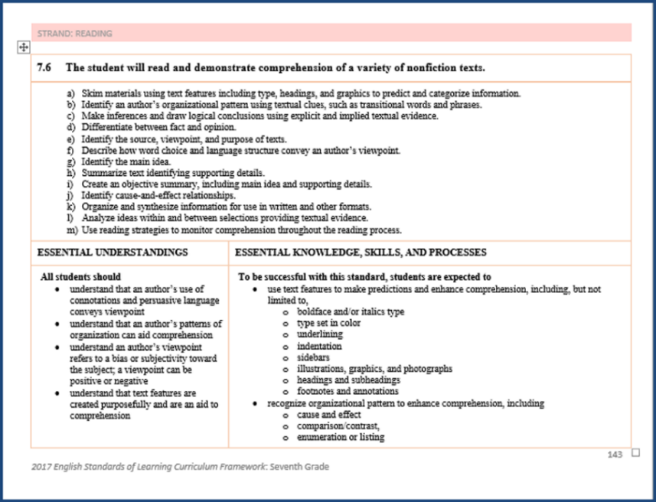
2017 Curriculum Framework (4 of 4)

Slide 36
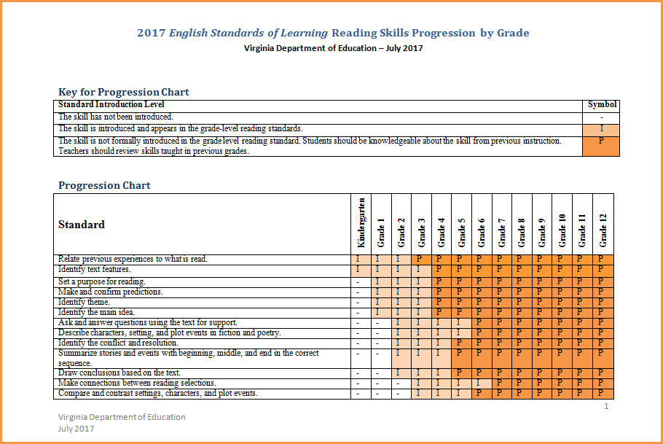
2017 SOL Progression Charts

Slide 37
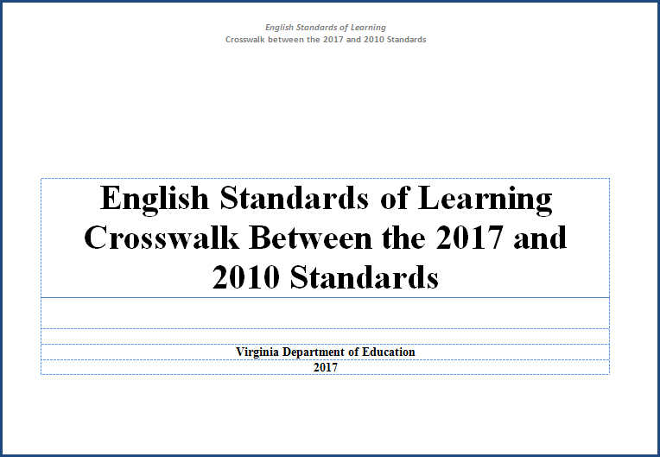
2017 SOL Crosswalk

Slide 38
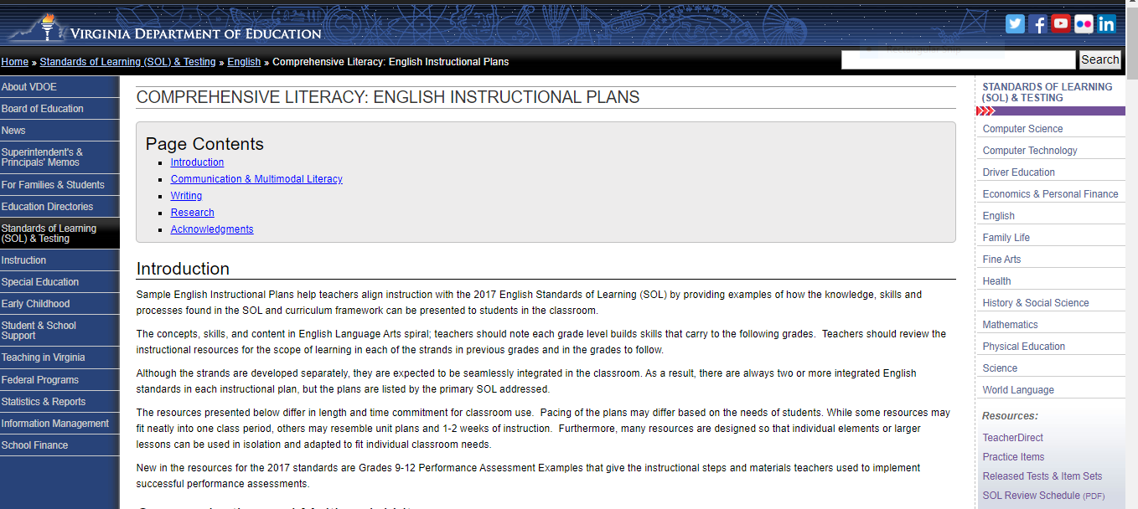
Resources that Align with the 2017 SOL
Comprehensive Literacy: English Instructional Plans
VDOE English Instructional Plans

Slide 39
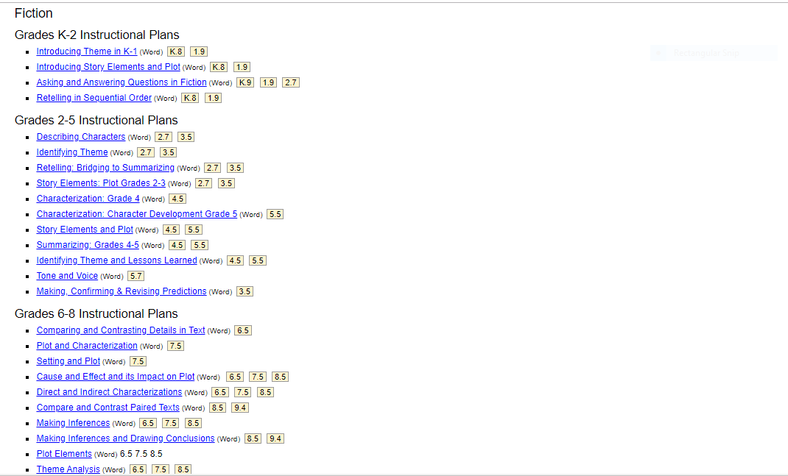
Comprehensive Literacy: English Instructional Plans

Slide 40
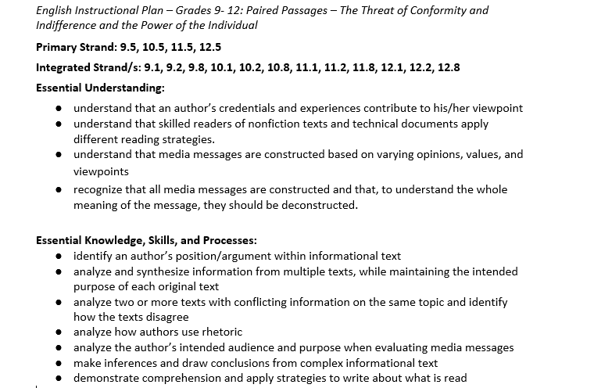
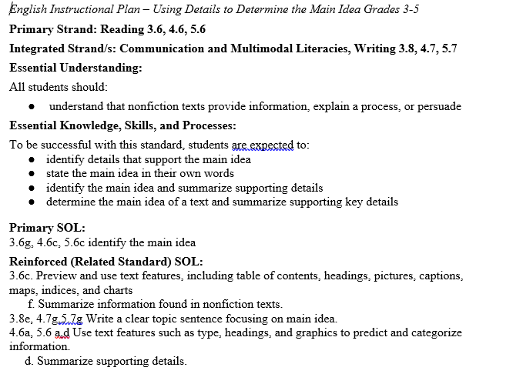
English Instructional Plan Samples

Slide 41
Additional Instructional Approaches
I feel like I don’t have time. How can I make time for meaningful reading and writing instruction?

Slide 42
Bridge the Gap to Adolescent Literacy
Use content area Standards of Learning as support
Work with other content teachers
Allow for student choice
No rigid reading or writing list
U

Slide 43
Integrating History and English Content
What’s your why?

Slide 44
Because the guidelines encourage it…
Superintendent’s Memo 025-19, Attachment A
“1. incorporate options for age-appropriate, authentic performance assessments and portfolios … 2. permit and encourage integrated assessments that include multiple subject areas
The legislation encourages integrated assessments that include multiple subject areas. For example, a local assessment might address content from both U.S. History I and 6th Grade English.

Slide 45

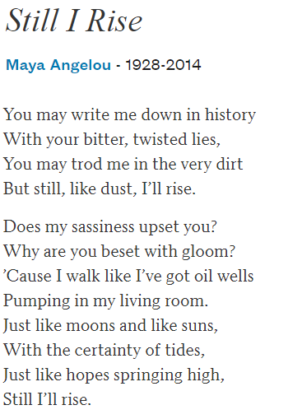

Because I don’t have time to teach history the way I want…
Courage, Bravery, and Local History
What does it mean to have courage?
How do people show they are brave?
Notes:
You can design entire units around a theme like courage or bravery, focus on historical content rooted in that theme and choose texts that help present the theme in different modes. Reinforcing theme as something that appears across contents will help students make these connections on their own.

Slide 46
Paired Texts: U.S. History 1865 – Present (1 of 2)
“What Everybody Knows Now” by Jacqueline Woodson
Even though the laws have changed
my grandmother still takes us
to the back of the bus when we go downtown
in the rain. It's easier, my grandmother says,
than having white folks look at me like I'm dirt…
I look around and see the ones
who walk straight to the back. See
the ones who take a seat up front, daring
anyone to make them move. And know
this is who I want to be. Not scared
like that. Brave
like that.
Still, my grandmother takes my hand downtown
pulls me right past the restaurants that have to let us sit
wherever we want now. No need in making trouble,
she says. You all go back to New York City but
I have to live here.
Source: PoetryFoundation.org
On July 16, after visiting her mother, Ethel Amos, in Hayes Store, Gloucester County, Morgan boarded a Greyhound bus en route to Baltimore.
Near Saluda, in Middlesex County, about twenty-six miles northwest of Hayes Store, two white passengers boarded the already crowded bus, and the driver asked Morgan and an African American woman with an infant to give up their seats. According to later court documents, "There were two vacant spaces upon the long rear seat, and six white passengers were standing. The bus driver requested [Morgan] and her seatmate … to change their seats and occupy the two vacant spaces on the rear seat." When Morgan refused, and even attempted to prevent the other woman from complying, the bus driver drove to the jail in Saluda.
Source: Encyclopedia Virginia
Notes:
If you don’t have time for an entire unit or even time in your own class, partnering with history colleagues to provide prose and poetry that supports the historical themes and topics they’re tackling increases the texts to which students are being exposed and creates a natural interdisciplinary chance for students to practice with paired passages.

Slide 47
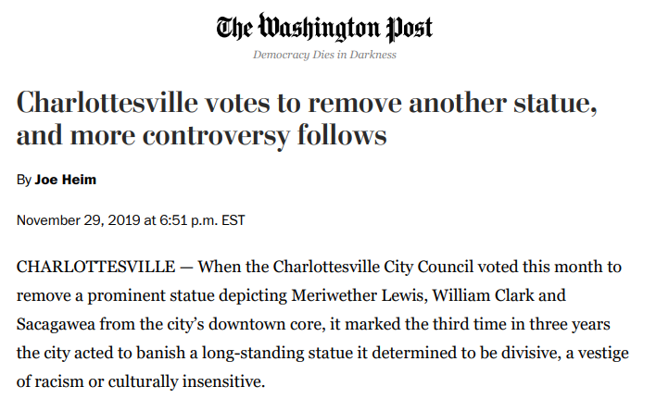

Paired Texts: U.S. History 1865 – Present (2 of 2)
Excerpts from the Journals of Lewis and Clark on Sacagawea source: Lewis and Clark Bicentennial Exhibition
The Corps was several days upriver from Fort Mandan. “When we halted for dinner the squaw busied herself in serching for the wild artichokes which the mice collect and deposit in large hoards. this operation she performed by penetrating the earth with a sharp stick about some small collections of drift wood. her labour soon proved successful, and she procured a good quantity of these roots.” —Meriwether Lewis, April 9, 1805
A sudden wind squall had caught the crew of the pirogue by surprise and water filled the boat. “By 4 oClock in the evening our Instruments, Medicine, merchandize provision &c, were perfectly dryed, repacked and put on board the perogue. the loss we sustained was not so great as we had at first apprehended… the Indian woman to whom I ascribe equal fortitude and resolution, with any person onboard at the time of the accedent, caught and preserved most of the light articles which were washed overboard” —Meriwether Lewis, May 16, 1805

Slide 48
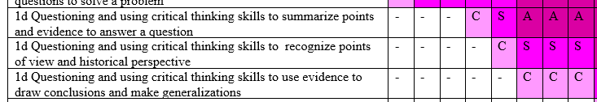
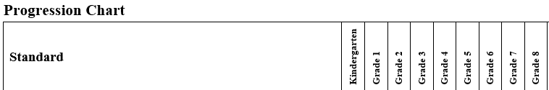
Because I want my students to think and write like historians…

Slide 49
Research
A Call to Action: What We Know About Adolescent Literacy Instruction. (2018, July 17). Retrieved January 8, 2020, from https://ncte.org/statement/adolescentliteracy/.
Beers, G. K., & Probst, R. E. (2017). Disrupting thinking: why how we read matters. New York, NY: Scholastic Inc.
Fisher, D., Frey, N., & Hattie, J. (2016). Visible learning for literacy. Thousand Oaks, CA: Corwin.
"Position Statement on the Value of Independent Reading in the School Library Program", American Library Association, September 27, 2006. http://www.ala.org/aasl/advocacy/resources/statements/ind-reading (Accessed January 8, 2020)
Willingham, D.T. (2013). Why don’t students like school? San Francisco: Jossey-Bass.

Slide 50
VDOE Disclaimer
Reference within this presentation to any specific commercial or non-commercial product, process, or service by trade name, trademark, manufacturer or otherwise does not constitute or imply an endorsement, recommendation, or favoring by the Virginia Department of Education.
Reference within this presentation to any specific commercial or non-commercial product, process, or service by trade name, trademark, manufacturer or otherwise does not constitute or imply an endorsement, recommendation, or favoring by the Virginia Department of Education.

Slide 51
Stay Connected
Jill Nogueras
K-12 English Coordinator
Jill.Nogueras@doe.virginia.gov
Carmen Kurek
Elementary English/Reading Specialist
Carmen.Kurek@doe.virginia.gov
Taylor Snow
English/History & Social Science Specialist
Taylor.Snow@doe.Virginia.gov
Assessment Office
Student_Assessment@doe.virginia.gov

