Slide 1
Comprehensive Literacy Webinar Series
PALS

Slide 2
Questions from the Field
Chat Feature
Use the chat feature to pose any questions to the group.
We will collect these and add additional information as necessary to the presentation before slides are mailed out.

Slide 3
Agenda
Explore purposes for examining PALS Mid-Year data
Examine PALS Mid-Year reports and data
Learn about some PALS reports and resources to inform and monitor instruction
Learn about upcoming professional development learning tools to support data analysis and knowledge building

Slide 4
Use and purpose of Mid-Year PALS Data
Mid-Year PALS
Evaluate the effectiveness of instruction
Inform instruction
Assess/Evaluate student growth
Maximize use of PALS resources
Fill in data gaps
Monitor student development relative to end or year expectations

Slide 5
Mid-Year Ranges
Kindergarten
The majority of K students falling within these ranges ended up reading on or above grade level at the end of 1st grade.
1st Grade
The majority of students reading on or above grade level at the end of first grade were reading within these ranges at midyear of first grade.
This does NOT mean that if children are within these ranges at midyear that they will be reading on or above grade level six months later.
Instruction matters!
Second Grade
The majority of students reading on or above grade level at the end of second grade were reading within these ranges at midyear of second grade.

Slide 6
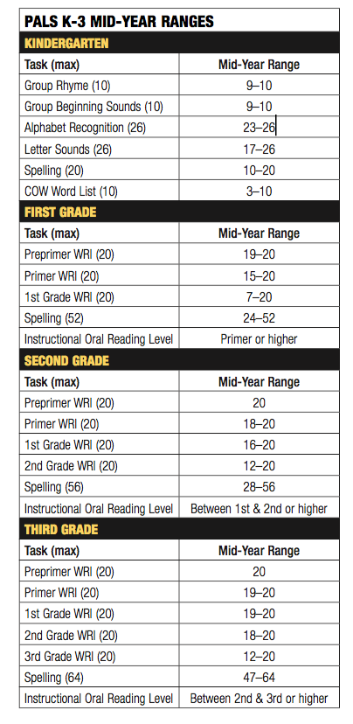
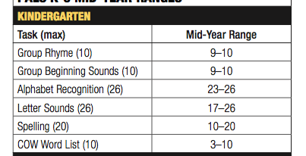
Mid-Year Ranges
PALS 1-3
PALS K

Slide 7
PALS K-3 Yearly Progress:
Understanding Growth
A Year’s Growth
in
a Year’s Time
+
When
needed,
Catch-Up
Growth

Slide 8

Setting Goals
Guiding questions...Be as specific as possible and look at individual tasks!
  Where did the student start the year and where are they now?
  Would you consider that sufficient growth so far this year?
  Is there a particular area of literacy development on which you should focus more intensely in order to get them to achieve their goals?

Slide 9
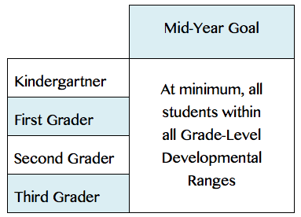
PALS K-3 Mid-Year Goal:
Within or Above Grade-Level
Developmental Ranges

Slide 10
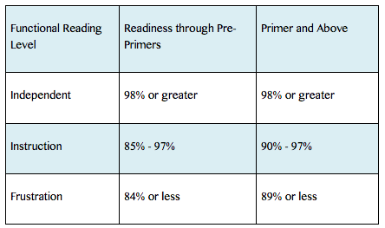
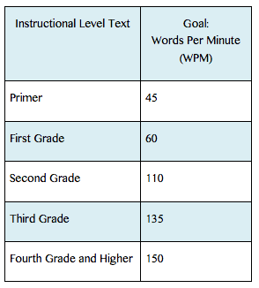
Passages
Accuracy ranges
Rate Goals
Prosody
Expressive, phrasal reading
Stress
Tone
Rhythm
Intonation
Expression

Slide 11
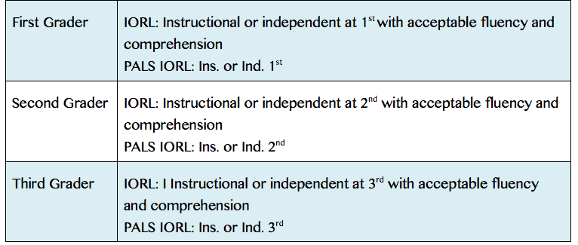
PALS 1-3 Spring Goal Examples for “typically” developing students

Slide 12
Additional Reports to Help Examine Student Growth
Individual Student History Reports
Individual Oral Reading Growth Reports 1-3
Individual Student Spelling/Phonics Report 1-3
Individual Task Growth Reports

Slide 13
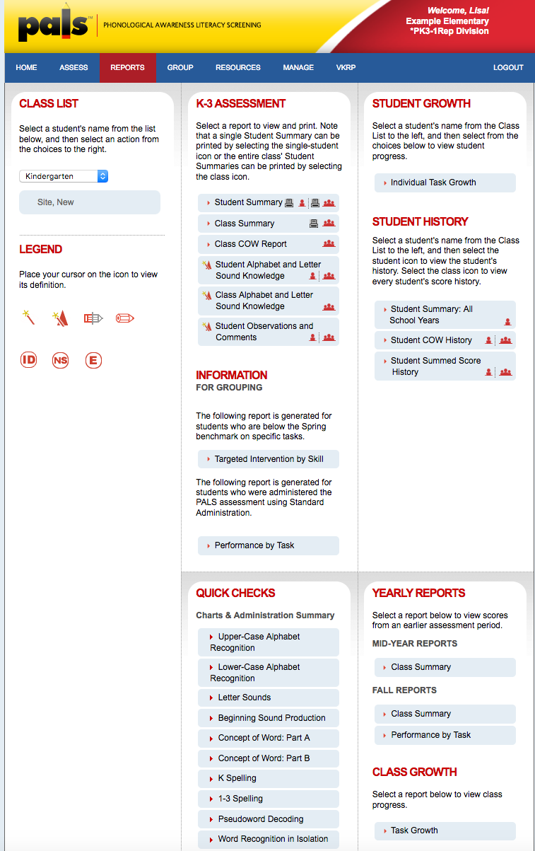
Student History Reports
Reports Tab
Student Summary History;
All School Years
Student COW History
3. Student Summed Score History

Slide 14
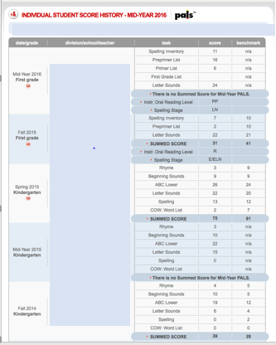
Analyze Student History
1. Did the student meet the Summed Score benchmark in the fall of kindergarten?
2. Did the student leave kindergarten with a firm Concept of Word?
3. Do you think this student has made adequate growth so far in first grade?
4. If necessary, did the student make any catch-up growth?
5. What else do you notice?

Slide 15
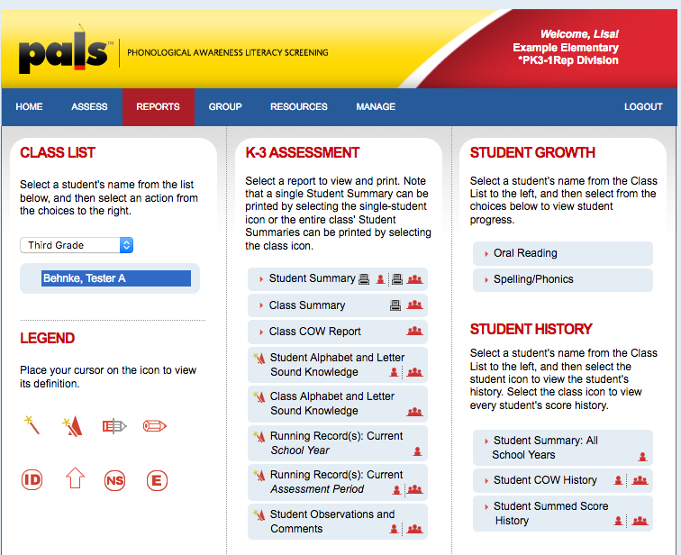
Individual Growth Reports
Reports tab
Student Growth Reports
Oral Reading
Spelling/Phonics
Notes:
Here you see the Individual growth reports that are available. They are again, on the Reports tab (CLICK). And there are two diff ones available... CLICK, Oral R and Sp/Ph. We will look at each of these reports in more detail in a minute.

Slide 16
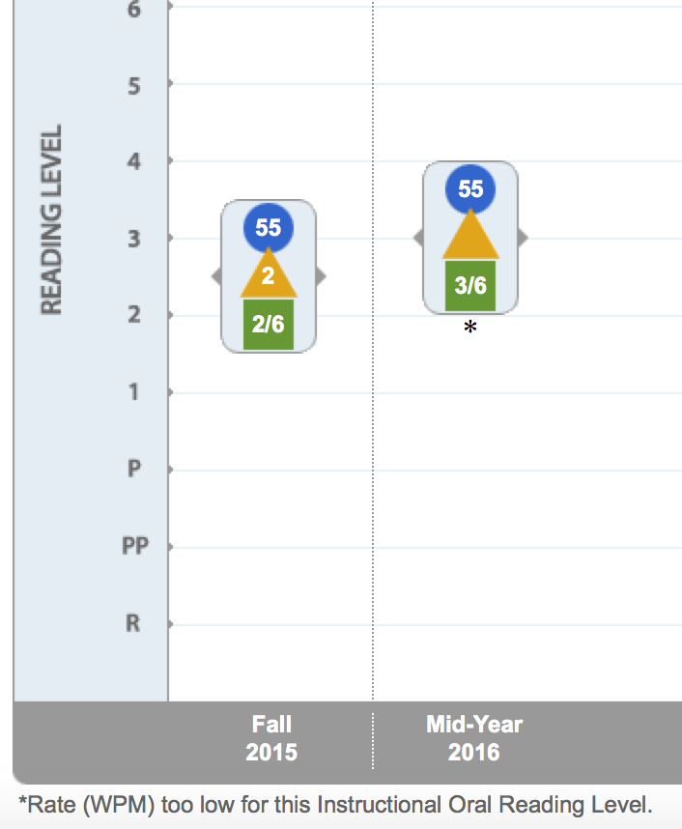

First Grader’s
Individual
Oral Reading Growth Report

Slide 17
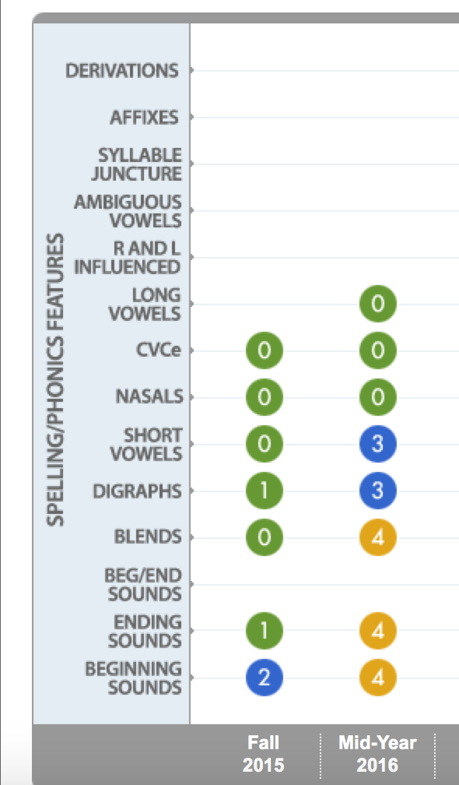

First Grader’s
Individual
Student
Spelling/Phonics Growth
Report

Slide 18
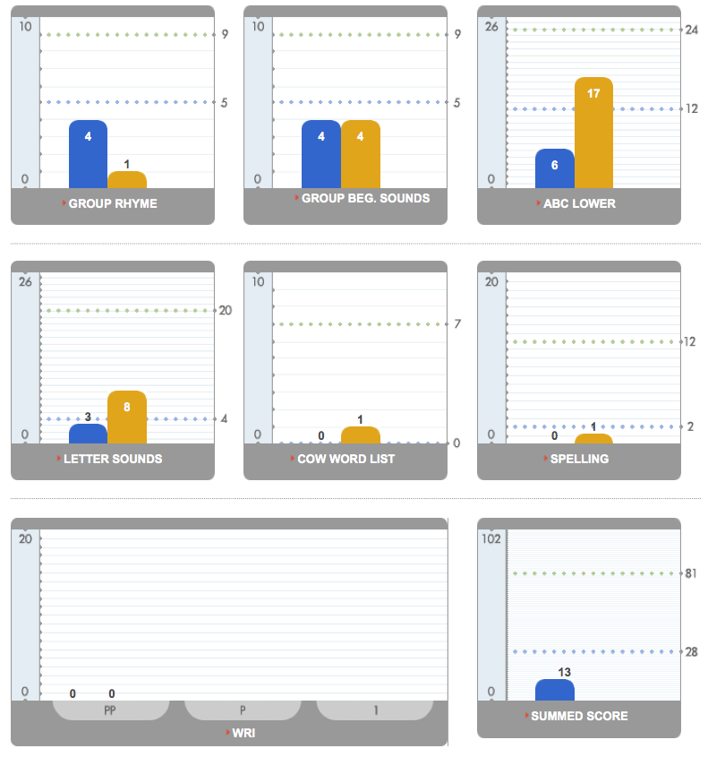

Kindergartener’s
Individual
Task
Growth
Report

Slide 19
Let’s Examine Class
Mid-Year Data Reports

Slide 20
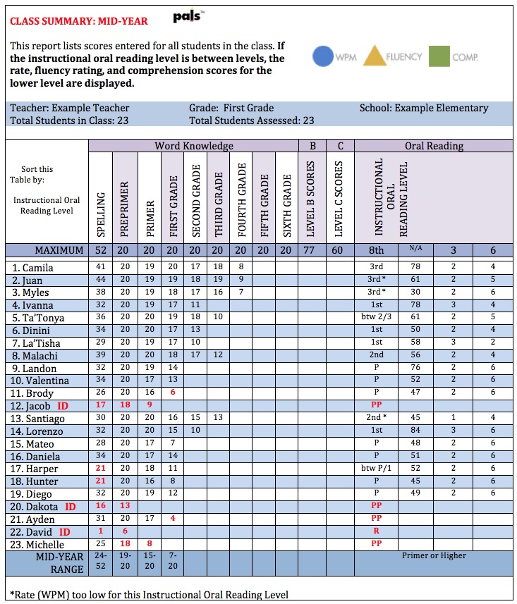
Mid-Year
First Grade
Class Summary

Slide 21
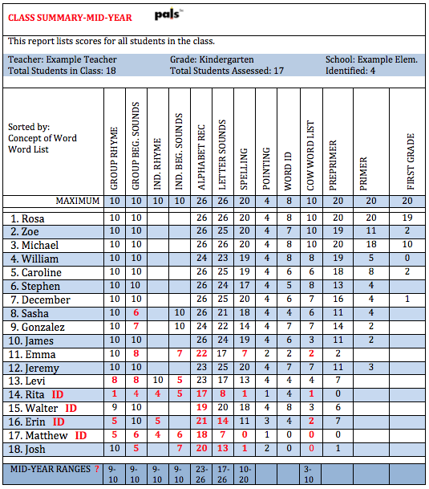
Mid-Year
Kindergarten
Class Summary

Slide 22

Linking PALS Data to PALS Resources
Notes:
Let’s now move on to what resources we have at PALS that can help you link to that data.

Slide 23
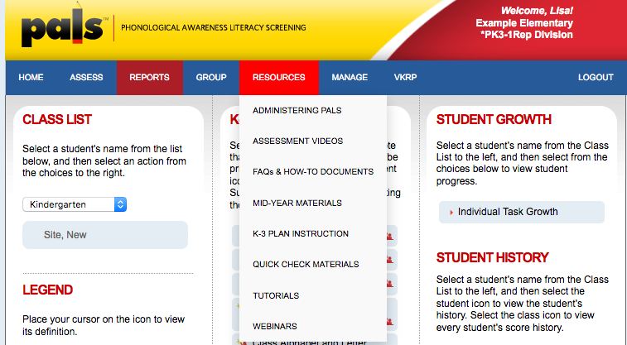
Resources for Instruction
Resources Tab
K-3 Plan Instruction
Notes:
The majority of our resources are found on the CLICK Resources Tab. From there you can pull down to CLICK K-3 Plan and Instruction

Slide 24
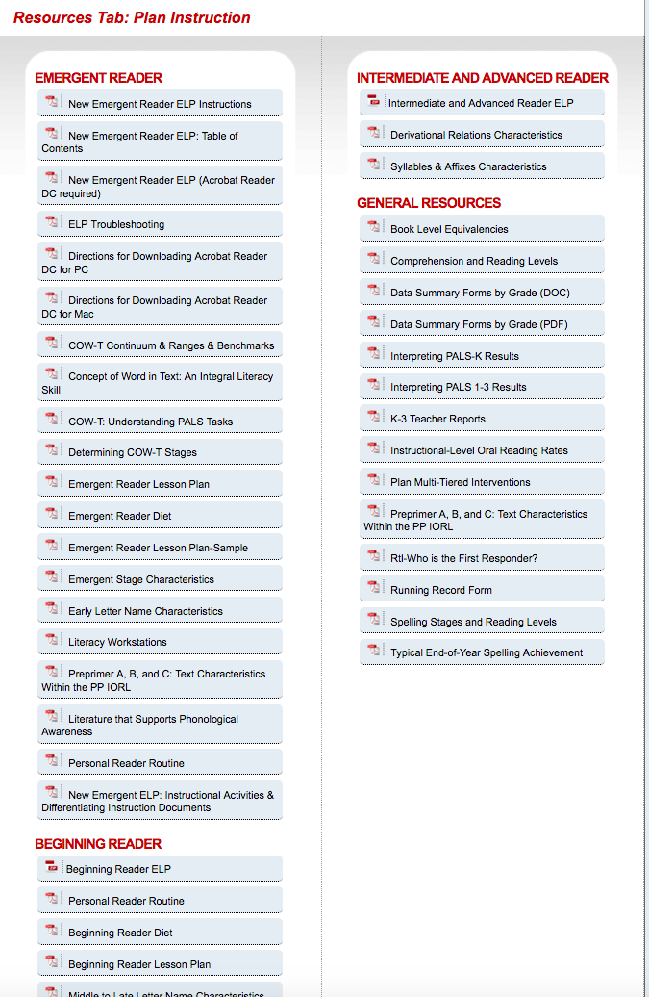
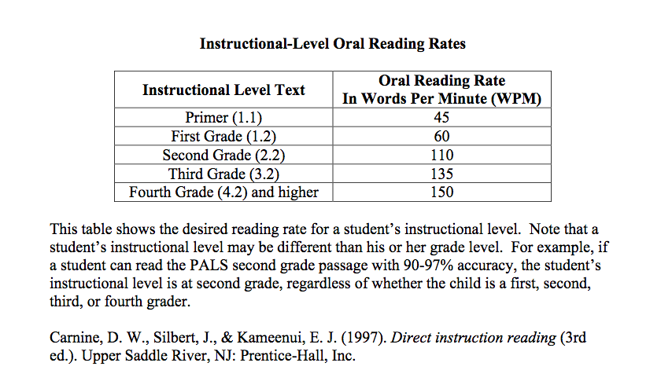
Instructional Oral
Reading Rates
Notes:
Just to give you an example of a heavily used resource, here you can find thing like IORR under General Resources.

Slide 25
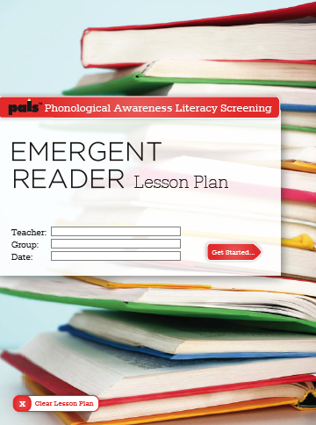
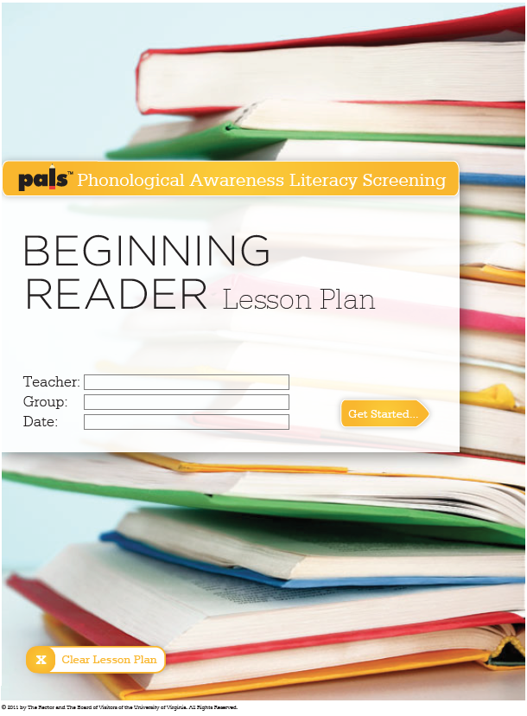
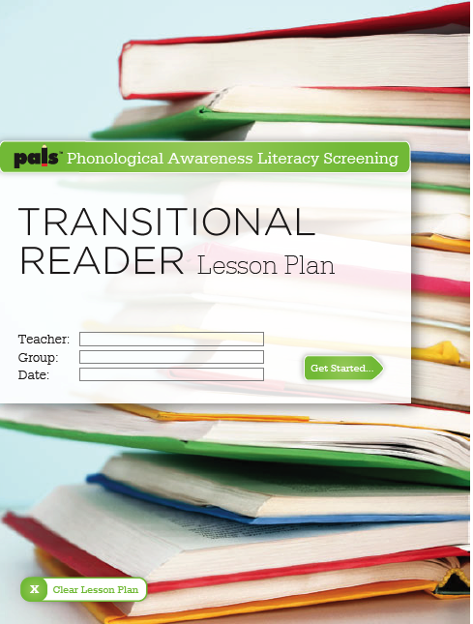
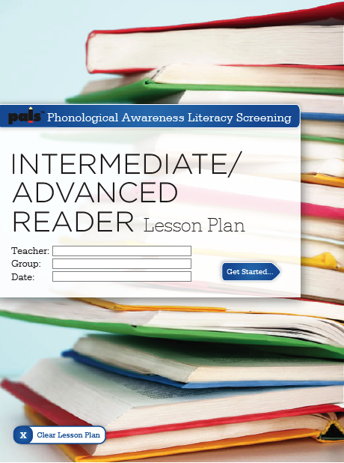
PALS Electronic Lesson Plans
Notes:
Of course you can look for differentiated resources as well on our site such as our Electronic Lesson Plans

Slide 26
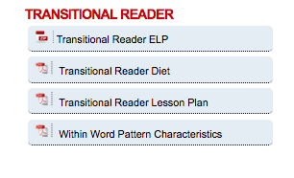
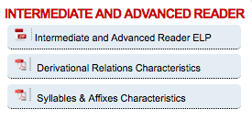
Electronic Lesson Plans

Slide 27
Quick Checks
Short probes given between PALS screening windows to measure progress in essential literacy skills
Criterion-referenced
Can provide frequent feedback about the cumulative effect of classroom instruction (Tier I) and supplemental reading interventions (Tiers II and III)

Slide 28
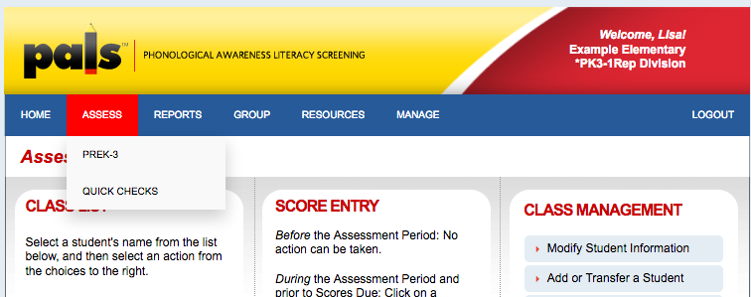
Quick Checks (1 of 2)
1. Assess Tab
2. Quick Checks

Slide 29
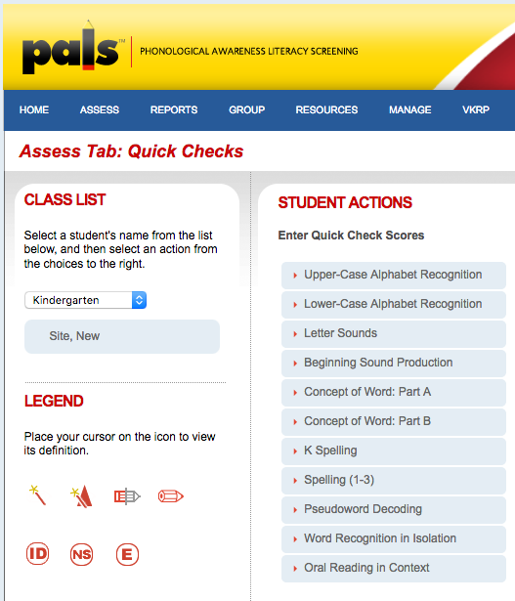
Quick Checks from Class List
3. Select Student
4. Select Quick Check task
Peggy Pals

Slide 30
Quick Check
Materials
Resources Tab
Quick Check Materials

Slide 31
Quick Checks
Reports
Reports Tab
2. Chart and Summaries

Slide 32
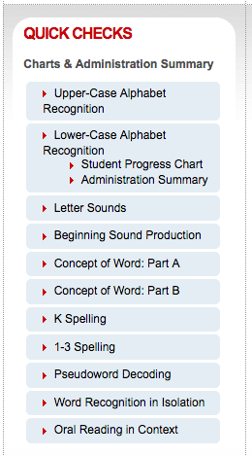
Quick Checks Reports
Student Progress Chart
2. Administration Summary

Slide 33
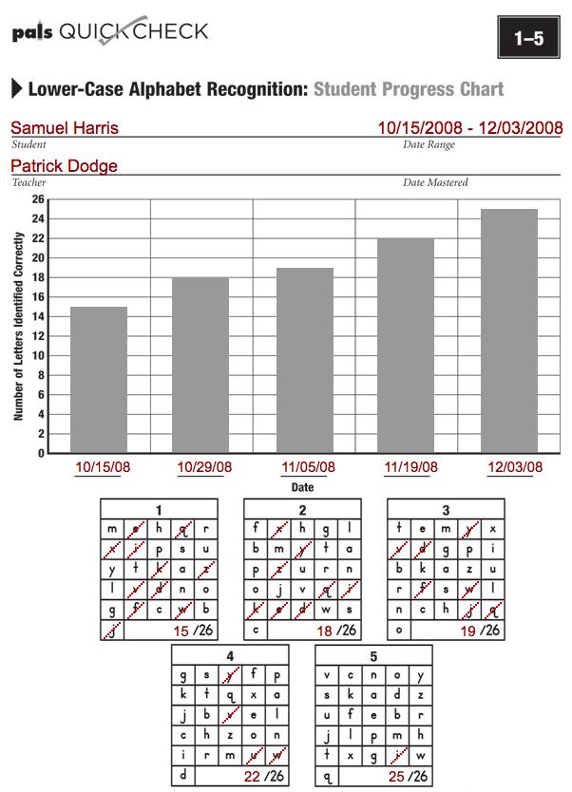
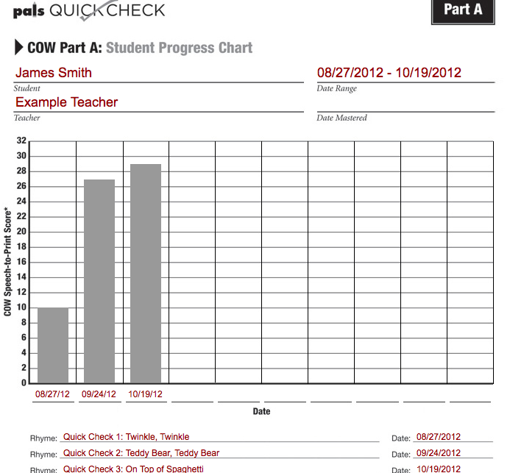
Quick Checks Student Progress Chart

Slide 34
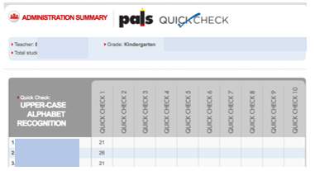
Quick Check: Administration Summary Report

Slide 35

Development vs. Data
Development
Data

Slide 36
Recognize the difference between screening and success
Know that the PALS benchmark is not proficiency.
Understanding patterns of performance on subskills and subcomponents offers a much more valuable lens.
PALS Benchmark

Slide 37
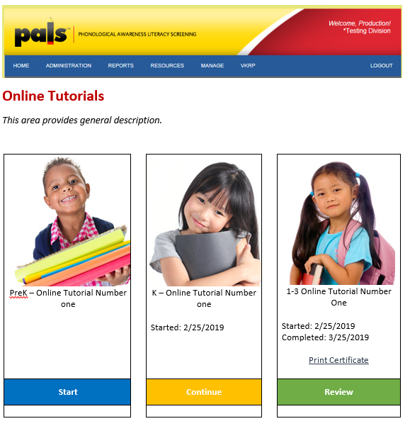
Resources for Going Beyond the Benchmark
Administrative Certification
Enhancing knowledge of development and the PALS assessment
“Putting PALS in a Developmental Context”
“Using PALS Data More Fully Across the Year”

Slide 38

PALS as a System of Support
Better understand reading development
Build a developmental
approach to using data
in an ongoing way
1
2
“Putting PALS in a Developmental Context”
Series of webinars that focus on reading development and where PALS does (and doesn’t) fit in.
“Using PALS Data More Fully Across the Year”
Learning Modules for a Coach to use with teachers

Slide 39
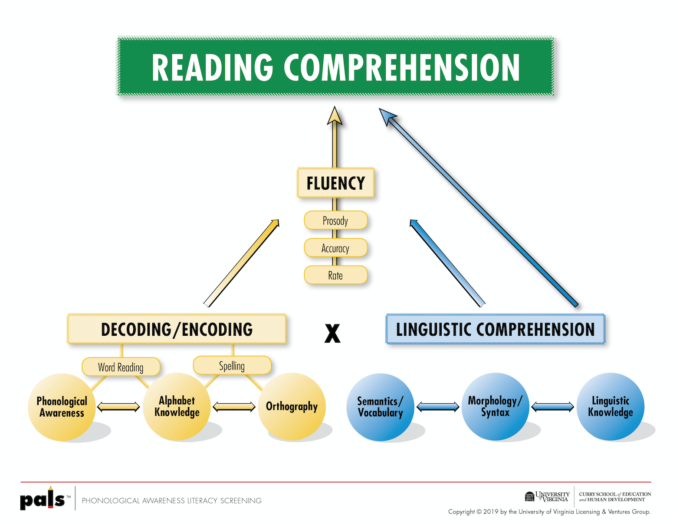
Reading Comprehension

Slide 40
Simple View Of Reading
D LC RC
X
=
Linguistic
Comprehension
Reading Comprehension
Decoding
Ability to make meaning from spoken words as they are in a sentence or in discourse
Efficient word reading

Slide 41
Some topics that will be covered
Putting PALS in a Developmental Context
Reading Comprehension Framework
Alphabet Knowledge
Phonological Awareness
Spelling/Phonics
Fluency

Slide 42
PALS as a System of Support (1 0f 2)
Better understand reading development
Build a developmental
approach to using data
in an ongoing way
1
2
Putting PALS in a Developmental Context
Series of webinars for educators that focus on reading development and where PALS does and doesn’t fit in.
Using PALS Data More Fully Across the Year
Learning Modules for a Coach to use with teachers

Slide 43
Professional Development Learning Modules
PALS Support
15-30 minutes; total time 60 min
Educator's Express
Recorded Webinars
Coach’s Corner
Support document for the coach to guide teachers through the module
Synopsis of the module
Revised content
Consistent and direct communication with a designated PALS team member
Collect feedback and answer questions
Includes goals, background knowledge, necessary materials and additional resources related to the module topic
Embedded reflection time
Planning time for data analysis
All materials that educators need to participate
*Individualized PALS Contact
Consistent structure
*this year only

Slide 44
Using PALS Data More
Fully Across the Year
Module 2 Forming Instructional Groups
Module 1
Get to know your class - Review Spring Data/ Give Quick Checks
Module 3 Small Group Instruction
Using PALS Data More
Fully Across the Year
Module 6
Getting Poised for Next Year
Module 4 Monitoring Growth and Reflecting on Instructional Practices
Module 5
The Spelling – Reading Connection

Slide 45
PALS Module Schedule
Module 1
Before students start
K
1st & 2nd
Module 2
After fall PALS data is collected
K
Module 3
After Fall data is collected
1st & 2nd
Emergent
Module 4
After Mid-Year data is collected
Beginning
Transitional
Module 6
After Spring data is collected
Module 5
Mid-Year
K
1st & 2nd
K
1st & 2nd
K-2

Slide 46
Each Module’s Roadmap
Setting the Stage
Case Study Demo
Modeling
Investigative Activity –
You Try It!
Field Work –
On Your Own

Slide 47
PALS as a System of Support (2 of 2)
Better understand reading development
Build a developmental
approach to using data
in an ongoing way
1
2
“Putting PALS in a Developmental Context”
Series of webinars that focus on reading development and where PALS does (and doesn’t) fit in.
“Using PALS Data More Fully Across the Year”
Learning Modules for a Coach to use with teachers

Slide 48


Your PALS Office Team is here to support you!
Please call or email us.
888-882-7257
pals@virginia.edu
Notes:
Please reach out by phone or email to the PALS office if we can support you in any way.

Slide 49
VDOE Disclaimer
Reference within this presentation to any specific commercial or non-commercial product, process, or service by trade name, trademark, manufacturer or otherwise does not constitute or imply an endorsement, recommendation, or favoring by the Virginia Department of Education.

Slide 50
Stay Connected
Jill Nogueras
K-12 English Coordinator
Jill.Nogueras@doe.virginia.gov
Carmen Kurek
Elementary English/Reading Specialist
Carmen.Kurek@doe.virginia.gov
Taylor Snow
English/History & Social Science Specialist
Taylor.Snow@doe.Virginia.gov
Assessment Office
Student_Assessment@doe.virginia.gov

