Slide 1
Comprehensive Literacy Webinar Series
English: Best Practices in K-2 Instruction

Slide 2
Agenda
Welcome and Introductions
National and State Focus Areas for Instruction
Best Practices for Word Level Reading
Best Practices for Comprehension
Practices that Support the 2017 English Standards of Learning
Instructional Resources

Slide 3
Questions from the Field
Chat Feature
Use the chat feature to pose any questions to the group.
We will collect these and add additional information as necessary to the presentation before slides are mailed out.

Slide 4
8VAC20-131-80. Instructional Program in Elementary Schools.
“C. To provide students with sufficient opportunity to learn, local school divisions shall provide a minimum of 680 hours of the required 990 hours of instructional time to students in elementary school in the four academic disciplines of English, mathematics, science, and history and social science.”
“B. In kindergarten through grade 3, reading, writing, spelling, and mathematics shall be the focus of the instructional program.”
Notes:
Code of Virginia-Standards of Accreditation
For a 6 hour school day, this is about 3.8 hours per day across the 4 disciplines

Slide 5
§ 22.1-253.13:1. Standard 1. Instructional programs supporting the Standards of Learning and other educational objectives.
“The Board shall seek to ensure that the Standards of Learning are consistent with a high-quality foundation educational program. The Standards of Learning shall include, but not be limited to, the basic skills of communication (listening, speaking, reading, and writing); computation and critical reasoning, including problem solving and decision making; proficiency in the use of computers and related technology; computer science and computational thinking, including computer coding; and the skills to manage personal finances and to make sound financial decisions.”
“The English Standards of Learning for reading in kindergarten through grade three shall be based on components of effective reading instruction, to include, at a minimum, phonemic awareness, phonics, fluency, vocabulary development, and text comprehension.”
Notes:
Code of Virginia-Standards of Quality
As you listen today, you may hear practices that sound familiar and are not entirely new. The action step after this webinar is to reflect on the implementation of these practices. What does daily implementation look like? Is it explicit? Is it systematic? Is it daily?

Slide 6
Skills and Knowledge
Critical to Comprehend Text
4. Knowledge and abilities required specifically to comprehend text
5. Thinking and reasoning skills
6. Motivation to understand and work toward academic goals
Word-level skills
2. Vocabulary knowledge and oral language skills
3. Broad Conceptual Knowledge
Shanahan, T., Callison, K., Carriere, C., Duke, N. K., Pearson, P. D., Schatschneider, C., & Torgesen, J. (2010). Improving reading comprehension in kindergarten through 3rd grade: A practice guide (NCEE 2010-4038). Washington, DC: National Center for Education Evaluation and Regional Assistance, Institute of Education Sciences, U.S. Department of Education. Retrieved from whatworks.ed.gov/publications/practiceguides.

Slide 7
What Research Says (1 of 5)
Phonics Instruction
“Phonics instruction is an essential part of early reading and writing instruction. Students need to learn how to efficiently decode words to increase their word recognition skills. The more words students recognize automatically, the better their reading fluency, which has a powerful effect on their comprehension of text. And that’s the point. Phonics instruction is designed to increase students’ ability to read and make meaning from text.”
“Students progress at a much faster rate in phonics when the bulk of instructional time is spent on applying the skills to authentic reading and writing experiences, rather than isolated skill-and-drill work. At least half of a phonics lesson should be devoted to application exercises. For students who are below level, the amount of reading during phonics instruction must be even greater.”
International Literacy Association. (2019). Meeting the challenges of early literacy phonics instruction [Literacy leadership brief]. Newark, DE: Author

Slide 8
What Research Says (2 of 5)
Characteristics of strong phonics instruction:
Explicit and systematic
Readiness Skills
Scope and Sequence
Blending
Dictation
Word Awareness
High-Frequency Words
Reading Connected Text
Building vocabulary and background knowledge
International Literacy Association. (2019). Meeting the challenges of early literacy phonics instruction [Literacy leadership brief]. Newark, DE: Author
Notes:
What does explicit and systematic mean? Explicit phonics instruction means that the letter(s)-sound relationship or skill is directly stated to the students “the /s/ sound is represented by the letter s.” Systematic means that the instruction follows a continuum that moves from easier to more complex skills.
Strong alphabet recognition and phonemic awareness are readiness skills needed for success in reading. Knowing the names and sounds of letters with fluency and being able to orally blend, segment, and manipulate sounds in words from Kindergarten moving up to grade 3 will be the biggest predictor of early reading success.
A strong scope and sequence moves from easier to more complex skills and builds on previous learning.
Blending-We teach students to segment or sounds in order to decode words, but students must be proficient in blending those sounds together in order to sound out words. Students must be proficient with blending orally before using it in text. Blending is used with early readers but should continue as students transition into multisyllabic words.
Dictation-Students must be provided opportunities to “try out” or apply their phonics skills with teacher support, just like the IES Guide discusses practciing phonics skills in connected text.
Word Awareness-Literacy blocks should consist of opportunities for students to analyze and notice patterns in word through tasks that require students to manipulate words to increase students’ ability to notice larger chunks in monosyllabic and multisyllabic words. Word building and word sorting are two examples of these tasks.
High-Frequency Words-Known as the most common words in English. Words that follow regular sound-spellings can be learned and applied during the normal phonics scope and sequence. Word do not, need to be explicitly taught to students.
Reading Connected Text-Students should have opportunities to practice and apply phonics instruction in decodable text.
Building vocabulary and background knowledge-As older elementary students encounter more complex texts and vocabulary, providing a balance of phonics instruction with best practices with vocabulary acquisition and expanding background knowledge is essential.
So as you are reflecting on the practices in your literacy block, continue to think about the implementation of these characteristics. Do you do these daily? Do you see these daily?

Slide 9

What Research Says (3 of 5)
Foundational Skills to Support Reading for Understanding
Recommendation 1- Teach students academic language skills, including the use of inferential and narrative language, and vocabulary knowledge.
Recommendation 2- Develop awareness of the segments of sound in speech and how they link to letters.
Recommendation 3-Teach students to decode words, analyze word parts, and write and recognize words.
Recommendation 4- Ensure that each student reads connected text every day to support reading accuracy, fluency, and comprehension.
Foorman, B., Beyler, N., Borradaile, K., Coyne, M., Denton, C. A., Dimino, J., Furgeson, J., Hayes, L., Henke, J., Justice, L., Keating, B., Lewis, W., Sattar, S., Streke, A., Wagner, R., & Wissel, S. (2016). Foundational skills to support reading for understanding in kindergarten through 3rd grade (NCEE 2016-4008). Washington, DC: National Center for Education Evaluation and Regional Assistance (NCEE), Institute of Education Sciences, U.S. Department of Education. Retrieved from the NCEE website: http://whatworks.ed.gov.
Notes:
These practice guides published by What Works Clearinghouse and the Institute of Education Sciences examine studies and make recommendations based on the evidence of the studies. The recommendations are ranked in order of strongest evidence to minimal.
Recommendation 1-Supporting the development of specific academic, inferential, and narrative language skills will broaden students’ listening comprehension skills which will prepare them for better reading comprehension. It also expands their vocabulary knowledge and syntax within the English language.
Recommendation 2-To effectively decode (convert from print to speech) and encode (convert from speech to print) words, students must be able to identify the individual sounds, or phonemes, that make up the words they hear in speech, name the letters of the alphabet as they appear in print, and identify each letter’s corresponding sound(s). This recommendation presents ways to support these skills such as; 1. Teaching students to recognize and manipulate segments of sound in speech. 2) Teaching students letter–sound relations. And 3. Using word-building and other activities to link students’ knowledge of letter–sound relationships with phonemic awareness.
Recommendation 3-This recommendation presents several ways to implement decoding and analyzing word parts. The first way is blending sounds with spelling patterns from left to right to produce a recognizable word. The next is providing instruction on common sound-spelling patterns. Is it explicit and systematic? Also continuing this instruction even as students move into learning syllables
Recommendation 4-The recommendation states that students should be reading a wide variety of connected text daily, with and without constructive feedback. As students are beginning to apply the alphabetic principal, text should provide examples of recently taught spelling patterns with support and feedback from teachers on applying decoding strategies learned. This recommendation also shares some suggested strategies for supporting students in reading more fluently.

Slide 10

What Research Says (4 of 5)
Teaching Elementary School Students to be Effective Writers
Recommendation 1-Provide daily time for students to write.
Recommendation 2- Teach students to use the writing process for a variety of purposes.
Recommendation 3- Teach students to become fluent with handwriting, spelling, sentence construction, typing, and word processing.
Recommendation 4- Create an engaged community of writers.
Graham, S., Bollinger, A., Booth Olson, C., D’Aoust, C., MacArthur, C., McCutchen, D., & Olinghouse, N.(2012).Teaching elementary school students to be effective writers: A practice guide (NCEE 2012- 4058). Washington, DC: National Center for Education Evaluation and Regional Assistance, Institute of Education Sciences, U.S. Department of Education. Retrieved from http://ies.ed.gov/ncee/ wwc/publications_reviews.aspx#pubsearch
Notes:
These practice guides published by What Works Clearinghouse and the Institute of Education Sciences examine studies and make recommendations based on the evidence of the studies. The recommendations are ranked in order of strongest evidence to minimal.
Recommendation 1-The guide recommends at least 30 minutes a day in Kindergarten for teaching skills, strategies and processes for writing, as well as an hour a day for older elementary students. 30 minutes of that for instruction, and 30 minutes for student writing. It also suggests that some of that student writing time could also occur within other content domains such as writing a lab report for Science.
Recommendation 2-This recommendation shares many strategies for engaging students within the writing process, from picking ideas and organizing all the way to sharing as well as strategies for writing for different purposes.
Recommendation 3-When young students begin to write, they scribble and will tell you a whole story for what that scribble means. They have learned that what I write stands for what I think. As they get older they are working to express their stories and ideas on paper as well as use their developing spelling knowledge to identify the sounds they need to express those ideas. They have two jobs. If students have not developed fluency with their letter formation then the ideas they want to express begin to change and adapt and their print no longer acts as the symbol for those ideas. Handwriting is not only essential for letter learning, but fluency with this is essential for expressing ideas. As students grow and begin to express their ideas in a variety of modes, these practices need to be implemented daily, such as word processing and utilizing technology for communication. It is important that this is intentional and not as time allows.
Recommendation 4-This recommendation shares some ways to create a strong community such as the teacher acting as a writer within the community, providing choices, providing opportunities for students to collaborate as writers, effective ways to publish student writings and providing continuous feedback.

Slide 11

What Research Says (5 of 5)
Recommendation 1-Teach students how to use reading comprehension strategies.
Comprehension Instruction
Recommendation 1: Teach students how to use reading comprehension strategies
Questioning
Visualization
Monitoring, clarifying, or fix-up
Inference
Retelling
Shanahan, T., Callison, K., Carriere, C., Duke, N. K., Pearson, P. D., Schatschneider, C., & Torgesen, J. (2010). Improving reading comprehension in kindergarten through 3rd grade: A practice guide (NCEE 2010-4038). Washington, DC: National Center for Education Evaluation and Regional Assistance, Institute of Education Sciences, U.S. Department of Education. Retrieved from whatworks.ed.gov/publications/practiceguides.
Notes:
These practice guides published by What Works Clearinghouse and the Institute of Education Sciences examine studies and make recommendations based on the evidence of the studies.
Recommendation 1-
• Teach students how to use several research-based reading comprehension strategies. • Teach reading comprehension strategies individually or in combination. • Teach reading comprehension strategies by using a gradual release of responsibility.
Recommendation 2-• Explain how to identify and connect the parts of narrative texts. • Provide instruction on common structures of informational texts
Recommendation 3-• Structure the discussion to complement the text, the instructional purpose, and the readers’ ability and grade level. • Develop discussion questions that require students to think deeply about text. • Ask follow-up questions to encourage and facilitate discussion. • Have students lead structured small-group discussions.
Recommendation 4-• Teach reading comprehension with multiple genres of text. • Choose texts of high quality with richness and depth of ideas and information. • Choose texts with word recognition and comprehension difficulty appropriate for the students’ reading ability and the instructional activity. • Use texts that support the purpose of instruction.
Recommendation 5-• Help students discover the purpose and benefits of reading. • Create opportunities for students to see themselves as successful readers. • Give students reading choices. • Give students the opportunity to learn by collaborating with their peers.

Slide 12
What a strategy is:
• Intentional mental actions during reading that improve reading comprehension.
• Deliberate efforts by a reader to better understand or remember what is being read.
What a strategy is not:
• Instructional activities such as completing worksheets. Worksheets rarely include instruction in what students should do actively in their heads to improve comprehension.
• Exercises that are aimed at giving students practice with skills such as sequencing or drawing conclusions, but that lack explicit instruction in how to think in these ways during reading.
Shanahan, T., Callison, K., Carriere, C., Duke, N. K., Pearson, P. D., Schatschneider, C., & Torgesen, J. (2010). Improving reading comprehension in kindergarten through 3rd grade: A practice guide (NCEE 2010-4038). Washington, DC: National Center for Education Evaluation and Regional Assistance, Institute of Education Sciences, U.S. Department of Education. Retrieved from whatworks.ed.gov/publications/practiceguides

Slide 13
Recommendation 2- Teach students to identify and use the text’s organizational structure to comprehend, learn, and remember content.
Narrative:
Characters
Setting
Goal
Problem/Conflict
Plot or action
Resolution
Theme(s)
Informational:
Description
Sequence
Problem and Solution
Cause and Effect
Compare and Contrast
Shanahan, T., Callison, K., Carriere, C., Duke, N. K., Pearson, P. D., Schatschneider, C., & Torgesen, J. (2010). Improving reading comprehension in kindergarten through 3rd grade: A practice guide (NCEE 2010-4038). Washington, DC: National Center for Education Evaluation and Regional Assistance, Institute of Education Sciences, U.S. Department of Education. Retrieved from whatworks.ed.gov/publications/practiceguides

Slide 14
Recommendation 3- Guide students through focused, high quality discussion on the meaning of text.
Locate and Recall
Integrate and Interpret
Critique and Evaluate
Recommendation 4- Select texts purposefully to support comprehension development.
Rich content
Strong organization
Word choice and sentence structure
Support the purpose of instruction
Shanahan, T., Callison, K., Carriere, C., Duke, N. K., Pearson, P. D., Schatschneider, C., & Torgesen, J. (2010). Improving reading comprehension in kindergarten through 3rd grade: A practice guide (NCEE 2010-4038). Washington, DC: National Center for Education Evaluation and Regional Assistance, Institute of Education Sciences, U.S. Department of Education. Retrieved from whatworks.ed.gov/publications/practiceguides
Notes:
Recommendation 3-
Locate and recall-identify the main ideas and supporting details, find elements of a story; focus on small amounts of text
Integrate and interpret-compare and contrast information or actions by characters; examine connections across parts of text; consider alternatives to what is presented in the text; use mental images
Critique and evaluate-assess from numerous perspectives, synthesizing what is read with other texts and other experiences; determine what is most significant in a passage; judge whether and the extent to which certain features in the text accomplish the purpose of the text; judge either the likelihood that an event could actually occur or the adequacy of an explanation in the text
Recommendation 4-
Broad types of literary and informational
Rich content (character development, elaborate detail)
Strong organization
Variation and richness in word choice and sentence structure
Supports the purpose of instruction-text where strategy can easily be applied, well above their reading level but at listening comprehension level, just above their reading level and support though big books, or digitally projecting text

Slide 15
Recommendation 5- Establish an engaging and motivating context in which to teach reading comprehension.
Help students discover the purpose and benefits of reading.
Create opportunities for students to see themselves as successful readers.
Give students reading choices.
Give students the opportunity to learn by collaborating with peers.
Shanahan, T., Callison, K., Carriere, C., Duke, N. K., Pearson, P. D., Schatschneider, C., & Torgesen, J. (2010). Improving reading comprehension in kindergarten through 3rd grade: A practice guide (NCEE 2010-4038). Washington, DC: National Center for Education Evaluation and Regional Assistance, Institute of Education Sciences, U.S. Department of Education. Retrieved from whatworks.ed.gov/publications/practiceguides
Notes:
Recommendation 5- Establish an engaging and motivating context in which to teach reading comprehension.
Help students discover the purpose and benefits of reading.- modeling, choose texts with relevant themes
Create opportunities for students to see themselves as successful readers.-feedback, chunking text, low risk opportunities
Give students reading choices.-activities, order of completion, questions that lead to interesting texts, text response, where they can read, text choice.
Give students the opportunity to learn by collaborating with peers.-partners read the same text and discuss, partners at different levels reading a higher level book alternating pages, sentences, paragraphs, retelling, dramatization, grouping.

Slide 16
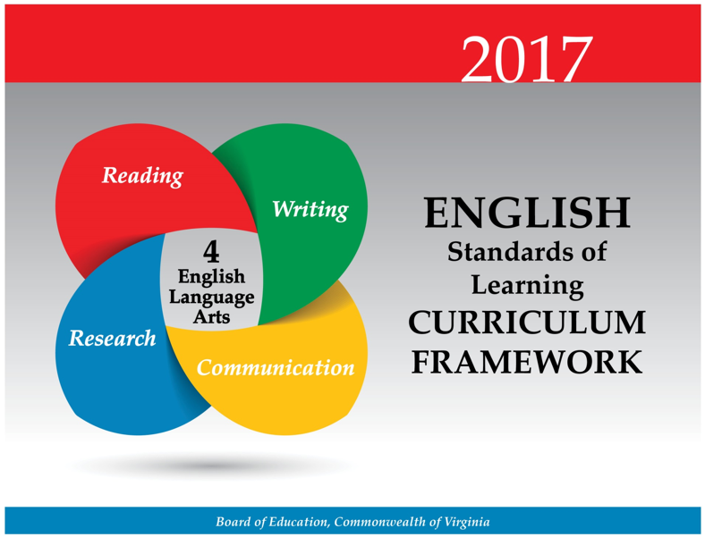
Virginia Department of Education Curriculum Framework
Notes:
We will look at some suggested practices that are already included in the new 2017 English Curriculum Frameworks.

Slide 17
Virginia Department of Education 2017 Standards (1 of 3)
New Communication Strand- Grades K-3 Formerly Oral Language
New Communication and Multimodal Literacies strand focuses on:
  Building communication skills
    Ask questions; collaborate with partners or groups
  Strengthening early oral literacy skills
    Retell stories; participate in creative dramatics
  Developing presentation skills
    Speak clearly; organize ideas; create a simple presentation using multimodal tools
Notes:
Now we will look at the new 2017 English Standards of Learning changes and updates as well as the teacher notes that are provided that suggest important best practices to include in K-2 literacy.
In K-3 former Oral Language strand is now named Communication and Multimodal Literacies to align with grades 4 and 5. An effective literacy block should be integrating these skills such as retelling, asking questions, and collaborating throughout the literacy block as modes to communicate about reading and writing, unless specific intervention is needed.

Slide 18
Virginia Department of Education 2017 Standards (2 of 3)
Now called Communication & Multimodal Literacies
Integrates multiple modes of communication and expression, digital citizenship, and current best practices
Encourages options such as podcasts, presentations with visuals and media, blogs, etc
Expands collaboration, consensus-building, team-building, and working toward common goals

Slide 19
Virginia Department of Education 2017 Standards (3 of 3)
Reorganization of important phonological and phonemic awareness skills formerly under an Oral Language Strand (K-2)
These skills provide the foundation for literacy and must be included in classroom instruction
  Moved to Reading Strand:
    Identify and produce rhymes; manipulate syllables; blend and segment phonemes
Notes:
One important change to note is that several oral early literacy skills were also moved from this strand into the reading strand. As many communication skills often get integrated into other areas, and often explicit instruction in these oral early literacy skills is not present. This change would allow more time for explicit instruction in these critical areas.

Slide 20
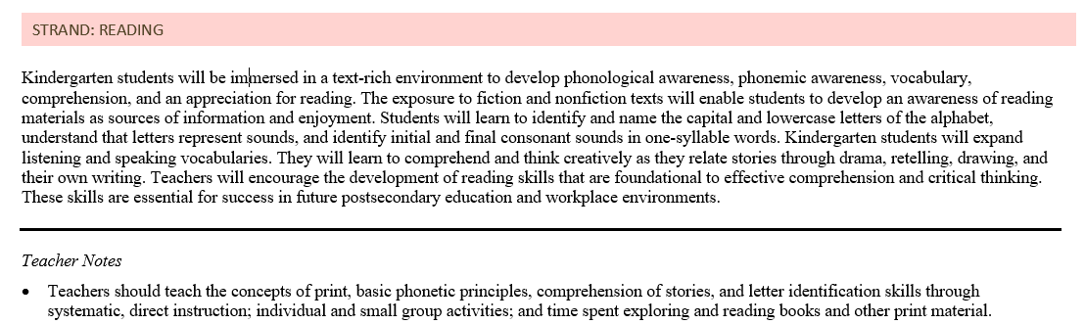
Virginia Department of Education CF Kindergarten Reading
Notes:
The overview page for each strand within each grade level also has teacher notes provided with some best practices to use when structuring a literacy block and providing instruction on the standards.
On this Kindergarten example notice that it states some specific skills that should be taught through systematic, direct instruction within small group, and independent tasks.

Slide 21
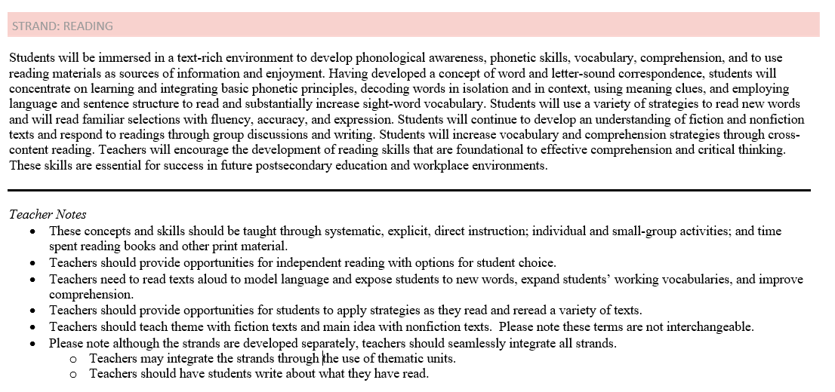
Virginia Department of Education CF First Grade Reading
Notes:
In the first grade teacher notes for reading, some recommendations to be included in a literacy block are systematic, explicit, and direct instruction during small group time, including time for independent reading and student choice within the literacy block, reading aloud to model strategies, and time for students to apply strategies in texts.
Grades 4-5 also contain recommendations such as reading longer and more complex texts along with student choice. So this would be something to consider when structuring a literacy block as well.

Slide 22
New Communication Strand Grades K-3
Formerly Oral Language
New Communication and Multimodal Literacies strand focuses on:
  Building communication skills
    Ask questions; collaborate with partners or groups
  Strengthening early oral literacy skills
    Retell stories; participate in creative dramatics
  Developing presentation skills
    Speak clearly; organize ideas; use multimodal tools

Slide 23
New Research Strand Grades K-3
Strand focuses on:
  Generating topics of interest
  Asking questions to gather information
  Identifying pictures, texts, or people as sources
  Collecting information
    From provided sources or student-selected resources
  Organizing and recording information
    Orally and/or in writing

Slide 24
Literary Nonfiction Grades 3-12
Previously referred to as Narrative Nonfiction in Grade 3
Literary Nonfiction is a type of narrative text
  Uses story elements and language to share accurate information about real people, places, and events
  Including but not limited to biography and autobiography

Slide 25
Clarification of Theme and Main Idea Grades K-5
Students will now identify theme in fictional texts and poetry
Teachers should teach theme as a literary term with fiction texts and main idea with nonfiction texts
  *Please note these terms are not interchangeable
Students will continue to identify main idea in nonfiction

Slide 26
Focus on the Writing Process
Emphasis on ethical use of the Internet when gathering and using information (Grades 3-12)
Writing process increases in complexity and rigor as students progress through K-12
  Kindergarten = narrative and descriptive
  Grade 1 = narrative, descriptive, and opinion
  Grade 2 = narrative, descriptive, opinion, and expository
  Grade 3 = narrative, descriptive, opinion, and expository
  Grade 4 = narrative, descriptive, opinion, and expository
  Grade 5 = narrative, descriptive, expository, and persuasive

Slide 27
Strands of the 2017 English Standards
The strands of the 2017 English Standards:
  Communication & Multimodal Literacies
  Reading
  Writing
  Research
  The goals are to teach students to read, write, research and communicate. The strands are developed separately, but expected to be seamlessly integrated in the classroom. Through the rigorous application of the English Standards of Learning, students become critical thinkers, effective contributors, and global citizens.

Slide 28
The Spiraling of Skills
The concepts, skills, and content in English Language Arts spiral; teachers should note each grade level builds skills that carry to the following grades. Each grade level within the English Curriculum Framework builds from kindergarten through grade 12, creating a comprehensive instructional tool, which prepares students for success in future postsecondary education and the workplace. Teachers should review the Curriculum Framework for the scope of learning in each of the strands in previous grades and in the grades to follow.

Slide 29
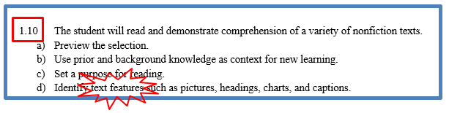
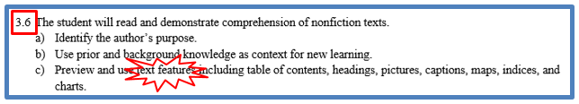




Vertical Articulation of the Standards

Slide 30

Seamless Integration of
English Strands
Reading
Writing
Research
Communication/ Multimodal Literacies

Slide 31
Successful English Instruction (1 of 3)
Integration of Stands
Choose a theme or topic
Choose a variety of text
and media options
Incorporate all strands during the unit
Select standards to introduce or review
Think about your students – What will interest them?
Provide opportunities for shared and independent reading
Model the writing process and meet with students for writing conferences

Slide 32
Successful English Instruction (2 of 3)
Integration of Stands
  Reading
      Specific vocabulary from authentic texts
      Both fiction & nonfiction text
      Text-rich environment with variety of text and media
      Student choice whenever possible
  Writing
      Writing as a process for a variety of authentic purposes
      Regular writing conferences
      Use of Writing Portfolios
  Research
      Ongoing and embedded in the learning process (when applicable)
  Communication/Multimodal Literacies

Slide 33
Successful English Instruction (3 of 3)
Best Practices
  Use of text-dependent questions
  Use of inference questions
  Use of text-based vocabulary
  Response to reading
  Writing components in every lesson
  Frequent research components

Slide 34
Paired Texts and Text Sets
Paired texts can include books, plays, articles, poems, functional text, graphics, or digital media
Focus on a common theme or topic that fits history and social science or science content
Compare and contrast texts to increase the level of thinking

Slide 35
The Reading/Writing Connection
Use mentor texts to read like a writer and write like a reader
  Imitate an author’s style and structure
  Appreciate the author’s craft
Incorporate daily writing
  A warm-up prior to beginning a unit of study
  Incorporate writing into formative assessment
  After a thought provoking reading, discussion, or class experiment, students write their thoughts
Find authentic writing opportunities
  Blogging or Social media connections
  Professional writing
Notes:
Writing can and should be integrated in all reading and all contents.

Slide 36
The Forgotten “R”
The elimination of the grade 5 Writing SOL assessment threatens writing/research instruction
Writing, like reading, is a life skill and should be included in all curricular areas.
How much writing does your job require?

Slide 37
Assigned vs. Taught
Students select their own topic, purpose, and audience
Teacher time is spent in class teaching writing skills and strategies
Students use models and strategies to complete each assignment
Students move through the recursive process
Students write only on teacher selected topic, purpose and audience
Students are given a task without the instruction on how to complete it successfully
Minimal improvement in writing
Students rewrite only to correct errors in usage and mechanics
Because Writing Matters by Carl Nagin
The National Writing Project
Notes:
There is a great difference between assigning writing and teaching writing. Although all students can write, direct instruction by the teacher is needed to develop an awareness of good writing and the skills needed to create it.
Direct instruction of concepts such as audience and purpose and skills such as revision can be followed by student choice and reflection. Then as the writing begins, the instruction continues with teacher modeling.

Slide 38
When writing is taught…
Teachers model by
  Writing with the students
  Revealing the hard work of writing
  Thinking aloud through revision of their writing
  Editing only after revision is complete
Notes:
Modeling is one of the most effective instructional strategies and that is true in writing as well as other areas. Teachers should write as students are writing and then model the steps in the writing process, fine tuning the modeling to meet the students’ needs. If composing is the weakest area then the teacher might conduct a think aloud through the process of selecting main ideas and developing organization and elaboration. If first drafts are generally solid but revision is lacking, then the teacher can model strategies such as developing sentence variety or replacing bland language for more vivid vocabulary.

Slide 39
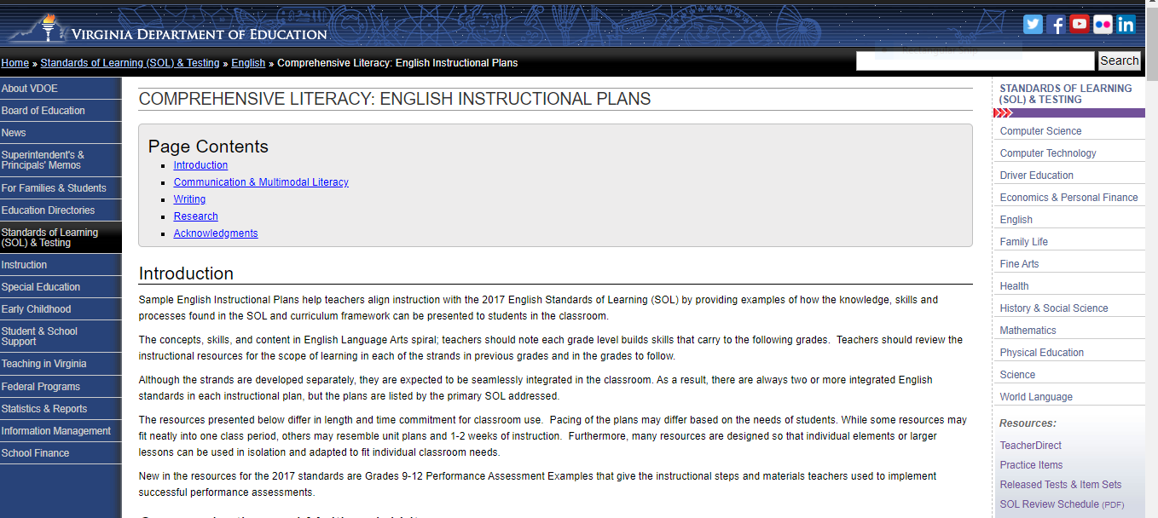
Resources that Align with the 2017 SOL
Comprehensive Literacy: English Instructional Plans
VDOE English Instructional Plans

Slide 40

Comprehensive Literacy: English Instructional Plans
Notes:
Listed by primary SOL

Slide 41

Let’s Look at Two Plans Together

Slide 42
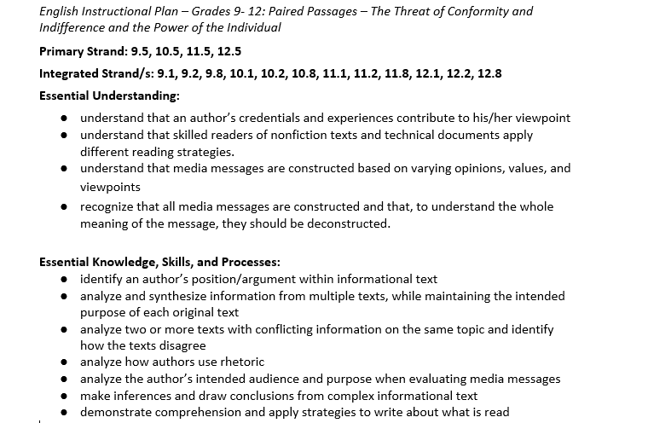
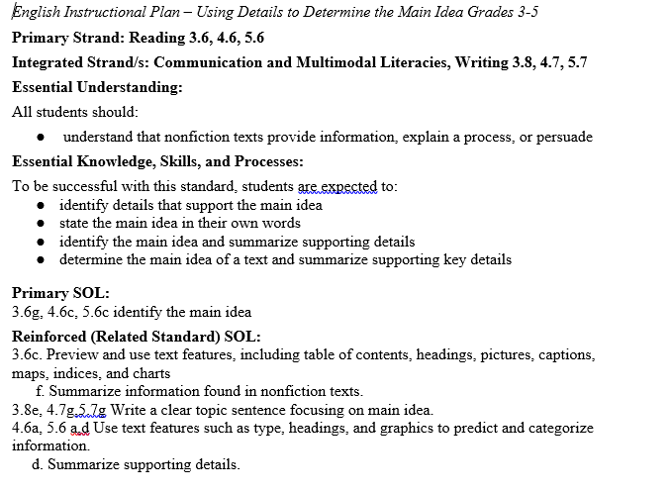
English Instructional Plan Samples

Slide 43
Professional Research
Meeting the Challenges of Early Literacy Phonics Instruction
Foundational Skills to Support Reading for Understanding in Kindergarten Through 3rd Grade
Teaching Elementary School Students to Be Effective Writers
Improving Reading Comprehension in Kindergarten Through Third Grade

Slide 44
VDOE Disclaimer
Reference within this presentation to any specific commercial or non-commercial product, process, or service by trade name, trademark, manufacturer or otherwise does not constitute or imply an endorsement, recommendation, or favoring by the Virginia Department of Education.
Reference within this presentation to any specific commercial or non-commercial product, process, or service by trade name, trademark, manufacturer or otherwise does not constitute or imply an endorsement, recommendation, or favoring by the Virginia Department of Education.

Slide 45
Stay Connected
Jill Nogueras
K-12 English Coordinator
Jill.Nogueras@doe.virginia.gov
Carmen Kurek
Elementary English/Reading Specialist
Carmen.Kurek@doe.virginia.gov
Taylor Snow
English/History & Social Science Specialist
Taylor.Snow@doe.Virginia.gov
Assessment Office
Student_Assessment@doe.virginia.gov

Slide 46



Connect with VDOE
Twitter: @VDOE_News
Facebook: @VDOENews
#VAis4Learners #EdEquityVA

