Slide 1
Comprehensive Literacy Webinar Series
English: Best Practices in 3-5 Instruction

Slide 2
Questions from the Field
Chat Feature
Use the chat feature to pose any questions to the group.
We will collect these and add additional information as necessary to the presentation before slides are mailed out.

Slide 3
Agenda
Welcome and Introductions
State Focus Areas for Instruction
Best Practices that Support the 2017
Best Practices for Complex Text
Instructional Resources
Notes:
If you have been listening to our other webinars, some slides will be repeated, but we will be looking at them through a different lens this time. Looking through the lens of grades 3-5. While some concepts will be familiar, we encourage you to think about your classroom/division and take an inventory of your practices to see are these things happening daily? Are they explicit and systematic? Is student choice involved? Hopefully seeing slides that are same across the webinars will help you find the themes. And this rhythm is going to get you to see what should be happening across K-5 and the slides that are different help you see what is appropriate for upper elementary students
Explicit meaning we tell students what we want them to know, directly stated. Systematic meaning it follows a continuum of skills from easier to more complex.

Slide 4
8VAC20-131-80. Instructional Program in Elementary Schools.
“C. To provide students with sufficient opportunity to learn, local school divisions shall provide a minimum of 680 hours of the required 990 hours of instructional time to students in elementary school in the four academic disciplines of English, mathematics, science, and history and social science.”
“B. In kindergarten through grade 3, reading, writing, spelling, and mathematics shall be the focus of the instructional program.”
Notes:
Code of Virginia-Standards of Accreditation
For a 6 hour school day, this is about 3.8 hours per day across the 4 disciplines

Slide 5
§ 22.1-253.13:1. Standard 1. Instructional programs supporting the Standards of Learning and other educational objectives.
“The Board shall seek to ensure that the Standards of Learning are consistent with a high-quality foundation educational program. The Standards of Learning shall include, but not be limited to, the basic skills of communication (listening, speaking, reading, and writing); computation and critical reasoning, including problem solving and decision making; proficiency in the use of computers and related technology; computer science and computational thinking, including computer coding; and the skills to manage personal finances and to make sound financial decisions.”
“The English Standards of Learning for reading in kindergarten through grade three shall be based on components of effective reading instruction, to include, at a minimum, phonemic awareness, phonics, fluency, vocabulary development, and text comprehension.”
Notes:
Code of Virginia-Standards of Quality
As you listen today, you may hear practices that sound familiar and are not entirely new. The action step after this webinar is to reflect on the implementation of these practices. What does daily implementation look like? Is it explicit? Is it systematic? Is it daily?

Slide 6

2017 English Curriculum Framework
Notes:
We will begin this webinar with updates to the English Standards of Learning. We are in the full implementation year this year, so it is important to know the best practices that the 2017 English SOL support and need to be implemented to be successful.

Slide 7
Literary Nonfiction Grades 3-12
Previously referred to as Narrative Nonfiction in Grade 3
Literary Nonfiction is a type of narrative text
  Uses story elements and language to share accurate information about real people, places, and events
  Including but not limited to biography and autobiography

Slide 8
Clarification of Theme and Main Idea Grades K-5
Students will now identify theme in fictional texts and poetry
Teachers should teach theme as a literary term with fiction texts and main idea with nonfiction texts
  *Please note these terms are not interchangeable
Students will continue to identify main idea in nonfiction

Slide 9
Pairing Literary and Informational Nonfiction Texts- Grades 4 & 5
Creation of standards requiring students to compare/contrast details between literary fiction and informational nonfiction texts
Students will:
  Analyze similarities and differences between paired fiction and nonfiction texts
  Texts can be paired based on similar themes, topics, or patterns of events
  Pairings can include books, articles, poems, media, or graphics

Slide 10
Focus on the Writing Process (1 of 2)
Emphasis on ethical use of the Internet when gathering and using information (Grades 3-12)
Writing process increases in complexity and rigor as students progress through K-12
  Kindergarten = narrative and descriptive
  Grade 1 = narrative, descriptive, and opinion
  Grade 2 = narrative, descriptive, opinion, and expository
  Grade 3 = narrative, descriptive, opinion, and expository
  Grade 4 = narrative, descriptive, opinion, and expository
  Grade 5 = narrative, descriptive, expository, and persuasive

Slide 11
Focus on the Writing Process (2 of 2)
Introduction of a focus on a mode of writing at each grade level:
  6th- narrative & reflective
  7th & 8th – expository & persuasive
  9th & 10th – persuasive & analytical
  11th & 12th – persuasive & argumentative

Slide 12
Strands of the 2017 English Standards
The strands of the 2017 English Standards:
  Communication & Multimodal Literacies
  Reading
  Writing
  Research
  The goals are to teach students to read, write, research and communicate. The strands are developed separately, but expected to be seamlessly integrated in the classroom. Through the rigorous application of the English Standards of Learning, students become critical thinkers, effective contributors, and global citizens.

Slide 13
The Spiraling of Skills
The concepts, skills, and content in English Language Arts spiral; teachers should note each grade level builds skills that carry to the following grades. Each grade level within the English Curriculum Framework builds from kindergarten through grade 12, creating a comprehensive instructional tool, which prepares students for success in future postsecondary education and the workplace. Teachers should review the Curriculum Framework for the scope of learning in each of the strands in previous grades and in the grades to follow.

Slide 14
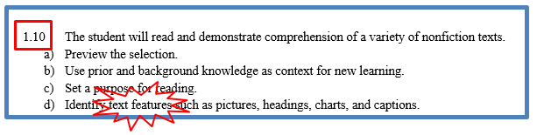
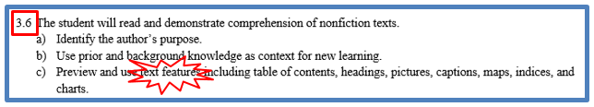




Vertical Articulation of Standards

Slide 15
Best Practices
2017 English Standards of Learning

Slide 16
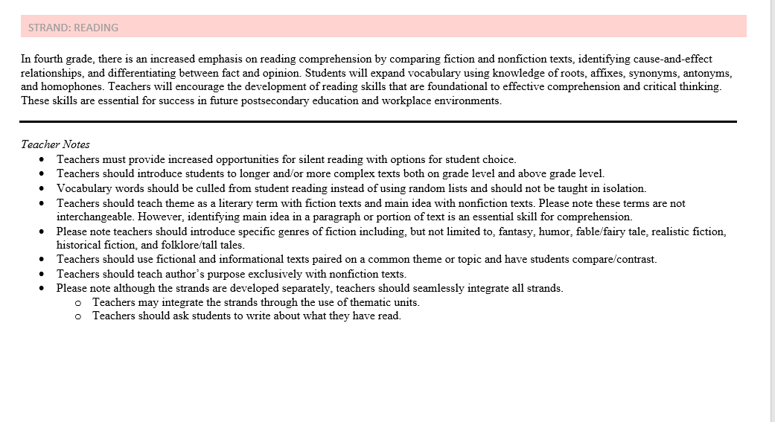
2017 Curriculum Framework (1 of 2)
Notes:
Student choice, increased opportunities for silent reading, longer more complex text, on and above grade level, vocabulary from text, paring texts

Slide 17
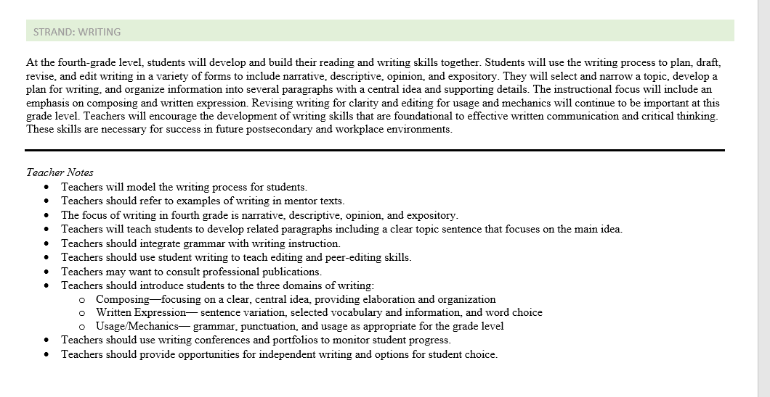
2017 Curriculum Framework (2 of 2)
Notes:
Process, mentor texts (teacher, author, student), integrate grammar with writing instruction (in context), conferences, portfolios

Slide 18

Seamless Integration of
English Strands
Reading
Writing
Research
Communication/ Multimodal Literacies

Slide 19
Successful English Instruction
Integrate the Strands
  Reading
      Specific vocabulary from authentic texts
      Both fiction & nonfiction text
      Text-rich environment with variety of text and media
      Student choice whenever possible
  Writing
      Writing as a process for a variety of authentic purposes
      Regular writing conferences
      Use of Writing Portfolios
  Research
      Ongoing and embedded in the learning process (when applicable)
  Communication/Multimodal Literacies

Slide 20
Successful English Instruction
Best Practices
  Use of text-dependent questions
  Use of inference questions
  Use of text-based vocabulary
  Response to reading
  Writing components in every lesson
  Frequent research components

Slide 21
What are Paired Texts?
A paired text is two texts that are conceptually related in some way, for example, topic, theme, or genre. Paired texts are based on the beliefs that reading is about making connections and “readers make personal connections between the books they are currently reading and their past experiences.” (Harste & Short, with Burke, 1988)
Link to YouTube video on Reading Paired Text
YouTube Video on Paired Passages

Slide 22
Paired Texts and Text Sets
Paired texts can include books, plays, articles, poems, functional text, graphics, or digital media
Focus on a common theme or topic that fits history and social science or science content
Compare and contrast texts to increase the level of thinking

Slide 23
Integration of Skills
Choose a theme or topic
Choose a variety of text and media options
Incorporate all strands during the unit
Select standards to introduce or review
Think about your students – What will interest them?
Provide opportunities for shared and independent reading
Model the writing process and meet with students for writing conferences

Slide 24
Read! Read! Read!
Students need opportunities to read daily.
Students need to read extended pieces of text and grade level material.
All students need opportunities to read grade level text daily, including nonfiction and fiction pieces.
Schools should provide students with opportunities to read and compare paired passages (fiction and nonfiction) on the same topic as appropriate.
When students are analyzing ideas in two texts and searching for textual evidence to support their conclusions, they are engaging in deeper learning and thinking critically.

Slide 25
Scaffolding Complex Text
Support Vocabulary
Use Deliberate Annotation
Use Questions as Planned Scaffolds
Allow Time for Reflection and Discussion
Provide many hours a week for independent reading
Access to grade level text
Locate complicated sentence structures
Explicit
Notes:
Supporting Vocabulary: re-format the text (visual cues, chunk, print size), student friendly glossaries, picture cues (story, strategy), pre-teach vocabulary,
Annotation: number lines of text, pre-annotating texts with a purpose, Key ideas, providing overviews
Questions: strong series of questions planned systematically, Build from basic comprehension to inferential, hint cards to direct them, using paragraph lines or numbers, or section headings
Reflection: writing in order to prepare for oral, or oral to prepare for writing, talk time with peers (models),
Time for independent reading-hours planned each week to read at their independent level, time to apply what they are learning from higher level texts.
Access to grade level text: planning close reading lessons, short chunks of text,
Sentence structures-identify and incorporate into discussion
Explicit-tell them when a text may be more challenging, teaching-tell them what the pronouns and referring to

Slide 26
Food for Thought
“It’s not always the text;
it’s what you do with it.”
~Jennifer Serravallo

Slide 27

What Research Says
Teaching Elementary School Students to be Effective Writers Practice Guide:
Recommendation 1-Provide daily time for students to write.
Recommendation 2- Teach students to use the writing process for a variety of purposes.
Recommendation 3- Teach students to become fluent with handwriting, spelling, sentence construction, typing, and word processing.
Recommendation 4- Create an engaged community of writers.
Graham, S., Bollinger, A., Booth Olson, C., D’Aoust, C., MacArthur, C., McCutchen, D., & Olinghouse, N.(2012).Teaching elementary school students to be effective writers: A practice guide (NCEE 2012- 4058). Washington, DC: National Center for Education Evaluation and Regional Assistance, Institute of Education Sciences, U.S. Department of Education. Retrieved from http://ies.ed.gov/ncee/ wwc/publications_reviews.aspx#pubsearch.
Notes:
Recommendation 1-The guide recommends at least 30 minutes a day in Kindergarten for teaching skills, strategies and processes for writing, as well as an hour a day for older elementary students. 30 minutes of that for instruction, and 30 minutes for student writing. It also suggests that some of that student writing time could also occur within other content domains such as writing a lab report for Science.
Recommendation 2-This recommendation shares many strategies for engaging students within the writing process, from picking ideas and organizing all the way to sharing as well as strategies for writing for different purposes.
Recommendation 3-When young students begin to write, they scribble and will tell you a whole story for what that scribble means. They have learned that what I write stands for what I think. As they get older they are working to express their stories and ideas on paper as well as use their developing spelling knowledge to identify the sounds they need to express those ideas. They have two jobs. If students have not developed fluency with their letter formation then the ideas they want to express begin to change and adapt and their print no longer acts as the symbol for those ideas. Handwriting is not only essential for letter learning, but fluency with this is essential for expressing ideas. As students grow and begin to express their ideas in a variety of modes, these practices need to be implemented daily, such as word processing and utilizing technology for communication. It is important that this is intentional and not as time allows. Cursive handwriting should be supporting students fluency of ideas at this point of the writing process. (2nd and 3rd grade)
Recommendation 4-This recommendation shares some ways to create a strong community such as the teacher acting as a writer within the community, providing choices, providing opportunities for students to collaborate as writers, effective ways to publish student writings and providing continuous feedback.

Slide 28
The Reading/Writing Connection
Use mentor texts to read like a writer and write like a reader
  Imitate an author’s style and structure
  Appreciate the author’s craft
Incorporate daily writing
  A warm-up prior to beginning a unit of study
  Incorporate writing into formative assessment
  After a thought provoking reading, discussion, or class experiment, students write their thoughts
Find authentic writing opportunities
  Blogging or Social media connections
  Professional writing
Notes:
Writing can and should be integrated in all reading and all contents.

Slide 29
The Forgotten “R”
The elimination of the grade 5 Writing SOL assessment threatens writing/research instruction
Writing, like reading, is a life skill and should be included in all curricular areas.
How much writing does your job require?

Slide 30
Assigned vs. Taught
Students write only on teacher selected topic, purpose and audience
Students are given a task without the instruction on how to complete it successfully
Minimal improvement in writing
Students rewrite only to correct errors in usage and mechanics
Students select their own topic, purpose, and audience
Teacher time is spent in class teaching writing skills and strategies
Students use models and strategies to complete each assignment
Students move through the recursive process
Because Writing Matters by Carl Nagin
The National Writing Project
Notes:
There is a great difference between assigning writing and teaching writing. Although all students can write, direct instruction by the teacher is needed to develop an awareness of good writing and the skills needed to create it.
Direct instruction of concepts such as audience and purpose and skills such as revision can be followed by student choice and reflection. Then as the writing begins, the instruction continues with teacher modeling.

Slide 31
When writing is taught…
Teachers model by:
  Writing with the students
  Revealing the hard work of writing
  Thinking aloud through revision of their writing
  Editing only after revision is complete
Notes:
Modeling is one of the most effective instructional strategies and that is true in writing as well as other areas. Teachers should write as students are writing and then model the steps in the writing process, fine tuning the modeling to meet the students’ needs. If composing is the weakest area then the teacher might conduct a think aloud through the process of selecting main ideas and developing organization and elaboration. If first drafts are generally solid but revision is lacking, then the teacher can model strategies such as developing sentence variety or replacing bland language for more vivid vocabulary.

Slide 32
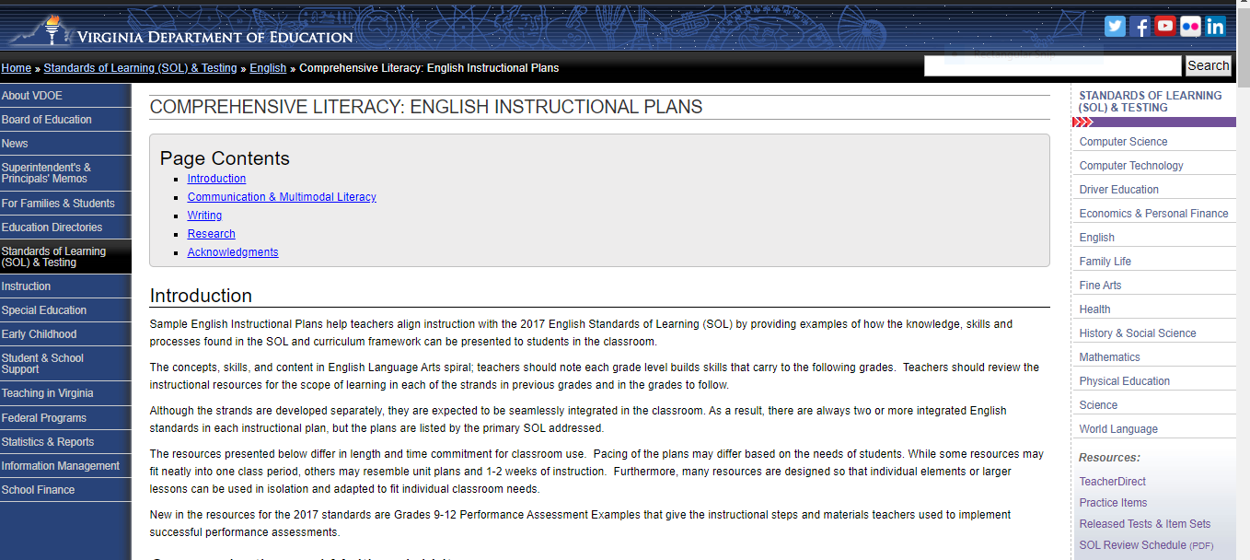
Resources that Align with the 2017 SOL
Comprehensive Literacy: English Instructional Plans
VDOE English Instructional Plans

Slide 33

Comprehensive Literacy: English Instructional Plans
Notes:
Listed by primary SOL

Slide 34
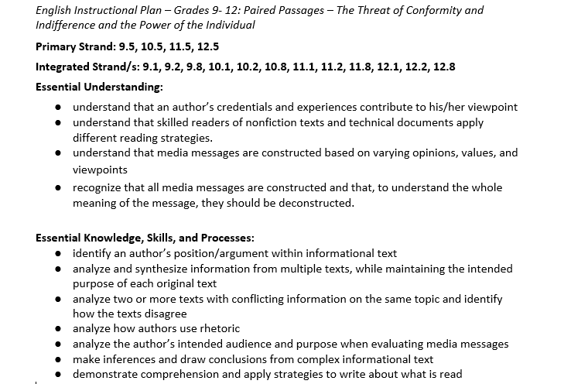
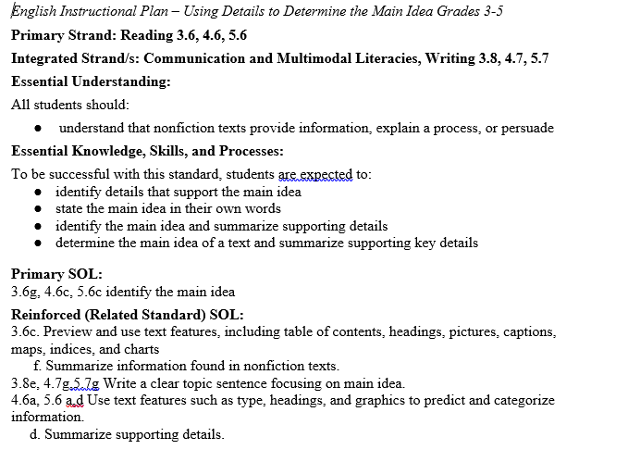
English Instructional Plan Samples

Slide 35
Professional Resources
Supporting All Learners with Complex Texts: Strategies to scaffold instruction of Standards-aligned, complex texts.
Teaching Elementary School Students to Be Effective Writers
How Can Complex Texts Ever Work for Below Grade Level Readers
Eight Ways to Help Students Read Complex Text

Slide 36
VDOE Disclaimer
Reference within this presentation to any specific commercial or non-commercial product, process, or service by trade name, trademark, manufacturer or otherwise does not constitute or imply an endorsement, recommendation, or favoring by the Virginia Department of Education.

Slide 37
Stay Connected
Jill Nogueras
K-12 English Coordinator
Jill.Nogueras@doe.virginia.gov
Carmen Kurek
Elementary English/Reading Specialist
Carmen.Kurek@doe.virginia.gov
Taylor Snow
English/History & Social Science Specialist
Taylor.Snow@doe.Virginia.gov
Assessment Office
Student_Assessment@doe.virginia.gov

