Slide 1
WELCOME!
You will be muted during the presentation.
Questions should be submitted through the Q&A.

Slide 2
Just In Time
Quick Checks
Grades 7, 8 and Algebra 1
Fall 2020 and Beyond
2

Slide 3
Today’s Presenters
Angela Byrd-Wright
Mathematics Curriculum Leader,
Hampton City Schools
Rebecca Hall
Instructional Liaison and
Mathematics Teacher,
CodeRVA
3

Slide 4
Agenda
Recover, Redesign, Restart 2020
When to Use Quick Checks
Components of a Quick Check
How to Use Quick Checks
Quick Check Availability
Other Resources
Questions can be added in the Q&A feature at the bottom of your screen.
4

Slide 5
Recover. Redesign. Restart. 2020
On June 9, 2020, Governor Northam announced a phased reopening plan for Virginia schools. During this press conference, Dr. Lane, Superintendent of Schools, shared the guidance document Recover, Redesign, Restart 2020.
Planning and preparing for instruction and assessment are key components of the guidance provided. Assessment should not be interpreted to mean a “testing event” but rather, a process of data collection that is ongoing, formative and low or no-stakes.
Assessment should include “just-in-time” formative assessments that inform immediate instructional needs.
5
Notes:
http://www.doe.virginia.gov/support/health_medical/covid-19/recover-redesign-restart-2020.pdf
This project is an effort to support teachers in this process.

Slide 6
Background Information
Mathematics staff from the Office of Student Assessment and the Office of STEM and Innovation at the Virginia Department of Education (VDOE), along with more than 40 mathematics teachers and leaders throughout Virginia, collaborated to develop “Just In Time Quick Checks” to assist teachers in identifying students’ unfinished learning while teaching current grade level content.
6

Slide 7
What is a Quick Check?
A Quick Check is a resource that generally includes 3 or more questions that are each designed to reveal common misconceptions or student errors when learning the content addressed by a standard and bullet.
7

Slide 8
Quick Check Content
Each mathematics standard and bullet from Kindergarten through Algebra I will have an associated Quick Check.
Each bullet of a standard has a separate Quick Check to allow for greater coverage of content.
8

Slide 9
Just in Time Instruction and Using Quick Checks (1 of 2)
Quick checks allow teachers to:
re-engage students in prerequisite knowledge within the context of grade level learning experiences;
remain focused on the learning happening today, not how we will “catch students up;” and
use “just in time” instruction versus “just in case” instruction.
9

Slide 10
Just in Time Instruction and Using Quick Checks (2 of 2)
Quick checks allow teachers to:
identify gaps in essential learning and additional scaffolding and support that may be required “just in time” to learn new content; and
respond to student needs in real time and in the context of grade level content.
10

Slide 11
Just in Case vs. Just in Time (1 of 2)
EXAMPLE: SOL 7.10a The student will determine the slope, m, in a proportional relationship.
“Just in case” instruction: Mrs. Merrick includes a re-teaching lesson on representing proportional relationships (SOL 6.12a) to all of her students prior to introducing slope.
Mrs. Merrick has used an entire class block to teach a lesson that most of her students may already understand.
11
Notes:
There is a distinct difference between Just in Case vs. Just in Time. Just in Case is not intentionally data-led and is based on an assumption that students might not know the content. Just in Case instruction can cause both teachers and students to waste valuable instructional time instead of engaging in instruction that is intentional and purposeful. Let us look at the next scenario to compare.

Slide 12
Just in Case vs. Just in Time (2 of 2)
EXAMPLE: SOL 7.10a The student will determine the slope, m, in a proportional relationship.
“Just in time” instruction: Mrs. Rodriguez identifies students who have unfinished learning by implementing a quick check of content from SOL 6.12a prior to introducing slope and reteaches those students.
Mrs. Rodriguez has used 10 minutes of class time to identify which students need additional reinforcement.
12
Notes:
In this example, based on identification of students’ unfinished learning from the 6.12a quick check, Mrs. Roddriguez is able to intentionally craft the learning and fold in the prerequisite standard of 6.12a while continuing with new learning for standard 7.10a. Only 10 minutes of class time was used to provide reinforcement in comparison to an entire class period from the previous example.

Slide 13
The VDOE Website
Both the Mathematics Standards of Learning (SOL) & Testing and Mathematics Instruction pages on the VDOE website will contain links to the Just in Time Mathematics Quick Checks.
13

Slide 14
The Web Page
Select the desired grade level.
14

Slide 15
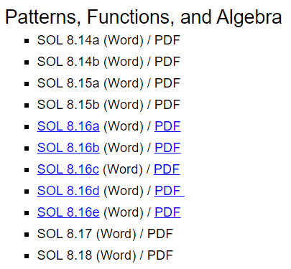
Grade Level Standards
Select the desired standard and bullet within the strand.
15
Notes:
Customize for Grade band (VDOE may have to do this)

Slide 16
Live Links vs. Coming Soon
Quick Checks that are available are hyperlinked and will appear blue and underlined.
Quick Checks that are coming soon will appear in black text (not yet hyperlinked).
16

Slide 17
How to Use Quick Checks (1 of 2)
Teachers should use Quick Checks while teaching current grade level content to:
identify and access supporting and prerequisite SOL that are necessary for current learning;
consider the most common student errors and misconceptions; and
plan for new instruction.
17

Slide 18
How to Use Quick Checks (2 of 2)
Teachers should use Quick Checks while teaching current grade level content to:
quickly assess newly taught content from the current grade level; and
quickly identify links to resources that support current grade level content.
18

Slide 19
How NOT to Use Quick Checks
Quick Checks are not intended to be used as a:
pre-assessment for a unit/semester/course of study;
practice SOL test;
practice packet for independent learning;
graded assignment/quiz/etc.; or
tool for determining course placement.
19

Slide 20
Quick Check Components
See link to Quick Check in the Chat box.
20
Notes:
http://www.doe.virginia.gov/testing/sol/standards_docs/mathematics/2016/jit/1a/1a-6a-jit.docx

Slide 21
Components of a Quick Check
Each Quick Check contains links to:
the Curriculum Framework;
questions designed to reveal possible student errors and misconceptions;
teacher notes for each question;
supporting resources; and
supporting and prerequisite SOL.
21

Slide 22
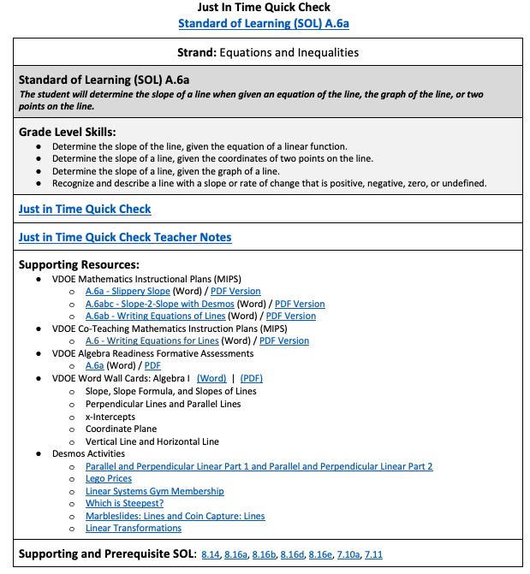
Quick Check A.6a
Each component offers a unique element of support to the content of the standard.
22
Notes:
As we are reviewing content from the 7 - Algebra I grade band, we have selected the A.6a Just In Time Quick Check due to the vertical articulation connects between grades 7 (7.10) and grade 8 (8.16).

Slide 23
Link to the Curriculum Framework
This link takes the user directly to the
Algebra I Mathematics Curriculum Framework.
23

Slide 24
The Strand, the Standard, and the Bullets
24

Slide 25
Student Questions and Teacher Notes
25
Notes:
The student questions and teacher notes are bookmarked within each document to quickly transport you to the applicable section. The Just In Time Quick Check will reroute you to the student problems while the Just In Time Quick Check Teacher Notes will reroute you to teacher notes with detailed student misconceptions and strategies or resources to mitigate those misconceptions.

Slide 26
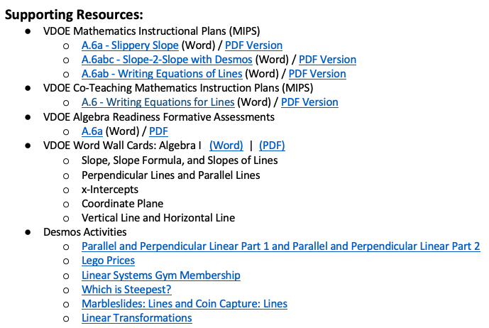
VDOE Supporting Resources
26
Notes:
Support resources are inclusive of applicable VDOE resources such as Mathematics Instructional Plans (MIPs); Co-Teaching Mathematical Instruction Plans; Algebra Readiness Formative Assessments or Plans; Word Wall Cards; and, Desmos Activities. At times, you may see instructional videos linked from the VDOE Mathematics website as well as eMediaVA.

Slide 27
Supporting and Prerequisite SOL
Quick Checks for supporting and prerequisite SOL are linked to each grade level Quick Check.
27
Notes:
The supporting and prerequisite standards are hyperlinked within each quick check. You will notice that the quick checks will most likely go back at most two grade levels in order to scaffold the instructional needs of students. Both the Mathematics Vertical Articulation Tool and extensive curriculum mapping process were used to identify the prerequisite standards needed to support current learning.

Slide 28
The Many Uses of Quick Checks:
Some Scenarios
28

Slide 29
Scenario 1
PLANNING
29

Slide 30
Uses of Quick Checks - Planning (1 of 4)
A group of Algebra I teachers is planning together and preparing to teach Standard of Learning A.6a.
The group accesses the Quick Check for A.6a on the VDOE website.
This Quick Check will provide them with quick access to the knowledge and skills expected at Algebra I, as well as knowledge and skills expected from previous grade levels.
30

Slide 31
Uses of Quick Checks - Planning (2 of 4)
Quick Check A.6a provides immediate access to the
Algebra I Curriculum Framework, the standard, and bullets for A.6a.
31

Slide 32
Uses of Quick Checks - Planning (3 of 4)
To determine what students should have learned in grade 8, the teachers select the link to the Grade 8 prerequisite SOLs, in particular 8.16b.
The Quick Check for 8.16b reveals that, in grade 8, students had to identify the slope and y-intercept of a linear function given a table of values (inclusive of the coordinates of the y-intercept), a graph, or an equation in y = mx + b form.
32

Slide 33
Uses of Quick Checks - Planning (4 of 4)
The Quick Check for 8.16b also reveals that in grade 8, when given the graph of a linear function, students are to identify the slope and y-intercept. The value of the y-intercept will be limited to integers. The coordinates of the ordered pairs shown in the graph will be limited to integers.
33

Slide 34
Scenario 2
IDENTIFYING SUPPORTING SOL
FROM PRIOR GRADE LEVELS
34

Slide 35
Uses of Quick Checks - Identifying Prior SOL (1 of 4)
Mrs. Lovings is teaching SOL A.6a and she notices that some students are consistently demonstrating errors or misconceptions in their understanding. She selects the link to Quick Check 8.16a and accesses the grade 8 questions by clicking on . She uses some of these questions to help her identify areas of unfinished learning for these students.
35

Slide 36
Uses of Quick Checks - Identifying Prior SOL (2 of 4)
Mrs. Lovings decides to use two questions from Quick Check 8.16a. Questions 1 and 3 will reveal whether students can distinguish from a graph of a line if the slope is positive, negative, or zero (0).
36

Slide 37
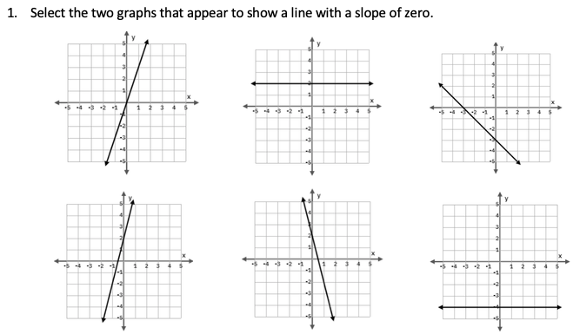
Uses of Quick Checks-Identifying Prior SOL (3 of 4)
Mrs. Lovings will be able to see if students are incorrectly identifying lines with a positive or negative slope as having a zero slope. This may indicate that students do not have an understanding of slope as a ratio of the vertical to horizontal change of a line and how that can be described as positive, negative, or zero slope.
37

Slide 38
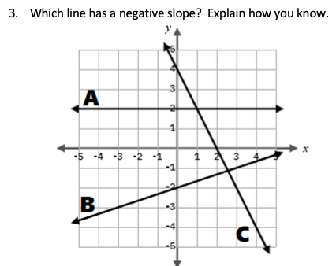
Uses of Quick Checks - Identifying Prior SOL (4 of 4)
The responses to this question will reveal whether students select line B as having a negative slope. This may indicate that students are looking at the y-intercept instead of the slope. Mrs. Lovings should also look for responses from students verbalizing the fact that lines with a negative slope are decreasing because they fall from left to right.
38

Slide 39
Scenario 3
FORMATIVE ASSESSMENT
39

Slide 40
Uses of Quick Checks - Formative Assessment (1 of 7)
Mr. Sellers provided instruction on SOL A.6a yesterday, during which students explored determining the slope from various situations. He wants to provide a quick warm-up activity at the start of class to see if his students understand these relationships and are ready for further instruction. He uses the from A.6a and selects Question 1 for his warm-up activity.
40

Slide 41
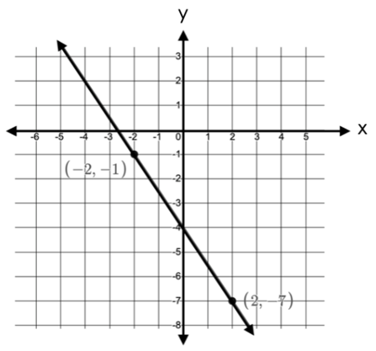
Uses of Quick Checks - Formative Assessment (2 of 7)
Student responses will help Mr. Sellers know which students need additional support or time to further develop understanding.
41

Slide 42
Uses of Quick Checks - Formative Assessment (3 of 7)
Mr. Sellers decides to use questions 4 and 5 at the end of his lesson to determine which students can determine the slope given two points without a graph.
42

Slide 43
Uses of Quick Checks - Formative Assessment (4 of 7)
Mr. Sellers uses this question to assess whether students have an understanding of slope given two points. The method students use to determine the slope will provide insight into their understanding.
43

Slide 44
Uses of Quick Checks - Formative Assessment (5 of 7)
Mr. Sellers uses this higher level question to assess whether students have an understanding of the relationship between the slope and the coordinates of the given points.
44

Slide 45
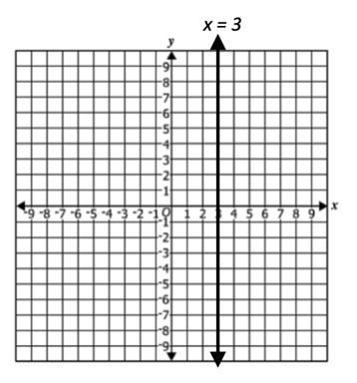
Uses of Quick Checks - Formative Assessment (6 of 7)
Mr. Sellers will save question 2 to use when students practice finding slope from a graph of a vertical line.
45

Slide 46
Uses of Quick Checks - Formative Assessment (7 of 7)
Mr. Sellers will save question 3 to use when students practice finding slope from an equation.
46

Slide 47
Scenario 4
PRE-ASSESSMENT
47

Slide 48
Uses of Quick Checks - Pre-Assessment
(1 of 5)
Mrs. Byers is concerned that students may have gaps in prior learning due to instructional time missed as a result of school closures. She plans to introduce SOL A.6a today but wants to determine her students’ prior knowledge of slope intercept form. As a bell ringer, she uses the questions from Quick Check 8.16b.
48

Slide 49
Uses of Quick Checks - Pre-Assessment
(2 of 5)
Mrs. Byers uses question 1 to determine whether students can correctly identify slope-intercept form.
49

Slide 50
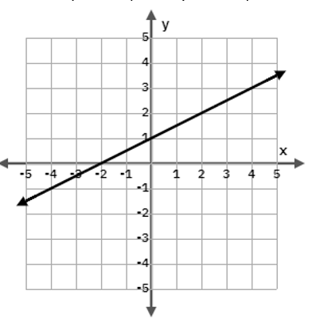
Uses of Quick Checks - Pre-Assessment
(3 of 5)
Mrs. Byers uses question 2 to determine whether students can identify slope and y-intercept given a graph.
50

Slide 51
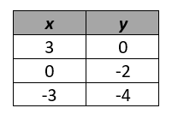
Uses of Quick Checks - Pre-Assessment
(4 of 5)
This question reveals whether students can use information provided in a table to identify the slope and y-intercept.
51

Slide 52
Uses of Quick Checks - Pre-Assessment
(5 of 5)
Mrs. Byers uses Quick Check 8.16b to gauge the amount of background knowledge her students have as they are introduced to the new content in SOL A.6a. These questions also provide opportunities to reactivate prior learning and help students recall graphing linear function concepts. In a short amount of time she has gained much information about her students.
52

Slide 53
Teacher Notes
53

Slide 54
The Teacher Notes
This link takes the user to a copy of the questions along with an explanation of students’ most common errors and misconceptions and what they may indicate. These notes also may include suggestions for helping students clarify the concept. These notes can be particularly useful for teachers as they assess student understanding and provide feedback.
54

Slide 55
Teacher Notes Example
A common error might be to say the slope is 2. This might indicate that the student sees slope as the coefficient of x regardless of whether the equation has been solved for y. Teachers may want to have students explore and compare the graphs of two linear equations where one is solved for y and the other is not (eg. y = 4x + 3 and 2y = 4x + 3). Teachers may benefit from using the Desmos Activity Marbleslides: Lines and Coin Capture: Lines to facilitate exploring the relationship between the equation and the slope of a line.
55
Notes:
The Teacher Notes from Algebra Quick Check SOL A.6a highlight a possible common student error, what that error might indicate about student understanding, and strategies that might benefit students who need additional support.

Slide 56
Ideas for Using Quick Checks in a Virtual Environment (1 of 2)
Have students complete their work and submit a picture using your school division’s Learning Management System (LMS).
Post the question on your shared screen (in a synchronous session) and have students do their work on paper or a small whiteboard. Then students can hold up their work so the teacher can review.
56

Slide 57
Ideas for Using Quick Checks in a Virtual Environment (2 of 2)
Have students create a Flipgrid video explaining how they have solved a particular problem. Students can use the whiteboard feature to show their work.
Have students show their work for each problem on Google Jamboard which provides a free whiteboard.
Include the selected questions into a Desmos Activity Builder so students can show their work for teachers to review.
57

Slide 58
When Will Quick Checks be Available?
The first round of Quick Checks are currently available on the webpage.
Quick Checks will continue to be uploaded over the next several weeks with all Quick Checks loaded and available by mid-September.
58

Slide 59
Users Group Opportunity for 2020-2021
The VDOE Team is looking to form a Users’ Group of mathematics teachers throughout Virginia who will:
participate in four webinars throughout the school year;
use the Quick Checks with their students throughout the year;
provide feedback based on their experiences; and
receive a stipend for their participation.
If you would be interested, please add your name to the Google Form link found in the Chat box. We will reach out with additional details in September.
59
Notes:
https://forms.gle/QthoUdJ4rQoyorvP8

Slide 60
Thank You - School Divisions Involved
Alexandria Henrico Stafford
Chesapeake Montgomery Waynesboro
Chesterfield Nottaway
CodeRVA Portsmouth
Danville Prince William
Franklin City Roanoke City
Hampton Roanoke County
Hanover Spotsylvania
60

Slide 61
Links to Other Resources
Addressing Unfinished Learning After COVID-19 School Closures , Council of the Great City Schools, June, 2020.
How to Select Math Intervention Content, February 2018, Achieve the Core, Aligned.
Restarting School: Planning for Acceleration in the 2020-2021 School Year, April 2020, TNTP, PDF.
61

Slide 62
Contacts
student_assessment@doe.virginia.gov
vdoe.mathematics@doe.virginia.gov
See link in the chat box for the
Just in Time – Mathematics Quick Checks
62
Notes:
The PowerPoints for today’s session will be made available on the webpage on Friday of this week; the recording will be posted following all of the webinars at the end of the month.

