Slide 1
Welcome!
Please note you have been muted for this presentation.
Questions should be submitted through the Q&A.

Slide 2
Just In Time
K-3 Quick Checks
Fall 2020 and Beyond
2

Slide 3
Today’s Presenters
Kathryn Munson
Elementary Math Coach
Henrico County Public Schools
Kimberly Bender
Instructional Designer
Chesterfield County Public Schools
3

Slide 4
Agenda
Recover, Redesign, Restart 2020
When to Use Quick Checks
Components of a Quick Check
How to Use Quick Checks
Quick Check Availability
Other Resources
Questions can be added in the Q&A feature at the bottom of your screen.
4

Slide 5
Recover. Redesign. Restart. 2020
On June 9, 2020, Governor Northam announced a phased reopening plan for Virginia schools. During this press conference, Dr. Lane, Superintendent of Schools, shared the guidance document Recover, Redesign, Restart 2020.
Planning and preparing for instruction and assessment are key components of the guidance provided. Assessment should not be interpreted to mean a “testing event” but rather, a process of data collection that is ongoing, formative and low or no-stakes.
Assessment should include “just-in-time” formative assessments that inform immediate instructional needs.
5
Notes:
http://www.doe.virginia.gov/support/health_medical/covid-19/recover-redesign-restart-2020.pdf
This project is an effort to support teachers in this process.

Slide 6
Background Information
Mathematics staff from the Office of Student Assessment and the Office of STEM and Innovation at the Virginia Department of Education (VDOE), along with more than 40 mathematics teachers and leaders throughout Virginia, collaborated to develop “Just In Time Quick Checks” to assist teachers in identifying students’ unfinished learning while teaching current grade level content.
6

Slide 7
What is a Quick Check?
A Quick Check is a resource that generally includes 3 or more questions that are each designed to reveal common misconceptions or student errors when learning the content addressed by a standard and bullet.
7

Slide 8
Quick Check Content
Each mathematics standard and bullet from Kindergarten through Algebra I will have an associated Quick Check.
Each bullet of a standard has a separate Quick Check to allow for greater coverage of content.
8

Slide 9
Just in Time Instruction and Using Quick Checks (1 of 2)
Quick checks allow teachers to:
re-engage students in prerequisite knowledge within the context of grade level learning experiences;
remain focused on the learning happening today, not how we will “catch students up;” and
use “just in time” instruction versus “just in case” instruction.
9

Slide 10
Just in Time Instruction and Using Quick Checks (2 of 2)
Quick checks allow teachers to:
identify gaps in essential learning and additional scaffolding and support that may be required “just in time” to learn new content; and
respond to student needs in real time and in the context of grade level content.
10

Slide 11
Just in Case vs. Just in Time (1 of 2)
EXAMPLE: SOL 3.2a The student will name and write fractions and mixed numbers represented by a model.
“Just in case” instruction: Mrs. Sanchez includes a re-teaching lesson on naming and writing fractions (SOL 2.4a).
Mrs. Sanchez has used an entire class block to teach a lesson that most of her students may already understand.
11

Slide 12
Just in Case vs. Just in Time (2 of 2)
EXAMPLE: SOL 3.2a The student will name and write fractions and mixed numbers represented by a model.
“Just in time” instruction: Mr. Rivers identifies students who have unfinished learning by implementing a quick check of content from SOL 2.4a prior to introducing identifying and naming fractions and mixed numbers.
Mr. Rivers has used 10 minutes of class time to identify which students need additional reinforcement.
12

Slide 13
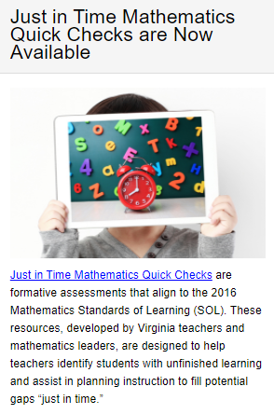
The VDOE Website
Both the Mathematics Standards of Learning (SOL) & Testing and Mathematics Instruction pages on the VDOE website will contain links to the Just in Time Mathematics Quick Checks.
13

Slide 14
The Web Page
Select the desired grade level.
14

Slide 15
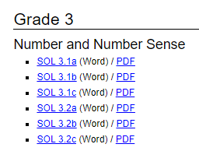
Grade Level Standards
Select the desired standard and bullet within the strand.
15

Slide 16
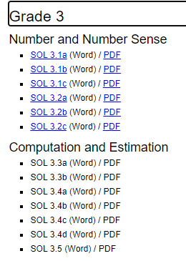
Live Links vs. Coming Soon
Quick Checks that are available will be blue and underlined.
Quick Checks that are coming soon will be in black text (not yet hyperlinked).
16

Slide 17
How to Use Quick Checks (1 of 2)
Teachers should use Quick Checks while teaching current grade level content to:
identify and access supporting and prerequisite SOL that are necessary for current learning;
consider the most common student errors and misconceptions; and
plan for new instruction.
17

Slide 18
How to Use Quick Checks (2 of 2)
Teachers should use Quick Checks while teaching current grade level content to:
quickly assess newly taught content from the current grade level; and
quickly identify links to resources that support current grade level content.
18

Slide 19
How NOT to Use Quick Checks
Quick Checks are not intended to be used as a:
pre-assessment for a unit/semester/course of study;
practice SOL test;
practice packet for independent learning;
graded assignment/quiz/etc.; or
tool for determining course placement.
19

Slide 20
Components of a Quick Check
See link to Quick Check in the Chat box.
20

Slide 21
Components of a Quick Check
Each Quick Check contains links to:
the Curriculum Framework;
questions designed to reveal possible student errors and misconceptions;
teacher notes for each question;
supporting resources; and
supporting and prerequisite SOL.
21

Slide 22
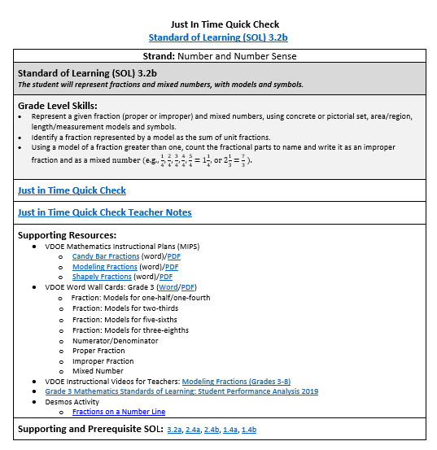
Quick Check 3.2b
Each component offers a unique element of support to the content of the standard.
22
Notes:
http://www.doe.virginia.gov/testing/sol/standards_docs/mathematics/2016/jit/3/3-2b-jit.docx

Slide 23
Link to the Curriculum Framework
This link takes the user directly to the Grade 3 Mathematics Curriculum Framework.
23

Slide 24
The Strand, the Standard, and the Bullets
24

Slide 25
Student Questions and Teacher Notes
25

Slide 26
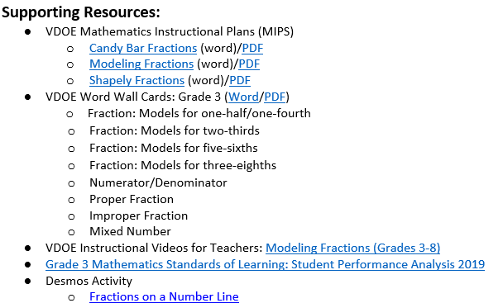
VDOE Supporting Resources
26

Slide 27
Supporting and Prerequisite SOL
Quick Checks for supporting and prerequisite SOL are linked to each grade level Quick Check.
27

Slide 28
The Many Uses of Quick Checks:
Some Scenarios
28

Slide 29
Scenario 1
PLANNING
29

Slide 30
Uses of Quick Checks - Planning (1 of 4)
A group of grade 3 teachers is planning together and preparing to teach Standard of Learning 3.2b.
The group accesses the Quick Check for 3.2b on the VDOE website.
This Quick Check will provide them with quick access to the knowledge and skills expected at grade 3, as well as supporting and prerequisite knowledge and skills expected from previous grade levels.
30

Slide 31
Uses of Quick Checks - Planning (2 of 4)
Quick Check 3.2b provides immediate access to the Grade 3 Curriculum Framework, the standard, and bullets for 3.2b.
31

Slide 32
Uses of Quick Checks - Planning (3 of 4)
To determine what students should have learned in grade 2, the teachers select the link to the Grade 2 prerequisite SOL (2.4a, 2.4b).
The Quick Checks for 2.4a and 2.4b reveal that, in grade 2, students learned to name and write fractions represented by a set, region, or length model.
32

Slide 33
Uses of Quick Checks - Planning (4 of 4)
The Quick Checks for 2.4a and 2.4b also reveal that, in grade 2, student expectations were limited to proper fractions including halves, fourths, eighths, thirds, and sixths. This information helps the grade 3 teachers know that students have not had formal experiences with mixed numbers or all denominators 12 or less, so this information will be new to students.
33

Slide 34
Scenario 2
IDENTIFYING SUPPORTING SOL
FROM PRIOR GRADE LEVELS
34

Slide 35
Uses of Quick Checks - Identifying Prior SOL (1 of 6)
Mrs. Lovings is teaching SOL 3.2b and she notices that some students are consistently demonstrating errors or misconceptions in their understanding. She selects the link to Quick Check 2.4b and accesses the grade 2 questions by clicking on .
She uses some of these questions to help her identify areas of unfinished learning for these students.
35

Slide 36
Uses of Quick Checks - Identifying Prior SOL (2 of 6)
Mrs. Lovings decides to use questions 1 and 3 from Quick Check 2.4b with these students to help her better identify student misconceptions about proper fractions with an area model.
36

Slide 37
Uses of Quick Checks - Identifying Prior SOL (3 of 6)
Question 1 will reveal whether these students can create an area model to represent a proper fraction.
37

Slide 38
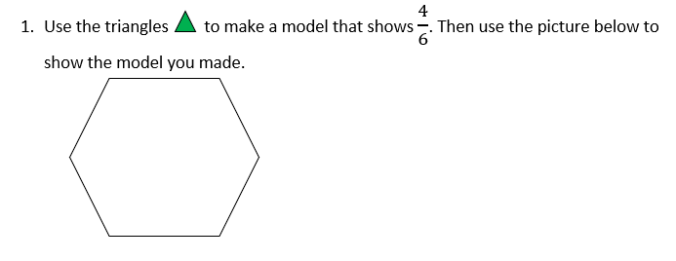
Uses of Quick Checks-Identifying Prior SOL (4 of 6)
Mrs. Lovings will be able to see how students decide to model $\frac{4}{6}$ and whether they do it accurately.
38

Slide 39
Uses of Quick Checks - Identifying Prior SOL (5 of 6)
Question 3 will reveal whether students are able to model fractions by creating equal-sized parts.
39

Slide 40
Uses of Quick Checks - Identifying Prior SOL (6 of 6)
Responses to question 3 will reveal whether students understand the numerator and denominator. In addition, Mrs. Lovings will know whether students understand that fractions should be equal parts. For example, folding the bar in half should create two equal parts.
40

Slide 41
Scenario 3
FORMATIVE ASSESSMENT
41

Slide 42
Uses of Quick Checks - Formative Assessment (1 of 6)
Mr. Sellers introduced SOL 3.2b to his students yesterday and discussed modeling fractions with an area model. He wants to provide a quick warm-up activity at the start of class to see if students understand modeling improper fractions. He uses the from 3.2b and selects Question 1 for his warm-up activity.
42

Slide 43
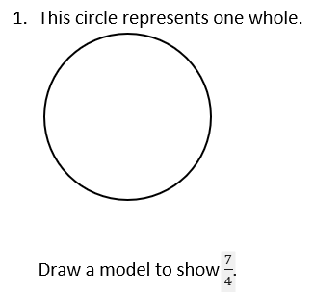
Uses of Quick Checks - Formative Assessment (2 of 6)
Student responses will help Mr. Sellers know which students need additional support understanding and representing improper fractions.
43

Slide 44
Uses of Quick Checks - Formative Assessment (3 of 6)
Mr. Sellers decides to use Question 4 at the conclusion of his lesson to determine whether all students are able to add tick marks between whole numbers on a given number line to represent proper and improper fractions.
44

Slide 45
Uses of Quick Checks - Formative Assessment (4 of 6)
Mr. Sellers uses this question to assess whether students have a better understanding of fractions on a number line following his lesson.
45

Slide 46
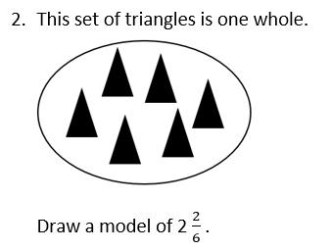
Uses of Quick Checks - Formative Assessment (5 of 6)
Mr. Sellers will save question 2 to use when the class is focusing on fractions of a set.
46

Slide 47
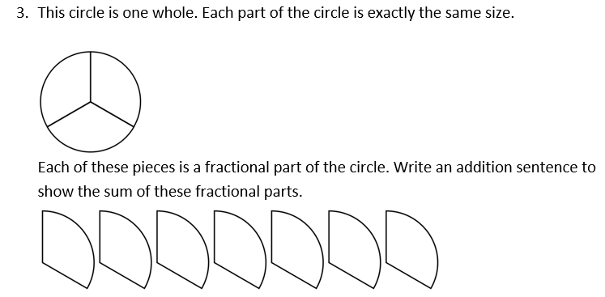
Uses of Quick Checks - Formative Assessment (6 of 6)
Mr. Sellers will use this question at a later time.
47

Slide 48
Scenario 4
PRE-ASSESSMENT
48

Slide 49
Uses of Quick Checks - Pre-Assessment
(1 of 5)
Mrs. Byers is concerned that students may have gaps in prior learning due to time missed from school. She plans to introduce SOL 3.2b today but wants to determine her students’ prior knowledge of fractions. As a bell ringer, she uses a question from Quick Check 2.4a.
49

Slide 50
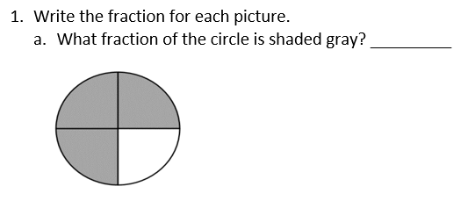
Uses of Quick Checks - Pre-Assessment
(2 of 5)
Mrs. Byers uses question 1 to determine whether students can name and write fractions represented by an area model.
50

Slide 51
Uses of Quick Checks - Pre-Assessment
(3 of 5)
Mrs. Byers uses question 2 to determine whether students can identify equal parts.
51

Slide 52
Uses of Quick Checks - Pre-Assessment
(4 of 5)
This question reveals whether students can name and write fractions represented by a set model.
52

Slide 53
Uses of Quick Checks - Pre-Assessment
(5 of 5)
Mrs. Byers uses Quick Check 2.4a to gauge the amount of background knowledge her students have as they are introduced to the new content in SOL 3.2b. These questions also provide opportunities to reactivate prior learning and help students recall the fraction concepts. In less than 10 minutes she has gained much information about her students.
53

Slide 54
THE TEACHER NOTES
54

Slide 55
The Teacher Notes
This link takes the user to a copy of the questions along with an explanation of students’ most common errors and misconceptions and what they may indicate. These notes also may include suggestions for helping students clarify the concept. These notes can be particularly useful for teachers as they assess student understanding and provide feedback.
55

Slide 56
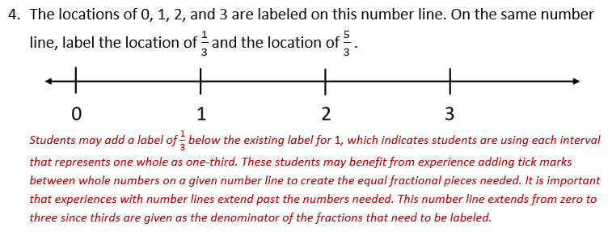
Teacher Notes Example
56

Slide 57
Ideas for Using Quick Checks in a Virtual Environment (1 of 2)
Have students complete their work and submit a picture using your school division’s Learning Management System (LMS).
Post the question on your shared screen (in a synchronous session) and have students do their work on paper or a small whiteboard. Then students can hold up their work so the teacher can review.
57

Slide 58
Ideas for Using Quick Checks in a Virtual Environment (2 of 2)
Have students create a Flipgrid video explaining how they have solved a particular problem. Students can use the whiteboard feature to show their work.
Have students show their work for each problem on Google Jamboard which provides a free whiteboard.
Include the selected questions into a Desmos Activity Builder so students can show their work for teachers to review.
58

Slide 59
When Will Quick Checks be Available?
The first round of Quick Checks are currently available on the webpage.
Quick Checks will continue to be uploaded over the next several weeks with all Quick Checks loaded and available by mid-September.
59
Notes:
VDOE will take over; thank leads and wrap up with logistical questions.

Slide 60
Users Group Opportunity for 2020-2021
The VDOE Team is looking to form a Users’ Group of mathematics teachers throughout Virginia who will:
Participate in four webinars throughout the school year;
Use the Quick Checks with their students throughout the year; and
Provide feedback based on their experiences and receive a stipend for their participation.
If you would be interested, please add your name to the
Google Form link found in the Chat box. We will reach
out with additional details in September.
60
Notes:
https://forms.gle/1QfdEg6aczZ73d5i7

Slide 61
Thank You - School Divisions Involved
Alexandria Henrico Stafford
Chesapeake Montgomery Waynesboro
Chesterfield Nottaway
CodeRVA Portsmouth
Danville Prince William
Franklin City Roanoke City
Hampton Roanoke County
Hanover Spotsylvania
61

Slide 62
Links to Other Resources
Addressing Unfinished Learning After COVID-19 School Closures , Council of the Great City Schools, June, 2020.
How to Select Math Intervention Content, February 2018, Achieve the Core, Aligned.
Restarting School: Planning for Acceleration in the 2020-2021 School Year, April 2020, TNTP, PDF.
62
Notes:
In addition, the PowerPoints for today’s session will be made available on the webpage on Friday of this week; at the conclusion of all webinars, the a recording of each grade band will be posted.

Slide 63
Contacts
student_assessment@doe.virginia.gov
vdoe.mathematics@doe.virginia.gov
See link in the chat box for the
Just in Time – Mathematics Quick Checks
63

