Slide 1
Unpacking the
Inquiry Design Model:
Pilot Opportunity for
State-Developed Performance Tasks
October 4, 2021

Slide 2
Agenda
Background
Superintendent’s Memo #276-21
Unpacking the Inquiry Design Model: Pilot Opportunity for State-Developed Performance Tasks
What teachers need to consider when planning for instruction and assessment
What will be provided directly to students
What may and may not be adjusted or altered
Frequently asked questions

Slide 3
.

Slide 4
Background

Slide 5
Background (1 of 6)
The 2020 and 2021 Virginia General Assembly’s Appropriations Acts (line 139) provided an additional option for students to earn a verified credit in history and social science.

Slide 6
Background (2 of 6)
D.1. . . .Such verified credit shall be earned by
(iv) successful completion of assessments that include state-developed performance tasks scored locally in accordance with Board guidelines using state-developed rubrics.
Notes:
Out of this appropriation, $300,000 the first year and $300,000 the second year from the general fund is provided for assessment related materials for a verified credit in high school history and social science. In establishing graduation requirements, the State Board of Education shall require students to earn one verified credit in history and social science.

Slide 7
Background (3 of 6)
As required by this legislation, the proposed revisions to the SOA Guidance Document will establish guidelines to which school divisions must adhere when exercising option (iv) as permitted by this legislation.
These guidelines will contribute to consistency among school divisions when determining if a student has earned a Locally Awarded Verified Credit (LAVC) in history and social science.

Slide 8
Background (4 of 6)
To comply with the emphasis on history and social science courses eligible for verified credit included in legislation from the 2020 General Assembly
2020 - VDOE convened a group of experienced teachers, division-level specialists, and division instructional leaders/supervisors responsible for history and social science instruction to develop performance tasks that could be used to verify a credit in Virginia and U.S. History.
Notes:
To comply with the emphasis on history and social science courses eligible for verified credit included in legislation from the 2020 General Assembly and accommodate the limited resources allocated for this work, VDOE narrowed its task development during 2020 to focus on the Virginia and United States History course.

Slide 9
Background (5 of 6)
To comply with the emphasis on history and social science courses eligible for verified credit included in legislation from the 2020 General Assembly (Continued)
2021 - VDOE convened a group of experienced educators to:
participate in a range-finding session to develop anchors for Virginia and U.S. History.
develop performance tasks that could be used to verify a credit in World History and Geography courses.
Notes:
To comply with the emphasis on history and social science courses eligible for verified credit included in legislation from the 2020 General Assembly and accommodate the limited resources allocated for this work, VDOE narrowed its task development during 2020 to focus on the Virginia and United States History course.

Slide 10
Background (6 of 6)
At its meeting on Thursday, September 23, 2021, the Virginia Board of Education approved Item D: Revisions to the Guidelines for Locally Awarded Verified Credits Contained in the Guidance Document Governing Certain Provisions of the Regulations Establishing Standards for Accrediting Public Schools in Virginia to Allow for the Use of Performance Assessments to Verify Credits in History and Social Science.

Slide 11
Superintendent’s Memo #276-21

Slide 12
Superintendent’s Memo #276-21(1 of 2)
“Revisions to the Guidelines for Locally Awarded Verified Credits to Allow for the Use of Performance Assessments to Verify Credits in History and Social Science”
Guidelines for Locally Awarded Verified Credits
Implementation Support for School Divisions Using State-Developed Performance Tasks to Verify Credits in History and Social Science

Slide 13
Superintendent’s Memo #276-21 (2 of 2)
The pilot opportunity with state-developed performance tasks in World Geography, World History I, and World History II offers some flexibility that would not be permitted if tasks were being used to verify credits in these courses.
Teachers can score any/all tasks for their own students.
Pilot tasks can be completed under remote conditions when all instruction is provided virtually.
Teachers can choose to use one or more tasks.

Slide 14
Pilot Opportunity for 2021-2022: Requirements for Implementation
Required: Use the summative task as written with students.
Do not provide additional prompting or materials as support during the administration of the summative assessment.
*A selection of slides from the August presentation that provided an overview of the pilot opportunity for school division leaders is included at the end of this presentation for reference.

Slide 15
What teachers need to consider when planning for instruction and assessment

Slide 16
Planning (1 of 7)
Why is this task so long?
In an effort to demonstrate the connections between instruction and assessment, the state-developed performance tasks provide background information, including an overview of the inquiry, information about the sources, the supporting questions, and instructional supports and strategies.

Slide 17
Planning (2 of 7)
Cover Sheet
Compelling Question
Image
Supporting Questions

Slide 18
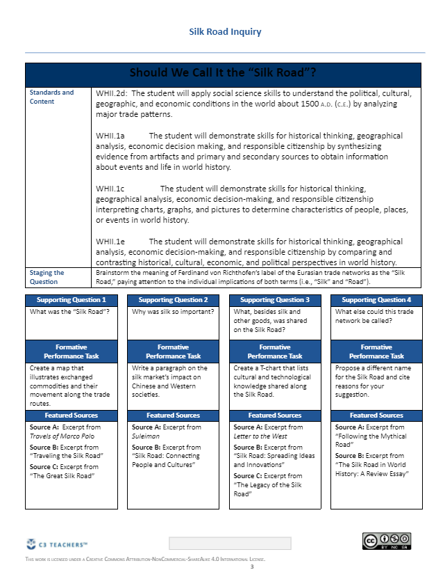
Planning (3 of 7)
Blueprint
Content Standards and Skills
Formative Assessments:
Supporting questions, Tasks, and Sources
Summative Assessment

Slide 19
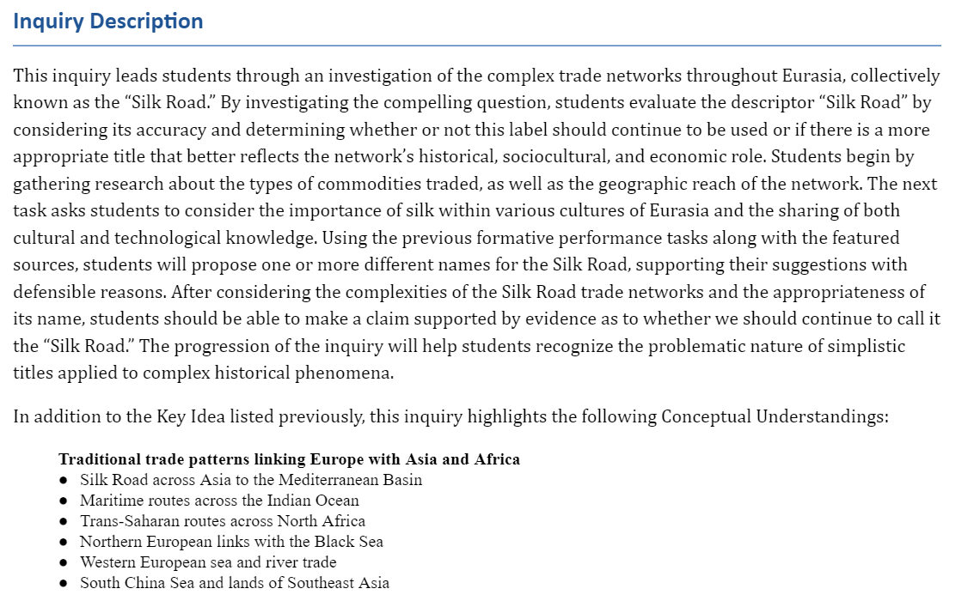
Planning (4 of 7)
Information about the inquiry, relevant understandings and knowledge

Slide 20
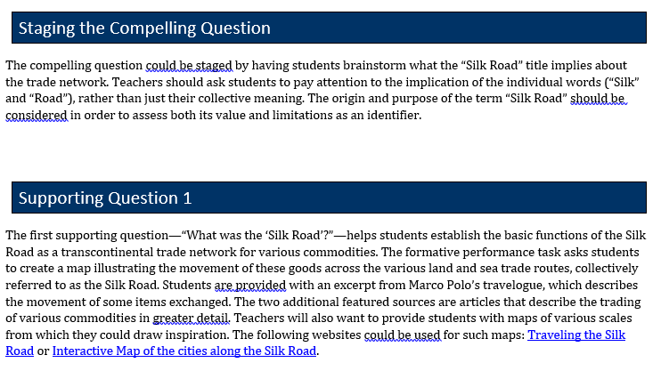
Planning (5 of 7) Questions, Tasks, and Sources
Staging the Compelling Question
Supporting Question
Shows how the question, tasks and sources are connected
Shows how all three will help students support their claim

Slide 21
Planning (6 of 7)
Summative Task
Summarizes what students should have gained thus far - knowledge and understanding.
After completing the formative tasks, students should be able to use evidence from multiple sources.
Also provides some likely arguments that students may present.

Slide 22
Planning (7 of 7)
Sources
Instructionally: What are some reading strategies that can be used with this source?
Guided Questions about the Source
Vocabulary and Graphic Organizers

Slide 23
Planning (7 of 7) Continued
Sources
These are great tools to use during instruction, but cannot be used to construct the summative assessment.
These help students understand the individual source.

Slide 24
What will be provided directly to students?

Slide 25
Provided directly to students (1 of 9)
Student work generated independently on the scaffolding questions that are a component of the state-developed performance task and a student’s notes and annotations for the task are examples of appropriate ancillary materials permitted for use by a student during construction of the final response to the state-developed task.

Slide 26
Provided directly to students (2 of 9)
As well, the appropriate state-developed common rubric should be provided to each student as written, without any modifications, additions, or deletions.

Slide 27
Provided directly to students (3 of 9)
The scaffolding questions provided as part of the recommended instructional implementation for each state-developed task are intended to be formative and provide an opportunity for constructive feedback from a teacher and/or peers.

Slide 28
Provided directly to students (4 of 9)
It is appropriate for the student to have access to feedback from a teacher and/or peers on the student’s responses to the formative task/scaffolding questions included in the state-developed performance task when independently composing the response to the summative task.

Slide 29
Provided directly to students (5 of 9)

Slide 30
Provided directly to students (6 of 9)
Ancillary materials that provide inappropriate assistance with the skills and content being assessed are not permitted and may prevent a student from independently demonstrating proficiency.

Slide 31
Provided directly to students (7 of 9)
Examples of ancillary materials that provide inappropriate assistance include, but are not limited to:
drafts for the final response,
notes or instructions from the teacher on information that should be included within different sections or paragraphs of the student’s response,
sentence frames or paragraph frames that lead or cue the student in developing the response,

Slide 32
Provided directly to students (8 of 9)
Examples of ancillary materials that provide inappropriate assistance include, but are not limited to:
a list of steps to follow when composing a response,
graphic organizers that lead students through the steps in developing an argument,
a state-developed rubric that has been modified to include examples specific to the course or task content, etc.

Slide 33
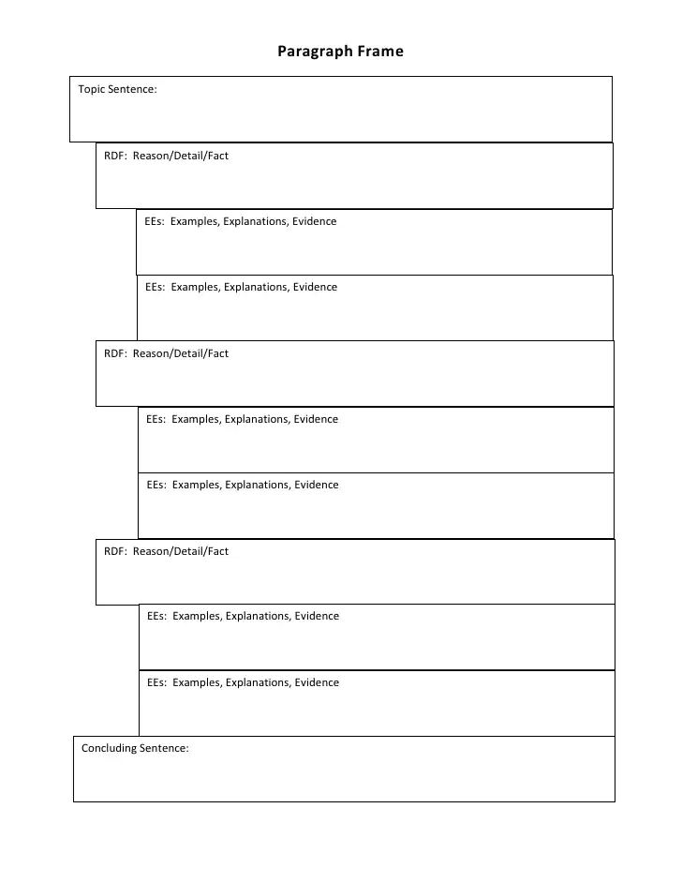
Provided directly to students (9 of 9)
Notes:
These are examples of inappropriate ancillary materials. They prompt or cue students to include certain specific elements in their response.

Slide 34
What may and may not be adjusted or altered within the performance task?

Slide 35
Adjusted or Altered (1 of 5)

Slide 36
Adjusted or Altered (2 of 5)

Slide 37
Adjusted or Altered (3 of 5)
You may add Additional Sources!
It is important to ensure resources are connected to building content knowledge while considering perspective, context, and accuracy of the resource. Many reputable sites offer FREE sources that work well with other resources shared in these state-developed performance tasks.

Slide 38
Adjusted or Altered (3 of 5) Continued
You may add Additional Sources!
It is important to ensure resources are connected to building content knowledge while considering perspective, context, and accuracy of the resource. Many reputable sites offer FREE sources that work well with other resources shared in these state-developed performance tasks.
Additional resources to consider

Slide 39
Adjusted or Altered (4 of 5)
You may NOT adjust or alter the “Compelling Question” as a part of the summative assessment.

Slide 40
Frequently Asked Questions

Slide 41
What will be required for eligible students to earn verified credit? (1 of 2)
A student who is eligible for locally awarded verified credit under this option:
is enrolled in a course eligible for verified credit
passes the course
demonstrates mastery of the entire course through a local verification process that must consist of evaluation of a collection of evidence

Slide 42
What will be required for eligible students to earn verified credit? (2 of 2)
The collection of evidence must include
the student’s responses to state-developed performance tasks for a majority of the different historical eras/categories for the entire course, completed and scored under conditions adhering to the Guidelines for Locally Awarded Verified Credits; AND
Local assessments that cover the remaining SOL not measured by the state-developed performance tasks

Slide 43
What supports and accommodations can be provided to EL or students with disabilities?
Allowable accommodations provide access to the task without providing inappropriate assistance with the content being assessed.
Accommodations that prompt or cue students to include specific elements in a response or to follow a certain structure are not permitted.
Refer to the Implementation Support for School Divisions Using State-Developed Performance Tasks to Verify Credits in History and Social Science.

Slide 44
Can some schools in a division use state-developed tasks to verify credit and others use SOL tests?
This decision can be made on a school-by-school basis (or on a course-by-course basis within one or more schools). The division is expected to build capacity with intentional and targeted professional development so that that the number of schools exercising this option increases annually and all schools are ready by year 4.
Implementation is NOT available on a teacher-by-teacher basis or student-by-student basis.
Notes:
For long term success, some flexibility for implementation will be allowed to provide time to build capacity and develop leadership for this type of instruction and assessment within schools as they scale up. (Example: year one- one or more schools; year 2- at least 1/3 of the schools in the division; year 3- at least 2/3 of the schools in the division; year 4- all schools in the division)
While scaling up, state-developed performance tasks are only shared with the teachers in the schools that are verifying credit with the tasks to limit exposure.

Slide 45
Will end-of-course SOL tests in history and social science still be administered?
School divisions continue to have the option to use SOL tests to verify credits in history/social science.
End-of-course SOL tests remain an option for verifying credit in history and social science unless eliminated by the Virginia General Assembly or Virginia Board of Education.

Slide 46
Can a student re-submit a response to a task for rescoring after making revisions?
This is not permitted. The student may be offered the opportunity to complete a different state-developed task.
Before a new task is completed, it is best practice:
to confer with the student to ensure feedback is understood, and
to provide additional instruction and guided practice based on the evidence in the response.
Notes:
A response that is re-submitted after making revisions is not representative of independent work.

Slide 47
Do we submit the student’s formative task responses and summative task response to VDOE?
Do not submit formative task responses to VDOE.
Summative task responses should be sorted as representing high/medium/low achievement but should not have scores assigned when submitted.
Be sure to remove personally identifiable information from each response.

Slide 48
Contact Information (1 of 2)
Christonya Brown, History and Social Science Education Coordinator, Christonya.Brown@doe.virginia.gov
Andrea Emerson, History and Social Science Secondary Specialist, Andrea.Emerson@doe.virginia.gov
Brandi McCracken, History and Social Science Elementary Specialist, Brandi.McCracken@doe.virginia.gov

Slide 49
Contact Information (2 of 2)
Office of Student Assessment
student_assessment@doe.virginia.gov
(804) 225-2102
Holli Cook, Assessment Coordinator, Holli.Cook@doe.virginia.gov
Chris Tsitsera, Assessment Specialist, Chris.Tsitsera@doe.virginia.gov

Slide 50
Resources

Slide 51
Resources (1 of 3)
Guidelines for Locally Awarded Verified Credits
Implementation Support for School Divisions Using State-Developed Performance Tasks to Verify Credits in History and Social Science
Annual notification through online survey
Locally Awarded Verified Credit for History and Social Science fillable form

Slide 52
Resources (2 of 3)
HSS State Developed Common Rubric-Upper Secondary: use “as is” when scoring responses to state-developed performance tasks used to verify credits in VA/US
HSS State Developed Common Rubric-Early Secondary: will be used “as is” to score responses to state-developed tasks used to verify credits in World Geography, World History I, and World History II

Slide 53
Resources (3 of 3)
Resources currently available on the VDOE website:
Conducting a Holistic Scoring Event - This presentation may be helpful in preparing for and conducting a local scoring event using the common rubrics for history and social science.
History and Social Science Scoring Supports (PPT) - These slides from the webinar hosted on March 31, 2021, by the Office of Student Assessment and Office of Humanities provide an overview of resources to support scoring performance assessments and performance tasks using the state common rubrics.

Slide 54
Pilot Opportunity for State-Developed Performance Tasks
*Slides in this section are from the presentation shared with school division instruction leaders and testing directors in August, 2021.

Slide 55
Pilot Opportunity for 2021-2022: Submitting Task Responses
Send student responses to VDOE, labeled as H/M/L, within 2 weeks of administering the task.
Send at least 5 student samples for each level
Submit Pilot Task Feedback Form for each task within 2 weeks of administering the task.
Follow directions from VDOE to prepare and submit student samples through the SSWS Dropbox.

Slide 56
Pilot Opportunity for 2021-2022:
Scoring Responses to Tasks
Use information from Conducting a Holistic Scoring Event in conjunction with Principles of Scoring Student Work (Stanford Center for Assessment, Learning & Equity) to provide training on scoring.
Teachers use the HSS State Developed Common Rubric-Early Secondary as written. (Note: Please do not submit scored student work to VDOE.)

Slide 57
Security for State-developed Tasks
Tasks will be sent to the DDOT through SSWS Dropbox.
The DDOT will establish the local process for storing and sharing the task with teachers in the pilot.
Tasks may be shared through the local network in the same manner that other divisionwide assessments are shared.
Do not email tasks to teachers.
Treat these tasks with the same type of security that would apply to a local final examination.

Slide 58
Pilot: Completing Tasks when All Instruction is Provided Virtually
State-developed tasks completed during the pilot program in 2021-2022 that will NOT be used for verifying a credit in history and social science can be completed in a remote setting when all instruction is being provided virtually.
When this occurs, testing conditions in place for local assessments being completed remotely are to be followed.

