Slide 1
Reading + Writing = Skilled Readers/ Writers
It Just Makes Sense!
Presenters:
Susan Hoch
and
Jessica Kidd

Slide 2
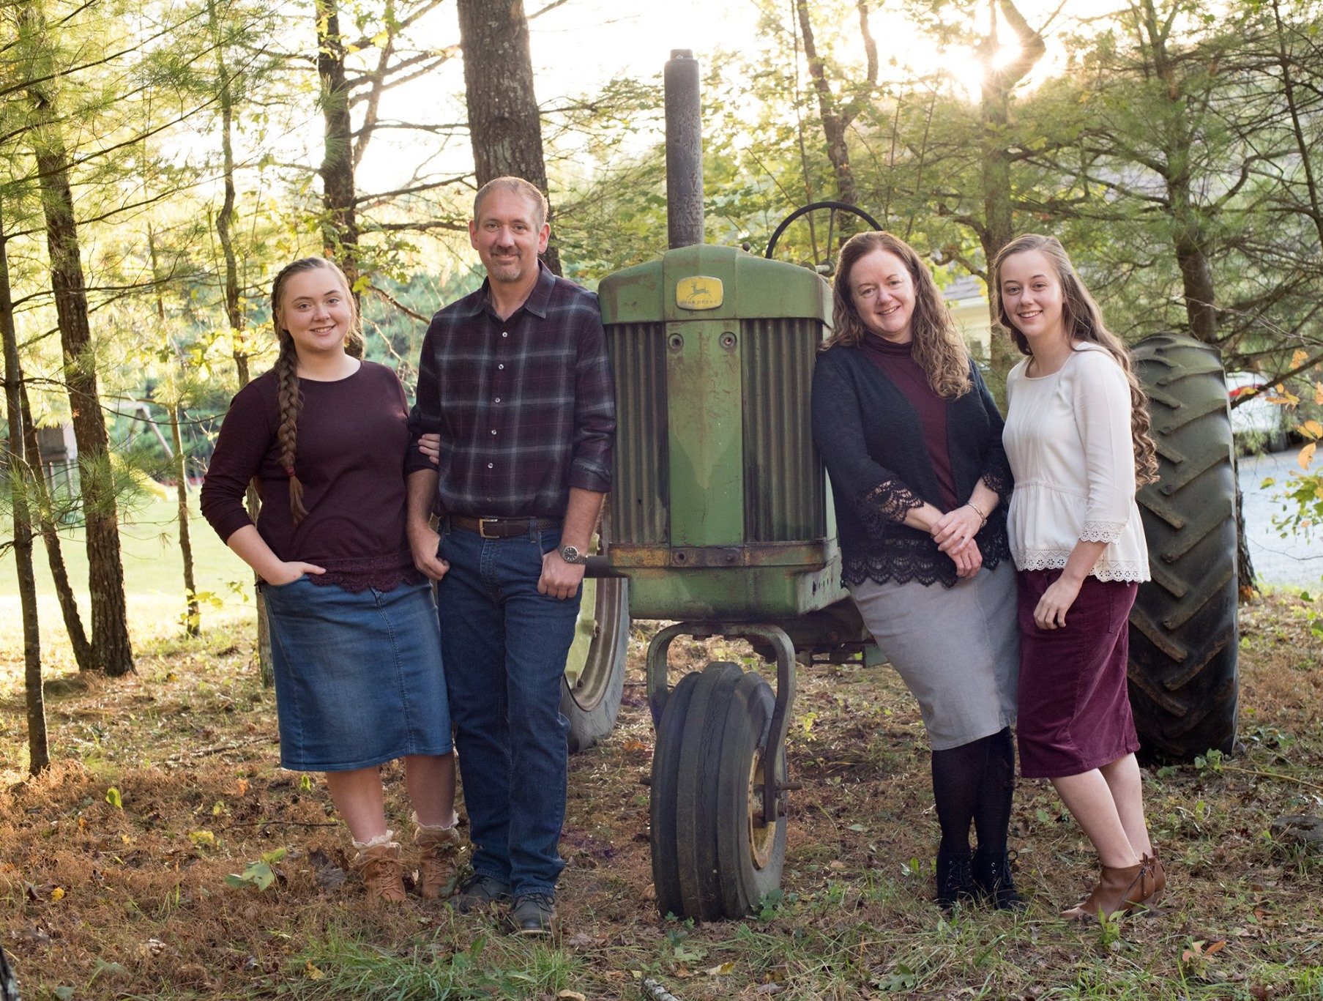
Who We Are
Susan Hoch
Galax Elementary School Reading Specialist Grades PreK-2
Jessica Kidd
Galax Elementary School Reading Specialist Grades 3-5
susanhoch@galaxschool.us
jessicakidd@galaxschools.us

Slide 3
Before we start…
If you have:
Questions?
“Ah-ha” moments?
Confusions?
https://tinyurl.com/vdoe3to5

Slide 4
Simple View of Reading
Word Recognition
Language Comprehension
Reading Comprehension
X
=
Phonological Awareness
Decoding
Sight Recognition
Background Knowledge
Vocabulary
Language Structures
Verbal Reasoning
Literacy Knowledge
Gough and Tunmer (1986)

Slide 5
Word Recognition
Phonological Awareness
conscious awareness of all levels of the speech sound system (syllables, stress/ unstressed, onset-rime, phonemes)
Decoding
ability to translate a word from print to speech (sound-symbol correspondences)
Sight Recognition
words a student instantly and effortlessly recognizes
Mastery of these skills must be reached before attention can be given to a deeper understanding of what is being read!

Slide 6
Language Comprehension
Background Knowledge
a student’s bank of knowledge and facts from previous experiences
Vocabulary
a memory storage of word meanings
Language Structures
how sentences are constructed (syntax, semantics, etc)
Verbal Reasoning
making inferences, understanding figurative language, etc
Literacy Knowledge
understanding genres, an understanding of print concepts

Slide 7
The Reading Rope

Slide 8
Simple View of Writing
Foundational Writing Skills
Composition
Skilled Written Expression
X
=
Letter Formation
Handwriting/ Typing Fluency
Spelling
Punctuation
Word/ Sentence Spatial Organization
Topic Knowledge
Vocabulary/ Word Choice
Sentence Formulation
Grammar and Usage
Literacy Form
Organization of Ideas
Audience Awareness
Voyagers Sopris Learning 2019

Slide 9
Foundational Writing Skills (1 of 3)
Letter Formation
lowercase first, then uppercase
lined/marked paper
good sitting posture/tripod pencil grip/paper position
sky write/trace/practice
Handwriting/ Typing Fluency
dominant hand (ex. ball)
one minute fluency drills building writing fluency
Spelling
Teach spelling patterns
Promote word analysis
Explicit phonics lesson - syllabication/dictation/practice
Punctuation,
Should be taught from Kindergarten
Simple Checklist Poster
Word/ Sentence Spatial Organization
Teacher introduces, guides through modeling.
Sentence Builder Chart

Slide 10
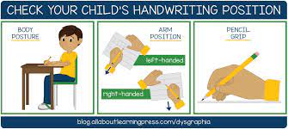
Foundational Writing Skills (2 of 3)
Mastery of these skills must be reached before attention can be given to composition!
TheSchoolRun.com

Slide 11
Foundational Writing Skills (3 of 3)

Slide 12
Composition
Topic Knowledge
Brainstorming
Vocabulary/ Word Choice
Effective & precise language that conveys meaning
Sentence Formulation
Sentence Builder Charts
Sencture Structure
Grammar and Usage
Correct placement of words/Using proper words
Literary Forms (for example: Genres)
realizing the distinction between type of writing
Organization of Ideas
Color Coding Sentence to build paragraphs
Audience Awareness
Knowing your audience so you convey the message effectively.

Slide 13
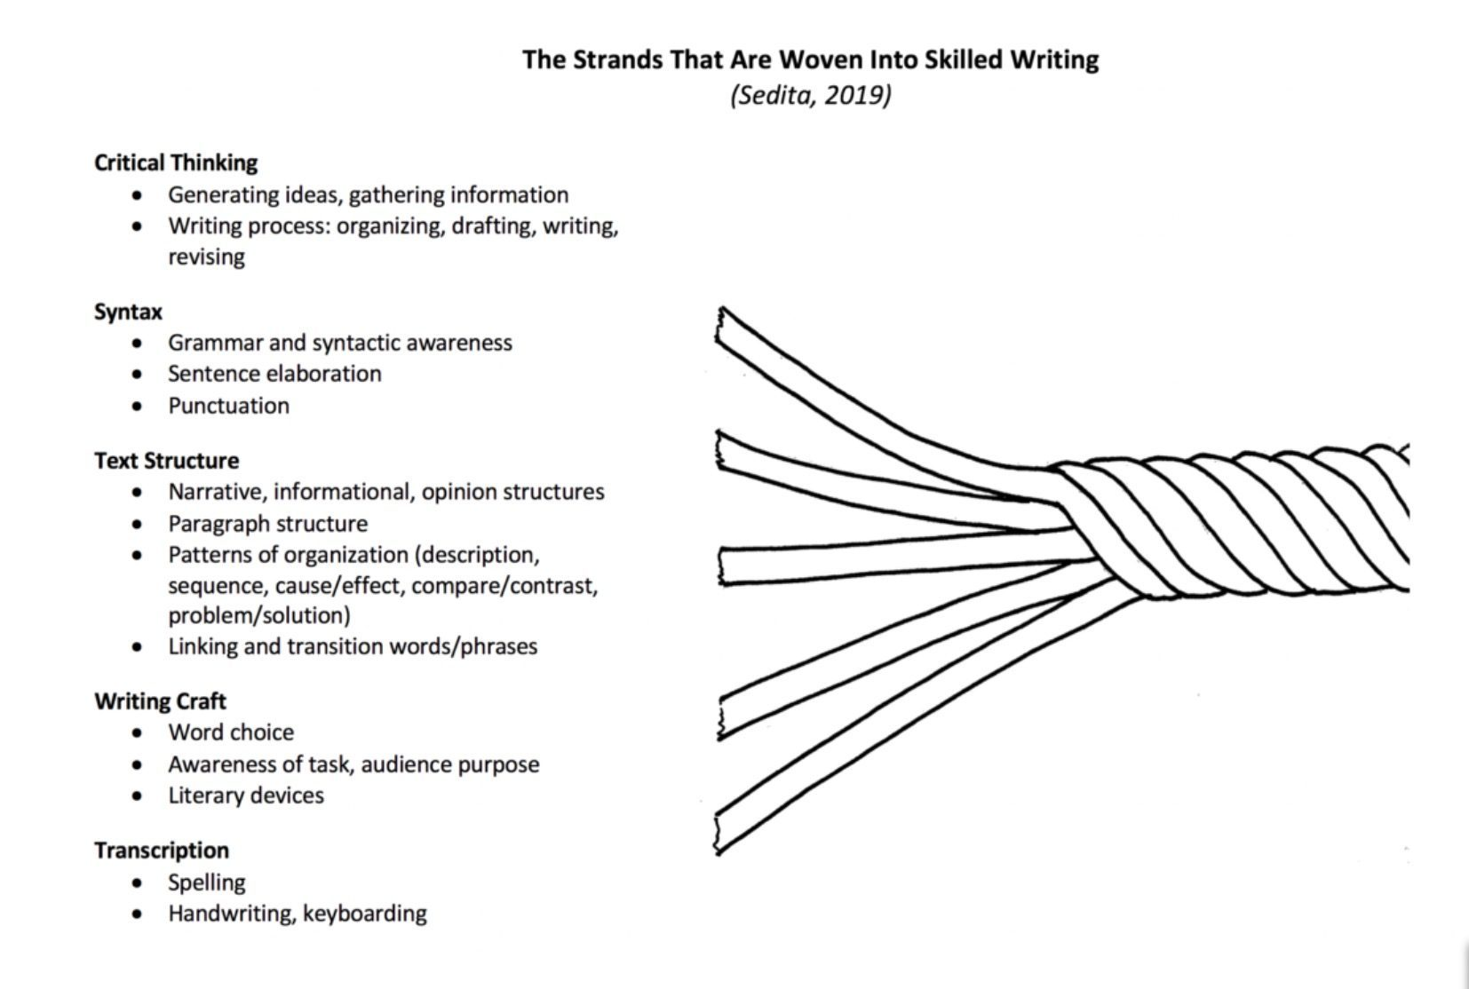
The Writing Rope
IES Practice Guide Elementary Writing

Slide 14
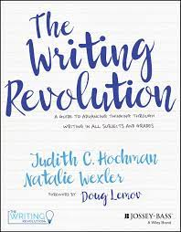
The Writing Revolution
“The Writing Revolution offers teachers
across the content areas ground-breaking
guidance on how to develop all students
into clear, coherent young writers.”
-Jessica Matthews-Meth
Former Director of secondary
literacy for DC Public Schools
Writing for ALL Students!

Slide 15
The End Goal!
Reading Comprehension
Skilled Written Expression
Skilled Readers and Writers
X
=

Slide 16
Reading Comprehension
Let’s Review & Reflect…
1.What is the bottom domain of The Reading Rope?
Word Recognition
2.What is the top domain of The Reading Rope?
Language Comprehension
3.What do we know about the importance of each domain?
Every strand must be taught to reach Reading Comprehension

Slide 17
Skilled Written Expression
Let’s Review & Reflect…
1.What is the first domain of The Writing Rope?
Foundational Writing Skills
2.What is the second domain of The Writing Rope?
Composition
3.What do we know about the importance of each domain?
Every strand must be taught to read Skilled Written Expression

Slide 18
How Can We Tie It All Together?
Phonemic Awareness
Writing
Phonics
Fluency
Vocabulary
Comprehension
Put Reading First
https://lincs.ed.gov/publications/pdf/PRFbooklet.pdf

Slide 19
What is the ULTIMATE GOAL?
Word Recognition
Language Comprehension
Reading Comprehension
X
=
Foundational Writing Skills
Composition
Skilled Writing Comprehension
Tying it all together to create skilled readers & writers

Slide 20
Why Reading Panel + Writing
Writing benefits reading. (Graham, Harris, & Fink, 2000)
Reading comprehension improves with writing in response to reading. (Graham & Hebert, 2010)
Writing about reading prompts student reflection about what they read - connecting ideas, sorting main ideas from details, paraphrasing in their words, and digging underneath the story for more meaning.
Share Example

Slide 21
Research on Application (1 of 2)
Reading comprehension improves when students write responses to something they have read.
Graham & Herbert, 2010

Slide 22
Research on Application (2 of 2)
One, several meta-analyses have found that writing about content classroom material can facilitate learning it. It is also possible that writing about material read enhances comprehension of it. Two, reading and writing share a close and reciprocal relationship, and there is evidence that reading instruction can improve students’ writing skills. Consequently, it is likely that writing instruction in turn improves students’ reading skills.
Graham and Herbert, 2010

Slide 23
How do we get the most bang for our buck?
Daily explicit instruction in ALL five pillars of Reading + Writing and using evidence based practices!

Slide 24
We MUST give our students…
Multiple Reads!
Always read rich text multiple times & dig for the meaning underneath.
Different Modalities!
Tune in to all learning modalities - read to them, with them, engage them, let them interact, and listen to them.
Exposure!
Lots of exposure to different types of text with the same view points, or differing viewpoints.
Experiences!
What are they bringing to the table? Is their schema correct?
In order to build a deeper understanding of vocabulary and text being used.

Slide 25
Now What?
If…
Connected text in ALL areas of reading/ writing makes the difference!
Then…
It gives purpose to reading and writing.
So…
Building lessons with connected text takes time, but it pays dividends!

Slide 26
Let’s Talk Writing Process
Should writing be designated
as specific stages of writing
or
Is writing a process that is recursive?

Slide 27
What does this represent?
Planning, Drafting, Review & Revising
Three Recursive Mental Processes Model, LETRS, 2019

Slide 28
Virginia SOLs for Grade 3
3.5 The student will read and demonstrate comprehension of fictional texts, literary nonfiction, and poetry.
a)Set a purpose for reading.
b)Make connections between reading selections.
g)Ask and answer questions about what is read.
k)Use reading strategies to monitor comprehension throughout the reading process.
m) Read with fluency, accuracy, and meaningful expression.
3.8 The student will write in a variety of forms to include narrative, descriptive, opinion, and expository.
b)Identify audience and purpose.
c)Use a variety of prewriting strategies.
d)Use organizational strategies to structure writing according to type.
e)Write a clear topic sentence focusing on main idea.
f)Elaborate writing by including supporting details.
i)Write a well-developed paragraph focusing on the main idea.
j)Revise writing for clarity of content using specific vocabulary and information.

Slide 29
Virginia SOLs for Grade 4
4.7 The student will write in a variety of forms to include narrative, descriptive, opinion, and expository.
b) Select audience and purpose.
c) Narrow the topic.
d) Use a variety of prewriting strategies.
f) Organize writing to convey a central idea.
g) Write a clear topic sentence focusing on the main idea.
h) Write related paragraphs on the same topic.
i) Elaborate writing by including details to support the purpose.
l) Utilize elements of style, including word choice and sentence variation.
j) Revise writing for clarity of content using specific vocabulary and information.
4.5 The student will read and demonstrate comprehension of fictional texts, literary nonfiction texts, and poetry.
a) Describe how the choice of language, setting, and characters contributes to the development of plot.
c) Summarize events in the plot.
k) Use reading strategies throughout the reading process to monitor comprehension.
l) Read with fluency, accuracy, and meaningful expression.

Slide 30
Virginia SOLs for Grade 5
5.7 The student will write in a variety of forms to include narrative, descriptive, expository, and persuasive.
a)Engage in writing as a process.
b)Select audience and purpose.
c)Use a variety of prewriting strategies.
d) Introduce and develop a topic, incorporating evidence and supporting details.
e)Organize information to convey a central idea.
g)Write a clear topic sentence focusing on the main idea.
i)Write multi-paragraph compositions.
j)Use precise and descriptive vocabulary to create tone and voice. l) Revise writing for clarity of content, using specific vocabulary and information.
5.5 The student will read and demonstrate comprehension of fictional texts, literary nonfiction, and poetry.
a)Summarize plot events using details from text.
b)Discuss the impact of setting on plot development.
c)Describe character development.
d)Identify theme(s).
m)Use reading strategies throughout the reading process to monitor comprehension.

Slide 31
The Purpose of Writing SOLs?
The benefits of writing about reading?
Prompts students to reflect on what they have learned
Helps them connect ideas
Helps them sort main ideas from less important ideas
Helps them paraphrase in their own words
Helps them pursue the meaning of the text more closely
Students who have learned to write well, do better on reading assessments.
Jenkins, Johnson & Hileman, 2004

Slide 32
Application in the Classroom
Practice is Where is Happens!

Slide 33
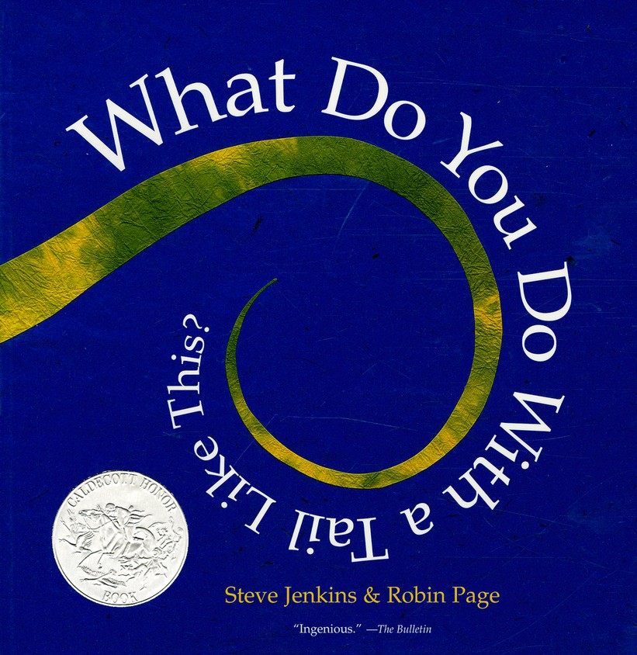
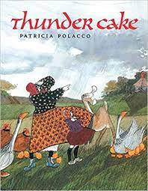
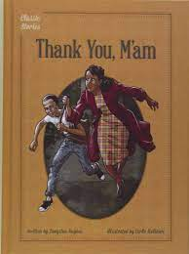
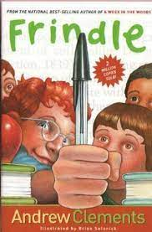
Rich Text

Slide 34
The Gist
Choose your text.
During the first read, the students will listen, follow along, and visualize the text. They can draw pictures as you read.
During the second reading, the students will be the ones doing the reading and will add short statements about their pictures and edit as necessary.
During the third reading, the students will stop and turn their statements into sentences.
To work with comprehension, the students will take their sentences, cut them apart, and put them back in order again.
Students will then use their sentences, statements, pictures, and text to write a summary of what they have read.

Slide 35
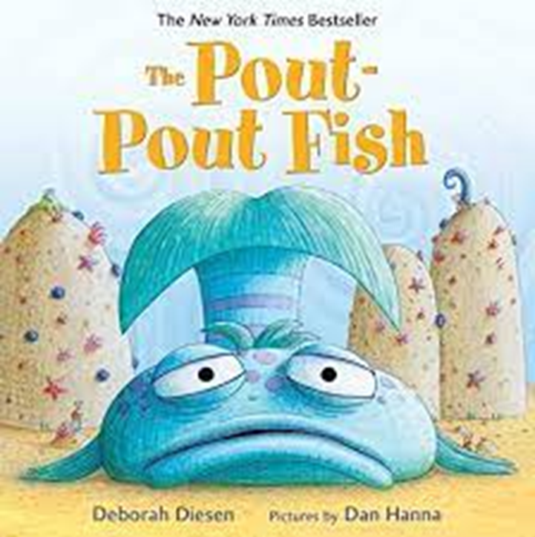
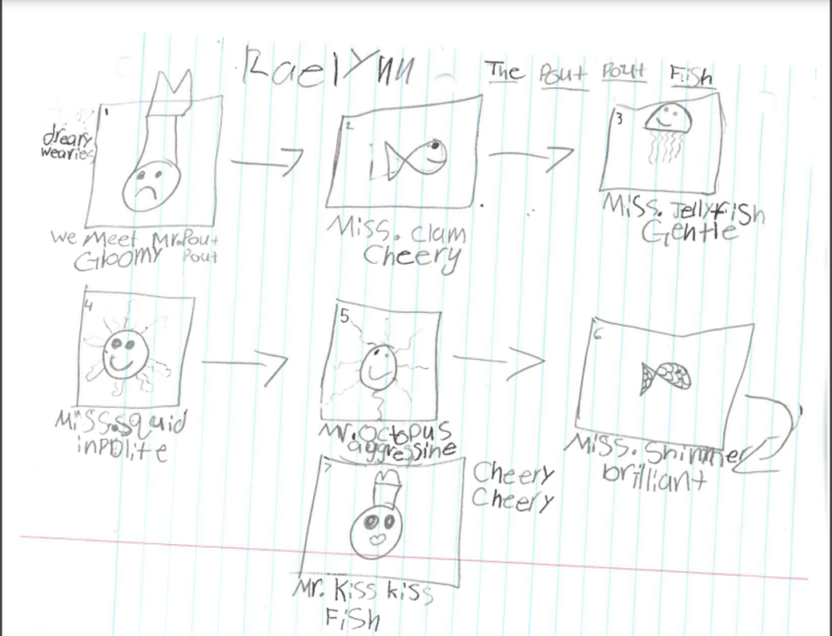
The Gist Example (1 of 3)
Read #1(Visualize) & Read #2 (Vocabulary)

Slide 36
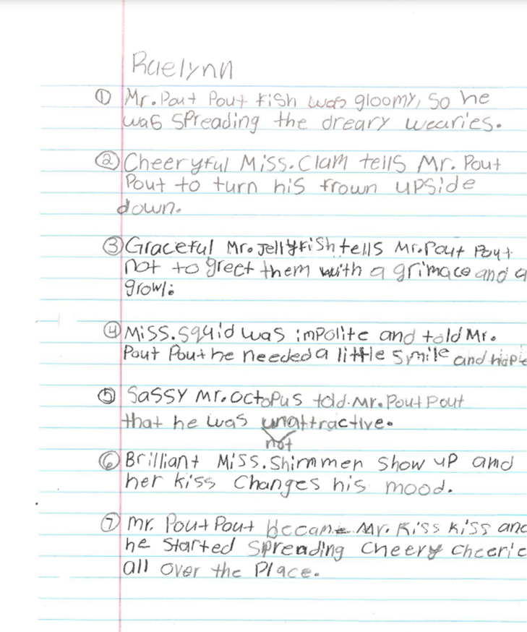
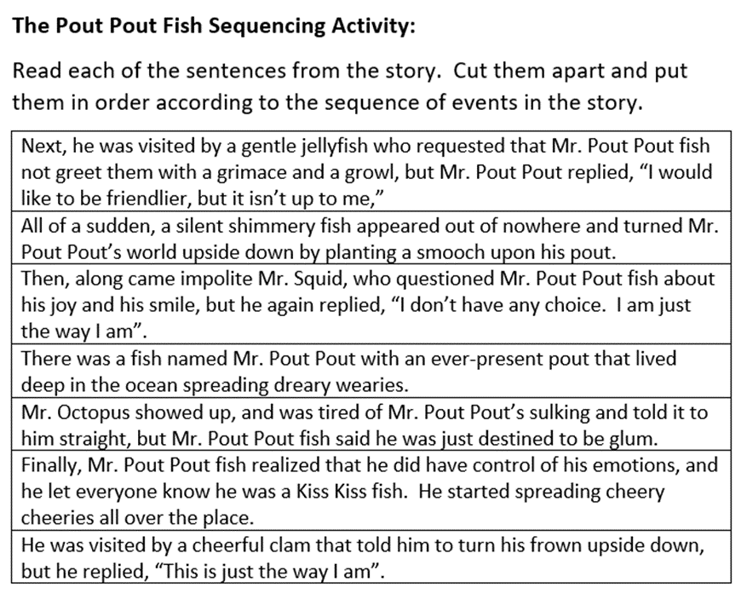
The Gist Example (2 of 3)
Read #4: Sequencing/ Comprehension activity
Read #3: Sentence Writing

Slide 37
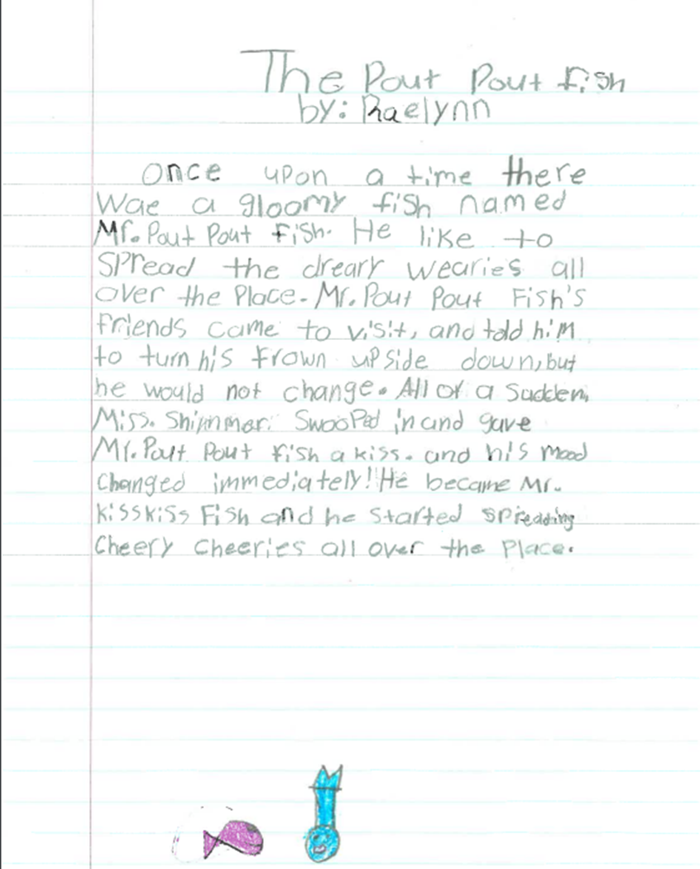
The Gist Example (3 of 3)
Here is the final summarization of the story written by the student.
The question:
Has deeper understanding been reached?

Slide 38
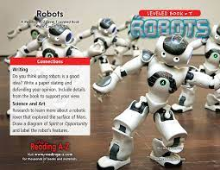
Paired Passages
Fiction/Nonfiction vs. Article (English & Spanish):
Suggestions:
•Teacher Read Aloud/Think Aloud – Teacher reads article, thinking aloud about the article.
•Students Read Together – Students reread the article analyzing the strengths in each piece of literature.
• Graphic Organizers
•T- Chart
•Students divide paper into 5 columns and write strengths (information learned) from each piece of literature.

Slide 39
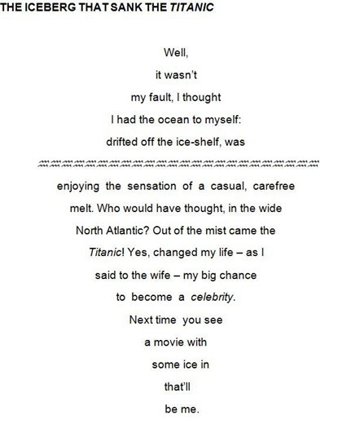
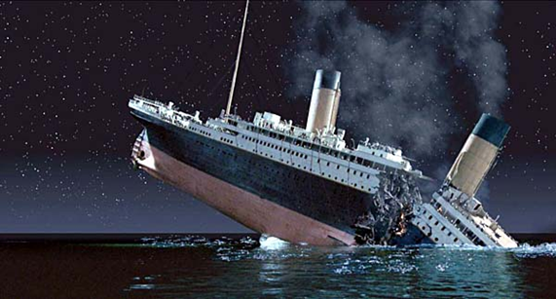
Paired Passages Example- Titanic Thematic Unit
Hook the students
Develop background knowledge
Build complexity
#2
#3
Show both pictures and write about them
#1
Background through poetry and pictural journals
Did you survive? Ask your students to complete a culminating presentation of research from character’s point of view!

Slide 40
FUNneling Map
*This graphic organizer teaches students how to narrow down their thoughts to write a solid response paragraph to something they have read.
After reading a passage, students will write down 3 facts.
These can be more teacher directed or just facts the student felt were important.
The student will then write down 2 connections they had to the passage.
Using portions of both of these, the students will write a topic sentence.
Referring to the facts and connections, the students will be able to write 3-4 detail sentences.
Using the topic sentence as a guide, the student will write a conclusion sentence.

Slide 41
FUNneling Map- Example
Important Fact from Reading
Important Fact from Reading
Important Fact from Reading
My Connection from Reading
My Connection from Reading
Topic Sentence
Details (Facts + Connections)
Conclusion

Slide 42
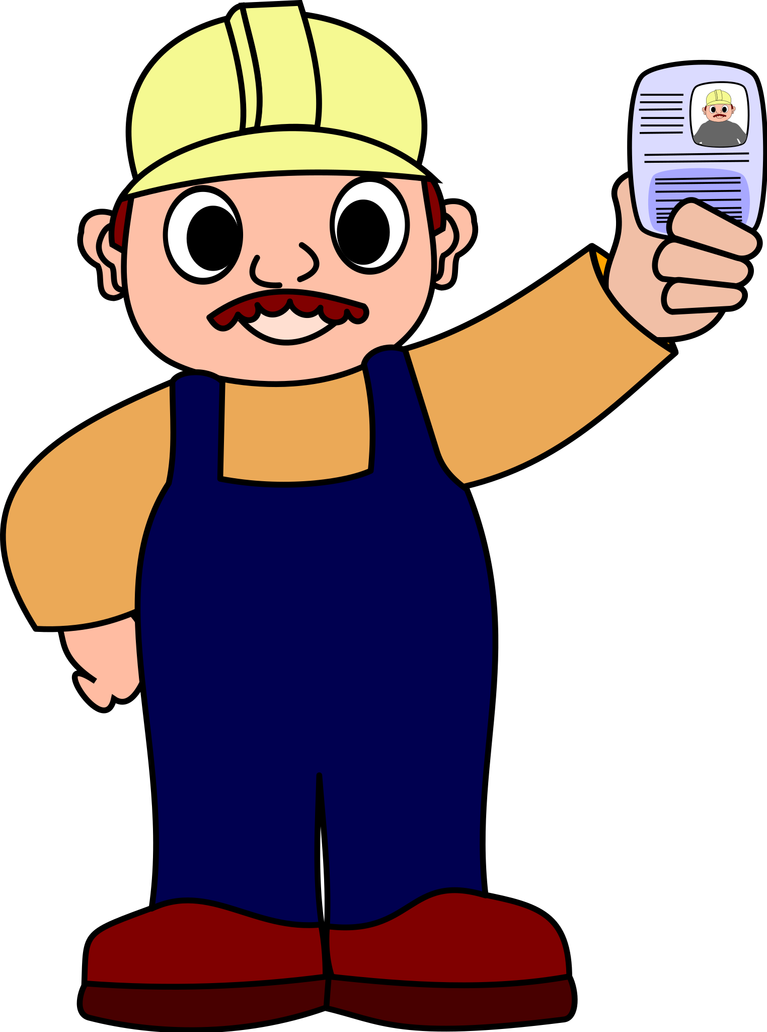
Last Thoughts…
Learning how to write well for different purposes is important not only for success in school, but also for active participation in professional and social life.
Institute of Education Science

Slide 43
Remember…
If you have:
Questions?
“Ah-ha” moments?
Confusions?
https://tinyurl.com/vdoe3to5
When We Know Better, We Do Better

Slide 44
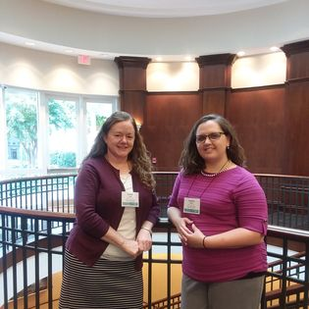
Contact Information
Susan Hoch
susanhoch@galaxschool.us
Jessica Kidd
jessicakidd@galaxschools.us

Slide 45
References
Institute of Education Sciences
https://ies.ed.gov/
Letrs Volume 1
Louisa C. Moats
Carol A. Tolman
Letrs Volume 2
Louisa C. Moats
Carol A. Tolman
Put Reading First
https://lincs.ed.gov/publications/pdf/PRFbooklet.pdf
When is Reading Also Writing
https://doi.org/10.1207/s1532799xssr0802_2
The Writing Revolution
Judith C. Hochman
Natalie Wexler

Slide 46
Disclaimer
Reference within this presentation to any specific commercial or non-commercial product, process, or service by trade name, trademark, manufacturer or otherwise does not constitute or imply an endorsement, recommendation, or favoring by the Virginia Department of Education.

