Slide 1
Guided Reading to Reading Guides
VDOE Virtual Literacy Conference

Slide 2
Who Are We?
Ellen Frackelton
Reading Specialist- Laurel Lane
Williamsburg-James City County Schools
Tammy Williams
Reading Specialist- Clara Byrd Baker
Williamsburg-James City County Schools
EllenFrackelton@wjccschools.org
@EFrackelton
Tamara.Williams@wjccschools.org
@twwilliamsABC

Slide 3
Goals of Presentation
What does the research say about all students reading grade level texts?
Virginia Standards
Understanding Comprehension
Reading Guides – A new Way to Look at Teaching Complex Texts

Slide 4
Let’s Continue the Conversation

Slide 5
01 What Does the Research Say?

Slide 6
What Does the Research Say?
Recommendation 2: Provide purposeful fluency-building activities to help students read effortlessly
Recommendation 3, Part B: Consistently provide students with opportunities to ask and answer questions to better understand the text they read.
Recommendation 3: Routinely use a set of comprehension-building practices to help students make sense of the text.
Recommendation 3, Part C: Teach students a routine for determining the gist of a short section of text.
Recommendation 3, Part A: Build students’ world and word knowledge so they can make sense of the text.
Recommendation 3, Part D: Teach students to monitor their comprehension as they read.
Recommendation 4: Provide students with opportunities to practice making sense of stretch text (i.e. challenging text) that will expose them to complex ideas and information

Slide 7
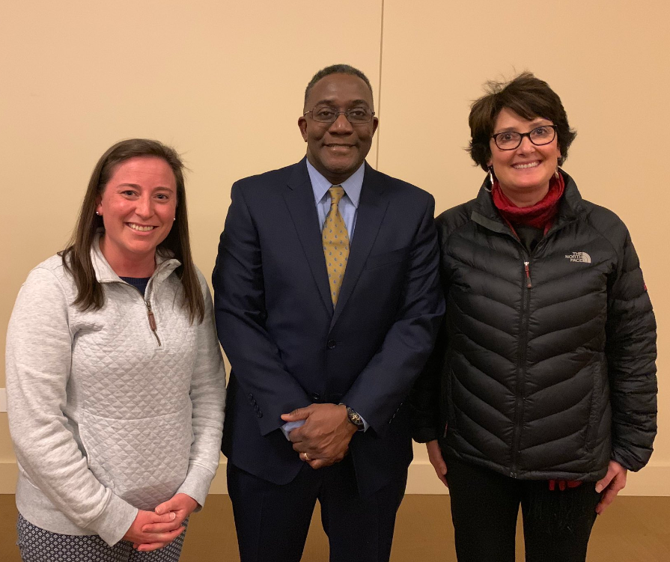
Catalyst to Change
“Leveled text leads to
leveled lives.”
-Dr. Alfred Tatum

Slide 8
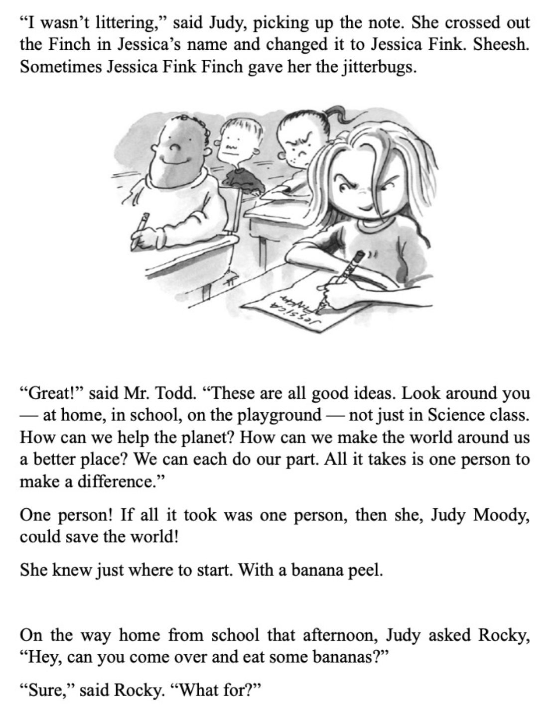
Looking at Leveled Texts
Judy Moody level M(28) vs. Wishtree level R(40)

Slide 9
02 Virginia Standards of Learning

Slide 10
Virginia Standards of Learning 1 of 2
Fluency | Vocabulary | Comprehension
3.5m/3.6j Read with fluency, accuracy, and meaningful expression 4.5l/4.6i Read with fluency, accuracy, and meaningful expression Essential Knowledge Skills and Processes in 5th grade: Read with fluency, accuracy, and meaningful expression | 3.4 Students will expand vocabulary when reading 4.4 Students will expand vocabulary when reading 5.4 Students will expand vocabulary when reading | 3.5 Students will read and demonstrate comprehension of fictional text, literary nonfiction, and poetry 3.6 Student will read and demonstrate comprehension of nonfiction text 4.5 Students will read and demonstrate comprehension of fictional text, literary nonfiction, and poetry 4.6 Student will read and demonstrate comprehension of nonfiction text 5.5 Students will read and demonstrate comprehension of fictional text, literary nonfiction, and poetry 5.6 Student will read and demonstrate comprehension of nonfiction text

Slide 11
Virginia Standards of Learning 2 of 2
3.5 The student will read and demonstrate comprehension of fictional text, literary nonfiction and poetry.
k- Use reading strategies to monitor comprehension throughout the reading process.
5.5 The student will read and demonstrate comprehension of fictional text, literary nonfiction and poetry.
m- Use reading strategies to monitor comprehension throughout the reading process.

Slide 12
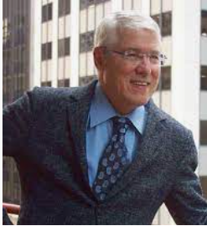
“Productive Struggle”
“… what this research reveals is that limiting students to text they can already read well reduces their opportunity to learn– by limiting their exposure to sophisticated vocabulary, rich content, and complex language.”
-Tim Shanahan

Slide 13
“Stretch Texts”
“... Work through stretch texts as a group with teacher support, rather than assigning stretch texts to students to work on independently or with a partner. Students will need ongoing support and direction to make sense of the more challenging words and sentences so that they can articulate and discuss the ideas in these stretch texts. ”
What Works Clearing House Practice Guide

Slide 14
We know what you’re thinking!

Slide 15
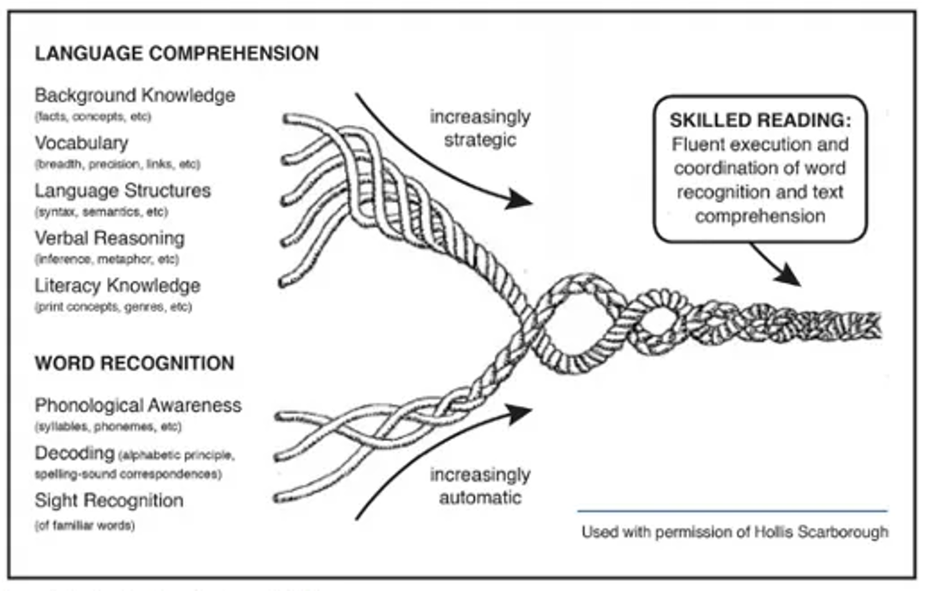
Scarborough’s Rope, 200, 1 of 2

Slide 16
03 Understanding Reading Comprehension

Slide 17
Reading Comprehension
The RAND panel (2002) defined comprehension as “the process of simultaneously extracting and constructing meaning through interaction and involvement with written language.”
Comprehension entails three primary elements:
The reader who is doing the comprehending
The text that is being comprehended
The activity in which comprehension is a part

Slide 18
“Sizing Up A Text” - Dr. Kristin Conradi Smith

Slide 19
Scarborough’s Rope, 2001, 2 of 2

Slide 20
Wild Robot
Lexile 740
F/P Level R
Background Knowledge | Vocabulary | Language Structures | Verbal Reasoning | Literacy Knowledge
Robots Living vs Nonliving Animal Adaptations Animal Characteristics | Tier 2/3 | Pronoun Reference Figurative Language | Inference Context Clues Sensory Words | Narrative 3rd Person Narration Conflict/Resolution Novel

Slide 21
Support and Scaffold!
“With knowledge of the research and effective reading instruction, skilled teachers can facilitate students’ productive interactions with harder text.”
-Tim Shanahan

Slide 22
04 Reading Guides A template to scaffold and support students BEFORE, DURING, and AFTER Reading

Slide 23
Putting the “Teach back in Teacher” Anita Archer
Before Reading
During Reading
After Reading
Build background knowledge
Teach necessary vocabulary
Discuss how text is structured
Set a purpose for reading “Pay attention to…”
Utilize graphic organizers to summarize the reading
Plan stopping points to think aloud and model strategic thinking
Plan opportunities for students to turn and talk
Plan whole class discussion to dig deeper using inferential questions using “How” and “Why”
Create and anchor chart that captures important information
Plan a written response

Slide 24
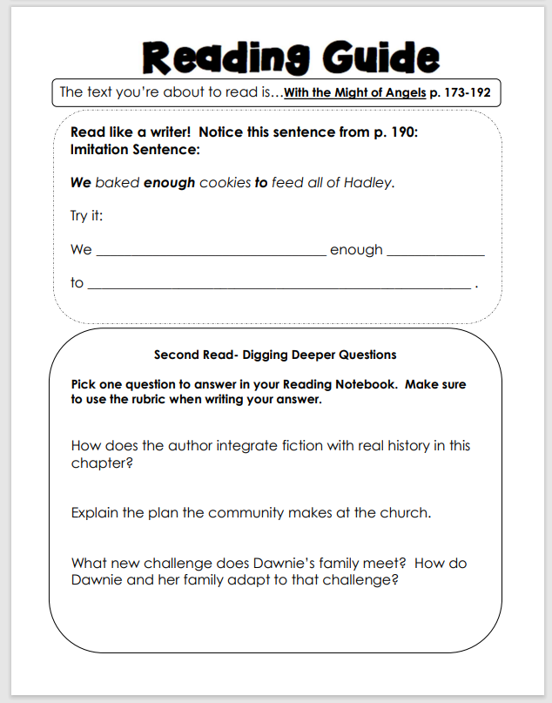
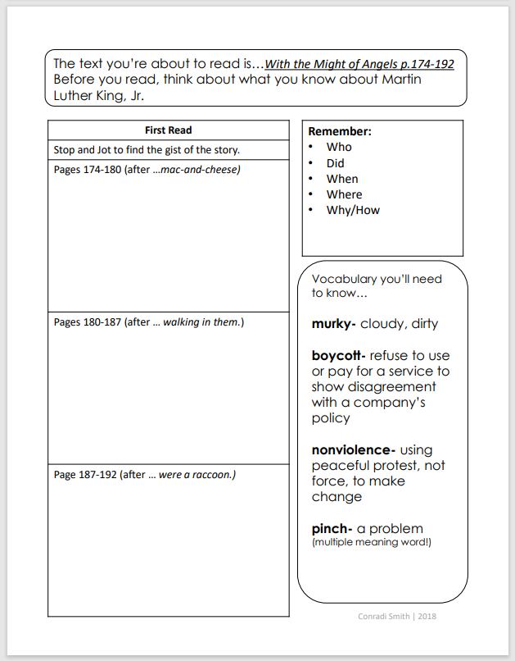
Example Reading Guides

Slide 25
Before Reading

Slide 26
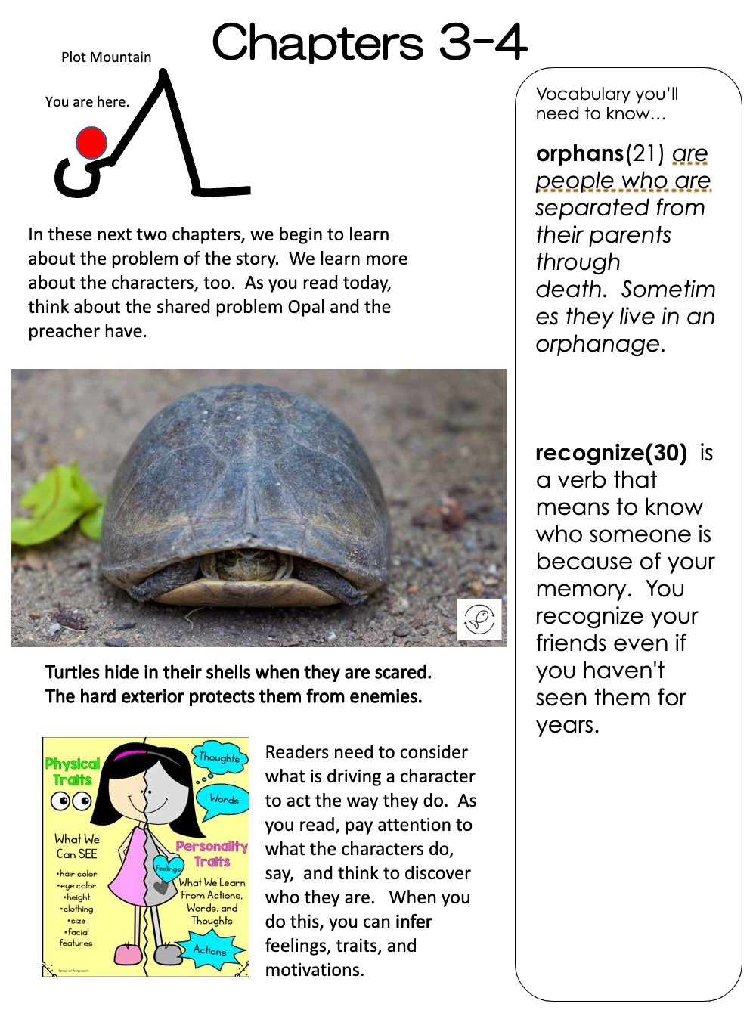
Before Reading Because of Winn Dixie 3rd Grade
Before Reading | What it looks like to plan
Build background knowledge | Think about what the author assumes the reader knows. Provide the knowledge via pictures, companion texts, brief explanations
Teach necessary vocabulary | Read through the text to think about what vocabulary may prove challenging. Pick two that essential for understanding the text
Provide Text structure | Think about how the text is organized
Set purpose | Use a “Pay Attention to statement” that draws students’ attention to the important ideas in the text

Slide 27
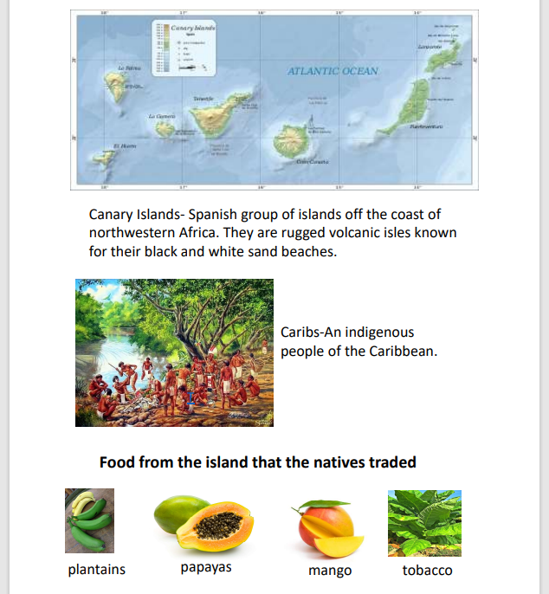
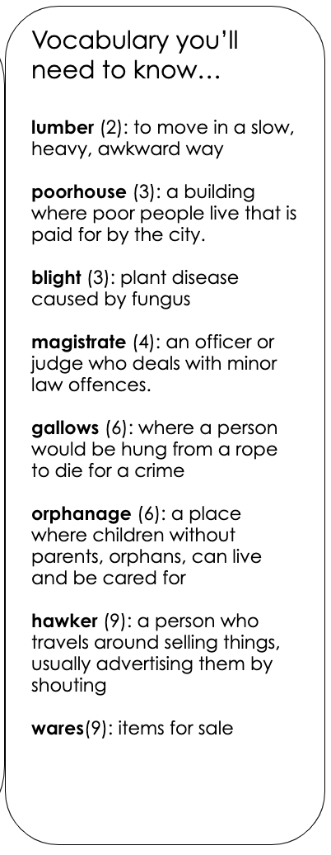
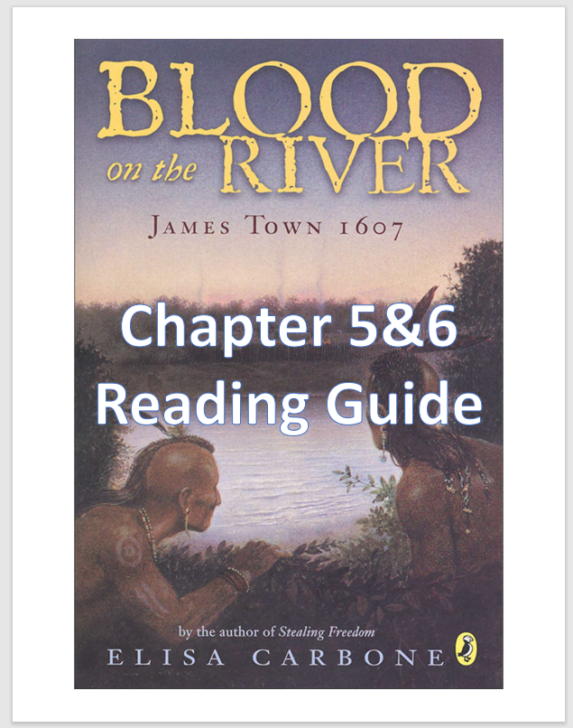
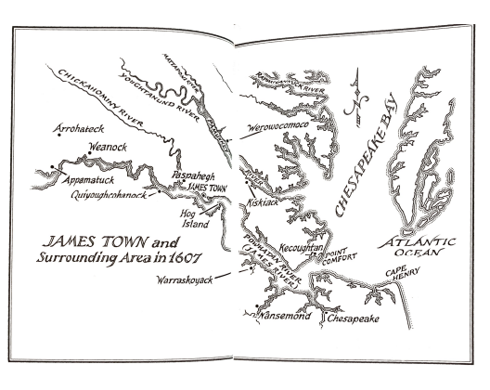
Before Reading
Blood on the River
4th Grade

Slide 28
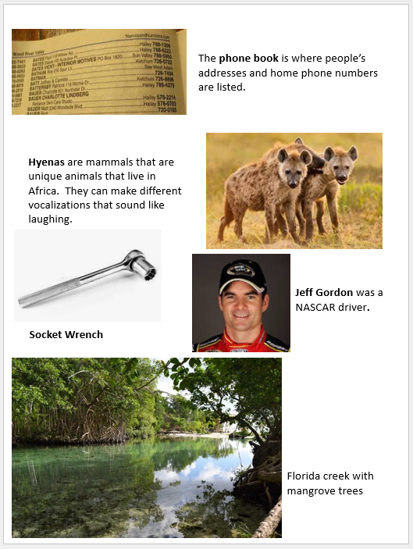
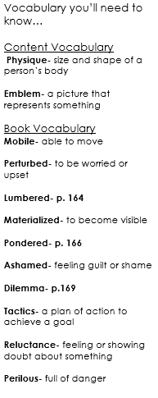
Before Reading
Hoot- 5th Grade

Slide 29
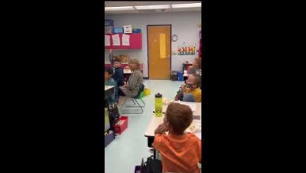
Vocabulary Video

Slide 30
“Stories lean on stories.”
Jane Yolen
30

Slide 31
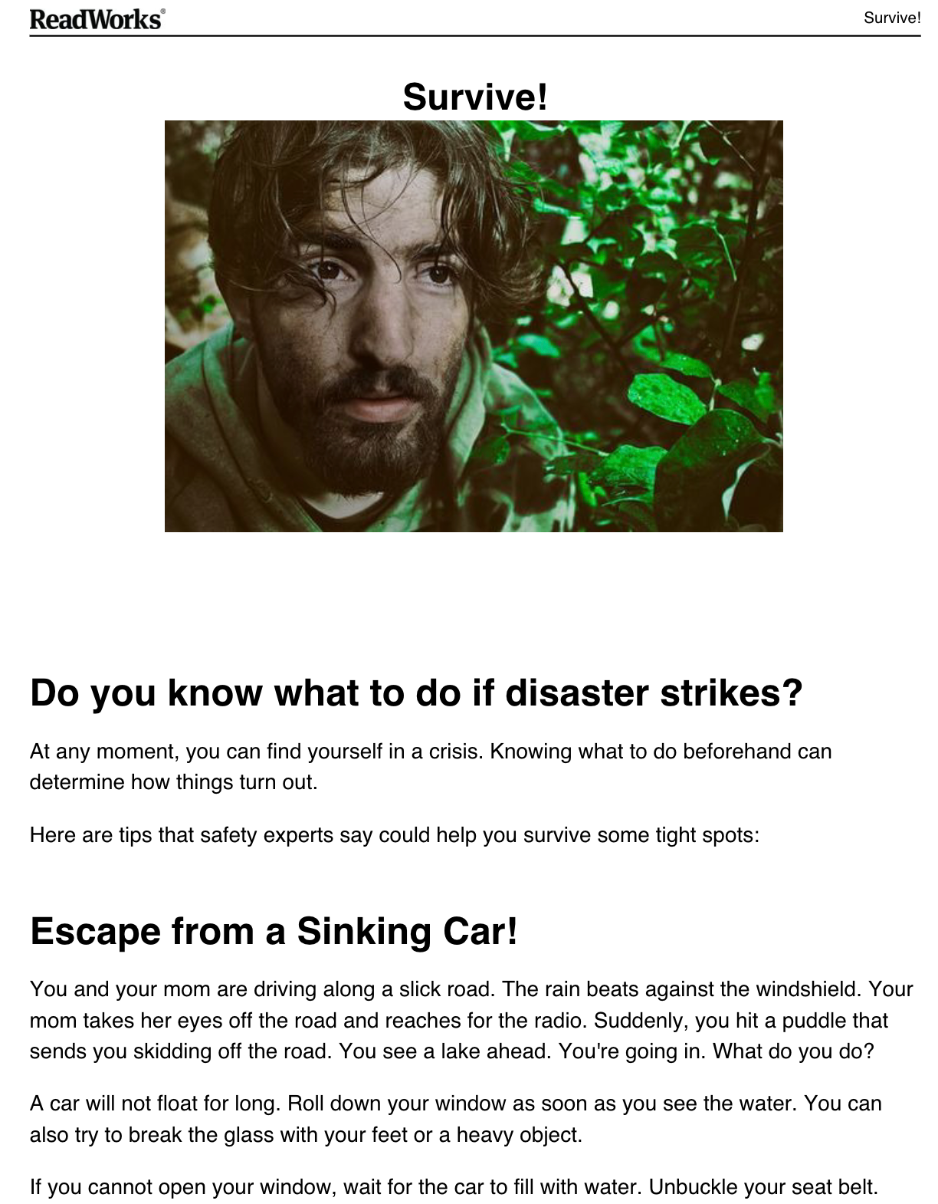
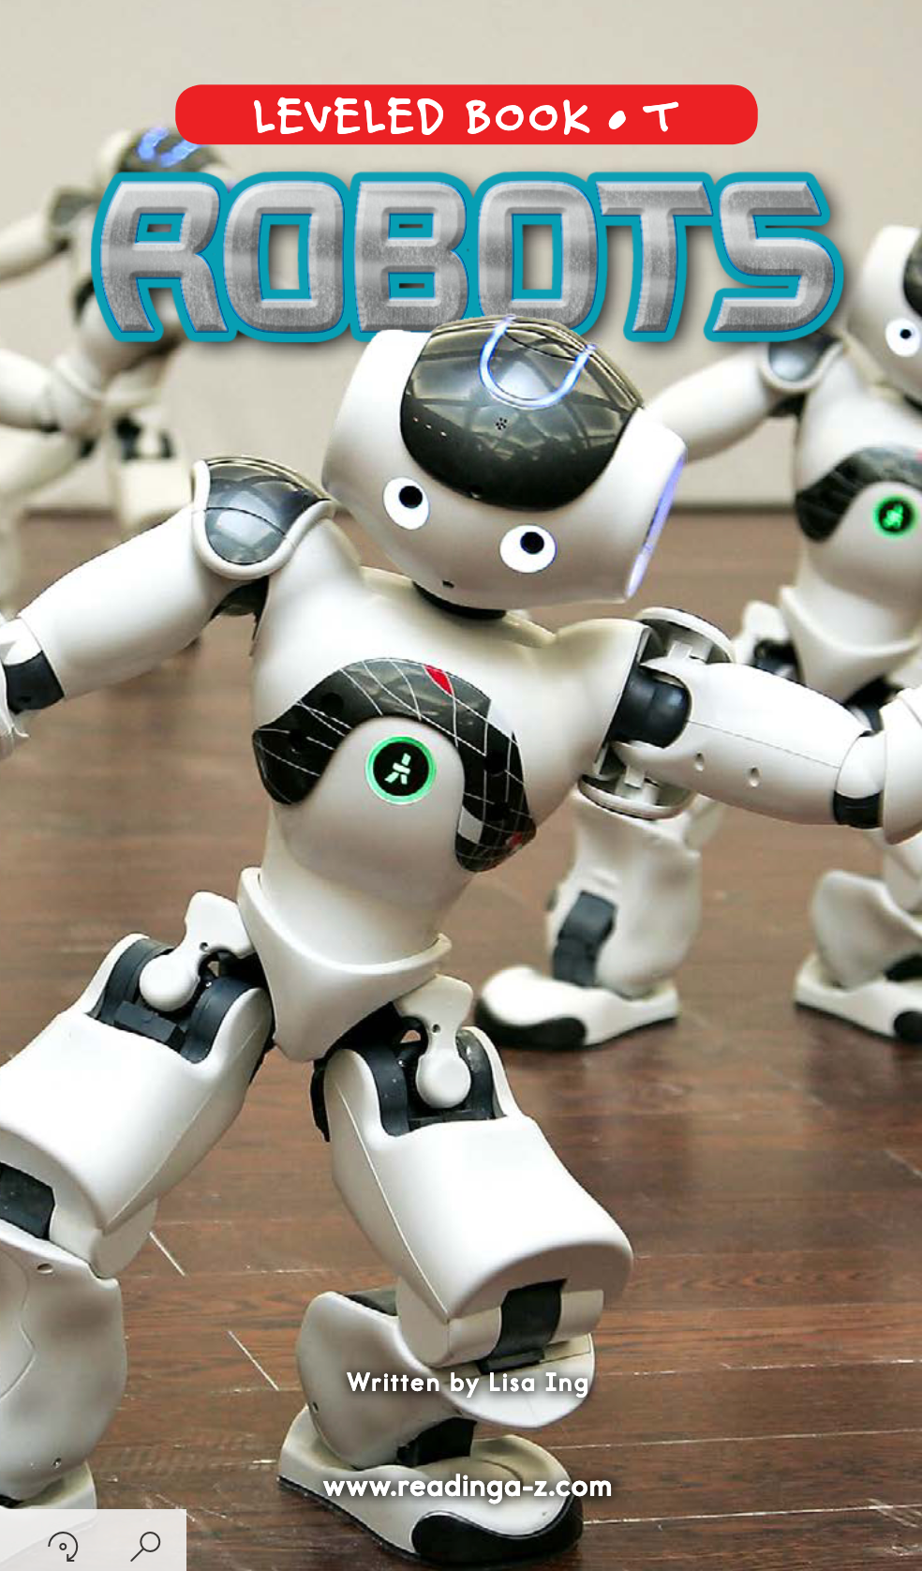
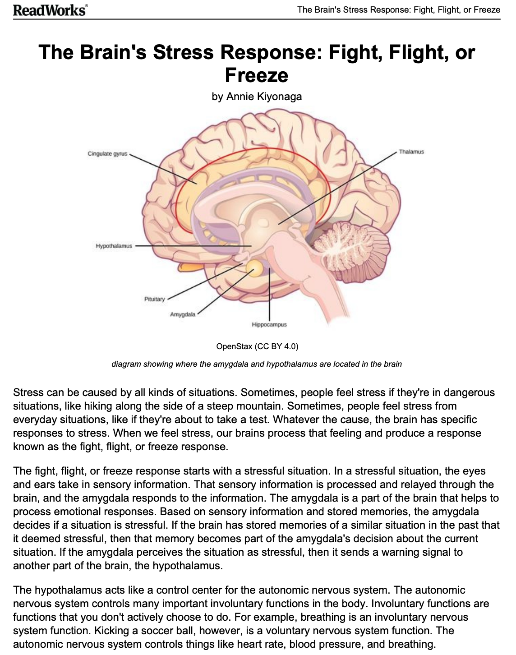
Companion Texts

Slide 32
During Reading

Slide 33
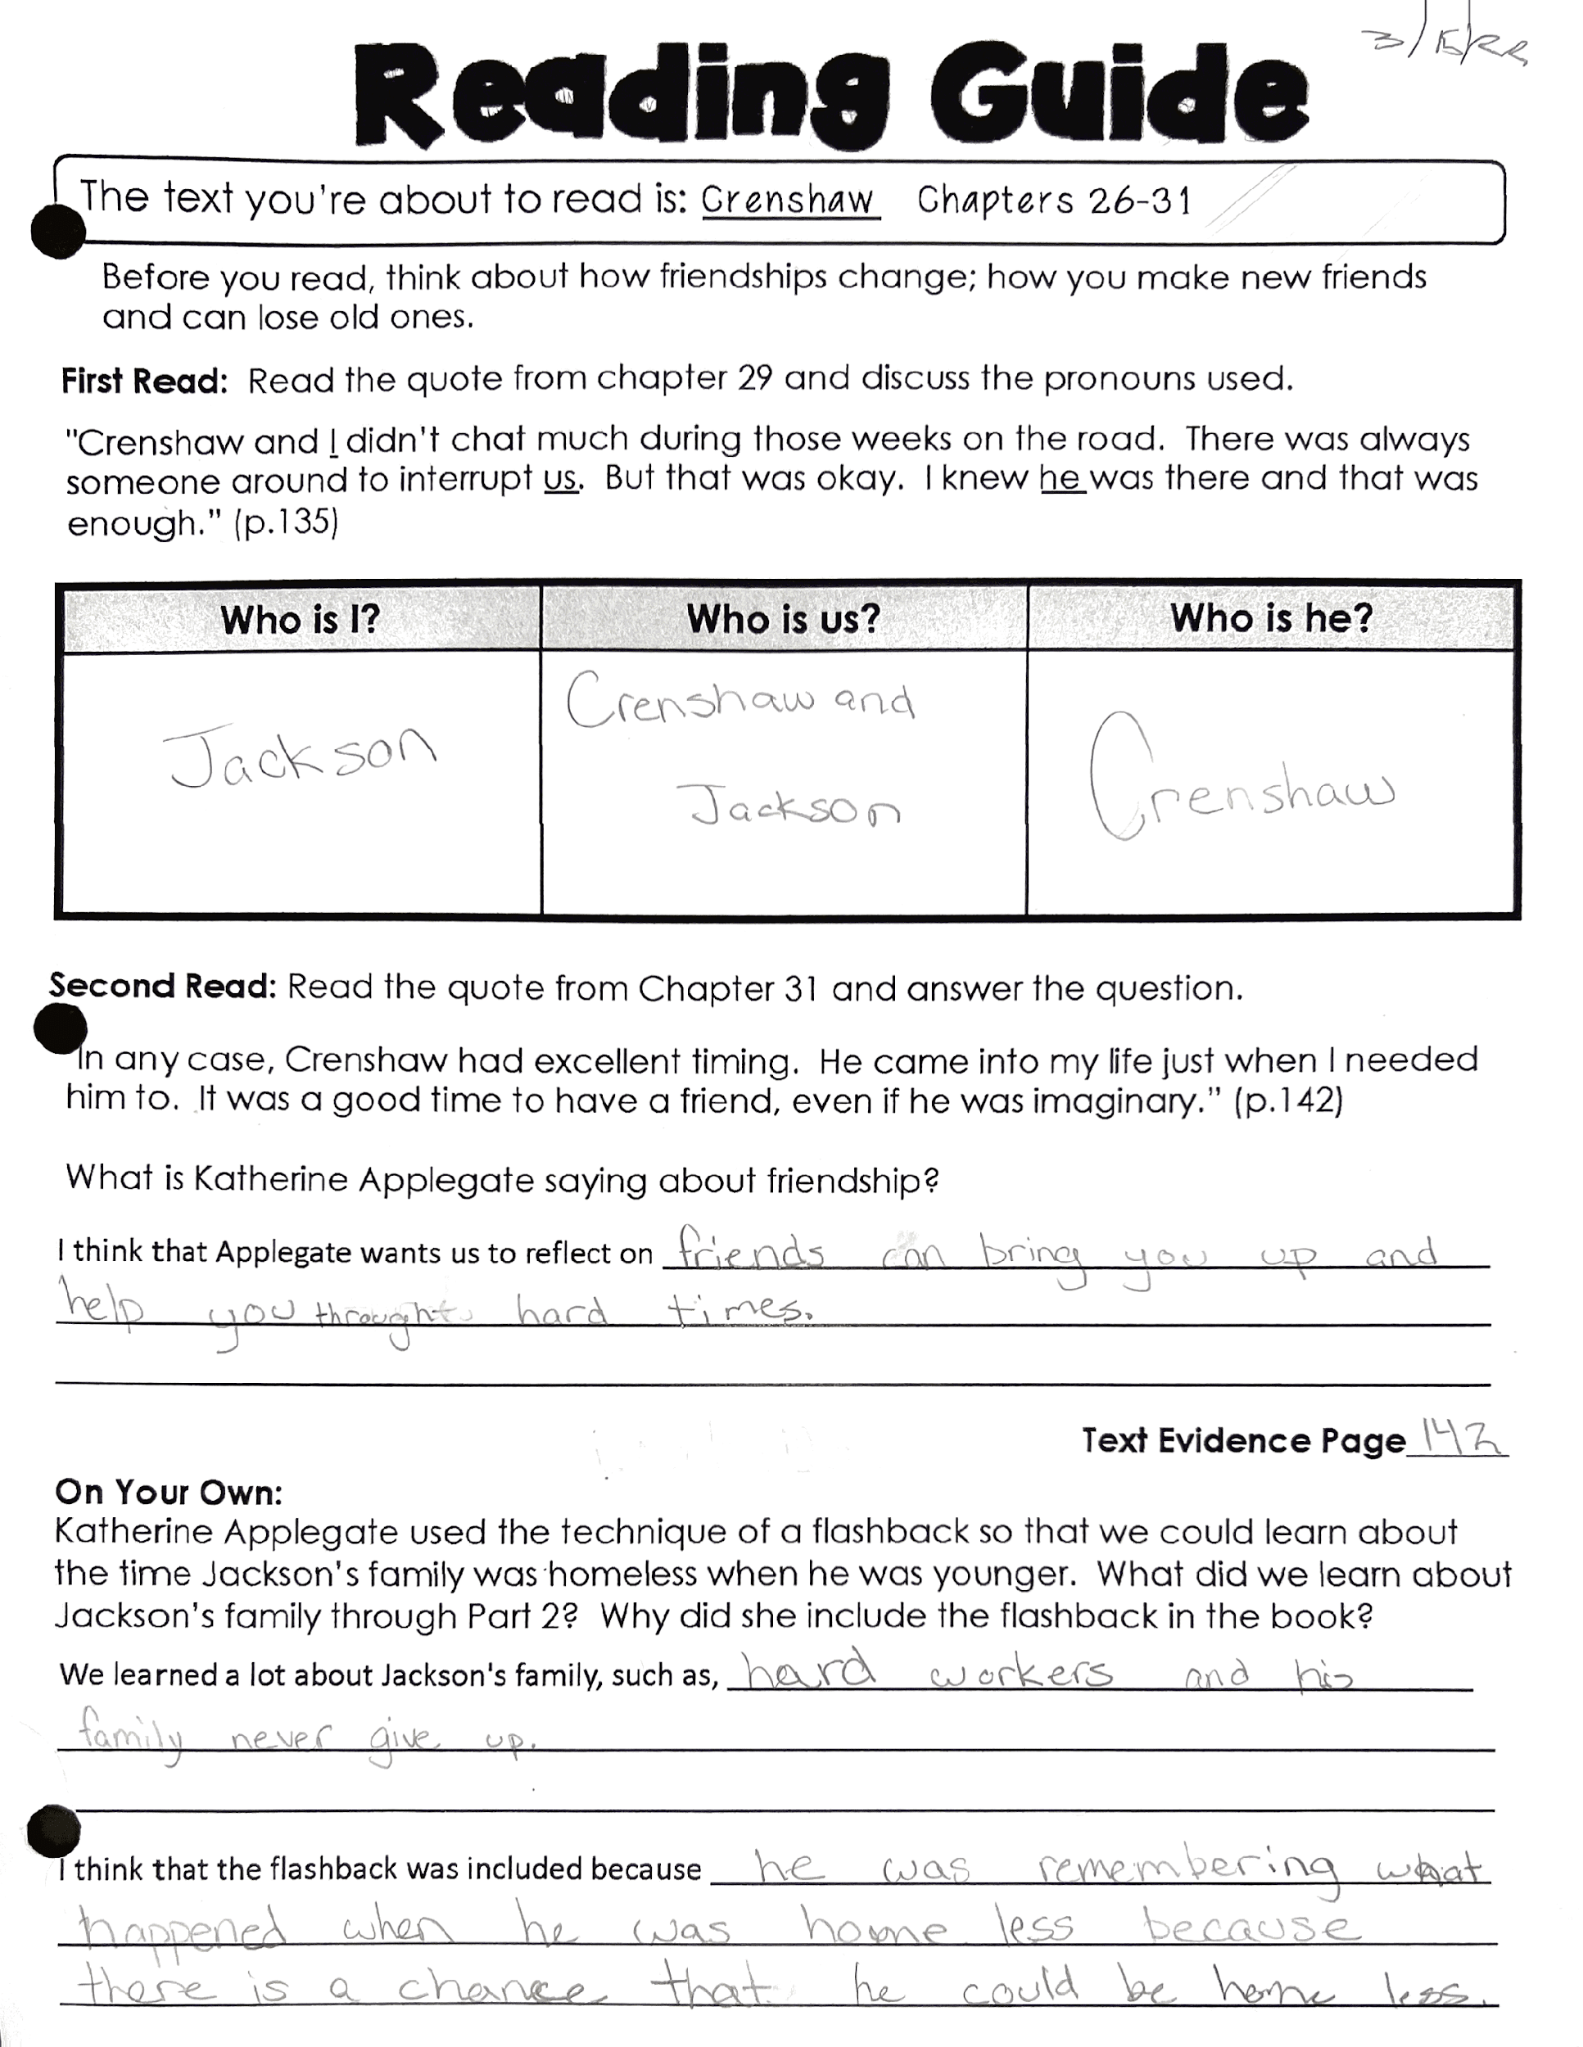
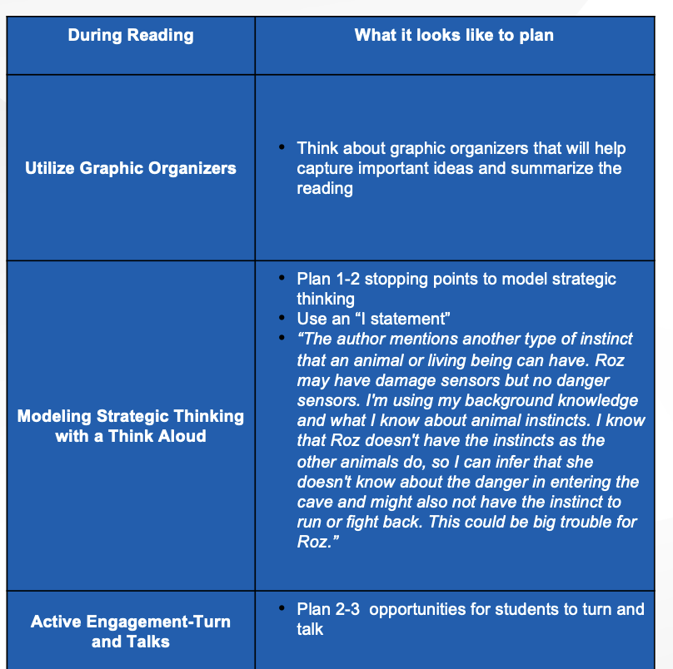
During Reading Planning

Slide 34
Choral Reading
First Read
Teacher’s voice is the support
Model fluent reading with natural phrasing
Teacher Think Alouds

Slide 35
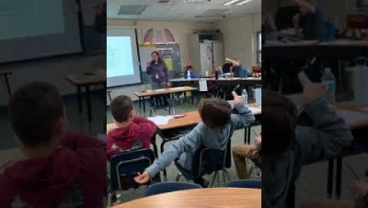
Choral Reading Video- 4th Grade

Slide 36
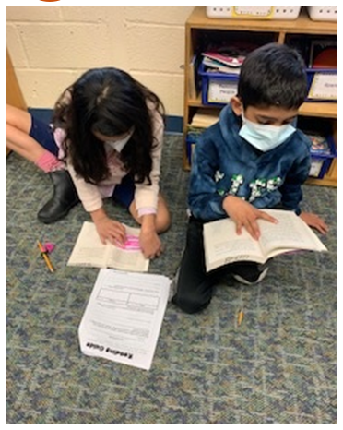
Partner Reading
Second Read with a new purpose for reading
Purposeful Partnerships
Students take on more ownership of decoding task but still supported from peer interaction
Repeated Readings to encourage fluency building

Slide 37
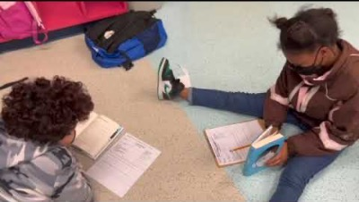
Partner Reading Video- Edwards

Slide 38
After Reading

Slide 39
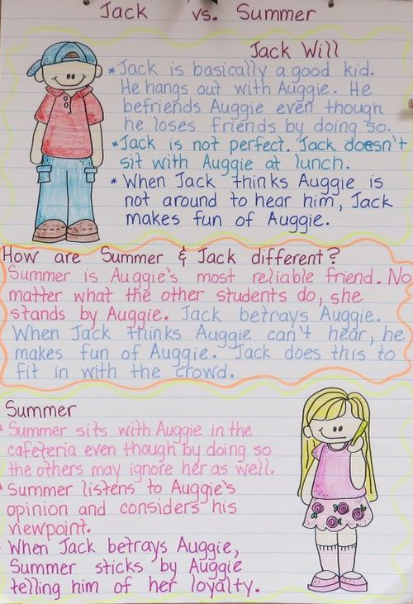
After Reading Activities and Planning Considerations
Whole Class Discussion
Plan 2-3 inferential questions using “How” and ”Why” to dig deeper and extend comprehension
Anchor Chart
Co-create an anchor chart that captures important information about plot, characters, etc
Written Response to Extend Comprehension
Plan a written response prompt.
Use sentence frames
Retrieved from Gay Miller, Pinterest on 7.22.2022

Slide 40
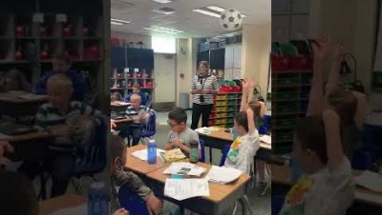
Whole Class Discussion
Building deeper understanding of text, focusing on inference making using background knowledge

Slide 41
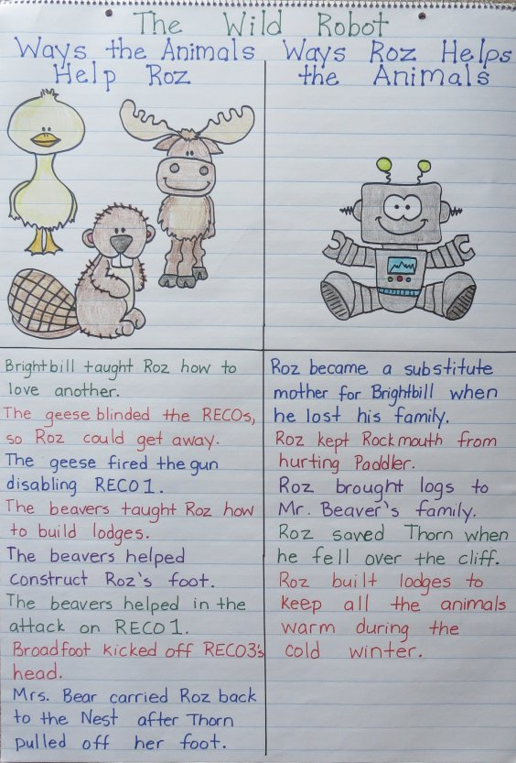
Anchor Chart 1 of 2
Text Driven
Fiction- Story Mapping
Nonfiction- Dependent of Text Structure
Summarizes the plot over multiple days and can be used for review
Captures most important details of the text
Retrieved from: bookunitsteacher.com on 8/13/2022

Slide 42
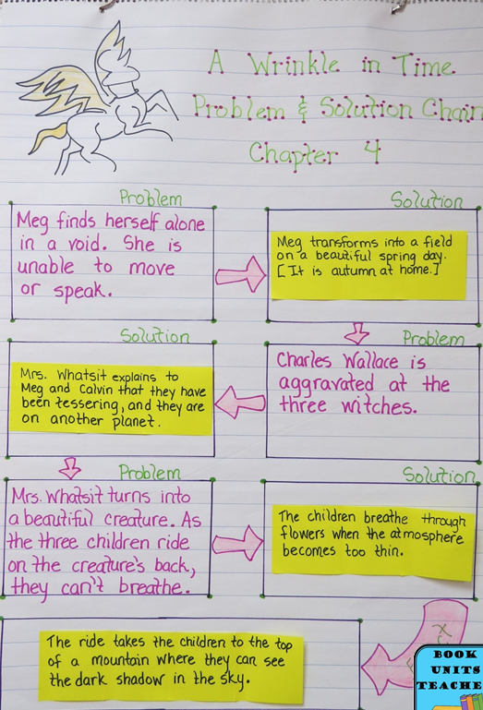
Anchor Chart 2 of 2
Text Driven
Fiction- Story Mapping
Nonfiction- Dependent of Text Structure
Summarizes the plot over multiple days and can be used for review
Captures most important details of the text
Retrieved from: bookunitsteacher.com on 8/13/2022

Slide 43
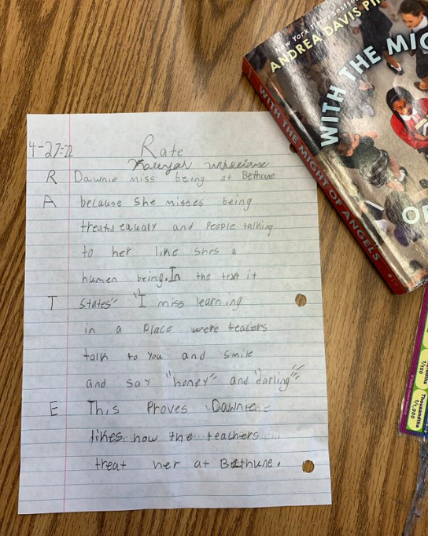
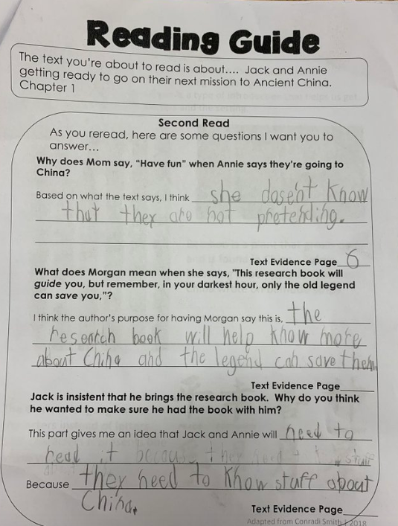
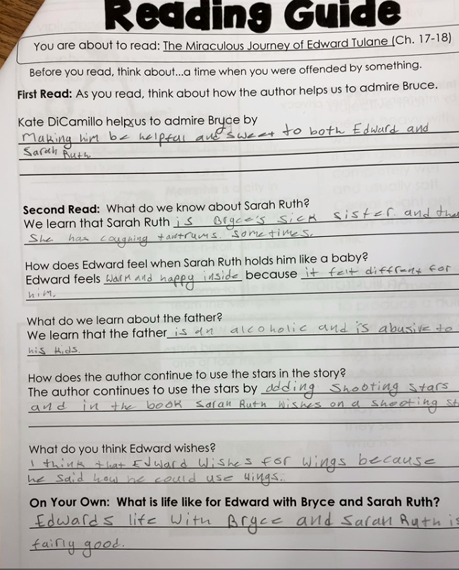
Written Response
Gives students the opportunity to respond to text in writing
Strong connection between reading comprehension and writing
Used to monitor students comprehension growth over time

Slide 44
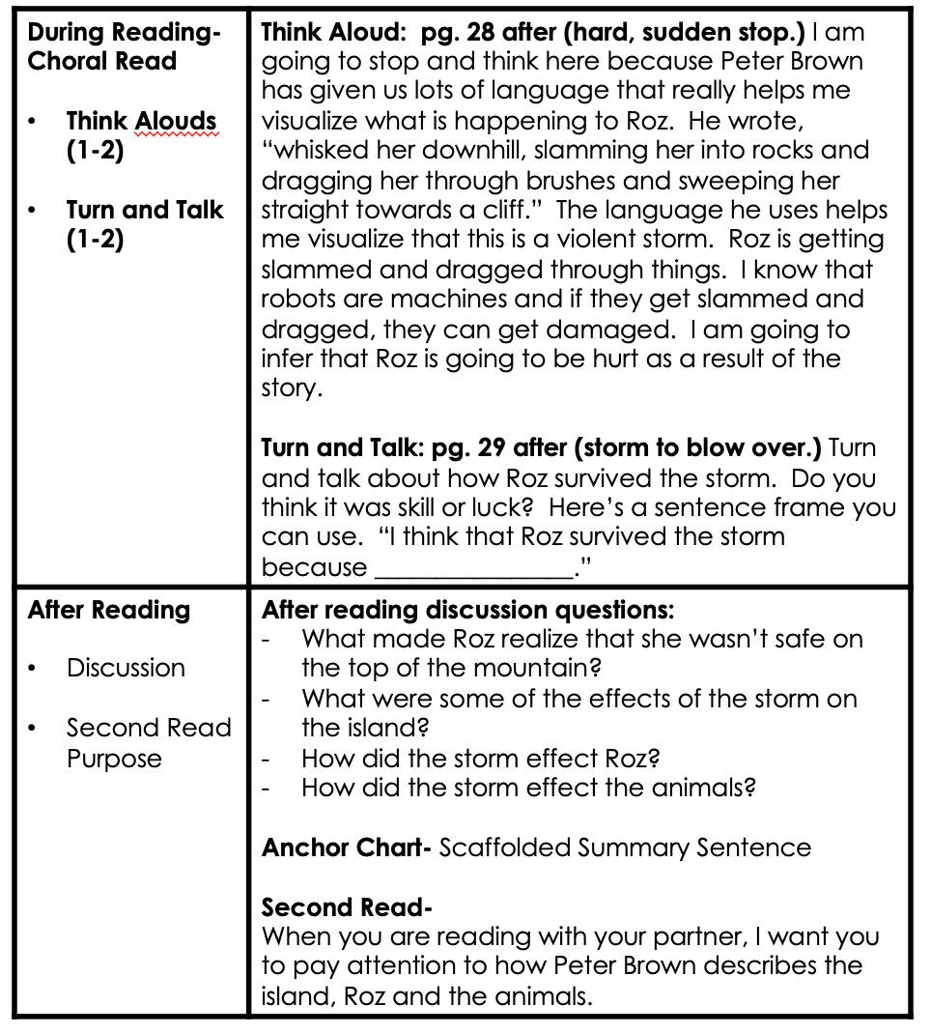
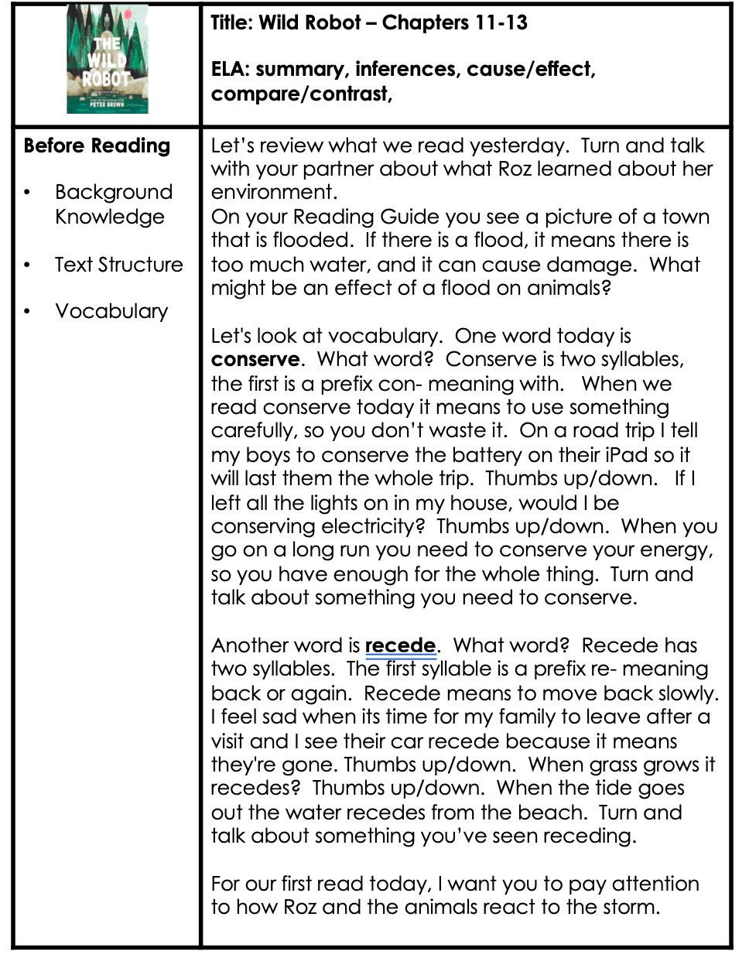
From Guided Reading to Reading Guides A Plan for Success

Slide 45
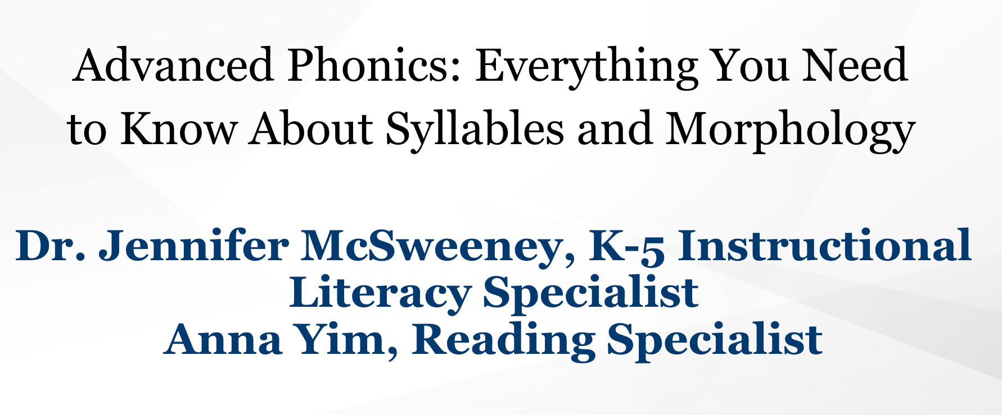
Keep Watching!

Slide 46
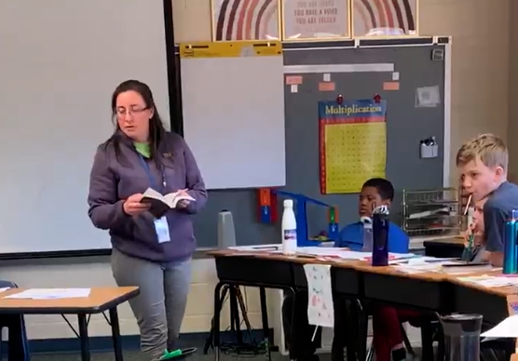
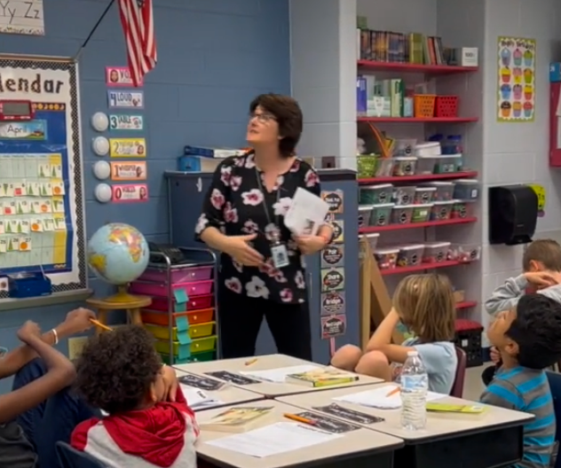
We Want To Hear From You
Ellen.Frackelton@wjccschools.org
@Efrackelton
Tamara.Williams@wjccschools.org
@twwilliamsABC

Slide 47
References
Applegate, Katherine. (2017). Wishtree. Feiwel and Friends.
Brown, Peter. (2016). The Wild Robot. Little, Brown and Company.
Carbone, Elisa. (2006). Blood on the river. Puffin Books.
Center for Dyslexia MTSU. (2019, April 19). Why explicit instruction? [Video]. YouTube. https://www.youtube.com/watch?v=i-qNpFtcynI
Davis Pinkney, Andrea. ( 2011). With the might of angels. Scholastic.
DiCamillo, Kate. (2000). Because of Winn-Dixie. Candlewick Press.
Hiaasen, Carl. (2002). Hoot. Yearling.
Honig, B., Diamond, L., Gutlohn, L., (2018). Teaching reading sourcebook, 3rd edition. Arena Press.
McDonald, Megan. (2002). Judy moody saves the world!. Candlewick Press.
Providing Reading Interventions for Students in Grades 4–9. (2022). Institute of Education Sciences. Retrieved from NCEE website: http://whatwords.ed.gov
Shanahan, Timothy. (2020). Limiting children to books they can already read. America Educator, Summer 2020. https://www.aft.org/ae/summer2020/shanahan
Sipe, L., Pearson, D. (2008). Storytime: Young children’s literary understanding in the classroom. Teachers College Press.
Tatum, Alfred. (2019, Nov. 19). Equally probable: Examining the long-term impacts of literacy development for our nation’s youth: An advanced literacy perspective. Hornsby Lecture, School of Education, William and Mary, Williamsburg, VA.

Slide 48
Disclaimer
Reference within this presentation to any specific commercial or non-commercial product, process, or service by trade name, trademark, manufacturer or otherwise does not constitute or imply an endorsement, recommendation, or favoring by the Virginia Department of Education.

