Slide 1
Primary Writing Instruction for All:
What? So What? Now What?
Kindergarten - 2nd Grade
VDOE SOL Conference Fall 2022
Barbara Brinker and Kelly Erickson
Newport News Public Schools

Slide 2
Introductions
Kelly Erickson
Elementary Instructional Specialist
Newport News Public Schools
Barbara Brinker
Reading Specialist
Newport News Public Schools

Slide 3
Questions
https://tinyurl.com/VDOEK-2

Slide 4
Learning Intentions
Participants will understand:
What: Standards/General Practices
So What: Research
Now What: Evidence-Based Practices

Slide 5
What?
“Writing is a complex and challenging task, requiring a considerable amount of instructional time to master”
Graham, Changing How Writing is Taught, 2019
“Because writing is essential to school and beyond. Writing Instruction must be an important part of an elementary school literacy curriculum. For children in the early grades the goals should be developing basic skills (learning how to write) as well as writing to learn.“
Sedita, Keys to Early Writing,2021, p. 14
“…Writing moves along a continuum of development… it takes many years of formal instruction and practice to master the writing process.”
Berninger, et. al Teaching Spelling and Composition Alone and Together: Implications for the Simple View of Writing, 2002, p. 302

Slide 6
K-2 Writing Standards
Kindergarten | 1st Grade | 2nd Grade
K10 The student will print in manuscript. a. Print capital and lowercase letters of the alphabet independently. b. Print his/her first and last name. K.11 The student will write in a variety of forms including narrative and descriptive. a. Differentiate pictures from writing. b. Use prewriting activities to generate ideas including drawing pictures. c.Use letters to phonetically spell words that describe pictures or experiences. d. Write left-to-right and top-to-bottom. e. Compose simple sentences. f. Begin each sentence with a capital letter and use ending punctuation. g. Share writing with others | = 1.1 The students will print legibly in manuscript. a. Form letters accurately. b. Space words within sentences. 1.12 The student will write in a variety of forms to include narrative, descriptive, and opinion. a. Identify audience and purpose. b. Use prewriting activities to generate ideas. c. Focus on one topic. d. Organize writing to suit purpose. e. Revise by adding descriptive words when writing about people, places, things, and events. f. Write to express an opinion and give a reason. g. Use letters to phonetically spell words h. Share writing with others. 1.13 The student will edit writing for capitalization, punctuation and spelling. a. Use complete sentences. b. Begin each sentence with a capital letter and use ending punctuation. c. Use correct spelling for commonly used sight words and phonetically regular words. | 2.9 The student will write in a variety of forms to include narrative, descriptive, opinion, and expository. a. Begin to write capital and lowercase letters of the alphabet. b. Begin to sign his/her last name. 2.10 The student will write in a variety of forms to include narrative, descriptive, and opinion. a. Identify audience and purpose. b. Use prewriting activities to generate ideas. c. Focus on one topic. d. Organize writing to suit purpose. e. Revise by adding descriptive words when writing about people, places, things, and events. f. Write to express an opinion and give a reason. g. Use letters to phonetically spell words h. Share writing with others. 2.11 The student will edit writing for capitalization, punctuation and spelling, and Standard English a. Recognize complete sentences. b. Use and punctuate declarative, interrogative, and exclamatory sentences. c. Capitalize all proper nouns and the word I. d. Use singular and plural nouns and pronouns. e-f

Slide 7
Standards Related to K Writing
Oral Language | Phonemic Awareness | Phonics | Vocabulary
K.10 Print in manuscript. K.11 Write in a variety of forms to include narrative and descriptive. | K.3 Orally identify, segment and blend various phonemes to develop phonological and phonemic awareness. | K.6 Develop an understanding of basic phonetic principles. | K.7 Expand vocabulary and use of word meanings.

Slide 8
Standards Related to 1st Grade Writing
Oral Language | Phonemic Awareness | Phonics | Vocabulary
1.1 Develop oral communication skills. 1.2 Demonstrate growth in early oral literacy skills. | 1.3 Orally identify, produce, and manipulate various phonemes within words to develop phonological and phonemic awareness. | 1.5 Apply phonetic principles to read and spell. | 1.7 Expand vocabulary and use of word meanings.

Slide 9
Standards Related to 2nd Grade Writing
Oral Language | Phonemic Awareness | Phonics | Vocabulary
2.1 Use oral communication skills Demonstrate an understanding of oral early literacy skills. | 2.1 Use oral communication skills, 2.3 Orally identify, produce, and manipulate various phonemes within words to develop phonemic awareness. | 2.4 Use phonetic strategies when reading and spelling. | 2.6 Expand vocabulary and use of word meanings.

Slide 10
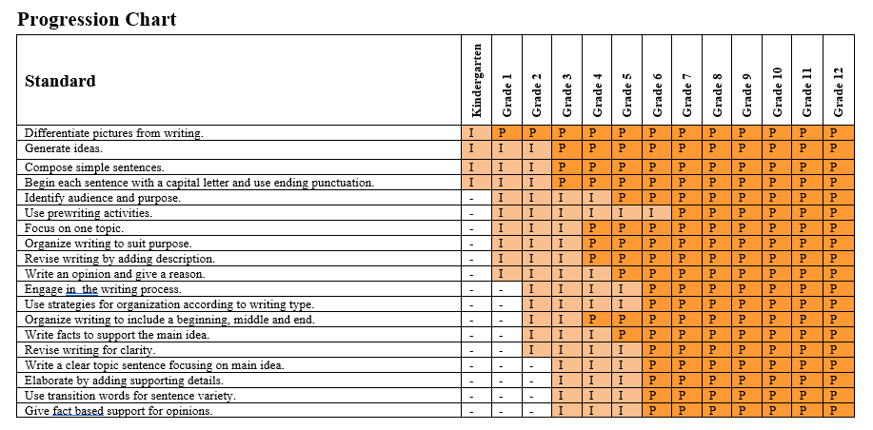
Progression of Virginia
Writing SOLs
VDOE 2017 SOL Writing Progression

Slide 11
Natalie Wexler

Slide 12
How is Writing Usually
Taught in School?
Graham, Changing How Writing is Taught, 2019
In some classrooms, writing instruction is exemplary. But most often that is not the case. Universally, writing and writing instruction in most classrooms is inadequate.
This lack of attention to teaching students how to plan and revise was also a common theme in other studies.
most of the writing activities applied for this purpose involved writing without composing (e.g., filling in blanks on a worksheet, note taking, and one-sentence responses to questions)
a majority of teachers did not devote enough time to teaching writing
While most writing outside of school today is done digitally, the use of digital tools for writing or writing instruction was notably absent in the typical classroom
recommendation is 1 hour of writing instruction
per day, but this is rarely operationalized
how frequently teachers applied specific instructional practices, made particular instructional adaptations, or assigned different types of writing was related to the time they devoted to teaching writing.
primary audience for students’ writing was the teacher
writing involved little collaboration among students
classroom resources for teaching writing were inadequate
formative evaluation occurred infrequently
motivation for writing was largely ignored
the writing needs of students with a disability or who were learning a second language were not sufficiently addressed

Slide 13
So What?
“Competence in writing appears at the forefront of educational concerns at the national level. However, there is little consensus on how writing should be taught.”
(Spear-Swerling, 2022, p. 190)
“In early grades teaching is often focused on the conventions of writing (ex: punctuation) and may ignore other parts of the writing process, such as sentence construction. And more generally, evidence-based practice is also not embedded in curricular competencies.”
(Spear-Swerling, 2022, p. 190)
“ Because writing is a valuable tool for communication, learning, and self-expression, people who do not have adequate writing skills may be at a disadvantage and may face restricted opportunities for education and employment.”
Sedita, Keys to Early Writing,2021, p. 14
Twenty-four percent of students at both grades 8 and 12 performed at the Proficient level in writing in 2011.
https://nces.ed.gov/nationsreportcard/pdf/main2011/2012470.pdf

Slide 14
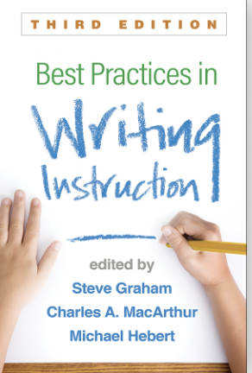
Characteristics of Structured Literacy
Explicit Instruction: key skills are directly taught, modeled and clearly explained
Systematic: instruction follows a planned, logical sequence simple to complex
Corrective Feedback: Targeted, unambiguous, prompt feedback
Attention to Prerequisite Skills: awareness of prior skills needed to complete or understand a more advanced tas
Planned, purposeful choices of examples, tasks and texts - carefully chosen to fit the children’s current skills and avoid confusion
Synthetic Phonics: phoneme grapheme level focus on blending and the sound unit
Consistent application of skills and teaching for transfer
Data Based decision making

Slide 15
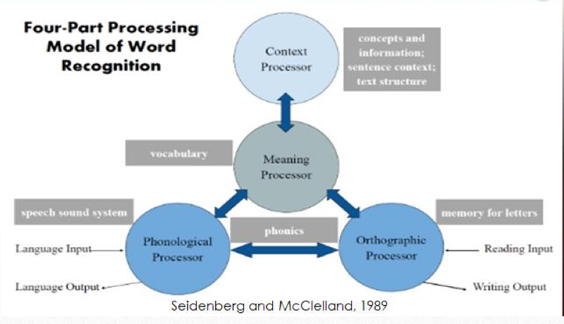
Theoretical Models of Reading

Slide 16
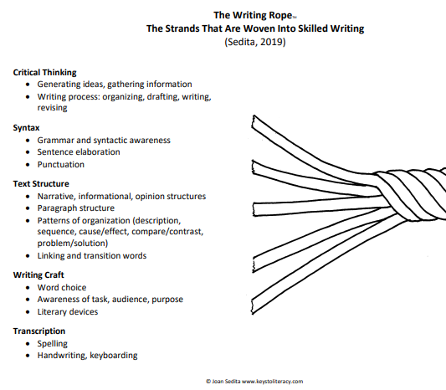
Theoretical Models of Writing

Slide 17
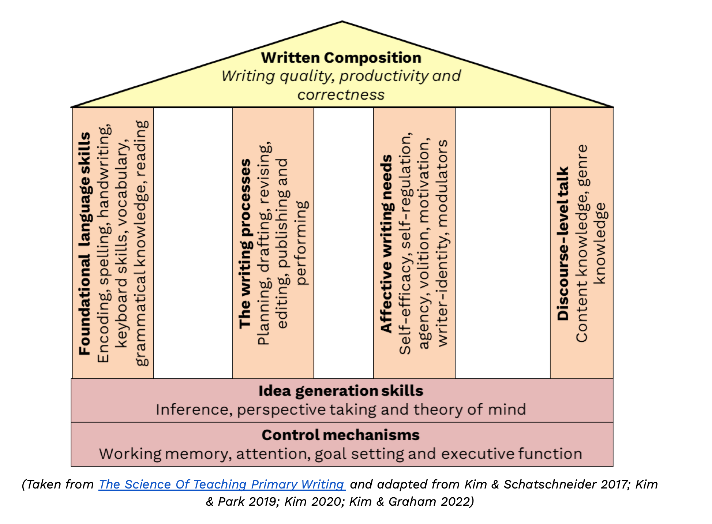
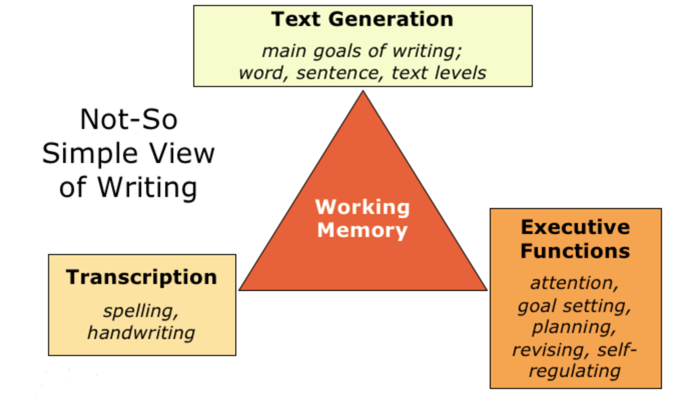
Not So Simple View of Writing
Theoretical Models for Writing…Continued

Slide 18
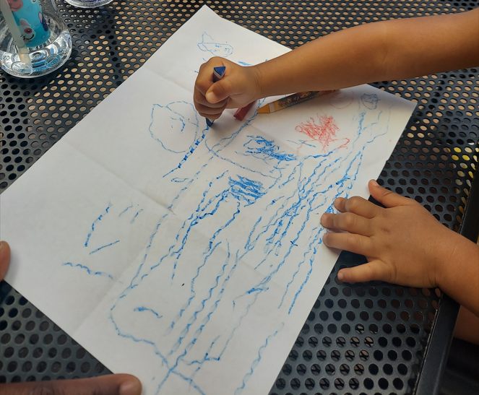
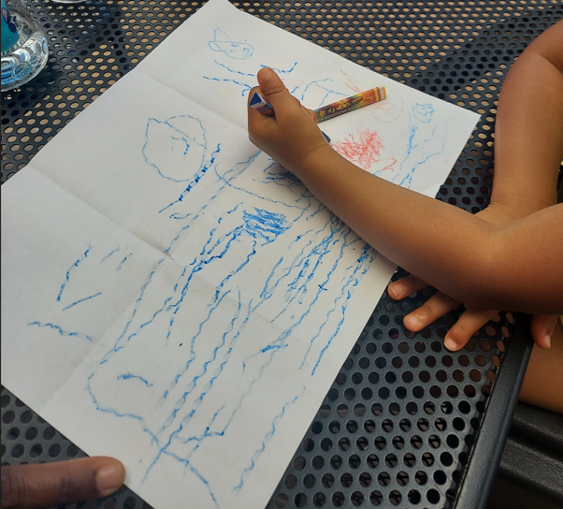
Spelling & Word-Writing Developmental Sequence: Kindergarten Into Grade 2

Slide 19
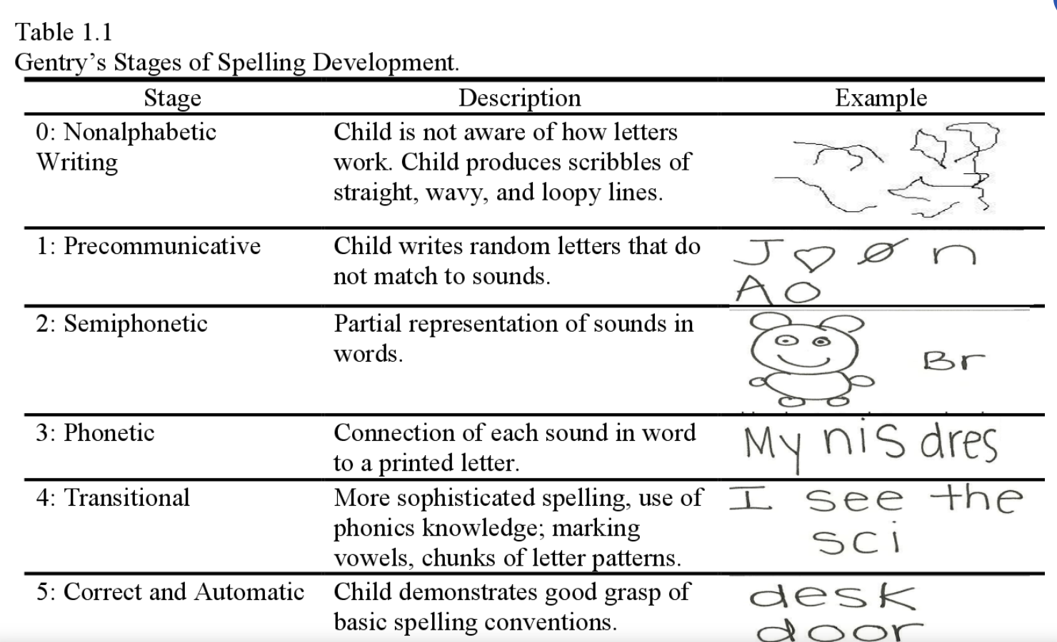
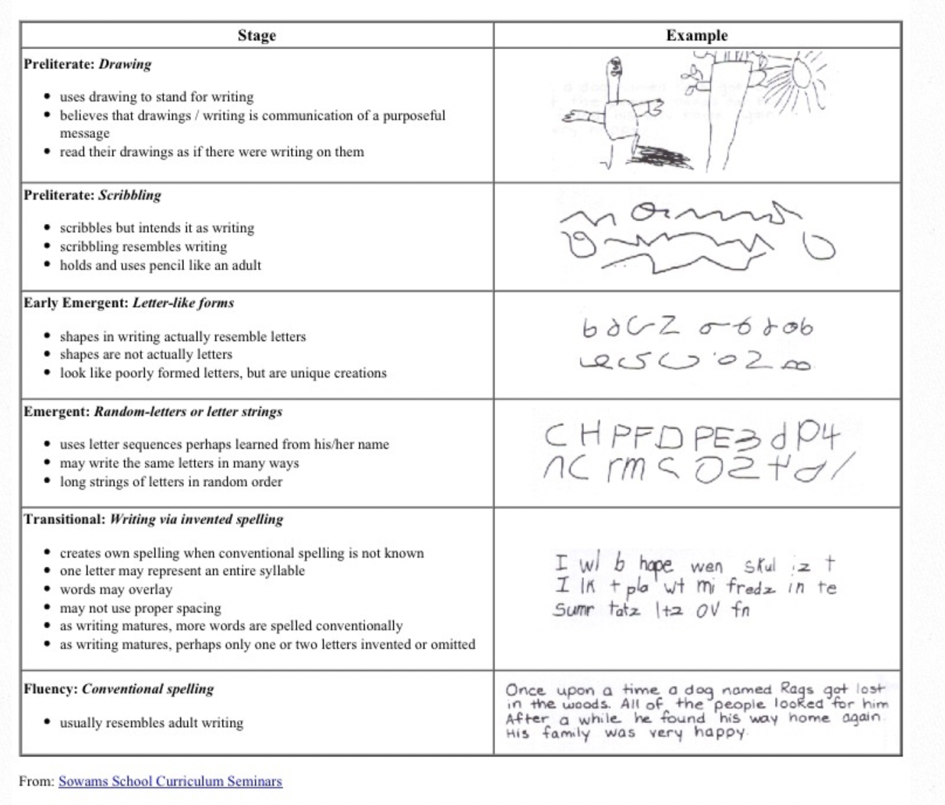
Gentry’s Stages Of Spelling Development

Slide 20
Teaching Elementary School Students to Be Effective Writers Practice Guide What Works Clearinghouse

Slide 21
Research Says #1…
Recommendation: Provide Daily Time for Students to Write | Instructional Suggestions
 | KIndergarten: 30 minute writing instruction with time for application 1st and 2nd Grade 60 minutes 30 minutes writing instruction 30 minutes application

Slide 22
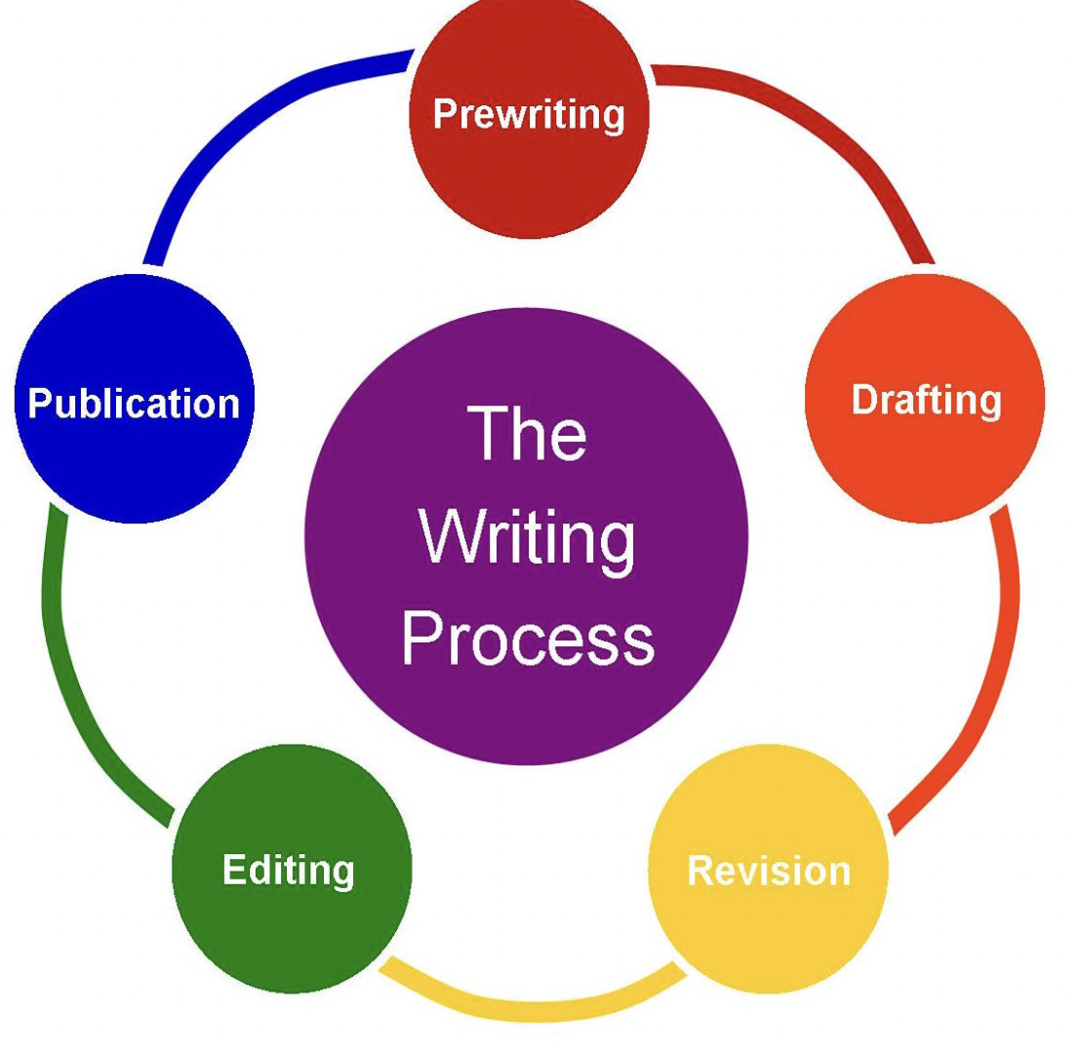
Research Says # 2a….
Recommendation: Teach students the writing process. | Instructional Suggestions
 | Gradual Release model (I Do, We Do, You Do) teach explicitly based on standards process: planning, drafting, revising/editing. sharing (grade-level standards) ise graphic organizers teacher modeling/mentor text/provide stems (springboard) student can copy → imitate→ emulate encourage students to be flexible in their use of hte process

Slide 23
Research Says # 2b….
Recommendation: Teach students about audience and purpose. | Instructional Suggestions
 | Gradual Release model (I Do, We Do, You Do) teach explicitly based on standards help students understand the different purposes of writing (describe, narrative, expository, inform, persuade (opinion) expand students understanding of audience and how audience impacts writing integrate use of mentor text as a model

Slide 24
Play-Doh & The Writing Process
Keys to Early Writing (37 minute mark)

Slide 25
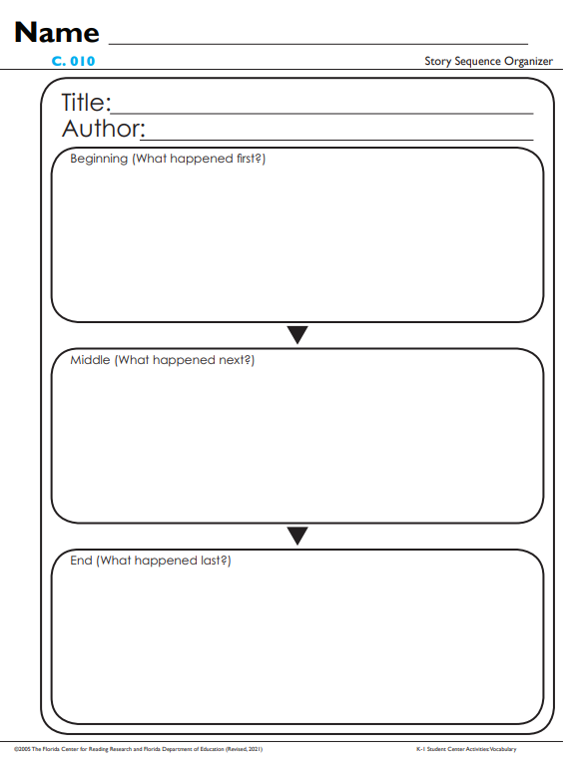
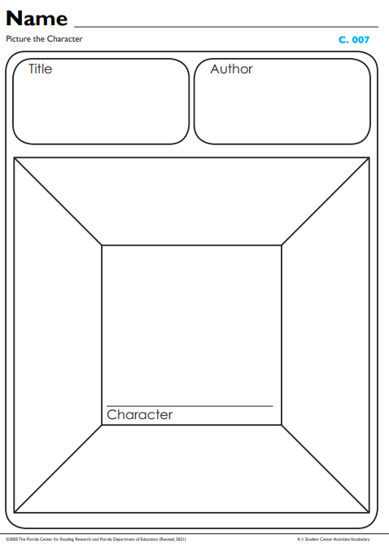
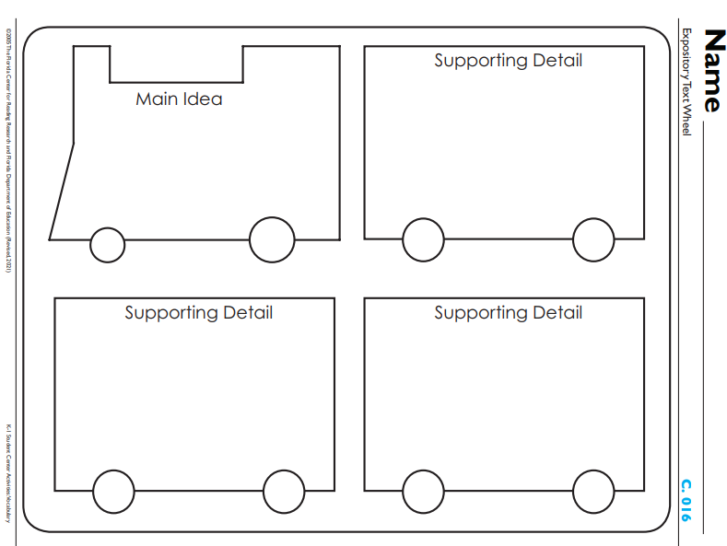
Now What…Instructional Strategies
Composition: Idea Organization

Slide 26
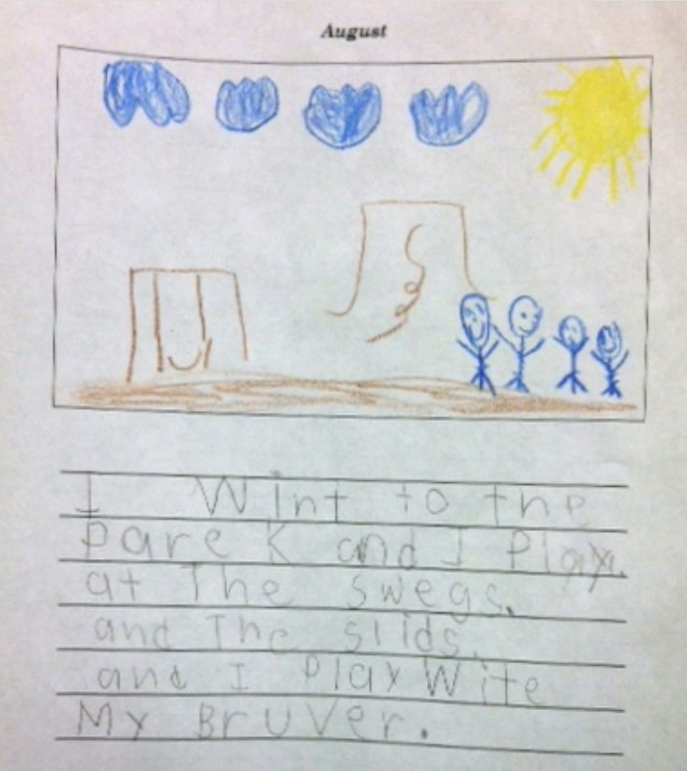
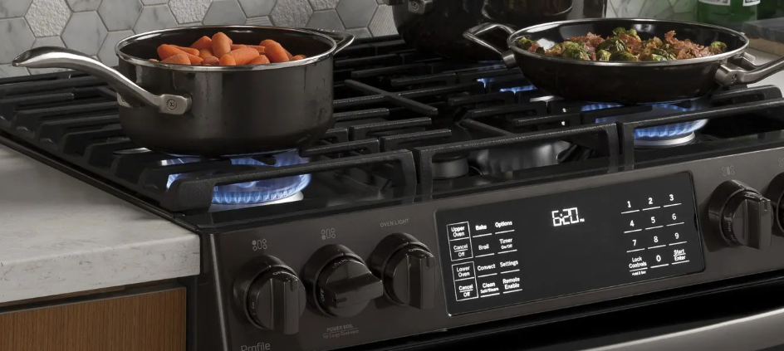
Research Says # 3.1
Recommendation: Teach students to become fluent with handwriting. | Instructional Suggestions
 | Gradual Release model (I Do, We Do, You Do) teach explicitly based on standard use letter stroke cues use lined paper (topline, midline, and baseline) start from the top of the letter gross motor, tracing*, handwriting (fine motor use of tripod pencil grip teacher modeling and immediate corrective feedback *tracing is not effective, students need to write the letter to internalize the motor pathway

Slide 27
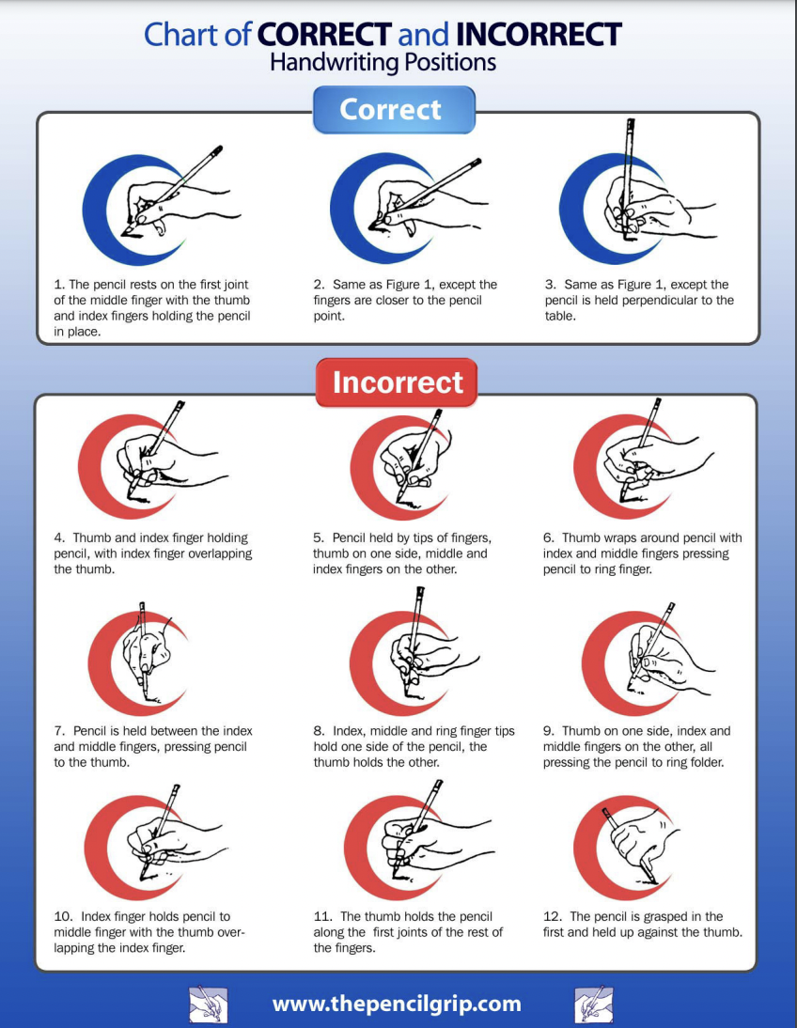
Pencil Grip
Skills that Support Transcription
Good Posture
Chair with a flat back
Bent elbows resting on the table - desk 2” higher than students’ bent elbows
Feet flat on the floor
Hips, knees all at 90 degree angle
Non writing hand should hold the paper in place
Proper Pencil Grip
Tripod grip
Tools
Short pencil - golf pencil
Preferably - no eraser
Paper
Angled parallel to the writing arm
Anchored with non-writing hand

Slide 28
Research Says # 3.2.
Recommendation: Teach students to become fluent with spelling. | Instructional Suggestions
 | Gradual Release model (I Do, We Do, You Do) teach explicitly based on standards written words are comprised of letters/letter patterns that represent sounds teach from sounds to letters/letter patterns use explicit/systematic instruction teacher modeling and immediate corrective feedback hold students accountable for spelling what has been taught
arrow

Slide 29
Research Says # 3.3….
Recommendation: Teach students to become fluent with sentence construction. | Instructional Suggestions
 | integrate complete and increasingly complex sentence generation into oral language Gradual Release Model (I Do, We Do, You Do) teach explicitly based on standards K - simple Sentence 1st simple Sentence with Adjective Descriptors 2nd Simple and Compound Sentences teacher modeling and immediate corrective feedback hold students accountable for spelling what has been taught
Sentence Structure

Slide 30
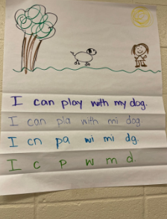
First Instructional Strategy for Sentence Construction
Picture Story Word Story

Slide 31
Second Instructional Strategy for Sentence Construction
Subject | Predicate
doer | do
The bear | is singing.
The bear is singing.
Explicit sentence composition
subject/predicate

Slide 32
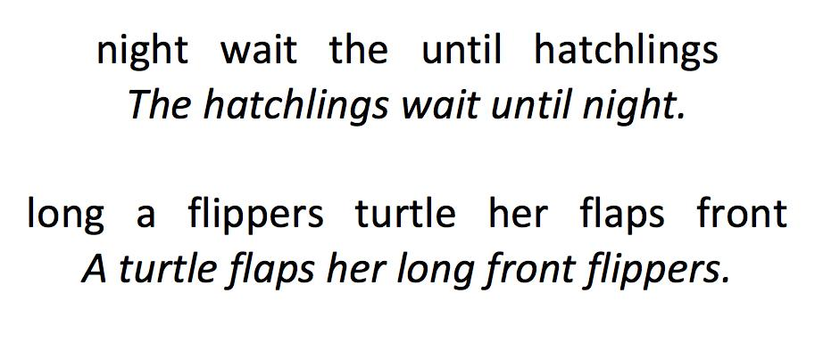
Third Instructional Strategy for Sentence Construction
o
Sentence Scramble

Slide 33
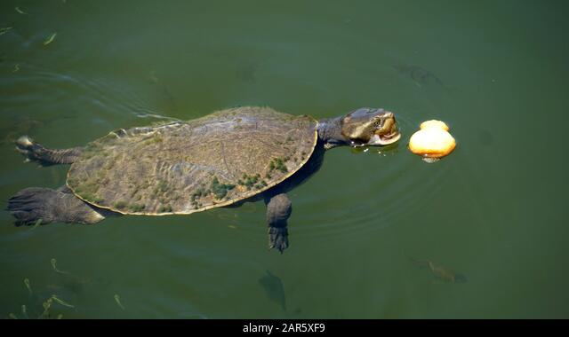
Fourth Instructional Strategy for Sentence Construction
Subject | Predicate | Where | When | How | Why | What Kind/Which
The turtle | swims.
The turtle | swims | across the pond | early in the morning | quickly | to find food | mother
The mother turtle swims quickly across the pond early in the morning to find food.
Sentence Expanding

Slide 34
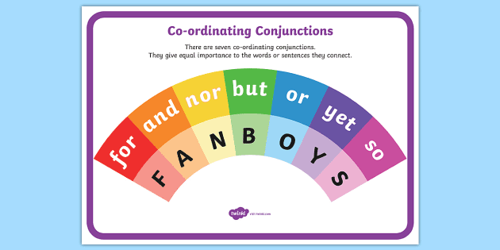
Fourth Instructional Strategy for Sentence Construction continued
Sentence Combining (Compound Sentences)
for, and, nor, but, or, yet, & so
My dog is fat.
My dog loves to play.
My dog is fat, but loves to play.

Slide 35
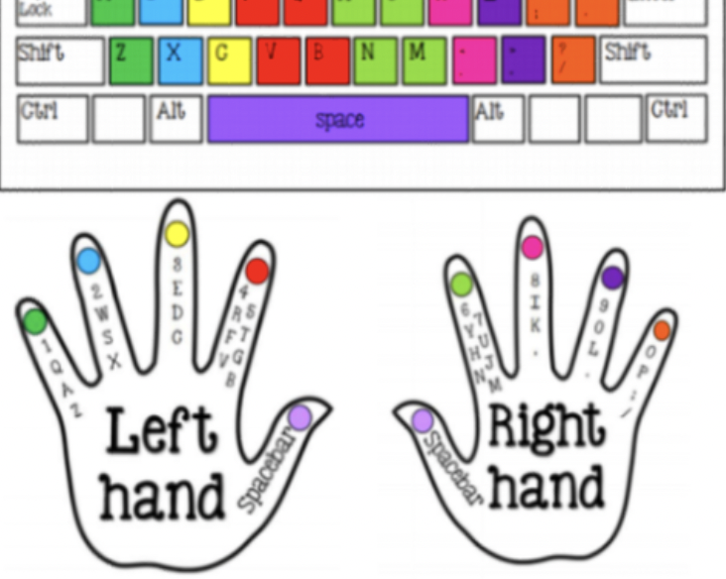
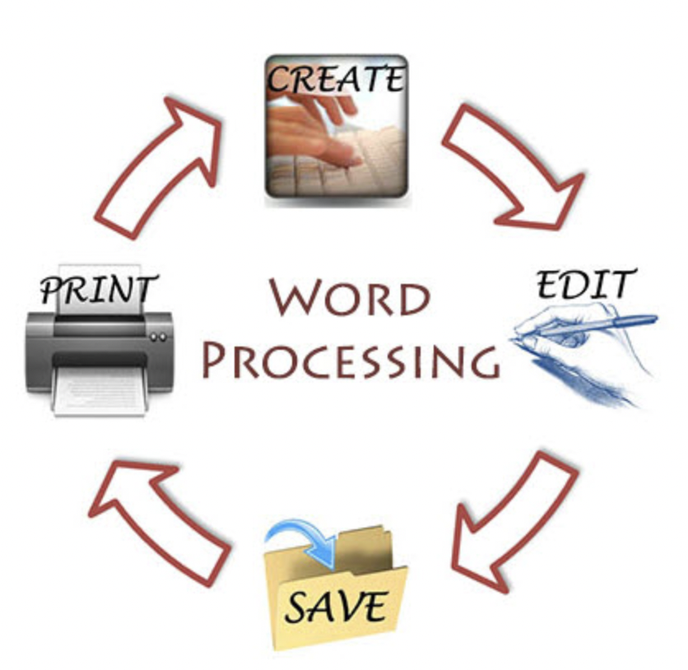
Research Says # 3.4….
Recommendation: Teach students to become fluent with keyboarding and word processing. | Instructional Suggestions
 | no expectation of keyboarding in K-2 Virginia Standards

Slide 36
Research Says # 4…
Recommendation: Create a community of writers. | Instructional Suggestions
 | focus on a single concept when instructing and providing feedback teachers model writing process participate as writers share their writing accept students where they are provide instruction to move students forward in their writing provide choice in writing when possible encourage students to collaborate when writing provide students with opportunities to give and receive feedback publish student writing extend student writing beyond the classroom encourage collaboration and feedback

Slide 37
Instructional Suggestions for Specialized Groups
English Language Learners and Students with Disabilities
develop students oral language provide familiar topics and vocabulary provide scaffolds provide explicit writing instruction focus on one concept at time break task down into component parts provide multisensory instruction for spelling and handwriting (letter formation) adhering to a basic framework of planning, writing, and revision explicitly teaching critical steps in the writing process providing specific feedback based on what is explicitly taught

Slide 38
Assessment
Recommendations
Formative short and given frequently to inform instruction | Summative schedule 3/year
Instructional Suggestions
Transcription Letter Formation, Spelling, Punctuation, and Spacing of Words/Sentences/Paragraphs | Composition Topic Knowledge, Vocabulary/Word Choice/ Sentence Formulation/ Grammar Usage/ Organization of Ideas/ Awareness of Audience
Teacher Feedback evaluate samples with a checklist compare student sample with exemplar

Slide 39
Key TakeAways
Teachers matter.
Writing instruction matters.
Understand the Standards
the standards are a guide, they explain what we expect students to be able to do
Plan writing instruction across the Unit first, then week by week, then day by day
Letter formation matters
Provide explicit systematic instruction
Use data to inform instruction
Focus instruction/feedback on one concept at a time
Provide explicit feedback
Develop a routine/habits you can stick to
Provide DAILY time for students to write
Teach students to use the writing process for a variety of purposes .
Teach students to become fluent with handwriting, spelling & sentence construction,
Create an engaged community of writers.

Slide 40
In Conclusion…
“Writing is process of expressing ourselves
so we are understood and validated.
Expressing ourselves is an innate human desire.
What writers need doesn’t change much over time, What writes need is the time,
instruction and feedback on the components of writing and time to apply what they have learned.
Teachers orchestrate their classrooms to support writing.”
Anderson,, 10 Things Every Writer Needs to Know, 2011 p. 1

Slide 41
Learning Targets
In today’s session we will understand:
A Way to Approach Writing Instruction in K-2 Classrooms
What: Standards/General Practices
So What: Research
Now What: Evidence-Based Practices

Slide 42
Questions…
https://tinyurl.com/VDOEK-2

Slide 43
Resources
Berninger, et al. Early Development of Language by Hand, V. 2006 page 87
Birsh & Carreker, Multisensory Teaching of Basic Language Skills, 2018
Cardenas-Hagan, Elsa, Literacy Foundations for English Learners: A Comprehensive Guide to Evidence-Based Instruction.
Edview 360, https://www.voyagersopris.com/podcast/2022/how-explicit-writing-instruction-can-compensate-for-gaps-in-background-knowledge?utm_source=news&utm_medium=email&utm_campaign=2022_Q3_VSL_Edview360_Podcast_Wexler, January 5, 2022.
Graham, S. Changing How Writing is Taught, Review of Research in Education Volume: 43 issue: 1, page(s): 277-303
Article first published online: May 22, 2019; Issue published: March 1, 201
Graham, S. & Hebert, M. Writing to Read: Evidence for How Writing Can Improve Reading, A Report from Carnegie Corporation of New York.
Graham, S. Best Practices in Writing Instruction, 2019.
Kastner, Pam The Kastner Collection: Effective Writing Practices https://wakelet.com/wake/lS4ZpgicSfNWPpIxMpBnk
Moats, Louisa C. and Tolman, Carol C.. LETRS 3rd Edition, V. 2, 2019.

Slide 44
Resources Continued..
Sedita, Joan, https://vimeo.com/414312488?fbclid=IwAR1POc12dBKbDg1B305-YvF4eQgszRRums5fe_rMiiG_gH639i6LvJrm2aM&fs=e&s=cl
https://keystoliteracy.com/free-resources/articles/
Sedita, Joan Keys to Early Writing, 2021
Spear-Swerling, Louise The Importance of Teaching Handwriting, Reading Rockets
Spear-Swerling, Louise, Structured Literacy Interventions, 2022
Van Cleave, William. Writing Matters, 2012.

Slide 45
Thank You
If you have any questions, feel free to contact us!
Barbara Brinker barbara.brinker@nn.k12.va.us
Kelly Erickson kelly.erickson@nn.k12.va.us

