Slide 1
Student Behavior and Administrative Response Data Collection
2022-2023 School Year

Slide 2
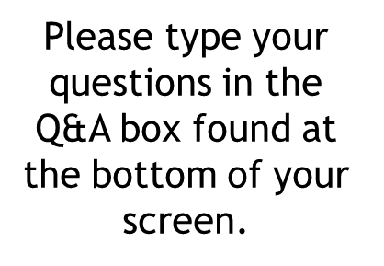
WEBINAR PARTICIPATION
This presentation will be available to participants once all webinars have been completed

Slide 3
A
AGENDA
Data Collection Overview
Updates with Scenarios
Persistently Dangerous Report
Timeline and Resources
Questions
Notes:
We are in the process with finishing up EOY SBAR submissions and implementing edits and code changes for the new school year. We are still waiting on a few regional programs to submit and complete EOY SBAR.

Slide 4
SBAR Data Collection Governance
Required by the Code of Virginia (§22.1-279.3:1) and used to satisfy federal assurances for ESSA, the Gun-Free Schools Act of 1994, and the Individuals with Disabilities Education Act (IDEA)
Replaced the Discipline, Crime, and Violence Collection (DCV) in 2021-2022
SBAR enables reporting of all administrative responses (behavioral interventions, instructional supports, and disciplinary sanctions) to student behaviors that occurred
On school property, a school bus, or at a school-sponsored activity
OR, occurred in the community with in charges filed and an administrative response from the school that resulted in the student being alternatively placed
Allows VDOE to identify inequities in disciplinary outcomes, exclusionary practices, and school safety issues

Slide 5
File Submissions
SBAR Data collected twice a year
Preliminary SBAR (February 1st through mid-March)
Collection may retire 2023-2024
This is not required of regional programs at this time, but submission is encouraged
End of Year (EOY) SBAR (July 3rd through August)
Required

Slide 6
Data File Layout
SBAR Data File includes:
A Record - Details about the submission type, school year and school division or regional center number
B Records (Events) - Details about the event including location and time of occurrence
C Records (Student Behaviors) - Individual student behaviors that result in an administrative response
D Records - Administrative responses include any behavioral intervention, instructional support, disciplinary sanction, alternative placement, or notification to law enforcement
E Records - The type and number of victims involved in the event
RecordCount= # (The number of A, B, C, D and E records in your data file)
Notes:
SBAR data files consist of an A, B (Events), C (Student Behaviors), D (Administrative Responses) and E (Victim) records.
Every file must have a record count which is the total number of A, B, C, D and E records in your data file. The count does not include the header information.

Slide 7
DATA File Layout
The Header must include all information exactly as indicated below
SenderID=999 3-digit Division or Regional Center Number (leading zero must be included,
i.e. 001)
CreateDate=08/31/2022 Current date in mm/dd/yyyy format
CreateTime=11:00:01 Current time in hh:mm:ss format
EMAIL=peterpan@xyz.com Sender’s e-mail address
~~
DATATYPE=SBAR Data Collection Type
~
A032021999 A Record (Record Type A, File Submission Type 03 (EOY), 09 (Pre-submission),
or 17 (Preliminary), Beginning School Year and the 3 digit school
division or regional center/program number)
Notes:
The Header is also required for each data file. It provides information about the file such as
The school division or regional program that is submitting the file
The date that the file was created
The time that the file was uploaded
The sender’s email address
The Datatype which should be SBAR
And the A record which is made up of 10 characters
The A which represents the record type
The next 2 numbers describe the submission type (03 for EOY, 09 for Pre-submission, and 17 for Preliminary)
The next 4 numbers represent the school year
And the last 3 numbers indicate the school division or regional program

Slide 8
Diagram of Connected Records Records
D Record: Student 1 Behavior 1
Response 1
C Record: Student 1 Behavior 1
D Record: Student 1 Behavior 1 Response 2
B Record: Event
C Record: Student 1 Behavior 2
D Record: Student 1 Behavior 2 Response 1
C Record: Student 2
Behavior 1
D Record: Student 2 Behavior 1 Response 1
E Record: Victims
(dependent on behavior code)
Notes:
This diagram shows how SBAR records are connected.
There should always be one B record per event regardless of the number of offenders, behaviors, administrate responses and victims.
Every B (event) record will have one or more C (student behavior) records. (1 event connected to 3 student behavior records)
One or more students can have a C record for an event. (1 event; 2 students)
A student can have multiple C records, one for each behavior. (student 1 has multiple behaviors associated with one event)
C Records include information on each student behavior involved in the event
Every event record will have one or more C records (1 event with 3 student behavior records)
One or more student can have a C record for an event (multiple students tied to one event)
A student can have multiple C records, one for each behavior (Student 1 has multiple behavior records; behavior 1 and behavior 2)
D Records include all administrative responses to the event.
There must be a minimum of one response per behavior. (there is one response tied to each student behavior)
There can be multiple responses per student. (Student 1 has a total of 3 responses)
There can be multiple D records per behavior. (Student 1 has multiple responses to the first behavior)
Last, E Records contain all victim data, and it is required for specific behavior codes and optional for all others. There must be only one E record for each qualifying B record. To learn which behavior codes require an E record, Please refer to the Behavior Codes document located on SBAR’s webpage.

Slide 9
Submitting SBAR File with No Data
Divisions or regional centers with no events or responses to report must still submit an SBAR file.
This includes:
Uploading a file that contains
A Header
An A Record
RecordCount=1
Submitting for local approval and superintendent’s electronic signature
NOTE: The submission will generate warnings for missing B, C and D Records which is expected and will not disrupt the approval process. The verification report will include a message of, “No data submitted”, which must be approved by the regional center director or division superintendent through SDCA.
Notes:
The best way to create a file with no data is to use Notepad.
First Create the Header
Then your A Record
And last create a RecordCount=1
The one is counting the A record; there are no B, C, D and E records in this file

Slide 10
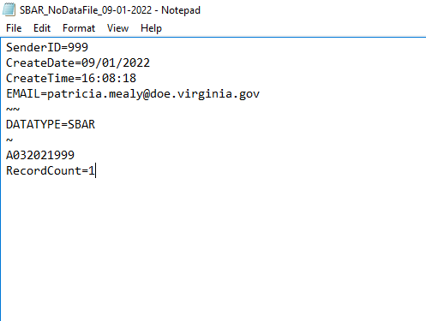
Submitting SBAR File with No Data
Notes:
Here is how your data file will look
Once the file has been uploaded, the submission will generate warnings for missing B, C and D Records which is expected and will not disrupt the approval process. The verification report will include a message of, “No data submitted”, which must be approved by the regional center director or division superintendent through SDCA.

Slide 11
SBAR Collection Updates with Scenarios
Data Elements
Code Values
Reporting Rules

Slide 12
Hours Sanctioned- *New Data Element*
Definition
Total number of school hours of the sanction
Edits
Must be blank or a value of 1-200; no decimals or factions
Must be null if Disciplinary Sanction Code is NONE
Must be null if a value is entered for Days Sanctioned
Cannot be used with STS1, SBP, LTS1, EX1, EX2 or ALT

Slide 13
Hours Sanctioned Scenario
Nick was caught cheating on his math exam, and he was immediately sent to the principal’s office. Nick admitted that he wanted a good grade, however, he didn’t get the chance to study for the Math exam. Nick was assigned to In-School-Suspension during his math class for one week. His parents were also contacted about his behavior.
Record Type | Local Event ID | Event Division | Event School | Date of Event | Time of Event | Location of Event | Firearms Confiscated | Weapons Confiscated
B | 6 | 99 | 9999 | 10/15/2021 | 1 | 1 | 0 | 0
Record Type | Local Event D | State Testing ID | Behavior Code | Unknown Offender Code | Enrolled Division | Enrolled School | Aggravating Circumstances | Law Enforcement Flag | Notified of Charges Filed Flag | Notified of Conviction Flag
C | 6 | 1019933333 | BAP3 |  | 99 | 999 | N | N | N | N
Record Type | Local Event ID | State Testing ID | Behavior Code | Behavioral Intervention Code | Instructional Support Code | Disciplinary Sanction Code | Days Sanctioned | Alternate Placement Educational Agency | Alternate Placement School | Hours Sanctioned
D | 6 | 1019933333 | BAP3 | 1 | 7 | ISS |  |  |  | 5
Notes:
Nick’s Math Class is an hour long; 5 hours represent an hour a day

Slide 14
Behavior Code Updates
Behavior Code | Description | Change
BSO4 | Failure to be in one’s assigned place | Retired
BSO15 | Student is not going to class as assigned | NEW
BSO16 | Student is in an unauthorized area of the campus (NOT related to school or class attendance/nonattendance). | NEW
BESO13 | Threatening, intimidating, or instigating violence, injury or harm to another student(s) or other(s) (not including written threats) | Updated Description
BESO14 | Threatening, intimidation, or instigating violence, injury or harm to another student(s) or other(s) in writing (reports to law enforcement when victim is staff) | NEW
PD15 | Illegal Possession of Other Firearms: firebombs, explosive materials or devices, hoax explosive devices per § 18.2-85, or explosive incendiary devices, as defined in § 18.2-433.1, or chemical bombs per § 18.2-87.1 | Updated Description

Slide 15
BSO15 and BSO16
Nicole skipped class and was found napping in the janitor’s closet. As a result, the principal had a talk with her, and then contacted Nicole’s parents.
Record Type | Local Event ID | Event Division | Event School | Date of Event | Time of Event | Location of Event | Firearms Confiscated | Weapons Confiscated
B | 1 | 99 | 9999 | 2/18/2022 | 1 | 1 | 0 | 0
Record Type | Local Event ID | State Testing ID | Behavior Code | Unknown Offender Code | Enrolled Division | Enrolled School | Aggravating Circumstances | Law Enforcement Flag | Notified of Charges Filed Flag | Notified of Conviction Flag
C | 1 | 1019955555 | BSO15 |  | 99 | 999 | N | N | N | N
C | 1 | 1019955555 | BSO16 |  | 99 | 999 | N | N | N | N
Record Type | Local Event ID | State Testing ID | Behavior Code | Behavioral Intervention Code | Instructional Support Code | Disciplinary Sanction Code | Days Sanctioned | Alternate Placement Educational Agency | Alternate Placement School | Hours Sanctioned
D | 1 | 1019955555 | BSO15 | 1 |  | NONE
D | 1 | 1019955555 | BSO16 | 12 |  | NONE
Notes:
The first response (D Record) indicates that Nicole parents were contacted about her behavior (skipping class and entering in an unauthorized area of the campus). The Second response involved administrative meeting with Nicole to discuss her behavior.

Slide 16
BESO14 Behavior Code
Lisa accidently left her notebook in the girls’ locker room. Another student found it, however, when she picked the book up to return it, a frightening drawing fell from the book. The drawing revealed a teacher who was shot, and it was labeled Mrs. Vaughn will get what is coming to her soon. Lisa’s possessions were searched and no weapons were found. Administrators reported the event to Law Enforcement. Lisa was suspended for 15 days with classwork provided. While out on suspension, the administrators decided to place Lisa at an Alternate Placement School for the remainder of the school year.
Record Type | Local Event ID | Event Division | Event School | Date of Event | Time of Event | Location of Event | Firearms Confiscated | Weapons Confiscated
B | 23 | 99 | 9999 | 2/25/2022 | 1 | 1 | 0 | 0
Record Type | Local Event ID | State Testing ID | Behavior Code | Unknown Offender Code | Enrolled Division | Enrolled School | Aggravating Circumstances | Law Enforcement Flag | Notified of Charges Filed Flag | Notified of Conviction Flag
C | 23 | 1019955550 | BESO14 |  | 99 | 999 | Y | Y | N | N
Record Type | Local Event ID | State Testing ID | Behavior Code | Behavioral Intervention Code | Instructional Support Code | Disciplinary Sanction Code | Days Sanctioned | Alternate Placement Educational Agency | Alternate Placement School | Hours Sanctioned
D | 23 | 1019955550 | BESO14 | 11 | 6 | STS1 | 10
D | 23 | 1019955550 | BESO14 | 1 |  | ALT | 90 | 88 | 88
Notes:
BESO14 was reported on the student behavior record which indicate that Lisa threatened a staff member with her drawing. Administration reported the incident to law enforcement (C Record).

Slide 17
BESO14 Behavior Code BESO14 BEHAVIOR CODE Cont.
Behavior Code BESO14 requires a victim count.
Record Type E | Local Event ID | Student Victims | Staff Victims | Other Adult Victims | Other/Unknowns Victims | Indeterminate Victims Flag | Filler | Filler | Filler | Filler
E | 23 | 0 | 1 | 0 | 0 | N

Slide 18
Updates to Other SBAR Codes
Data Element | Code Value | Description | Change
Behavioral Intervention Code | 12 | Administrative conference with student *This should be used for administrative responses to reportable behaviors in an event that have no sanctions or other interventions or supports | New
Disciplinary Sanction Code | CAHO | Court Appointed Hearing Office by Virginia Supreme Court; Special Education Only | New
Disciplinary Sanction Code | STS2 | Short term suspension with no instructional support services | Retired
Disciplinary Sanction Code | LTS2 | Long term suspension with no instructional support services | Retired
Notes:
Disciplinary Sanction Code STS2 and LTS2 are being removed from the code list. Student should be provided with graded work without face-face-face teacher contact while out on suspension.

Slide 19
Using Behavior Code 12
During a group assignment, Mr. Rowe assisted students with their project. Devin tried to get his attention, however, he felt ignore. Devin walked out the classroom, went to the restroom and returned to class 10 minutes later. Mr. Rowe sent Devin to the principal’s office for leaving the class without permission. The principal spoke with Devin about his behavior and sent him to his next class.
Record Type | Local Event ID | Event Division | Event School | Date of Event | Time of Event | Location of Event | Firearms Confiscated | Weapons Confiscated
B | 18 | 99 | 9999 | 8/5/2021 | 1 | 1 | 0 | 0
Record Type | Local Event ID | State Testing ID | Behavior Code | Unknown Offender Code | Enrolled Division | Enrolled School | Aggravating Circumstances | Law Enforcement Flag | Notified of Charges Filed Flag | Notified of Conviction Flag
C | 18 | 1019922888 | BSO16 |  | 99 | 999 | N | N | N | N
Record Type | Local Event ID | State Testing ID | Behavior Code | Behavioral Intervention Code | Instructional Support Code | Disciplinary Sanction Code | Days Sanctioned | Alternate Placement Educational Agency | Alternate Placement School | Hours Sanctioned
D | 18 | 1019922888 | BSO16 | 12 |  | NONE
Notes:
Devin left class without permission, therefore, BSO16 (Student is in an unauthorized area of the campus) was reported as the behavior involved. The principal responded to the behavior by having an administrative conference with the student and then sending him to the next class.

Slide 20
Multiple Student Behaviors for an Event
Ryan disrupted the class with loud noises. When the teacher asked him to stop, he cursed at the teacher, and proceeded to walk out the classroom. The teacher tried to stop him, however, he pushed her away from him. She stumbled backwards, however, she wasn’t injured. Administration responded with 10 days of STS1 with classwork provided; a referral to Specialized Instructional Support Personnel; an administrative conference with the student and his parents were contacted.
Record Type | Local Event ID | Event Division | Event School | Date of Event | Time of Event | Location of Event | Firearms Confiscated | Weapons Confiscated
B | 2 | 99 | 9999 | 8/5/2021 | 1 | 1 | 0 | 0
Record Type | Local Event ID | State Testing ID | Behavior Code | Unknown Offender Code | Enrolled Division | Enrolled School | Aggravating Circumstances | Law Enforcement Flag | Notified of Charges Filed Flag | Notified of Conviction Flag
C | 2 | 1019922222 | BESO4 |  | 99 | 999 | N | N | N | N
C | 2 | 1019922222 | RB8 |  | 99 | 999 | N | N | N | N
C | 2 | 1019922222 | BSO16 |  | 99 | 999 | N | N | N | N
Record Type | Local Event ID | State Testing ID | Behavior Code | Behavioral Intervention Code | Instructional Support Code | Disciplinary Sanction Code | Days Sanctioned | Alternate Placement Educational Agency | Alternate Placement School | Hours Sanctioned
D | 2 | 1019922222 | BESO4 | 3 | 6 | STS1 | 10
D | 2 | 1019922222 | RB8 | 1 |  | NONE
D | 2 | 1019922222 | BSO16 | 12 |  | NONE
Notes:
This event involves multiple behaviors, therefore, the disciplinary sanction was placed on the most egregious behavior, BESO4. Administration responded to the other behaviors with behavioral interventions.

Slide 21
Multiple Student Behaviors for an Event Cont.
Ryan disrupted the class with loud noises. When the teacher asked him to stop, he cursed at the teacher, and proceeded to walk out the classroom. The teacher tried to stop him, however, he pushed her away from him. She stumbled backwards, however, she wasn’t injured. Behavior Code BESO4 requires a victim count.
Record Type E | Local Event ID | Student Victims | Staff Victims | Other Adult Victims | Other/Unknowns Victims | Indeterminate Victims Flag | Filler | Filler | Filler | Filler
E | 2 | 0 | 1 | 0 | 0 | N

Slide 22
Reports to Law Enforcement
All PD Codes
BSC21 - Stalking as described in the Code of Virginia section 18.2-60.3
BESO14 – Threatening, intimidation, or instigating violence, injury or harm to another student(s) or other(s) in writing. If the written threat is to a staff member, a report to law enforcement is required unless the student making the threat has a disability.
BESO17 - Any threats or false threats to bomb, as described in § 18.2-83, made against school personnel or involving school property or school buses.
Notes:
These behavior codes are required to be reported to law enforcement.

Slide 23
Disciplinary Sanction Code - None
Behavioral Intervention and/or Instruction Support codes are required when the Disciplinary Sanction Code is NONE in order to complete the administrative response. When reporting administrative responses, consider the following:
Were the parents contacted for any of the behaviors? If so, then Behavioral Intervention Code 1 should be entered to complete the response.
Did a conversation take place between the administration and student regarding the behavior/s involved? If so, then Behavior Intervention Code 12 should be entered to complete the response.
Notes:
Disciplinary Sanction Code – NONE means no disciplinary sanctions were given for the student’s behavior, however, SBAR still requires a response. Were the parent contacted about the student’s behavior if so behavioral intervention code 1 should be entered? Did a conversation take place between administration and the student, if so behavioral intervention code 12 should be reported with NONE to complete your response?

Slide 24
Behaviors without a Disciplinary Sanction
Michael was whistling loudly and walking around his table when he was supposed to be doing independent work. He then started taking other student’s pencils. He didn’t respond to the teacher when asked to stop. This is not the first time he has exhibited this behavior in Math class. His parents were contacted and he was referred to his grade level’s Check-In Team.
Record Type | Local Event ID | Event Division | Event School | Date of Event | Time of Event | Location of Event | Firearms Confiscated | Weapons Confiscated
B | 5 | 99 | 9999 | 8/5/2021 | 1 | 1 | 0 | 0
Record Type | Local Event ID | State Testing ID | Behavior Code | Unknown Offender Code | Enrolled Division | Enrolled School | Aggravating Circumstances | Law Enforcement Flag | Notified of Charges Filed Flag | Notified of Conviction Flag
C | 5 | 1019994444 | BAP1 |  | 99 | 999 | N | N | N | N
Record Type | Local Event ID | State Testing ID | Behavior Code | Behavioral Intervention Code | Instructional Support Code | Disciplinary Sanction Code | Days Sanctioned | Alternate Placement Educational Agency | Alternate Placement School | Hours Sanctioned
D | 5 | 1019994444 | BAP1 | 1 |  | NONE
D | 5 | 1019994444 | BAP1 | 4 |  | NONE

Slide 25
Persistently Dangerous Report

Slide 26
SBAR Persistently Dangerous and Unsafe School Report
This report is a continuation of the DCV Persistently Dangerous and Unsafe Schools Verification Report. It includes SBAR data submitted to VDOE, and it shows whether a school identifies as a persistently dangerous school. The process for determining an unsafe school is based on the school size and the following categories:
Category I - Any event is an Automatic Caution (AC). This category includes PD1, PD2, PD3, PD4 and PD5 offense codes.
Category II - Each event equals 2 points. This category includes PD6, PD7, PD8, PD9 and PD10 offense codes.
Category III - Each event equals 1 point. This category includes PD11, PD12, PD13, PD14, PD15 and PD16 offense codes
Notes:
Review Behavior Code document on SBAR’s webpage for PD code descriptions.

Slide 27
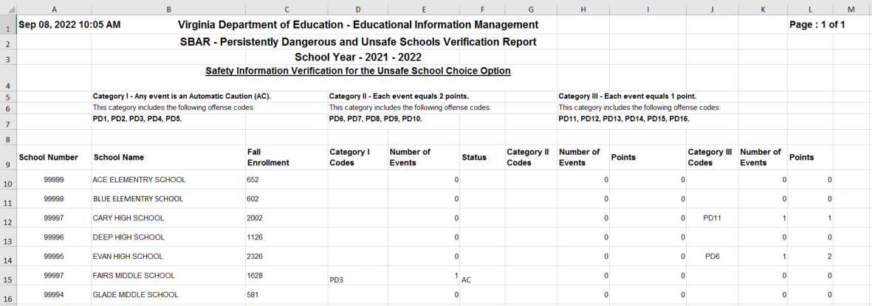
SBAR Persistently Dangerous and Unsafe School Report

Slide 28
Timeline and Resources

Slide 29
SBAR Data Reporting Timeline 2022-2023
File Submission | Opening Date | Closing Date | Snapshot Date
Preliminary | February 1, 2023 | March 3, 2023 | First day of school through January 31st
End of Year | July 3, 2023 | August 1, 2023 (tentatively) | First day of school through June 30th
Pre-submission | After completion of EOY SBAR | When Preliminary and EOY are open | Any time- allows for checking file format and data edits
Notes:
Pre-submission SBAR Window - The Pre-submission window opens after the completion of Preliminary SBAR Submission and after the completion of all EOY SBAR Submissions. It allows school divisions and regional centers/programs to continue to review data, upload files, troubleshoot fatal errors, and prepare for the next SBAR data submission. If the Pre-submission link is not available, that indicates the SBAR Submission process is not complete (there is no successful file or final verification).

Slide 30
SBAR Application Support
Contact your local SSWS Account or back-up Account Manager if you need assistance with the following:
Assigning the SBAR application contact in ERA
This is critical for VDOE to contact the correct person with important updates regarding SBAR
Determining rights and privileges to the SBAR application
This includes setting up the SBAR collection manager, local approvers, and rights to submit the data or access reports
Establishing Superintendent Data Collection Approval (SDCA) account for Superintendent or Director
Notes:
If you need help, your local co-workers can assist you.
SSWS Account or back-up account manager
ERA contact

Slide 31
VDOE Contacts
Student Behavior And Administrative Response Collection website:
https://www.doe.virginia.gov/info_management/data_collection/sbar/index.shtml
Patricia Mealy, Data Specialist, Office of Data Services
Email: patricia.mealy@doe.virginia.gov or
resultshelp@doe.virginia.gov
Rebecca Kahila, School Safety and Discipline Specialist, Office of Student Services
Email: rebecca.kahila@doe.virginia.gov
Notes:
Other contact information:

Slide 32
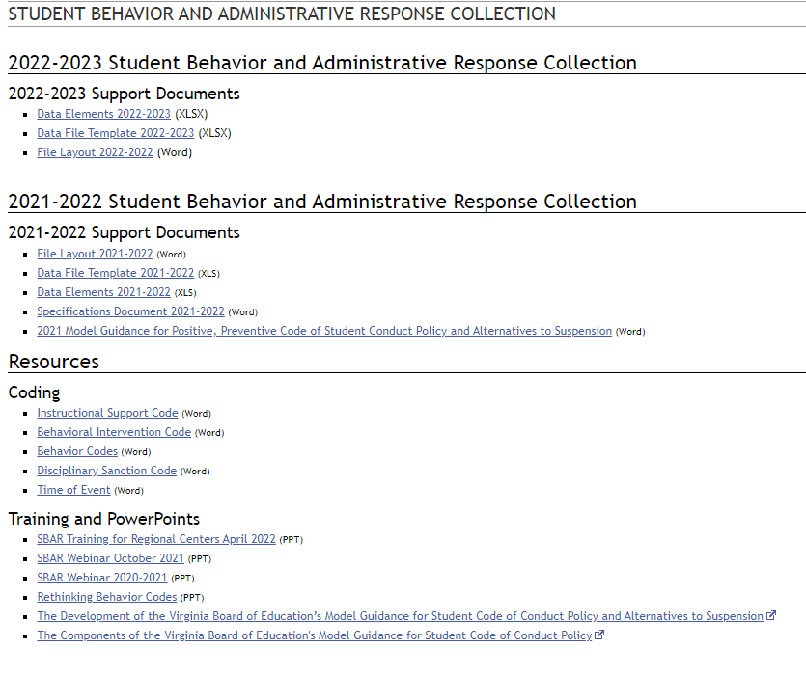
Webpage
SBAR’s webpage VDOE :: Data Collection :: Student Behavior and Administrative Response Collection (virginia.gov)
Notes:
Our SBAR Webpage and Resources contain links to information on the current file layout, the header file, data elements, specification document, behavior, instructional support, behavior intervention and , disciplinary sanction codes. There are also additional Training and PowerPoint slides for guidance. These documents go hand and hand they can assist you with completing your SBAR data file and answer questions.

Slide 33
Thank You
Notes:
This is the end of the presentation. Thank you.

