Slide 1
SOL Substitute Test Data Collection
November 5,2021

Slide 2
Agenda
Collection and File Overview
Submitting a Data File
Reports and Data Verification
FAQs and Scenarios
Timeline
Questions

Slide 3
Purpose of the Collection
Collect scores for students where a substitute test has been taken in place of an SOL
As permitted by the Standards for Accrediting Public Schools (8VAC20-131-110 ), the Virginia Board of Education has approved various “substitute” tests and set the minimum score that must be achieved for the purpose of awarding verified credit to students.
SOL substitute test scores are used in the calculations for both state and federal accountability.
All passing scores on Board approved substitute tests are considered passing test scores in the state Accreditation pass rates. Passing scores for limited tests have been approved for use under Virginia’s ESSA plan for federal accountability.
Scores for these tests are not maintained in Pearson Access Next and must be submitted by LEAs to the VDOE

Slide 4
SOL Substitute Test Application
Tab delimited text file with a specified layout
Multiple record types (A and C records)
Submitted through the SOL Substitute Test application in SSWS
Available November through August
Uploaded file will go through a process of edit checks
List of errors will be available for unsuccessful files
Superintendent must electronically sign the verification report

Slide 5
Record Types
Record Type | Record Name | Number of Data Elements
A | Header | 4
C | Student and Test Result Data | 29

Slide 6
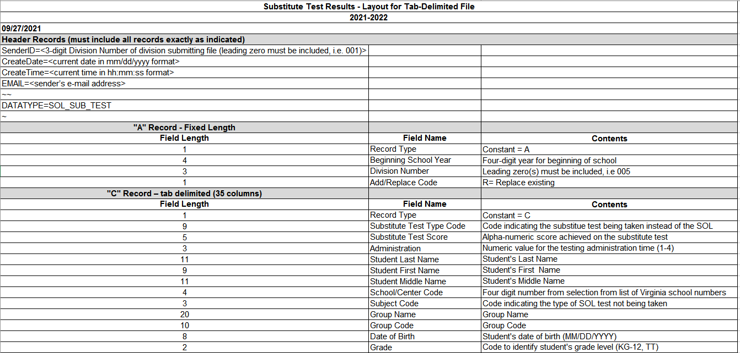
File Layout

Slide 7
A Record (Header Record)
Record Type (A)
Beginning School Year
2021
Division Number
Three digit division number with leading 0 (001, 002, 010, etc.)
Add/Replace Code
Always use “R”
The option to use the “Add” function was retired when the B records were retired
Since each file replaces the next, cumulative files must be submitted
EXAMPLE: A2021099R

Slide 8
C Record (Student and Test Data)
Record Type (C)
Substitute Test Type Code*
Substitute Test Score*
Administration
Student Last Name
Student First Name
Student Middle Name
School/Center Code
Subject Code
Group Name
Group Code
Date of Birth
Grade
Gender
State Testing Identifier (STI)
Ethnicity
Race
Military Connected Student Code
Student Number
Initial Primary Nighttime Residence Code
Foster Care
Economically Disadvantaged Flag
Receiving EL Services Code
Disability Status
Formerly EL
SOA Adjustment-EL
Transfer
Recently Arrived EL
Filler
Retest
Filler (x5)

Slide 9
C Record: Substitute Test Type Code
Substitute Test Type Code
Code indicating the substitute test being taken instead of the SOL
The list of codes posted in the application in SSWS, and will also on the VDOE website: http://www.doe.virginia.gov/info_management/data_collection/index.shtml).
Edits
Invalid Substitute Test Type Code-Must be a valid Substitute Test Code from the list.
Invalid Substitute Test Type Code/Subject Code Combination- The Substitute Test Code must be a valid combination with the SOL Subject Code. For Example, the ACT WorkKeys Writing cannot be used in combination with End-of-Course Reading.

Slide 10
C Record: Substitute Test Score
Substitute Test Score
Alpha-numeric score achieved on the substitute test
Minimum and maximum score ranges are based on the “Substitute Tests Approved for Awarding Verified Credit” document: http://www.doe.virginia.gov/testing/substitute_tests/substitute_tests_verified_credit.pdf
Edit
Must be a valid number or letter
Note: If the score is not a valid value associated with that test, the proficiency level cannot be set.

Slide 11
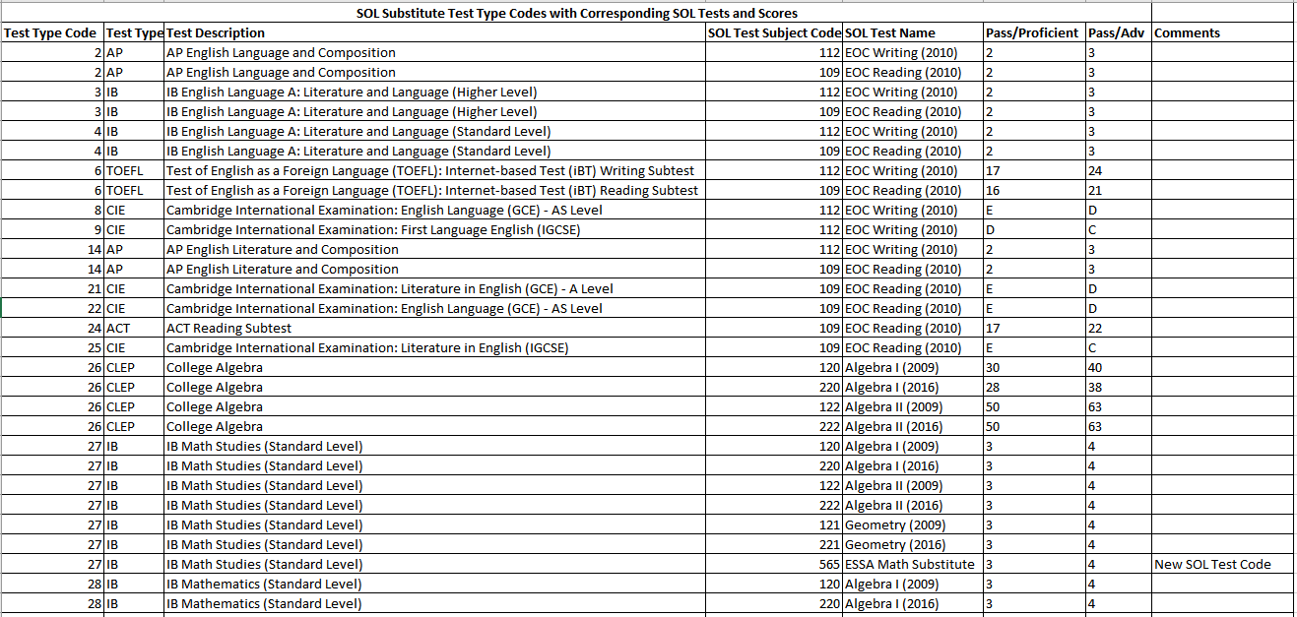
Substitute Test Type Code/Subject Code/Substitute Test Score

Slide 12
What Scores Should be Submitted?
Submit scores for all Board approved substitute tests for students that were expected to take an SOL in that year.
Exception
Test Code = 565 “ESSA Math Substitute” - This substitutes as an EOC Math test for students that passed Algebra II before entering high school.
This allows students that have met Math requirements before entering high school to be included in the Federal Accountability participation and pass rates.
The ESSA Math Substitute scores can be submitted any time before the student graduates, because the student was not expected to take an SOL and that test may not be tied to a specific year.

Slide 13
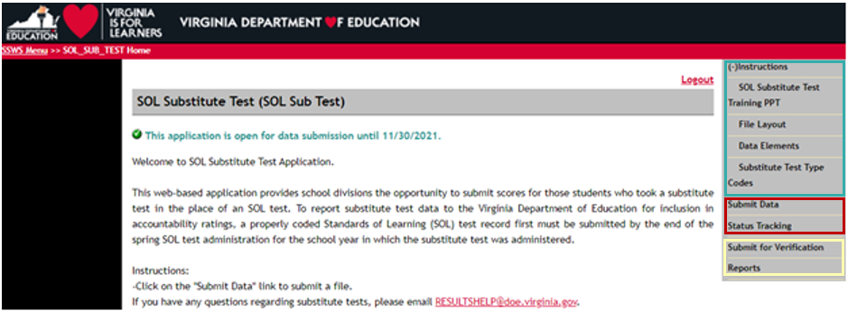
Submitting the Data File

Slide 14
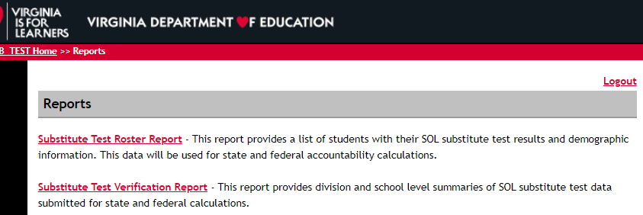
Reports
Both reports update overnight when VDOE runs the process to set the SOL proficiency levels based on the substitute test scores.

Slide 15
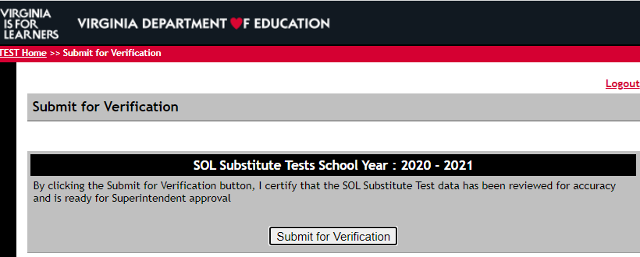
Verification
Once the Substitute Test Verification Report has been reviewed for accuracy by the collection manager, it should be submitted for verification, which sends an email to the Division Superintendent for final electronic signature.
Reminder: Always check the report before submitting for verification. If the nightly process has not run to set the proficiency levels, this report will be blank when it is submitted to the Division Superintendent.

Slide 16
FAQs
1. Will the substitute test application file replace a failing SOL score or will it be an additional score?
A passing substitute test score will replace a failing SOL score for state accreditation. In this case, the substitute test acts as a retest in the calculation and the initial failing SOL score will be removed from the calculation.
For federal accountability, the failing SOL score remains in the performance rate if the substitute test is a not a ESSA Math Substitute (565).

Slide 17
FAQs
2. If only one record was rejected in the submission, do we just repair that record and resubmit OR is the whole file rejected because of the one record?
The whole file will be rejected, but you will just need to repair the one record with the error and resubmit for a successful submission. VDOE does not store any data from files that have errors and are in a “Failed” status, meaning that you will have to resubmit the whole file to fix an error.
3. When we send a record to Replace, is it replacing all previous records for the Fall through Summer testing of that school year?
A “replace” file will rewrite all of the data that has been submitted for the current school year. If you submit files in December that have Fall testing data, and then resubmit a file in June with Spring testing data using the “replace” option, all of the Fall data will be overwritten with Spring data.

Slide 18
FAQs
4. ESSA Calculation: What will happen if a student transfers to our division, we are not aware that the prior division reported an ESSA Math substitute test, and we re-report that test?
The ESSA calculation will not allow for this student to be “double counted” in the participation or pass rates. The cohort based calculation looks for the highest or best attempt and only selects one. You can also use the Longitudinal Data Reports in SSWS to see if the student was reported by another division.
5. Accreditation Calculation: If a student took the ACT WorkKeys Business Writing in another division, how do we know if it was reported to VDOE and how do we prevent re-reporting it?
The Longitudinal Data Reports in SSWS will indicate if a student has been reported with a substitute test. Also, the student’s transcript should indicate whether or not they need to be tested. If the student is not expected to take an EOC Writing SOL in your division, then you should not report a writing substitute test for that student unless it is administered by your division.

Slide 19
Scenarios
Reporting substitute test records for Accreditation
All 10th Grade students in a school took the PSAT in the 2019-2020 school year. Those same students took the Reading EOC SOL (109) in 11th Grade during the Spring 2021 testing Administration.
Do not report the PSAT scores as substitute tests for the 10th grade students in 2019-2020. The PSAT scores should only be reported to VDOE if the student did not attempt or failed the Reading EOC SOL (109) in 11th Grade. The substitute test should only be reported for an expected or attempted SOL.
For the students that failed or did not attempt the Reading EOC SOL (109) in 11th Grade, their PSAT score should be submitted on the 2020-2021 Substitute Test submission as “C” records with an Administration Code of 2 (Spring).

Slide 20
Scenarios
Reporting 565 substitute test records for ESSA
Student A fulfilled all Math requirements (passed the Algebra II SOL in 8th grade) before reaching high school. This student is currently in 12th grade in the 2022 cohort. The school has documentation that the student took and passed the SAT II Math IC as a 10th grader in the 2019-2020 school year.
Report this student with a “C” record on the 2020-2021 substitute test file with an Administration Code of 2 (Spring), an SOL Testing Code 565, and a Substitute Test Code = 29.
Since the ESSA calculation is cohort based, and the student was not expected to take Math SOL in high school in a given year, these tests can be reported at any time prior to the student’s graduation and do not have to be directly tied to a testing year or testing administration.
Substitute tests for ESSA should be reported in the school year the test is taken.

Slide 21
Data Reporting Timeline
Division-level data gathering is ongoing July- August
November 29, 2021: Data collection window opens November 29, 2021
Data can be submitted throughout the year
Subsequent files replace previous ones, so the file must be cumulative
August 26, 2022: Superintendent electronic signatures due for verification report

Slide 22
Contact Information
Substitute Test web site (will be updated next week)
https://www.doe.virginia.gov/info_management/data_collection/testing/index.shtml
Carol Wells Bazzichi, Data Collection Manager, Office of Data Services
Email: carol.wellsbazzichi@doe.virginia.gov or
resultshelp@doe.virginia.gov
Office of Accountability
Email: accountability@doe.virginia.gov
Office of Student Assessment
Email: student_assessment@doe.virginia.gov

Slide 23
Questions

