Slide 1
2016 Mathematics Standards of Learning
Algebra I
Overview of Revisions from 2009 to 2016
Related documents available on VDOE Mathematics 2016 webpage
Notes:
Welcome to the Algebra I Overview of Revisions to the Mathematics Standards of Learning from 2009 to 2016. It would be helpful to have a copy of the Algebra I – Crosswalk (Summary of Revisions) and a copy of the 2016 Algebra I Curriculum Framework to reference during this presentation. These documents are available electronically on the VDOE Mathematics 2016 webpage under Standards of Learning and Testing.

Slide 2
Purpose
Overview of the 2016 Mathematics Standards of Learning and the Curriculum Framework
Highlight information included in the Essential Knowledge and Skills and the Understanding the Standard sections of the Curriculum Framework
Notes:
The purpose of this presentation is to provide an overview of the revisions and to highlight information included in the Essential Knowledge and Skills and Understanding the Standard sections of the curriculum framework. This presentation is a brief overview of revisions and not a comprehensive list of all revisions. Teachers are encouraged to thoroughly review the 2016 Curriculum Framework to obtain a comprehensive understanding of the revisions.

Slide 3
Agenda
Overview and Implementation Timeline
Resources Currently Available
Crosswalk (Summary of Revisions)
Standards and Curriculum Frameworks
Comparison of 2009 to 2016 Standards
Expressions and Operations
Equations and Inequalities
Functions
Statistics
Notes:
In this presentation, the timeline for implementation will be shared followed by a brief overview of the Crosswalk and Curriculum Frameworks, and lastly a side by side comparison of the 2009 standards to the new 2016 (two thousand sixteen) standards.

Slide 4
Implementation Timeline
2016-2017 School Year – Curriculum Development VDOE staff provides a summary of the revisions to assist school divisions in incorporating the new standards into local written curricula for inclusion in the taught curricula during the 2017-2018 school year.
2017-2018 School Year – Crossover Year 2009 Mathematics Standards of Learning and 2016 Mathematics Standards of Learning are included in the written and taught curricula. Spring 2018 Standards of Learning assessments measure the 2009 Mathematics Standards of Learning and include field test items measuring the 2016 Mathematics Standards of Learning.
2018-2019 School Year – Full-Implementation Year Written and taught curricula reflect the 2016 Mathematics Standards of Learning. Standards of Learning assessments measure the 2016 Mathematics Standards of Learning.
Notes:
During the 2016-2017 school year, school divisions should begin incorporating the new standards into local curricula.
During the 2017-2018 school year, both the 2009 and 2016 standards should be included during instruction. The Spring 2018 assessments will measure the 2009 standards and include field test items measuring the 2016 standards.
Full implementation of the new standards will occur during the 2018-2019 School Year. Written and taught curriculum will reflect the 2016 Mathematics Standards of Learning, and the SOL assessments will measure the 2016 Mathematics Standards.

Slide 5
2016 SOL Revisions
Improve the vertical progression of mathematics content
Ensure developmental appropriateness of student expectations
Increase support for teachers in mathematics content
Clarify expectations for teaching and learning
Improve precision and consistency in mathematical language and format
Ensure proficiency of elementary students in computational skills
Notes:
The revisions focus on several things – improving vertical progression of the content, ensuring developmental appropriateness, increasing support for teachers, clarifying expectations for both teaching and for student learning, improving precision and consistency in mathematical vocabulary and format, and to better ensure computational fluency at the elementary level.

Slide 6
Support for Teachers
Significant additions to the Understanding the Standard column including
Definitions
Explanations
Examples
Instructional connections
Improvements in precision, clarity, and consistency in language K-12
Indicators of SOL sub-bullet added to each bullet within the Essential Knowledge and Skills
Notes:
Additional support was added to the Understanding the Standard (or US) column in the 2016 Mathematics Curriculum Frameworks to provide background information for teachers to include definitions, explanations, examples, and statements that help to make instructional connections between content. These changes result in better precision, greater clarity and consistency in language across the K-12 curriculum frameworks. In the Essential Knowledge and Skills (or EKS) section of the frameworks, expectations for learning and assessment are provided.
Corresponding EKS bullets and SOL bullets are indicated with the same letter. An example is provided on the next slide.
Teachers are encouraged to read both the Understanding the Standard (US) and Essential Knowledge and Skills (EKS) columns in the Curriculum Frameworks.

Slide 7
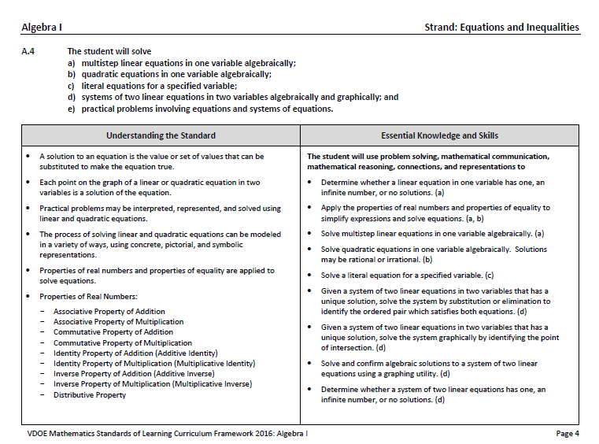
Notes:
This is a page from the Algebra I curriculum framework. It is very important that teachers spend time exploring the new curriculum framework. This slide contains examples of edits (CLICK) made to the Understanding the Standard section including clarity in definitions and explanations that have been provided. In some standards, examples have also been included.
In addition, where appropriate, corresponding EKS bullets and SOL bullets are indicated with the same letter.

Slide 8
Overview of Changes
Reporting Category | # of Standards (2009) | # of Standards (2016)
Expressions and Operations | 3 | 3
Equations and Inequalities | 3 | 3
Functions | 1 | 1
Statistics | 4 | 2
Total | 11 | 9
Notes:
There was an overall reduction in the number of mathematics standards spanning K-12. This is a result of consolidation of related concepts and skills, a reduction of repetition, an improvement of the developmental progression, and/or deletion of content.
In Algebra I, the number of standards was reduced from 11 to 9.
The revisions occurring in Algebra I will be addressed later in this presentation.

Slide 9
Mathematics Process Goals for Students
“The content of the mathematics standards is intended to support the five process goals for students” - 2009 and 2016 Mathematics Standards of Learning
Mathematical Understanding
Problem Solving
Connections
Communication
Representations
Reasoning
Notes:
The mathematical process goals continue to play an instrumental role in the teaching and learning of mathematics with understanding.
We encourage educators to review these sections included in the introduction of the 2016 curriculum frameworks.

Slide 10
Standards of Learning Curriculum Frameworks
Introduction includes:
Mathematical Process Goals for Students
Instructional Technology
Computational Fluency
Algebra Readiness
Equity
New
Notes:
Four additional sections have been included in the introduction to the 2016 curriculum framework -- Instructional Technology, Computational Fluency, Algebra Readiness, and Equity. The content of each section addresses the impact on students’ learning and instruction. Educators are encouraged to review these sections included in the introduction.

Slide 11
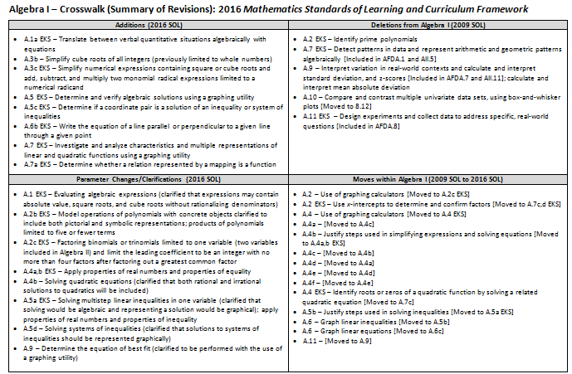
2009
2016
2009
2016
Notes:
This is a snapshot of the Algebra I Crosswalk and Summary of Revisions page one. There are four quadrants – (CLICK) additions, (CLICK) deletions, (CLICK) parameter changes or clarifications, and (CLICK) moves within the standards.
The upper left quadrant (CLICK) includes additions to the 2016 standards. The standards referenced (CLICK) are the 2016 numbers and may include additions to the Essential Knowledge and Skills (EKS) as well as the standard.
The upper right quadrant (CLICK) identifies deletions from the 2009 standards (CLICK) and may indicate where that content was moved using the 2016 standard number (CLICK).
The bottom left quadrant (CLICK) indicates parameter changes (for example SOL A.2c Essential Knowledge and Skills (CLICK) – indicates factoring binomials or trinomials is limited to one variable (with two variables included in Algebra II) Further parameters (leading coefficient, for example, is an integer) may also be indicated.
In the bottom right quadrant (CLICK), moves within the course are indicated with the first number (CLICK) being the 2009 SOL number and the number in the brackets representing the 2016 number.

Slide 12
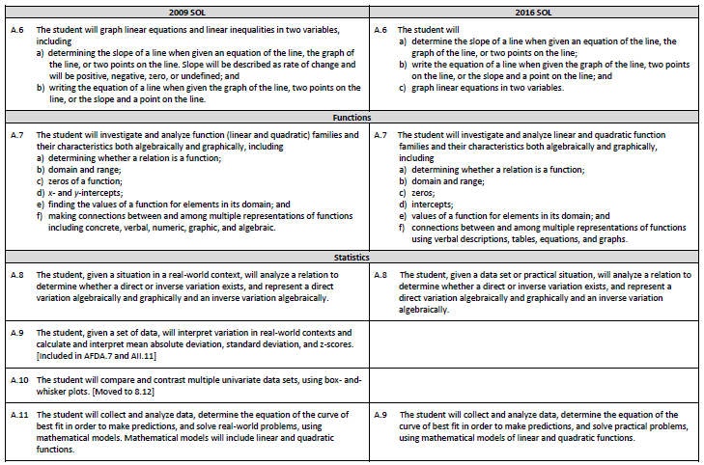
Notes:
On page 2 and the remaining pages of the Crosswalk, a side by side comparison of the 2009 standards (CLICK) and 2016 standards (CLICK) can be found. For comparison purposes, the standards are in numerical order for both columns. The standards are divided into strands, with the title of each indicated. (CLICK) When deleted content was moved or already found in another grade or course, it is indicated in brackets. For example, the content from the 2009 SOL A.9 is now only included in Algebra, Functions, and Data Analysis or Algebra II. (CLICK) Empty boxes on the right column indicate that content has either been deleted or moved. The two blank boxes shown in the example (CLICK) indicate that both the 2009 standards A.9 and A.10 have been moved to another course or grade level.

Slide 13
EXPRESSIONS AND OPERATIONS
Notes:
We will begin reviewing the revisions to the Algebra I standards by looking at the Expressions and Operations strand, which includes SOL A.1, A.2, and A.3.

Slide 14
2009 SOL | 2016 SOL
A.1 The student will represent verbal quantitative situations algebraically and evaluate these expressions for given replacement values of the variables. | A.1 The student will represent verbal quantitative situations algebraically; and evaluate algebraic expressions for given replacement values of the variables.
Revisions:
SOL A.1a EKS - Translate between verbal quantitative situations algebraically with expressions and equations (previously included only expressions) is included
SOL A.1b EKS - Clarified to evaluate algebraic expressions contain absolute value, square roots, and cube roots without rationalizing denominators
Notes:
SOL A.1 is now divided into two parts, where part (a) and (b) now represent two concepts with (a) representing verbal situations algebraically and (b) evaluating algebraic expressions. In the Essential Knowledge and Skills (EKS) section of A.1(a) clarification is provided that students will translate not only between verbal situations and expressions, but also between verbal situations and equations. Clarification is provided in the Essential Knowledge and Skills (EKS) of A.1(b) regarding the parameters involved when evaluating algebraic expressions, which may include absolute value, square roots, and cube roots (without rationalizing the denominator). It is also notable to mention that real-world situations are now primarily referenced as “practical” situations throughout the 2016 Mathematics Standards of Learning.

Slide 15
2009 SOL | 2016 SOL
A.2 The student will perform operations on polynomials, including applying the laws of exponents to perform operations on expressions; adding, subtracting, multiplying, and dividing polynomials; and factoring completely first- and second-degree binomials and trinomials in one or two variables. Graphing calculators will be used as a tool for factoring and for confirming algebraic factorizations. [Moved to EKS] | A.2 The student will perform operations on polynomials, including applying the laws of exponents to perform operations on expressions; adding, subtracting, multiplying, and dividing polynomials; and factoring completely first- and second-degree binomials and trinomials in one variable.
Revisions:
SOL A.2b EKS - Modeling operations of polynomials with concrete objects includes both pictorial and symbolic representations; products of polynomials are limited to five or fewer terms
SOL A.2c EKS - Factoring binomials or trinomials is limited to one variable (two variables included in Algebra II) and the leading coefficient is limited to be an integer with no more than four factors after factoring out a greatest common factor; identifying prime polynomials is no longer included
SOL A.2c EKS - Graphing calculator used as a tool moved from standard to EKS and referred to as “graphing utility”
Notes:
In A.2, there are still three parts to this standard. In the Essential Knowledge and Skills (EKS) of A.2b clarification was provided for modeling operations with polynomials – models will include both pictorial and symbolic representations. In addition, the Essential Knowledge and Skills (EKS) of A.2b provides the parameter that the product of polynomials (after simplification) are limited to five or fewer terms. In the Essential Knowledge and Skills (EKS) of A.2c, factoring of polynomials is limited to polynomials in one variable. Parameters were specified in the Essential Knowledge and Skills (EKS) to specify some limiters when factoring in Algebra I. In addition, identifying prime polynomials is no longer included in the Essential Knowledge and Skills (EKS) of A.2, but students would benefit from a discussion of factorability of polynomials. The use of a graphing calculator as a tool for factoring was removed from the standard itself and included in the Essential Knowledge and Skills (EKS) section. References to a graphing calculator have been replaced by the term “graphing utility,” in most instances in the mathematics standards for high school.

Slide 16
2009 SOL | 2016 SOL
A.3 The student will express the square roots and cube roots of whole numbers and the square root of a monomial algebraic expression in simplest radical form. | A.3 The student will simplify square roots of whole numbers and monomial algebraic expressions; cube roots of integers; and numerical expressions containing square or cube roots.
Revisions:
SOL A.3b – Simplify cube roots of all integers (previously limited to whole numbers)
SOL A.3c EKS – Includes simplifying numerical expressions containing square or cube roots that may involve addition, subtraction, and multiplication of two monomial radical expressions (limited to a numerical radicand)
Notes:
In SOL A.3, there are now three parts to this standard, with some notable changes. A revision in SOL A.3b is that students are now expected to simplify the cube roots of integers, which was previously limited to whole numbers in the 2009 standards. The Essential Knowledge and Skills (EKS) of A.3c includes simplifying numerical expressions containing square roots or cube roots. More specifically, and one of the more notable changes in the 2016 Algebra I standards, is that students will be expected to add, subtract, and multiply two monomial radical expressions (when the radicand is numeric). The Understanding the Standard (US) section of A.3 includes several explanations that help to clarify the standard. One example of a US statement included in this standard is that “any non-negative number other than a perfect square has a principal square root that lies between two consecutive whole numbers.”

Slide 17
Equations and inequalities
Notes:
The next strand of the Algebra I standards that we will examine is Equations and Inequalities, which includes SOL A.4, A.5, and A.6.

Slide 18
2009 SOL | 2016 SOL
A.4 The student will solve multistep linear and quadratic equations in two variables, including solving literal equations (formulas) for a given variable; justifying steps used in simplifying expressions and solving equations, using field properties and axioms of equality that are valid for the set of real numbers and its subsets; solving quadratic equations algebraically and graphically; solving multistep linear equations algebraically and graphically; solving systems of two linear equations in two variables algebraically and graphically; and solving real-world problems involving equations and systems of equations. Graphing calculators will be used both as a primary tool in solving problems and to verify algebraic solutions. [Moved to EKS] | A.4 The student will solve multistep linear equations in one variable algebraically; quadratic equations in one variable algebraically; literal equations for a specified variable; systems of two linear equations in two variables algebraically and graphically; and practical problems involving equations and systems of equations.
Revisions:
SOL A.4a EKS - Includes determining if a linear equation has one solution, no solution, or an infinite number of solutions
SOL A.4a,b EKS - Includes applying properties of real numbers and properties of equality when solving linear and quadratic equations
SOL A.4b EKS - Clarifies that solving quadratic equations includes those with both rational and irrational solutions
SOL A.4e - Real-world problems are now referred to as practical problems in the 2016 standards
Notes:
In the curriculum framework of SOL A.4, there were numerous revisions made. The Essential Knowledge and Skills (EKS) of SOL A.4a clarifies that students should be able to determine if a linear equation in one variable has one solution, no solutions, or an infinite number of solutions. In the Essential Knowledge and Skills (EKS) related to SOL A.4a, students will be expected to apply the properties of real numbers and properties of equality when solving equations. This is a notable shift from the 2009 standards in that the focus is not to identify a specific property being used, but to correctly apply the properties to simplify expressions and solve equations. SOL A.4b Essential Knowledge and Skills (EKS) clarifies that solving a quadratic equation includes both rational and irrational solutions. The use of a graphing calculator as a tool for solving equations and verifying solutions was removed from the standard itself and included in the Essential Knowledge and Skills (EKS) section. The Understanding the Standard (US) portion of this standard makes note that formulas are considered literal equations, thus in SOL A.4c, students should have experience with formulas as a form of literal equations.

Slide 19
2009 SOL | 2016 SOL
A.5 The student will solve multistep linear inequalities in two variables, including solving multistep linear inequalities algebraically and graphically; justifying steps used in solving inequalities, using axioms of inequality and properties of order that are valid for the set of real numbers and its subsets; [Moved to EKS] solving real-world problems involving inequalities; and solving systems of inequalities. | A.5 The student will solve multistep linear inequalities in one variable algebraically and represent the solution graphically; represent the solution of linear inequalities in two variables graphically; solve practical problems involving inequalities; and represent the solution to a system of inequalities graphically.
Revisions:
SOL A.5a-d EKS - Includes determine and verify algebraic solutions using a graphing utility
SOL A.5a EKS - clarifies that students will solve multistep linear inequalities in one variable algebraically and represent the solution graphically; includes apply properties of real numbers and properties of inequality
SOL A.5c - Real-world problems are now referred to as practical problems in the 2016 standards; A.5c EKS includes determine if a coordinate pair is a solution of an inequality or system of inequalities
SOL A.5d EKS - Clarified that solutions to systems of inequalities should be represented graphically
Notes:
In all parts (a-d) of SOL A.5, students are expected to be able to determine and verify algebraic solutions of linear inequalities using a graphing utility, which is now part of the Essential Knowledge and Skills (EKS) section. A.5a Essential Knowledge and Skills (EKS) clarifies that students will solve linear inequalities in one variable algebraically and represent the solution graphically. As in SOL A.4, the Essential Knowledge and Skills (EKS) of SOL A.5a expects students to apply properties of real numbers and properties of inequalities to solve inequalities in one variable. A.5c Essential Knowledge and Skills (EKS) includes determining if a coordinate pair is a solution (for both inequalities and systems of inequalities). In the Essential Knowledge and Skills (EKS) of SOL A.5d, clarification is provided that solutions to systems of inequalities should be represented graphically.

Slide 20
2009 SOL | 2016 SOL
A.6 The student will graph linear equations and linear inequalities in two variables, including determining the slope of a line when given an equation of the line, the graph of the line, or two points on the line. Slope will be described as rate of change and will be positive, negative, zero, or undefined; and writing the equation of a line when given the graph of the line, two points on the line, or the slope and a point on the line. | A.6 The student will determine the slope of a line when given an equation of the line, the graph of the line, or two points on the line; write the equation of a line when given the graph of the line, two points on the line, or the slope and a point on the line; and graph linear equations in two variables.
Revisions:
SOL A.6 - Includes linear equations in two variables only (graphing linear inequalities in two variables is now included in A.5)
SOL A.6b EKS - Includes writing the equation of a line parallel or perpendicular to a given line through a given point
Notes:
SOL A.6 is now specifically focused on linear equations in two variables. In the 2016 standards, graphs of linear inequalities in two variables is now an expectation in SOL A.5. Thus, it is important for teachers to make a connection between the content in SOL A.5 and A.6. New to SOL A.6b Essential Knowledge and Skills (EKS) is the expectation that students will write the equation of a line parallel or perpendicular to a given line through a given point. Teachers are encouraged to review the new expectations in the middle school strand of Patterns, Functions, and Algebra in order to ensure a clear vertical articulation of content in regards to linear functions. For example, in the 2016 middle school standards, students are expected to write the equation of a line and graph a line in slope-intercept form. The Understanding the Standard (US) of SOL A.6 specifies that students have experiences with writing and graphing equations of lines in various forms, including standard form, slope-intercept form, or point-slope form.

Slide 21
FUNCTIONS
Notes:
The Functions strand of the Algebra I Standards of Learning includes SOL A.7. We will now examine the revisions included in this strand.

Slide 22
2009 SOL | 2016 SOL
A.7 The student will investigate and analyze function (linear and quadratic) families and their characteristics both algebraically and graphically, including determining whether a relation is a function; domain and range; zeros of a function; x- and y-intercepts; finding the values of a function for elements in its domain; and making connections between and among multiple representations of functions including concrete, verbal, numeric, graphic, and algebraic. | A.7 The student will investigate and analyze linear and quadratic function families and their characteristics both algebraically and graphically, including determining whether a relation is a function; domain and range; zeros; intercepts; values of a function for elements in its domain; and connections between and among multiple representations of functions using verbal descriptions, tables, equations, and graphs.
Revisions:
SOL A.7 EKS - No longer includes detect patterns in data and represent arithmetic and geometric patterns algebraically [Included in AFDA.1 and AII.5]
SOL A.7 EKS - Includes investigate and analyze characteristics and multiple representations of linear and quadratic functions using a graphing utility
SOL A.7a EKS - Includes determine whether a relation represented by a mapping is a function
SOL A.7d EKS - Includes the use of x-intercepts from the graphical representation of a quadratic function to determine and confirm its factors
Notes:
SOL A.7 no longer includes the expectation that students detect patterns in data and represent arithmetic and geometric patterns algebraically. While students benefit from an informal examination of arithmetic and geometric patterns, these will be formally addressed in the Algebra, Functions, and Data Analysis standards and Algebra II standards. The Essential Knowledge and Skills (EKS) of A.7 includes the expectation of investigating and analyzing linear and quadratic functions using a graphing utility. Mappings are now included as a representation of a function in the Essential Knowledge and Skills (EKS) of A.7a. In SOL A.7d, the Essential Knowledge and Skills (EKS) includes the use of x-intercepts from the graphical representation of a quadratic function to determine and confirm its factors.

Slide 23
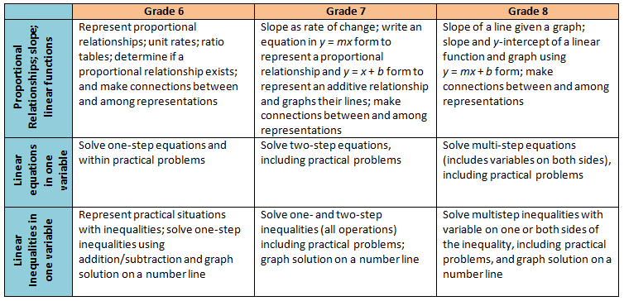
Middle School Revisions Leading to Algebra I
Notes:
Before continuing on to the Statistics strand of Algebra I, it is important to provide Algebra I teachers with a summary of the changes in middle school regarding functions and algebra. There will be a big shift in the development of the concept of linear functions beginning in grade 6. The 2016 standards will recognize the relationship between proportional relationships and linear functions. In grade 6 students will represent a proportional relationship using tables and identify the unit rate (leading to the concept of slope) in a proportional relationship. In grade 7 students learn to write the equation of a proportional relationship in y = mx form and contrast that relationship with a simple additive relationship of the form y = x + b and graph each of these types of functions, first as the slope changes in the proportional relationship, and then separately as the y-intercept changes in an additive relationship. The, in grade 8, students then put these two transformational approaches together to explore linear functions in y = mx + b form. Students will be expected to build the concepts through graphing and tables and will not be expected to use the slope formula. In Algebra I, students will then take a deeper dive into slope (including exposure to the slope formula), other forms of linear functions such as point-slope and standard form, and undefined slope. Knowing this progression and the intended development of these concepts in middle school will help teachers in Algebra I. The chart on this slide provides a summary of this progression, along with the progression of solving equations and inequalities. That progression for equations and inequalities has very few revisions, thus Algebra I teachers can expect students to have a prior knowledge similar to what they are currently exposed to in middle school.

Slide 24
Statistics
Notes:
The Statistics strand in the 2016 Algebra I Standards of Learning includes two standards, A.8 and A.9. In this strand, we will make note of some content no longer included in Algebra I and will note other revisions.

Slide 25
2009 SOL | 2016 SOL
A.8 The student, given a situation in a real-world context, will analyze a relation to determine whether a direct or inverse variation exists, and represent a direct variation algebraically and graphically and an inverse variation algebraically. | A.8 The student, given a data set or practical situation, will analyze a relation to determine whether a direct or inverse variation exists, and represent a direct variation algebraically and graphically and an inverse variation algebraically.
Revisions:
Replace “given a situation” in the 2009 standard with “given a data set or practical situation” in the 2016 standard
Notes:
There are very few changes to SOL A.8 involving the concept of direct and inverse variation. The wording of the standard has been slightly changed from “given a situation in a real-world context” to “given a data set or practical situation.” Again we see the preference in the 2016 standards for the description “practical” versus “real-world.”

Slide 26
2009 SOL | 2016 SOL
A.9 The student, given a set of data, will interpret variation in real-world contexts and calculate and interpret mean absolute deviation, standard deviation, and z-scores. [Included in AFDA.7 and AII.11]
A.10 The student will compare and contrast multiple univariate data sets, using box- and-whisker plots. [Moved to 8.12]
Revisions:
Interpret variation in real-world contexts and calculate and interpret standard deviation, and z-scores now included in AFDA.7 and AII.11
Calculate and interpret mean absolute deviation removed
Compare and contrast multiple univariate data sets, using box-and-whisker plots moved to 8.12
Notes:
The 2009 standards A.9 and A.10 are no longer included in Algebra I. Interpret variation and calculate and interpret standard deviation and z-scores is now included in Algebra, Functions and Data Analysis and Algebra II. Calculate and interpret mean absolute deviation is no longer included in Algebra I. The use and interpretation of box-and-whisker plots to represent univariate data sets is now included in the Grade 8 Mathematics Standards of Learning.

Slide 27
2009 SOL | 2016 SOL
A.11 The student will collect and analyze data, determine the equation of the curve of best fit in order to make predictions, and solve real-world problems, using mathematical models. Mathematical models will include linear and quadratic functions. | A.9 The student will collect and analyze data, determine the equation of the curve of best fit in order to make predictions, and solve practical problems, using mathematical models of linear and quadratic functions.
Revisions:
Design experiments and collect data to address specific, real-world questions was removed [Included in AFDA.8]
Determine the equation of best fit was clarified to be performed with the use of a graphing utility
Real-world problems are now referred to as practical problems in the 2016 standards
Notes:
Standard of Learning A.9 in the Essential Knowledge and Skills (EKS) will no longer include the expectation from the 2009 Standard of Learning A.11 that students design experiments and collect data to address specific questions. This expectation is included in the Algebra, Functions, and Data Analysis standards. SOL A.9 clarifies that determining the equation of a curve of best fit is to be performed using a graphing utility.

Slide 28
Questions?
Please contact the
VDOE Mathematics Team
Mathematics@doe.virginia.gov
Notes:
So this concludes the presentation on the 2016 Standards of Learning for Algebra I. As mentioned at the beginning of this presentation, teachers are encouraged to refer to the curriculum framework where additional information can be found.
Should you have any questions, feel free to contact a member of the Mathematics Team at the website shown on the slide. Thank you so much.

