Slide 1
Summative Assessment vs. Formative Assessment
AdvancED
February 24, 2015
Ann Abbett, Holli Cook, and Katherine Ringley
Assessment Specialists
Division of Student Assessment and School Improvement
Virginia Department of Education

Slide 2
Summative vs. Formative (a)

Slide 3
Dylan Wiliam
“When teachers do formative assessment effectively, students learn at roughly double the rate than they do without it.”
Dylan Wiliam

Slide 4
Today’s Goals
Develop a common meaning for “summative assessment” and “formative assessment”
Provide an overview of different assessment types and the purpose of each within a comprehensive assessment system
Look at the components of formative assessment
Highlight the benefits of formative assessment
Share information about the Virginia Department of Education’s Formative Assessment Pilot

Slide 5
What is Summative Assessment?
Summative assessment is used to measure competency or attainment of a body of knowledge. That body of knowledge can be very large or relatively small.
Summative assessments can be administered at different points in time during a unit of study.
Instruction stops so that summative assessment can occur.

Slide 6
NCTE
“When teachers do formative assessment effectively, students learn at roughly double the rate than they do without it.”
Dylan Wiliam

Slide 7
National Research Council
“Summative assessment… is used to determine whether a student has attained a certain level of competency after completing a particular phase of education, whether it be a classroom unit or 12 years of schooling.”
National Research Council, 2001

Slide 8
Summative vs. Formative (b)
“Summative assessment… is used to determine whether a student has attained a certain level of competency after completing a particular phase of education, whether it be a classroom unit or 12 years of schooling.”
National Research Council, 2001

Slide 9
What is Formative Assessment?
Formative assessment is a continuous process that occurs during instruction while learning is taking place. Teachers closely monitor how learning is developing minute by minute, using evidence to make adjustments and provide students feedback that helps move them forward.

Slide 10
James Popham
“Formative assessment is a planned process in which assessment-elicited evidence of students’ status is used by teachers to adjust their ongoing instructional procedures or by students to adjust their learning tactics.”
Popham, W. James. (2006). Defining and Enhancing Formative Assessment. (p.6).

Slide 11
Bell and Bronwen
“Formative assessment … is defined as the process used by teachers and students to recognize and respond to student learning in order to enhance that learning, during the learning.”
Bell, Beverly and Cowie, Bronwen. (2000). Formative Assessment and Science Education. (p.536).

Slide 12
Modeling Formative Assessment
A Writing Conference
Video Clip from Module 5, Lesson 3 Part 1, Formative Assessment Program: Assisting Teachers to Support Student Achievement.
Please note that this video clip is no longer available in the public domain. 7/2023
The Assessment and Accountability Comprehensive Center and The North Central Comprehensive Center at McREL. (2012).

Slide 13
Examples of Assessment Types (a)
Norm-referenced tests
Criterion-referenced tests
International or national tests
Statewide tests (Virginia
Standards of Learning)
Division-wide tests
Interim tests
Benchmark tests
Annual common tests
Quarterly tests
Unit tests
Weekly tests
Quizzes
Formative Assessment

Slide 14
Examples of Assessment Types (b)
Type of assessment | Description | How are data used?
Criterion-referenced tests Standards-based tests Virginia Standards of Learning tests | Measure the attainment or mastery of knowledge and skills within the standards Compare students’ learning to overall standards | To identify strengths and weaknesses in curriculum, instruction, and programs To adjust curriculum, instruction, and programs To inform professional development needs For reporting, monitoring, and accountability

Slide 15
Examples of Assessment Types (c)
Type of assessment | Description | How are data used?
Division-wide tests Interim tests Benchmark tests Annual common tests | Measure the attainment or mastery of knowledge and skills within the standards Students’ learning is typically compared to a portion of annual standards Typically cumulative in nature | To inform remediation To determine strengths and weaknesses in individual and group learning To highlight strengths and weaknesses in curriculum and instruction To adjust curriculum and instruction For reporting to administrators, students, and parents

Slide 16
Examples of Assessment Types (d)
Type of assessment | Description | How are data used?
Quarterly tests Unit tests | Measure medium-term learning goals Compare students’ learning to goals of a specific unit of study or quarter (portion) of standards | To determine strengths and weaknesses in individual and group learning To inform targeted remediation for students who are weak in specific areas To highlight strengths and weaknesses in curriculum and instruction For reporting to parents and students

Slide 17
Examples of Assessment Types (e)
Type of assessment | Description | How are data used?
Weekly tests Quizzes | Measure short-term goals, lesson goals Compare students’ current learning status to short-term goals | To inform the next day’s or next week’s instruction To adjust grouping of students

Slide 18
Examples of Assessment Types (f)
Type of assessment | Description | How are data used?
Formative assessment; minute-by-minute assessment in the classroom | Measure short-term goals, lesson goals Compare each student’s current learning status to goals | To inform immediate instruction To adjust instruction and close existing gap between what student currently knows and what student needs to learn To identify individual misconceptions To uncover missing building blocks To move student learning closer to the goals during instruction

Slide 19
Summative vs. Formative (c)
Implementing summative assessment results in a loss of instructional time. The teacher must stop instruction in order to administer the summative assessment.
Implementing formative assessment should not result in a loss of instructional time.

Slide 20
Why is Formative Assessment Important?
Continuously gathering evidence during the course of instruction helps ensure that each student is moving toward the desired goals.
Formative assessment may decrease the need for remediation.
Closing the gap during instruction is more efficient than waiting for results of a summative assessment to determine which students have not met the learning goals.
Formative assessment may decrease the dependence on some assessments that, when administered, require a loss of instructional time.

Slide 21
A Closer Look at Formative Assessment
We will consider:
Classroom culture and structure
The teacher’s role
The student’s role, both as an individual learner and as a peer to other learners

Slide 22
Classroom Culture (a)
Teacher attributes and beliefs about learners and learning are associated with the characteristics of a classroom culture that supports formative assessment strategies.
Students’ attitudes and beliefs about themselves and about learning are part of the classroom culture.

Slide 23
Classroom Culture (b)
A classroom culture that supports formative assessment is characterized by:
an expectation that all students learn
intellectual rigor
shared responsibility for learning
mutual trust
models of positive interactions
supportive, collaborative relationships
The Assessment and Accountability Comprehensive Center and The North Central Comprehensive Center at McREL. (2012). Formative assessment program: Assisting teachers to support student achievement.
Notes:
Each of these elements of classroom culture reflect beliefs about learning- how students learn, the teacher’s role in learning, the student’s role in learning, and how peer interactions and interactions between teacher and students impact learning. Establishing a positive classroom culture takes time and consistency. It cannot be forced and must be an authentic reflection of teacher beliefs.
Students are impacted by the presence of six characteristics AND by the absence of six characteristics.

Slide 24
Classroom Structures
Classroom structures need to be designed in a manner that are supportive of formative assessment.
Will the physical environment foster or hamper planned interactions (teacher-student and student-student)?
Have appropriate interactions been modeled for students? What scaffolding is planned (e.g. sentence starters, voice level and tone reminders, etc.)?
Notes:
There are many different ways to set up your classroom to be supportive of formative assessment, but how you set it up should be planned and is important. Providing appropriate models for students is critical if feedback is to be effective.

Slide 25
Learning Progressions
Learning progressions:
provide a framework for formative assessment
describe the way that an idea develops and what it looks like as it develops
The ability to develop a learning progression requires both extensive content knowledge as well as an understanding of how students learn.

Slide 26
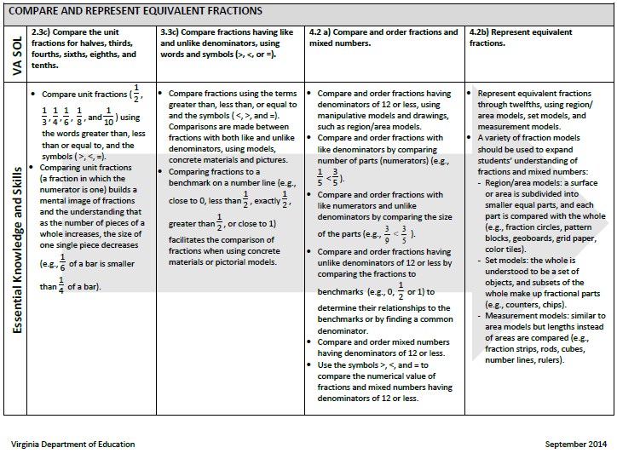
Learning Progression Example

Slide 27
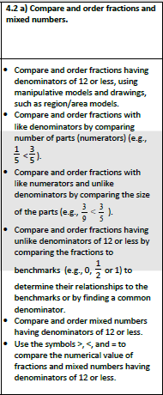
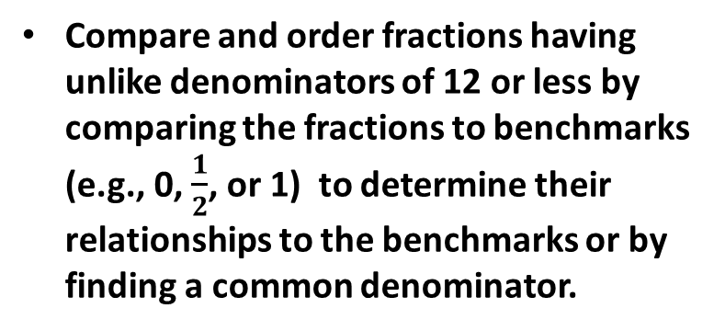
Learning Progression Example part 2
Compare and order fractions having denominators of 12 or less, using manipulative models and drawings, such as region/area models.
Compare and order fractions with like denominators by comparing number of parts (numerators) (e.g., $\frac{1}{5}< \frac{3}{5}$ ).
Compare and order fractions with like denominators and unlike denominators by comparing number the size of the parts (numerators) (e.g., $\frac{3}{9}< \frac{3}{5}$ ).
Compare and order fractions having unlike denominators of 12 or less by comparing the fractions to benchmarks (e.g., 0, $\frac{1}{2}$, or 1) to determine their relationships to the benchmarks or by finding a common denominator.

Slide 28
Teacher’s Content Knowledge
Teachers must know their content deeply, including prior knowledge, next steps, how learning develops, and common misconceptions, in order to meet each student’s needs.
Careful planning enhances the ability to be flexible and responsive, whether or not the student’s needs fall within the prescribed standards or curriculum. Teachers need content knowledge that is both deep and wide.

Slide 29
Learning Goals and Success Criteria (a)
Learning goals describe what students will learn, not what they will do.
Success criteria explain how students (and the teacher) will know they have met the goals.
Learning goals and success criteria are most effective when stated in student-friendly language so that students can readily monitor their own progress toward the goal.

Slide 30
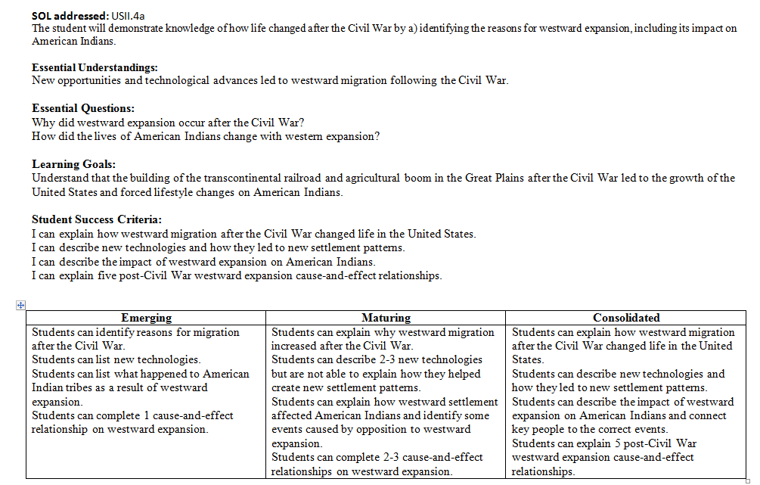
Formative Assessment Planning Model

Slide 31
Learning Goals and Success Criteria (b)
Learning Goals: Understand that the building of the transcontinental railroad and agricultural boom in the Great Plains after the Civil War led to the growth of the United States and forced lifestyle changes on American Indians.
Student Success Criteria:
I can explain how westward migration after the Civil War changed life in the United States.
I can describe new technologies and how they led to new settlement patterns.
I can describe the impact of westward expansion on American Indians.
I can explain five post-Civil War westward expansion cause-and-effect relationships.

Slide 32
The Teacher’s Role (a)
Use learning progressions aligned to standards (and to summative standards-based assessments) to develop learning goals for students
Building blocks of learning
Continuum of understanding, from emerging to consolidated
Establish learning goals and success criteria

Slide 33
The Teacher’s Role (b)
Plan lessons and purposeful interactions designed to move each student toward the goals
Communicate learning goals and success criteria to students
Gather evidence during instruction to determine gaps
Respond to evidence during instruction to move students closer to learning goals

Slide 34
The Teacher’s Role (c)
A teacher must provide learning opportunities, in the form of responsive action, that match students’ current needs based on evidence elicited during instruction.
Using a differentiated approach to respond to these needs is an essential attribute of formative assessment.

Slide 35
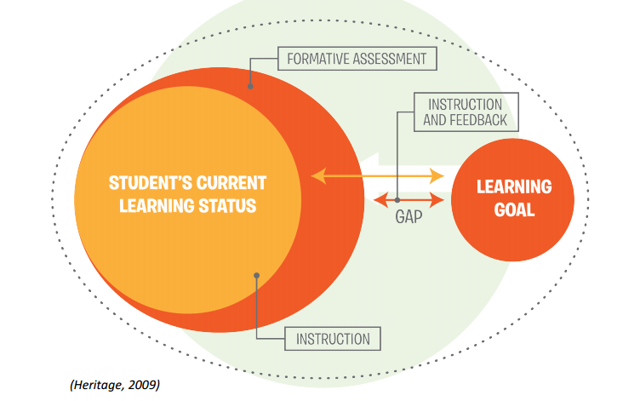
“Just Right” Instruction and Feedback

Slide 36
Evidence Responsive Action (a)
IF … THEN …
evidence elicited during instruction shows that students are moving toward, and likely to meet, the learning goals
instruction continues as planned.

Slide 37
Evidence Responsive Action (b)
IF … THEN …
evidence elicited during instruction shows learning has resulted, but a gap exists between students’ current understanding and the desired goal
adjust instruction in the context of the planned lesson, provide feedback that can be used by the students, or adjust instruction and provide feedback together.

Slide 38
Evidence Responsive Action (c)
IF … THEN …
evidence elicited during instruction shows no learning has occurred
planning a new approach to instruction is necessary. What has been planned and enacted is not moving students toward the learning goals.

Slide 39
Formative Assessment Strategies: Examples
Exit Slips – Short written response by students to a question or problem.
3-2-1 – Students fill out template to indicate what they learned, want to know more about, and what they didn’t understand.
Minute Papers – Students take one minute to write about a concept of their choice.
Think, Pair, Share – Students respond to a question by discussing it with a partner while the teacher listens and then calls on pairs to share.

Slide 40
Effective Feedback
Effective feedback includes strategies or next steps based on learning progressions and common misconceptions.
Feedback is only effective if it is used to close the gap.
Effective feedback can be oral, written, or both.
Feedback must be timely.
Effective feedback is focused on student performance/ evidence and not on the students themselves.
Effective feedback can come from the teacher or from peers.
Complete solutions and step-by-step instructions are NOT considered effective feedback.

Slide 41
The Student’s Role
Students actively monitor their own progress and adjust learning strategies to meet the learning goals.
The success criteria provide a clear target for comparison.
Student adjustments may take many forms, including:
Asking the teacher (or peer) a question
Applying a different comprehension or problem-solving strategy
Listening to a peer’s explanation and then restating
Requesting a peer (or teacher) conference

Slide 42
Peer Feedback (a)
Peers provide feedback to each other on a specific task. This can occur in a one-to-one, small group, or whole group setting.
Students must have a clear understanding of the task and the success criteria—the “look-fors”—in order to give effective feedback.
Modeling, using examples and non-examples, builds an understanding of the process. A strong understanding of what appropriate feedback looks like and sounds like is essential.

Slide 43
Peer Feedback (b)
“Research shows that the people providing the feedback benefit just as much as the recipient, because they are forced to internalize the learning intentions and success criteria in the context of someone else’s work, which is less emotionally charged than one’s own.”
Dylan Wiliam (2006)
Video clip: Peer Feedback
From Module 6, Lesson 3, Formative Assessment Program: Assisting Teachers to Support Student Achievement.
Please note that this video clip is no longer available in the public domain. 7/2023

Slide 44
Benefits of
Formative Assessment

Slide 45
Benefits of Formative Assessment (a)
Metacognition, critical thinking, and collaboration are developed in conjunction with content understanding.
Learning that is processed and consolidated during the interactions with teacher and peers is more likely to become long-term.
Knowledge is more likely to be “connected,” and students are more likely to be able to retrieve it from memory.

Slide 46
Benefits of Formative Assessment (b)
Teachers look more deeply at content.
Teachers who develop learning progressions have thought carefully about the building blocks for the learning and are prepared to recognize the need to intervene, adjust, or extend.
Teachers may become more aware of their own need for deeper content knowledge and more invested in opportunities to increase this.

Slide 47
Benefits of Formative Assessment (c )
Students learn to monitor their own learning.
Students become aware of when they are not meeting learning goals and know that they need to change their strategy to make progress.
Students take action to further their own learning (e.g. use materials, interact with peers and teacher, revise strategies).
Student engagement increases.

Slide 48
Benefits of Formative Assessment (d)
Student learning increases at a faster rate when formative assessment is used effectively and growth toward stated goals is constantly measured.
Mind-sets about learning are positively impacted.

Slide 49
Benefits of Formative Assessment (e)
When formative assessment is used effectively, it may be possible to decrease the frequency of the use of some summative assessments.

Slide 50
Formative Assessment Pilot
Superintendent’s Memo 195-14 announced the pilot in
July 2014.
The Division of School Improvement and Student Assessment and the Division of Instruction are working collaboratively to support the pilot.
Principals responded to a recruitment survey to apply for consideration.
Seven elementary schools representing six school divisions and four superintendent’s regions were selected for participation.
K-2, K-5, and K-7 schools
Rural, urban, and suburban schools
Title I schools

Slide 51
Formative Assessment Pilot: 2014-2015 Participants
Six elementary schools
Teams of 6-10 teachers and an administrator
Online modules developed by Center for Standards and Assessment Implementation
Support from VDOE and Appalachia Regional Comprehensive Center (ARCC)
Two-year participation and commitment to expand the use of formative assessment within the school division
Online community dedicated to the pilot
VDOE and ARCC are collecting data to determine what resources are needed to supplement modules and support schools/facilitators/teachers implementing this professional development.

Slide 52
Formative Assessment Pilot: 2015-2016 Expansion
Current school divisions will add new participants.
A Superintendent’s Memo in spring 2015 will announce the opportunity for additional schools to apply.
Additional schools will be selected and begin implementation.
Elementary
Secondary
A two-year commitment will be required.
The agreement to expand the use of formative assessment within the school division will be required.

Slide 53
Summary
How do summative and formative assessment differ?
What are the characteristics of formative assessment?
What are the characteristics of a classroom that supports formative assessment?
What are the benefits of formative assessment?

Slide 54
References and Sources
Dweck, C. S. (June 2010). Mind-Sets and equitable education. Principal Leadership. National Association of Secondary School Principals. Retrieved from http://www.principals.org/Content.aspx?topic=61219
Heritage, M., et. al. (2009). From evidence to action: A seamless process in formative assessment? Educational Measurement: Issues and Practice, volume 28 (3), 24-31.
The Assessment and Accountability Comprehensive Center and The North Central Comprehensive Center at McREL. (2012). Formative assessment program: Assisting teachers to support student achievement.
Wiliam, D. (July 2006). Does assessment hinder learning? Paper Presented at ETS Invitational Seminar, Institute of Civil Engineers, London, UK. (p.6).

Slide 55
Questions?
Student_Assessment@doe.virginia.gov
or
(804) 225-2102

