Slide 1
PROPOSED AMENDMENTS TO GUIDANCE REGARDING THE SEQUENTIAL ELECTIVE REQUIREMENTS FOR VIRGINIA GRADUATES
Dr. Leslie Sale, Director of Policy

Slide 2
SOA GUIDANCE DOCUMENT
The Guidance Document Governing Certain Provisions of the Regulations Establishing the Standards for Accrediting Public Schools in Virginia (8VAC20-131) is a companion document to the Standards of Accreditation.
  Expands on the requirements set out in the Standards of Accreditation, including how to satisfy certain graduation requirements.
The SOA guidance document was reorganized in 2019.
  Aligned the guidance to the Board’s comprehensive revision of the Standards of Accreditation, finalized in 2017.
  Incorporated a number of standalone guidance documents to create a single, consolidated companion resource.

Slide 3
SEQUENTIAL ELECTIVE REQUIREMENT
Prior to 2016, two sequential electives were only a requirement for the Standard Diploma.
In 2016, the General Assembly passed legislation extending this requirement to all students regardless of diploma.
  § 22.1-253.13:4(D)(5):
  “In establishing graduation requirements, the Board shall … [r]equire students to complete at least one course in fine or performing arts or career and technical education, one course in United States and Virginia history, and two sequential elective courses chosen from a concentration of courses selected from a variety of options that may be planned to ensure the completion of a focused sequence of elective courses that provides a foundation for further education or training or preparation for employment.
This change, as well as limited awareness of the SOA guidance document, has resulted in some confusion and inconsistency as to how the sequential elective requirement has been understood and applied at the local level.

Slide 4
FULFILLING THE SEQUENTIAL ELECTIVE
There are some existing flexibilities for the sequential elective requirement in the SOA guidance document:
  The two sequential electives may be in any discipline as long as the courses are not specifically required for graduation in the SOA.
  Certain courses may be used to partially satisfy the requirement.
The Superintendent of Public Instruction recently issued a waiver of the sequential elective requirement for those students graduating in 2020-2021 who meet certain conditions, due to COVID’s impact on course availability.

Slide 5
PROPOSED TEMPORARY FLEXIBILITY
“For students seeking to graduate with a Standard diploma or an Advanced Studies Diploma in the 2021-2022 or 2022-2023 cohorts, a World Language course used to satisfy the World Language, Fine Arts, or Career and Technical Education requirement for the Standard diploma or the World Language requirement for the Advanced Studies Diploma may be used to partially satisfy the sequential elective requirement, so long as the total number of required credits for the diploma are achieved.”
Notes:
While the flexibility is limited, it ensures students are meeting both the “sequential” and ”elective” components of the requirement. More expansive flexibility would have means students are only receiving sequential course content, but through required (or non-elective) courses.

Slide 6
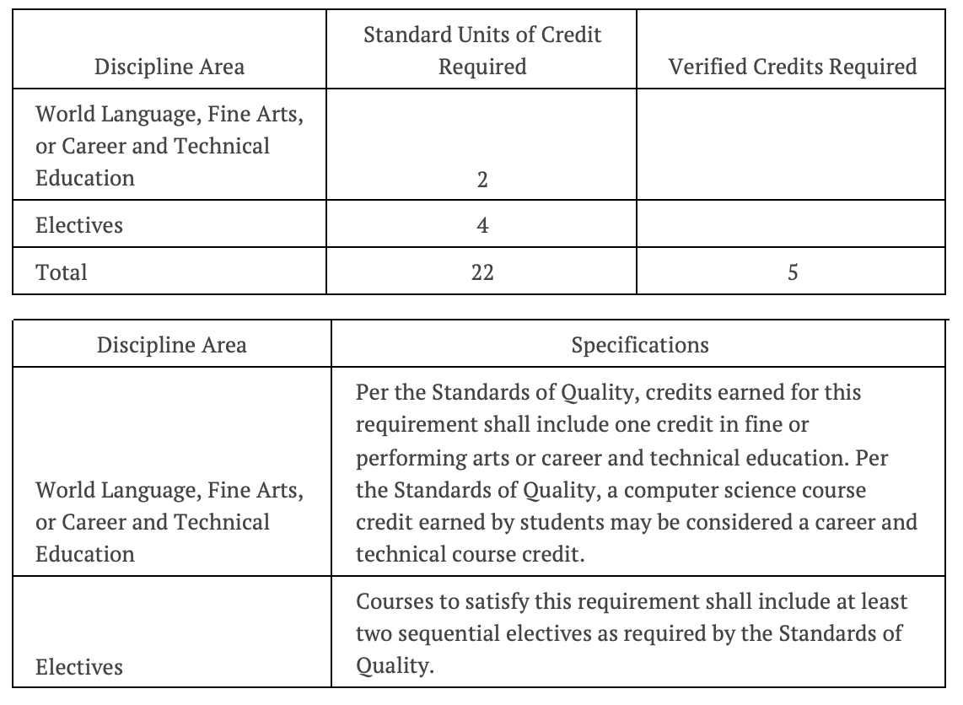
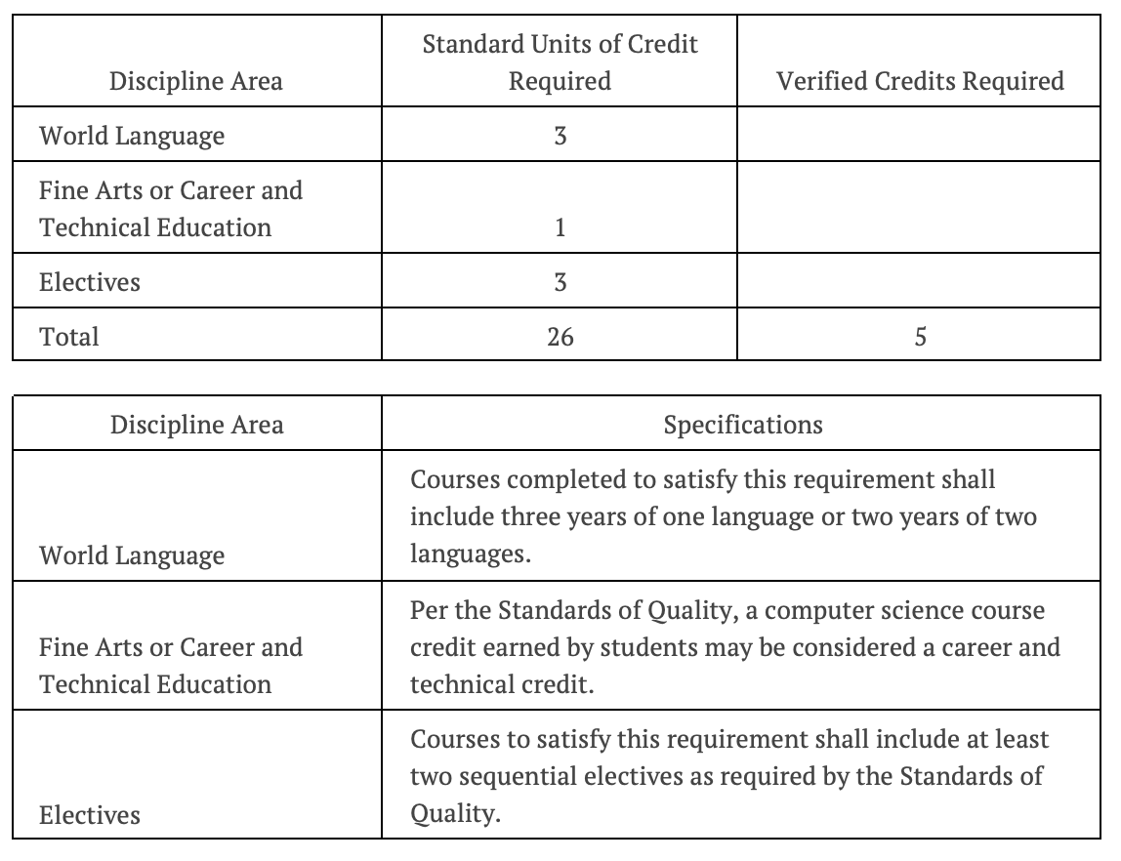
GRADUATION REQUIREMENTS UNDER 8VAC20-131-51
Standard Diploma
Advanced Studies Diploma

Slide 7
OTHER PROPOSED CHANGES
Reincorporates language that a career and technical education course can be used to partially satisfy the sequential elective requirement.
  This language was inadvertently excluded in the 2019 reorganization of the SOA guidance document because of changes in terminology around “practical arts.”
Adds a provisions regarding two credit courses, which can be used to meet both credits of the sequential elective requirement so long as the courses are not specifically required for graduation and if course content builds on itself and creates a foundation for further education or training or preparation for employment.

