Slide 1





NAVIGATING EdEquityVA:
Virginia’s Road Map to Equity
Leah Dozier Walker, Director
Office of Equity & Community Engagement
Virginia Department of Education

Slide 2



Slide 3



Education Equity in Virginia
Education Equity is achieved when we eliminate the predictability of student outcomes based on race, gender, zip code, ability, socioeconomic status or languages spoken at home.

Slide 4

EdEquityVA is
Data Informed:

Slide 5

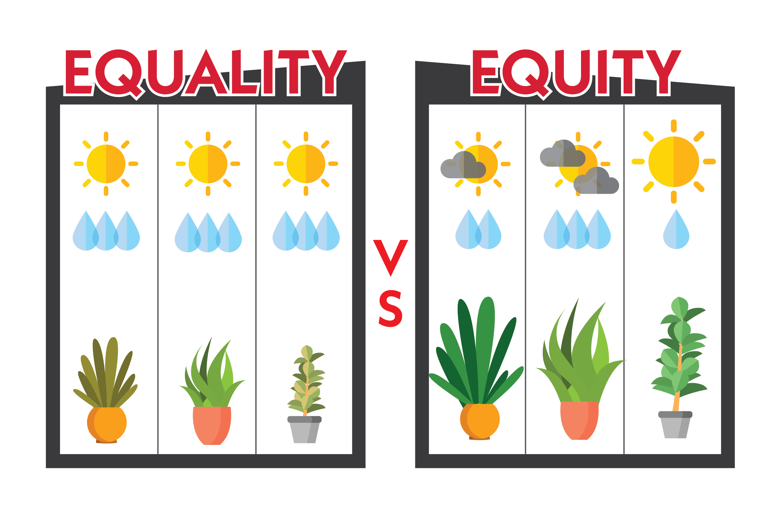

Operationalizing Systemic Equity
The System Provides Equal Inputs
The System Differentiates Inputs
Our
Plants are Surviving
Our
Plants are Thriving

Slide 6



Increasing the Cultural Competency of Virginia’s Educator Workforce
Closing
Opportunity
Gaps
Virginia’s leaders have a shared responsibility to deliver on the promise of a high-quality education for every child, and together, with intentional action to dismantle racism and eliminate achievement gaps, we can fulfill that promise for every learner.
- Virginia Board of Education

Slide 7
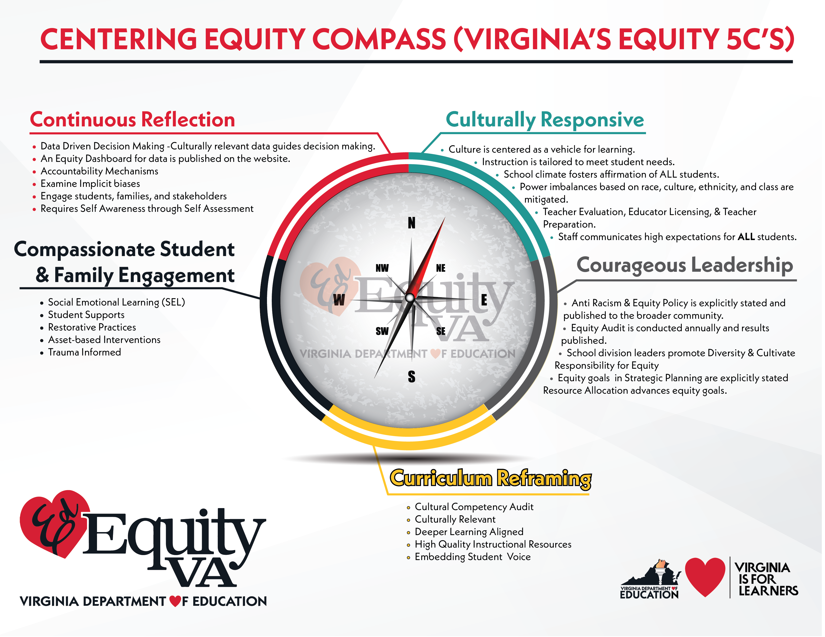


Slide 8

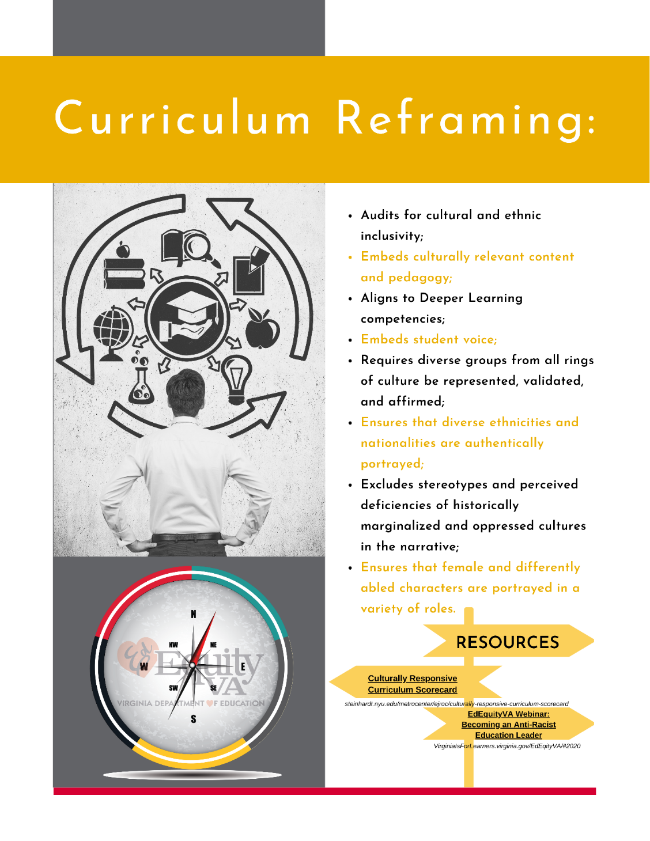
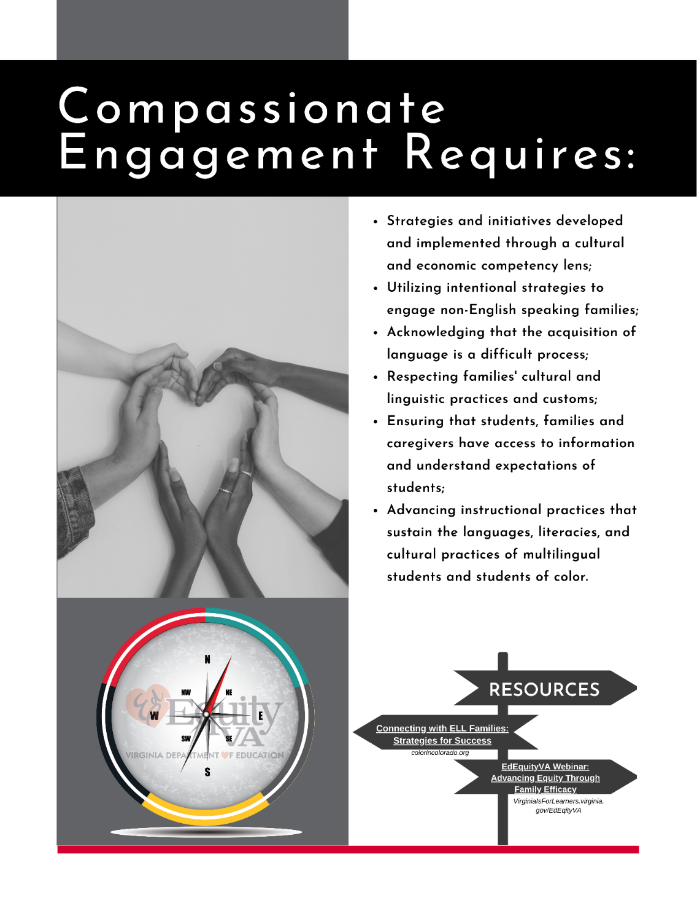

Slide 9
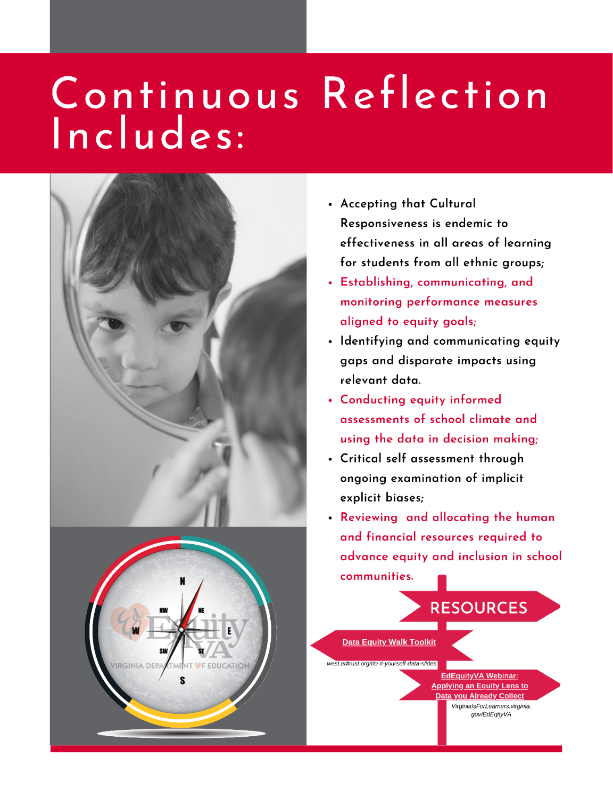
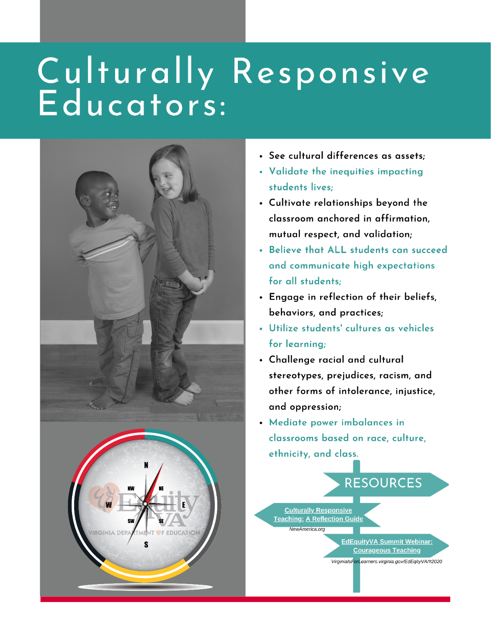

Slide 10

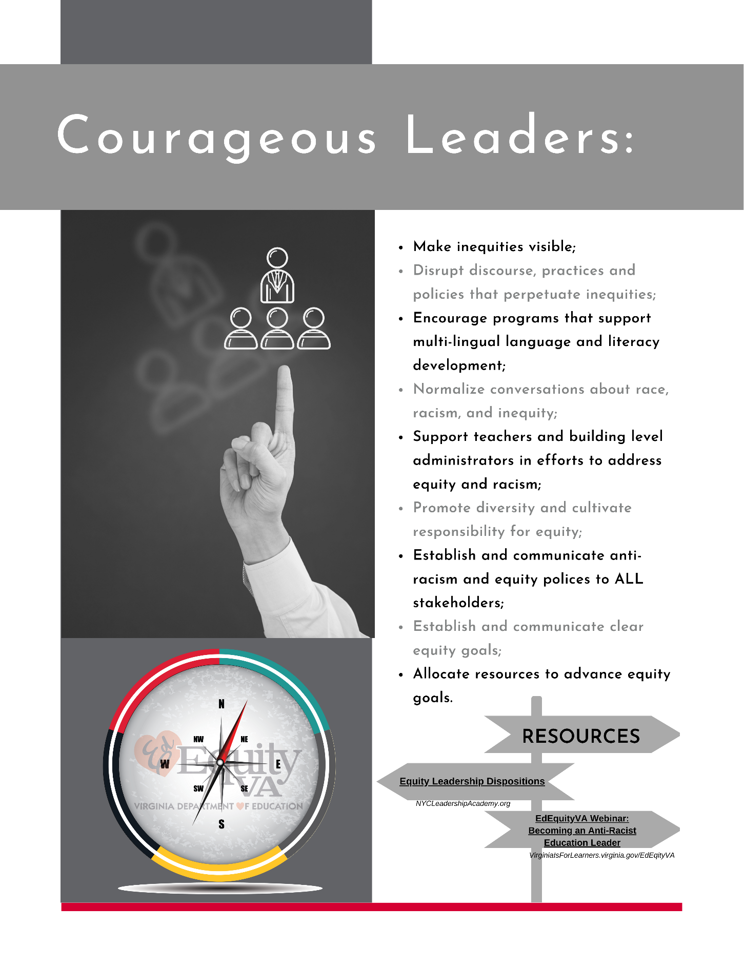
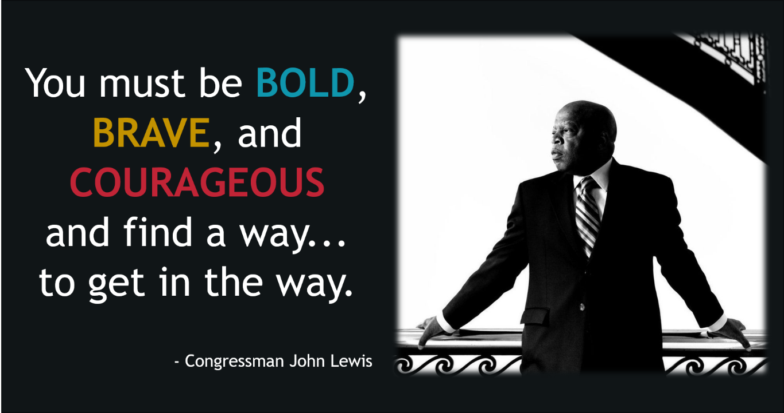

Slide 11


Slide 12
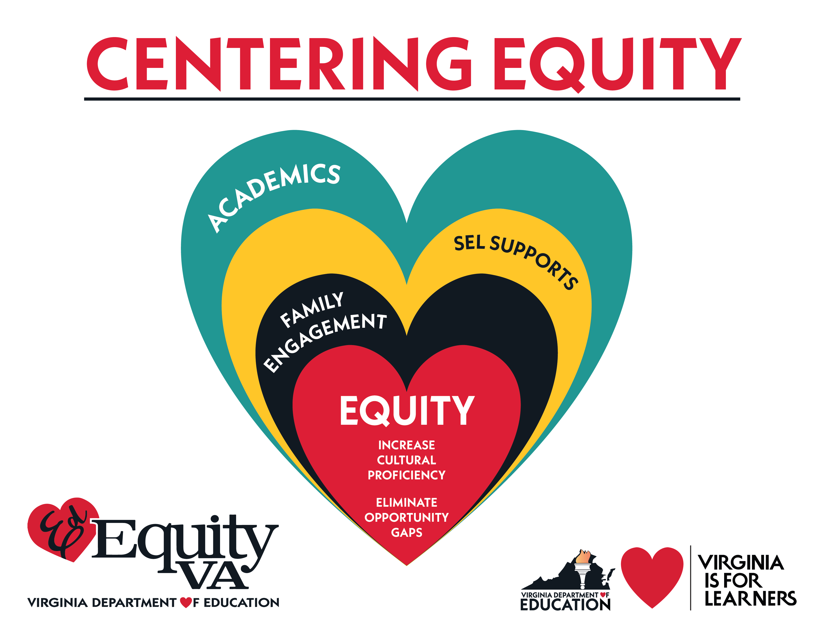


Slide 13


Slide 14


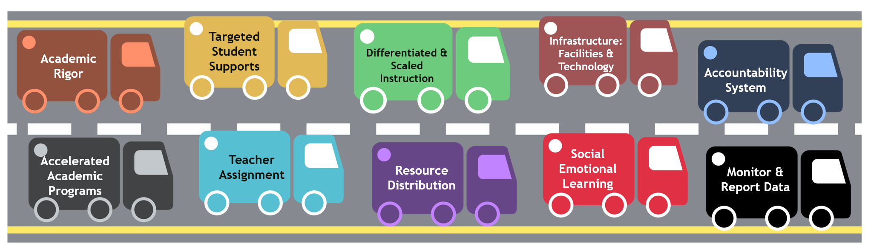
Closing
Opportunity
Gaps

Slide 15


Opportunity Gap:
Describes the complex issues that contribute to achievement gaps and recognizes the historical and societal implications of the way race and class influence the kind of education and access to support a student is likely to receive.

Slide 17
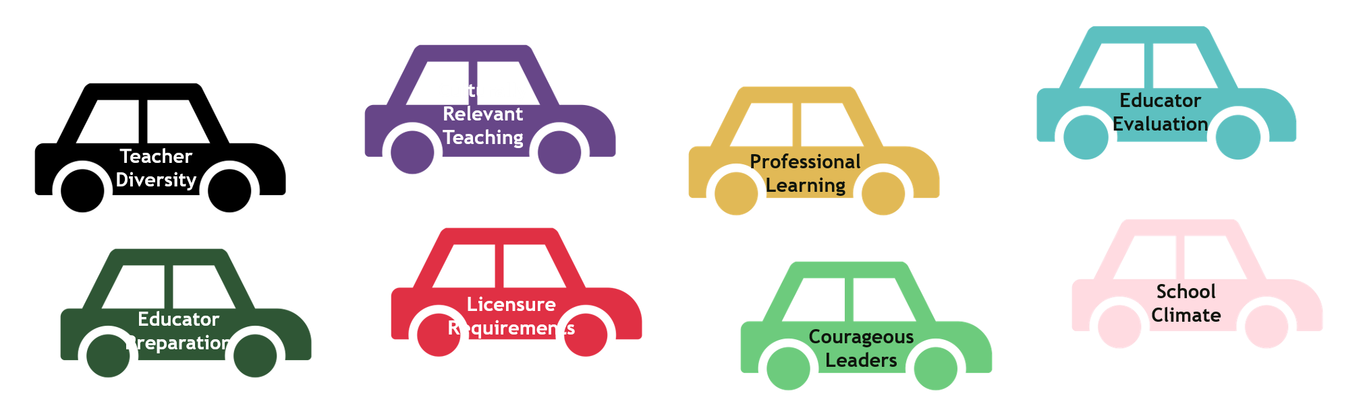

Increasing the Cultural Competency of Virginia’s Educator Workforce

Slide 18
Cultural Proficiency:
Environments that create opportunities for access, empowerment, and achievement by acknowledging, valuing, advocating, and empowering cultural diversity in all aspects of the educational process.

Slide 19

Culturally Responsive Practices: Four Critical Levels
Culturally Responsive Schools | Culturally Responsive Leadership
Safe, inclusive, and secure environments where all students are affirmed. Provide universal access to culturally relevant pedagogy that builds positive cultural identities. Have an educational environment that is free from implicit and explicit racial/ethnic and gender biases. | Accept cultural responsiveness as endemic to effectiveness in all areas of learning for students from all ethnic groups. Deploy resources and professional learning opportunities to advance cultural proficiency. Evaluate cultural responsive efficacy during teaching observations and evaluations. Establish high expectations for all students. Mitigate power imbalances based on race, culture, ethnicity, and class.
Culturally Responsive Educators | Culturally Responsive Pedagogy/Teaching
Reflect on their own cultural lens. Model high expectations for all students. Promote respect for student differences. Challenge stereotypes, prejudices, racism, and other forms of intolerance, and oppression. Cultivate relationships beyond the classroom anchored in affirmation, mutual respect and validation. Engage in reflection of their beliefs, behaviors and practices. Communicate in linguistically and culturally responsive ways. | Identifies and nurtures students’ cultural strengths to promote student achievement. Affirms cultural and individual identity. Uses cultural differences as assets necessary to inform the development of instructional resources. Mediates power imbalances based on race, culture, ethnicity, and class. Utilize students’ culture as a vehicle for learning. Establishes high expectations for all students and provides support to ensure success. Diverse groups from all rings of culture are represented, validated, and affirmed.
Notes:
Establishes a 3-pronged approach: institutional, personal, and instructional. Institutional: recognizes a need for reform of school policies and procedures based on cultural factors. Personal: requires teachers to become culturally responsive. Instructional: provides educational materials that are culturally affirming and aid in delivering culturally responsive instruction.

Slide 21


Follow
Our Work @
@VDOE_News
#EdEquityVA
#VAis4Learners
www.VirginiaIsForLearners.Virginia.Gov/EdEquityVA
EdEquityVA@doe.virginia.gov
www.doe.virginia.gov

