Slide 1
Virginia’s Early Childhood Advisory Committee (ECAC)
March 24, 2022

Slide 2
Agenda
Full advisory committee convenes
Presentation: Proposed Guidelines for VQB5, Practice Year 2
Questions and discussion
Review of public comment
Adjournment

Slide 3
Presentation: Proposed Guidelines for VQB5, Practice Year 2

Slide 4
Objectives
During today’s meeting, ECAC members will:
Review purpose and goals of the Virginia Quality Birth to Five System (VQB5)
Receive an update on Practice Year 1 of VQB5
Learn about the proposed plans and enhancements for Practice Year 2
Provide feedback and recommendations on the draft proposal to be shared with the Board of Education in April.
Order of topics:
Vision and Overview of VQB5
Practice Year 1 (2021-2022) Progress Update
Practice Year 2 (2022-2023) Plans and Enhancements
Next Steps - Preparing for Practice Year 2
Questions and Discussion

Slide 5
Our Shared Vision
Four out of ten Virginia children enter school without the key literacy, math, and social-emotional skills needed. We envision a Virginia where all children have the opportunity to enter school ready.
All families have affordable access to and support to choose the option that meets their unique needs.
All early childhood programs that take public funds benefit from measurement and supports for improvement, ensuring quality choices are available for all families.
Programs are rewarded for continual improvement and educators are adequately compensated.
Overall Virginia’s early childhood system is unified, data-driven and resource-effective so families can work, go to school or pursue employment and children have every opportunity to be successful.

Slide 6
A Simplified View
Access + Quality
More Choices for More Families
Improved School Readiness Outcomes

Slide 7
Unified Measurement and Improvement
Virginia’s early childhood system must ensure that all children have access to quality teaching and learning experiences that meet their unique needs.
Working together, through VQB5, we will:
UNIFY around shared and equitable expectations for quality.
MEASURE and strengthen teacher-child interactions and curriculum use in all publicly-funded birth-to-five programs.
IMPROVE supports for educators, prioritizing those who need it most.

Slide 8
Measuring Quality
VQB5 measures the quality of infant, toddler and preschool teaching and learning based on two nationally-recognized quality indicators.
Interactions | Curriculum
Measure teacher-child interactions and instruction in a developmentally-appropriate way using the Classroom Assessment Scoring System (CLASS) | Measure the use of approved curricula that are aligned with Virginia’s Early Learning and Development Standards
Research shows that stimulating and supportive interactions between teachers and children and effective use of quality curricula promote children’s holistic learning and development, resulting in improved school readiness.
Details can be found on the Quality Measurement and Improvement (VQB5) website

Slide 9
Continuous Quality Improvement
PREPARE
Leaders and educators understand what is being measured and why
RECOGNIZE, REFLECT AND ADJUST
Leaders and educators use data to recognize growth, reflect on what works and make adjustments to address challenges and gaps
MEASURE AND IMPROVE
All infant, toddler and preschool classrooms are observed and consistent information is collected to understand the experience of all children
SUPPORT
Leaders and educators receive professional development that addresses their unique classrooms
GIVE FEEDBACK
Leaders provide educators with individualized feedback on their classroom’s strengths and opportunities for growth

Slide 10
Purpose of the Practice Years
The practice years allow programs the chance to practice collecting information and receiving supportive feedback, with targeted supports for interactions and curriculum. The practice years also allow state and local leaders to gather information to inform future guidelines and procedures.
VQB5 Practice Year 1 (Currently underway in 1450+ sites)
Participation available through PDG communities (about 85% of the state)
Practice Year 1 ratings shared with site leaders in fall of 2022
2021-2022
VQB5 Practice Year 2
Participation available statewide through Ready Regions to 100% of programs (registration opens in August)
Practice Year 2 ratings shared with site leaders in fall of 2023
2022-2023
VQB5 Year 1
All publicly funded programs required to participate
Quality Ratings from Year 1 publicly shared in the fall 2024
2023-2024

Slide 11
Who Will Have to Participate in VQB5?
Starting in the fall of 2023, all publicly funded providers will be required to participate in the new unified VQB5 system*. This includes...
Virginia Preschool Initiative (VPI)
Early Childhood Special Education (ECSE or IDEA Part B, Section 619 preschool)
Title I Preschool
Head Start/Early Head Start
Virginia’s Child Care Subsidy Program
Local child care assistance, such as Fairfax’s Child Care Assistance and Referral (CCAR) program
The federal Child Care Access Means Parents in School (CCAMPIS) program
Virginia Early Childhood Foundation (VECF) Mixed Delivery program
Federal Department of Defense Military Child Care Fee Assistance
For the definition of publicly funded programs, as well as answers to frequently asked questions please refer to the VQB5 Participation FAQ document.
*Programs that do not receive public funds will have the option to participate

Slide 12
RecognizeB5
The Teacher Recognition Program, now called “RecognizeB5”, awards a financial incentive to eligible teachers in child care centers and family day homes.
Awards financial incentives of at least $2000 to certain eligible teachers in VQB5
Is an innovative strategy for supporting, retaining, and rewarding early educators in non-school early-learning settings;
Helps reduce turnover which can positively impact children, improve classroom quality and reduce stress for programs;
Can help address the staffing crisis; and
Enables Virginia to lead with compensation as it builds its statewide measurement and improvement system.
RecognizeB5 will continue to be a key VQB5 activity in Practice Year 2
Report: The Effects of Financial Incentives on Teacher Turnover in Early Childhood Education Settings: Experimental Evidence from Virginia.

Slide 13
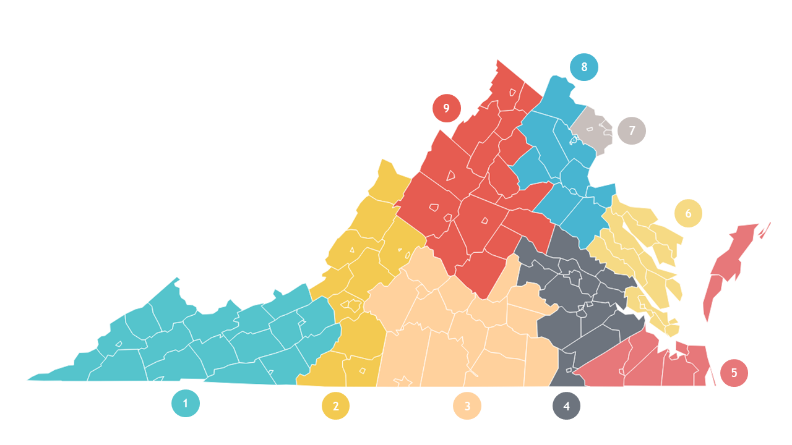
VQB5 Coordination
Beginning this summer, VQB5 will be coordinated through a new statewide structure called Ready Regions. This will allow for 100% participation in Practice Year 2 and beyond.
1 - Southwest
2 - West
3 - Southside
4 - Central
5 - Southeastern
6 - Chesapeake Bay
7 - Capital Area
8 - North Central
9 - Blue Ridge
Visit the Virginia Early Childhood Foundation website to learn more about Ready Regions.

Slide 14
Practice Year 1: What have we accomplished and learned?
A detailed Practice Year 1 Progress Report is also provided in Appendix A of the Guidelines for Practice Year 2 document

Slide 15
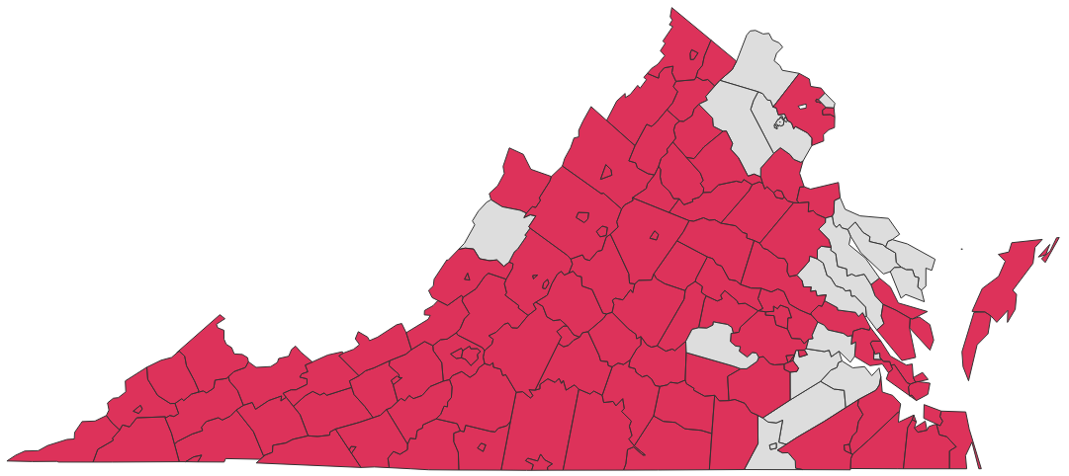
Thousands of Sites are Participating
During Aug/Sept 2021, 1450+ sites registered to participate in VQB5 Practice Year 1, representing the different types of early childhood settings in Virginia.
Among sites participating:
More than 650 centers
Over 500 public schools
250+ family day homes

Slide 16
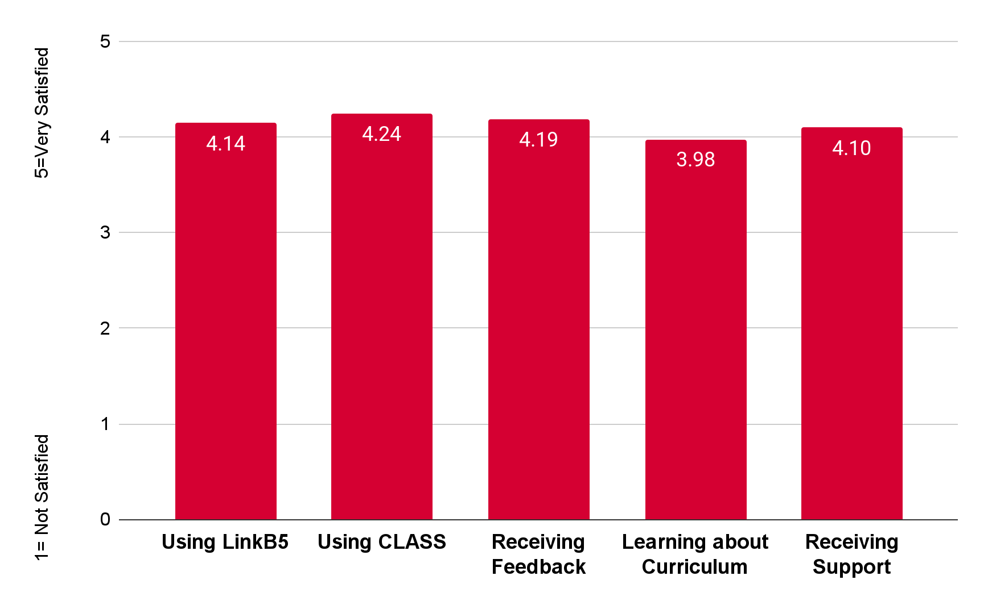
Data Snapshot - Participant Experience
The majority of VQB5 Practice Year 1 participants were satisfied with their experience this fall
VQB5 Fall 2021 Participant Feedback Survey

Slide 17
Programs are Positive about VQB5
I have been enlightened to know how the CLASS tool works and the indicators teachers should be focusing on during their interactions with students. (Center Director/Fairfax)
I have received new ideas and have better ways of doing things (FDH/Charlottesville)
I have been able to take my classroom to a whole new level with the tools from CLASS (PreK teacher/Giles)
I appreciate all of the help and quick response when I had questions (FDH/Fairfax)
I loved the observations. It’s always good to have someone from the outside to give your program a fresh look. (Owner Childcare Center/Suffolk)
I appreciate that "we" are all talking the same language and have comparable results.
(VPI Program/Isle of Wight)
It’s great to see teachers excited about their new curriculum (Center Director/Roanoke)
My teachers saw how good they are doing with their class from an outside source (Center Director/Caroline County)
From Fall 2021 Participant Feedback Survey

Slide 18
Communities Completed 4200+ Observations this Fall
Accomplishments as of March 2022
Over 4000+ Local CLASS Observations have been completed (with another 4200+ expected to be completed by June)
Program leaders and teachers are receiving individualized feedback on their strengths and needs, as well as targeted resources for improvement
Over 200 External Observations have been completed (with another 600+ expected to be completed by June)
State and community leaders have information to help support local observers

Slide 19
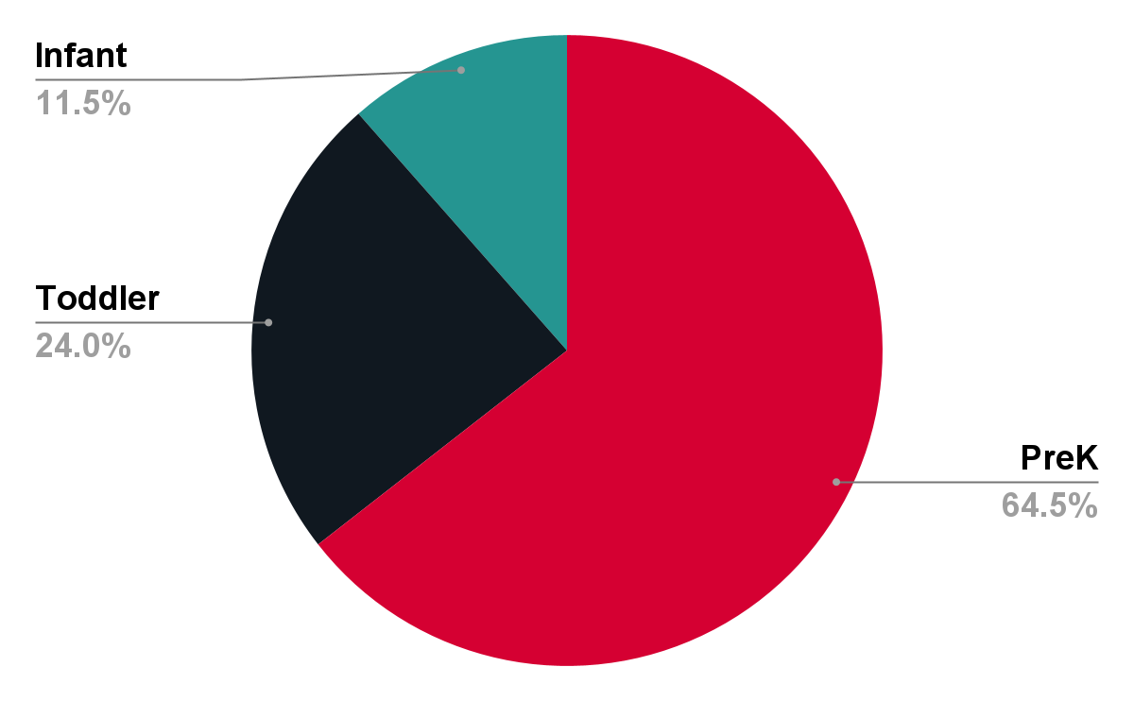
Fall Data Snapshot - Teacher-Child Interactions
Infant, toddler, preschool and family day homes are ALL receiving CLASS observations and feedback
VQB5 Fall 2021

Slide 20
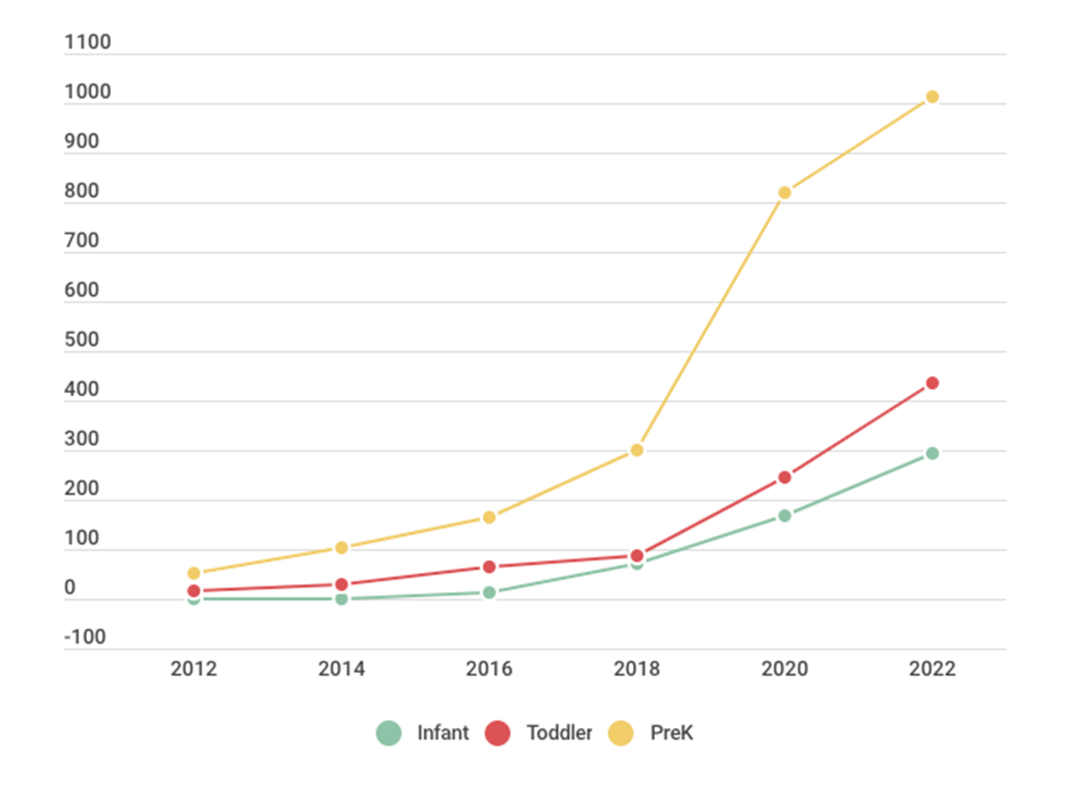
Data Snapshot - CLASS Growth 2012-2022
The number of certified CLASS observers in Virginia has increased greatly across all age levels
64% of all certified Virginia observers are currently conducting local observations for PY1
Updated March 8, 2022

Slide 21
ICP-CLASS Pilot Progress Update
To support improvement in inclusive settings, VDOE is working with TTACs to pilot the use of the Inclusive Classroom Profile (ICP) with CLASS in some inclusive classrooms that are participating in VQB5.
As of March 2022,
29 inclusive classrooms received an ICP and CLASS observation
ICP-CLASS correlations documents were developed
Feedback was gathered from teachers and administrators. Initial feedback indicated…
Most felt the ICP when used with the CLASS provided helpful information about teacher-child interactions and inclusive practices
There were mixed responses about when and how the ICP should be used in conjunction with the CLASS tool.
In July, VDOE will compare findings from the ICP to the VQB5 Practice Year information collected through CLASS observations and additional participant surveys to identify potential learnings for pilot continuation in Practice Year 2.
See Section 7 in the PY2 Guidelines document for more information about the ICP-CLASS pilot

Slide 22
More Programs are Using Quality Curriculum
Accomplishments as of March 2022
Launched a new birth-five curriculum review process.
32 curricula currently approved, including 9 infant/toddler and family day home curricula
Launched no-to-low cost birth to five curriculum option, STREAMin3
Information gathered on curriculum use from 4700+ classrooms participating in Practice Year 1 (updated curriculum information being gathered this spring)
Data on curriculum use is being used to prioritize support for programs who do not yet have access to an approved curriculum

Slide 23
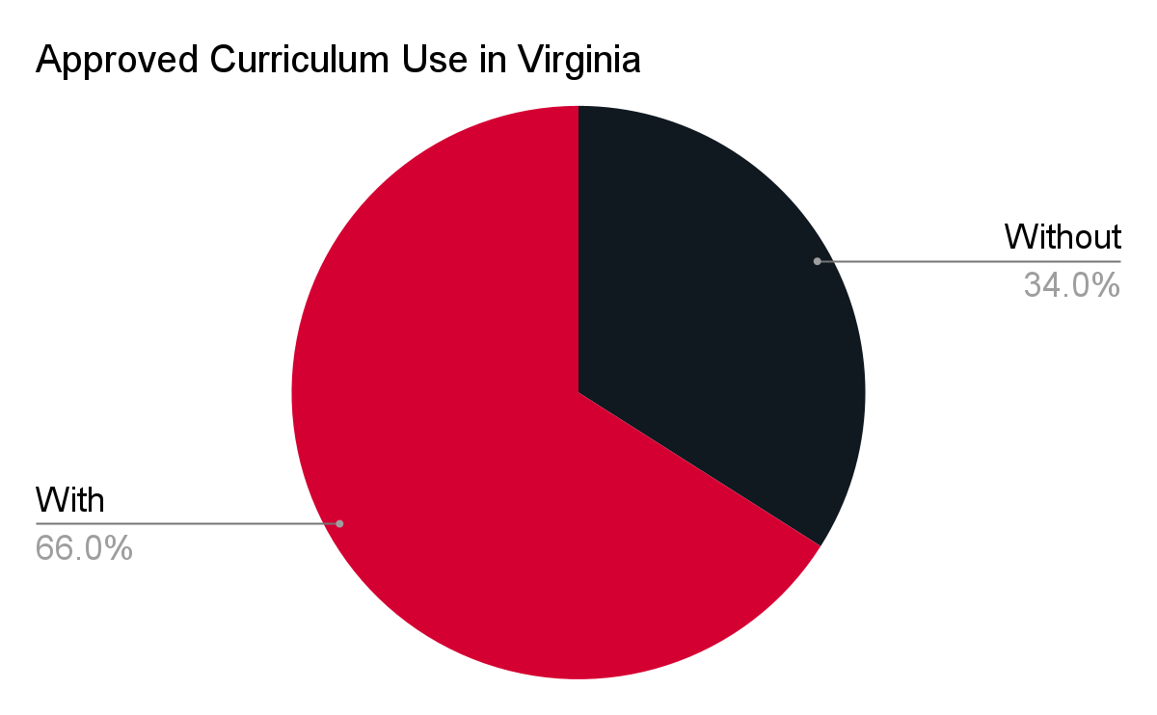
Fall Data Snapshot - Curriculum Use
Two thirds of early childhood programs participating in VQB5 have an approved curriculum in place
VQB5 Fall 2021

Slide 24
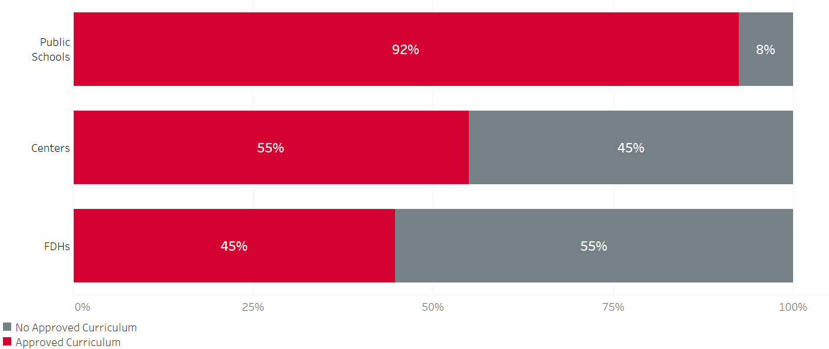
Fall Data Snapshot-Curriculum Use
Use of an approved curriculum varies across program types
VQB5 Fall 2021

Slide 25
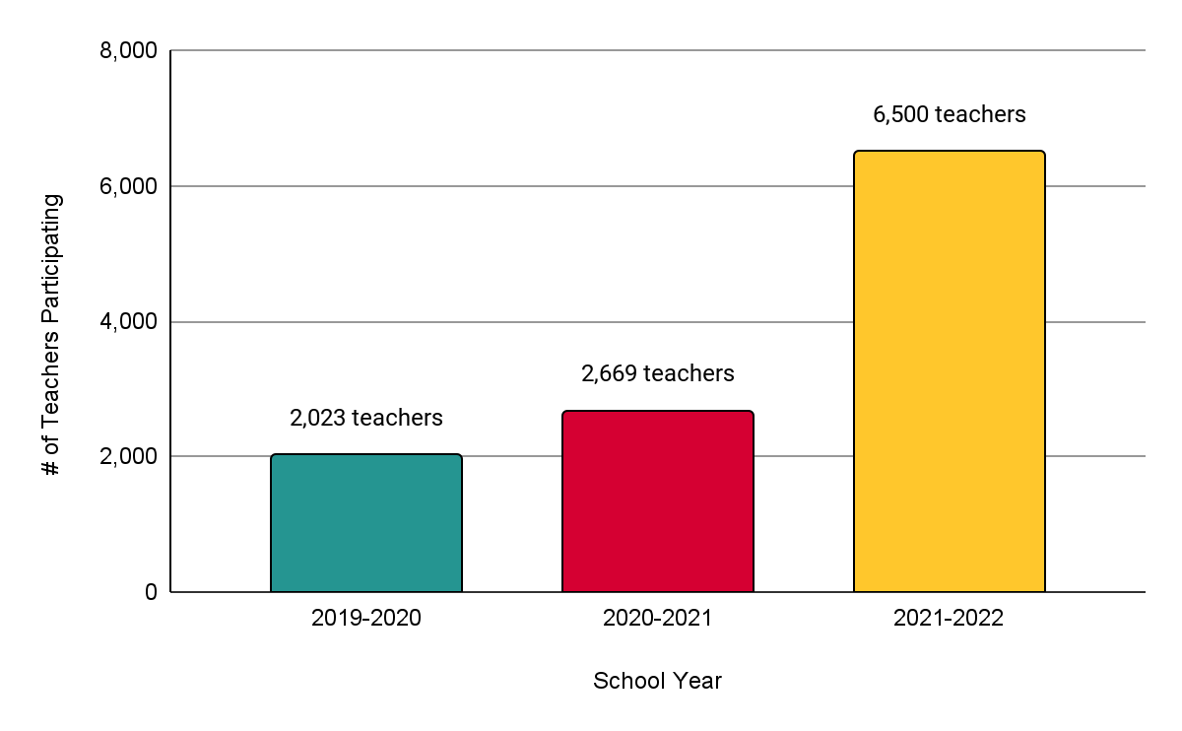
Reach and Impact of RecognizeB5
Participation in RecognizeB5 has increased significantly year over year, with more teachers in child care centers and family day homes benefiting during Practice Year 1.
$12.5M* investment
$5M investment
$2.9M investment
*$12.5M is an estimate based on current participation in the program

Slide 26
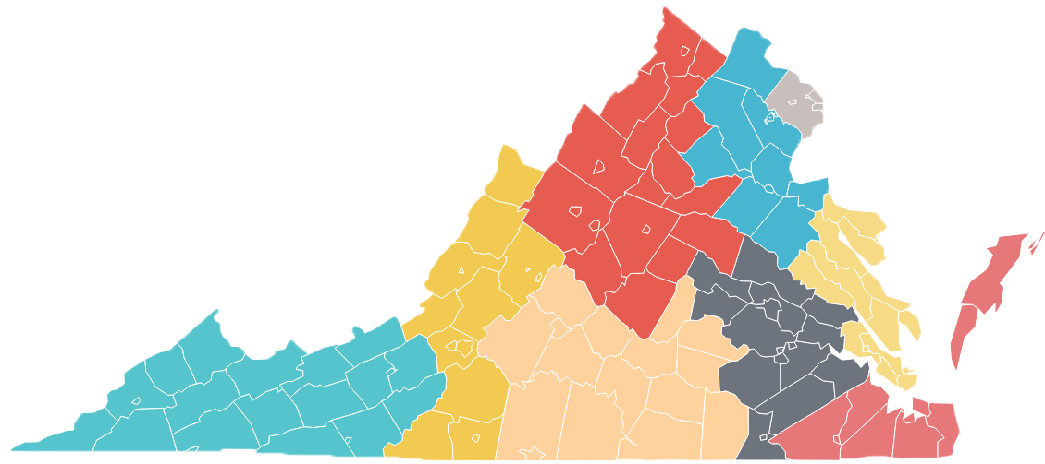
RecognizeB5: Words from Educators
“I spent it on things I needed and wanted for my class.”
Region 8 - North Central
“Because of this grant, I was able to keep a roof over my children's head. My youngest was hospitalized and I didn't have enough PTO left to use.”
Region 7 - Capital Area
“It truly made me feel appreciated and valued. Money is not why I do what I do and has little to do with the rewarding feeling I get for doing my job. However, working tirelessly in a notoriously underpaid profession can weigh on my heart and mind at times when I feel like my paycheck doesn't even closely reflect the quality of my work and the effort I put in.”
Region 2 - West
“Being an educator can, at times, feel overwhelming and undervalued. We do more than just educate children, and we do not exactly do it for the salary we get paid. The money we received through the grant made me feel more valued for what I do, and hopeful that our government can work towards seeing educators as real professionals who hold an important position in our society.”
Region 9 - Blue Ridge
“I’m a single mom of 3, and when I found myself completely struggling to make ends meet, the payments showed up and helped me get through that financially insecure time.”
Region 4 - Central
“It is sometimes easy to be overlooked or considered as babysitters and not true educators. This recognition allowed me to feel extra appreciated and valued for the work I do.”
Region 1 - Southwest

Slide 27
Engagement with the Field
During Practice Year 1, the VDOE has continually engaged and listened to a diverse group of stakeholders about the VQB5 system.
Implementation Guide and Video for Program Leaders (843 views)
Curriculum Review Process Webinar (396 views)
Local CLASS Observations Webinar (752 views)
Presentations to a variety of stakeholder groups (35 presentations)
Improvement Partner Quarterly Webinars (avg of 200 views each)
Fall VQB5 Participant Feedback Survey (465 Responses)
Ongoing engagement with the field through…
Weekly office hours with PDG Communities
LinkB5 TA Hotline Support
Ongoing consultation with data and content experts
Information and announcements about VQB5 have also been shared broadly through weekly Readiness Connections e-newsletter and webinar recordings are available on the Quality Measurement and Improvement (VQB5) webpage.

Slide 28
Fall Stakeholder Feedback
Throughout the fall and from the online participant survey, VDOE has been listening to the field about their experiences, questions and concerns. Here are the themes:
Positive Experiences with VQB5 | Questions/Concerns
Unified approach across all birth-to-five programs Individualized feedback, that included strengths and specific areas to work on Understanding the importance of interactions by using the CLASS tool Helpful ideas and strategies for improvement Support and resources provided from local and state partners when assistance was needed Financial incentive for childcare and family day home teachers (RecognizeB5) | Clarity on participation requirements Clarity about CLASS observation requirements and protocols More information about curriculum options LinkB5 data entry expectations/timeline Staffing shortages and eligibility for RecognizeB5 Educator stress Increased mental health needs and challenging behaviors in the classroom

Slide 29
Practice Year 2 (2022-2023)

Slide 30
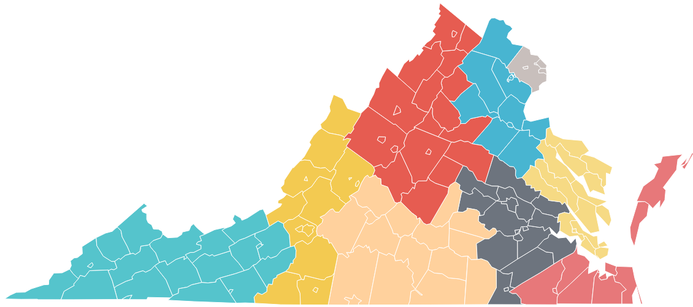
Key Points about Practice Year 2 (2022-2023)
The required activities and expectations for participating programs will generally remain the same for Practice Year 2
100% of early childhood programs in Virginia are invited to participate in Practice Year 2
Starting in July 2022 and beyond
VQB5 Coordinated statewide through READY REGIONS

Slide 31
VQB5 Activities Timeline
Practice Year 2 will follow the VQB5 annual measurement and improvement cycle, as summarized below:
Summer 2022 | Fall 2022 | Winter 2023 | Spring 2023
Program registration and preparation for fall CLASS observations | Local CLASS observations and curriculum use information for every classroom entered in LinkB5. | Programs use information from fall to engage in professional development based on program and classroom needs. | Local CLASS observations and curriculum use information updated (if needed) for every classroom entered in LinkB5.
Reflect and Prepare
Measurement, Feedback and Support for Every Classroom
External CLASS observations are also used in some classrooms as a secondary method to gather information and provide additional feedback.

Slide 32
Practice Year Ratings
Practice Year ratings are calculated at the end of the academic year using the following point system. Practice Year 2 ratings will be shared privately with site administrators in the fall of 2023 for information only.
Interactions Points (700 total points) | Average of all CLASS scores from the fall and the spring (all classrooms at a site) x 100
Curriculum Points (100 total points) | Programs using an approved curriculum in at least one classroom, by May 31st, will receive 100 points added to their score
Total Points | Interactions Points + Curriculum Points = Total Points
Practice Year 2 Ratings | Exceeds Practice Year Expectations = 700 - 800 points Meets Practice Year Expectations = 400 - 699 points Needs Support = 100 - 399 points
Sites with practice ratings will be provided with Professional Development options in response to their practice rating results. Programs that fall into the “Needs Support” category within the practice years will be a priority for improvement support.

Slide 33
Practice Year 2 Enhancements

Slide 34
Overview of Enhancements for 2022-2023
Based on data analysis and in response to feedback from the field, the following enhancements are proposed for Practice Year 2 (2022-2023).
1
PARTICIPATION
Increase participation of publicly funded programs
2
CLASS OBSERVATIONS
Ensure educators receive consistent observations and supportive feedback
3
CURRICULUM
Increase support for accessing and using quality curriculum
4
IMPROVEMENT SUPPORT
Prioritize VQB5 participants for Improvement Supports
5
PRACTICE RATINGS
Pilot a Site-Level Quality profile
6
LINKB5
Improve LinkB5 user experience
7
APPEAL PROCESS
Develop a structured process to address unique situations

Slide 35
Increase Participation of Publicly Funded Programs
1
Here is how we are responding to feedback from the field to ensure all publicly funded programs are informed and prepared for the new system.
Practice Year 2 Enhancements
VQB5 participation available statewide through Ready Regions (100% of programs are invited to participate) Practice Year 2 Interest Form and Info-Flyer available for new programs Updated FAQs related to participation Clarifications added to Practice Year 2 Guidelines (see Appendix slide) Direct Communications with publicly funded program leaders regarding participation requirements (letters to site leaders, webinars/presentations for specific stakeholders, Supt Memos and updated guidelines for school divisions)

Slide 36
Ensure educators receive consistent observations and supportive feedback
2
Here is how we are responding to feedback from the field to ensure local observers are supported, and educators receive consistent and supportive feedback
Practice Year 2 Enhancements
Update and strengthen local CLASS observation guidelines, protocols and feedback procedures. Use local-external observation alignment data gathered by AEII during Practice Year 1, to develop and implement regional plans for supporting local observers to provide educators with consistent and supportive feedback. In addition to local observations, increase the use of external observations to support local observers and provide educators with additional feedback. (see Appendix slides)

Slide 37
Increased Support for Accessing and Using Quality Curriculum
3
Here is how we are responding to feedback from the field to ensure VQB5 programs have access and support for using quality curriculum.
Practice Year 2 Enhancements
Continue to expand program choices and provide additional supports to access quality curriculum, focusing on VQB5 programs without an approved curriculum in place (see Appendix slide) Curriculum options for VQB5 during Practice Year 2 include: Option 1 - Seek approval for a curriculum the site already has in place Option 2 - Choose and use one of the 32 (and growing) VDOE approved curriculum options Option 3 - Access STREAMin3 as an open-source option, with low-or-no cost training and resources

Slide 38
Prioritize VQB5 Participants for Improvement Supports
4
Here is how we are responding to feedback from the field to ensure VQB5 programs are prioritized for improvement supports in response to their needs.
Practice Year 2 Enhancements
Ready Regions lead agencies will work with existing improvement partners to ensure there are PD options, such as resources, training, coaching and learning communities, available to the VQB5 programs in their region. Improvement supports will be prioritized for publicly funded programs participating in VQB5 and in response to needs identified in VQB5 measurements. VDOE will continue to unify and align all state- and federally-funded quality improvement efforts, including ensuring supports for VQB5 programs are available consistently across Ready Regions. (see Appendix Slide)

Slide 39
Pilot a Site-Level Quality Profile
5
Here is how we are responding to feedback from the field to ensure the practice year rating information is provided in a clear and helpful manner.
Practice Year 2 Enhancements
With input from the field, VDOE will develop a site quality profile prototype to include information about completion of required activities, performance on measurements (i.e. practice rating results), improvement progress and other topics of interest to families and the general public to better prepare sites for the information that will be shared following the practice years. Site Quality Profiles for Practice Year 2 would be shared privately with site administrators in the fall of 2023 (not posted publicly) Feedback from the practice year site quality profile prototype will inform the development of the public site quality profiles, to be shared in the fall of 2024.
See appendix slides for additional details regarding eligibility for Practice Year 2 rating

Slide 40
Improve LinkB5 User Experience
6
Here is how we are responding to feedback from the field to ensure all users in LinkB5 data portal have a positive experience entering and using VQB5 data.
Practice Year 2 Enhancements
When LinkB5 opens for registration in August 2022, Ready Regions will be represented in the online data portal. The windows for fall and spring CLASS score data entry will align with the observation windows. Users can have multiple roles within one user-account. New user dashboards and upgrades to improve system navigation, data entry, and user experience. Hotline support will continue to increase to support more users.
Information about LinkB5 can be found on the LinkB5 Resources website

Slide 41
Develop a Structured Process to Address Unique Situations
7
Here is how we are responding to feedback from the field to address unique situations related to VQB5 required activities.
Practice Year 2 Enhancements
VDOE will provide a structured process for programs to request a review of a decision related to site/classroom eligibility, observation results, curriculum approval, practice rating or other applicable topics. Information gathered during Practice Year 2 will help document the frequency and types of requests to inform the development of future guidelines and procedures, including the development of a formal appeals process in future years.

Slide 42
Enhancements for 2022-2023
These enhancements for Practice Year 2 will help move our work forward to ensure all children have access to quality teaching and learning experiences that meet their unique needs.
1
PARTICIPATION
Increase Participation of Publicly Funded programs
2
CLASS OBSERVATIONS
Ensure educators receive consistent observations and supportive feedback
3
CURRICULUM
Increase support for accessing and using quality curriculum
4
IMPROVEMENT SUPPORT
Prioritize VQB5 participants for Improvement Supports
5
PRACTICE RATINGS
Pilot a Site Level Quality Profile
6
LINKB5
Improve LinkB5 user experience
7
APPEAL PROCESS
Develop a structured process to address unique situations
Additional details about Practice Year 2 plans and activities can be found in the Appendix slides and in the Guidelines for Practice Year 2 document shared with ECAC members for the March 24th meeting (Also posted on the ECAC website).

Slide 43
Next Steps

Slide 44
VQB5 Next Steps
March - June 2022 | Spring Observation Window for currently participating programs (Jan. 17th-June 10th) Bring proposed Practice Year 2 Guidelines to the Board of Education and continue to gather feedback from the field (online survey). Work with PDG/Ready Regions and Improvement Partners to prepare for Practice Year 2 (including engaging new sites) Develop and share new PD resources to support improvement efforts
July - December 2022 | Launch Practice Year 2 statewide through Ready Regions Registration For Practice Year 2 (Aug. 1st-Sept. 16th) Share Practice Year 1 rating results with site leaders Sites use their results to guide improvement PD options provided to sites in response to needs Fall Observation and data entry (Aug. 22nd-Dec. 23rd) Continue to strengthen alignment of improvement partner support for VQB5 sites in response to statewide and regional needs.

Slide 45
Preparing for VQB5 Practice Year 2
Registration for the second practice year will occur between Aug.1st-Sept. 16th, 2022 through Ready Regions, and will be available to all early childhood programs in every part of Virginia.
All publicly-funded programs should participate in the second practice year to prepare for the new VQB5 system*.
Programs that are already participating in VQB5 Practice Year 1, will be automatically invited to register for Practice Year 2 beginning in August 2022.
Programs not yet participating in VQB5 can fill out the Practice Year 2 interest form to get more information from their Ready Region.
*Beginning in the fall of 2023, VQB5 will be required for all publicly-funded early childhood programs. Practice Year 2 is the final practice year. Non-publicly funded programs have the option to participate.

Slide 46
Questions and Discussion

Slide 47
Review of public comment

Slide 48
Adjournment

Slide 49
Appendix
Proposed Guidelines for VQB5, Practice Year 2

Slide 50
Appendix: VQB5 Resources and Information
Topic | Primary Website | Resources and Information
VQB5 Information | VDOE Quality Measurement and Improvement (VQB5) | VQB5 Implementation Guide (English/Spanish) VQB5 Overview information (English/Spanish) Participation FAQs
CLASS in VQB5 | AEII Tools and Resources for Conducting CLASS Observations | CLASS Summary Docs (English/Spanish) Local CLASS Observations Guidebook & FAQs Guidance for Using CLASS in Diverse Settings Information about External CLASS Observations
Curriculum in VQB5 | VDOE Early Childhood Standards, Curriculum and Instruction | Early Learning & Development Standards (ELDS) Approved Curriculum List Information about the Curriculum Review Process
Continue to keep up to date with VQB5 information by signing up for the VDOE weekly e-newsletter Readiness Connections Updates

Slide 51
Appendix: Participation Requirements
Enhancement 1 - Participation
Beginning in the fall of 2023, all birth-to-five publicly funded programs will be required to participate in VQB5. The following clarifications (in red) have been added to the Practice Year 2 Guidelines.
“Publicly Funded” requirement includes: | “Publicly Funded” requirement does not include:
Virginia Preschool Initiative (VPI) Early Childhood Special Education (ECSE or IDEA Part B, Section 619 preschool) Title I Preschool Head Start/Early Head Start Virginia’s Child Care Subsidy Program (subsidy vendor) Local government child care assistance, such as Fairfax’s Child Care Assistance and Referral (CCAR) program Federal Child Care Access Means Parents in School (CCAMPIS) VECF Mixed Delivery Program Federal Department of Defense Military Child Care Fee Assistance (MCCYN-Plus) | Any program for which the sole source of public funding is the federal Child and Adult Care Food Program (CACFP) administered by the U.S. Department of Agriculture Food and Nutrition Service. Programs for which the sole source of public funding is COVID-related relief funding that is not related to serving children directly (i.e. ARPA, CARES, PPP), Publicly funded programs that only provide before/after school care or summer camps Programs that are not operating full-time (full-time refers to a program which operates at least four days per week for at least 128 days per year, with classes that operate for a minimum of 3.5 hours per day).
See section 2 in PY2 Guidelines Document for more information about participation requirements

Slide 52
Appendix: Types of CLASS Observations in VQB5
Enhancement 2 - CLASS Observations
VQB5 | LOCAL OBSERVATIONS | EXTERNAL OBSERVATIONS
Purpose | Primary method for gathering classroom level information and providing feedback about the quality of teacher-child interactions. | Secondary method to gather information about the accuracy and consistency of local observations in Ready Regions and to provide additional feedback.
Definition | Coordinated and scheduled at the local level by Ready Regions, with results recorded in LinkB5. Conducted by locally identified reliable observers. | Coordinated, scheduled, and recorded by an external organization. Conducted by externally identified reliable observers.
Annual Cycle | All birth-to-five classrooms will get two local observations each year. One in the fall and one in the spring. | Only some birth-to-five classrooms will get an external observation. At least one classroom in every site will receive an external observation.
Practice Year 2 | Ready Regions will be responsible for coordinating and scheduling local CLASS observations. | External vendor (TBD) will be responsible for coordinating and scheduling external CLASS observations.
See section 4 in PY2 Guidelines Document for more information about CLASS observation requirements
Notes:
Kris

Slide 53
Appendix: External CLASS Observations
Enhancement 2 - CLASS Observations
External CLASS Observations are a secondary method to gather information about the consistency of local observations and to ensure educators receive consistent feedback. During Practice Year 2 external observations will be conducted to support observers and provide additional feedback in preparation for the first year of full implementation in 2023-2024, as summarized in the chart below
Year | Coordinated By | % classrooms | Purpose
Practice Year 1 2021-2023 | AEII | Approx 20% (randomly selected) | Gather baseline observation alignment data to support local observers
Practice Year 2 2022-2023 | External Vendor (TBD) | Approx 50% (every site will get at least one external observation) | Gather observation alignment data to support local observers and provide additional feedback
Year 1 2023-2024 | External Vendor (TBD) | Approx 75% (every age-level at a site will get at least one external observation) | Use external observations to ensure educators receive consistent and accurate observations and feedback
Results from external observations do not count towards practice ratings, but will be used to inform future policies and procedures. Details about external observations can be found on in Section 4 of the Practice Year 2 Guidelines document.

Slide 54
Appendix: Curriculum Options for Programs Without An Approved Curriculum
Enhancement 3 - Curriculum
In Practice Year 2, VDOE will continue to expand program choice and access to curriculum, focusing on the publicly-funded programs without a curriculum in place. Early childhood curriculum options for VQB5 include:
Option 1: Seek approval for a curriculum the site already has in place | Option 2: Choose and use one of the 32 (and growing) VDOE-approved curriculum options | Option 3: Access StreamIn3 as an open-source option, with low-or-no cost training and resources
Resources: Overview of Curriculum Review Process Baseline Criteria for High Quality Birth-to-Five Curriculum | Resources: Visit the EC Standards, Curriculum and Instruction webpage for the current approved list. | Resources: Visit the STREAMin3 webpage. (one-pagers, FAQs and enrollment info for programs)
Details about use of Curriculum in VQB5 can be found in section 5 of the PY2 Guidelines document.

Slide 55
Appendix: VDOE Improvement Partners
Enhancement 4 - Improvement Support
The following list includes the current quality improvement partners that the VDOE works with and provides funding arrangements for through either federal- or state-funding sources.
Virginia Infant Toddler Specialist Network (ITSN)
Advancing Effective Instruction and Interactions (AEII)
Virginia Quality (Regional Hubs)
Child Care Aware of Virginia (CCA)
Training and Technical Assistance Centers (TTAC)
VCU Autism Center for Excellence Early Childhood
Early Childhood Special Education Consortium
Virginia Head Start Association
VCU - Head Start Statewide Needs Assessment
Better Kid Care - Penn State Extension
Virginia Child Care Provider Scholarship Program
Community College Workforce Alliance
PD Essentials (Virginia Cross-Sector Professional Development Team - VCPD)
Virginia’s Early Childhood Professional Development Registry (IMPACT)
Early Childhood Mental Health Consultation
Early Learning Standards Microcredential
Wolf Trap Early Childhood STEM Learning Through the Arts Initiative
Literacy Lab
Improvement partners will continue to be essential to a successful Practice Year 2 of VQB5.
Partner list and descriptions available in Section 7 of the PY2 Guidelines Document

Slide 56
Appendix: Supporting Improvement Partners
Enhancement 4 - Improvement Support
Improvement Partners will collaborate with Ready Regions and early childhood programs to support success on VQB5.
The VDOE will continue efforts to support improvement partners to collaborate and coordinate services during Practice Year 2. These strategies included:
Hosting quarterly improvement partner webinars for professional development providers
Facilitating CLASS Coaching Collaborative for state-partners who provide coaching on teacher-child interactions
Developing additional tools and resources to support the use of CLASS and curriculum data to guide professional development planning
Connecting partners to local Ready Region leadership to develop plans for identifying and responding to program needs in a timely and responsive manner
Working with Ready Regions to understand any gaps or additional improvement needs for programs based on regional data and findings
Additional information about VQB5 improvement support can be found in section 7 of the PY2 Guidelines document

Slide 57
Appendix: VQB5 Program Definition
Enhancement 5 - Practice Ratings
For VQB5, a program is defined as one site based on the physical location. Each site (e.g., each public school location, each child care center, etc.) will receive one rating specific to their physical location, based on the measures obtained during the practice year.
The following clarifications have been added to the Practice Year 2 Guidelines:
In situations where there are multiple programs located at the same location, and children from each program are served in different classrooms, VDOE may allow for the programs to be rated separately.
VDOE will review the individual program governance structures, policies and other related program documentation (such as classroom enrollment details or partnership agreements) to make this determination.
Additional information about program measurement can be found in section 6 of the PY2 Guidelines document.

Slide 58
Appendix: Determining Practice Year Results
Enhancement 5 - Practice Ratings
The VQB5 site practice rating is calculated at the end of the annual data collection cycle (i.e. end of the academic year), and shared in the following fall.
The following clarifications have been added to the Practice Year 2 Guidelines:
A site will receive a complete Practice Year 2 rating if:
They are registered in LinkB5 as of September 16th, 2022, and
All of their full-time* classrooms have both fall and spring observations.
A classroom will be included in the site’s calculated complete Practice Year 2 rating if:
The classroom is registered in LinkB5 as of September 16th, 2022,
The classroom is observed in both the fall and the spring observation windows, and
The classroom is operating as full time*.
*Full-time refers to a classroom which operates at least four days per week for at least 128 days per year, with classes that operate for a minimum of 3.5 hours per day. (See section 6 in the PY2 guidelines for additional information about practice rating eligibility)

Slide 59
Appendix: Investment in Measurement and Improvement
Virginia will continue to increase funding to strengthen VQB5 including:
Funding communities to build relationships, conduct CLASS observations and support educators in Practice Year 2 through Ready Regions.
Supporting increased access to quality early childhood experiences by supports and funding for VPI, Mixed Delivery and Child Care Subsidy.
Strengthening improvement resources and making them accessible to programs that typically have fewer resources (i.e., child care and family day homes):
Millions in federal and state funding will support instructional and social-emotional supports (e.g., curriculum, mental health consultation, etc.)
Incenting educators directly through RecognizeB5:
Child care and family day home educators receive up to $2000 annually to encourage participation, reduce turnover and support improvement.*
Study showed that incentive reduced turnover by half (30% to 15%).
*Eligibility is generally limited to child care, FDH and Head Start educators who work 30 or more hours/week with children in publicly-funded programs and are not school system employees. Eligibility is subject to change.

Slide 60
Appendix: Detail on Current Investments
Amount | How Funding Supports Improvement
~$107 million* | Total Virginia Preschool Initiative funding for at-risk 3- and 4-year-olds, including a 21% increase in the per-pupil rate and nearly $5 million to support community or private providers who offer VPI
$16 million* | Total Mixed Delivery Grant (MDG) funding for at-risk 3- and 4-year-old children at a higher per-child rate to support quality preschool in private settings
~$177 million estimated | Federal funding through the Child Care and Development Block Grant for child care assistance to low income families and quality supports across the system
~$9 million | Preschool Development Grant (PDG B-5) funding to support quality measurement and improvement efforts in PDG B-5 communities and Ready Regions, including the educator incentive program
$7 million | Governor’s Educational Emergency Relief Fund (GEER) funding to bolster early childhood mental health consultation (ECMHC) services in schools, increase the educator incentive program, expand developmental assessments for children in preschool, and develop a resource hub for educators
~$204 million** | Consolidated Appropriations Act of 2021 funding to expand eligibility for and strengthen the child care subsidy program, bolster ECMHC services, and strengthen improvement supports for child care
~$794 million** | American Rescue Plan Act funding including direct grants to providers and expanding access to child care, and Ready Regions
~$1.3 billion | TOTAL
*Based on FY22 funding (to be updated pending FY23 budget approval)
**Some funding is multi-year and chart does not include federal-to-local funding to support Head Start programs.

