Slide 1
Virginia’s Early Childhood Advisory Committee (ECAC)
June 23, 2022

Slide 2
Agenda
Full Advisory Committee convenes
Approval of agenda
Approval of May minutes
Presentation: Update on Workgroup Progress on the Regulations for Licensed Child Day Centers
Presentation: Update on FY22 General Assembly Session
Presentation: Update on Revisions to Provider Payment Rates and Family Copayment Obligations in the Child Care Subsidy Program
Presentation: Proposed Changes to Child Care Subsidy Program Regulations Based on FY 23-24 Biennial Budget
Presentation: Proposed Revisions to General Procedures and Background Checks
Questions and discussion
Notes:
Kris

Slide 3
Update on Workgroup Progress on the Regulations for Licensed Child Day Centers

Slide 4
Health and Safety Regulation Workgroup: Updated Timeline (From November Meeting)
VDOE will convene the work group to review child care health and safety regulations by the end of 2021.
Will consist of ECAC members and other key stakeholders to ensure broad representation among provider types and stakeholder parties.
Will focus on the licensed child day center regulations first.
Regulatory changes recommended by the work group will be continue to brought to the ECAC for further discussion and endorsement.

Slide 5
Update on FY22 General Assembly Session

Slide 6
Legislative Update: Ready Regions and Overpayment
House Bill 389/Senate Bill--signed into law April 11, 2022
Directs the Board of Education to establish a system of regional entities that will be responsible for:
Coordinating family access to early childhood care and education services
Implementing the uniform measurement and improvement system
Supporting continuous quality improvement efforts
Establishes the Child Care Subsidy Overpayment Fund, which allows VDOE to recoup public funds in instances of intentional or unintentional program violations and use these funds for the purposes of training for early childhood programs

Slide 7
Overview of State Biennial Budget
The early childhood investments in the Biennial Budget seek to:
Complete implementation of early childhood system at state and regional level, specifically the new statewide accountability system (VQB5);
Support more choices for young learners via the Child Care Subsidy Program (CCSP), Virginia Preschool Initiative (VPI) and Mixed Delivery;
Enable a data-driven recovery from COVID-19; and
Lay the groundwork for future expansion of public-private parent choice system

Slide 8
Key Wins for Early Childhood
The FY23-24 budget includes additional state investments in:
Virginia’s statewide uniform measurement improvement system (VQB5), including funding external classroom observations;
The Virginia Preschool Initiative and the Mixed Delivery Grant Program, allowing VDOE to serve more eligible three- and four-year-old children in high-quality preschool settings;
The early childhood educator incentive, RecognizeB5, to expand the program to additional educators and offer higher incentive rates;
Expanding the Virginia Kindergarten Readiness Program (VKRP) to help address learning and social-emotional needs related to COVID-19.
Detailed line items from the FY23-24 budget are available in Appendix A.

Slide 9
Key Changes to Child Care Subsidy
New state budget language directs VDOE to increase access and ensure choice across the public-private system after July 1 by:
Removing the 72 month limit for time that families may participate
Supporting parents to pursue work
Paying based on enrollment and for additional planned days of closure
Setting 85% of State Median Income as threshold for families with young children
Eliminating the waitlist for child care subsidy
Estimating the actual cost of providing high quality care and education services in community-based settings and adjusting rates accordingly
Eliminating or reducing copayments for private child care options to align with public options

Slide 10
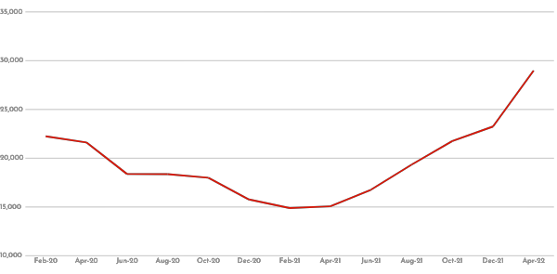
Impact of Child Care Subsidy Changes To Date
Child Care Subsidy Program Enrollment, February 2020 – April 2022
28,980
March 2021: Implementation of expanded eligibility
23,245
22,252
19,342
18,379
14,887
‹#›

Slide 11
Questions and Discussion

Slide 12
Update on Revisions to Provider Rates and Family Copayments in the Child Care Subsidy Program

Slide 13
Overview
This section summarizes current proposals to make quality child care more accessible to Virginia families and providers.
The Challenge: Child Care Market = Market Failure
Three Key Principles for Public Investments in Early Childhood Care and Education in Virginia
Virginia’s New Cost Estimation Model and Proposed Revisions to Provider Rates
Proposed Revisions to Parent Copayments
Discussion

Slide 14
The Challenge

Slide 15
Child Care Market Failure
The child care system represents a “market failure.”
The child care market is fragmented, composed largely of small organizations-- for-profit and nonprofit--that rely on private financing (e.g., parent pay).
Profit margins are razor thin. The Federal Reserve Bank reports that most child care providers operate on profit margins of less than 1 percent.
Half of the providers in Virginia reported losing money last year.
Parents are expected to pay for care at a time when they can least afford it. Assistance with costs is limited.
In many communities, providers cannot increase tuition rates to account for better staff compensation, quality supports, and other resources because parents cannot afford to pay any more.
Notes:
Voice over what it means to be a market failure
Love this quote -- think it succinctly summarizes this market failure for me “The market failure is that we count on parents to pay for the bulk of the cost of child care, yet to provide good-quality care costs far more than many parents can afford” - Gina Adams, Urban Institute.

Slide 16
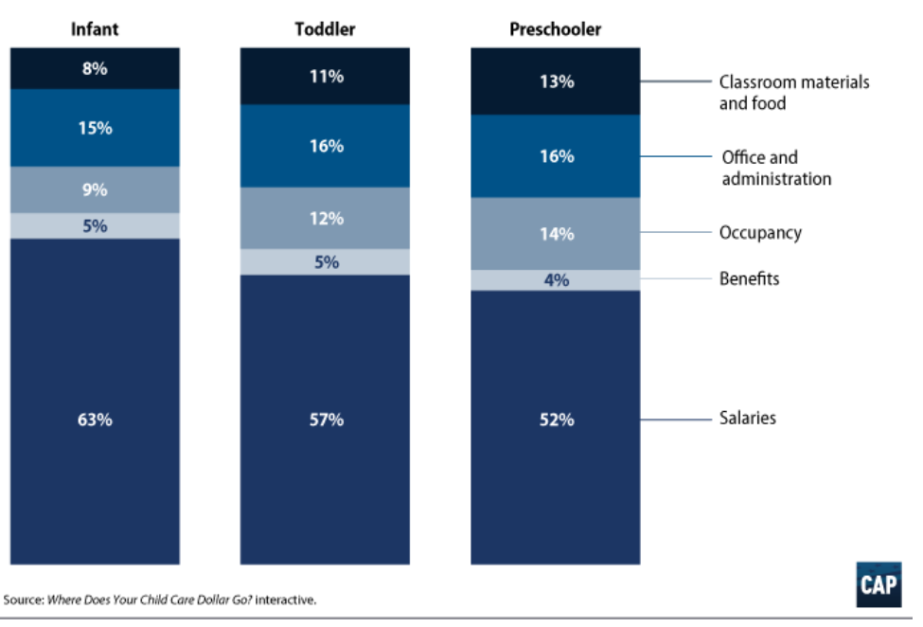
Paying Teachers More Means Charging Parents More
Child care is a labor intensive industry.
Staffing costs (salaries and benefits) account for 56-68% of classroom operating costs.
Staff compensation and benefits are one of the only areas where programs can cut costs.

Slide 17
Tuition Rates ≠ Actual Cost of Child Care
Historically, states set payment rates for publicly-funded child care programs based on market rates, or the prices providers charge. However, the prices programs charge--and how tuition is collected--are influenced what parents can pay.
Prices often do not reflect realistic operating costs.
Data on prices alone do not account for other sources of revenue or the balance of enrollment among different age groups.
Common practices--like setting tuition for the semester but collecting payments weekly--demonstrate sensitivity to parents’ ability to make payments.
Notes:
Due to the broken nature of the child care market, where the consumers— parents—are not able to pay for the actual cost of the service they are purchasing, using a market rate-setting approach that relies on the tuition these consumers can pay presents an inherently inaccurate relationship between rates and cost of the service
Historically, payment rates for community-based child care programs receiving public funding have been based on market rates, or the prices providers charge in a given locality.
Advocates and policymakers increasingly recognize that market rates do not reflect true costs and cannot reliably be used to set per-child payment rates in public programs.
The prices programs charge are primarily influenced by what parents can pay.
The market often does not fully reveal how other sources of revenue that offset operating costs and how the balance of age groups affects prices.

Slide 18
Addressing the Challenge: 2 Proposals
To prepare more children for kindergarten, the VDOE seeks to 1) fund child care programs to meet quality expectations and 2) make public child care more accessible and affordable for parents by:
Using a cost estimation model to determine the “true cost” to deliver quality care and education with competitive compensation, and setting payment rates based on a percentage of these costs.
Restructuring parent copayments in the Child Care Subsidy Program (CCSP) to reduce financial burdens for families and promote consistency with other publicly-funded programs.

Slide 19
Three Key Principles for Public Investments in Early Childhood Care and Education in Virginia

Slide 20
Summary: Key Principles
1. Our unique public-private system should offer true choice for families. | 2. Rates should reflect higher quality expectations. | 3. Educator compensation should be competitive.
Eligible families have different preferences and should be able to choose based on what is best for their child; not be limited because of affordability. The public school day is free for all families. The ECE equivalent should be free for eligible families to the greatest extent feasible. Families living in poverty should not have payment obligations. | All publicly-funded programs have same quality expectations under VQB5. Public payment rates should reflect the supports educators need to foster strong teacher-child relationships and implement effective curricula. All providers should have access to payment rates that support continuous quality improvement. | Compensation for early childhood educators should attract and help retain competent professionals. Compensation for publicly-funded early childhood programs should be pegged to public teacher salaries and should include benefits. Wages/salaries at publicly-funded programs should generally be reflective of competency, education levels and experience, noting that all educators will be a part of VQB5.
Notes:
Whenever possible, the framework for setting per-child payment rates and parent cost-sharing obligations should be consistent across the public-private system.

Slide 21
True Choice: Supporting Differing Needs and Preferences
Per-child investments are inconsistent across publicly-funded early childhood programs; this limits access, availability and family choice.
Program | Number of children served FY22 | Total spending | Hours per year Investment per hour | Estimated investment per-child
Child Care Subsidy Program (CCSP) | 31,343 (52% birth-5) | $156,708,114 (SGF, CCDBG, and COVID relief funds) | Up to 3,120 hours $3.48 per hour | Up to $10,900 (average $6,900)
Virginia Preschool Initiative (VPI) | 20,596 (93% 4-year-olds) | $136,238,757 (SGF) | 990 hours $4.95 per hour (state) | $7,655 ($4,899 in state funds)
Early Head Start (EHS) and Head Start (HS) | 14,890 (80% 3- and 4- year-olds) | $155,435,668 (Federal) | Varies | Between $9,507-$17,911
Mixed Delivery Preschool Grant Program (MDG) | 1,250 (3- and 4-year-olds) | $16,000,000 (SGF and COVID relief funds) | 2,860 - 3,120 hours $4.51 per hour | Between $12,000-14,000
Notes:
Data sources: https://docs.google.com/presentation/d/1Kv6-wbJvi601XKuTvpjZEtvduGJz4o1k/edit#slide=id.p1 and “DRAFT_Early Childhood Biennial Budget Proposals_5.9.22 FOR GOV” (slides 5 and 12)
Notes:
VPI: VPI set rate is $7,655 per-child or $7.73. State contribution for VPI is $4,899 ($4.95 per hour); the difference ($2,756 per-child) is paid by local match.
K-12 enrollment this from https://p1pe.doe.virginia.gov/buildatable/fallmembership

Slide 22
True Choice: Aligning Family Costs
Most publicly-funded programs do not require families to pay for services, at least during “instructional hours.” Families that participate in MDG, EHS/HS, or VPI may also participate in the CCSP to help with costs associated with before/after-school and summer care.
Poverty threshold | Annual income for a family of 4 with two children | Annual copayment obligation for a preschooler *services may not be full-day, full-year
 |  | CCSP | MDG* | EHS/HS* | VPI*
100% | $27,750 | $1,388 | $0 | $0 | $0
125% | $34,688 | $2,081 | $0 | $0 | $0
150% | $41,625 | $2,914 | $0 | $0 | $0
160% | $44,400 | $3,552 | $0 | $0 | $0
185% | $51,338 | $4,620 | $0 | $0 | $0
250% | $69,375 | $6,938 | $0 | $0 | $0

Slide 23
Quality Expectations: Educators are Core
Research shows that stimulating and supportive interactions between teachers and children and effective use of quality curricula promote children’s holistic learning and development, resulting in improved school readiness.
Children in classrooms with high-quality interactions benefit academically, socially, and behaviorally – across diverse settings.
Teachers who report lower levels of stress and feeling supported professionally are better equipped to engage in responsive interactions and implement quality curricula. They are also more likely to stay in their roles.
Having stable, consistent caregivers (i.e., minimal turnover) in ECCE classrooms is an important predictor of child outcomes.
Notes:
The greatest determinant of program quality is the teacher—specifically, the quality of their interactions with children.
High-quality programs provide higher teacher compensation
Children who experienced higher-quality classrooms showed gains in social and cognitive skills, including inhibitory control, working memory, and language and literacy skills. (Hamre, Hatfield, Pianta, & Jamil, 2014)
Responsive interactions with teachers provide young children a secure base from which to explore their environments.
Scaffolded interactions with teachers help children master increasingly difficult tasks that extend their learning and development.

Slide 24
Quality Expectations: Virginia is Raising the Bar
All publicly-funded classrooms serving children ages birth to 5 are required to participate in VQB5 beginning in the fall of 2023.
VQB5 measures the quality of infant, toddler, and preschool teaching and learning based on two nationally-recognized quality indicators:
Interactions (measured by the CLASS tool); and
Curricula (determined by the use of an approved curricula).

Slide 25
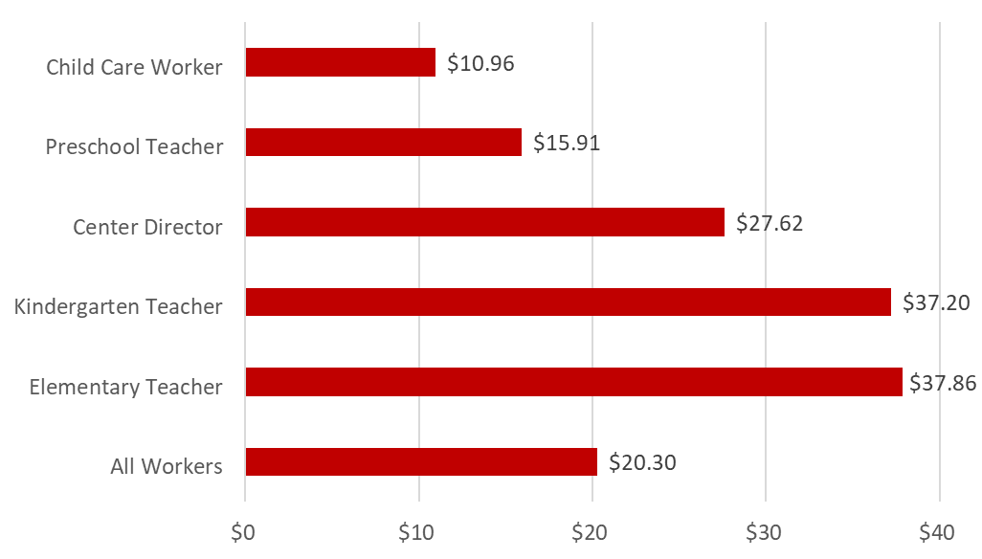
Competitive Compensation: Child Care Educators are Underpaid
Median Annual Wages in Virginia, 2019
Early educators pay a penalty for working with younger children. Virginia early educators with a bachelor’s degree are paid 22% less than their K-8 peers.
40% of child care workers are experiencing some level of poverty.
31% of child care workers experienced food insecurity last year.
Source: Center for the Study of Child Care Employment
Notes:
Stats in table: https://cscce.berkeley.edu/workforce-index-2020/states/virginia/ (And first bullet, “Early educators pay a penalty for working with younger children…” stats come from Berkeley) The poverty rate for early educators in Virginia is 16%, double the state average across workers (8%) and 7.9 times as high as for K-8 teachers (2.1 percent).**
Second bullet: 40% of child care workers are experiencing some level of poverty. (CECI White Paper Food Insecurity in ECE https://drive.google.com/file/d/1TUlsKYpJFkftAnuUXykfje67ThIdaPEK/view Colin McGinnis, 2022)
31% of child care workers experienced food insecurity last year. (https://www.the74million.org/article/about-1-in-3-child-care-workers-are-going-hungry/)
Care providers earn, on average, $24,000 a year, on average, less than a fast-food worker or janitor, even though 87% of them have some form of higher education. (“How Child Care Became the Most Broken Business in America”, Claire Suddath, November 18, 2021)
Research suggests that families need an income of at least 200% of the Federal Poverty Level to afford basic needs such as food and shelter (Jiang et al., 2017).

Slide 26
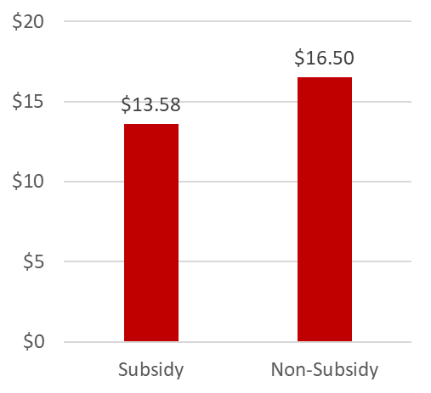
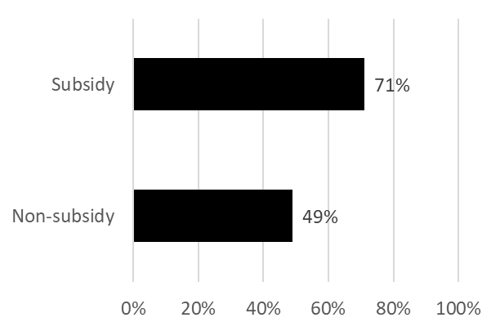
Competitive Compensation: Low Public Rates Impact Wages and Staffing
A survey of child care centers in Virginia demonstrates that programs that participate in the Child Care Subsidy Program pay staff less and experience greater staffing instability.
Lead educators in subsidy- participating centers earn $2.92 less, on average, than those in non-subsidy sites.
71 percent of subsidized centers reported applicants turning down jobs due to insufficient pay and/or benefits,versus less than half of non-subsidy sites.
On average, subsidized centers reported 4 teacher vacancies. Non-subsidy sites reported just 2.
Subsidy
Non-subsidy

Slide 27
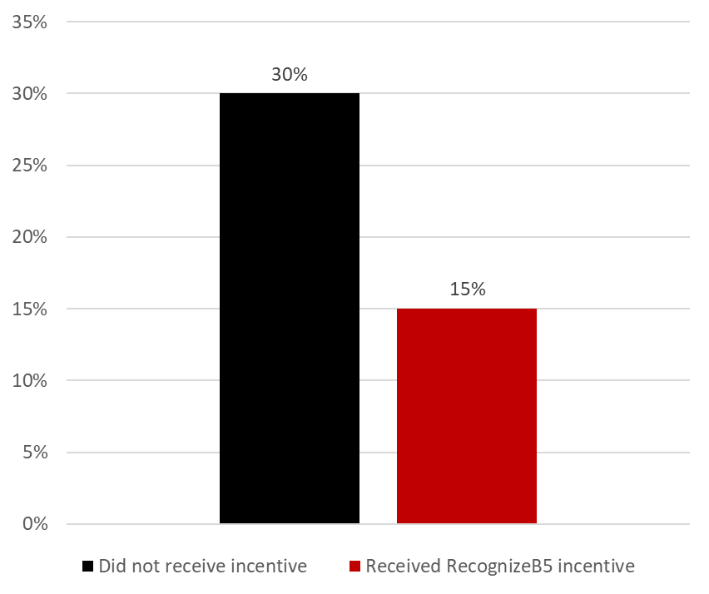
Competitive Compensation: Increasing Compensation Increases Stability
Impact of Teacher Recognition Incentive on Center-based Teacher Turnover Rates (2019)
In child care centers, the offer of a $1,500 financial incentive cut teacher turnover in half.
“All of the teachers who were eligible appreciated it and it definitely made an impact on how long they continued to work at [our site].”
-Participating Early Childhood Educator
Notes:
Virginia’s Teacher Recognition Program (https://files.elfsightcdn.com/022b8cb9-839c-4bc2-992e-cefccb8e877e/6de6fd54-e921-4c88-a452-ad7cabccc362.pdf)
In 2019, Virginia was awarded a federal Preschool Development Birth through Five Initial Grant (PDG).
Partnership between the Virginia Department of Education, the Virginia Early Childhood Foundation, and the University of Virginia
Financial incentive program designed to support teacher retention and to recognize teachers for their work with young children.
In its pilot year, eligible teachers at publicly funded sites participating in the PDG B-5 initiative could receive up to $1,500. More than 500 center- and home-based child care sites accepting child care subsidies, Head Start centers, and school-based pre-k sites were included.
To be eligible teachers worked directly with young children ages 0 to 5 for at least 30 hours per week. To receive the full $1,500 amount, teachers had to continue meeting these requirements and remain at the same site for the full eight-month duration of the program (May 1st, 2019 through December 31st, 2019).
The experiment showed that the Teacher Recognition Program led to significant drops in turnover, especially among child care teachers.
Follow-up survey in May 2020, about 4-5 months after still eligible teachers received their last payments. One way in which the Teacher Recognition Program may have influenced teachers is by increasing their sense that their work was appreciated. Nearly all respondents indicated that the program made them feel like their hard work was valued (98%) and made them more excited for the work they do (95%).
Overall, about 1 in 4 (24%) child care teachers in our sample left their center over an eight-month period prior to the COVID-19 pandemic. Turnover rates were slightly lower among lead teachers (22%) compared to assistant teachers (26%). Teachers working with infants and toddlers left their centers at about the same rate as those working with preschool-age children.

Slide 28
Competitive Compensation: Retention Matters
Research demonstrates that children who have stable, consistent educators over the course of a school year show:
Greater school readiness gains, including social-emotional and language development;
Fewer behavior challenges; and
Stronger relationships with adults in the classroom.
Low levels of turnover also minimize logistical and operational challenges for programs that otherwise can affect operating hours, pick-up and drop-off procedures, and family engagement.

Slide 29
Virginia’s New Cost Estimation Model

Slide 30
Using a Model to Estimate “True Costs”
Cost estimation models examine different program characteristics, cost drivers, and business decisions to assess the “true cost” of operating a child care program.
Program characteristics | Cost drivers | Business decisions
Center vs. family day home Geography For- vs. non-profit Public (i.e., government-run) vs. private | Licensing standards Teacher-child ratios Materials and supplies Facility costs Compensation and benefits Educator supports | Enrollment efficiency Funding sources Share of children that are publicly- vs. privately-funded

Slide 31
Key Assumptions in VDOE’s Model
Here are the key assumptions:
The model generates separate estimates for child day centers and family day homes, and account for differences in program size and auspice.
The model accounts for geographic variations in wages and other operating costs. Localities will be organized regionally into Ready Regions.
Licensing standards serve as the baseline for the cost of meeting basic health and safety standards, including age-based group sizes and teacher-child ratios.
Costs at increasing levels of quality under VQB5 reflect competitive compensation and supports for educators.
The model assumes a certain level of enrollment efficiency, or the number of children enrolled relative to capacity.

Slide 32
Using Cost Estimation to Set Rates
VDOE will use the cost estimation model to phase in:
Phase I: Set Regional payment rates in the Child Care Subsidy Program based on a percentage of estimated costs.
Phase II: Set voluntary wage scale to encourage programs to increase wages over time.
Phase III: Additional supports for continuous quality improvement based on VDOE’s evaluation during the final VQB5 practice year.
Notes:
Voice over→ if we get compensation high enough, we’d phase out RecognizeB5

Slide 33
Funding All Providers to Meet Expectations
All publicly-funded providers should have access to the tools and resources they need to offer safe spaces for learning and to support continuous quality improvement.
Payment rates will be set based on modeled costs to meet the quality expectations of VQB5.
Doing so help support all programs in the subsidy program to provide higher staff compensation, better benefits, and opportunities for performance bonuses.
Notes:
Federal law requires states to model the costs associated with meeting higher levels of quality, as defined by the state quality rating and improvement system. Many states use this information to established tiered reimbursement rates based on levels of quality.

Slide 34
What Does the Change in Payment Rates Mean…
For families? | For child care providers? | For Virginia?
The state will cover a greater share of costs for providers in the Child Care Subsidy Program, allowing more providers to serve publicly-funded families. Families will have more options when selecting a provider. Families will be able to choose the option that best meets their needs and preferences. | Payment rates will be commensurate with expectations for delivering quality as measured by VQB5, primarily by accounting for competitive compensation. Providers that serve a large share of publicly- funded children will have sufficient public resources and will be encouraged to increase educator compensation over time. | Virginia will have a consistent method for per-child payment rates in public programs, promoting coordination and choice across the system. Our public-private system ECCE system will better prepare children for kindergarten, resulting in more children coming to school with the key literacy, math, and social-emotional skills needed to succeed. Virginia will establish a national model for a public-private parent choice system.

Slide 35
Important Notes Regarding Payment Rates
Shifting the basic principles and methodology for setting payment rates is an exciting opportunity in Virginia. However, it is also important to note what the new methodology does NOT do:
Set new or additional requirements associated with higher payment rates;
Require all providers to implement the voluntary wage scale when increased payment rates go into effect; or
Cap earnings for any program or individual.

Slide 36
Overview: Proposed Revisions to Parent Copayment Scale
Making Child Care Assistance More Accessible to Families

Slide 37
Federal Requirements for Family Copayments
Federal law requires most families in the CCSP to pay a copayment.
VDOE has the authority to waive copayments for families in poverty, homeless families, children in child protective services/foster care, and “other priority populations” as identified by the state.
Copayments must reflect a sliding fee scale based on income.
Copayments can be a flat rate or a percentage of family income. They cannot be based on prices charged by providers.

Slide 38
Priorities for Virginia’s Copayment Scale
Virginia’s priorities are rooted in the 3 key principles for investment.
Families at or below the poverty line should not have a copayment obligation.
Copayments should be simple and straightforward.
Copayments should mirror cost obligations in other publicly-funded programs, to the extent possible.

Slide 39
Proposed Structure
Here’s how Virginia will restructure copayments:
Copayment rates will be established per day and per child receiving assistance (up to three children).
Daily payment rates will start at $0 for families with incomes below the poverty guidelines, and increase as a family’s income increases.
Copayments will be paid to providers on a monthly basis.

Slide 40
Proposed Copayment Scale: 0-100% FPG
Families with incomes up to 100 percent of the federal poverty guidelines (FPG; $27,750 for a family of 4)
Daily per-child copayment | Per-child cost per week (assuming 5 days) | Per-child cost per month (assuming an average of 21 days per month) | Annual copayments collected for all families based on current enrollment
$0 | $0 | $0 | $0
Families with household incomes below the poverty guidelines would pay an average of ~$50 per month under the current copayment scale. Collectively, this equals ~$1.9 million in payments annually.
Notes:
Let’s take a look at the rates. Again, we won’t charge families below the poverty level a copayment under the new scale. Currently, families in poverty would pay about $2.5 million in copayments to child care providers each year.

Slide 41
Proposed Copayment Scale: 101-200% FPG
Families with incomes 101-200% FPG (up to $55,500 for a family of 4)
Scenario | Daily per-child copayment | Per-child cost per week (assuming 5 days) | Per-child cost per month (assuming an average of 21 days per month) | Annual copayments collected for all families based on current enrollment
A | $1.00 | $5 | $21 | $5.1 million
B | $2.50 | $13 | $53 | $12.8 million
C | $3.00 | $15 | $63 | $15.3 million
Families with household incomes between 101-200% FPG would pay between ~$135-290 on average each month under the current copayment scale. Collectively, this equals ~$13.6 million annually.
Notes:
For the remaining three income thresholds, there are three different potential scenarios for daily payment rates presented. We have not yet decided on the final scale, and welcome your feedback on the payment rate for each income threshold.
The chart lays out the potential daily rates, what that would equal on a weekly basis assuming 5 days per week, and the estimated per-child cost based on a current average of 21 authorized days of attendance per month. The final column tells you how much we estimate families would pay in copayments annually, based on the current number of families enrolled in this income range and the average number of children per family.

Slide 42
Proposed Copayment Scale: 201-300% FPG
Families with incomes 201-300% FPG (up to $83,250 for a family of 4)
Scenario | Daily per-child copayment | Per-child cost per week (assuming 5 days) | Per-child cost per month (assuming an average of 21 days per month) | Annual copayments collected for all families based on current enrollment
A | $2.00 | $10 | $42 | $2.8 million
B | $5.00 | $25 | $105 | $7.1 million
C | $8.50 | $43 | $179 | $12 million
Families with household incomes between 200-300% FPG would pay an average of ~$450 per month under the current scale. Collectively, this equals ~$18 million annually.

Slide 43
Proposed Copayment Scale: 301% FPG-85% SMI
Families with incomes over 301% FPG up to 85% SMI (up to $92,604 for a family of 4)
Scenario | Daily per-child copayment | Per-child cost per week (assuming 5 days) | Per-child cost per month (assuming an average of 21 days per month) | Annual copayments collected for all families based on current enrollment
A | $4.50 | $23 | $95 | $1.3 million
B | $8.50 | $43 | $179 | $2.4 million
C | $12.00 | $60 | $252 | $3.3 million
Families with household incomes over 300% FPG would pay an average of ~$550 per month under the current scale. Collectively, this equals ~$2.7 million annually.

Slide 44
What Does the Change in Copayments Mean…
For families? | For child care providers? | For Virginia?
Family copayment burdens will be significantly reduced, allowing more families to access child care assistance. Families will have more choices among publicly-funded programs that meet their needs. More families will be able to access full-day, full-year experiences for their preschool-age children. | Family copayments will be affordable, minimizing the likelihood that families will struggle to make monthly payments. Coupled with higher payment rates, fewer families will owe providers tuition beyond the copayment and state payment. | More families will have access to stable, quality child care, supporting parental employment and maximum workforce participation and productivity. Our public-private system ECCE system will better prepare children for kindergarten, resulting in more children coming to school with the key literacy, math, and social-emotional skills needed to succeed. Virginia will establish a national model for a public-private parent choice system.
Notes:
And again, here are the outcomes we hope to see based on the revisions to the copayment scale. Most importantly for families, copayment burdens will be significantly reduced, which eliminate cost as a barrier to participate in the subsidy program. This will also give more families more options for programs and providers that meet their needs, and can open the door to full-day, full-year experiences for more families.

Slide 45
Questions and Discussion

Slide 46
Proposed Changes to Child Care Subsidy Program Regulations Based on FY 23-24 Biennial Budget

Slide 47
Proposing Regulatory Changes through Exempt Action
VDOE can pursue regulatory changes through exempt action under two conditions:
When directed by state law (including the biennial budget)
When it does not exercise discretion in the proposed changes
The budget directives related to the Child Care Subsidy Program reflect a significant departure from current regulation.
VDOE proposes a set of very discreet revisions to 8VAC20-790 to make the regulations consistent with these directives.

Slide 48
Required Changes to Child Care Subsidy
New state budget language directs VDOE to increase access and ensure choice across the public-private system by taking the following actions after July 1:
Estimating the actual cost of providing high quality care and education services in community-based settings and adjusting rates accordingly
Paying based on enrollment, setting rates based on cost benchmarks
Eliminating or reducing copayments for private child care options that aligns with public options
Removing the existing 72 month limit on the duration of time that families may participate
Setting 85% of State Median Income as income threshold for families with young children
Encouraging parents to pursue work
Eliminating the waitlist for child care subsidy

Slide 49
Summary of Proposed Changes (1 of 3)
VDOE proposes the following changes to 8VAC20-790:
Item 129 | Corresponding regulatory change
P. Notwithstanding 8VAC-20-790, the Department of Education shall not set a limit on the duration of time that families may participate in the Child Care Subsidy Program, subject to available funds. | 8VAC20-790-40. P. Adequate documentation supporting the reasons for termination must be filed in the case record. Eligibility in the Fee Program is limited to a total of 72 months per family. Receipt of assistance in any other program category does not count toward the 72-month limitation.
Q. Notwithstanding 8VAC-20-790, the Department of Education shall increase participation in the Child Care Subsidy Program among families and providers using non-general funds by: 1) making child care assistance available to parents or guardians who are searching for work; | 8VAC20-790-20. A.9. Resides with a family in which there is a need for child care services, arising from one of the following situations: a. In a two-parent household, there must be a documented reason why one of the parents cannot provide the needed child care. b. Parents who need child care to support the following approved activities: (1) Employment or employment search; (2) Education or training leading to employment; (3) Child protective services; or (4) Assigned VIEW or SNAPET activity.
Note: Item Q. 2) does not require regulatory revisions and can be addressed through Child Care Subsidy Program guidance manual changes alone.

Slide 50
Summary of Proposed Changes (2 of 3)
VDOE proposes the following changes to 8VAC20-790:
Item 129 | Corresponding regulatory change
Q. Notwithstanding 8VAC-20-790, the Department of Education shall increase participation in the Child Care Subsidy Program among families and providers using non-general funds by: … 3) issuing payments to Child Care Subsidy Program vendors for authorized enrollment, subject to the attendance threshold established by the Department of Education; 4) issuing payments to providers for up to 15 days of planned closure for all vendors in the Child Care Subsidy Program for holidays, vacations, and professional development or planning time; 5) issuing payments to family day homes in the Child Care Subsidy program for up to three sick days to care for themselves or a family member; …7) ensuring that Child Care Subsidy Program vendor payment rates for infants and toddlers fully reflect the cost of care; | 8VAC20-790-80. A. Maximum reimbursable rates. D. Level two providers Providers may be paid up to 10 15 days of planned closure for holidays, vacations, and professional development or planning time on which no child care services are provided as identified in the vendor agreement. Certified preschools, religious exempt centers, and voluntary registered family day homes that are classified as level one providers may be paid for holidays on which no child care services are provided in accordance with the provisions of the vendor agreement. All other level one providers will not receive payment for any holiday unless services are provided on such day. E. Level two providers may be paid for up to 36 days the child is absent per fiscal year. The Department shall issue payments to Child Care Subsidy Program vendors for authorized enrollment, subject to the attendance threshold established by the Department of Education. F. Family day home providers in the Child Care Subsidy program may be paid for up to three sick days to care for themselves or a family member. G. Child Care Subsidy vendor payment rates for infants and toddlers shall fully reflect the cost of care.
Note: Item Q. 6) does not require regulatory revisions and can be addressed through Child Care Subsidy Program guidance manual changes alone.

Slide 51
Summary of Proposed Changes (3 of 3)
VDOE proposes the following changes to 8VAC20-790:
Item 129 | Corresponding regulatory change
Q. Notwithstanding 8VAC-20-790, the Department of Education shall increase participation in the Child Care Subsidy Program among families and providers using non-general funds by: … 8) eliminating copayments for families at or below 100 percent of the federal poverty guidelines and reducing copayments for families above 100 percent of the federal poverty guidelines. | 8VAC20-790-40. F. Families receiving child care subsidy and services shall be required to pay a copayment unless their gross monthly income is at or below the federal poverty guidelines and they are recipients of TANF, participants in the SNAPET program, or families where all children participate in the Head Start program. The copayment amount will be based on a scale set out in the current Child Care and Development Fund Plan for Virginia. Copayments may be increased at redetermination and during graduated phase out if the family's countable income exceeds the initial eligibility limit but is below the exit eligibility limit. Local departments shall be required to act on changes reported by the family that would reduce the family's copayment during the 12-month eligibility period.

Slide 52
What’s Next?

Slide 53
Timeline for Implementation
Engagement Summer 2022 | June/July 2022: conduct stakeholder engagement sessions July 2022: bring exempt action subsidy regulations to the Board August 1, 2022: submit proposed changes to Town Hall for public comment September 1, 2022: baseline child care provider survey
Implementation Fall 2022 - Spring 2023 | October 1, 2022: new payment rates go into effect January 1, 2023: new copayment scale goes into effect March 1, 2023: voluntary wage scale takes effect
Notes:
January 1 minimum wage increase

Slide 54
Timeline for Implementation (continued)
Evaluation and Next Steps Summer 2023 and beyond | VDOE will monitor: The implementation of the voluntary wage scale Staffing retention and program fiscal stability Planning time and other supports for continuous quality improvement Family application and enrollment rates Based on outcomes, VDOE will identify next steps for payment policies in the CCSP.
Notes:
January 1 minimum wage increase

Slide 55
Questions, Discussion, and Endorsement

Slide 56
Proposed Revisions to General Procedures and Background Checks

Slide 57
Approach for Revisions
Here’s a summary of approach for revising the General Procedures and Criminal Background Checks Regulations:
Remove any unnecessary language and complexity;
Adjust the structure, format, and language of the current regulation;
Incorporating updates to address everchanging national health and safety guidelines and practices;
Only add requirements conducive to the greater protection of the health, safety, and welfare of children in care; and
Balance health and safety with any increased cost to child care providers and families.
Notes:
the revision of the GP (a summary of what was shared at the last ECAC meeting):

Slide 58
Proposed General Procedures (GP)
The proposed revisions to General Procedures and Information for Licensure have:
Removed any unnecessary language, general information, and complexity;
Only added language that reduces confusion;
Ensured changes do not limit providers’ rights or responsibilities; and
Repealed the “Fee Requirements For Processing Applications” regulation and added it to the General Procedures.

Slide 59
Proposed Background Checks (BC)
The proposed revisions to the Background Checks would repeal these regulations as written and add what is NOT covered in Code into General Procedures:
The Code of Virginia has become much more specific regarding background checks for child care programs over the years.
The Code of Virginia has more restrictions and requirements for background checks than the Federal requirements.
Approximately 90% of the current BC regulation repeats what was or is written in the Code of Virginia or Federal requirements so VDOE recommends that the remaining 10% be placed in General Procedures.
VDOE then recommends a repeal of 8VAC20-770: Background Checks for Child Day Programs and Family Day Systems.

Slide 60
Questions, Discussion, and Endorsement

Slide 61
Appendices

Slide 62
Appendix A: Item Detail on Early Childhood Investments in HB/SB 30

Slide 63
A1: Item 129 - SGF Impact
In response to 2017 JLARC Study and pursuant to 22.1-289.05, the VDOE continues to build out a statewide uniform measurement and improvement system for all publicly-funded birth-to-five programs that promotes school readiness.
 | FY22 | FY23 | FY24 | Rationale for Increase
H. Virginia Kindergarten Readiness Program (VKRP) | 1,750,000 | 2,777,000 | 2,777,000 | Expansion of preschool VKRP to more 4 year olds and to pilot three year version; increase in administration costs
J. External Classroom Observations (CLASS) | 350,000 | 805,600 | 1,047,000 | Statewide expansion of accountability system; SGF is for state-funded classrooms; NGF is for federally-funded classrooms
NOTE: AMOUNTS ARE TOTAL SGF FUNDING (NOT INCREASES FROM PRIOR YEAR)

Slide 64
A2: Item 129 - Language Changes (No SGF Impact)
New budget language calls for specific actions from the VDOE to ensure maximum choice for families across the public-private early childhood system:
Convene a workgroup to develop recommendation for the use of marijuana tax revenues to maximize access to public and private pre-kindergarten programs for three and four year and children (N)
Develop a methodology to estimate the actual cost of providing high quality care and education services in community-based settings (O)
Remove the existing 72 month limit on the duration of time that families may participate on the Child Care Subsidy Program (P)
Offer more choice to families in FY23 and FY24 by strengthening the Child Care Subsidy Program, including encouraging parents to pursue work, paying based on enrollment, setting rates based on cost benchmarks and eliminating or reducing copayments for private child care options that aligns with public options (Q)
Eliminate the waitlist for child care subsidy and set 85% SMI as income threshold for families with young children for biennium

Slide 65
A3: Item 136 - SGF Impact
Item includes investments to expand public-private partnerships and innovative initiatives that have demonstrated impact.
 | FY22 | FY23 | FY24 | Rationale for Increase
O. Wolftrap for STEM and Early Literacy | 725,000 | 1,000,000 | 1,300,000 | Expand services into currently unserved divisions in an equitable manner, with a special focus on capacity building and establishing new services in specific regions
S. Expand Virginia Early Childhood Foundation Mixed Delivery (S) | 5,000,000 | 6,971,900 | 9,736,015 | Offer high quality preschool to more at-risk 4 and 4 year olds in private settings; pilot for 200 infants and toddlers; new language aligns eligibility with VPI to ensure maximum choice for families
CC. Early Childhood Educator Incentive | 5,000,000 | 10,000,000 | 10,000,000 | Expand program that seeks to strengthen quality, attract new educators and reduce turnover in child care and family day home classrooms in support of VQB5
NOTE: AMOUNTS ARE TOTAL SGF FUNDING (NOT INCREASES FROM PRIOR YEAR)

Slide 66
A4: Item 137 - SGF Impact
Increasing the VPI per-pupil funding and the number of slots enables school divisions and community partners to prepare more children for kindergarten.
 | FY22 | FY23 | FY24 | Rationale for Increase
14. Virginia Preschool Initiative - Per-Pupil Amount | 81,03,402 | 117,240,609 | 117,531,866 | Increase per-pupil amount to $8,359 from $7,655 based on benchmarked costs
Early Childhood Expansion | 21,778,364 | 34,368,036 | 45,116,920 | Details provided below
Serve at risk 3 year olds | 5,487,917 | 12,729,291 | 20,029,791 | Provide a two year experience for at-risk children to better prepare them for school
Serve children on waitlists | 966,504 | 3,587,390 | 3,587,390 | Enable communities to serve more children if need is identified
Community provider add-ons | 2,501,500 | 4,886,000 | 8,334,384 | Support school divisions to partner with community-based providers to increase family choice and address physical space limitations
Increase ratios provided | 6,693,927 | 7,711,560 | 7,711,560 | Allow more children to be served with existing staff to maximize resources
Flexible funding | 6,128,516 | 5,453,795 | 5,453,795 | Enable VDOE to respond to needs in the field
NOTE: AMOUNTS ARE TOTAL SGF FUNDING (NOT INCREASES FROM PRIOR YEAR)

Slide 67
A5: Item 137 - Language Changes
New budget language seeks to ensure VPI promotes greater school readiness:
Consider eligible at-risk five-year-olds who are not eligible to attend kindergarten, or who did not have access to a sufficient preschool experience and whose families request preschool as the most appropriate placement (14.a.1)
Require VDOE to biennially rebenchmark the VPI per pupil amounts using a formula similar to the current formula supporting public K-12 education in Virginia (14.a.4)
Expand eligibility criteria to include children with disabilities or delays who are eligible for special education services under the Individuals with Disabilities Education Act, regardless of household income (14.d)
Require VDOE to estimate the actual cost of providing high-quality early childhood education services in community-based setting and provide recommendations for the amount of the community-provider add-on grants in the second year (14.g.2)

Slide 68
Appendix B: Background on Family Copayments in the Child Care Subsidy Program

Slide 69
B1. Child Care Subsidy Copayments and Rates
The Child Care Subsidy Program (CCSP) pays a portion of child care tuition for eligible families, up to the Maximum Reimbursement Rate (MRR), less the family copayment.
Copayments are currently set based on a percentage of families’ incomes. Families with any countable income owe copayments, unless they are on TANF.
Currently, the MRR is set based on a percentile of the prevailing market rate--the prices charged by child care providers in each locality.

Slide 70
B2. How are Family Copayments Set?
Federal law requires most families in the CCSP to contribute to the cost of child care by paying a copayment.
Copayments are based on family size and income, and may consider other factors, such as the number of children in care or whether care is full- or part-time.
Copayments may be based a share of income or a flat dollar amount. They may not be based on the cost of care.
The federal Office of Child Care recommends that copayments not exceed 7 percent of family income.
Note: States may permit child care providers to charge families the difference between the MRR and their tuition rates.

Slide 71
B3. Current Copayment Rates Limit Access
Poverty threshold | Annual income for a family of 4 | Copayment obligation (% of income) | Annual copayment obligation (in dollars)
100% | $27,750 | 5% | $1,388
125% | $34,688 | 6% | $2,081
150% | $41,625 | 7% | $2,914
160% | $44,400 | 8% | $3,552
185% | $51,338 | 9% | $4,620
250% | $69,375 | 10% | $6,938
300% | $83,250 | 10% | $8,325
85% SMI | $88,954 | 10% | $8,895
Notes about current copayment structure in Virginia:
Copayments are based on a percent of monthly income and assessed on a monthly basis.
Copayments are not differentiated for full vs. part-time care.
Families pay one copayment, regardless of the number of children in care.

Slide 72
Appendix C: Background on Maximum Reimbursement Rates in the Child Care Subsidy Program

Slide 73
C1. How do States Determine Maximum Reimbursement Rates?
States set payment rates in their child care assistance programs using one of the following methods:
A market rate survey, which is a study of the fees that child care programs charge based on the program type (center or family day home), age group, unit of care, and geography; or
An approved alternative methodology that estimates the cost of operating a child care program versus the prices programs charge families.
Notes:
Statistically valid and reliable MRS:
• Include the full priced child care market
• Contain complete and current data
• Represent geographic variation
• Use rigorous data collection procedures
• Analyze data in a manner that captures market differences

Slide 74
C2. Limitations to the Market Rate Survey
Increasingly, advocates and policymakers recognize the limitations of using a market rate survey to set payment rates. For example:
The survey is conducted every three years. Current rates or prices are used to set future payment rates.
Market rates do not reflect true costs. The prices programs charge are primarily influenced by what parents can pay. In addition, the market often does not fully reveal how other sources of revenue that offset operating costs and how the balance of age groups affects prices.
Survey findings are dependent on response rates. If programs of a certain auspice or size are over- or under-represented in the sample, it can skew price estimates.

Slide 75
We are experiencing technical difficulties.
The livestream will return momentarily.

