Slide 1
Virginia’s Early Childhood Advisory Committee (ECAC)
May 19, 2022

Slide 2
Agenda
Full Advisory Committee convenes
Approval of agenda
Approval of March minutes
Presentation: Update on VQB5 Practice Year 2 Guidelines and Implementation Planning
Presentation: Update on VDOE Efforts to Adjust Provider Payment Rates and Parent Obligations
Presentation: Update on Proposed Revisions to 8VAC20-820: General Procedures and Information for Licensure
Presentation: Update on Proposed Revisions to 8VAC20-770: Background Checks for Child Day Programs and Family Day Systems
Questions and discussion
Notes:
Kris

Slide 3
Update on VQB5 Practice Year 2 Guidelines and Implementation Planning

Slide 4
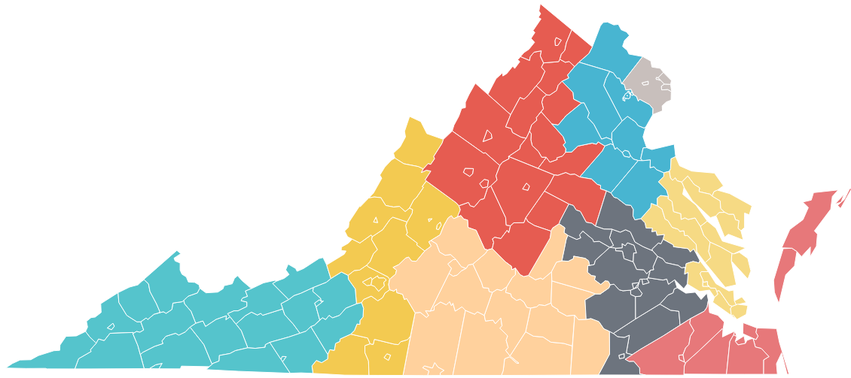
Big Picture: VQB5 Practice Year 2 (2022-2023)
Here are the key overall points:
Required activities and expectations for participating programs will generally remain the same for Practice Year 2.
100% of early childhood programs in Virginia are invited to participate in Practice Year 2 with a focus of including all publicly-funded programs.
Ready Regions (not PDG Community Networks) will support the implementation at the community level.
As of July 2022…
VQB5 Coordinated statewide through READY REGIONS

Slide 5
Enhancements for 2022-2023
These enhancements for Practice Year 2 will help move our work forward to ensure all children have access to quality teaching and learning experiences that meet their unique needs.
1
PARTICIPATION
Increase Participation of Publicly Funded programs
2
CLASS OBSERVATIONS
Ensure educators receive consistent observations and supportive feedback
3
CURRICULUM
Increase support for accessing and using quality curriculum
4
IMPROVEMENT SUPPORT
Prioritize VQB5 participants for Improvement Supports
5
PRACTICE RATINGS
Pilot a Site Level Quality Profile
6
LINKB5
Improve LinkB5 user experience
7
APPEAL PROCESS
Develop a structured process to address unique situations
Additional details about Practice Year 2 plans and activities can be found in the Guidelines for Practice Year 2 document shared with ECAC members for the March 24th meeting

Slide 6
Engagement with the Field
Since sharing the proposed Practice Year 2 Guidelines and enhancements in March, the VDOE has continued to engage and listen to a diverse group of stakeholders about the VQB5 system.
Practice Year 1 Online Feedback Survey
PDG/RR partner office hours and March TA Session
Presentations to stakeholder groups (VPI, HS, MD, VQ, Licensing, Local DSS offices)
Practice Year 2 Interest form and Info Flyer
Launched STREAMin3 Enrollment and Webinar series
Direct Communications with publicly funded programs
Launched Ready Regions North Central Task Force
Held Spring Improvement Partner Webinar
Information and announcements about VQB5 Practice Year 2 have also been shared broadly through weekly Readiness Connections e-newsletter and webinar recordings are available on the Quality Measurement and Improvement (VQB5) webpage.
Notes:
KRIS

Slide 7
Spring Stakeholder Feedback
Based on feedback from the Practice Year 2 survey and meetings with stakeholders, here are the themes:
Strengths of PY2 Proposal | Questions/Concerns about PY2
Similar approach/Not a lot of changes Opportunity for 100% of programs to participate Used data and feedback to inform enhancements Focusing on Consistency across the state Continued focus on Interactions Continuation of RecognizeB5 Increased options for curriculum, including STREAMin3 | Workforce stress/staffing challenges Clarity of communications with the field Questions about eligibility regarding Recognize B5 Questions about access/enrollment in STREAMin3 Ensuring settings that serve children with special needs and dual language learners have appropriate support
Notes:
KRIS

Slide 8
VQB5 Data Update
Follow up on classrooms and CLASS observer data

Slide 9
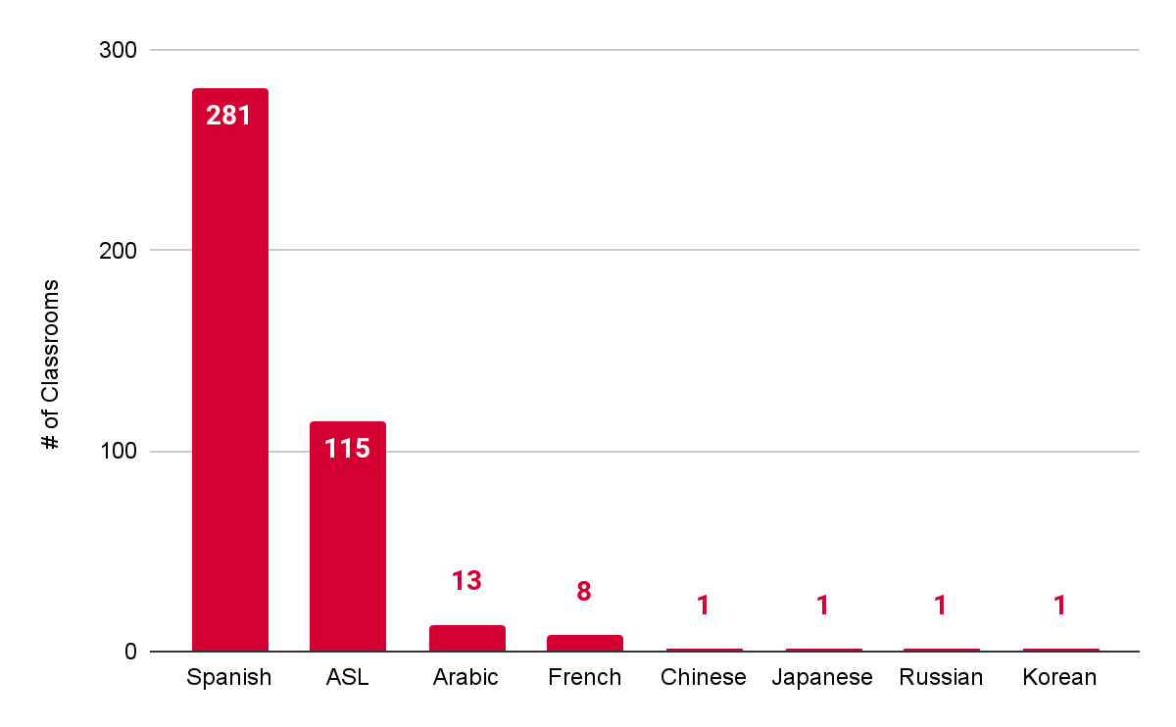
Languages Other than English Spoken in VQB5 Classrooms

Slide 10
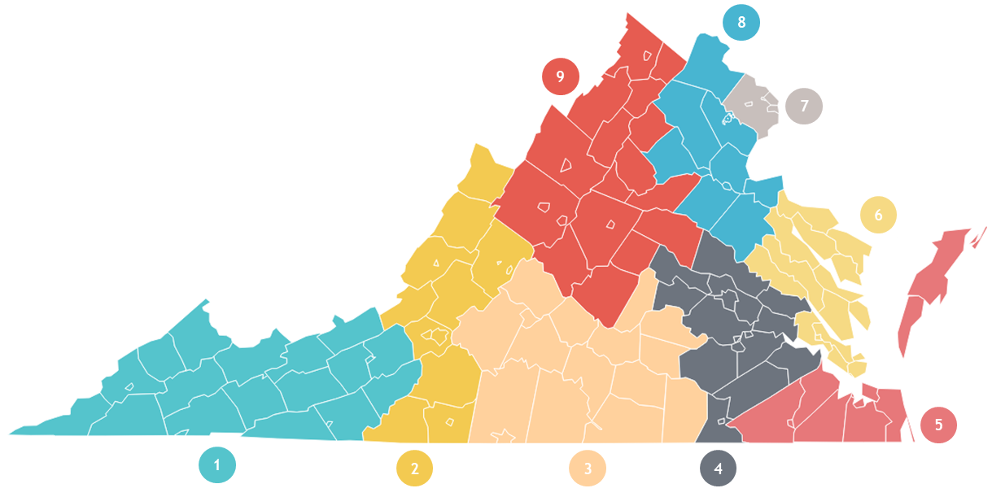
Languages Spoken in Classrooms by Region
Spanish - 22
ASL - 13
Spanish - 15
ASL - 9
Spanish - 172
ASL - 19
Arabic - 10
French -3
Spanish - 1
ASL - 9
French - 2
Spanish - 5
ASL - 4
Spanish - 5
ASL - 13
Korean - 1
Chinese - 1
Spanish - 22
ASL - 24
Arabic - 2
Japanese - 2
Spanish - 37
ASL - 23
Arabic - 1
French - 2
Russian - 1
Spanish - 2
ASL - 1

Slide 11
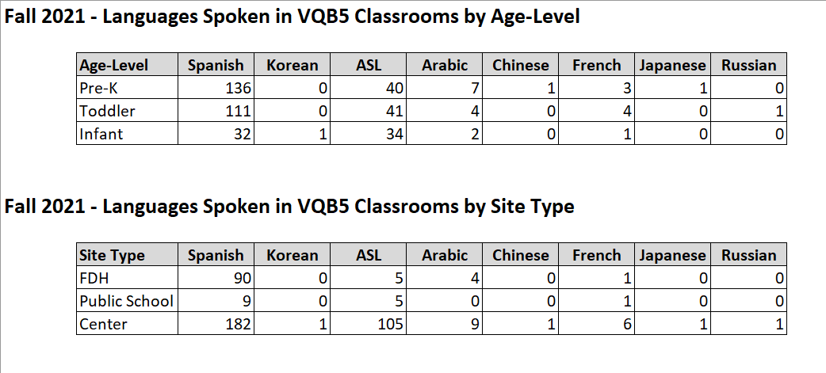
VQB5 Classrooms by Languages Spoken

Slide 12
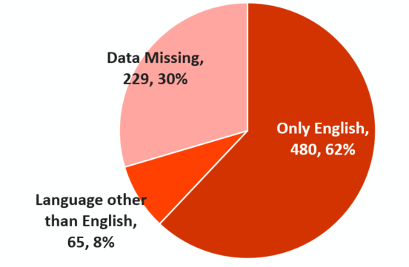
Local Observers: Languages Spoken
Information about Local CLASS Observers is gathered twice a year through the collection of PDG observer inventories. (next year to be gathered through Ready Regions). The chart below shows responses gathered as of 1/31/22.
65 local observers in PDG Communities, indicated that they speak a language other than English (63% speak Spanish).
All but two Ready Regions have observers who speak a language other than English.

Slide 13
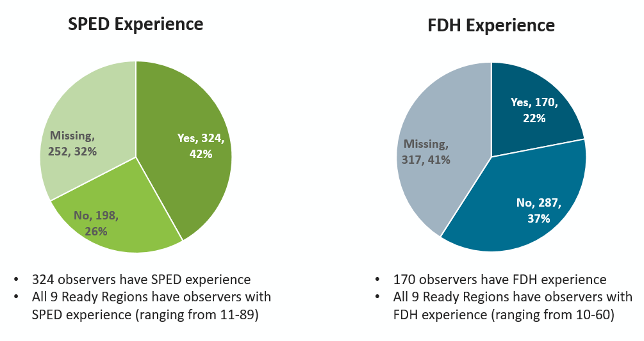
Local Observers with Unique Experience

Slide 14
Enhancements for Practice Year 2
The VDOE will continue to strengthen supports for family day home providers and programs that serve children with disabilities and dual language learners.
These strategies include:
Prioritizing targeted coaching for family day homes and programs that serve children with disabilities and dual language learners.
Developing new tools and resources to support effective teaching practices in family day homes settings, as well as for programs serving children with disabilities and dual language learners.
Connecting improvement partners to local Ready Regions to develop plans for identifying and responding to program needs in a timely and responsive manner
Working with Ready Regions to understand any additional observer and improvement needs based on regional data and findings, with a specific focus on reviewing the needs of family day homes and programs serving children with disabilities and dual language learners.

Slide 15
Next Steps

Slide 16
VQB5 Activities Timeline
Practice Year 2 will follow the VQB5 annual measurement and improvement cycle, as summarized below:
Summer 2022 | Fall 2022 | Winter 2023 | Spring 2023
Program registration and preparation for fall CLASS observations | Local CLASS observations and curriculum use information for every classroom entered in LinkB5. | Programs use information from fall to engage in professional development based on program and classroom needs. | Local CLASS observations and curriculum use information updated (if needed) for every classroom entered in LinkB5.
Reflect and Prepare
Measurement, Feedback and Support for Every Classroom
External CLASS observations are also used in some classrooms as a secondary method to gather information and provide additional feedback.
Notes:
KRIS

Slide 17
Upcoming VQB5 Engagement
VQB5 Webinars and Communication
May - Letter about VQB5 participation sent to publicly funded programs
May 25 at 12pm - Webinar: Using CLASS to Strengthen Interactions in Virginia’s Early Learning Programs (Program Leader Panel Discussion) - Info and Registration
June 16 - BOE final review of VQB5 Practice Year 2 Guidelines
Mid-June - A Superintendent Memo encouraging participation in VQB5 will be sent to all Superintendents
June 22 at 12pm - Webinar: VQB5 Information Session for VPI Coordinators - Info and Registration
August 1-Sept. 16 - VQB5 Practice Year 2 Registration through Ready Regions
Second letter to publicly-funded programs

Slide 18
Questions and Discussion

Slide 19
Update on VDOE Efforts to Adjust Provider Payment Rates and Parent Obligations

Slide 20
Overview
The child care system represents a “market failure:”
The market often fails to match supply and demand.
Tuition rates don’t reflect the true costs to operate a high-quality child care program, yet families can’t afford to pay higher costs.
The benefits of quality child care may accrue not only to children and families, but to society as a whole. To the extent that parents make decisions without considering these externalities, they may underinvest in high-quality care.
This presentation summarizes the current market state and plans to make the Child Care Subsidy Program more accessible to families and providers.

Slide 21
Child Care Market = Market Failure
The current child care system primarily relies on private funds but the market does not work effectively.
The child care market is fragmented, composed largely of small, single-establishment firms--both profit and non-profit--that rely on private financing.
Parents are expected to pay for care at a time when they can least afford it. Assistance with costs is limited.
In many communities, providers cannot increase tuition rates to account for better staff compensation, quality supports, and other resources without pricing themselves out of the market. Half of providers reported losing money last year.

Slide 22
Child Care in Virginia is Expensive
Virginia is ranked 10th highest in the nation for child care costs. The price of care is higher than most families can afford to pay. The average annual rate for an infant is $14,063; for a preschooler is $10,867.
Percent of median income in VA | Annual income for a family of 4 | Share of income for infant care | Share of income for preschool-age care
30% | $31,396 | 45% | 35%
60% | $62,791 | 22% | 17%
85% | $88,954 | 16% | 12%
100% | $104,652 | 13% | 10%
150% | $156,978 | 9% | 7%

Slide 23
Costs vs. Price
The true cost of high-quality child care is not the same as the prices providers can charge. True costs primarily account for:
Salaries and employer-sponsored benefits that reflect the complexity and demands of the early childhood profession
Adequate staffing for educators to engage in planning, coaching, and other professional development opportunities
Other costs related to facilities, materials and supplies
https://www.costofchildcare.org/

Slide 24
Child Care Subsidy Copayments and Rates
The Child Care Subsidy Program (CCSP) pays a portion of child care tuition for eligible families, up to the Maximum Reimbursement Rate (MRR), less the family copayment.
Copayments are currently set based on a percentage of families’ incomes. Families with any countable income owe copayments, unless they are on TANF.
Currently, the MRR is set based on a percentile of the prevailing market rate--the prices charged by child care providers in each locality.

Slide 25
How are Family Copayments Set?
Federal law requires most families in the CCSP to contribute to the cost of child care by paying a copayment.
Copayments are based on family size and income, and may consider other factors, such as the number of children in care or whether care is full- or part-time.
Copayments may be based a share of income or a flat dollar amount. They may not be based on the cost of care.
The federal Office of Child Care recommends that copayments not exceed 7 percent of family income.
Note: States may permit child care providers to charge families the difference between the MRR and their tuition rates.

Slide 26
Current Copayment Rates Limit Access
Poverty threshold | Annual income for a family of 4 | Copayment obligation (% of income) | Annual copayment obligation (in dollars)
100% | $27,750 | 5% | $1,388
125% | $34,688 | 6% | $2,081
150% | $41,625 | 7% | $2,914
160% | $44,400 | 8% | $3,552
185% | $51,338 | 9% | $4,620
250% | $69,375 | 10% | $6,938
300% | $83,250 | 10% | $8,325
85% SMI | $88,954 | 10% | $8,895
Notes about current copayment structure in Virginia:
Copayments are based on a percent of monthly income and assessed on a monthly basis.
Copayments are not differentiated for full vs. part-time care.
Families pay one copayment, regardless of the number of children in care.

Slide 27
Family Costs: Virginia vs. Other States
Poverty threshold | Annual income for a family of 4 with two children | Annual copayment obligation for a preschooler and an infant Assumes full-day, full-year care
 |  | Virginia | Washington, DC | Maryland (Baltimore) | Pennsylvania | North Carolina
100% | $27,750 | $1,388 | $0 | $944 | $1,924 | $2,775
125% | $34,688 | $2,081 | $606 | $1,545 | $2,756 | $3,469
150% | $41,625 | $2,914 | $871 | $3,015 | $3,536 | $4,163
160% | $44,400 | $3,552 | $1,022 | $3,825 | $4,056 | $4,440
185% | $51,338 | $4,620 | $1,544 | $5,370 | $4,940 | $5,134
250% | $69,375 | $6,938 | $2,904 | $6,030 | ineligible | ineligible
*A high-level summary of other states’ copayment rates is available in the Appendices.

Slide 28
Family Costs: CCSP vs. Other Public Programs
Poverty threshold | Annual income for a family of 4 with two children | Annual copayment obligation for a preschooler *services may not be full-day, full-year
 |  | Child Care Subsidy Program | Mixed Delivery* | Head Start* | Virginia Preschool Initiative*
100% | $27,750 | $1,388 | $0 | $0 | $0
125% | $34,688 | $2,081 | $0 | ineligible | $0
150% | $41,625 | $2,914 | $0 | ineligible | $0
160% | $44,400 | $3,552 | $0 | ineligible | $0
185% | $51,338 | $4,620 | $0 | ineligible | $0
250% | $69,375 | $6,938 | $0 | ineligible | $0

Slide 29
How do States Determine Maximum Reimbursement Rates?
States set payment rates in their child care assistance programs using one of the following methods:
A market rate survey, which is a study of the fees that child care programs charge based on the program type (center or family day home), age group, unit of care, and geography; or
An approved alternative methodology that estimates the cost of operating a child care program versus the prices programs charge families.
Notes:
Statistically valid and reliable MRS:
• Include the full priced child care market
• Contain complete and current data
• Represent geographic variation
• Use rigorous data collection procedures
• Analyze data in a manner that captures market differences

Slide 30
Limitations to the Market Rate Survey
Increasingly, advocates and policymakers recognize the limitations of using a market rate survey to set payment rates. For example:
The survey is conducted every three years. Current rates or prices are used to set future payment rates.
Market rates do not reflect true costs. The prices programs charge are primarily influenced by what parents can pay. In addition, the market often does not fully reveal how other sources of revenue that offset operating costs and how the balance of age groups affects prices.
Survey findings are dependent on response rates. If programs of a certain auspice or size are over- or under-represented in the sample, it can skew price estimates.

Slide 31
Evidence from Virginia: CCSP Payment Rates
Market rate survey findings result in inconsistent maximum reimbursement rates.
Daily full-time rates for Level 2 programs in select counties
 | Centers |  |  |  | Family day homes
 | Infant | Toddler | Pre- school | School- age | Infant | Toddler | Pre- school | School- age
Chesterfield | $56 | $56 | $45 | $40 | $35 | $33 | $29 | $25
Hampton | $43 | $38 | $35 | $28 | $30 | $28 | $26 | $28
Fairfax | $82 | $78 | $70 | $61 | $55 | $52 | $50 | $45
Botetourt | $30 | $28 | $25 | $30 | $27 | $22 | $22 | $20
Norton | $25 | $24 | $26 | $21 | $20 | $20 | $20 | $20

Slide 32
Average annual difference between private-pay and subsidy rates
In the fall of 2021, 1,661 CCSP vendors reported payment rates to the Virginia Department of Social Services. On average, 45 percent indicated tuition rates higher than the MRR. This chart shows the number of providers reporting rates for each age group and the average annual difference in rates by Ready Region. preliminary.
 | Southwest (1) | West (2) | Southside (3) | Central (4) | South- eastern (5) | Chesapeake Bay (6) | Capital Area (7) | North Central (8) | Blue Ridge (9)
Infant | $638 | $2,279 | $52 | -$24 | $466 | $516 | $1,167 | $454 | $1,059
 | 67 | 69 | 68 | 204 | 220 | 95 | 586 | 250 | 102
Toddler | $631 | $1,921 | $220 | $125 | $457 | $2,055 | $1,116 | $639 | $793
 | 69 | 74 | 71 | 224 | 235 | 100 | 606 | 260 | 113
Preschool | $498 | $939 | $409 | -$11 | $265 | -$56 | $46 | -$1,083 | $286
 | 83 | 119 | 91 | 287 | 348 | 135 | 782 | 356 | 142
School-age | $31 | $647 | $244 | $263 | $431 | $52 | $383 | -$808 | $188.15
 | 88 | 109 | 89 | 283 | 340 | 134 | 743 | 363 | 141
Note: Analysis is preliminary. Sample is not representative of all CCSP vendors. Vendors are more likely to submit payment rates to VDSS if their rates are below the MRR. This data may underestimate the extent to which private tuition rates exceed the subsidy rate.

Slide 33
Evidence from Virginia: Subsidy payment rates impact staffing
Preliminary findings from a survey of child care centers in Virginia demonstrate the impact of low payment rates.
Average hourly wages for lead teachers in subsidized programs are 21 percent ($2.92) less than programs that don’t accept subsidy.
71% of centers in subsidy reported applicants turning down jobs due to insufficient pay and/or benefits, compared to 49% of centers that don’t accept subsidy.
65% of centers in subsidy reported turning away families or serving fewer children due to staffing shortages, compared to 38% of centers that don’t accept subsidy.

Slide 34
Making Child Care More Affordable
VDOE is taking steps to make the CCSP more accessible to families and providers based on the following key principles:
Maximum reimbursement rates should:
Encourage all providers to participate in the CCSP Reflect the true costs of providing quality care, including competitive compensation for staff Reflect meaningfully higher costs associated with infant-toddler care Incentivize investments in staff supports, such as paid planning time and coaching
Family copayments should:
Be $0 for any family at or below the federal poverty level Enable more eligible families to participate in the CCSP Mirror cost obligations in other publicly-funded programs, to the extent possible Be simple and straightforward

Slide 35
Looking Ahead
In the June meeting, VDOE will present for ECAC’s endorsement:
A proposed alternative methodology using a cost estimation model based on the Provider Cost of Quality Calculator
A proposed sliding fee scale for family copayments
Note: The biennial budget currently under consideration in the General Assembly directs VDOE to take steps to make the CCSP more accessible to families and providers, including modifying copayments and setting payment rates based on true costs.
If the budget passes as-is prior to the June meeting, VDOE will bring modifications to the Child Care Subsidy Program regulation for the ECAC to endorse as an exempt action.

Slide 36
Questions and Discussion

Slide 37
Update on Proposed Revisions to 8VAC20-820: General Procedures and Information for Licensure

Slide 38
Proposed General Procedures (GP)
Here is an overview on the General Procedures (GP):
GP regulates the application and licensure process. The majority of that process is controlled by other processes and the Code of Virginia.
It currently contains a substantial amount of “information.”
Original promulgation 1984. No substantial updates since then.
VDOE has submitted a NOIRA to repeal and replace the regulation.
Governor Youngkin’s Executive Directive Number 1 calls for the reduction of regulations that affect business which is inclusive of the child care health and safety regulations.

Slide 39
Proposed General Procedures (GP)
Here is how the VDOE has approached the revision of the GP:
Remove any unnecessary language, general information, and complexity;
Remove as much information as possible that is duplicative of the Code of Virginia without jeopardizing clarity or instruction except what is necessary to operationalize the program;
Only add language that reduces confusion;
Ensure changes do not limit providers’ rights or responsibilities; and
Repeal the “Fee Requirements For Processing Applications” regulation and add it to the GP.

Slide 40
Update on Proposed Revisions to 8VAC20-770: Background Checks for Child Day Programs and Family Day Systems

Slide 41
Proposed Background Checks (BC)
Here is an overview on the Background Checks:
BC helped “operationalize” Federal requirements and the Code of Virginia background check process.
Original promulgation of the current version was ~2004. There have been no substantial updates since then. Any updates were Exempt Actions as a result of Code or Federal Changes.
VDOE has submitted a NOIRA to repeal and replace the regulation.
Governor Youngkin’s Executive Directive Number 1 calls for the reduction of regulations that affect business which is inclusive of the child care health and safety regulations.

Slide 42
Proposed Background Checks (BC)
Here are key things to know about the background checks:
The Code of Virginia has become much more specific regarding background checks for child care programs over the years.
The Code of Virginia has more restrictions and requirements for background checks than the Federal requirements.
Approximately 90% of the current BC regulation repeats what was or is written in the Code of Virginia or Federal requirements.
Notes:
BC have not been updated with the current Code of Virginia requirements since around 2018.

Slide 43
Proposed Background Checks (BC)
Here is how the VDOE has approached the revision of the BC:
VDOE recommends that we do not replace the current BC.
Instead, language needed to clarify or operationalize the Code of Virginia and Federal requirements as relates to BC should be moved to the General Procedures.

Slide 44
Questions and Discussion

Slide 45
Appendix A: Summary of State Copayments

Slide 46
State Copayment Structures
 | Rate structure | Frequency | Accounts for number of children in care? | Accounts for full- or part-time care? | Exempts families < 100% FPG from copays | Maximum eligibility level
Virginia | Percent of monthly income | Monthly | No | No | No, unless receiving TANF | 85% SMI
Washington, DC | Dollar amount | Daily | Yes, up to 2 | Yes | Yes | 85% SMI
Maryland | Dollar amount | Weekly | Yes, up to 3 | Yes | No | 60% SMI
Pennsylvania | Percent of monthly income | Weekly | No | No | No | 200% FPG
North Carolina | Percent of monthly income | Monthly | No | No | No | 200% FPG

Slide 47
We are experiencing technical difficulties.
The livestream will return momentarily.

