Slide 1
Virginia Department of Education
Culturally Responsive
World Language
Instruction
Dr. Jessica Costa
EL Instructional Specialist

Slide 2



Sharing Ideas and Questions
Share ideas and respond to others
Pose questions to the facilitator to answer at the end of the presentation

Slide 3
Logistics
This session is being recorded and closed captioning is provided. The recording and slides will be available after the webinar.
This webinar will last approximately one hour and you will receive a follow up email for your documentation. You will need to speak with your division regarding the awarding of professional points.

Slide 4
Webinar Goals and Sequence
Connect to current practice
Describe impacts of culture on learning
Identify components of culturally responsive instruction
Leave equipped with strategies for enhancing culturally responsive World Language Instruction

Slide 5
Goal 1
Connect to current practice

Slide 6

Culturally Responsive Practice
Intentional culturally responsive teaching means that teachers learn and use the student’s culture to help children access knowledge, practice skills and demonstrate knowledge. Instead of ignoring culture or pretending that culture has no affect on how students learn, culturally responsive teaching takes the opposite tact, it seeks to thoroughly learn, affirm and validate different cultural characteristics in the classroom and uses it to have a dynamic classroom of learners.
(Larry Ferlazzo, 2020)
Notes:
There are many definitions and descriptions of “culture”. For the purposes of this webinar, we will use the word culture to refer to a student’s ways of being, thinking, speaking, acting; the ways they have learned to interact and engage with others in their homes and communities.

Slide 7
Connect to Current Practice
  What is one culturally responsive strategy you include in your World Language instruction?
“….thoroughly learn, affirm and validate different cultural characteristics in the classroom and uses it to have a dynamic classroom of learners.” (Larry Ferlazzo, 2020)
Please type your responses in the chat box.
Notes:
World Language teachers engage students in studying, not only the language, but also the similarities and differences of distinct groups in connection with or contrast to the American culture. Within that, they also have the opportunity to honor and celebrate the uniqueness of the backgrounds of all students, creating a climate with a strong sense of belonging, safety and confidence that differences are embraced as new learning and expands our view of the world. But what does that look and sound like, how do we create that safe space? How do we intentionally affirm different cultures within a class focused on learning about the culture of one language group in a new language?

Slide 8
Goal 2
Describe impacts of culture on learning

Slide 9

Inclusion Activity
Picture a tree.
In the chat box, write a brief description or the name of the tree (10 seconds).

Slide 10





Activity Debrief and Instructional Implications
Does yours look like mine?
Does it have to?
Does your tree look like mine?
Notes:
As educators, we have a vision of our lessons, what they should look and sound like. We could describe those to very finite details. Yet, a colleague may have a very different picture of what instruction should be. Our vision depends on our context, backgrounds, experiences, our schema, or cognitive framework.
As the facilitator, if I wanted you all to think of a palm tree so that we were all on the same page, I would have needed to give a lot more instructions, describing the palm tree, maybe even showing an image of one.
I would like to extend this analogy to represent our notions of what a world language class should be, how students should engage in the target language, how to complete specific assignments, etc. For example, when I am not explicit with my students about assignment expectations, I may end up with a variety of products that did not meet my expectations. When I was working with my EL students on writing and I asked for the student to “add more details”, I got a rewritten paragraph with a list of singular adjectives of color and size. What I had wanted, to help make the writing more complex and vivid, was how the animal moved, even going so far as hoping for some figurative language. I had to take a moment to reflect on my feedback to the student. I had not really set them up for success on the task by not giving an example of what I meant by “add detail”.

Slide 11


Context and Perspective Matter
“We don’t see things as they are, we see things as we are.” (Anaïs Nin, Author and Diarist)
Frames of Reference
MentalModels
Notes:
To extend that idea, how we think, how we perceive and judge others is influenced by our contexts, our experiences, our identities. All of those have helped to shape our frames of reference and mental models.
Our schema, or cognitive framework, depends on our context, backgrounds, experiences and essentially dictates how we learn.

Slide 12

Another Tree Analogy:
Cultural Impacts on Learning
Concept of self
Definition of success
Concept of justice
Conversational patterns in social contexts
Concepts of past and future
Ordering of time
Patterns of handling emotions
Etc.
Surface culture
Deep culture
Items on list from Understanding ESL Learners: Moving Toward Cultural Responsiveness— A Guide for Teachers
Notes:
Our beliefs, our values, our thought patterns, our reactions to our environment, are all culturally influenced. The list on the screen provides a few examples of the impacts of culture on learning. For example, concept of self refers to one’s perspective of themselves. If learners perceive themselves as personal advocates, they may ask more questions or seek additional supports. Conversely, if learners have not developed that perception, they may not be vocal about their needs. They may even feel that it is the teacher’s job, not their own, to support learning
Let’s explore the concept of handling emotions, often an area of disconnect between teachers and students with different identities and cultural practices. A learner from one cultural background may have been taught that it is respectful to look away when being disciplined, or even to laugh, as a symbol that they are not trying to be confrontational. These may also be learner reactions to embarrassment. Based on my frame of reference as a beginning teacher, both of those would be disrespectful. I shamefully admit that there may have been times in my teaching career that I did not handle my emotions well when I assumed I was being disrespected. The situation escalated and the student was disciplined further, unnecessarily. My relationship with the student suffered and it was very difficult to get them to re-engage in learning and re-establish trust.
What is critical in culturally responsive instruction is to recognize and appreciate differences, finding ways to integrate and respond to those differences within instruction and class structures so that all students feel the class is a safe space for them. Reflecting on my own culture as a teacher is very enlightening when analyzing the instructional decisions I make. Remembering Maslow’s Hierarchy, a foundational component for student success and actualization is their need to feel safe, to know that they belong regardless of their cultural backgrounds.

Slide 13

Culturally Responsive World Language Teachers
think beyond the culture they are teaching as content, and seek to learn about the cultures and identities of their students;
reflect on their own culture and frame of reference; and
use what they know about their students to structure lessons that engage students who have varied interests, motivations, preferred learning styles, and ways of making sense of new learning, even when those are not the same as their own.
Responsive Lesson
Notes:
If we take a moment to just think about the word “responsive” it really helps to situate the topic for today. Being culturally responsive means that we respond to the needs of the learners based on their culture, which I mentioned earlier the learner’s ways of being, thinking, speaking, acting; the ways they have learned to interact and engage with others in their homes and communities.
Culturally responsive teachers match their instruction to their student’s cultures, not necessarily to their own learning styles and preferences, ways of working through tasks, techniques for organizing thought and conveying ideas, and ideal settings and structures for task performance.

Slide 14
Goals 3 & 4
Identify components of culturally responsive instruction
Leave equipped with strategies for enhancing culturally responsive World Language Instruction

Slide 15
Components and Characteristics of CRI
Culturally Relevant Curriculum Connections
Supportive Learning Environment
Affirming and Asset-Based Approaches
Notes:
While there are a number of components of culturally responsive instruction, we will only focus on a few for today’s webinar. Within each of these categories of culturally responsive instruction is a list of observable features of instruction that could be used as part of teacher reflection. Within each category, I will present at least one strategy that you could build into your practice, if you are not doing so already. I selected focus areas based on what I wished I had been taught earlier in my language teaching career and that go beyond the standards and typical activities in for world language lessons that I have experienced.

Slide 16
Culturally Relevant Curriculum Connections
Tap into students’ prior knowledge and background experiences.
Provide opportunities and supports for students to make relevant connections between the target language and culture as they share about their own languages, cultures, interests, and experiences.
Display/share artifacts, pictures, and relevant materials that reflect people of all cultures positively.

Slide 17
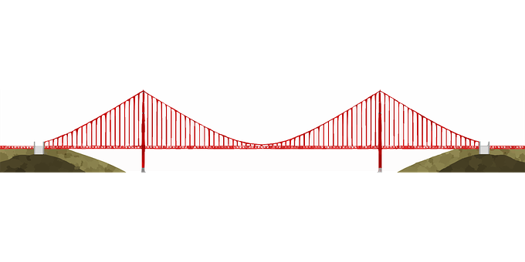
Making Connections
Cultural Awareness
For Students: Explicit instruction and bridging activities
For Teachers: Learning about Students’ Cultures
Appreciation of differences and more effective cross-cultural communication
Learning about new cultures and identities
Connecting to one’s own identity
Notes:
Cultural awareness is all about recognizing and understanding that we all have different values shaped by our diverse cultural backgrounds. What we consider to be 'normal' behavior in one country can be entirely different in another. By being respectful of others and accepting people's opinions, rights and feelings – even when they are different to our own – we allow ourselves to develop more successful personal and professional relationships and benefit from cultural diversity (MacMillianEnglish.com). This notion works for students as they learn, in a classroom where cross-cultural connections are part of instruction, as well as when applied to teachers as they learn about their students and reflect on their own identities.
Understanding our culture [and language] is important so that we understand how we interact with individuals from cultures [and language groups] that are different from ours. This understanding helps us see our students and their families more clearly, and shape policies and practice in ways that will help our students to succeed (NEA Diversity Toolkit).

Slide 18


Windows and Mirrors
Reflects one’s own culture
Helps build identity
View into someone
else’s experience.
Mirrors, Windows and Sliding Doors (Bishop,1990)
Notes:
Another concept that you may be familiar with is using the metaphor of windows and doors as a way to reflect on the curriculum and instructional materials. By nature, a World Language classroom may provide a window into a new culture and experience as integrated through the study of a new language. As an educator of students who may be of a different cultural background than you, what activities can you use that gives you a window into your learner’s experiences and perspectives? How can what you learn build your identity as a culturally responsive teacher?

Slide 19

Sample Guiding Questions for
Making Connections
How is this [cultural aspect] the same as or different from my own?
How can we make connections between different experiences (that honors everyone’s perspective)?
Learner response options: Chat box, Flipgrid, in class pair discussions, written response or graphic organizer sent by text/email

Slide 20
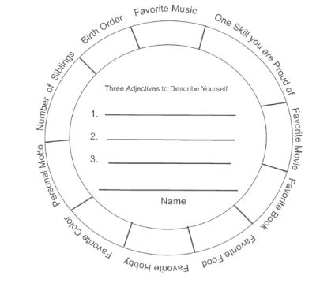
Student Identity Reflection Tool
I learn best when…
Something I do when I am frustrated and wish I had help:
It is important that my teacher know this about me:
___ makes me nervous.___ makes me less nervous.
I need ____ to be successful.
I prefer activities that ___.
Inclusive Teaching at University of Michigan
Notes:
One strategy as a window into your student’s backgrounds, so to speak, are surveys. This is an example of a tool for learning about students. There are other versions that dig more into racialized identities. You can create your own with questions that you feel will really help you make instructional decisions or to get important insight into their behaviors. I included some on the right side. I created my own portrait as a teacher that I shared with students at the beginning of the year so they could get to know me a bit more as well.

Slide 21
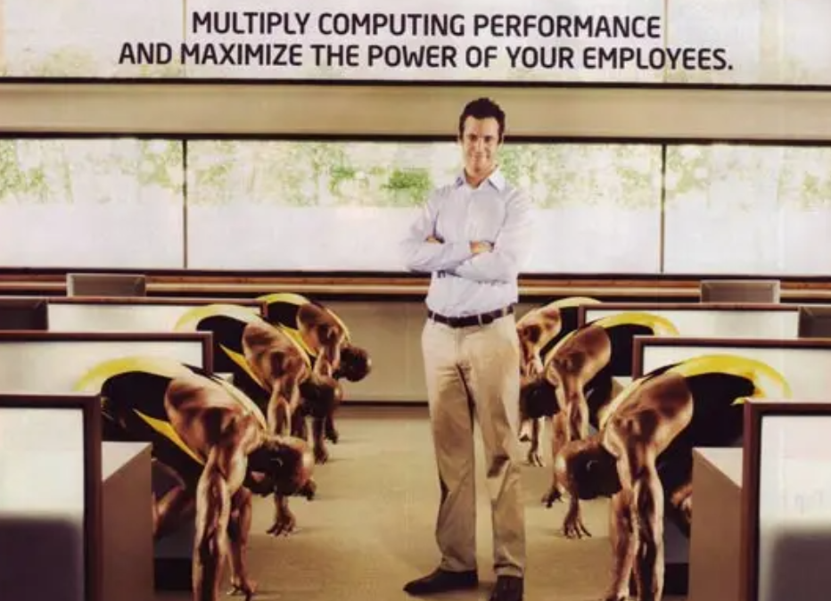
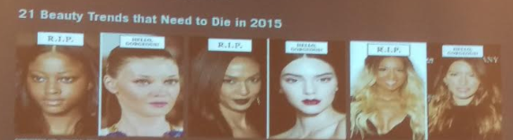



Critical Analysis of Materials
Brown-face
How might any images or materials situate a group of people as superior?
Do the materials authentically and positively present all people?
Are people represented as individuals as opposed to representative of a group of people/culture?
Brands and company information have been removed intentionally.
Notes:
Part of providing culturally relevant and respectful materials is to ensure those materials are not possibly reinforcing any deficit beliefs about that culture or an individual from a specific group. Often times, without realizing it, simple images and graphics that could be used as realia or as a window into another culture, or even to represent the cultures of the learners in a class, can reinforce negative, implicit biases. To be culturally relevant and respectful, teachers need to critically examine any instructional materials for biases that can reinforce deficit thinking or stereotypes.

Slide 22
Reflect: Culturally Relevant Curriculum Connections
Share another idea or strategy for
Culturally Relevant Curriculum Connections
Please type your responses in the chat box.

Slide 23
Affirming and Asset-Based Approaches
Validate errors as part of the learning process and model vulnerability.
Provide productive feedback that highlights student strengths while giving students direct information about next steps and growth opportunities.
Provide empowering affirmations for students to use throughout class.
Expect and support opportunities for all students to think critically and practice the target language.
Celebrate successes and growth.

Slide 24
Teacher Language Norms
Asset-Based Language
Solutions-Focused
Obstacles as Opportunities
Focus on frustrations ≠ Productive dialogue
DEFICIT MINDSET:
Not responsive/Non Compliant
Illiterate
At-risk
These kids have no…/can’t
ASSET MINDSET:
Background and perspective to learn more about
Resilient and Resourceful
My students are not yet …..and can
I can help my students develop…
Notes:
As part of my dissertation on socially just educational leadership, I read a number of journal articles about how the language educators use about students indicates their mindset and expectations about students. These research reports argued that with a simple, yet intentional change in how we talk and think about learners, teachers’ expectations of learners also shifted. In those reports, when the teachers held the higher expectations and reframed any of their deficit thoughts to ones focused on student assets, there were increases in student’s positive perceptions of the class and teacher, as well as increases in their performance within that class.
I would encourage you, if you are using any of the terms on the left, which are often throughout the literature we read, the data meetings we attend, and in conversations with colleagues, to make any intentional shift to reframe in a way that does not place blame on the students, but in way that empowers you as a professional dedicated to student learning to leverage what students know and can do in order to teach them the new language and content. This asset-based language positions teachers are solution-seekers.

Slide 25
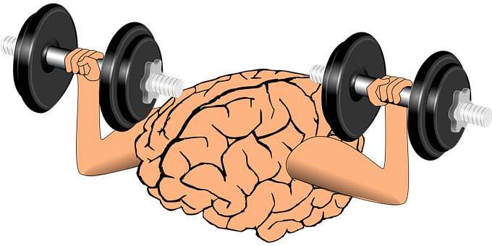
Affirmations Matter
I will work to my highest ability.
I can learn when I work hard and use my resources.
I will preserve though challenges and focus on solutions.
My mind is a muscle and I am working on its growth. I will embrace my mistakes as part of the learning process.
I’ve made progress in understanding and using my target language. I am really good at ___ and can use that to learn ___.
I choose to take each opportunity to speak in my target language and I’m impressed by my courage to do so.
Notes:
Another strategy that supports an affirming and asset-based approach to instruction is reciting affirmations. I admit, when I first heard about the strategy of using positive affirmations in my middle school class, I automatically thought my students would find it patronizing. Yet just like any other classroom agreement or norm, it quickly became a structure for productive work and language use. I explained that I had read about it in one of my own classes, that when I get frustrated with a situation, reciting a positive affirmation helped me. I even have gym shirts with affirmations, “I am stronger than my strongest excuse” for when I know it will be a tough workout and I will ant to give up or at least not push myself to my full potential.
These kinds of affirmations, when modeled and encouraged, have many benefits for learners of all ages.
Thoughts have a direct impact on emotions and feelings. We can choose to trigger positive thoughts. There are many studies related to this notion within psychology, related to cognitive coaching.
There are studies that have linked affirmations to increased self-image and esteem. They realize that the teacher is going to hold them to a high standard and expects them to meet that standard since the teacher is using affirmations as encouragement coupled with the support students need to preserve and be successful. Other studies have linked affirmations to problem-solving abilities.
3. Within one study with Latinx learners, the students were able to overcome negative stereotypes that they had internalized from previous teacher’s; and peer’s negative expectations.
[https://www.kirstenskaboodle.com/benefits-of-using-positive-affirmations-in-the-classroom/]
When using affirmations, it is important to keep them realistic and attainable within a specific setting. We want the affirmations to be responsive and reflective of the immediate students’ needs and to their needs to develop the sense of self, inclusion, and connection as part of a diverse learning community.

Slide 26
Critical Thinking in World Language Learning
“By building on the cognitive skills students have in their L1 and their knowledge from other disciplines, instructors can transform language classrooms into spaces of higher-order thinking and learning, even at the introductory level of instruction.” (Modern Language Association)
Focus on meaning-making and authentic communication, not linguistic accuracy
Notes:
Language is not a list of vocabulary lists and grammar rules to learn for the purpose of reciting those. Language is dynamic, fluid, complex, and purposeful. Instruction of language should match its purpose for use. Students of all backgrounds can connect with material on deeper levels when it is authentic, relevant, useful, and challenges them to actively think and participate. We can ignite student interest in the new language to a much greater extent through tasks that move beyond grammar drills, dictations, and memorizing lists.

Slide 27
With Language Supports, World Language Students Can…
  Combine both language and analytic skills to:
  Sequence pictures of short stories based on a reading or listening text
  Complete graphic organizers to classify geographical aspects of countries
  Compare two objects of study, e.g., folktales, works of art (given sentence frames for functional, comparative language)
  Predict and confirm outcomes of a simple experiment
Notes:
There is an opportunity in every language classroom to move beyond simple, contrived conversations about daily lives and provide opportunities for students to practice new language in authentic contexts, to focus on language function within a variety of contexts. Maybe they complete an activity like the example list on the screen. Maybe they have a choice in a task they want to try to practice their new language, such as interview a native speaker about their fashion preferences based on their culture, if there is any. Maybe it is to complete a job application in the target language.
World Language teachers can collaborate with their grade-level teacher colleagues to integrate content and further develop the cognitive skills needed in those contexts. For example, on a lesson on shapes in my Spanish 1A class, I added in a bit on angles and degrees in the target language and was able to have them practice content for their math class. Yes, I had to go beyond my text, but it was so encouraging when students were applying the basic language I was teaching towards their learning in another subject.
Part of being culturally responsive and having an asset-based mind frame about your language learners manifests through lessons that support thinking and application of the new language in ways that interest the learners and leverage what they already know and can do.

Slide 28
Reflect: Affirming and Asset-Based Approaches
Share another idea or strategy for
Affirming and Asset-Based Approaches
Please type your responses in the chat box.

Slide 29
Supportive Learning Environment
Use multiple teaching approaches and strategies and provide options for assignments that match a variety of learning styles and needs.
Integrate multi-modal scaffolds to make key concepts and skills explicit and accessible (e.g., visual, kinesthetic, auditory, interactive, sentence frames, graphic organizers). Model often and allow processing time and practice before any whole group questioning.
Make success criteria clear. Monitor progress toward the success criteria by circulating around the classroom/checking-in remotely. Amplify individualized instruction as needed.

Slide 30

Multiple Approaches and Supports
Example Supports
Visuals
Information presented verbally and in writing
Graphic Organizers
Modeled Conversations
Writing frames
Conversation sentence starters
Cognate lists connected to the lesson
Peer
Cooperative Structures and Activities
Example Approaches
Communicative Approach: Tasks connected to thematic unit
Task-based learning: Use language authentically to complete a task
Direct Instruction/ Immersion
Total Physical Response: Connecting motion to new language
Audio-lingual model: repeating key language pieces after listening, i.e., for affirmations
Notes:
I am not going to go into much depth here, as this is possibly familiar content. In order to respond to the diverse needs of your group of learners, it is important to vary your teaching styles, approaches, strategies, and supports. Through the use of multiple methods and scaffolds, teachers set all learners up for success. Some students may need to hear and see the new language, while others come from a cultural background where verbal interactions dominate and they pick up quickly from just listening to the new language.
The approaches and supports listed are not exhaustive lists and overlap. Within one lesson, a teacher can provide multiple supports while implementing a variety of approaches. In a lesson on commands and directions, I may have students act out the command, practice repeating key phrases, practice giving and responding to commands with a peer, follow written directions for completing a scavenger hunt. I may even need to have a mini-grammar lesson and make a connection to their native language as an extension for students who still need additional support.

Slide 31
Reflect: Supportive Learning Environment
Share another idea or strategy for
Supportive Learning Environment
Please type your responses in the chat box.

Slide 32
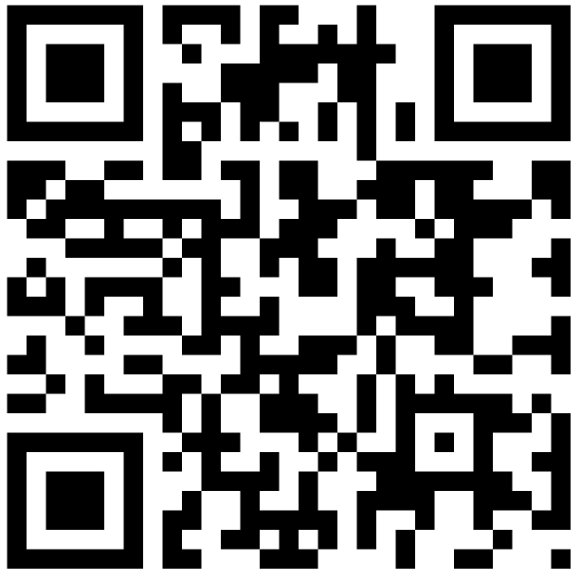
References and Resources for Further Exploration
Clickable link

Slide 33
Disclaimer
Reference within this presentation to any specific commercial or non-commercial product, process, or service by trade name, trademark, manufacturer or otherwise does not constitute or imply an endorsement, recommendation, or favoring by the Virginia Department of Education.

Slide 34
Questions?
Contact Information:
Dr. Jessica Costa
VDOE EL Instruction Specialist
jessica.costa@doe.virginia.gov

