Slide 1
Virginia Department of Education
Supporting English Learners (EL) in Fine Arts
Webinar
Facilitated by VDOE’s EL Instruction Specialist

Slide 2
Webinar Objectives
Teachers will be able to:
Describe differentiation strategies for ELs
Identify culturally responsive teaching practices in Fine Arts

Slide 3
Differentiation through a Variety of Supports
Screenshot for VDOE Resource: EL Teacher Toolkit
Notes:
Screenshot is hyperlinked

Slide 4
Engaging ELs in Fine Arts Content*
Support the Language of Fine Arts
Make Learning Visible
Use Cooperative Learning Structures and Strategies
Reduce cognitive load and allow processing time
Connect to Students’ Backgrounds and Skills
*Order of webinar different from infographics
Infographics available by Fine Arts content area

Slide 5
Support the Language of Fine Arts
Teach language explicitly
Provide opportunities for students to use new, academic language and communicate about their and their peers’ ideas
Provide language supports for differentiation

Slide 6
The Language of Fine Arts
How do experts in the arts use language?
How do VA’s SOLs and 5C’s require your young artists to use language?
Notes:
Word splash, scribe

Slide 7
Think About It…
“There are no native speakers of academic language.”
All students are academic language learners.
There are no “low-incidence” academic language learner schools.
NCELA Webinar (2013)
Notes:
Each content area has its own language students need to understand to be successful
Car shop example
Apprentice analogy: sound like an expert takes explicit instruction

Slide 8
Support: Language Objectives
Implementing language objectives can be a powerful first step in ensuring that English learners have equal access to the curriculum even though they may not be fully proficient in the language. This is because the second language acquisition process requires opportunities for the language learner to be exposed to, practice with, and then be assessed on their language skills (Echevarria, Short, & Vogt, 2008).
Notes:
Equal access unfortunately does not equate to proficient performance. But if we are not taking the steps, or paying explicit attention to the academic language needed to comprehend the content or produce it at appropriate levels according to their current level of proficiency, then they will never have an opportunity to develop the capacity to be proficient in the content. As Shawn said yesterday, do it NOW! Don’t wait for the next teacher. Focus on language development WHILE you are building content.
A site to recommend teaching ELLs using Common Core: Colorin Colorado. We have a member of our PD team who is involved with the website. Multiple ideas for how teachers are including ELLs in Common core lessons.

Slide 9
Language Objectives Ideas
Academic Language Functions
Compare and Contrast
Sequence
Describe
Justify
Classify
Predict
Identify Cause and Effect
Language Objectives should support student communication about SOL.
These are examples. This list is not exhaustive.
Notes:
Language objectives tied to SOL
Use Scholar Sheet as a support

Slide 10
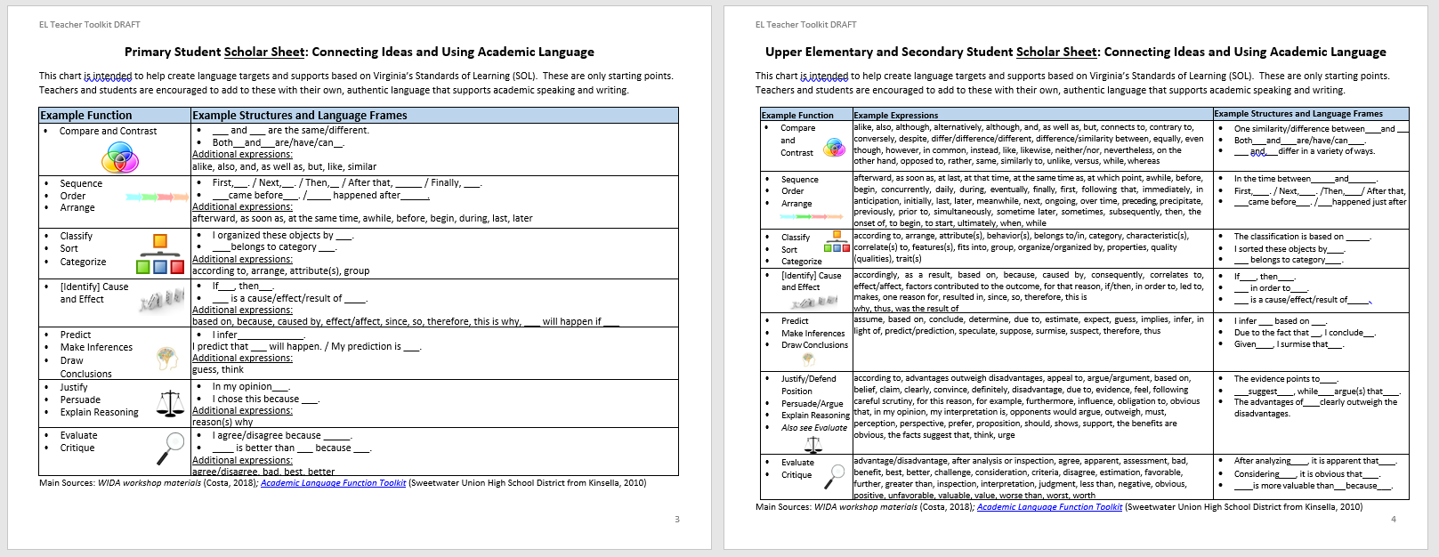
Support: Sentence Frames
Screenshot for VDOE Resource: EL Teacher Toolkit
Notes:
From EL Teacher Toolkit Online VDOE Resource
Hyperlinked
These are only examples.

Slide 11
Deciding on Language Objectives by SOL
SOL?
Which language function is connected to this SOL?
What are examples of language that students need to understand and use to meet the SOL?
Academic Language Functions
Compare and Contrast
Sequence
Describe
Justify
Classify
Predict
Identify Cause and Effect
Notes:
If time, people can type in some examples

Slide 12
Example: Describe cultural influences
Language Objective: Identify Cause & Effect
___ was a popular form of [art] during (time period) because ___. ___[art/artist] may have been impacted/influenced by ___. ___ influenced ___. The most likely reason for ___ was ___. ___ possibly led to ___. Several factors may have contributed to ___, such as ___and ___.
[art/artist] is used to be inclusive of all of the Fine Arts content areas.

Slide 13
Example: Compare and contrast aspects
Language Objective: Compare and Contrast
This [art] is/has ___ but that one is/does not. These are different/the same because ___. Both [art] are/have ____. The difference between 1 and 2 is _____. Unlike [art] A, [art] B ____. 1 and 2 share the following characteristics: ____.
[art/artist] is used to be inclusive of all of the Fine Arts content areas.

Slide 14
Crafting Language Objectives: Practice
Content Standards (before proposed revisions) | Language Function | Academic Language Examples
2.7 TSW identify in works of art color, line, shape, texture, pattern | ? | ?
4.4 TSW compare and contrast characteristics of diverse cultures depicted in works of art | ? | ?
6.11 TSW describe ways artists contribute to society through their work | ? | ?
8.18 TSW critique personal work and the work of others | ? | ?
AII.9 TSW use a variety of perspective techniques to create the illusion of space | ? | ?
HIAD.11 TSW demonstrate preparatory procedures, including 2)describing the process for tuning the instrument | ? | ?
Academic Language Functions
Compare and Contrast
Sequence
Describe
Justify
Classify
Predict
Identify Cause and Effect
Notes:
K-5 READING EMPHASIS

Slide 15
Support Language Progression
How do your supports support academic language development? How are supports differentiated for language level?
Example:
Simple Sentence→
Complex Sentence→
Multiple Sentences (some compound, some complex)
Source: 2007 WIDA ELP Standards and Resource Guide
Notes:
Opportunity for 13% of ELs identified as LTELs

Slide 16
Language, not Content, Differentiation
Screenshot for VDOE Resource: EL Teacher Toolkit
Notes:
Use for creating frames, student goal setting, progress monitoring

Slide 17
Modeling UP & Differentiation
Providing students language frames are a research-based strategy to help students share their ideas with a peer. This helps make learning visible and reinforces understanding of the content.
Providing differentiated frames supports students at different levels to advance their academic language proficiency. Students should be encouraged to continue conversations using their own, authentic language.
Beginning | Developing | Bridging
__ and __ are the same/different. They both ___. OR 1 has/is ___ but 2 has/is ___. | ___ and ___ are similar/different because____. Both 1 and 2 share the following characteristic(s): ___. | Whereas 1 has/is ____, 2 has/is ___. These two pieces have the following qualities in common: _______.

Slide 18
Make Learning Visible
Refer to language objectives
Draw attention to supports and model how to use them
Complement written language with visuals and graphics

Slide 19
Support: Visuals
Photos or Images
Videos
Artifacts*
Diagrams or Charts
Maps or Globes
TPR (physical movements)
*Students may want to bring in their own cultural artifacts
Notes:
Reduces anxiety
Builds background, text may have unfamiliar concepts (e.g. snow)
Act out character emotions, certain adverbs, etc. to help students learn new words in context
Example: Adults and Directions

Slide 20
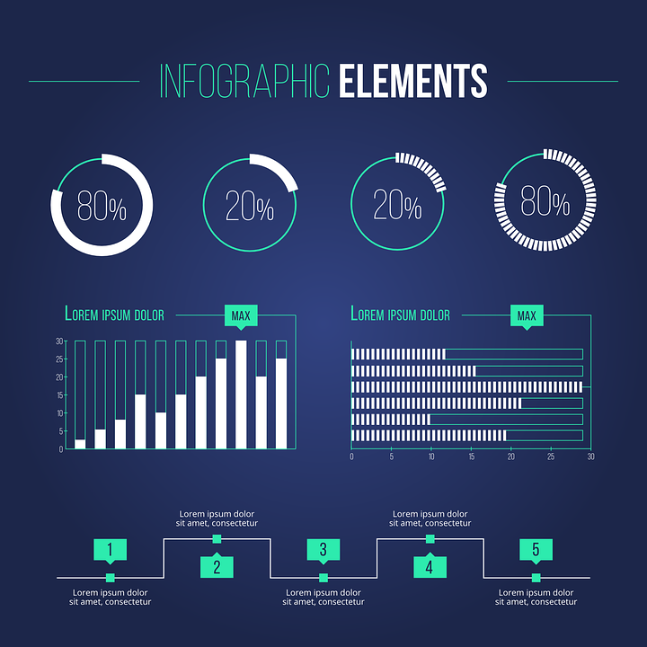
Support: Anchor Charts with Visuals
Anchor charts that combine visuals with language*
Infographics
*Students may want create their own culturally relevant analogies and metaphors for anchor charts.
Notes:
Older ideas for anchor charts: the hamburger model which has lost some popularity, as an example of a visual anchor chart combined with language.

Slide 21
Support: Sentence Frames and Anchor Charts
Co-create with students
Create your own
Collaborate with peers
Sentence Frames &
Anchor charts

Slide 22
Use Cooperative Learning Structures
Structure time and protocols for student collaboration and communication (e.g., talk moves)
Ask pairs to “Notice and Wonder” to start conversations
Use fluid and flexible student grouping (e.g., same language groups to make sense of new content)

Slide 23
Support: Peer Interaction
Students need opportunities to:
share their ideas and thoughts about [fine arts] and
hear from their peers.
“According to the cognitive approach, language has the power to shape the human mind…” (Diana Tihan)
Notes:
Language development, part of the work ELs do everyday in classes, requires language models.
By hearing about the strategies their peers are using, ELs learn more language needed for comprehension and classroom participation in a meaningful way.

Slide 24
Support: Cooperative Structures
Academic Discussions with talk moves
Reciprocal Teaching
Information Gap Activities or Jigsaws
Structured Think-Pair-Shares
Dictation and Draw
These are only examples.
Notes:
Considerations: grouping by language, proficiency level, etc.
Add other types of supports as needed.

Slide 25
Reduce cognitive load and allow processing time
Break tasks and texts into smaller chunks or sections with adequate processing time
Read tasks and texts out loud as a class, in pairs, or provide audio clips
Use simple language and models when giving directions or explaining new skills

Slide 26
Support: Graphic Organizers
Topic 1
Topic 2
Topic
Idea
Idea
Idea
Idea
Beginning
Middle
End
Also considered a visual support
Notes:
Helps visually
Models organization of ideas
Supports explicit instruction and visible thinking

Slide 27
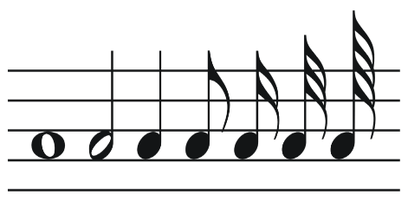
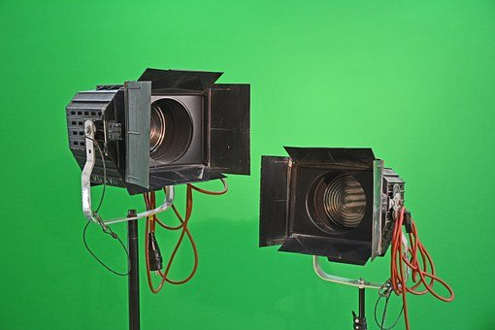
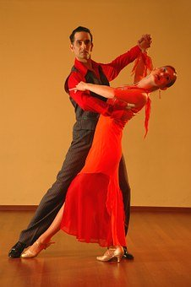
Support: Models and Examples
Talk through/sing the counting of a measure of music of how to play or sing that music
Demonstrate brush strokes or how to blend colors as you vocalize directions for the motion or technique, as students do the same
Show the effects of different positions of lighting on the stage and articulate why a particular position is used for a specific purpose
Show a video of a specific dance, stop at strategic points, have students recreate a motion/move
As you describe the skill/topic, have students practice explaining and describing using the academic language (by repeating or completing sentence frames).

Slide 28
Connect to Students’ Backgrounds and Skills
Make connections to [Art]…
Highlight contributions to [Art]…
Facilitate primary language use
Model respect for new perspectives
…using the EL’s culture, country, and/or primary language

Slide 29
Support: Cultural Identity in Class
“Recognizing and validating multiple cultural identities in the classroom community and developing positive student–teacher relationships strengthen individuals’ sense of worth and, ultimately, their academic performance.”
(Sumaryono ,2004)
Preserving the Cultural Identity of the English Language Learner

Slide 30
Why is that?
Language skills and cognitive skills are related to each other. Stronger language skills mean stronger cognitive skills. (Language and cognition).
Remember that most ELs are coming with age-appropriate primary language and cognitive skills.
Language and culture have a complex, homologous relationship. Language is complexly intertwined with culture (they have evolved together, influencing one another in the process…). (Guessabi, Language Magazine)

Slide 31
Important Concepts
Multicultural Education | Culturally Responsive Teaching/Instruction
Refers to content (what) | Refers to pedagogy (how)
Any form of education or teaching that incorporates the histories, texts, values, beliefs, and perspectives of people from different cultural backgrounds. (Glossary of Education Reform, 2013) | Building bridges: starting with what children already know about something (cultural relevance, funds of knowledge) and moving toward new learning (e.g. responding to the cultures in the class) (Theorizing Practices in Households, Communities, and Classrooms, 2001)
Appreciation, acceptance, and promotion of multiple cultures in the classroom. (Banks, 1995) | Modeling how to examine the curriculum from multiple perspectives (Lucas, Villegas & Freedson- Gonzales, 2008)

Slide 32
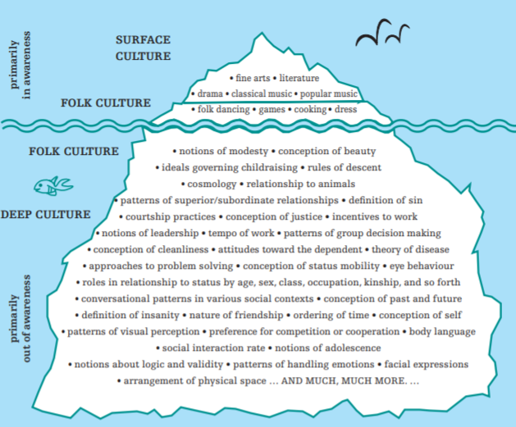
Culture
Culture impacts how we see the world and interact with others and our environments
Teach and model respect for individual student identities and core values at the deep cultural level
Graphic retrieved from Understanding ESL Learners: Moving Toward Cultural Responsiveness— A Guide for Teachers

Slide 33
Examining Multiple Perspectives
Why should one particular style of [art] not be promoted over another? Why should teachers be intentional about incorporating examples of art from multiple cultures, specifically those that might connect with the students in the course/class?
What additional styles of [art] can be explored that represent a new perspective or style?
Does this [style/art] carry more power, prestige, popularity within the U.S. because it was created by someone of the majority culture (Caucasian/English-speaking)? How might someone from a culture/background perceive this piece?

Slide 34
Support: Use Asset-Based/Growth Language
DEFICIT MINDSET:
Not responsive/Non Compliant
Illiterate or No/low English
At-risk
These kids have no…/can’t
ASSET MINDSET:
New background and perspective to learn more about
Beginning English proficiency with primary language (oral) proficiency
Resilient and Resourceful
My students are not yet …..and can
I can help my students develop…

Slide 35
Support: Primary Language
ELs can be encouraged to use their primary language when making meaning of new texts and topics.
Teachers may be able to find key terms or ask ELs to share key terms in their languages.
ELs are still held accountable for English output using supports (even from the beginning levels of English proficiency).
Notes:
Virginia is proud to provide dual language instruction as a language instruction education program (LIEP)
Even if not involved in a Dual Language LIEP, research shows inclusion of an EL’s primary language makes a difference.
Affective filter theory
Teachers can allow primary language use for a specific purpose. Teachers can find key words in the EL’s primary language and provide those. Teachers can point out language connections and cognates (words that look or sound the same between languages).

Slide 36
Support: Multicultural Mirrors
How does this style of [art] relate to your life? How do you see yourself and culture?
How can we make positive connections to and between pieces/works of [art] from a variety of cultures, especially when they are different from our own?
Reflects one’s own culture
Helps make connections
Sims Bishop, R. (1990). Mirrors, windows, and sliding glass doors.
Notes:
Connections to peers, related to social learning and social-emotional learning theories
When teachers support students’ cultures and languages in meaningful ways, students feel recognized and validated in the mainstream classroom, which results in a strong sense of self.

Slide 37
Culturally Responsive Practices: Review
Effective teachers must not mouth the words; rather, they must:
Be willing to be introspective about themselves and their teaching, monitor their beliefs and actions for bias and prejudice,
Believe that all students can achieve and hold high expectations for all learners
Build a community of learners in the classroom and connect with students’ families
Be learners themselves and vary instruction to meet the needs of students
Know that students have a wealth of skills and knowledge; use these in teaching
Taken from: A Candid Talk to Teacher Educators about Effectively Preparing Teachers
Who Can Teacher Everyone’s Children (Grant & Gillette, 2006)

Slide 38
Engaging ELs: Review*
Support the Language of Fine Arts
Make Learning Visible
Use Cooperative Learning Structures and Strategies
Reduce cognitive load and allow processing time
Connect to Students’ Backgrounds and Skills
*Order of webinar different from infographics
Infographics available by Fine Arts content area

Slide 39
Reflect
Are you able to:
Describe differentiation strategies for ELs?
Identify culturally responsive practices in Fine Arts?

Slide 40
Thank you for your commitment to equity for ELs! Email questions about EL Instruction to jessica.costa@doe.virginia.gov

Slide 41
VDOE Disclaimer
Reference within this presentation to any specific commercial or non-commercial product, process, or service by trade name, trademark, manufacturer or otherwise does not constitute or imply an endorsement, recommendation, or favoring by the Virginia Department of Education.

