Slide 1


Spring 2013 Student Performance Analysis with Instructional Guidance
Grade 3 and Grade 5 Standards of Learning
Presentation may be paused and resumed using the arrow keys or the mouse.
Notes:
In order to support instruction of students in the science Standards of Learning (SOL), this PowerPoint presentation has been developed to provide information about the content for which student performance was weak or inconsistent during the spring 2013 test administration. In collaboration with the Division of Student Assessment and School Improvement, the Division of Instruction has provided instructional information for teachers and school divisions for the content areas highlighted in this presentation.
It is important to note that the SOL, examples, and instructional information highlighted in this presentation should not be the sole focus of instruction in the classroom, nor should these suggestions replace the data that teachers or school divisions have collected on student performance. Rather, this PowerPoint presentation contains information that supports the instruction of the Science Standards of Learning for which statewide student performance showed the need for improvement.

Slide 2

Drawing Conclusions
SOL 2.1 The student will demonstrate an understanding of scientific reasoning, logic, and the nature of science by planning and conducting investigations in which
j) conclusions are drawn.
Students need additional experiences drawing conclusions during investigations and from real life situations.
Notes:
The first standard highlighted is SOL 2.1j. Throughout this presentation, the areas in which overall student performance was weak or inconsistent will be highlighted in blue.
Standard 2.1j reads: The student will demonstrate an understanding of scientific reasoning, logic, and the nature of science by planning and conducting investigations in which bullet j) conclusions are drawn.
Students need additional experiences drawing conclusions during investigations and from real life situations.

Slide 3
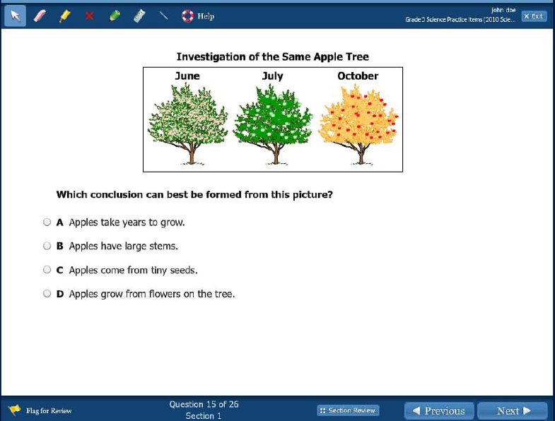
Instructional Guidance for 2.1j
Drawing Conclusions
Notes:
Students had difficulty on items that required students to draw conclusions when presented familiar situations. An example of this skill is shown on the screen, along with its answer. Drawing conclusions may be difficult for some students because they have to sort through statements that may be true, but may not necessarily be the best conclusion to draw from a given situation.
Hands-on activities should be provided in the classroom that offer students the opportunity to plan and conduct investigations, and draw discrete conclusions.

Slide 4
Important Plant Products are Classified
SOL 2.8 The student will investigate and understand that plants produce oxygen and food, are a source of useful products, and provide benefits in nature. Key concepts include
a) important plant products are identified and classified;
Students need additional practice identifying and classifying important plant products at school and at home.
Notes:
The next standard highlighted is SOL 2.8a. This standard reads: The student will investigate and understand that plants produce oxygen and food, are a source of useful products, and provide benefits in nature. Key concepts include bullet a) important plant products are identified and classified.
Students need additional practice identifying and classifying important plant products at school and at home.

Slide 5
Important Plant Products are Classified (2.8a)
1. Which of these natural resources comes from plants?
Steel
Wood
Aluminum
Cement
2. Select three products that come from plants.
Paper Eggs Wool
Leather Spices Cotton
Notes:
Two examples that assess the content associated with SOL 2.8a are shown. The answers are shown on the screen.
The second item is similar to a technology enhanced item that students found more challenging, and one in which students showed overall lower performance. If students are asked to demonstrate a more rigorous skill set, such as analyzing options to select more than one that satisfies a given situation, performance tends to be lower.

Slide 6
Examples of Compound and Simple Machines
SOL 3.2 The student will investigate and understand simple machines and their uses. Key concepts include
a) purpose and function of simple machines;
b) types of simple machines;
c) compound machines; and
d) examples of simple and compound machines found in the school, home, and work environments.
Students need additional experiences identifying examples of simple and compound machines.
Notes:
The next standard highlighted is SOL 3.2d. It reads: The student will investigate and understand simple machines and their uses. Key concepts include bullet d) examples of simple and compound machines found in the school, home, and work environments.
Students need additional experiences identifying examples of simple and compound machines.

Slide 7
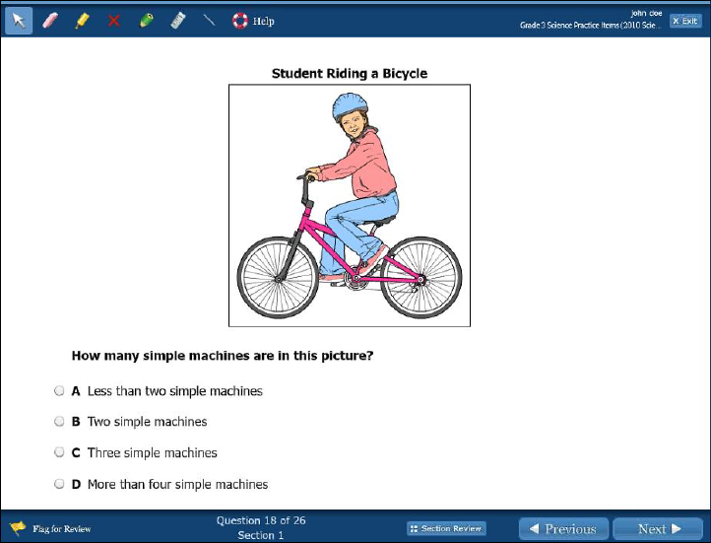
Instructional Guidance for 3.2d
Examples of Compound and Simple Machines
Notes:
The example shown is similar in content to one that students found challenging concerning simple machines. This item is rigorous in that it requires students to apply their knowledge of simple machines to identify those shown in the picture. In this particular example, there are more than four simple machines. <click to show answer> Opportunities that allow students to identify simple machines within a compound machine can provide experiences that will enhance this critical thinking skill.
Experiential activities that focus on the construction, testing, and use of simple and compound machines can be used to help students with sorting and classifying machines, as in this item. In addition, activities that provide students the opportunity to verbally explain and differentiate between simple and compound machines would be beneficial.

Slide 8
Observations, Conclusions,
Inferences and Predictions
SOL 4.1 The student will demonstrate an understanding of scientific reasoning, logic, and the nature of science by planning and conducting investigations in which
a) distinctions are made among observations, conclusions, inferences, and predictions;
Students need additional practice making distinctions among observations, conclusions, inferences, and predictions.
Notes:
The next standard highlighted is SOL 4.1a. It reads: The student will demonstrate an understanding of scientific reasoning, logic, and the nature of science by planning and conducting investigations in which bullet a) distinctions are made among observations, conclusions, inferences, and predictions.
Students need additional practice making distinctions among observations, conclusions, inferences, and predictions.

Slide 9
Instructional Guidance for 4.1a
Observations, Conclusions,
Inferences and Predictions
Students notice that sugar maple tree leaves change from green to red during the fall months, and black oak tree leaves change from green to brown during the same time. The students are making -
an observation
a conclusion
a prediction
an inference
Notes:
The example shown on the screen requires students to differentiate between observations, conclusions, inferences, and predictions. Items similar to this example showed lower overall performance. The answer to the example is shown on the screen.
Students should be offered opportunities, in the context of either real laboratory situations, to practice distinguishing between observations, conclusions, inferences and predictions. Having students write rationales explaining the classification of a statement could be helpful.

Slide 10
Identifying Atoms and Compounds
SOL 5.4 The student will investigate and understand that matter is anything that has mass and takes up space; and occurs as a solid, liquid, or gas. Key concepts include
a) distinguishing properties of each phase of matter;
b) the effect of temperature on the phases of matter;
c) atoms and elements;
d) molecules and compounds; and
e) mixtures including solutions.
Students need additional practice making distinctions among atoms, molecules, and compounds.
Notes:
The next standard highlighted is SOL 5.4 c and d. These standards read: The student will investigate and understand that matter is anything that has mass and takes up space; and occurs as a solid, liquid, or gas. Key concepts include bullet c) atoms and elements and bullet d) molecules and compounds.
Students need additional practice making distinctions among atoms, molecules, and compounds.

Slide 11
Identifying Atoms and Compounds (5.4c and d)
The smallest part of matter that is identifiable as an element is the-
Atom
Molecule
Cell
Compound
All elements are made up of-
Atoms
Compounds
Mixtures
Solutions
Notes:
These items both have the same answer <click to show answers>, but require students to differentiate between different levels of organization. Further, more complex technology enhanced items testing levels or organization also showed lower performance.

Slide 12
Identifying Basic Cell Structures
SOL 5.5 The student will investigate and understand that organisms are made of one or more cells and have distinguishing characteristics that play a vital role in the organism’s ability to survive and thrive in its environment. Key concepts include
basic cell structures and functions;
classification of organisms using physical characteristics,
body structures, and behavior of the organism; and
traits of organisms that allow them to survive in their
environment.
Students need additional practice identifying basic cell structures.
Notes:
The last standard highlighted is SOL 5.5a. It reads: The student will investigate and understand that organisms are made of one or more cells and have distinguishing characteristics that play a vital role in the organism’s ability to survive and thrive in its environment. Key concepts include bullet a) basic cell structures and functions.
Students need additional practice identifying basic cell structures.

Slide 13
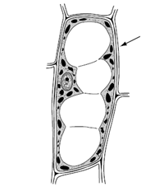
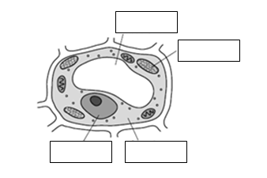
Identifying Basic Cell Structures (5.5a)
1. What part of the plant cell is shown at the arrow?
Cell wall
Cell membrane
Vacuole
Nucleus
2. Label the plant cell structures in the diagram.
Use four of the structures from this list:
Cytoplasm Nucleus
Chloroplast Vacuole
Cell Wall Lysosome
Vacuole
Chloroplast
Nucleus
Cytoplasm
Notes:
Here are two examples that assess SOL 5.5a. The item on the right mimics a drag and drop technology enhanced item. If students are asked to drag and drop multiple cell structures as labels in a diagram, or asked to select the identified cell structures from a list of given structures, performance is lower. Again, models, simulations or activities that reinforce cell structures, functions and structure locations would benefit students. The answers to the two questions are shown on the screen.

Slide 14
Practice Items
This concludes the student performance information for the spring 2013 Grade 3 and 5 Science SOL tests.
Additionally, test preparation practice items for Grade 3 and 5 Science can be found on the Virginia Department of Education Web site at:
http://www.doe.virginia.gov/testing/sol/practice_items/index.shtml#science
14
Notes:
This concludes the student performance information for the spring 2013 Grade 3 and 5 Science SOL test.
Additionally, test preparation practice items for Grade 3 and 5 Science can be found on the Virginia Department of Education Web site at the URL shown on the screen.

Slide 15
Contact Information
For questions regarding assessment, please contact
Student_assessment@doe.virginia.gov
For questions regarding instruction, please contact
Instruction@doe.virginia.gov
Notes:
No audio.

