Slide 1
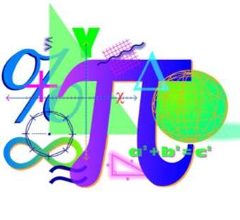
Spring 2012 Student Performance Analysis
Geometry
Standards of Learning
Presentation may be paused and resumed using the arrow keys or the mouse.

Slide 2
Translating a Short Verbal Argument into Symbolic Form
SOL G.1
The student will construct and judge the validity of a logical
argument consisting of a set of premises and a conclusion. This
will include:
a) identifying the converse, inverse, and contrapositive of a conditional statement;
b) translating a short verbal argument into symbolic form;
c) using Venn diagrams to represent set relationships; and
d) using deductive reasoning.

Slide 3
Suggested Practice for SOL G.1
Students need additional practice using and interpreting the
symbols : V Λ ∴
Let m represent:
Angle A is obtuse.
Let n represent:
Angle B is obtuse.
Which is a symbolic representation of the following argument?
Angle A is obtuse if and only if Angle B is obtuse.
Angle A is obtuse or Angle B is obtuse.
Therefore, Angle A is obtuse and Angle B is obtuse.
A. m → n B. m → n C. m ↔ n D. m ↔ n
m ∧ n m ∨ n m ∧ n m ∨ n
∴ m ∨ n ∴ m ∧ n ∴ m ∨ n ∴ m ∧ n

Slide 4
Verifying Parallelism Using Deductive Proofs
SOL G.2
The student will use the relationships between angles formed
by two lines cut by a transversal to
determine whether two lines are parallel;
verify the parallelism, using algebraic and coordinate methods as well as deductive proofs; and
solve real-world problems involving angles formed when parallel lines are cut by a transversal.

Slide 5
Suggested Practice for SOL G.2
Students need additional practice identifying which parts of a figure can be
used to determine whether lines are parallel when more than one
statement may be true.
Lines a and b intersect lines c and d.
Which statement could be used to prove a║b and c║d?
A. ∠1 and ∠2 are supplementary and ∠5 ≅ ∠6
B. ∠1 ≅ ∠3 and ∠3 ≅ ∠5
C. ∠3 and ∠5 are supplementary, and ∠5 and ∠6 are supplementary
D. ∠3 ≅ ∠4 and ∠2 ≅ ∠6
c
d
a
1
b
2
4
6
3
5

Slide 6
Applying Slope to Verify and Determine Parallel or Perpendicular Lines and Determining Transformation of a Figure
SOL G.3
The student will use pictorial representations, including computer software,
constructions, and coordinate methods, to solve problems involving
symmetry and transformation. This will include
investigating and using formulas for finding distance, midpoint, and slope;
applying slope to verify and determine whether lines are parallel or perpendicular;
investigating symmetry and determining whether a figure is symmetric with respect to a line or a point; and
determining whether a figure has been translated, reflected, rotated, or dilated, using coordinate methods.

Slide 7
Suggested Practice for SOL G.3
Students need additional practice using slopes related to
parallel or perpendicular lines.
Line a passes through points with coordinates (-4, 5) and (2, -2).
What is the slope of a line perpendicular to line a?
Slope of perpendicular line =

Slide 8
Suggested Practice for SOL G.3
Students need additional practice finding the coordinates of
vertices after a figure has been transformed.
Given: Triangle ABC with vertices located at
A(1, 1), B(2, -3), and C(-1, -4).
Triangle ABC will be reflected over the line y = x. What will be
the integral coordinates of point C' after this transformation?

Slide 9
Determining the Range in Which the Length of the Third Side of a Triangle Must Lie
SOL G.5
The student, given information concerning the lengths of sides
and/or measures of angles in triangles, will
a) order the sides by length, given the angle measures;
b) order the angles by degree measure, given the side lengths;
c) determine whether a triangle exists; and
d) determine the range in which the length of the third side must lie.
These concepts will be considered in the context of real-world
situations.

Slide 10
Suggested Practice for SOL G.5
Students need additional practice finding all possible lengths
for a third side of a triangle when given lengths of two sides of
the triangle.
Given: Triangle ABC with AB = 42 and BC = 20
Which of the following are possible lengths for AC? 12 20 22 32 42 50 62 70

Slide 11
Proving Triangles Congruent
SOL G.6
The student, given information in the form of a figure or
statement, will prove two triangles are congruent, using
algebraic and coordinate methods as well as deductive proofs.

Slide 12
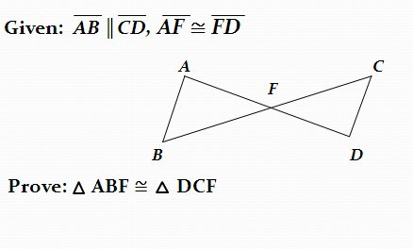
Suggested Practice for SOL G.6
Students need additional practice completing the steps and
reasons in two-column deductive proofs that prove triangles
congruent.

Slide 13
Proving Triangles Similar
SOL G.7
The student, given information in the form of a figure or
statement, will prove two triangles are similar, using algebraic
and coordinate methods as well as deductive proofs.

Slide 14
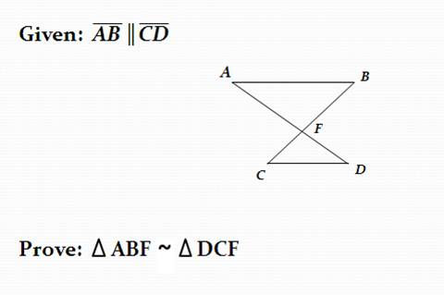
Suggested Practice for SOL G.7
Students need additional practice proving triangles similar by
using postulates or theorems.

Slide 15
Solving Problems Using Trigonometry
SOL G.8
The student will solve real-world problems involving right
triangles by using the Pythagorean Theorem and its converse,
properties of special right triangles, and right triangle
trigonometry.

Slide 16
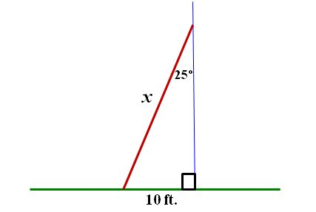
Suggested Practice for SOL G.8
Students need additional practice using trigonometry to solve
practical problems.
A ladder leans against a wall. The bottom of the ladder is 10
feet from the base of the wall, and the top of the ladder makes
an angle of 25° with the wall. Find the length, x, of the ladder.

Slide 17
Solving Problems Involving Angles of Polygons
SOL G.10
The student will solve real-world problems involving angles of
polygons.

Slide 18
Suggested Practice for SOL G.10
Students need additional practice understanding the
relationship between the measures of the angles of a polygon
and its ability to tessellate a plane.
Which of these regular polygons could tessellate a plane?
Square Pentagon Octagon Hexagon Decagon

Slide 19
Solve Problems Involving Circles
SOL G.11
The student will use angles, arcs, chords, tangents, and
secants to
investigate, verify, and apply properties of circles;
solve real-world problems involving properties of circles; and
find arc lengths and areas of sectors in circles.

Slide 20
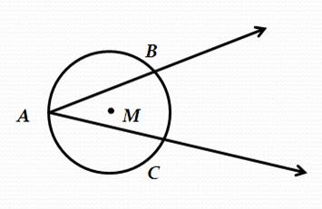
Suggested Practice for SOL G.11
Students need additional practice using a measure of one part
of the circle to find measures of other parts of the circle.
Given: Circle M with secants AB and AC
m ∠ A = 30°
If the length of arc BC is 3 cm, what is the circumference of the circle?

Slide 21
Suggested Practice for SOL G.11
Bob divides his circular garden into 10 congruent sectors to
plant different types of flowers. The circumference of Bob’s
garden is 50.5 feet. What is the area of one sector of Bob’s
garden?
1-Draw a figure.
2- Find diameter or radius.
3- Find the area.
4- Find the area of one sector.
Approximately 20.3 sq ft

Slide 22
Solve Problems Involving Circles
SOL G.12
The student, given the coordinates of the center of a circle and
a point on the circle, will write the equation of the circle.

Slide 23
Suggested Practice for SOL G.12
Students need additional practice using the equation of a circle
to identify the radius, diameter, center, and/or a point on the
circle.
The coordinates of the center of a circle are (-2, 6). This circle
has a diameter of 10 units.
What is the equation of the circle?
Give the integral coordinates of two points that lie on the circle.

Slide 24
Suggested Practice for SOL G.12
The equation of a circle is (x - 3)² + (y + 4)² = 16.
What are the coordinates of the center of the circle?
What is the radius of the circle?
What is the diameter of the circle?
Give the integral coordinates of two points that lie on the circle.
(3,-4)
4
8
Possible points: (-1,-4) (7,-4) (3,-8) (3,0)

Slide 25
Changes in Dimensions or Area/Volume of Geometric Objects
SOL G.14
The student will use similar geometric objects in two- or three-
dimensions to
compare ratios between side lengths, perimeters, areas, and volumes;
determine how changes in one or more dimensions of an
object affect area and/or volume of the object;
c) determine how changes in area and/or volume of an object
affect one or more dimensions of the object; and
d) solve real-world problems about similar geometric objects.

Slide 26
Suggested Practice for SOL G.14
Students need additional practice determining the relationship
between changes that affect one dimension (linear), changes
that affect two dimensions (area), and changes that affect
three dimensions (volume), particularly when figures are not
provided.
A rectangular prism has a volume of 36 cm³.
If the height of the prism is tripled and the other dimensions do not change, what is the volume of the new rectangular prism?
b) If all dimensions of the original rectangular prism are tripled, what is the volume of the new rectangular prism?

Slide 27
Suggested Practice for SOL G.14
A cylinder has a surface area of 96 square inches. If all
dimensions of this cylinder are multiplied by to create a new
cylinder, what will be the surface area of the new cylinder?

Slide 28
Practice Items
This concludes the student performance information for the
spring 2012 Geometry SOL test.
Additionally, test preparation practice items for Geometry can be
found on the Virginia Department of Education Web site at:
https://www.doe.virginia.gov/teaching-learning-assessment/student-assessment/sol-practice-items-all-subjects

