Slide 1
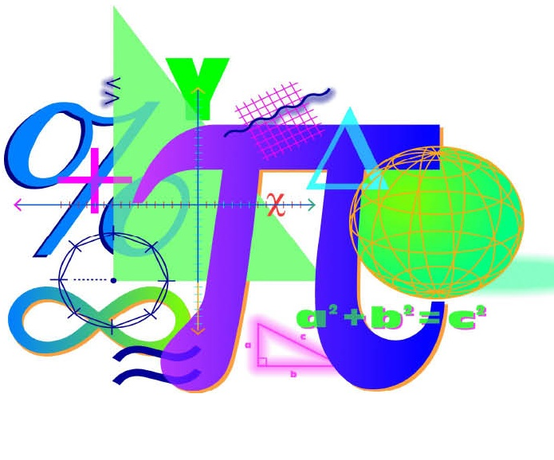
Spring 2012 Student Performance Analysis
Algebra I
Standards of Learning
Presentation may be paused and resumed using the arrow keys or the mouse.
Revised November 21, 2012

Slide 2
Representing and Evaluating Cube Roots and Square Roots
SOL A.1
The student will represent verbal quantitative situations
algebraically and evaluate these expressions for given
replacement values of the variables.

Slide 3
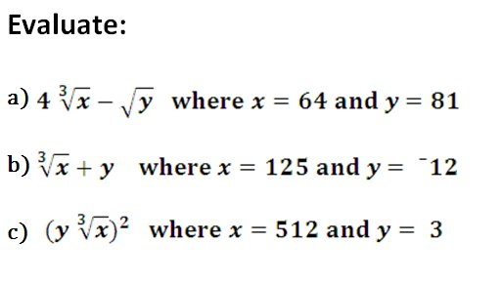
Suggested Practice for SOL A.1
Students need additional practice using replacement values to
evaluate expressions with cube roots and square roots.

Slide 4
Suggested Practice for SOL A.1
Students need additional practice translating expressions with
square and cube roots.
Translate into an algebraic expression:
The quotient of the square root of x and five
The cube root of the product of x and y, less twelve
The sum of the square root of sixteen and the product of four and the cube root of eight
Translate into a verbal expression:
d)
e)
Five times the cube root of the product of 4 and x less the square root of y
A number y plus the cube root of a number x

Slide 5
Performing Operations on Polynomials
SOL A.2
The student will perform operations on polynomials, including
applying the laws of exponents to perform operations on expressions;
adding, subtracting, multiplying, and dividing polynomials; and
factoring completely first- and second-degree binomials and trinomials in one or two variables. Graphing calculators will be used as a tool for factoring and for confirming algebraic factorizations.

Slide 6
Suggested Practice for SOL A.2
Students need additional practice finding the quotient of a trinomial and a
binomial and using exponent rules when negative numbers are involved.
Find the quotient:
a)
b)
Simplify:
c) d) e)

Slide 7
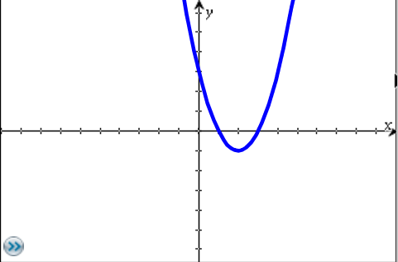
Suggested Practice for SOL A.2
Students need additional practice identifying factors of the polynomial
from the graph of the related quadratic function.
What are the apparent factors of the function f(x)?
f(x)
Related questions:
Identify all x- and y-intercepts of the function f(x). (SOL A7.d)
Identify the domain and range of the function f(x). (SOL A7.b)
the x-intercepts are 1 and 3,
and the y-intercept is 3.
The domain is all real numbers and the range is any number greater than or equal to -1.

Slide 8
Express Square Roots and Cube Roots in Simplest Radical Form
SOL A.3
The student will express the square roots and cube roots of
whole numbers and the square root of a monomial algebraic
expression in simplest radical form.

Slide 9
Suggested Practice for SOL A.3
Students need additional practice simplifying square roots of
monomial expressions and cube roots of whole numbers.
Completely simplify:
a)
b)
c)
d)

Slide 10
Solving Linear and Quadratic Equations
SOL A.4
The student will solve multistep linear and quadratic equations
in two variables, including
Solving literal equations (formulas) for a given variable;
Justifying steps used in simplifying expressions and solving equations, using field properties and axioms of equality that are valid for the set of real numbers and its subsets;
Solving quadratic equations algebraically and graphically;
Solving multistep linear equations algebraically and graphically;
Solving systems of two linear equations in two variables algebraically and graphically; and
Solving real-world problems involving equations and systems of equations.
Graphing calculators will be used both as a primary tool in solving problems and to
verify algebraic solutions.

Slide 11
Suggested Practice for SOL A.4
Students need additional practice solving a literal equation for
a given variable.
Solve each equation:
a)
b)

Slide 12
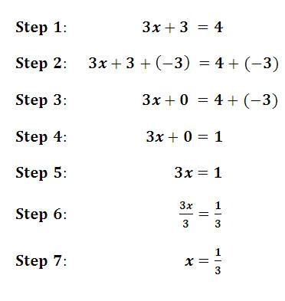
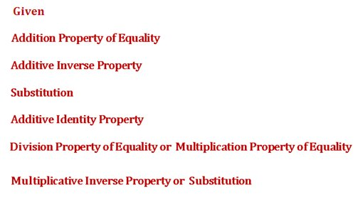
Suggested Practice for SOL A.4
Students need additional practice solving multi-step equations with the
variable on both sides and with fractions. Students also need additional
practice justifying steps in solving a linear equation.
Solve for x:
What property justifies the work between each step?

Slide 13
Suggested Practice for SOL A.4
Students need additional practice identifying a solution or root
of a quadratic equation.
Find the solutions or roots of the function.
a)
b)

Slide 14
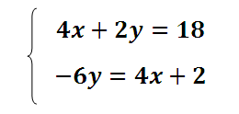
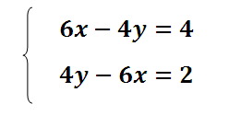
Suggested Practice for SOL A.4
Students need additional practice finding the x value or the y value for a
solution to a system of equations and identifying a system of equations with
one real solution, no real solution, or infinitely many solutions.
Find the x-value of the solution to this equation:
Identify whether this system of equations has one real solution,
no real solution or infinitely many solutions:
No real solution

Slide 15
Solving Multi-Step Inequalities and Systems of Inequalities
SOL A.5
The student will solve multistep linear inequalities in two
variables, including
Solving multistep linear inequalities algebraically and graphically;
Justifying steps used in solving inequalities, using axioms of inequality and properties of order that are valid for the set of real numbers and its subsets;
Solving real-world problems involving inequalities; and
Solving systems of inequalities.

Slide 16
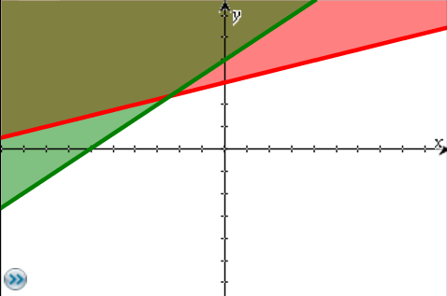
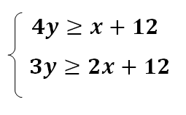
Suggested Practice for SOL A.5
Students need additional practice identifying solutions to a system of
inequalities.
Graph the solution to the system of inequalities:
A
a) Name two points that are in the solution set.
b) Select the point(s) that are part of the solution set:
(-7,-2) (-6,0) (-6,1) (-4,2) (-4,4) (-3,0) (2,3) (4,4)
Any point located within region A.

Slide 17
Suggested Practice for SOL A.5
Students need additional practice solving multistep linear inequalities which
require a sign change.
Solve and graph on a number line:

Slide 18
Identifying or Plotting Two Points on a Given Line and Writing Equations of a Line
SOL A.6
The student will graph linear equations and linear inequalities
in two variables, including
Determining the slope of a line when given an equation of the line, the graph of the line, or two points on the line. Slope will be described as rate of change and will be positive, negative, zero, or undefined; and
Writing the equation of a line when given the graph of the line, two points on the line, or the slope and a point on the line.

Slide 19
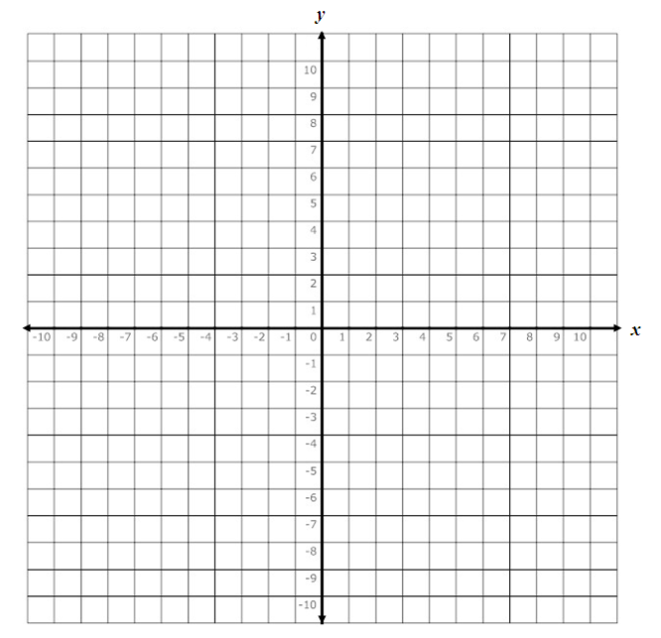
Suggested Practice for SOL A.6
Students need additional practice plotting two points that lie
on a line.
Plot two points that lie on the line:
a)
b)
A related question would be to ask students to name the slope
of these two lines.

Slide 20
Suggested Practice for SOL A.6
Students need additional practice identifying the equation of a
line given a point and the x- or y-intercept.
Write the equation of a line that:
Passes through the point (4,-2) and has an x-intercept of 3
Passes through the point (5,1) and has a y-intercept of -3
Graph the lines represented in a and b above.
a
b

Slide 21
Investigating and Analyzing Functions
SOL A.7
The student will investigate and analyze function (linear and
quadratic) families and their characteristics both algebraically
and graphically, including
determining whether a relation is a function;
domain and range;
zeros of a function;
x- and y-intercepts;
finding the values of a function for elements in its domain; and
making connections between and among multiple representations of
functions including concrete, verbal, numeric, graphic, and algebraic.

Slide 22
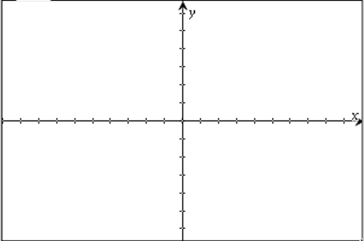
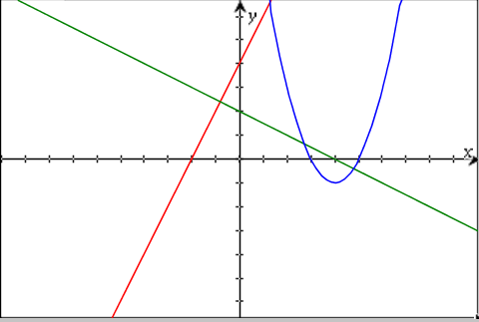
Suggested Practice for SOL A.7
Students need additional practice plotting points where zeros
of linear and quadratic functions are located.
Graph these functions on a coordinate plane and identify the zeros of the
function:
a)
b)
c)

Slide 23
Analyzing Direct and Inverse Variations
SOL A.8
The student, given a situation, will analyze a relation to
determine whether a direct or inverse variation exists, and
represent a direct variation algebraically and graphically and an
inverse variation algebraically.

Slide 24
Suggested Practice for SOL A.8
Students need additional practice selecting or plotting ordered
pairs to make a relation that is a direct variation.
Select three of these points that will create a relation that is a
direct variation.

Slide 25
Suggested Practice for SOL A.8
Point A (-3,3) lies on a line that represents a direct variation
equation. Plot three other points on that line.
A

Slide 26
Suggested Practice for SOL A.8
Students need additional practice identifying an equation that represents a
real world direct or inverse variation and identifying the type of variation.
This chart shows how the cost per person to rent a vacation home varies with the
number of people in a group.
Cost Per Person to Rent a Vacation Home
Which statement is true about the relationship?
It is a direct variation relationship because .
It is a direct variation relationship because .
It is an inverse variation relationship because .
It is an inverse variation relationship because .
Number of People in Group | Cost Per Person ($)
5 | 530.00
8 | 331.25
10 | 265.00
20 | 132.50

Slide 27
Interpret Standard Deviation and Z-Scores
SOL A.9
The student, given a set of data, will interpret variation in
real-world contexts and calculate and interpret mean absolute
deviation, standard deviation, and z-scores.

Slide 28
Suggested Practice for SOL A.9
Students need additional practice finding values within a given standard
deviation of the mean.
A teacher gave a quiz. The following stem-and-leaf plot shows the scores of
the students in her class.
Quiz Scores
STEM | LEAF
4 | 0
5 | 0 0
6 | 0 0 0
7 | 0 0 0 0
8 | 0 0 0
9 | 0 0
10 | 0
The mean score of this data set is 70 and the standard deviation (rounded to the nearest tenth) is 15.8.
Which scores are within one standard deviation of the mean?
Any student who scored a 60, 70 or 80 scored within one standard deviation of the mean.
Key: 6|0 equals 60

Slide 29
Suggested Practice for SOL A.9
Students need additional practice identifying an interval in
which an element lies.
A data set has a mean of 16.5 and a standard deviation of 3.
The element x has a z-score of 1.5. In which interval does the
element lie?
10.5 ≤ x < 13.5
13.5 ≤ x < 16.5
16.5 ≤ x < 19.5
19.5 ≤ x < 22.5
22.5≤ x < 25.5

Slide 30
Suggested Practice for SOL A.9
Students need additional practice finding an element of a data
set given the mean, standard deviation, and z-score.
A data set has a mean of 34 and a standard deviation of 4.5. An
element in the data set has a z-score of -1.2.
Without doing a calculation, state whether this element is less than, equal to, or greater than 34.
Determine the element of the data set.
a) Less than 34 (the mean) because the z-score is negative.
b) The element is 28.6

Slide 31
Analyzing Box-and-Whisker Plots
SOL A.10
The student will compare and contrast multiple univariate data
sets, using box-and-whisker plots.

Slide 32
Suggested Practice for SOL A.10
Students need additional practice analyzing changes to a data set when a
data point is added or removed, and analyzing two box-and-
whisker plots to draw a conclusion about the distribution of the data.
This box-and-whisker plot represents nine pieces of data. No number is repeated.
The number 23 is removed from the data set and a new box-and-whisker plot is drawn.
Compared to the values in the original box-and-whisker plot, describe the changes to each of
these values (increases, decreases or stays the same):
the lower extreme
the lower quartile
the median
the upper quartile
the upper extreme
It stays the same.
It stays the same.
It decreases.
It decreases.
It decreases.

Slide 33
Suggested Practice for SOL A.10
Each of these box-and-whisker plots represents a data set with 10 distinct elements.
Which statements about these plots appear to be true?
There are more elements in the lower quartile of plot B than plot A, because the left whisker of plot B is longer than the left whisker of plot A.
Since both data sets have 10 distinct elements, the box of plot A and the box of plot B contain the same number of elements.
There are fewer elements in the upper quartile of plot B than plot A, because the right whisker of plot B is shorter than the right whisker of plot A.
The interquartile range of plot A is greater than the interquartile range of plot B.
The range of both plots are equal.

Slide 34
Using the Curve of Best Fit
SOL A.11
The student will collect and analyze data, determine the
equation of the curve of best fit in order to make predictions,
and solve real-world problems, using mathematical models.
Mathematical models will include linear and quadratic
functions.

Slide 35
Suggested Practice for SOL A.11
Students need additional practice making predictions using the
linear or quadratic curve of best fit.
Determine the quadratic curve of best fit for the data. Then
estimate what the value of y will be when x = -4.

Slide 36
Practice Items
This concludes the student performance information for the
spring 2012 Algebra I SOL test.
Additionally, test preparation practice items for Algebra I can be
found on the Virginia Department of Education Web site at:
https://www.doe.virginia.gov/teaching-learning-assessment/student-assessment/sol-practice-items-all-subjects

