Slide 1
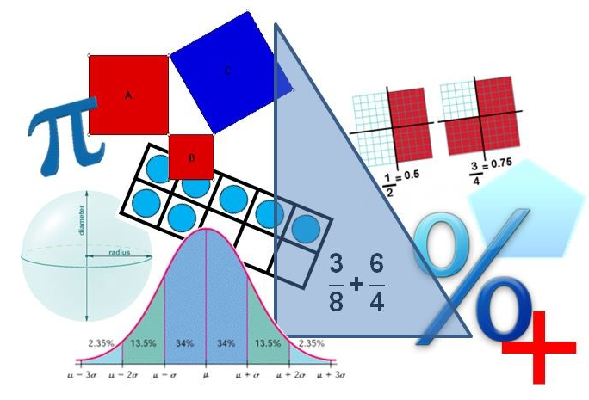
Student Performance Analysis Spring 2019
Grade 8
Mathematics Standards of Learning

Slide 2
Student Performance Analysis Spring 2019 (1 of 3)
Statewide results for the spring 2019 mathematics tests based on the 2016 Mathematics Standards of Learning (SOL) have been analyzed to determine specific content that may have challenged students. In order to support preparation of students for the Grade 8 Mathematics test, this PowerPoint presentation has been developed to provide examples of SOL content identified by this analysis.

Slide 3
Student Performance Analysis Spring 2019 (2 of 3)
It should be noted that these items are not SOL test questions and are not meant to mimic SOL test questions. Instead, they are intended to provide mathematics educators with further insight into the concepts that challenged students statewide.

Slide 4
Student Performance Analysis Spring 2019 (3 of 3)
It is important to keep the content of this statewide analysis in perspective. The information provided here should be used as supplemental information.
Instructional focus should remain on the standards as a whole, with school- or division-level data being used as the focal guiding resource to help improve instruction.

Slide 5
Transformations
SOL 8.7
The student will
given a polygon, apply transformations, to include translations, reflections, and dilations, in the coordinate plane; and
identify practical applications of transformations.

Slide 6
Dilations (8.7a)
Students would benefit from additional practice sketching dilations and locating the coordinates of the image of a right triangle or rectangle that has been dilated.
Common errors on SOL test items include:
reflecting a point about the x- or y-axis instead of dilating the point with respect to the origin; and
using the opposite of the x- and y-coordinates as the location of the image of a point after a dilation.

Slide 7
Suggested Practice #1 with Dilations (8.7a)
A rectangle is shown on the grid. The rectangle will be dilated by a factor of 2 with the origin as the center of dilation.
Plot a point on the grid that represents the image of the point located at (2, 0) after this dilation.

Slide 8
Answer to Practice #1 with Dilations (8.7a)
A rectangle is shown on the grid. The rectangle will be dilated by a factor of 2 with the origin as the center of dilation.
Plot a point on the grid that represents the image of the point located at (2, 0) after this dilation.
Students should plot a point at (4,0).
Common error: plotting (0,2) or (-2, 0)

Slide 9
Suggested Practice #2 with Dilations (8.7a)
A rectangle is shown on the grid. The rectangle will be dilated by a factor of $\frac{1}{2}$ with the origin as the center of dilation.
Plot a point on the grid that represents the image of the point located at (2, 2) after this dilation.

Slide 10
Answer to Practice #2 with Dilations (8.7a)
A rectangle is shown on the grid. The rectangle will be dilated by a factor of $\frac{1}{2}$ with the origin as the center of dilation.
Plot a point on the grid that represents the image of the point located at (2, 2) after this dilation.
Students should plot a point at (1,1).
Common error: plotting (2,-2), (-2, 2), or (-2, -2)

Slide 11
Boxplots
SOL 8.12
The student will
represent numerical data in boxplots;
make observations and inferences about data represented in boxplots; and
compare and analyze two data sets using boxplots.

Slide 12
Analyzing Boxplots (8.12 a, b, c)
Students would benefit from additional practice representing data using boxplots, and analyzing and comparing data represented in boxplots. In addition, students need to be familiar with vocabulary related to boxplots.
Common errors on SOL test items include:
determining and representing lower and upper quartiles from a data set incorrectly.

Slide 13
Suggested Practice #1 with Boxplots (8.12a)
Jackson is training for a race. He listed the number of miles he ran each day for 9 days.
6, 3, 5, 4, 8, 2, 8, 12, 2
He computed the five-number summary before creating a boxplot. What is the five-number summary for this set of data?
Lower Extreme:
Lower Quartile:
Median:
Upper Quartile:
Upper Extreme:

Slide 14
Answer to Practice #1 with Boxplots (8.12a)
Jackson is training for a race. He listed the number of miles he ran each day for 9 days.
6, 3, 5, 4, 8, 2, 8, 12, 2
He computed the five-number summary before creating a boxplot. What is the five-number summary for this set of data?
Lower Extreme:
Lower Quartile:
Median:
Upper Quartile:
Upper Extreme:
2
Common error: not determining the correct values for the either the lower or upper quartile.
2.5
5
8
12

Slide 15
Suggested Practice #2 with Boxplots (8.12a)
Which boxplot best represents this set of data?
6, 5, 1, 2, 12, 4, 2, 11
Plot A
Plot B
Plot C
Plot D
Plot A B. Plot B
C. Plot C D. Plot D

Slide 16
Answer to Practice #2 with Boxplots (8.12a)
Which boxplot best represents this set of data?
6, 5, 1, 2, 12, 4, 2, 11
Plot A
Plot B
Plot C
Plot D
Plot A B. Plot B
C. Plot C D. Plot D
Common error: incorrectly identifying the lower and upper quartiles.

Slide 17
Suggested Practice #3 with Boxplots (8.12b)
The number of runs scored during some baseball games was recorded. The data are summarized in the boxplot.
Runs Scored in Baseball Games
Based on this boxplot, what are the approximate values for these statistics?
maximum
minimum
interquartile range
median
2 | 3 | 3.5 | 4 | 4.5 | 5.5 | 6 | 8 | 12

Slide 18
Answer to Practice #3 with Boxplots (8.12b)
The number of runs scored during some baseball games was recorded. The data are summarized in the boxplot.
Runs Scored in Baseball Games
Based on this boxplot, what are the approximate values for these statistics?
maximum
minimum
interquartile range
median
12
2
4.5
5.5
2 | 3 | 3.5 | 4 | 4.5 | 5.5 | 6 | 8 | 12

Slide 19
Suggested Practice #4 with Boxplots (8.12c)
Shay is comparing these four boxplots.
Plot A
Plot B
Plot C
Plot D
Which statement is NOT true?
Plot A and Plot B have the same interquartile range.
Plot C and Plot D have the same lower extreme.
Plot A has the same range as Plot D.
Plot B has a smaller median than Plot C.

Slide 20
Answer to Practice #4 with Boxplots (8.12c)
Shay is comparing these four boxplots.
Plot A
Plot B
Plot C
Plot D
Which statement is NOT true?
Plot A and Plot B have the same interquartile range.
Plot C and Plot D have the same lower extreme.
Plot A has the same range as Plot D.
Plot B has a smaller median than Plot C.

Slide 21
Evaluating and Simplifying Expressions
SOL 8.14
The student will
evaluate an algebraic expression for given replacement values of the variables; and
simplify algebraic expressions in one variable.

Slide 22
Simplifying Expressions (8.14b)
Students would benefit from additional practice simplifying algebraic expressions, particularly involving the subtraction of two expressions within parentheses.
Common errors on SOL test items include:
incorrectly applying the distributive property when subtracting terms in an expression.

Slide 23
Suggested Practice #1 with Simplifying Expressions (8.14b)
Which expression is equivalent to this expression?
$$\left(x−1\right)−\left(1−x\right)+x$$
A. $x$
B. $3x$
C. $x−2$
D. $3x−2$

Slide 24
Answer to Practice #1 with Simplifying Expressions (8.14b)
Which expression is equivalent to this expression?
$$\left(x−1\right)−\left(1−x\right)+x$$
A. $x$
B. $3x$
C. $x−2$
D. $3x−2$
Common error: incorrectly applying the distributive property to both terms in the subtracted expression.

Slide 25
Suggested Practice #2 with Simplifying Expressions (8.14b)
Which expression is equivalent to $−4\left(2x−8\right)−2x$?
A. $−6x+32$
B. $−6x−32$
C. $−10x+32$
D. $−10x−32$

Slide 26
Answer to Practice #2 with Simplifying Expressions (8.14b)
Which expression is equivalent to $−4\left(2x−8\right)−2x$?
A. $−6x+32$
B. $−6x−32$
C. $−10x+32$
D. $−10x−32$
Common error: incorrectly applying the distributive property to both terms in the expression.

Slide 27
Functions
SOL 8.15
The student will
determine whether a given relation is a function; and
determine the domain and range of a function.

Slide 28
Relations and Functions – Vocabulary (8.15)
Students would benefit from additional practice exploring the terminology used with functions.
Common errors on SOL test items include:
assuming that the y -values cannot repeat when the terminology “y is a function of x” is used.

Slide 29
Suggested Practice with Relations and Functions (8.15a)
Which relation represents y as a function of x?
{(3, 4), (3, 5), (3, 6)}
{(2, 5), (3, 4), (2, 4), (3, 5)}
x | 3 | 4 | 5 | 6
y | 3 | 3 | 3 | 3
x | 0 | 1 | 0 | 1
y | 4 | 5 | 6 | 7

Slide 30
Answer to Practice with Relations and Functions (8.15a)
Which relation represents y as a function of x?
{(3, 4), (3, 5), (3, 6)}
{(2, 5), (3, 4), (2, 4), (3, 5)}
x | 3 | 4 | 5 | 6
y | 3 | 3 | 3 | 3
Common error: assuming
y-values cannot repeat and recognizing that all x-values cannot all be the same value.
x | 0 | 1 | 0 | 1
y | 4 | 5 | 6 | 7

Slide 31
Linear Functions (1 of 2)
SOL 8.16
The student will
recognize and describe the graph of a linear function with a slope that is positive, negative, or zero;
identify the slope and y-intercept of a linear function given a table of values, a graph, or an equation in y= mx + b form;
determine the independent and dependent variable, given a practical situation modeled by a linear function;

Slide 32
Linear Functions (2 of 2)
SOL 8.16
The student will
graph a linear function given the equation in y= mx + b form; and
make connections between and among representations of a linear function using verbal descriptions, tables, equations, and graphs.

Slide 33
Linear Functions – Vocabulary, Points, Slopes (8.16)
Students would benefit from additional practice applying vocabulary related to linear functions, including descriptions of slope, identifying slope from a set of points, and determining/graphing a set of points that satisfies a linear function.
Common errors on SOL test items include:
assuming all x- or y- values of points on a line with a negative slope are negative;
determining slope as the change in x over the change in y; and
graphing intercepts and determining additional points that lie on a line.

Slide 34
Suggested Practice #1 with Describing Slope (8.16a)
Line a has a negative slope. Which statement about line a must be true?
All x-values for points on line a must be negative.
All y-values for points on line a must be negative.
Line a slants down to the right.
Line a is a horizontal line.

Slide 35
Answer to Practice #1 with Describing Slope (8.16a)
Line a has a negative slope. Which statement about line a must be true?
All x-values for points on line a must be negative.
All y-values for points on line a must be negative.
Line a slants down to the right.
Line a is a horizontal line.
Common error: assuming the x-values are negative when the slope of the line is negative.

Slide 36
Suggested Practice #2 with Describing Slope (8.16a)
Which best describes the slope of this line?
The line has a positive slope because the line rises from right to left.
The line has a positive slope because the y-intercept is positive.
The line has a negative slope because the line falls from left to right.
The line has a negative slope because it contains negative y-values.

Slide 37
Answer to Practice #2 with Describing Slope (8.16a)
Which best describes the slope of this line?
The line has a positive slope because the line rises from right to left.
The line has a positive slope because the y-intercept is positive.
The line has a negative slope because the line falls from left to right.
The line has a negative slope because it contains negative y-values.
Common error: assuming the y-values are negative when the slope of the line is negative.

Slide 38
Suggested Practice #1 with Determining Slope and y-Intercept (8.16b)
This table of values shows coordinates
for points that satisfy a linear function.
What are the slope and y-intercept
of this function?
The slope is 3 and the y-intercept is (2, 0).
The slope is $\frac{1}{3}$and the y-intercept is (2, 0).
The slope is 3 and the y-intercept is (0, -6).
The slope is $\frac{1}{3}$and the y-intercept is (0, -6).
x | y
0 | -6
1 | -3
2 | 0
3 | 3

Slide 39
Answer to Practice #1 with Determining Slope and y-Intercept (8.16b) (1 of 2)
This table of values shows coordinates
for points that satisfy a linear function.
What are the slope and y-intercept
of this function?
The slope is 3 and the y-intercept is (2, 0).
The slope is $\frac{1}{3}$and the y-intercept is (2, 0).
The slope is 3 and the y-intercept is (0, -6).
The slope is $\frac{1}{3}$and the y-intercept is (0, -6).
x | y
0 | -6
1 | -3
2 | 0
3 | 3
Common errors on next slide.

Slide 40
Answer to Practice #1 with Determining Slope and y-Intercept (8.16b) (2 of 2)
Common errors: selecting answer option A or B.
A misconception is selecting the x-intercept instead of the y-intercept or miscalculating the slope.

Slide 41
Suggested Practice #2 with Determining Slope and y-Intercept (8.16b)
A linear function contains the points listed in the table of values.
What are the slope and y-intercept of this function?
The slope is $\frac{−1}{ 2}$ and the y-intercept is (0, 2).
The slope is -2 and the y-intercept is (0, 2).
The slope is $\frac{−1}{ 2}$ and the y-intercept is (1, 0).
The slope is -2 and the y-intercept is (1, 0).
x | -2 | -1 | 0 | 1 | 2
y | 6 | 4 | 2 | 0 | -2

Slide 42
Answer to Practice #2 with Determining Slope and y-Intercept (8.16b) (1 of 2)
A linear function contains the points listed in the table of values.
What are the slope and y-intercept of this function?
The slope is $\frac{−1}{ 2}$ and the y-intercept is (0, 2).
B. The slope is -2 and the y-intercept is (0, 2).
The slope is $\frac{−1}{ 2}$ and the y-intercept is (1, 0).
The slope is -2 and the y-intercept is (1, 0).
x | -2 | -1 | 0 | 1 | 2
y | 6 | 4 | 2 | 0 | -2
Common error on next slide.

Slide 43
Answer to Practice #2 with Determining Slope and y-Intercept (8.16b) (2 of 2)
Common error: selecting answer option A or C. Slope is miscalculated as a change in x over a change in y.

Slide 44
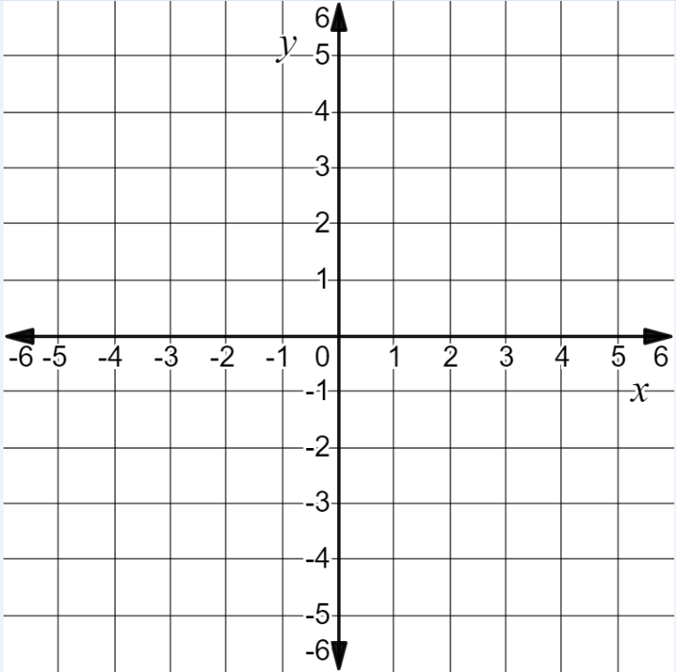
Suggested Practice with Equations and Graphs (8.16d)
Graph three points on this line.
$$y=2x+2$$

Slide 45
Answer to Practice with Equations and Graphs (8.16d)
Graph three points on this line.
$$y=2x+2$$
Any three points on the line $y=2x+2$.
Common error: plotting the points
(0, 2) and (2, 0) and a third point on the line passing through these points.

Slide 46
Linear Inequalities
SOL 8.18
The student will solve multistep linear inequalities in one variable with the variable on one or both sides of the inequality symbol, including practical problems, and graph the solution on a number line.

Slide 47
Solving and Graphing Inequalities (8.18)
Students would benefit from additional practice solving and graphing multistep linear inequalities, particularly when the variable is on both sides of the inequality symbol and/or negative signs are included.
Common errors on SOL test items include:
neglecting to change the direction of the inequality when multiplying or dividing both sides of the inequality by a negative value;
graphing the solution of an inequality in the wrong direction when using the format (2 < x).

Slide 48
Suggested Practice #1 with Linear Inequalities (8.18)
Solve and graph:
$$3x−5x+8>2x−4$$
-5
-4
-3
-2
-1
0
1
2
3
4

Slide 49
Answer to Practice #1 with Linear Inequalities (8.18)
Solve and graph:
$$3x−5x+8>2x−4$$
$$x<3$$
-5
-4
-3
-2
-1
0
1
2
3
4
Common error: entering x > 3 as the answer. The direction of the inequality was not switched when multiplying or dividing by a negative value.

Slide 50
Suggested Practice #2 with Linear Inequalities (8.18)
Solve and graph:
$$−3.2x−2+0.2x<−2x$$
-5
-4
-3
-2
-1
0
1
2
3
4

Slide 51
Answer to Practice #2 with Linear Inequalities (8.18)
Solve and graph:
$$−3.2x−2+0.2x<−2x$$
$$x>−2$$
-5
-4
-3
-2
-1
0
1
2
3
4
Common error: entering x < -2 as the answer. The direction of the inequality was not switched when multiplying or dividing by a negative value, or the solution was not correctly represented with the variable on the left of the inequality (-2 < x).

Slide 52
Practice Items
This concludes the student performance information for the spring 2019 Grade 8 Mathematics SOL test.
Additional information on accessing practice items and the Guided Practice Suggestions can be found on the Virginia Department of Education website.

Slide 53
Contact Information
For questions regarding assessment, please contact student_assessment@doe.virginia.gov
For questions regarding instruction, please contact vdoe.mathematics@doe.virginia.gov

