Slide 1
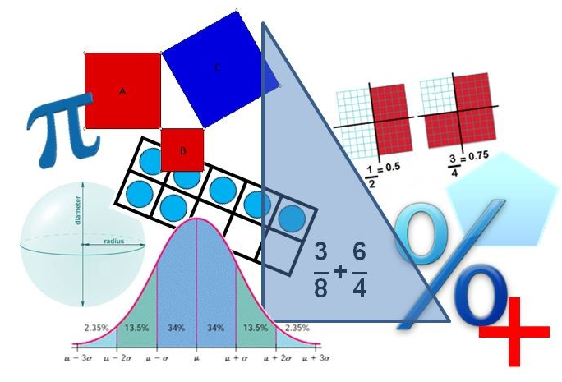
Student Performance Analysis Spring 2019
Grade 7
Mathematics Standards of Learning

Slide 2
Student Performance Analysis Spring 2019 (1 of 3)
Statewide results for the spring 2019 mathematics tests based on the 2016 Mathematics Standards of Learning (SOL) have been analyzed to determine specific content that may have challenged students. In order to support preparation of students for the Grade 7 Mathematics test, this PowerPoint presentation has been developed to provide examples of SOL content identified by this analysis.

Slide 3
Student Performance Analysis Spring 2019 (2 of 3)
It should be noted that these items are not SOL test questions and are not meant to mimic SOL test questions. Instead, they are intended to provide mathematics educators with further insight into the concepts that challenged students statewide.

Slide 4
Student Performance Analysis Spring 2019 (3 of 3)
It is important to keep the content of this statewide analysis in perspective. The information provided here should be used as supplemental information.
Instructional focus should remain on the standards as a whole, with school- or division-level data being used as the focal guiding resource to help improve instruction.

Slide 5
Rational Numbers
SOL 7.2
The student will solve practical problems involving operations with rational numbers.

Slide 6
Practical Problems Involving Rational Numbers
Students would benefit from additional practice with solving practical problems involving operations with rational numbers.
Common errors on SOL test items include:
using equivalencies among multiple forms of rational numbers;
misinterpreting the question in a multi-step problem; and
using incorrect operations to solve practical problems.

Slide 7
Suggested Practice #1 with Rational Numbers (7.2)
Andrew will fill the fuel tank of his boat. Fuel costs $3.19 per gallon. The fuel tank has a capacity of 28.2 gallons. If the fuel tank of his boat is already $\frac{1}{5}$ full, which is closest to the cost of fuel needed to completely fill this tank?
A. $89.96
B. $71.97
C. $17.99
D. $5.64

Slide 8
Answer to Practice #1 with Rational Numbers (7.2)
Andrew will fill the fuel tank of his boat. Fuel costs $3.19 per gallon. The fuel tank has a capacity of 28.2 gallons. If the fuel tank of his boat is already $\frac{1}{5}$ full, which is closest to the cost of fuel needed to completely fill this tank?
A. $89.96
B. $71.97
C. $17.99
D. $5.64
Common error: misinterpreted the question and found the cost of 1/5 of the fuel tank

Slide 9
Suggested Practice #2 with Rational Numbers (7.2)
On Monday the temperature in Chicago was -15.4 degrees Fahrenheit ($℉$). The temperature decreased by 20% over 4 days. Which is closest to the temperature, in $℉$, after this decrease?
A. -3.1 $℉$
B. -12.3 $℉$
C. -15.6 $℉$
D. -18.5 $℉$

Slide 10
Answer to Practice #2 with Rational Numbers (7.2)
On Monday the temperature in Chicago was -15.4 degrees Fahrenheit ($℉$). The temperature decreased by 20% over 4 days. Which is closest to the temperature, in $℉$, after this decrease?
A. -3.1 $℉$
B. -12.3 $℉$
C. -15.6 $℉$
D. -18.5 $℉$
Common error: misinterpreted the question and only found the percent decrease
Common error: used an incorrect operation and added the percent decrease

Slide 11
Suggested Practice #3 with Rational Numbers (7.2)
Drake and Evan are teammates on a high school swim team.
Drake swam 312.63 meters during practice.
Evan swam exactly $\frac{1}{3}$ times farther than Drake.
Exactly how far did Evan swim?
A. 104.21 m
B. 312.96 m
C. 416.84 m
D. 445.96 m

Slide 12
Answer to Practice #3 with Rational Numbers (7.2)
Drake and Evan are teammates on a high school swim team.
Drake swam 312.63 meters during practice.
Evan swam exactly $\frac{1}{3}$ times farther than Drake.
Exactly how far did Evan swim?
A. 104.21 m
B. 312.96 m
C. 416.84 m
D. 445.96 m
Common error: converted the fraction to a decimal and then added (incorrect operation) that amount to the given decimal value

Slide 13
Suggested Practice #4 with Rational Numbers (7.2)
Bill has a total of $124\frac{1}{2}$ feet of wooden board to use for two projects.
He used $40\%$of the board to repair a fence.
He used $41\frac{2}{5}$ feet of the board to repair a deck.
Exactly how much board, in feet, was left over?
feet

Slide 14
Answer to Practice #4 with Rational Numbers (7.2)
Bill has a total of $124\frac{1}{2}$ feet of boards to use for two projects.
He used $40\%$of the boards to repair a fence.
He used $41\frac{2}{5}$ feet of the boards to repair a deck.
Exactly how much board, in feet, was left over?
Common error: converted all values in the problem to decimal equivalencies and subtracted these amounts from the original amount 124.5, resulting in 82.7 feet.
33.3 feet

Slide 15
Proportional Reasoning
SOL 7.3
The student will solve single-step and multistep practical problems, using proportional reasoning.

Slide 16
Using Proportional Reasoning
Students would benefit from additional practice with solving single-step and multistep practical problems using ratios.
Common errors on SOL test items include:
using the two portions of a ratio independently to determine an outcome; and
misinterpreting the question and only finding one part of the solution.

Slide 17
Suggested Practice with Using Proportional Reasoning (7.3)
There are a total of 120 rides at an amusement park. The ratio of the number of children’s rides to adult rides is 3 to 5. Exactly how many more adult rides are at this amusement park than children’s rides?
A. 16
B. 30
C. 45
D. 75

Slide 18
Answer to Practice with Using Proportional Reasoning (7.3)
There are a total of 120 rides at an amusement park. The ratio of the number of children’s rides to adult rides is 3 to 5. Exactly how many more adult rides are at this amusement park than children’s rides?
A. 16
B. 30
C. 45
D. 75
Common error: dividing the total number of rides by 3 and 5, and finding the difference (40-24), instead of using $\frac{5}{8}$ and $\frac{3}{8}$.
Common error: misinterpreted the question and only found the number of children’s rides
Common error: misinterpreted the question and only found the number of adult rides

Slide 19
Quadrilaterals
SOL 7.6
The student will
compare and contrast quadrilaterals based on their properties; and
determine unknown side lengths or angle measures of quadrilaterals.

Slide 20
Properties of Quadrilaterals
Students would benefit from additional practice with properties of quadrilaterals.
Common error on SOL test items include:
difficulty in differentiating characteristics (properties) among quadrilaterals.

Slide 21
Suggested Practice #1 with Properties of Quadrilaterals (7.6a)
Select all the correct answers.
Identify each property that is true of every rectangle.
It has 4 sides.
It has 4 congruent angles.
It has 4 congruent sides.
It has 2 pairs of parallel sides.
Diagonals are congruent.
Diagonals bisect each other at right angles.

Slide 22
Answer to Practice #1 with Properties of Quadrilaterals (7.6a)
Select all the correct answers.
Identify each property that is true of every rectangle.
It has 4 sides.
It has 4 congruent angles.
It has 4 congruent sides.
It has 2 pairs of parallel sides.
Diagonals are congruent.
Diagonals bisect each other at right angles.
Common error: Selecting diagonals bisect each other at right angles.

Slide 23
Suggested Practice #2 with Properties of Quadrilaterals (7.6a)
Which of these statements is true?
The diagonals of a rhombus are congruent and bisect each other.
B. The diagonals of a parallelogram are congruent and bisect each other.
C. The diagonals of a square are congruent and bisect each other at right angles.
D. The diagonals of a rectangle are congruent and bisect each other at right angles.

Slide 24
Answer to Practice #2 with Properties of Quadrilaterals (7.6a) (1 of 2)
Which of these statements is true?
A. The diagonals of a rhombus are congruent and bisect each other.
B. The diagonals of a parallelogram are congruent and bisect each other.
C. The diagonals of a square are congruent and bisect each other at right angles.
D. The diagonals of a rectangle are congruent and bisect each other at right angles.
Common error: See next slide.

Slide 25
Answer to Practice #2 with Properties of Quadrilaterals (7.6a) (2 of 2)
Common error: Students selected option A thinking diagonals of a rhombus must be congruent since all of the sides are congruent. Students also selected option D; the misconception is that a rectangle has 4 right angles and the diagonals must bisect at right angles

Slide 26
Angle Measures of Quadrilaterals
Students would benefit from additional practice with determining unknown angle measures in a quadrilateral.
Common errors include:
assuming that diagonals of a quadrilateral always bisect the vertices of that quadrilateral; and
using the supplement incorrectly to identify missing angles in a quadrilateral.

Slide 27
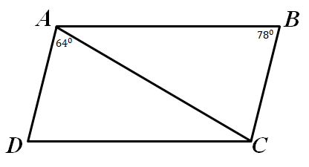
Suggested Practice with Angle Measures of Quadrilaterals (7.6b)
Parallelogram ABCD is shown.
$$m∠DAC={64}^{°} \text{and} m∠ABC={78}^{°}$$
What is the measure of $∠ADC$?
What is the measure of $∠BAC$?

Slide 28
Answer to Practice with Angle Measures of Quadrilaterals (7.6b)
Common error in finding $m∠ADC$: used the supplement of ${78}^{°}$ to obtain ${102}^{°}$.
Parallelogram ABCD is shown.
$$m∠DAC={64}^{°} \text{and} m∠ABC={78}^{°}$$
What is the measure of $∠ADC$?
What is the measure of $∠BAC$?
Common error in finding $m∠BAC$: assumed the diagonal bisected vertex A into two congruent angles to obtain ${64}^{°}.$
$${78}^{°}$$
$${38}^{°}$$

Slide 29
Probability
SOL 7.8
The student will
a) determine the theoretical and experimental probabilities of an event; and
b) investigate and describe the difference between the experimental probability and theoretical probability of an event.

Slide 30
Experimental Probability
Students would benefit from additional practice with describing the changes in the experimental probability as the number of trials increase.
A common error on SOL test items is a lack of understanding that the experimental probability gets closer to the theoretical probability as the number of trials increase.

Slide 31
Suggested Practice #1 with Experimental Probability (7.8b)
David has a spinner with 4 equal sections labeled Blue, Green, Orange, and Pink.
David spun the arrow on the spinner 21 times. The spinner landed on Orange 3 times.
David will spin the arrow on the spinner an additional 1,000 times.
David expects the experimental probability of the arrow landing on Orange to-
A. decrease to about 0.15
B. increase to about 0.15
C. decrease to about 0.25
D. increase to about 0.25

Slide 32
Answer to Practice #1 with Experimental Probability (7.8b)
David has a spinner with 4 equal sections labeled Blue, Green, Orange, and Pink.
He spun the arrow on the spinner 21 times, and it landed on Orange 3 times.
He will spin the arrow on the spinner an additional 1,000 times.
David expects the experimental probability of the arrow landing on Orange to-
A. decrease to about 0.15
B. increase to about 0.15
C. decrease to about 0.25
D. increase to about 0.25
Common error: assumed the probability would remain the same.

Slide 33
Suggested Practice #2 with Experimental Probability (7.8b)
A bag contains 8 balls.
All the balls are the same size and shape.
There are 3 yellow, 2 red, 1 green, and 2 purple balls.
A student randomly selects one ball from the bag, records the color, and places the ball back into the bag.
This process was completed 10 times.
The experimental probability of selecting a yellow ball was 40%.
This process will be completed 1,000 more times. The experimental probability of selecting a yellow ball will get closer to-

Slide 34
Answer to Practice #2 with Experimental Probability (7.8b)
A bag contains 8 balls.
All the balls are the same size and shape.
There are 3 yellow, 2 red, 1 green, and 2 purple balls.
A student randomly selects one ball from the bag, records the color, and places the ball back into the bag.
This process was completed 10 times.
The experimental probability of selecting a yellow ball was 40%.
This process will be completed 1,000 more times. The experimental probability of selecting a yellow ball will get closer to-
37.5%
Common responses were 40%, assuming the probability would remain the same, and 25% since there are four colors.

Slide 35
Proportional Relationships (1 of 2)
SOL 7.10 The student will
determine the slope, m, as rate of change in a proportional relationship between two quantities and write an equation in the form y = mx to represent the relationship;
graph a line representing a proportional relationship between two quantities given the slope and an ordered pair, or given the equation in y = mx form where m represents the slope as rate of change;
determine the y-intercept, b, in an additive relationship between two quantities and write an equation in the form y = x + b to represent the relationship;

Slide 36
Proportional Relationships (2 of 2)
SOL 7.10 The student will
graph a line representing an additive relationship between two quantities given the y-intercept and an ordered pair, or given the equation in the form y = x + b, where b represents the y-intercept; and
e) make connections between and among representations of a proportional or additive relationship between two quantities using verbal descriptions, tables, equations, and graphs.

Slide 37
Slope and Writing Equations
Students would benefit from additional practice with determining slope in a proportional relationship and writing equations in y = mx form.
Common errors on SOL test items include:
using the reciprocal slope;
using the difference between y and x of the first ordered pair in a table;
using the change in y-values only; and
using the x-value to describe the relationship in a practical situation.

Slide 38
Suggested Practice #1 with Slope and Writing Equations (7.10a)
A recipe for butter used 6 pints of cream to make approximately 2 pounds of butter. Which equation best represents the number of pints of cream, x, needed to make a certain number of pounds of butter, y?
A. $\frac{1}{6}$x = y
B. $\frac{1}{3}$x = y
3x = y
D. 6x = y

Slide 39
Answer to Practice #1 with Slope and Writing Equations (7.10a)
A recipe for butter used 6 pints of cream to make 2 pounds of butter. Which equation best represents the number of pints of cream, x, needed to make a certain number of pounds of butter, y?
A. $\frac{1}{6}$x = y
B. $\frac{1}{3}$x = y
3x = y
D. 6x = y
Common error: used the reciprocal slope
Common error: used the x-value to describe the relationship in a practical situation

Slide 40
Suggested Practice #2 with Slope and Writing Equations (7.10a)
A certain recipe for chocolate milkshake used $\frac{3}{2}$ cups of chocolate ice cream to make 6 cups of milkshake . Which equation best represents the number of cups of chocolate ice cream, x, needed to make a certain number of cups of milkshake, y?
A. y = $\frac{1}{4}$x
B. y = $\frac{3}{2}$x
C. y = 4x
D. y = 6x

Slide 41
Answer to Practice #2 with Slope and Writing Equations (7.10a)
A certain recipe for chocolate milkshakes used $\frac{3}{2}$ cups of chocolate ice cream to make 6 cups of milkshake . Which equation best represents the number of cups of chocolate ice cream, x, needed to make a certain number of cups of milkshake, y?
A. y = $\frac{1}{4}$x
B. y = $\frac{3}{2}$x
C. y = 4x
D. y = 6x
Common error: used the reciprocal slope

Slide 42
Suggested Practice #3 with Slope and Writing Equations (7.10a)
This table of values represents a proportional relationship between x and y.
What is the slope of the line that best represents this relationship?
x | y
3 | 5
6 | 10
9 | 15
12 | 20

Slide 43
Answer to Practice #3 with Slope and Writing Equations (7.10a)
This table of values represents a proportional relationship between x and y.
What is the slope of the line that best represents this relationship?
x | y
3 | 5
6 | 10
9 | 15
12 | 20
Common errors:
used the reciprocal slope of $\frac{3}{5}$ , and
used the difference between y and x in the first ordered pair to obtain a slope of 2.
Slope = $\frac{5}{3}$

Slide 44
Suggested Practice #4 with Slope and Writing Equations (7.10a)
Time, x (minutes) | Distance, y (miles)
15 | $$1\frac{7}{8}$$
17 | $$2\frac{1}{8}$$
This table of values represents a proportional relationship between x and y.
Which equation best represents the relationship shown in this table?
A. $y= \frac{1}{8}$x B. $y= \frac{1}{4}$x
C. y = 2x D. y = 8x

Slide 45
Answer to Practice #4 with Slope and Writing Equations (7.10a)
Time, x (minutes) | Distance, y (miles)
15 | $$1\frac{7}{8}$$
17 | $$2\frac{1}{8}$$
This table of values represents a proportional relationship between x and y.
Which equation best represents the relationship shown in this table?
A. $y= \frac{1}{8}$x B. $y= \frac{1}{4}$x
C. y = 2x D. y = 8x
Common errors: (B) used the change in y-values and (D) used the reciprocal slope.

Slide 46
Graphing a Line in y = mx Form
Students would benefit from additional practice with graphing a line representing a proportional relationship in y = mx form.
Common errors on SOL test items include:
using the slope value of the line as both the x-intercept and
y-intercept values when plotting points;
using the reciprocal slope to plot additional points for a given equation; and
omitting (0, 0) as an ordered pair for any line of the form y = mx

Slide 47
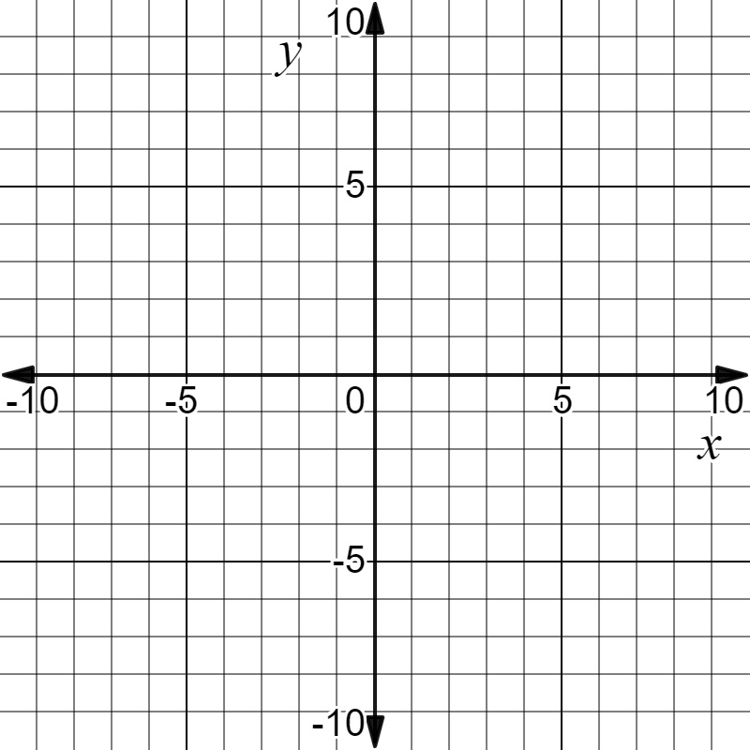
Suggested Practice #1 with Graphing a Line in y = mx Form (7.10b)
Plot two points that lie on the line that passes through (3, 4) and has a slope of $\frac{4}{3}$ ?

Slide 48
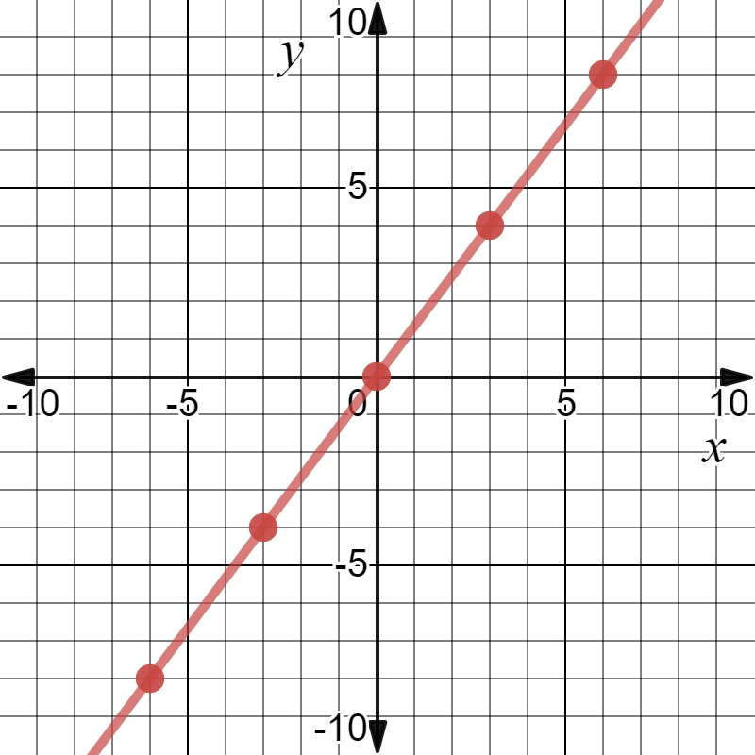
Answer to Practice #1 with Graphing a Line in y = mx Form (7.10b)
Plot two points that lie on the line that passes through (3, 4) and has a slope of $\frac{4}{3}$ ?
Any two ordered pairs that lie on the line $y=\frac{4}{3}$x.
Common errors: used the reciprocal slope to plot
(7, 7) and did not consider (0, 0).

Slide 49
Suggested Practice #2 with Graphing a Line in y = mx Form (7.10b)
Plot two points that lie on the line y = 4x.

Slide 50
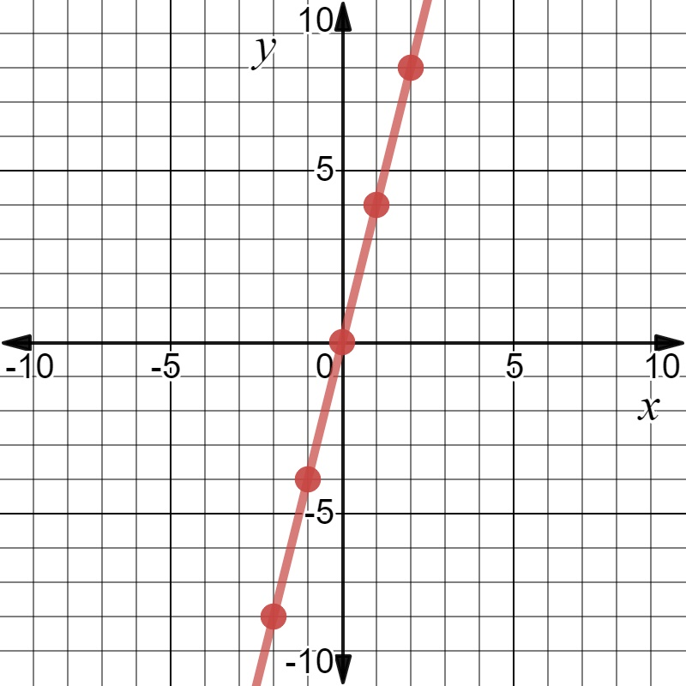
Answer to Practice #2 with Graphing a Line in y = mx Form (7.10b)
Plot two points that lie on the line y = 4x.
Any two ordered pairs that lie on the line $y=4$x.
Common error: used the slope value of 4 as intercept values and plotted points at (4, 0) and (0, 4).

Slide 51
Writing Equations in y = x + b Form
Students would benefit from additional practice with writing equations in y = x + b form.
Common errors on SOL test items include:
using an incorrect symbol when describing a practical situation involving an equation in y = x + b form.

Slide 52
Suggested Practice #1 with Writing Equations in y = x + b Form (7.10c)
Place the answers in the correct boxes.
Marcus is 8 inches taller than Carlos.
Let x represent Marcus’s height.
Ley y represent Carlos’s height.
Create an equation that represents the relationship between x and y?
y =
$$+$$
$$−$$
$$⋅$$
$$÷$$
8
$$1/8$$
x

Slide 53
Answer to Practice #1 with Writing Equations in y = x + b Form (7.10c)
Place the answers in the correct boxes.
Marcus is 8 inches taller than Carlos.
Let x represent Marcus’s height.
Ley y represent Carlos’s height.
Create an equation that represents the relationship between x and y?
y =
Common error: used addition symbol rather than subtraction symbol
x
$$−$$
8
$$+$$
$$−$$
$$⋅$$
$$÷$$
8
$$1/8$$
x

Slide 54
Graphing a Line in y = x + b Form
Students would benefit from additional practice with graphing a line representing an additive relationship in y = x + b form.
Common errors on SOL test items include:
using the y-intercept value (b) of the line for plotting both the x-intercept and the y-intercept.

Slide 55
Suggested Practice #1 with Graphing a Line in y = x + b Form (7.10d)
Plot two points that lie on the line represented by this equation.
y = x + 3

Slide 56
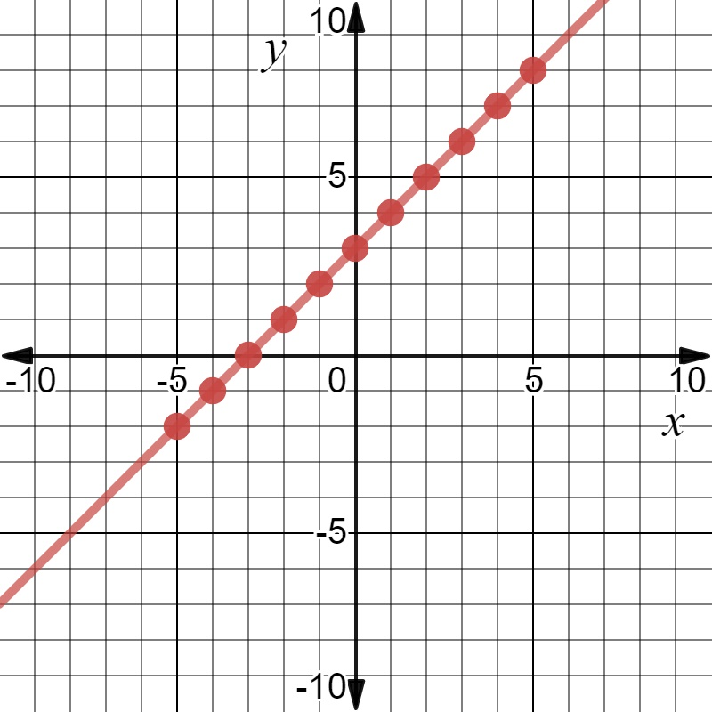
Answer to Practice #1 with Graphing a Line in y = x + b Form (7.10d)
Plot two points that lie on the line represented by this equation.
y = x + 3
Any two points on the equation y = x + 3.
Common error:
plotting (3, 0) and (0, 3).

Slide 57
Suggested Practice #2 with Graphing a Line in y = x + b Form (7.10d)
Plot two points that lie on the line represented by this equation.
y = x – 6

Slide 58
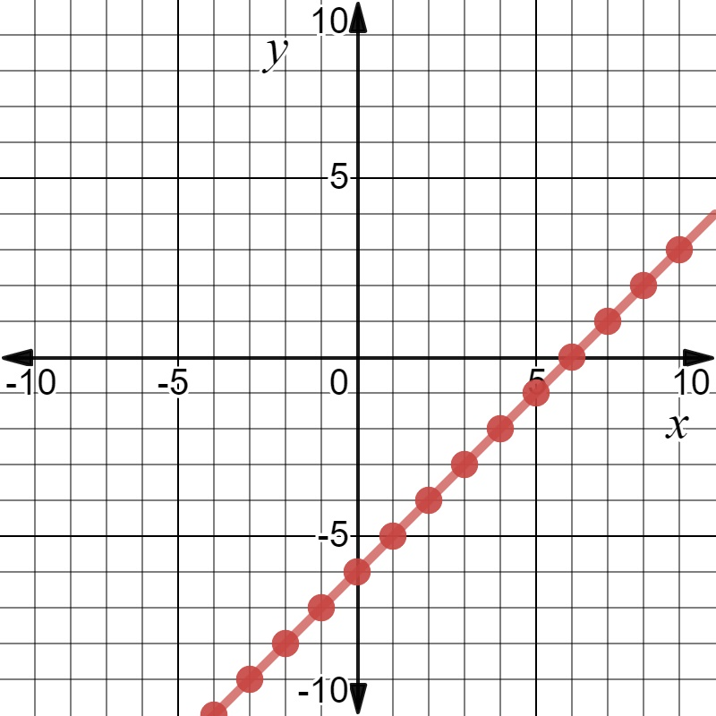
Answer to Practice #2 with Graphing a Line in y = x + b Form (7.10d)
Plot two points that lie on the line represented by this equation.
y = x – 6
Any two points on the line y = x – 6 .
Common error:
plotting (-6, 0) and (0, -6).

Slide 59
Linear Inequalities
SOL 7.13
The student will solve one- and two-step linear inequalities in one variable, including practical problems, involving addition, subtraction, multiplication, and division, and graph the solution on a number line.

Slide 60
Solving Linear Inequalities
Students would benefit from additional practice with solving
two-step inequalities.
Common errors on SOL test items include:
not reversing the inequality when multiplying or dividing by a negative value;
combining numeric and variable rational terms; and
incorrectly equating inequalities with the variable on the right side of the inequality to an inequality with the variable to the left of the inequality symbol.

Slide 61
Suggested Practice #1 with Solving Linear Inequalities (7.13)
What is the solution to this inequality?
-13 > -8x + 27
A. -1.75 > x
B. -1.75 < x
C. 5 > x
D. 5 < x

Slide 62
Answer to Practice #1 with Solving Linear Inequalities (7.13)
What is the solution to this inequality?
-13 > -8x + 27
A. -1.75 > x
B. -1.75 < x
C. 5 > x
D. 5 < x
Common error: did not reverse the direction of the inequality symbol.

Slide 63
Suggested Practice #2 with Solving Linear Inequalities (7.13)
What is the solution to this inequality?
$\frac{3}{4}$ + $\frac{3}{4}x$ < 12
A. x < 8
B. x < 12
C. x < 15
D. x < 18

Slide 64
Answer to Practice #2 with Solving Linear Inequalities (7.13)
What is the solution to this inequality?
$\frac{3}{4}$ + $\frac{3}{4}x$ < 12
A. x < 8
B. x < 12
C. x < 15
D. x < 18
Common error: combined $\frac{3}{4} \text{and} \frac{3}{4}x.$

Slide 65
Suggested Practice #3 with Solving Linear Inequalities (7.13)
Place the answers in the correct boxes.
What is the solution to this inequality?
-7 – x $≥$ 14
x
$≥$
$≤$
21
7
2
-2
-7
-21

Slide 66
Answer to Practice #3 with Solving Linear Inequalities (7.13)
Place the answers in the correct boxes.
What is the solution to this inequality?
-7 – x $≥$ 14
x
Common error: did not reverse the direction of the inequality symbol resulting in x $≥$ -21.
$≤$
-21
$≥$
$≤$
21
7
2
-2
-7
-21

Slide 67
Suggested Practice #4 with Solving Linear Inequalities (7.13)
Place the answers in the correct boxes.
What is the solution to this inequality?
-3 $≤$ 4 x + 17
x
-24
- $5$
- $7/2$
$7/2$
5
24
$≥$
$≤$

Slide 68
Answer to Practice #4 with Solving Linear Inequalities (7.13)
Place the answers in the correct boxes.
What is the solution to this inequality?
-3 $≤$ 4 x + 17
x
Common error: Students entered $x ≤−5$, misrepresenting an equivalent inequality.
$≥$
- 5
-24
- $5$
- $7/2$
$7/2$
5
24
$≥$
$≤$

Slide 69
Practice Items
This concludes the student performance information for the spring 2019 Grade 7 Mathematics SOL test.
Additional information on accessing practice items and the Guided Practice Suggestions can be found on the Virginia Department of Education website.

Slide 70
Contact Information
For questions regarding assessment, please contact student_assessment@doe.virginia.gov
For questions regarding instruction, please contact vdoe.mathematics@doe.virginia.gov

