Slide 1
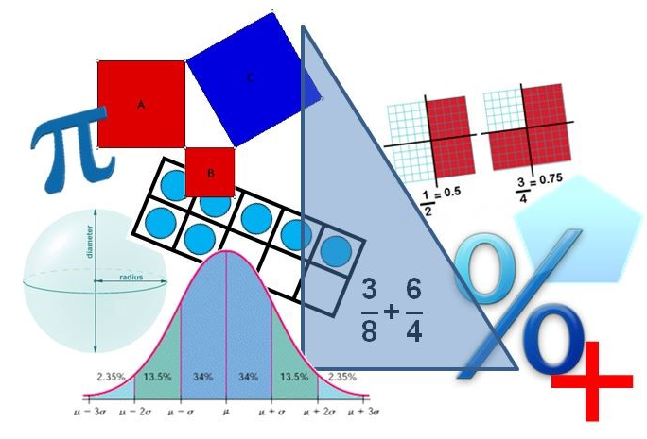
Student Performance Analysis Spring 2019
Grade 4
Mathematics Standards of Learning

Slide 2
Student Performance Analysis Spring 2019 (1 of 3)
Statewide results for the spring 2019 mathematics tests based on the 2016 Mathematics Standards of Learning (SOL) have been analyzed to determine specific content that may have challenged students. In order to support preparation of students for the Grade 4 Mathematics test, this PowerPoint presentation has been developed to provide examples of SOL content identified by this analysis.

Slide 3
Student Performance Analysis Spring 2019 (2 of 3)
It should be noted that these items are not SOL test questions and are not meant to mimic SOL test questions. Instead, they are intended to provide mathematics educators with further insight into the concepts that challenged students statewide.

Slide 4
Student Performance Analysis Spring 2019 (3 of 3)
It is important to keep the content of this statewide analysis in perspective. The information provided here should be used as supplemental information.
Instructional focus should remain on the standards as a whole, with school- or division-level data being used as the focal guiding resource to help improve instruction.

Slide 5
Fractions and Mixed Numbers
SOL 4.2
The student will
compare and order fractions and mixed numbers, with and without models;
represent equivalent fractions; and
identify the division statement that represents a fraction, with models and in context.

Slide 6
Ordering Fractions and Mixed Numbers (4.2a)
Students would benefit from additional practice ordering sets of numbers that include not only proper fractions but also improper fractions and/or mixed numbers.
The most common error in SOL test item performance occurs when students consider only the denominator and treat it as a whole number.

Slide 7
Suggested Practice with Ordering Fractions and Mixed Numbers (4.2a)
Order these numbers from least to greatest.
3$\frac{2}{8}$ $\text{3}\frac{2}{5}$ 3$\frac{1}{10}$ 3$\frac{3}{4}$
Order these numbers from greatest to least.
$\frac{6}{5}$ $1\frac{2}{3}$ 1$\frac{1}{8}$ $\frac{5}{6}$

Slide 8
Answers to Suggested Practice with Ordering Fractions and Mixed Numbers (4.2a)
Order these numbers from least to greatest.
3$\frac{2}{8}$ $\text{3}\frac{2}{5}$ 3$\frac{1}{10}$ 3$\frac{3}{4}$
3$\frac{1}{10}$ 3$\frac{2}{8}$ $\text{3}\frac{2}{5}$ 3$\frac{3}{4}$
Order these numbers from greatest to least.
$\frac{6}{5}$ $1\frac{2}{3}$ 1$\frac{1}{8}$ $\frac{5}{6}$
$1\frac{2}{3}$ $\frac{6}{5}$ 1$\frac{1}{8}$ $\frac{5}{6}$
7

Slide 9
Determining Equivalent Fractions Modeled on Number Lines (4.2b)
Students would benefit from additional practice determining equivalent fractions when given a fraction represented on a number line. Determining equivalent fractions when given an area/region or set model is a relative strength statewide.
Common errors on SOL test items vary but suggest students have difficulty naming the given fraction when it is represented on a number line.

Slide 10
Suggested Practice #1 with Equivalent Fractions (4.2b)
Which fraction has the same value as point H on the number line shown?
A. $\frac{2}{3}$ B. $\frac{3}{4}$
C. $\frac{5}{6}$ D. $\frac{10}{13}$

Slide 11
Answer to Practice #1 with Equivalent Fractions (4.2b)
Which fraction has the same value as point H on the number line shown?
A. $\frac{2}{3}$ B. $\frac{3}{4}$
C. $\frac{5}{6}$ D. $\frac{10}{13}$

Slide 12
Suggested Practice#2 with Equivalent Fractions (4.2b)
Point K represents a fraction on this number line.
Name two fractions that could each be used to represent point K.

Slide 13
Answer to Practice#2 with Equivalent Fractions (4.2b)
Point K represents a fraction on this number line.
Name two fractions that could each be used to represent point K. Any two fractions equivalent to $\frac{4}{6}$ should be considered correct (e.g., $\frac{4}{6}$ , $\frac{2}{3}$ , $\frac{6}{9}$ , $\frac{8}{12}$ , etc.).

Slide 14
Extension with Equivalent Fractions (4.2b)
Teachers are encouraged to use fractions represented on number lines to extend students’ thinking. This extension corresponds to the previous model as shown.
The fraction located at point K has a value of $\frac{4}{6}$. Use the number line or create a different model to show two different fractions having the same value as $\frac{4}{6}$.

Slide 15
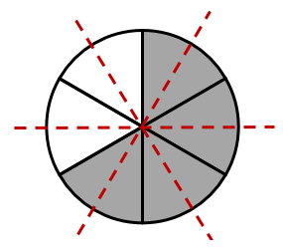
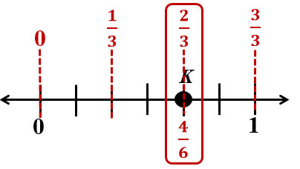
Possible Answers to Extension with Equivalent Fractions (4.2b)
The fraction located at point K has a value of $\frac{4}{6}$. Use the number line or create a different model to show two different fractions having the same value as $\frac{4}{6}$. Possible answers are provided.
This shows $\frac{4}{6}=\frac{2}{3}.$
This shows $\frac{4}{6}=\frac{8}{12}.$

Slide 16
Identifying Division Equations that Represent Fractions (4.2c)
Students would benefit from additional practice identifying the division equation that represents a fraction when given a division model and/or division context.
Common errors on SOL test items include:
using numbers from the context in the order given rather than using numbers that correspond to the dividend and divisor as described in the context; and
selecting number sentences with proper fractions when the result of division is greater than one.

Slide 17
Suggested Practice #1 with Division Equations Representing Fractions (4.2c)
A group of 6 children shared 3 ice cream sandwiches equally.
Which division statement can be used to find the amount of ice cream sandwich each child received?
A. $6÷3= \frac{6}{3}$ B. $6÷3= \frac{3}{6}$
C. $3÷6= \frac{3}{6}$ D. $3÷6= \frac{6}{3}$

Slide 18
Answer to Practice #1 with Division Equations Representing Fractions (4.2c)
A group of 6 children shared 3 ice cream sandwiches equally.
Which division statement can be used to find the amount of ice cream sandwich each child received?
A. $6÷3= \frac{6}{3}$ B. $6÷3= \frac{3}{6}$ common error
C. $3÷6= \frac{3}{6}$ D. $3÷6= \frac{6}{3}$

Slide 19
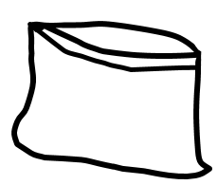
Suggested Practice #2 with Division Equations Representing Fractions (4.2c)
There are 5 cookies. These cookies will be divided equally into the 4 bags shown.
Which division statement represents the amount of these cookies that will be put into each bag?
A. $4÷5=\frac{4}{5}$ cookie
B. $4÷5=\frac{5}{4}$cookies
C. $5÷4=\frac{4}{5}$ cookie
D. $5÷4=\frac{5}{4}$ cookies

Slide 20
Answer to Practice #2 with Division Equations Representing Fractions(4.2c)
There are 5 cookies. These cookies will be divided equally into the 4 bags shown.
Which division statement represents the amount of these cookies that will be put into each bag?
A. $4÷5=\frac{4}{5}$ cookie
B. $4÷5=\frac{5}{4}$cookies
C. $5÷4=\frac{4}{5}$ cookie common error
D. $5÷4=\frac{5}{4}$ cookies

Slide 21
Understanding Decimals
SOL 4.3
The student will
read, write, represent, and identify decimals expressed through thousandths;
round decimals to the nearest whole number;
compare and order decimals; and
given a model, write the decimal and fraction equivalents.

Slide 22
Identifying Decimals (4.3a)
Students would benefit from additional practice identifying decimals. Teachers are encouraged to represent one whole using a variety of models.
The most common error on SOL test items occurs when students do not recognize the whole, as it has been defined in the given problem and model, when naming the quantity represented.

Slide 23
Suggested Practice #1 with Identifying Decimals (4.3a)
This model represents one whole.
Model K represents a decimal.
Model K
Which decimal is represented by Model K?
A. 136
B. 13.6
C. 1.36
D. 0.136

Slide 24
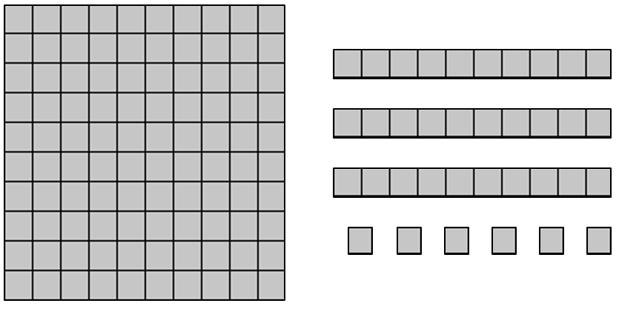
Answer to Practice #1 with Identifying Decimals (4.3a)
This model represents one whole.
Model K represents a decimal.
Model K
Which decimal is represented by Model K?
A. 136 common error
B. 13.6
C. 1.36
D. 0.136

Slide 25
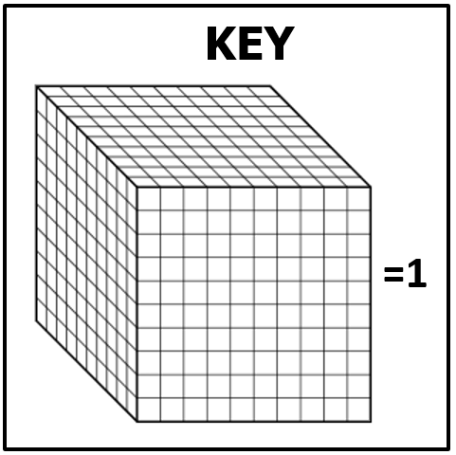
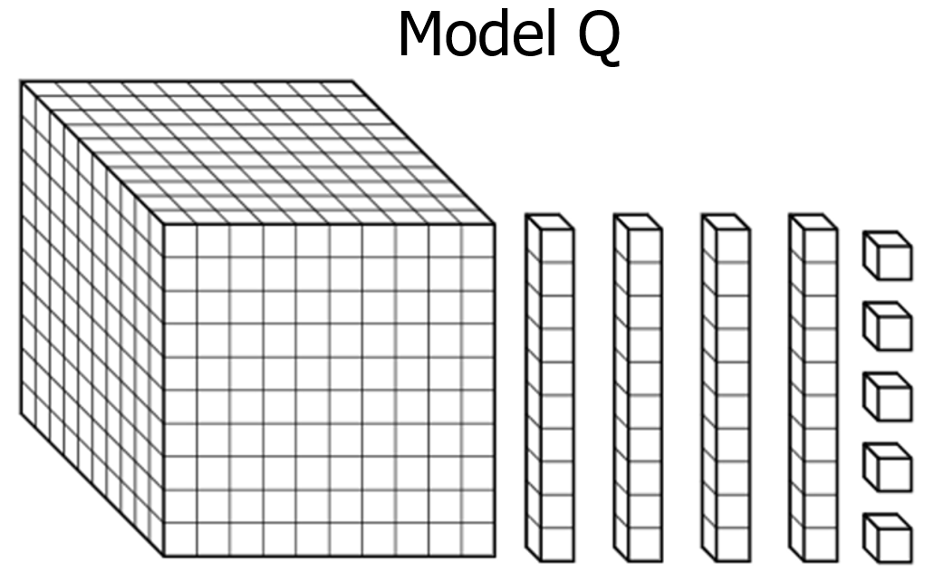
Suggested Practice #2 with Identifying Decimals (4.3a)
What number is represented by Model Q? _________

Slide 26
Answer to Practice #2 with Identifying Decimals (4.3a)
What number is represented by Model Q? _________
1.045
common error:
1,045

Slide 27
Naming Equivalent Fractions and Decimals Represented on a Number Line (4.3d)
Students would benefit from additional practice writing the decimal and fraction equivalents for mixed numbers represented on a number line.
Common errors on SOL test items suggest that students have difficulty recognizing the fraction represented on the number line and/or have difficulty recognizing the decimal equivalent for the fraction.

Slide 28
(4.3d)
Suggested Practice with Equivalent Fractions and Decimals Represented on a Number Line (4.3d)
Which set of numbers best represents the location of point P shown on this number line?
A. $5.5$ and $5\frac{1}{2}$ B. $5.13$ and $5\frac{1}{3}$
C. $5.25$ and $5\frac{1}{4}$ D. $5.2$ and $5\frac{1}{5}$

Slide 29
(4.3d)
Answer to Practice with Equivalent Fractions and Decimals Represented on a Number Line (4.3d)a
Which set of numbers best represents the location of point P shown on this number line?
A. $5.5$ and $5\frac{1}{2}$ B. $5.13$ and $5\frac{1}{3}$
C. $5.25$ and $5\frac{1}{4}$ D. $5.2$ and $5\frac{1}{5}$ common error
common
error

Slide 30
Solving Multistep Practical Problems
SOL 4.4
The student will
demonstrate fluency with multiplication facts through $12×12$ and the corresponding division facts;
estimate and determine sums, differences, and products of whole numbers;
estimate and determine quotients of whole numbers, with and without remainders; and
create and solve single-step and multistep practical problems involving addition, subtraction, and multiplication, and single-step practical problems involving division with whole numbers.

Slide 31
Solving Multistep Practical Problems with Whole Numbers (4.4d)
Students would benefit from additional practice solving multistep practical problems in which they must use the information from the context to determine an operation or operations needed to find the solution.
Common errors on SOL test items include adding or subtracting the given numbers instead of applying the information from the context correctly to find a solution.

Slide 32
Suggested Practice with Solving Multistep Practical Problems with Whole Numbers (4.4d)
A store had a total of 6,721 customers on Friday, Saturday, and Sunday. This store had exactly:
2,704 customers on Saturday
288 more customers on Sunday than on Saturday
Exactly how many customers did the store have on Friday?
9,713
4,305
3,729
1,025

Slide 33
Answer to Practice with Solving Multistep Practical Problems with Whole Numbers (4.4d)
A store had a total of 6,721 customers on Friday, Saturday, and Sunday. This store had exactly:
2,704 customers on Saturday
288 more customers on Sunday than on Saturday
Exactly how many customers did the store have on Friday?
9,713 common error: 6,721 + 2,704 + 288 = 9,713
4,305
3,729 common error: 6,721 – 2,704 – 288 = 3,729
D. 1,025
R

Slide 34
Solving Practical Problems Involving Fractions and Mixed Numbers
SOL 4.5
The student will
determine common multiples and factors, including least common multiple and greatest common factor;
add and subtract fractions and mixed numbers having like and unlike denominators; and
solve single-step practical problems involving addition and subtraction with fractions and mixed numbers.

Slide 35
Solving Practical Problems Involving Fractions and Mixed Numbers (4.5c)
Students would benefit from additional practice with a variety of practical problem types involving addition and subtraction with fractions and mixed numbers, such as situations in which the amount of change is unknown or a starting value is unknown.
Common errors on SOL test items vary depending on problem type and may result from using “key words” rather than developing an understanding of the complete context to solve the problem.

Slide 36
Suggested Practice with Practical Problems Involving Fractions and Mixed Numbers (4.5c)
Devon had $\frac{1}{2}$ pound of potatoes. He bought some more potatoes. Now Devon has$3\frac{7}{8}$ pounds of potatoes. Exactly how many pounds of potatoes did Devon buy?
A. $3\frac{3}{8}$ B. $3\frac{4}{5}$ C. $4$ D. $4\frac{3}{8}$

Slide 37
Answer to Practice with Practical Problems Involving Fractions and Mixed Numbers (4.5c)
Devon had $\frac{1}{2}$ pound of potatoes. He bought some more potatoes. Now Devon has$3\frac{7}{8}$ pounds of potatoes. Exactly how many pounds of potatoes did Devon buy?
A. $3\frac{3}{8}$ B. $3\frac{4}{5}$ C. $4$ D. $4\frac{3}{8}$
most common error
$3\frac{7}{8}+\frac{1}{2}$ = $3\frac{11}{8}=4\frac{3}{8}$

Slide 38
Solving Practical Problems Involving Perimeter and Area
SOL 4.7
The student will solve practical problems that involve determining perimeter and area in U.S. Customary and metric units.

Slide 39
Distinguishing between Area and Perimeter (4.7)
Students would benefit from additional practice distinguishing between area and perimeter of given figures.
Common errors on SOL test items involve finding area when a given situation describes perimeter and vice versa.

Slide 40
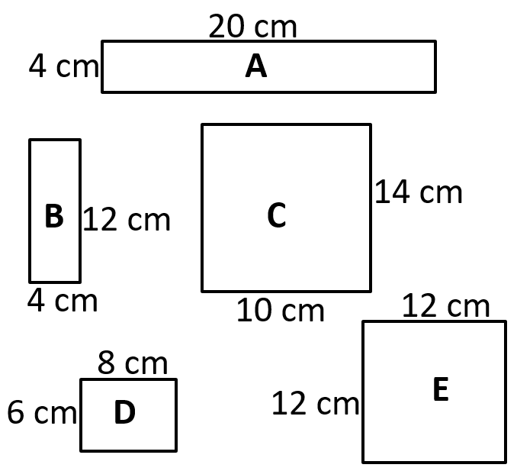
Suggested Practice with Distinguishing between Area and Perimeter (4.7)
Figures A, B, C, D and E are shown.
Which figures have a perimeter of 48 centimeters?
Which figures have an area of 48 square centimeters?

Slide 41
Answers to Practice with Distinguishing between Area and Perimeter (4.7)
Figures A, B, C, D and E are shown.
Which figures have a perimeter of 48 centimeters? A, C, E
Which figures have an area of 48 square centimeters? B, D

Slide 42
Solving Practical Problems Involving U.S. Customary Units (1 of 2)
SOL 4.8
The student will
estimate and measure length and describe the result in U.S. Customary and metric units;
estimate and measure weight/mass and describe the result in U.S. Customary and metric units;

Slide 43
Solving Practical Problems Involving U.S. Customary Units (2 of 2)
SOL 4.8
The student will
given the equivalent measure of one unit, identify equivalent measures of length, weight/mass, and liquid volume between units within the U.S. Customary system; and
solve practical problems that involve length, weight/mass, and liquid volume in U.S. Customary units.

Slide 44
Solving Practical Problems Involving U.S. Customary Units (4.8d)
Students would benefit from additional practice solving practical problems involving length in U.S. Customary units, given the equivalent measure of one unit.
Common errors suggest:
students may have difficulty applying measurement skills from earlier grade levels to determine the length of an object and then using that length to find the solution to a practical situation;
students may be unsure how to deal with measurements involving more than one unit.

Slide 45
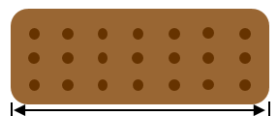
Suggested Practice #1 with Solving Practical Problems Involving U.S. Customary Units (4.8d)
Measure the length of this ice cream sandwich to the nearest inch.
Tom will place 4 of these ice cream sandwiches, without overlapping, to decorate part of a cake. Which measurement is closest to the total length of 4 ice cream sandwiches?
A. 2 inches B. 4 inches C. 6 inches D. 8 inches

Slide 46
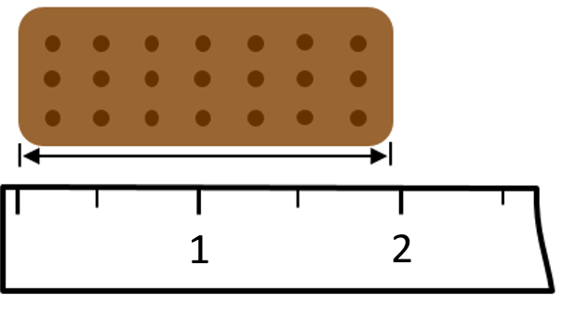
Step 1 for Practice #1 with Solving Practical Problems Involving U.S. Customary Units (4.8d)
Measure the length of this ice cream sandwich to the nearest inch.
Students need to use the correct ruler, align it correctly, determine the length of the ice cream sandwich to the nearest inch, and use that information to solve the problem.
inches

Slide 47
Answer to Practice #1 with Solving Practical Problems Involving U.S. Customary Units (4.8d)
Measure the length of this ice cream sandwich to the nearest inch.
Tom will place 4 of these ice cream sandwiches end-to-end, without overlapping, to decorate part of a cake. Which measurement is closest to the total length of 4 ice cream sandwiches?
A. 2 inches B. 4 inches C. 6 inches D. 8 inches
common errors: 2 inches (length of the ice cream sandwich) and 4 inches (the number of ice cream sandwiches)

Slide 48
Suggested Practice #2 with Solving Practical Problems Involving U.S. Customary Units (4.8d)
1 foot = 12 inches
John’s father is 6 feet 4 inches tall. John’s father is exactly _________ inches tall.

Slide 49
Answer to Practice #2 with Solving Practical Problems Involving U.S. Customary Units (4.8d)
1 foot = 12 inches
John’s father is 6 feet 4 inches tall. John’s father is exactly _________ inches tall.
76

Slide 50
Describing Parallel Lines and Perpendicular Lines
SOL 4.10
The student will
identify and describe points, lines, line segments, rays, and angles, including endpoints and vertices; and
identify and describe intersecting, parallel, and perpendicular lines.

Slide 51
Describing Parallelism and Perpendicularity with Symbolic Notation (4.10b)
Students would benefit from additional practice using symbolic notation to describe lines that are parallel and lines that are perpendicular when given a figure that includes more than two lines.
Errors vary on SOL test items, suggesting that students may have difficulty determining which lines in the figure are involved in the comparison or that students are confusing the meanings of the symbols.

Slide 52
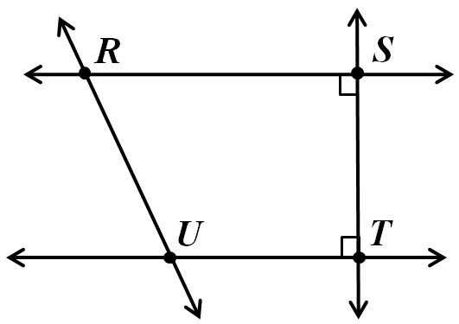
Suggested Practice with Describing Parallel Lines and Perpendicular Lines (4.10b)
This figure shows four lines.
Select three statements about the figure that appear to be true.
RS$⊥$ UT RS$⊥$ ST
RU $∥$ RS UT $⊥$ ST
ST $∥$ RS UT $∥$ RS

Slide 53
Answers to Practice with Describing Parallel Lines and Perpendicular Lines (4.10b)
This figure shows four lines.
Select three statements about the figure that appear to be true.
RS$⊥$ UT RS$⊥$ ST
RU $∥$ RS UT $⊥$ ST
ST $∥$ RS UT $∥$ RS

Slide 54
Classifying Quadrilaterals
SOL 4.12
The student will classify quadrilaterals as parallelograms, rectangles, squares, rhombi, and/or trapezoids.

Slide 55
Recognizing Trapezoids and Rhombi (4.12)
Students would benefit from additional practice with trapezoids and rhombi, including verbal descriptions without pictorial support and pictorial representations in varied spatial orientation.
Common errors suggest that students have difficulty with figures that can be classified in more than one way (e.g., squares are also rhombi).

Slide 56
Suggested Practice #1 with Trapezoids and Rhombi (4.12)
A quadrilateral has these characteristics.
Exactly one pair of opposite sides is parallel.
It has exactly two right angles.
Exactly two sides are congruent.
This figure can be described as a ̶
A. parallelogram
B. rhombus
C. trapezoid
D. rectangle

Slide 57
Answer to Practice #1 with Trapezoids and Rhombi (4.12)
A quadrilateral has these characteristics.
Exactly one pair of opposite sides is parallel.
It has exactly two right angles.
Exactly two sides are congruent.
This figure can be described as a ̶
A. parallelogram
B. rhombus most common error
C. trapezoid
D. rectangle

Slide 58
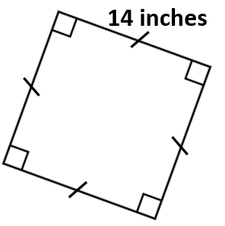
Suggested Practice #2 with Trapezoids and Rhombi (4.12)
A figure is shown.
Which list contains only words that describe this figure?
A. Rectangle, rhombus, trapezoid
B. Parallelogram, rhombus, square
C. Square, trapezoid, parallelogram
D. Rhombus, square, trapezoid

Slide 59
Answer to Practice #2 with Trapezoids and Rhombi (4.12)
A figure is shown.
Which list contains only words that describe this figure?
A. Rectangle, rhombus, trapezoid
B. Parallelogram, rhombus, square
C. Square, trapezoid, parallelogram
D. Rhombus, square, trapezoid

Slide 60
Practice Items
This concludes the student performance information for the spring 2019 Grade 4 Mathematics SOL test.
Additional information on accessing practice items and the Guided Practice Suggestions can be found on the Virginia Department of Education website.

Slide 61
Contact Information
For questions regarding assessment, please contact student_assessment@doe.virginia.gov
For questions regarding instruction, please contact vdoe.mathematics@doe.virginia.gov

