Slide 1
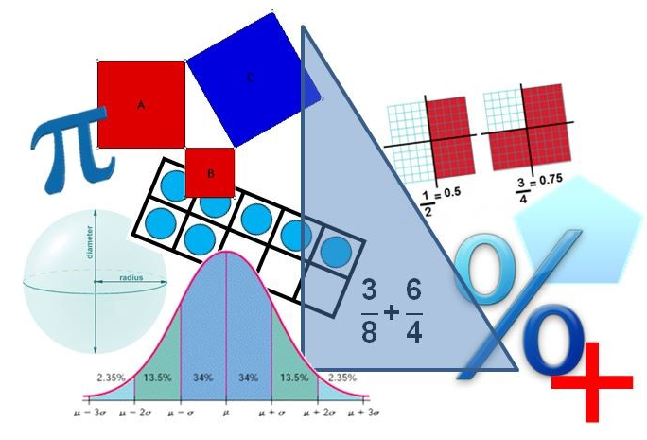
Student Performance Analysis Spring 2019
Algebra I
Mathematics Standards of Learning

Slide 2
Student Performance Analysis Spring 2019 (1 of 3)
Statewide results for the spring 2019 mathematics tests based on the 2016 Mathematics Standards of Learning (SOL) have been analyzed to determine specific content that may have challenged students. In order to support preparation of students for the Algebra I test, this PowerPoint presentation has been developed to provide examples of SOL content identified by this analysis.

Slide 3
Student Performance Analysis Spring 2019 (2 of 3)
It should be noted that these items are not SOL test questions and are not meant to mimic SOL test questions. Instead, they are intended to provide mathematics educators with further insight into the concepts that challenged students statewide.

Slide 4
Student Performance Analysis Spring 2019 (3 of 3)
It is important to keep the content of this statewide analysis in perspective. The information provided here should be used as supplemental information.
Instructional focus should remain on the standards as a whole, with school- or division-level data being used as the focal guiding resource to help improve instruction.

Slide 5
Laws of Exponents
SOL A.2
The student will perform operations on polynomials, including
applying the laws of exponents to perform operations on expressions;
b) adding, subtracting, multiplying, and dividing polynomials; and
c) factoring completely first- and second-degree binomials and trinomials in one variable.

Slide 6
Applying Laws of Exponents (A.2a)
Students would benefit from additional practice simplifying ratios of monomial expressions using laws of exponents.
Common errors on SOL test items include:
squaring or cubing the exponents instead of multiplying the powers when raising a power to a power; and
taking the difference between the exponents when using the quotient theorem without regard to the sign of the exponent in the denominator.

Slide 7
Suggested Practice #1 with Applying Laws of Exponents (A.2a)
Simplify: $({{3x}^{2})}^{3} ({{2x}^{4})}^{2}$
7

Slide 8
Answer to Practice #1 with Applying Laws of Exponents (A.2a)
Simplify: $({{3x}^{2})}^{3} ({{2x}^{4})}^{2}$
$${108x}^{14}$$
Common error: squaring or cubing an exponent instead of multiplying the exponents
$\left({27x}^{8}\right)\left({4x}^{16}\right)=$ ${108x}^{24}$
8

Slide 9
Suggested Practice #2 with Applying Laws of Exponents (A.2a)
Given:
$$\frac{{\left(x^{8} \right)}^{p}}{{\left(x^{4} \right)}^{−4}}$$
For what value of p is the given expression equivalent to $x^{48}$ when x $≠0$ ?
A. 2
B. 4
C. 6
D. 8
9

Slide 10
Answer to Practice #2 with Applying Laws of Exponents (A.2a)
Given:
$$\frac{{\left(x^{8} \right)}^{p}}{{\left(x^{4} \right)}^{−4}}$$
For what value of p is the given expression equivalent to $x^{48}$ when x $≠0$ ?
A. 2
B. 4
C. 6
D. 8
10
Common error: using 8p – 16 = 48 to solve for p

Slide 11
Suggested Practice #3 with Applying Laws of Exponents (A.2a)
a) For what value of p is the given expression equivalent to $x^{48}$ when x $≠0$ ?
$$\frac{{\left(x^{8} \right)}^{p}}{{\left(x^{−p} \right)}^{−4}}$$
b) For what value of p is the given expression equivalent to $x^{48}$ when x $≠0$ ?
$$\frac{{\left(x^{8} \right)}^{3}}{{\left(x^{p} \right)}^{−4}}$$
11

Slide 12
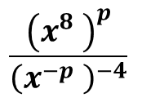
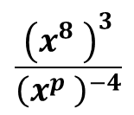
Answer to Practice #3 with Applying Laws of Exponents (A.2a)
a) For what value of p is the given expression equivalent to $x^{48}$ when x $≠0$ ?
b) For what value of p is the given expression equivalent to $x^{48}$ when x $≠0$ ?
Common error: incorrectly writing the equation to find the value of p when a negative exponent is involved, as in
8p + (-4)(-p) = 48; p = 4
p = 12
p = 6
12
Common error: using 24 – 4p = 48; p = -6

Slide 13
Suggested Practice #4 with Applying Laws of Exponents (A.2a)
If the given expression is simplified to $n^{x}$ where $n≠0$, what is the value of x?
$\frac{\left(n^{22} \right) (n^{−6} )}{{(n^{3} )}^{−4}}=n^{x}$
x =
13

Slide 14
Answer to Practice #4 with Applying Laws of Exponents (A.2a)
If the given expression is simplified to $n^{x}$ where $n≠0$, what is the value of x?
$\frac{\left(n^{22} \right) (n^{−6} )}{{(n^{3} )}^{−4}}=n^{x}$
x =
The common error is using 16 – 12 and obtaining x = 4. The product and power theorems were applied correctly; however, the quotient theorem was used incorrectly.
28
14

Slide 15
Simplifying Square Roots and Cube Roots
SOL A.3
The student will simplify
a) square roots of whole numbers and monomial algebraic expressions;
b) cube roots of integers; and
c) numerical expressions containing square or cube roots.

Slide 16
Simplifying Cube Roots (A.3b)
Students would benefit from additional practice expressing the cube root of an integer in simplest form.
Common errors on SOL test items include:
using perfect squares rather than perfect cubes when simplifying a cube root; and
assuming that the radicand of a cube root is simplified when the original value is not a perfect cube.

Slide 17
Suggested Practice with Simplifying Cube Roots (A.3b)
A student claims that $\sqrt[3]{80}$ is in simplest radical form. Which statement is true?
A. The claim is correct because $80$ is not divisible by three.
B. The claim is correct because $80$ is not a perfect cube.
C. The claim is incorrect because $80$ has a factor of 4.
D. The claim is incorrect because $80$ has a factor of $8$.

Slide 18
Answer to Suggested Practice with Simplifying Cube Roots (A.3b)
A student claims that $\sqrt[3]{80}$ is in simplest radical form. Which statement is true?
A. The claim is correct because $80$ is not divisible by three.
B. The claim is correct because $80$ is not a perfect cube.
C. The claim is incorrect because $80$ has a factor of 4.
D. The claim is incorrect because $80$ has a factor of $8$.
Common errors include:
selecting option B because $80$ is not a perfect cube; and
selecting option C since 4 is a perfect square and a factor of $80$.

Slide 19
Solving Equations and Systems of Equations
SOL A.4
The student will solve
a) multistep linear equations in one variable algebraically;
b) quadratic equations in one variable algebraically;
c) literal equations for a specified variable;
d) systems of two linear equations in two variables algebraically and graphically; and
e) practical problems involving equations and systems of equations.

Slide 20
Solving Linear Equations (A.4a)
Students would benefit from additional practice solving linear equations having no solution and linear equations having infinitely many solutions.
Common errors on SOL test items include:
finding the difference between the constant terms as the solution for a linear equation with no solutions; and
using the constant value in the equation as the solution when solving a linear equation that has infinitely many solutions
(e.g., $3x+10=3x+10$; thinking that $10$ is the solution).

Slide 21
Suggested Practice #1 with Solving Linear Equations (A.4a)
For what value of k does the equation have no solution?
$kx+6=2x+10$
$k=$

Slide 22
Answer to Practice #1 with Solving Linear Equations (A.4a)
For what value of k does the equation have no solution?
$kx+6=2x+10$
k = 2
Common error: solving the equation by calculating the difference of the constant terms, 10 – 6, and obtaining 4 as the value of k

Slide 23
Suggested Practice #2 with Solving Linear Equations (A.4a)
For what value(s) of k does each equation have infinitely many solutions?
$15−3kx=6(2.5−x)$ $\frac{1}{3}\left(x+k\right)= \frac{1}{3}x+12$
$k=$
$k=$

Slide 24
Answers to Practice #2 with Solving Linear Equations (A.4a)
For what value(s) of k does each equation have infinitely many solutions?
$15−3kx=6(2.5−x)$ $\frac{1}{3}\left(x+k\right)= \frac{1}{3}x+12$
k = 2
k = 36
Common errors include:
simplifying the first equation to 15 – 3kx = 15 – 6x and assuming k = 6; and
not distributing correctly in the second equation, obtaining $\frac{1}{3}x+k=\frac{1}{3}x+12$ and assuming k = 12.

Slide 25
Solving Quadratic Equations (A.4b)
Students would benefit from additional practice solving quadratic equations with irrational solutions and leading coefficients that are rational and/or negative.
Common errors on SOL test items include:
using the values of a, b, and c in a quadratic equation without regard to having all of the terms on one side of the equation;
not recognizing a solution in simplest form; and
incorrectly applying the quadratic formula when coefficients are rational numbers and/or negative numbers.

Slide 26
Suggested Practice with Solving Quadratics (A.4b)
1) Solve: $−2x^{2 }= −7x+4$
2) Solve: $\frac{1}{3}x^{2}−\frac{4}{3}x=1$
$x=$
$x=$

Slide 27
Answers to Practice with Solving Quadratics (A.4b)
1) Solve: $−2x^{2 }= −7x+4$ $x= \frac{7±\sqrt{17}}{4}$
2) Solve: $\frac{1}{3}x^{2}−\frac{4}{3}x=1$ $x= 2±\sqrt{7}$
Common error: using a = $−$2, b = $−$7, and c = 4 as values in the quadratic formula to find the solution of the equation
Common error: incorrectly using the fractional coefficients as values in the quadratic formula, or incorrectly writing an equivalent quadratic equation without fractions to use as values

Slide 28
Solving Literal Equations (A.4c)
Students would benefit from additional practice solving literal equations for a specified variable.
Common errors include:
writing the reciprocal of the rational solution; and
solving without using the greatest common factor (GCF) when the specified variable is the GCF.

Slide 29
Suggested Practice #1 with Solving Literal Equations (A.4c)
Solve the equation for k.
$$h=\frac{4}{k}+n$$
$k=$

Slide 30
Answer to Practice #1 with Solving Literal Equations (A.4c)
Solve the equation for k.
$$h=\frac{4}{k}+n$$
$$k= \frac{4}{h−n}$$
Common error: solving for the specified variable without regard to its position in the fraction and writing the reciprocal of the solution
$h−n=\frac{4}{k} ⇒ k=\frac{h−n}{4}$

Slide 31
Suggested Practice with Solving Literal Equations (A.4c)
The formula A = P + Prt represents the relationship between the principal, P, interest rate, r , and amount of money, A, in an account over a period of time, t.
Solve the equation for P.

Slide 32
Answers to Practice with Solving Literal Equations (A.4c)
The formula A = P + Prt represents the relationship between the principal, P, interest rate, r , and amount of money, A, in an account over a period of time, t.
a) Solve the equation for P. $P= \frac{A}{1+rt}$
Common error: not using the GCF of P. Students appear to solve by dividing both sides of the equation by rt, adding P + P, and dividing both sides by 2 to yield $P= \frac{A}{2rt}$.

Slide 33
Additional Practice with Solving Literal Equations (A.4c)
The formula A = P + Prt can be used to find the interest rate in a problem involving money where A is the amount in the account, P is the principal, r is the interest rate, and t is the time in years that the money has been invested.
b) Solve the equation for r.

Slide 34
Answers to Additional Practice with Solving Literal Equations (A.4c)
The formula A = P + Prt can be used to find the interest rate in a problem involving money where A is the amount in the account, P is the principal, r is the interest rate, and t is the time in years that the money has been invested.
b) Solve the equation for r.
$$r=\frac{A−P}{Pt}$$

Slide 35
Solving Linear Inequalities and Systems of Linear Inequalities
SOL A.5
The student will
a) solve multistep linear inequalities in one variable algebraically and represent the solution graphically;
b) represent the solution of linear inequalities in two variables graphically;
c) solve practical problems involving inequalities; and
d) represent the solution to a system of inequalities graphically.

Slide 36
Representing Solutions to a System of Linear Inequalities (A.5)
Students would benefit from additional practice representing the solutions to a system of linear inequalities in two variables.
Common errors on SOL test items include discerning which points are part of the solution set to a system of linear inequalities in two variables when given a graph with one or more dotted boundary lines.

Slide 37
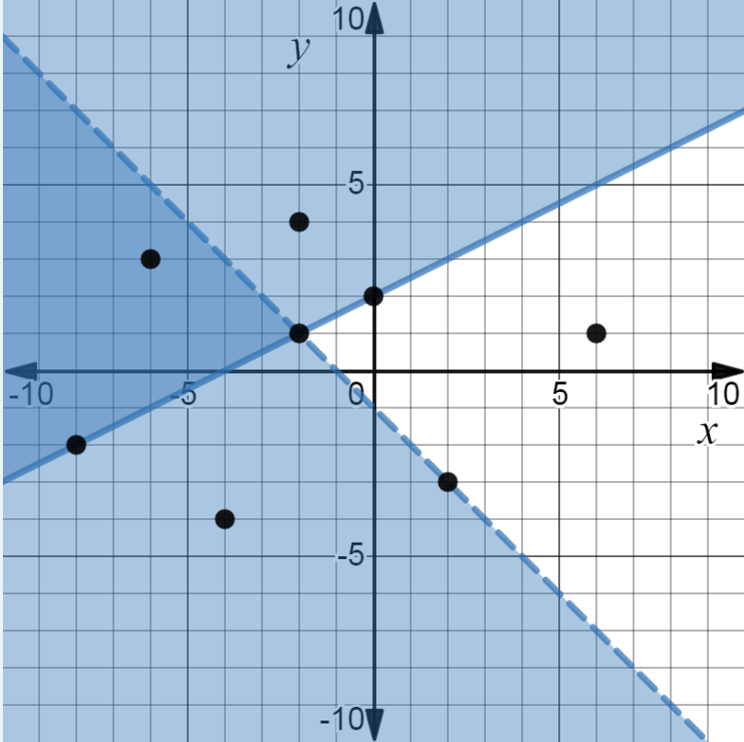
Suggested Practice with Systems of Linear Inequalities (A.5d)
The solutions to a system of linear inequalities and points F, G, H, J, K, L, M, and N are shown. All labeled points have integral coordinates.
Points F, J, and M each lie on a boundary line.
Point G lies on both boundaries.
N
H
F
K
G
Identify each labeled point that represents a solution to this system of linear inequalities.
M
J
L

Slide 38
Answer to Practice with Systems of Linear Inequalities (A.5d)
The solutions to a system of linear inequalities and points F, G, H, J, K, L, M, and N are shown. All labeled points have integral coordinates.
Points F, J, and M each lie on a boundary line.
Point G lies on both boundaries.
N
H
F
K
Identify each labeled point that represents a solution to this system of linear inequalities.
G
M
J
L
Common error: selecting point G as a solution

Slide 39
Graphing and Writing Linear Equations
SOL A.6
The student will
a) determine the slope of a line when given an equation of the line, the graph of the line, or two points on the line;
b) write the equation of a line when given the graph of the line, two points on the line, or the slope and a point on the line; and
c) graph linear equations in two variables.

Slide 40
Determining Slope of a Line (A.6a)
Students would benefit from additional practice determining the slope of a line from an equation presented in any algebraic form (i.e., slope-intercept, standard, or point-slope form).
Common errors on SOL test items include:
confusing the slopes of vertical and horizontal lines when given an algebraic equation; and
incorrectly determining the slope of a line when the coefficient for the y-term is a rational number.

Slide 41
Suggested Practice #1 with Determining Slope of a Line (A.6a)
Which of these best describes the slope of a line represented by y = n, where n is a constant?
A. The slope is zero only if n = 0.
B. The slope is zero for all values of n.
C. The slope is undefined only if n = 0.
D. The slope is undefined for all values of n.

Slide 42
Answer to Practice #1 with Determining Slope of a Line (A.6a)
Which of these best describes the slope of a line represented by y = n, where n is a constant?
A. The slope is zero only if n = 0.
B. The slope is zero for all values of n.
C. The slope is undefined only if n = 0.
D. The slope is undefined for all values of n.
Common error: selecting option A, assuming that the slope is zero only if the variable is equal to zero

Slide 43
Suggested Practice #2 with Determining Slope of a Line (A.6a)
What is the slope of the line represented by this equation?
$$\frac{1}{3}y=3x−3$$
$\frac{1}{3}$
$3$
$1$
$9$

Slide 44
Answer to Practice #2 with Determining Slope of a Line (A.6a)
What is the slope of the line represented by this equation?
$$\frac{1}{3}y=3x−3$$
$\frac{1}{3}$
$3$
$1$
$9$
Common error: selecting the coefficient of $x$ without solving the equation for $y$

Slide 45
Additional Practice with Determining Slope of a Line (A.6a)
What is the slope, $m$, of the line represented by this equation?
$$y−2=3\left(\frac{4}{3}x−3\right)$$
$$m=$$

Slide 46
Answer to Additional Practice with Determining Slope of a Line (A.6a)
What is the slope, $m$, of the line represented by this equation?
$$y−2=3\left(\frac{4}{3}x−3\right)$$
$$m= 4$$

Slide 47
Writing Equations of Parallel and Perpendicular Lines (A.6b)
Students would benefit from additional practice writing equations of lines parallel or perpendicular to a given line and through a given point. Practice should include lines represented in the format of an equation, the slope and a point on the line, or two points.
Common errors on SOL test items include:
using the reciprocal slope instead of the negative reciprocal slope when writing equations of perpendicular lines; and
using the reciprocal slope or the negative reciprocal slope when writing equations of parallel lines.

Slide 48
Suggested Practice #1 with Equations of Parallel and Perpendicular Lines (A.6b)
Line m passes through the points located at (5, 12) and (7, 15). Write the equation of the line that is perpendicular to line m and passes through the point located at (-6, 3).
Slope-Intercept Form:
Standard Form:

Slide 49
Answers to Practice #1 with Equations of Parallel and Perpendicular Lines (A.6b)
Line m passes through the points located at (5, 12) and (7, 15). Write the equation of the line that is perpendicular to line m and passes through the point located at (-6, 3).
Slope-Intercept Form: $y=\frac{−2}{3}x−1$
Standard Form: $2x+3y=−3$
Common error: using the reciprocal slope $→ y=\frac{2}{3}x+7$
Common error: multiplying only the coefficient of $x$ by $3$ to eliminate the fraction$→ 2x+y=−1$

Slide 50
Suggested Practice #2 with Equations of Parallel and Perpendicular Lines (A.6b)
Line p is represented by the equation $5x−4y=12$. Line k is parallel to line p and has an x-intercept of 4. Which of these could represent the equation of line k ?
A. $\left(y−4\right)=\frac{5}{4}\left(x−0\right)$
B. $\left(y−0\right)=\frac{5}{4}(x−4)$
C. $\left(y−0\right)=\frac{−4}{5}\left(x−4\right)$
D. $\left(y−4\right)=\frac{−4}{5}(x−0)$

Slide 51
Answer to Practice #2 with Equations of Parallel and Perpendicular Lines (A.6b)
Line p is represented by the equation $5x−4y=12$. Line k is parallel to line p and has an x-intercept of 4. Which of these could represent the equation of line k ?
A. $\left(y−4\right)=\frac{5}{4}\left(x−0\right)$
B. $\left(y−0\right)=\frac{5}{4}(x−4)$
C. $\left(y−0\right)=\frac{−4}{5}\left(x−4\right)$
D. $\left(y−4\right)=\frac{−4}{5}(x−0)$
Common error: using the negative reciprocal slope instead of the same slope

Slide 52
Transformations (A.6c)
Students would benefit from additional practice describing the changes in slope and y-intercept when given a transformation of the parent function, y = x.
Common errors on SOL test items include:
when translating the parent function y = x left or right, assuming that the y-intercept is negative for a translation to the left and positive for a translation to the right; and
when dilating the parent function y = x, changing both the slope and the y-intercept.

Slide 53
Suggested Practice #1 with Transformations (A.6c)
The graph of the parent function y = x is translated 5 units to the left. What are the slope and y-intercept of this line?
A. slope = 1, y-intercept = -5
B. slope = 1, y-intercept = 5
C. slope = 5, y-intercept = -5
D. slope = 5, y-intercept = 5

Slide 54
Answer to Practice #1 with Transformations (A.6c)
The graph of the parent function y = x is translated 5 units to the left. What are the slope and y-intercept of this line?
A. slope = 1, y-intercept = -5
B. slope = 1, y-intercept = 5
C. slope = 5, y-intercept = -5
D. slope = 5, y-intercept = 5
Common error: assuming the y-intercept is negative since the graph was
translated left

Slide 55
Suggested Practice #2 with Transformations (A.6c)
What are the slope and y-intercept for the graph of the parent function y = x that is –
a) dilated by a factor of 3 ?
b) reflected over the y-axis?
c) dilated by a factor of $\frac{2}{5}$ ?

Slide 56
Answer to Practice #2 with Transformations (A.6c)
What are the slope and y-intercept for the graph of the parent function y = x that is –
a) dilated by a factor of 3 ?
b) reflected over the y-axis?
c) dilated by a factor of $\frac{2}{5}$?
slope = 3, y-intercept is 0
Common error: assuming the y-intercept is also 3
slope = -1, y-intercept is 0
slope = $\frac{2}{5}$, y-intercept is 0

Slide 57
Linear and Quadratic Functions
SOL A.7
The student will investigate and analyze linear and quadratic function families and their characteristics both algebraically and graphically, including
a) determining whether a relation is a function;
b) domain and range;
c) zeros;
d) intercepts;
e) values of a function for elements in its domain; and
f) connections between and among multiple representations of functions using verbal descriptions, tables, equations, and graphs.

Slide 58
Relations and Functions (A.7a)
Students would benefit from additional practice applying mathematical vocabulary, such as “y as a function of x.”
Common errors on SOL test items include the misuse of “y as a function of x,” assuming that the y-value of an ordered pair in a relation cannot repeat.

Slide 59
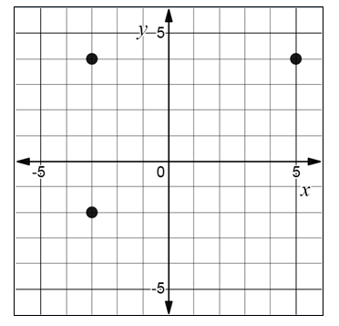
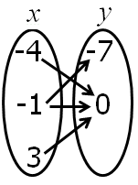
Suggested Practice #1 with Relations and Functions (A.7a)
Relations G and H are shown. Select an ordered pair to make each statement true.
Relation G
Relation H
Relation G represents y as a function of x if the point with coordinates is removed from the relation.
Relation H represents y as a function of x if the point with coordinates is removed from the relation.
(-4, 0)
(-1, -7)
(5, 4)
(-3, -2)

Slide 60
Answers to Practice #1 with Relations and Functions (A.7a)
Relations G and H are shown. Select an ordered pair to make each statement true.
Relation G
Relation H
Relation G represents y as a function of x if the point with coordinates is removed from the relation.
Relation H represents y as a function of x if the point with coordinates is removed from the relation.
(-3, -2)
(-1, -7)
(-4, 0)
(-1, -7)
(5, 4)
(-3, -2)

Slide 61
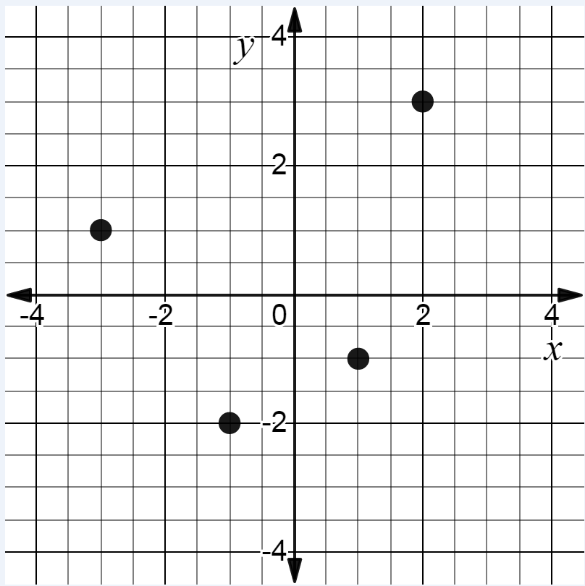
Suggested Practice #2 with Relations and Functions (A.7a)
Four points of a relation are shown. Plot one additional point so that the resulting relation does NOT represent y as a function of x.

Slide 62
Answer to Practice # 2 with Relations and Functions (A.7a)
Four points of a relation are shown. Plot one additional point so that the resulting relation does NOT represent y as a function of x.
Students should plot any point with an x-coordinate of -3, -1, 1, or 2.
Common error: plotting a point with a y-coordinate of -2, -1, 1, or 3

Slide 63
Determining Domain and Range (A.7b)
Students would benefit from additional practice finding domain and range when given an equation and using parameters for domain and range to graph a function.
Common errors on SOL test items include:
using the x-coordinate of the vertex to describe the range of the function; and
using restricted domain and range intervals as an actual point to graphically represent a relation. For example, when given a restricted domain of values greater than or equal to -4 and less than or equal to 2, student plots (-4, 2).

Slide 64
Suggested Practice # 1 with Domain and Range (A.7b)
The range of $g\left(x\right)=−{\left(x−7\right)}^{2}+ 3$ is all real numbers –
less than or equal to $7$
less than or equal to $3$
greater than or equal to $7$
greater than or equal to $3$

Slide 65
Answer to Practice # 1 with Domain and Range (A.7b)
The range of $g\left(x\right)=−{\left(x−7\right)}^{2}+ 3$ is all real numbers–
A. less than or equal to $7$
B. less than or equal to $3$
C. greater than or equal to $7$
D. greater than or equal to $3$
Common error: using the x-coordinate of the vertex as the range

Slide 66
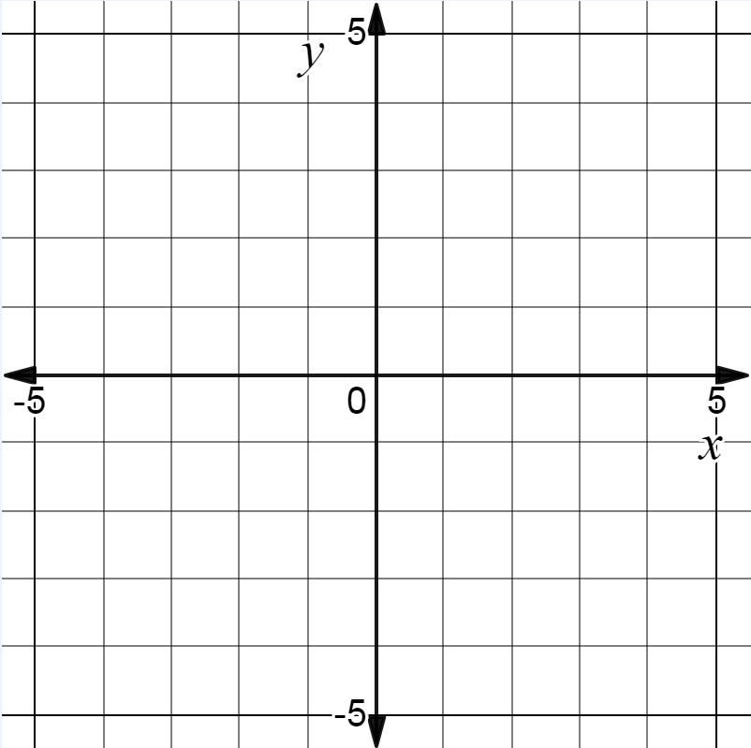
Suggested Practice #2 with Domain and Range (A.7b)
Plot the endpoints of a line segment that represents a relation with:
Domain: the set of all real numbers greater than or equal to -1 and less than or equal to 3
Range: the set of all real numbers greater than or equal to -2 and less than or equal to 4

Slide 67
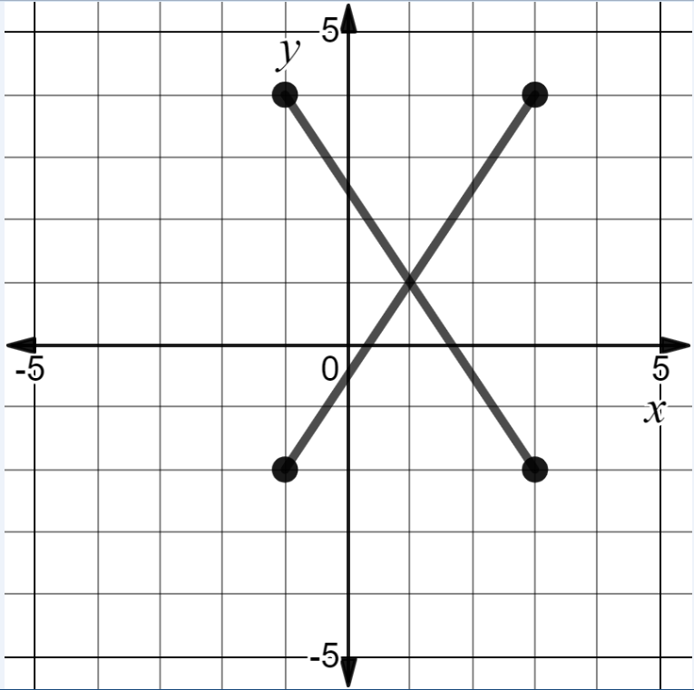
Answer to Suggested Practice #2 with Domain and Range (A.7b)
Plot the endpoints of a line segment that represents a relation with:
(-1, 4)
(3, 4)
Domain: the set of all real numbers greater than or equal to -1 and less than or equal to 3
Range: the set of all real numbers greater than or equal to -2 and less than or equal to 4
(-1, -2)
(3, -2)
Possible solutions: (-1, -2) and (3, 4)
or (-1, 4) and (3, -2)

Slide 68
Zeros of a Function (A.7c)
Students would benefit from additional practice with finding zeros of a function and comparing functions that contain numeric or variable terms that are constant.
Common errors on SOL test items include:
replacing x with zero instead of setting the function equal to zero when determining zeros of a function;
finding equivalent zeros when comparing functions; and
using a y-intercept value as a zero of a function.

Slide 69
Suggested Practice with Zeros of a Function (A.7c)
Let $g\left(x\right)=4x−20$ and $h\left(x\right)=−\frac{1}{2}x+k$. For what value of k is the zero of $h(x)$ equivalent to the zero of $g(x)$?
A. $−20$
B. $−\frac{5}{2}$
C. $\frac{5}{2}$
D. $5$

Slide 70
Answer to Practice with Zeros of a Function (A.7c)
Let $g\left(x\right)=4x−20$ and $h\left(x\right)=−\frac{1}{2}x+k$. For what value of k is the zero of $h(x)$ equivalent to the zero of $g(x)$?
A. $−20$
B. $−\frac{5}{2}$
C. $\frac{5}{2}$
D. $5$
Common error: using the y-intercept of g (x) as value for k
Common error: using the zero of g(x) as the value for k

Slide 71
Determining x- and y-intercepts of a Function (A.7d)
Students would benefit from additional practice with finding the x- and y-intercepts when comparing two functions.
Common error on SOL test items include using an intercept of one function to determine an unknown value of a second function.

Slide 72
Suggested Practice with Determining x- and y-intercepts of a Function (A.7d)
Let $p\left(x\right)=4x−18$ and $q\left(x\right)=2x+k$. For which value of k will the x-intercept of $q(x)$ be equivalent to the x-intercept of $p(x)$?
A. $9$
B. $\frac{9}{2}$
C. $−\frac{9}{2}$
D. $−9$

Slide 73
Answer to Practice with Determining x- and y-intercepts of a Function (A.7d)
Let $p\left(x\right)=4x−18$ and $q\left(x\right)=2x+k$. For which value of k will the x-intercept of $q(x)$ be equivalent to the x-intercept of $p(x)$?
A. $9$
B. $\frac{9}{2}$
C. $−\frac{9}{2}$
D. $−9$
Common error: using the x-intercept of p(x) as the value for k

Slide 74
Determining Values of a Function (A.7e)
Students would benefit from additional practice with finding values of a function.
Common errors on SOL test items include mistaking the value of the unknown variable for the value of a specified domain when the value of a function and a missing coefficient must be determined first.

Slide 75
Suggested Practice with Determining the Value of a Function (A.7e)
Let $h\left(x\right)=x^{2 }+kx−8$. If $h\left(−1\right)=−5$, what is the value of $h(4)$?
A. $−2$
B. $−1$
C. $0$
D. $8$

Slide 76
Answer to Practice with Determining the Value of a Function (A.7e)
Let $h\left(x\right)=x^{2 }+kx−8$. If $h\left(−1\right)=−5$, what is the value of $h(4)$?
A. $−2$
B. $−1$
C. $0$
D. $8$
Common error: using the k-value
Common error: selecting the given x-value of $−1$

Slide 77
Direct and Inverse Variation
SOL A.8
The student, given a data set or practical situation, will analyze a relation to determine whether a direct or inverse variation exists, and represent a direct variation algebraically and graphically and an inverse variation algebraically.

Slide 78
Equations and Practical Problems with Direct and Inverse Variation (A.8)
Students would benefit from additional practice identifying equations that represent a direct or inverse variation and modeling practical problems involving either a direct or inverse variation.
Common errors on SOL test items include:
identifying equations where x has a rational coefficient as representing an inverse variation; and
using a direct relationship to model an inverse relationship and vice versa.

Slide 79
Suggested Practice #1 with Variation (A.8)
1) Label each equation as a direct variation, an inverse variation, or neither direct nor inverse variation.
$y=\frac{x}{60}$ $x+y=60$ $xy=60$ $y=\frac{60}{x}$ $y=60x$
2) The points (-4, 8) and (x, 2) are elements of an inverse variation. What is the value of x ?

Slide 80
Answer to Practice #1 with Variation (A.8)
1) Label each equation as a direct variation, an inverse variation, or neither direct nor inverse variation.
$y=\frac{x}{60}$ $x+y=60$ $xy=60$ $y=\frac{60}{x}$ $y=60x$
2) The points (-4, 8) and (x, 2) are elements of an inverse variation. What is the value of x ?
Direct
Neither
Inverse
Inverse
Direct
x = -16
Common error: using a direct relationship to obtain x = -1

Slide 81
Suggested Practice #2 with Variation (A.8)
It takes Lucy 20 minutes to complete her homework at a rate of 2 problems per minute. Let y represent the total number of minutes it takes Lucy to complete her homework at a rate of x problems per minute. Which equation can be used to represent the relationship between x and y?
A. $y=10x$ B. $y=40x$
C. $y=\frac{10}{x}$ D. $y=\frac{40}{x}$

Slide 82
Answer to Practice #2 with Variation (A.8)
It takes Lucy 20 minutes to complete her homework at a rate of 2 problems per minute. Let y represent the total number of minutes it takes Lucy to complete her homework at a rate of x problems per minute. Which equation can be used to represent the relationship between x and y?
A. $y=10x$ B. $y=40x$
C. $y=\frac{10}{x}$ D. $y=\frac{40}{x}$
Common error: believing 2 problems per minute is a fixed rate and thus assuming a direct relationship exists

Slide 83
Suggested Practice #3 with Variation (A.8)
The number of cakes sold varies directly with the number of people who attend a fair each day. If 200 cakes are sold when 3,000 people attend the fair, which two statements are true?
The number of cakes sold is 80 when 7,500 people attend the fair.
The number of cakes sold is 275 when 4,125 people attend the fair.
The number of cakes sold is 300 when 2,000 people attend the fair.
The number of cakes sold is 650 when 9,750 people attend the fair.

Slide 84
Answer to Practice #3 with Variation (A.8)
The number of cakes sold varies directly with the number of people who attend a fair each day. If 200 cakes are sold when 3,000 people attend the fair, which two statements are true?
Common error: using an inverse relationship
The number of cakes sold is 80 when 7,500 people attend the fair.
The number of cakes sold is 275 when 4,125 people attend the fair.
The number of cakes sold is 300 when 2,000 people attend the fair.
The number of cakes sold is 650 when 9,750 people attend the fair.

Slide 85
Curves of Best Fit
SOL A.9
The student will collect and analyze data, determine the equation of the curve of best fit in order to make predictions, and solve practical problems, using mathematical models of linear and quadratic functions.

Slide 86
Making Predictions with Curves of Best Fit (A.9)
Students would benefit from additional practice with making predictions using a curve of best fit.
Common errors on SOL test items result from students only using the first two points in a given data set to determine the equation of the curve of best fit and then using that equation to make predictions.

Slide 87
Suggested Practice with Curves of Best Fit (A.9)
A restaurant lists the total number of fat grams, x, and total calories, y, of each item on its menu.
Using the line of best fit for this data, complete each sentence.
1) If the value of x is 45 fat grams, then the value of y is expected to be approximately ________ total calories.
2) If the value of x is approximately _______ fat grams, then
the value of y is 800 total calories.
x | 5 | 9 | 13 | 20 | 21 | 30 | 34
y | 280 | 300 | 320 | 440 | 420 | 530 | 590

Slide 88
Answer to Practice with Curves of Best Fit (A.9)
A restaurant lists the total number of fat grams, x, and total calories, y, of each item on its menu.
Using the line of best fit for this data, complete each sentence.
1) If the value of x is 45 fat grams, then the value of y is expected to be approximately ________ total calories.
2) If the value of x is approximately _______ fat grams, then
the value of y is 800 total calories.
x | 5 | 9 | 13 | 20 | 21 | 30 | 34
y | 280 | 300 | 320 | 440 | 420 | 530 | 590
700
54

Slide 89
Practice Items
This concludes the student performance information for the spring 2019 Algebra I SOL test.
Additional information on accessing practice items and the Guided Practice Suggestions can be found on the Virginia Department of Education website.

Slide 90
Contact Information
For questions regarding assessment, please contact student_assessment@doe.virginia.gov
For questions regarding instruction, please contact vdoe.mathematics@doe.virginia.gov

