Slide 1
History and Social Science Scoring Supports Webinar
March 31, 2021

Slide 2
Agenda
Overview of History and Social Science Scoring Resources
Sample Scoring Calibration Protocol
Sharing: Dr. Melanie Falls, Rockbridge County Public Schools
Questions from School Divisions

Slide 3
Overview of History and Social Science Scoring Resources

Slide 4
State-Developed Common Rubrics: Links
The state-developed common rubrics are final and available on the Virginia Department of Education (VDOE) webpage for History and Social Science instruction (Home > Instruction > History & Social Science).
HSS State Developed Common Rubric-Early Elementary
HSS State Developed Common Rubric-Upper Elementary
HSS State Developed Common Rubric-Middle School
HSS State Developed Common Rubric-Early Secondary
HSS State Developed Common Rubric-Upper Secondary

Slide 5
Selecting the Common Rubric for a Course (1 of 3)
The state common rubrics are not specific to a single course or grade level.
The language in the rubrics may not match the verbiage in the Standards of Learning verbatim.
The rubrics are based upon skills outlined in the History and Social Science Standards of Learning Skills’ Progression Chart.
To a certain extent, school divisions have the flexibility to choose the rubric best-suited to its students’ needs.
Please note: The link to the 2015 skills' progression chart has been removed. Stay tuned for updates on the newly adopted 2023 HSS Standards of Learning.
7/2023

Slide 6
Selecting the Common Rubric for a Course (2 of 3)
Early Elementary: generally intended for use with K-3
Upper Elementary: generally intended for use with 4-6
Middle School:
intended for use with 6-8/ middle school courses not associated with graduation requirements
use to score local performance assessments in Civics & Economics*
*Note: At this time, the option to administer local alternative assessments, which include local performance assessments, is available for the 2020-2021 school year for Civics & Economics.

Slide 7
Selecting the Common Rubric for a Course (3 of 3)
Early Secondary: use to score local performance assessments in World History I, World History II, World Geography*
Upper Secondary:
use to score state-developed performance assessments in Virginia & U.S. History*
use to score local performance assessments in Virginia & U.S. History* and Government**
*as described in Option Two of the Emergency Guidelines for Locally Awarded Verified Credit (LAVC), available during the 2020-2021 school year
** Neither verified credit nor LAVC can be awarded for Government.

Slide 8
The HSS Common Rubric Components (1 of 4)
Notes:
This is an example of the portions of the Upper Secondary rubric you might use with teachers for holistic scoring. Note that this is specific to a task/level and is not the entire common rubric for upper secondary, but rather an abbreviated version with the task specific dimension that corresponds to a specific task that students have completed.

Slide 9
The HSS Common Rubric Components (2 of 4)
Rating Scale

Slide 10
The HSS Common Rubric Components (3 of 4)
Two Dimensions: Core Expectations and Task Specific Expectations
Notes:
Two dimensions are always included; Core Expectations and Task Specific Expectations. Core Expectations remain the same for every task, but Task Specific Expectations depend on the task itself. The Core Expectations and Task Specific Expectations are scored separately.

Slide 11
The HSS Common Rubric Components (4 of 4)
Indicators
Notes:
The bullets are not intended to serve as a checklist. For example, when scoring we are not counting 2 of 3 bullets, etc. Just because a student only has evidence for 2 of the 3 bullets does not mean that you cannot earn that score point.

Slide 12
Conducting a Holistic Scoring Event
Conducting a Holistic Scoring Event is a YouTube video presentation from VDOE that may help school division leaders plan and conduct holistic scoring events.
While the presentation describes a process used to develop scoring consistency with teachers for range-finding in Virginia and U.S. History, the process can also be adapted for training potential scorers to apply a certain rubric to sample responses from your school division.
Notes:
The remaining slides in this section highlight information that is shared and discussed in detail in the YouTube video presentation.

Slide 13
What is focused holistic scoring?
Focused holistic scoring in history and social science involves the evaluation of two dimensions- core expectations and task-specific expectations.
First, each dimension is evaluated independent of the other. The scorer considers the indicators for each dimension collectively to determine the score that reflects the scorer’s overall impression of the evidence for that dimension. Individual indicators are not scored separately or used as a checklist.
After focused holistic scoring occurs, the strengths and weaknesses evident in the response are considered among the various indicators, and the scorer determines a single, overall score for the response as a whole.

Slide 14
Using Scores to Inform Instruction
Assigning separate holistic scores that focus on core expectations and task-specific expectations assists a teacher in diagnosing a student’s relative strengths and weaknesses so that instructional activities can be planned for those specific skills identified as features within the rubric.
The descriptive feedback provided by the rubric, considered alongside the evidence in the student’s response to a performance task, can help a student recognize features in his/her own work to target for improvement.
Notes:
Using scores to inform instruction is another reason why the rubric should not be modified. The validity of the inferences a teacher makes for future instructional decisions is tied to the language in the rubric, which is correlated to the skills’ progression. If the rubric is modified, a teacher is no longer holding students to the same expectations established by VDOE for all students and correlated to the skills’ progression.
P

Slide 15
A Range at Every Score Point
At every score point, a range of responses representing the lower, middle, and upper ends of the score point are possible.
Responses receiving the same score point may look very different from each other.
A response assigned a score of 3 might have some characteristics of a 2-level response and some characteristics of a 4-level response, but overall, its 3-level characteristics predominate.
A 3-level response that has only 2- and 3-level characteristics might look very different from the response described above.
It is important to evaluate each student’s response against the rubric, not against other students’ responses.
Notes:
Information on this slide is adapted from Understand Scoring.
Talk about the range at a 4- 4 is not perfection, but pretty consistent control is evident. Missing evidence for one part of one indicator does not prevent the student from earning a 4.

Slide 16
Grading versus Scoring
Grading
Scoring
Letter grade (A/B/C/D/F) or percentage
Focused on achievement, motivation, behavior, etc.
Based on an individual teacher’s expectations
Final authority rests with the teacher - fixed
Score rating (4/3/2/1) accompanied by rubric description
Focused on achievement
Based on the expectations in the scoring rubric
Authority resides with the consensus formed by experienced scorers - flexible

Slide 17
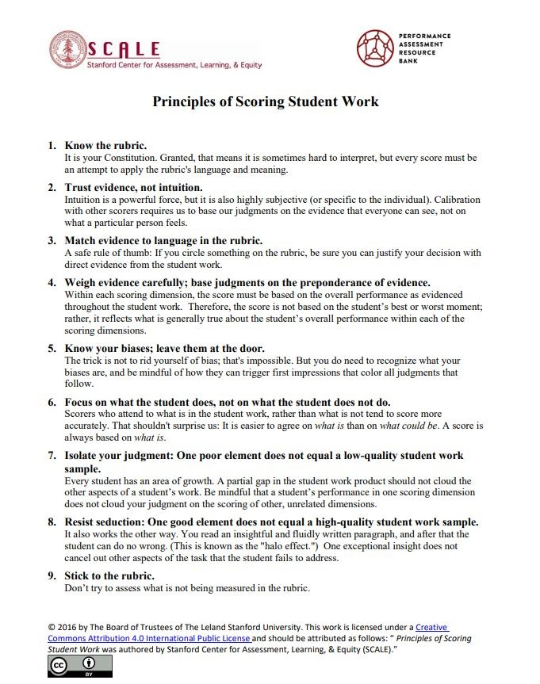
Principles of Scoring Student Work
Notes:
Principles of Scoring Student Work was authored by Stanford Center for Assessment, Learning, & Equity (SCALE). This document provides guidance for using a rubric to score performance tasks and performance assessments.

Slide 18
Sample Scoring Calibration Protocol

Slide 19
Scoring Calibration Protocol
This sample protocol is based on an adaptation by Jeri Thompson, Center for Assessment (2013) from Quality Performance Assessment: A Guide for Schools and Districts (2012).
These six steps can be used to calibrate the scoring of student work:
Norms
Examination
Clarifying Questions
Read and Score
Score Sharing
Discussion and Debrief
Notes:
Adapted by Jeri Thompson, Center for Assessment (2013) from Quality Performance Assessment: A Guide for Schools and Districts (2012)

Slide 20
Making Meaning: Steps 1-3
Norms: Facilitator reviews the protocol process and establishes norms with the group. (2 minutes)
Examination: Teachers silently examine the prompt or task, student work, and the rubric. (2 minutes)
Clarifying Questions: Teachers ask any clarifying questions they have about the materials and process. (2 minutes)
Notes:
The facilitator may provide norms for the group or the group may generate the norms together. It is important that the norms are clear and focused on what its team members need to know and do in order function effectively as a group.
The times suggested may vary. In particular, the time needed for step 2 will vary with the degree of familiarity with the rubric.
Time for clarifying questions is especially important, as the whole point of the protocol is to calibrate our understanding of what the student was supposed to be able to write/say/make/do and what we should expect to see in a student response, and how we are going to use that rubric to score the student response.

Slide 21
Scoring and Reaching Consensus: Steps 4-6 (1 of 2)
Read and Score:
Teachers independently and silently read and score the student work, recording a score for each dimension of the rubric and making notes about specific evidence in the student work to justify their scores.
After scoring each dimension, teachers look at the rubric and scale as a whole and focus overall on notes made regarding the evidence the student presented to make an overall holistic judgment of the student’s performance.
Teachers enter each dimension score as well as one holistic score on a score report (sample Google form). (20 minutes)
Score Sharing: Scores captured from the Google form are displayed for discussion. (2 minutes)
Please note that the sample Google form provided in 2021 is no longer available. For additional information, please contact the Office of Student Assessment.

Slide 22
Scoring and Reaching Consensus: Steps 4-6 (2 of 2)
Discussion and Debrief: (20 minutes)
The facilitator invites the group to consider where the differences in the scores occurred and why people scored differently, particularly the highest and lowest scores.
Group members explain and justify scores by pointing to specific language in the rubric and evidence in the student work.
Group members reach consensus by resolving issues centered on either the meaning of the rubric or the merit of the evidence.
Debrief: What revisions should be considered for the task and instructions? What are next steps for instructing this student? What are the implications for our instructional practice?

Slide 23
Sharing: Dr. Melanie Falls
Rockbridge County Public Schools

Slide 24
Process for Planning, Administering, and Scoring PAs
1.
Planning for Instruction and Assessment through Local Alternative Assessments (PAs)
2.
Providing Feedback to the Performance Assessment Creation Teams (VQCRT)
3.
Implementing the Performance Assessments
4.
Scoring the Performance Assessments
5.
Providing Feedback to Students and Parents
6.
Collecting, Analyzing, and Interpreting Student Performance Data to Inform Future Instructional Sequences
7.
Revising the Performance Assessments with Lessons Learned from this Year’s Experience
Provided by Dr. Melanie Falls, Rockbridge County Public Schools rockbridge.k12.va.us
Notes:
We are just going to focus on #4, scoring the performance assessments.

Slide 25
Step #4: Scoring the Performance Assessments (1 of 5)
a.
Preparing the PAs for Scoring
Once teachers have administered the PAs, then the student responses must be organized for scoring:
How will your division collect the PAs all in one place?
Shared Google Drive? Performance Matters?
Designated box with paper copies?
How will your scorers actually score the student responses?
Traditional paper/pencil so that teachers can underline, highlight, and write notes
Digitally where teachers use digital tools to underline, highlight, and write notes
How will you minimize scorer bias to ensure accuracy of the rubric scores?
“Single blind” by allowing scorers from another school to score student responses other than their own?
“Double blind” by removing names of students and not allowing the classroom teachers to score their own student responses?
Provided by Dr. Melanie Falls, Rockbridge County Public Schools rockbridge.k12.va.us

Slide 26
Step #4: Scoring the Performance Assessments (2 of 5)
b.
Identifying Scoring Team Members
Once the PAs are organized for scoring, then teachers need to be identified as scorers:
What grade-level teachers are needed for scoring?
Teachers of the same grade level/school(s)?
Teachers of different grade levels/school(s)?
Will you need alternates on standby just in case?
What content areas are needed for scoring?
Teachers from the H&SS content area only?
Teachers from English/H&SS contents?
Will you need Specialists to support your scoring event?
Reading Specialists?
Special Education teachers?
Provided by Dr. Melanie Falls, Rockbridge County Public Schools rockbridge.k12.va.us

Slide 27
Step #4: Scoring the Performance Assessments (3 of 5)
c.
Preparing Scorers for the Scoring Events
Once the teachers have been identified that will score the PAs, they need to participate in professional development to calibrate their understanding of scoring/grading, develop an awareness of the requirements of the rubrics, understand the PA in what it is asking students to know, understand, and do, and finally, understand inter-rater reliability:
When will this event take place?
1 to 2 days before scoring? 1 to 2 weeks before scoring?
Morning? Afternoon?
Where will this event take place?
Face-to-Face in a single location?
Virtually utilizing ZOOM or Google Meets?
How will you deliver the Professional Development?
Electronic materials?
Paper/Pencil materials?
Provided by Dr. Melanie Falls, Rockbridge County Public Schools rockbridge.k12.va.us

Slide 28
Step #4: Scoring the Performance Assessments (4 of 5)
c.
Preparing Scorers for the Scoring Events...continued
What materials will you provide scorers during your professional development?
YouTube video Conducting a Holistic Scoring Event in its entirety or broken into segments?
Electronic/hard copies of SCALE document Principles of Scoring Student Work?
Electronic/hard copies of a sample PA?
Electronic/hard copies of Scoring Calibration Protocol?
How will you group your scorers so that they develop inter-rater reliability?
In pairs with teachers from the same grade-level/content area?
In pairs with teachers from different grade-levels/content areas?
In small groups? In break-out sessions?
Provided by Dr. Melanie Falls, Rockbridge County Public Schools rockbridge.k12.va.us

Slide 29
Step #4: Scoring the Performance Assessments (5 of 5)
d.
Holding the Scoring Event
When/where will your event be held?
Face-to-Face on designated dates/times?
Virtually over a period of time?
How will you set up the venue to ensure everything is organized?
Tables/chairs?
Devices/hard copies?
Breaks/lunch
How will the scores be collected?
Electronically via Google form?
Hand-written notes on hard-copies of the rubric?
Provided by Dr. Melanie Falls, Rockbridge County Public Schools rockbridge.k12.va.us

Slide 30
Questions from School Divisions

Slide 31
Question 1
If a teacher determines that content in a student response is plagiarized, is the score a zero? Do we have to give the student a second attempt?
School divisions are encouraged to score the portion of the student’s response that is the student’s original work. The school division has the discretion to decide if the student will be given another opportunity with a different performance task.

Slide 32
Question 2
How should we translate rubric scores to a percentage?
Translating rubric scores to percentages is not recommended, as the resulting percentage may not accurately reflect the level of achievement demonstrated by the student. Best practice is to provide a copy of the full rubric along with the scored student work. When considered together, relative strengths evident in the student work and possible areas for growth may be readily identified.

Slide 33
Question 3
What guidance can you provide for determining the percentage of students “passing” the local performance assessments, as required by the periodic reporting survey?
There is no cut score established that correlates to a single performance assessment. As grading scales and local alternative (LAA) assessments will vary by school division, there is no standard method for calculating a “pass.” When LAA are used, the division has the discretion to determine what constitutes “passing” when considering the combination of local assessments that have been administered to cover the content for the course as a whole. The local grading scale should be taken into consideration, along with the overall achievement on LAA (both multiple-choice and performance tasks) for the course.

Slide 34
Question 4
How much autonomy do we have to modify the rubric? Can we change the wording to language that is student friendly?
The rubrics should not be modified. Using the rubrics as written provides consistency in expectations across the state and contributes to the validity of instructional implications drawn from scores based on the rubric.
Teachers are encouraged to use the rubrics with students during instruction to build understanding for the expectations described in the rubric. It is best practice to ensure that students understand how their work will be evaluated.

Slide 35
Question 5
What is the best way to determine a performance level?
School divisions are not expected to determine or report the performance levels that are associated with Standards of Learning tests (Pass/Advanced, etc.) when exercising the option to administer local alternative assessments in lieu of SOL tests during the 2020-2021 school year. School divisions are expected to determine the percentage of students passing/failing the overall collection of local alternative assessments administered.

Slide 36
Question 6
If English learners (ELs) are exempted from participating in local performance assessments and other LAA administered in lieu of SOL tests during this school year, will the one-time exemption still be available for eligible students in the future if needed?
The one-time exemption would still be available in the future for EL students meeting the criteria. School divisions are encouraged to include ELs in LAA whenever possible, providing the accommodations in place for other classroom assessments that allow students to access the test. Local decisions should be made on a student-by-student basis.

Slide 37
Question 7
Can a student resubmit the response to a performance task after receiving feedback from a teacher and have that response re-scored?
This is not permissible for responses that would be used as part of a collection to verify credit. The score on such a resubmission would not be indicative of the student’s independent skills and content knowledge. Students needing another attempt after receiving feedback and additional instruction could be provided with a different task to be scored when time allows.
Receiving feedback on work completed prior to the final task is appropriate. Students may have access to these pieces of work when independently completing a final task response in history and social science.

Slide 38
Stay Connected
Christonya.Brown@doe.virginia.gov
Andrea.Emerson@doe.virginia.gov
Brandi.McCracken@doe.virginia.gov
Holli.Cook@doe.virginia.gov
Chris.Tsitsera@doe.virginia.gov
Student_Assessment@doe.virginia.gov or (804) 225-2102
Melanie_Falls@rockbridge.k12.va.us

