Slide 1
Local Alternative Assessments: Reporting to Parents & Reminders for Scoring
Best Practices and
Examples from School Divisions

Slide 2
Please Note
These slides have been adapted from the Assessment Updates Webinar held in February, 2021, by the Office of Student Assessment in conjunction with the Office of Humanities.
2

Slide 3
To Consider (1 of 2)
What information about student performance does your school division share about Balanced Assessment Plans and the local alternative assessments that are administered in place of the Standards of Learning tests eliminated by the General Assembly in 2014?
Who are the stakeholders to be considered when sharing this information?
What information is provided to parents about the rubrics used for scoring and how to interpret the resulting scores?

Slide 4
To Consider (2 of 2)
How (and how often) is information concerning performance assessments and a student’s scores on LAA communicated to parents and families?
Will information on student performance also be shared as part of a summary at the conclusion of the year?

Slide 5
Feedback on Student Performance (1 of 2)
Feedback on student performance should be provided whether the performance assessment is formative or summative.
School divisions may want to avoid determining proficiency levels that are associated with the SOL tests (e.g., Pass/Proficient, Fail/Does Not Meet).

Slide 6
Feedback on Student Performance (2 of 2)
For summative assessments, school divisions should determine criteria for passing based on local scoring and local grading practices.
Feedback to parents on LAA performance should indicate if a student has passed. Consider if it is helpful to indicate when a student needs more instruction in the content/ skills measured by the LAA.
Consider providing feedback to parents on a student’s performance on individual LAA as well as overall performance on LAA for the course.

Slide 7
Considerations for Reporting to Parents (1 of 5)
Key considerations
In reports to parents, school divisions should indicate if students are passing/ meeting grade level expectations in the course or if they would benefit from additional instruction in the skills and content measured by the LAA.
Changing rubric scores to percentages to determine a grade is not recommended.

Slide 8
Considerations for Reporting to Parents (2 of 5)
Rubric scores should not be translated to percentages used in grading, as the resulting percentage may not accurately represent the student’s achievement.
Example: ¾ = 75% may translate to a C/D on the local grading scale, but this grade may not accurately represent the meaning of the score assigned

Slide 9
Considerations for Reporting to Parents (3 of 5)
Instead, a statement such as the following may be more appropriate for the preceding example:
A work sample earns 3 out of 4 possible points, demonstrating an ability to analyze and interpret the information sources provided and to support an explanation and accurately distinguish fact from opinion. On this assessment, the student demonstrates mastery of the Core Expectations.

Slide 10
Considerations for Reporting to Parents (4 of 5)
LAA may be formative or summative. The nature and intent of the LAA should be clear in the information reported to parents.
School divisions can choose to use formative assessment and provide feedback to students on task responses as part of instruction.
If feedback from teachers or peers has been provided and applied by students before scoring, it is best practice to include this information in reporting, as the results reflect the ability to interpret and apply feedback.

Slide 11
Considerations for Reporting to Parents (5 of 5)
School divisions are encouraged to include opportunities for both formative and summative LAA when this is feasible.
Formative assessment opportunities may result in stronger independent performance on summative assessments.
Formative assessments offer opportunities for teachers to provide parents information on “glows and grows” that will be used to guide instruction.

Slide 12
Reporting Performance Assessment Results Administered as LAA in History and Social Science
Core Expectations: One holistic score that reflects the preponderance of the evidence for the core expectations should be reported for each performance task.
Task Specific Content and Skills: One holistic score that reflects the preponderance of the evidence for the content and skills that are specific to the performance task should be reported.
In addition to these holistic scores, it will be helpful to show the range of possible scores and the descriptors or indicators for each score.
Notes:
This applies to reporting to parents on an individual assessment.

Slide 13
Reporting Performance Assessment Results Administered as LAA in Science (1 of 2)
The 3-5 science common rubrics were created as formative assessment tools to indicate student growth over time as students engage in the scientific and engineering practices and develop science conceptual understanding.
Expectations for student performance for each category of the rubrics during different times of the year should be determined by educator teams and communicated to parents.

Slide 14
Reporting Performance Assessment Results Administered as LAA in Science (2 of 2)
Task Specific Content and Skills: One holistic score that reflects the preponderance of the evidence for the content and skills that are specific to the performance task may be reported. Alternatively, parent communication may include areas of strength and areas of growth in lieu of a holistic score.
It may be helpful to show the range of possible scores and the descriptors or indicators for each score that reflects where students should perform at different points through the academic year.

Slide 15
Reporting Performance Assessment Results Administered as LAA in Writing
Consider mirroring what is reported for the short paper component on the SOL Writing tests.
On the SOL test, one score for each domain (Composing/Written Expression and Usage and Mechanics) is reported, and then domain scores are combined. An example is provided on the next slide.
Composing/Written Expression: one score that is counted twice
Usage and Mechanics: one score that is counted once
It is best practice to include the rubric, which shows the range of possible scores and the descriptors or indicators for each score.

Slide 16
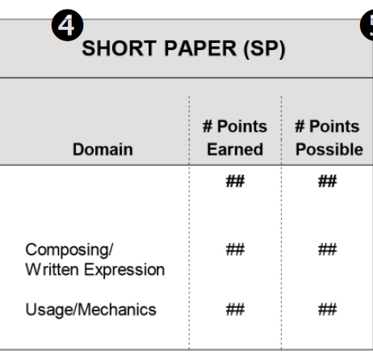
Short Paper SOL Score Report Example
“Writing: Understanding Your Student’s SOL Report” (available in PearsonAccess^{next}) shows how domain scores are reported on the SOL Writing Tests. The document also states:
All short papers are read by at least two readers* who assign a score to each of two domains: 1) composing/written expression and 2) usage/mechanics.
The student’s short paper score is the sum of both* readers’ scores and is presented for each domain and for the short paper as a whole. The number of points possible for each domain and the short paper are shown in the Short Paper (SP) column.
*For LAA, having two readers is best practice but is not required.
Notes:
For comparison, the short paper component of the Grade 8 Writing SOL test has two readers. Having two readers is best practice but is not required for the LAA. School divisions are not expected to mimic the way that SOL scores are reported but are encouraged to include the same information.

Slide 17
Resources for LAA

Slide 18
History and Social Science LAA Resources
State-developed common rubrics are posted on the History and Social Science (HSS) Instruction web page.
Additional resources for these local alternative assessments are posted on the Performance Assessments & Local Alternative Assessments web page.
Performance assessments and performance tasks in HSS should be scored holistically using the common rubric chosen by the school division, as these rubrics are not course or grade-specific.
For example, school divisions may use either the Upper Elementary or Middle School common rubric when scoring student responses in U.S. History to 1865, depending on which is most appropriate for their students.

Slide 19
History and Social Science Scoring Support
Conducting a Holistic Scoring Event: This YouTube video can be used virtually or in person to establish local training processes for scoring. It can be used directly with potential scorers to
Establish norms for scoring
Familiarize potential scorers with the rubrics
Conduct calibration exercises with locally developed tasks
Principles of Scoring Student Work: Principles of Scoring Student Work was authored by the Stanford Center for Assessment, Learning, & Equity (SCALE). This document provides guidance for using a rubric to score performance tasks and performance assessments.

Slide 20
Writing Resources
State-developed writing rubrics aligned to the 2017 English SOL are available on the Performance Assessments & Local Alternative Assessments web page and must be used for scoring.
Additional resources for these local alternative assessments are included on this web page.
Performance assessments and performance tasks administered as LAA should be scored holistically.

Slide 21
Writing: Scoring Training and Support
Understand Scoring: This resource is available to assist with the training processes for scoring in writing. The Learn About Scoring section contains information necessary for accurately scoring student writing according to VDOE standards. It can be used directly with potential scorers to
Establish norms for scoring
Familiarize potential scorers with the rubrics and anchor sets
Practice and verify scoring through use of Virginia student writing
Note: Unlike with the performance assessment to verify credits in writing for the end of course, VDOE does not require scorers pass a Verification Set to qualify to score the local alternative assessments for grade 8 writing.

Slide 22
Science LAA Resources
State-developed common rubrics are posted on the Science Instruction Performance Assessment Page. Additional resources on this page include exemplar performance assessments, common rubrics for different grade bands, and student-friendly versions of several of these rubrics.
Additional resources for these local alternative assessments are posted on the Performance Assessments & Local Alternative Assessments web page.
The “leaves” in the 2018 Science Standards of Learning Curriculum Framework serve as guidance for the development of performance assessments.

Slide 23
Reminders for LAA Administration and Holistic Scoring

Slide 24
LAA Administration Reminders (1 of 2)
School divisions have the discretion to administer local alternative assessments virtually (synchronously or asynchronously) and/ or in person.
Appropriate testing conditions for LAA are at the discretion of the local school division and should reflect the practices established for other local assessments that are administered virtually or in person.
LAA should be scored before the end of the semester/ school year in order to include performance information in final grades.

Slide 25
Information on Holistic Scoring
Information on holistic scoring is provided to assist school divisions as they establish local processes and practices for scoring performance assessments.
The information on the next two slides is from Principles of Scoring Student Work, authored by the Stanford Center for Assessment, Learning, & Equity (SCALE).

Slide 26
Holistic Scoring (1 of 4)
From Principles of Scoring Student Work, SCALE, 2016:
Rubric scores are “an attempt to apply the rubric’s language and meaning.”
“Calibration with other scorers requires us to base our judgments on the evidence that everyone can see, not on what a particular person feels.”
Scorers who attend to what is in the student work, rather than what is not, tend to score more accurately.

Slide 27
Holistic Scoring (2 of 4)
From Principles of Scoring Student Work, SCALE, 2016:
“The [holistic] score must be based on the overall performance as evidenced throughout the student work. Therefore, the score is not based on the student’s best or worst moment; rather, it reflects what is generally true about the student’s overall performance within each of the scoring dimensions.”

Slide 28
Holistic Scoring (3 of 4)
Rubrics are not meant to be lists of mandatory criteria a student must meet in order to achieve a score point.
Student work may demonstrate some characteristics of one score point and some of another but ultimately should be assigned a "best fit" or most appropriate score.

Slide 29
Holistic Scoring (4 of 4)
One of the most important points in learning how to apply a rubric consistently is to let go of existing prejudices.
When scoring with a rubric, one of the most difficult tasks is to accept the boundaries of the rubric when those boundaries differ from a scorer’s own teaching practices or beliefs.
This is not to suggest teachers must adopt that rubric’s criteria for classroom assignments. Large-scale assessments and classroom-based assessments may very well measure somewhat different skills in a different manner.

Slide 30
Examples of Reporting LAA Performance

Slide 31
Examples from School Divisions
Examples that highlight ways to report student achievement on local alternative assessments have been taken from documents shared with VDOE by school divisions.
The willingness to share the information contained in these local reports and how they are structured is much appreciated!
Please refer to the “notes” section for each slide for important considerations.
Notes:
Note: Some examples from the February 2021 presentation have been adapted to fit the local alternative assessments that are required for the tests eliminated by the General Assembly in 2014.

Slide 32
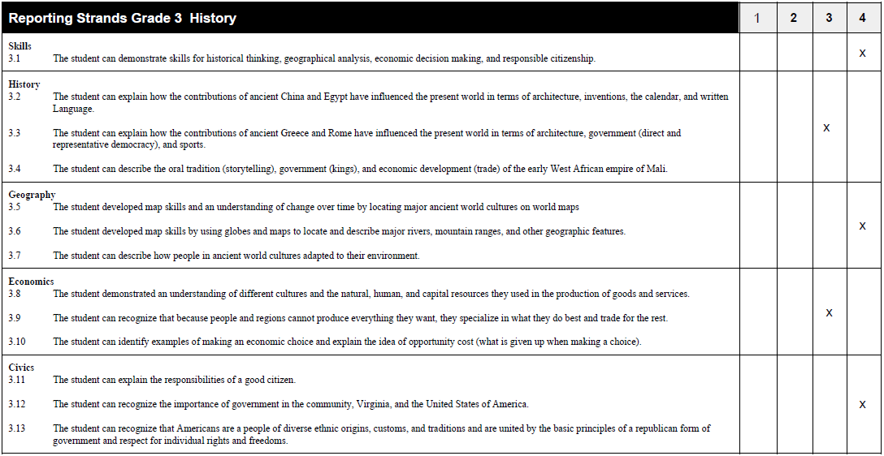
3rd Grade SOL History Portfolio Assessment
Notes:
This example from a school division shows one way that scores for local alternative assessments collected in a portfolio to cover the Reporting Strands could be reported in one document. Separate scores for each performance task should be reported as the individual tasks are completed and scored.

Slide 33
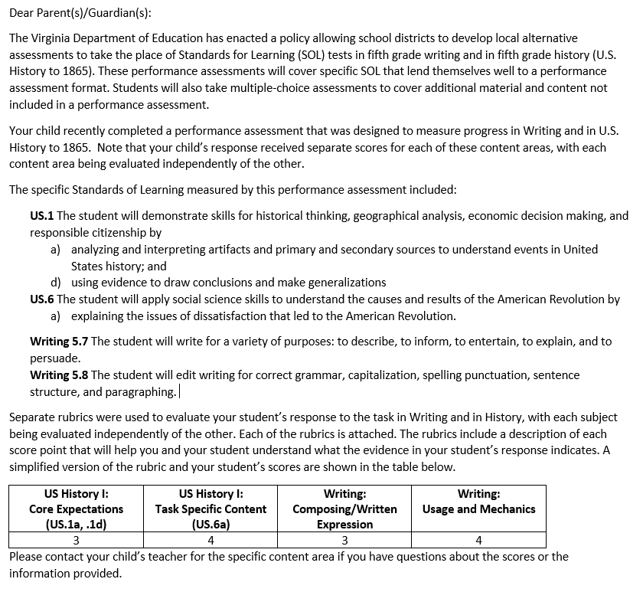
Parent Letter and Scoring Combined
In this example, one performance assessment has been used to measure progress in Writing and in U.S. History to 1865.
Evidence is evaluated in each content area independently of the other.
Notes:
A narrative for parents provides an easy-to-follow description of why this type of assessment was administered in addition to information about the content that was measured.

Slide 34
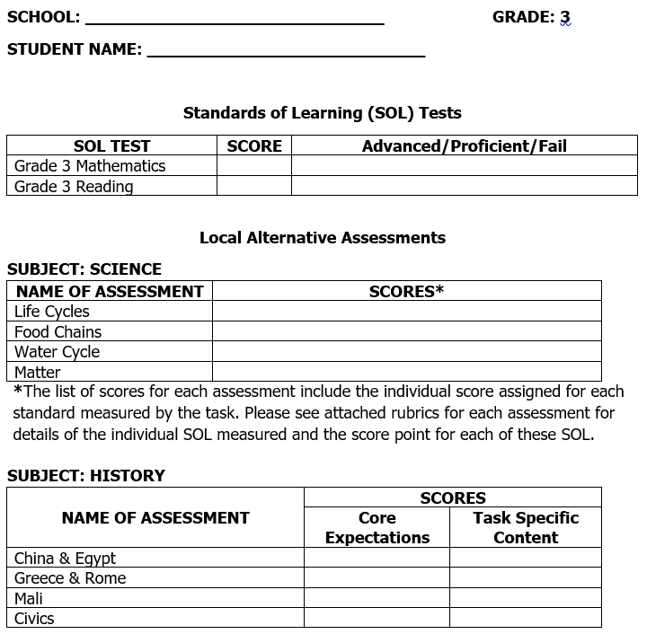
Grade 3 SOL Tests and LAA Combined Report
This example combines information from Standards of Learning tests and Local Alternative Assessments administered in grade 3.
Each science assessment covers several SOL and each is evaluated separately.
Listing the SOL for each LAA on the report itself is best practice.
Notes:
One score report that combines information on SOL test scores and all of the LAA administered throughout the year might be helpful to send at the end of the school year. It is important to provide feedback on performance on LAA as those are scored to keep families informed of current progress.

Slide 35
Scoring Explanation: Writing (1 of 3)
Sample Note to Parents:
Student responses to writing tasks for Grade 5 Writing are scored using focused holistic scoring. Writing samples are evaluated based on specific elements or domains of writing, and each domain is scored independent of the other. Each student response receives two scores, one for each of the writing domains identified: Composing/Written Expression and Usage/Mechanics. Each domain is scored holistically. The score reflects the reader’s overall impression of each of the domains. The scorer weighs the student’s relative strengths or weaknesses in each of the two domains and then assigns a score point for each domain that most accurately describes the attributes of the paper. Therefore, each paper receives a separate score for Composing/Written Expression and for Usage/Mechanics.
Notes:
This slide, along with the following two slides, provides an example of a narrative that describes the way that grade 5 writing samples have been scored.
Note: This explanation for scoring in grade 5 writing is adapted from slides that originally described the scoring in grade 8 writing.

Slide 36
Scoring Explanation: Writing (2 of 3)
(Sample Note to Parents, continued)
In our school division, all papers are read by two readers, which is best practice. The student’s score for each domain being the total of the score assigned by both readers. The Composing/Written Expression score is counted twice, and the Usage/Mechanics score is counted once in calculating the total score. Therefore, in the total score of the student’s writing sample, the Composing/Written Expression score counts 2/3 and the Usage/Mechanics score counts 1/3. For example, in the Composing/Written Expression domain, if Reader A scores the student’s paper a 3 and Reader B scores the student’s paper a 2, the student’s weighted score in the Composing/Written Expression domain is 10 (5 points, counted twice).
Notes:
Having two readers is best practice for grade 5 writing but is not required.
Note: This explanation for scoring in grade 5 writing is adapted from slides that originally described the scoring in grade 8 writing.

Slide 37
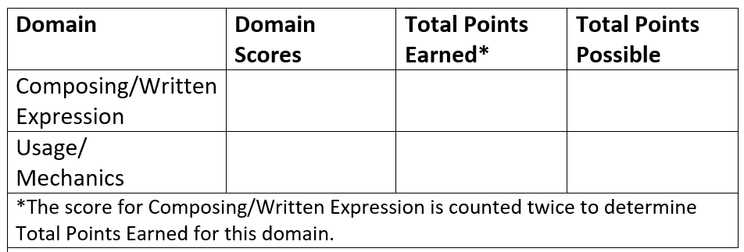
Scoring Explanation: Writing (3 of 3)
Performance Task Topic: _________________________
Students completed their responses to this topic independently over the course of two class periods. Students had access to notes taken previously on the literature used in the response and to blank graphic organizers.
Please refer to the attached Scoring Rubric for descriptive information about scores for each domain.
Notes:
The description indicates that this assessment was completed independently without teacher feedback or collaboration with peers during the drafting process.
Note: This explanation for scoring in grade 5 writing is adapted from slides that originally described the scoring in grade 8 writing.

Slide 38
Contact Information
Office of Student Assessment
Student_Assessment@doe.virginia.gov
(804) 225-2102
Jill Nogueras, K-12 English Coordinator
Jill.Nogueras@doe.Virginia.gov
History and Social Science
vdoe.hss.secondary@doe.virginia.gov
vdoe.hss.elementary@doe.virginia.gov
Anne Petersen, Ph.D., Science Coordinator
Anne.Petersen@doe.virginia.gov

