Slide 1
Student Record Collection
2022-2023 Updates
July 2022

Slide 2
Agenda
Updates & Clarification to Data Elements
Scenarios
Resources
Questions

Slide 3
Updates & Clarification to Data Elements for 2022-2023

Slide 4
Overview
Internet Access for Remote Learning Code
Full Time Virtual Program Code
CTE Finisher Code
Credit Accommodation Code
PK Age for VPI
Retired Miscellaneous Collection

Slide 5
New Code Values

Slide 6
Active Internet Access for Remote Learning Codes
1. Internet access at home allows for live streaming, classroom instruction, real time interaction with teachers and classmates
2. Internet access at home is available but too slow for live streaming or real time interaction
5. No internet connection available at home for unknown reasons
7. No internet connection at home due to cost of service
8. No internet connection at home due to service availability
Notes:
This data will be used to support Virginia Department of Housing and Community Development for its Virginia Telecommunication Initiative and Senate Bill 724. Required for all students.
Note the three retired codes – Public access, Other, and Unknown.

Slide 7
Retired Internet Access for Remote Learning Codes
3. Public connection NOT at home (coffee shop, fast food restaurant, recreation center, etc.)
4. Other
6. Unknown
Notes:
These codes were retired in an effort to get the best data.

Slide 8
CTE Finisher Codes
1. Student finished CTE requirements for completion. (Perkins IV)
3. Student took at least one state-approved CTE course since 7th grade but has not finished CTE requirements for completion
4. Student has not taken any state-approved CTE courses since 7th grade
5. Student finished CTE requirements for completion and completion of a CTE dual enrollment course
6. Student has completed 2 state-approved CTE courses in a sequence but has not met the requirements for graduation (Perkins V)
7. Student has completed at least 3 years of Junior Reserve Officers’ Training Corps (JROTC)
Notes:
CTE Completer Code 7 has been added for students who have completed at least 3 years of JROTC. Eligible for inclusion in CCCRI if they pass a CTE credentialing exam.

Slide 9
Credit Accommodation
New!
5 - World Language and Computer Science – Computer Science substitutes for World Language
Only Credit Accommodation code allowed with an Advanced Diploma (Graduate/Other Completer Code 2).
For the full list, please visit the SRC Website and select Code Values.
Notes:
A new edit will ensure that this Credit Accommodation code is only reported with an Advanced Diploma. All others are only for Standard diploma (Graduate/Other Completer Code 1).

Slide 10
Data Element Updates

Slide 11
Full Time Virtual Program Codes
1. Participates from home, not homebound, not homebased.
2. Participates from home while on homebound or homebased education
4. Participates from home during a home-ed short-term suspension
5. Participates from a public school facility
6. Participates from a private school facility
7. Participates from another location
8. Participates in a full-time Virtual Virginia program
3. Participates from home during a home-ed expulsion or long-term suspension
Notes:
The Full Time Virtual Program code language has been adjusted to accommodate the addition of Home-ed services. Code 3 still refers to a long-term suspension or expulsion and code 4 still refers to a short term expulsion. We added the language for clarification. Used to say homebased

Slide 12
PK Age for VPI
The maximum age for VPI students was increased in 2021-2022 due to Covid.
The age edits will be revised to allow students
greater than 4 and less than 6 as of 9/30 for PK Funding Source 3 (VPI).
greater than 3 and less than 4 as of 9/30 for PK Funding Source 12 (VPI - Pilot for Three-Year-Old Students).

Slide 13
Retired Miscellaneous Collections

Slide 14
Retired Miscellaneous Collections
The following counts are being retired from the Fall Miscellaneous Collection.
ADM Projections
Head Start Counts
Membership in English Courses 6-12
Notes:
VDOE fulfills these requirements through other means and they are no longer necessary in the Fall Miscellaneous Collection.

Slide 15
Scenarios

Slide 16
No Show
Mike was expected to begin school on September 6th this year but he did not attend a single day by October 1st . Administration has not been able to contact his parents.
Active Status Code | Entry Code | Entry Date | Exit Code | Exit Date | Aggregate Days Present | Aggregate Days Absent
N | Null | Null | W880 | 9/6/2022 | 0 | 0
Notes:
Student who miss >=15 consecutive days must be withdrawn from VA Public Schools. Since this student never attended, they must have an N record with zero days present. Entry Date and Entry Code are not required with N records.

Slide 17
Student Expected to Return
Julian completes the previous school year with the division but the student returns to school late because the family went back to their country in the summer and has planned to return in the middle of October.
Active Status Code | Entry Code | Entry Date | Exit Code | Exit Date | Aggregate Days Present | Aggregate Days Absent
N | Null | Null | W970 | 9/6/2022 | 0 | 0
Notes:
Only when you have an expected return date can you use W970. If the LEA doesn’t have contact or an expected return date, the student cannot be reported with a W970.

Slide 18
PK - No Show
Luke was enrolled to begin PK services this Fall. After thinking about it more, their parents decided to wait one more year before enrolling this student.
VDOE does not require a record for this student since they were never enrolled in VA Public Schools.
Notes:
Typically, we would require a withdraw for students with at least one day in membership. Since this student has never had a day in membership, we do not require a withdraw record.

Slide 19
Virtual Virginia
Bryce in enrolled full time in Virtual Virginia (501/10). Virtual Virginia provides the curriculum and instruction.
Active Status Code | Responsible Division | Responsible School | Serving Division | Serving School | Tuition Paid | MOP Flag | Full Time Virtual Program | Remote Instruction Percent of Time
V | 133 | 60 | 501 | 10 | 18 | N | 8 | 100
Notes:
These codes are specific to Virtual Virginia and are all required.

Slide 20
Full Time Stride
Luke attends a division that offers services through Stride. The division has created a virtual academy (140) to serve students like him and has partnered with Stride to provide the curriculum and instruction.
Active Status Code | Responsible Division | Responsible School | Serving Division | Serving School | Tuition Paid | MOP Flag | Full Time Virtual Program | Remote Instruction Percent of Time
V | 133 | 60 | 133 | 140 | null | Y | 1 | 100
Notes:
We can tell part time Stride students from MSC. The rule of thumb is to report where the student received 50% or more of their instruction as the Serving School.

Slide 21
Part Time Stride
Nevaeh attends a division that offers services through Stride. She takes one course a semester with Stride which provides the curriculum and instruction.
Active Status Code | Responsible Division | Responsible School | Serving Division | Serving School | Tuition Paid | MOP Flag | Full Time Virtual Program | Remote Instruction Percent of Time
A | 133 | 60 | 133 | 60 | null | N | null | 25
Notes:
We can tell part time Stride students from MSC. The rule of thumb is to report where the student received 50% or more of their instruction as the Serving School.

Slide 22
Resources
Notes:
Plug training webinar and website updates

Slide 23
SRC Resources
SRC Website
Documentation
Code values
Data Definitions
Scenarios
Webinars

Slide 24
SRC Resources
SSWS SRC Application
SRC Documentation and Private School Listing

Slide 25
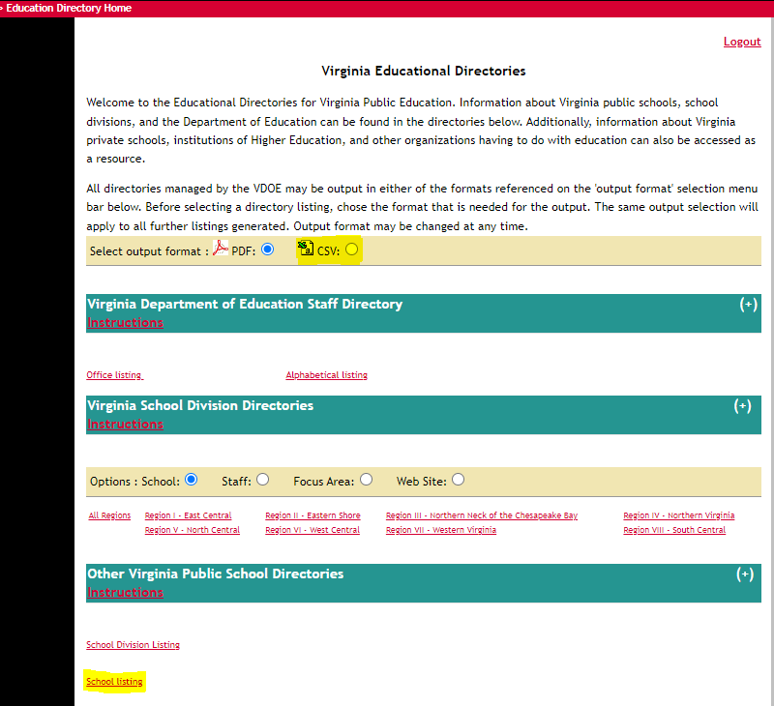
SRC Resources
School Listing Report- includes all school numbers needed for VDOE reporting that are not provided in the public listing on the VDOE website.

Slide 26
Upcoming Intro to SRC Webinar
Training webinar is scheduled for September 20th at 1:00 pm
Ideal for staff new to SRC or experienced staff looking for a refresher
Will provide overview of requirements
Review use of SRC data
SSWS submission and error resolution
Reporting Tools

Slide 27
Questions
Notes:
Write down QA

Slide 28
SRC Contact Information
Student Record Collection web site
http://www.doe.virginia.gov/info_management/data_collection/student_record_collection/index.shtml
Brittney Kanard, Education Data Specialist
Phone: 804-225-3909
Email: Brittney.Kanard@doe.virginia.gov or
resultshelp@doe.virginia.gov
Carol Wells Bazzichi, Data Collection Manager
Email: Carol.WellsBazzichi@doe.virginia.gov
Susan Williams, Director of Data Services
Email: Susan.M.Williams@doe.virginia.gov

