Slide 1
CTE Civil Rights Review Process
Office of Career, Technical, and Adult Education

Slide 2
Overview
CTE Civil Rights Review
Purpose
CTE is Interrelated
Federal Laws and Regulations
Review Process
Scope of On-Site Visit
Program Compliance
Facility Compliance
Comparable Facilities

Slide 3
Purpose of CTE Civil Rights Reviews (1 of 2)
Ensure that each student enjoys equal access to CTE programs and activities, receiving federal funds, regardless of race, color, national origin, sex, or disability.

Slide 4
Purpose of CTE Civil Rights Reviews (2 of 2)
Fulfill VDOE’s obligations to the U.S. Department of Education’s Office for Civil Rights (OCR) to review and/or assist school division's CTE programs, that receive federal funding, in complying with the federal civil rights laws using the “Vocational Education Program Guidelines for Eliminating Discrimination and Denial of Services on the Basis or Race, Color, National Origin, Sex, and Handicap” (Guidelines)
Provide for methods of administration (MOA) by states to give reasonable assurance that each state and federal funding recipients will comply with requirements.

Slide 5
CTE Civil Rights Review
1973 lawsuit against, the U.S. Department of Education to enforce civil rights requirements in CTE
As a result, the guidelines were created to preform the CTE Civil Rights compliance review
The guidelines continue to regulate the application of the related federal civil rights laws to govern the review of CTE programs

Slide 6
Federal Laws and Regulations (1 of 2)
The Guidelines
Requires, and provides guidance for, state recipients to monitor sub-recipients for civil rights compliance through collecting and analyzing data, conducting periodic reviews, providing technical assistance and reporting of activities and findings to OCR
Title IX of the Education Amendments of 1972
Prohibits discrimination on basis of sex in education programs receiving federal funding
U.S. Department of Education Title IX Final Rule
Carries the force and effect of law as of August 14, 2020

Slide 7
Federal Laws and Regulations (2 of 2)
Section 504 of the Rehabilitation Act of 1973
Prohibits discrimination on the basis of disability in any program or activity receiving federal funding
Title VI of the Civil Rights Act of 1964
Prohibits discrimination on the basis of race, color and national origin in any program receiving federal funding
Title II of the Americans with Disabilities Act
Prohibits discrimination on the basis of disability by public entities

Slide 8
Civil Rights Review Process (1 of 2)
Targeting Plan- School divisions are targeted on a 6-year cyclical schedule with about 22 school divisions ranked per year
Notification Letter- Sent to four top-ranked school divisions per year identified by targeting plan
Scheduled Telephone Conferences
Request for Information- Information needed prior to on-site visit
On-Site Visit

Slide 9
Civil Rights Review Process (2 of 2)
Letter of Findings (LOF)- Report detailing noncompliance issues provided to school division within 45 days of the conclusion of the on-site visit
Voluntary Compliance Plan (VCP)- Plan detailing school division’s proposed actions to remedy noncompliance issues to be finalized within 90 days of school division’s receipt of LOF
Monitor- State-level follow-up with school division to ensure completion of VCP
Letter of Closure- Sent to superintendent upon evidence of completion approved by VDOE

Slide 10
Compliance is a Shared Responsibility
Who should be involved?
Superintendent
CTE Administrator/Director
Director of Facilities/Maintenance/Construction
Director of Human Resources
Title IX Coordinator
504 Coordinator
Directors of Special Education, School Counseling, and EL/LEP
Building Administrators

Slide 11
Scope of On-Site Visit (1 of 2)
VDOE CTE team
Reviews data
Interviews central office administration, building administration, CTE teaching staff, Section 504 building coordinator, EL/LEP lead teacher/building coordinator, transition specialist, special education lead teacher/ building coordinator, school counselors, and CTE students
Performs walkthroughs of schools to determine the level of compliance in the following categories:

Slide 12
Scope of On-Site Visit (2 of 2)
Program Accessibility
Administrative
Site Location and Student Eligibility
Admission
Recruitment
Student Financial Assistance
Career Guidance and School Counseling
Services for Students with Disabilities (SWD)
Work-Based Learning
Employment
Facility Accessibility
Facility Comparability

Slide 13
Administrative (1 of 9)
Basic procedures are in place to ensure nondiscrimination
continuous notice of nondiscrimination
grievance procedure must be disseminated to allow students, parents, and staff process for reporting alleged discrimination
annual public notice of nondiscrimination
designation of a person or persons to coordinate activities under Title IX, Section 504, and Title II

Slide 14
Administrative (2 of 9)
All procedures must also be provided in the language of any community of national origin that is approximately equal to or greater than 5% of the total enrollment of the school division

Slide 15
Administrative (3 of 9)
Continuous Notice of Nondiscrimination
Post in CTE classrooms and guidance area, and include in all handbooks and other major publications
Disseminate to students, employees, parents and the general public

Slide 16
Administrative (4 of 9)
Example of a Continuous Notice of Nondiscrimination
The XYZ Schools and its Career and Technical Education Programs do not discriminate on the basis of race, color, national origin, sex, disability, or age in its programs and activities and, if applicable, provides equal access to the Boy Scouts and other designated youth groups.

Slide 17
Administrative (5 of 9)
Grievance Procedures
Board-approved procedures must be disseminated based on federal requirements
The procedures must be included in student and employee handbooks

Slide 18
Administrative (6 of 9)
Annual Notice of Nondiscrimination
Prior to the start of the school year, LEAs must advise students, parents, employees and general public that all CTE opportunities will be offered without regard to race, color, national origin, sex, or disability
Notice includes
Brief summary of program offerings and admission criteria
Name, title, address, email, and telephone number of person designated to coordinate Title IX and Section 504

Slide 19
Administrative (7 of 9)
Annual Notice of Nondiscrimination
Published in
Local newspapers
School major publications
School division website
Other media that reaches students, parents, employees and the general public, including minorities, women, and persons with disabilities

Slide 20
Administrative (8 of 9)
Annual Notice of Nondiscrimination Example:
XYZ Schools offer a wide range of Career and Technical Education programs, including Agricultural Education, Business & Information Technology, Career Connections, Family & Consumer Sciences, Health & Medical Sciences, Marketing, Technology Education, and Trade & Industrial Education.
The XYZ Schools and its Career and Technical Education Programs do not discriminate on the basis of race, color, national origin, sex, disability, or age in its programs and activities and, if applicable, provides equal access to the Boy Scouts and other designated youth groups.

Slide 21
Administrative (9 of 9)
Annual Notice of Nondiscrimination Example:
The following person(s) has/have been designated to handle inquiries regarding the nondiscrimination policies: (If two different persons have been designated, list separately)
Name and Title
Office Address
Email
Telephone Number

Slide 22
Site Location and Student Eligibility
Eligibility criteria for admission to division facilities or programs do not discriminate on basis of race, color, national origin, sex, or disability.

Slide 23
Recruitment (1 of 2)
Policies, procedures and/or practices for selecting and using representative recruitment materials to ensure that career and occupational opportunities are not limited on the basis of race, color, national origin, sex, or disability

Slide 24
Recruitment (2 of 2)
School divisions should have:
Recruitment plans
Brochures and materials with persons of differing races, sexes, and disabilities
Brochures available for students and parents who speak languages other than English
Orientation session
Parent night

Slide 25
Admission (1 of 3)
Admission criteria to CTE programs does not discriminate on the basis of race, color, national origin, sex, or disability
Provide access to CTE courses to students with a disability despite perceptions that employment opportunities may be more limited for individuals with disabilities
Assess students with limited English proficiency on their ability to participate in and benefit from CTE programs

Slide 26
Admission (2 of 3)
Compare the demographic data:
School division’s CTE student enrollment demographics to the overall demographics of the school division
Student enrollment demographics for each CTE course to the student demographics of the high school

Slide 27
Admission (3 of 3)
Look outside of the scope of the CTE civil rights review process
Consider enrollment in higher level mathematics and science courses, or honors and Advanced Placement courses, etc…
Build student interest and skills throughout elementary, middle, and high school

Slide 28
Student Financial Assistance
Information is equitably written and includes the nondiscrimination statement
May include scholarships, dues, fees, clothing, transportation
Previous years’ scholarship awards should be representative of school division’s demographics
Persons with limited English proficiency receive information about financial assistance in their language

Slide 29
Career Guidance and School Counseling (1 of 2)
School divisions must ensure that school counselors do not direct a student to enroll in a particular course or predict a student’s likelihood of success based on race, color, national origin, sex, or disability

Slide 30
Career Guidance and School Counseling (2 of 2)
School counselors
May not counsel Students with Disabilities (SWD) toward more restrictive career objectives than students without disabilities with similar abilities and interest
May not counsel students toward gender-specific career choices
Must be able to effectively communicate with students who have limited English language skills and/or hearing impairments

Slide 31
Services for Students with Disabilities (SWD) (1 of 2)
On the basis of disability, a division may not exclude any qualified SWD from any course, course of study, or other part of its educational program or activity
Provision of Free Appropriate Public Education (FAPE)
Placement decisions made by a group of people knowledgeable about the student, the meaning of the evaluation and data, and placement options

Slide 32
Services for Students with Disabilities (SWD) (2 of 2)
Related instructional aids or services should be available as determined by Individualized Education Program (IEP) or Section 504 team
Academic achievement tests should measure ability and achievement, rather than disability
SWD placed in the educational setting most appropriate for the student’s individual needs (Least Restrictive Environment [LRE])

Slide 33
Work-Based Learning
Work-based learning opportunities are available to all students regardless of race, color, national origin, sex, or disability
Work-training agreements must contain a written assurance of nondiscrimination signed by the employer and school personnel

Slide 34
Employment
Employment practices are conducted without regard to race, color, national origin, sex, or disability of applicants or employees
Application forms and materials are free from prohibited questions concerning disability, marital, or parental status
Salaries are based upon the conditions and responsibilities of employment without regard to race, color, national origin, sex, or disability

Slide 35
Facility Compliance (1 of 3)
Accessible Facilities: Individuals with disabilities may not be excluded from enjoying the benefits of a school’s programs or services because its facilities are inaccessible to or unusable by person with disabilities

Slide 36
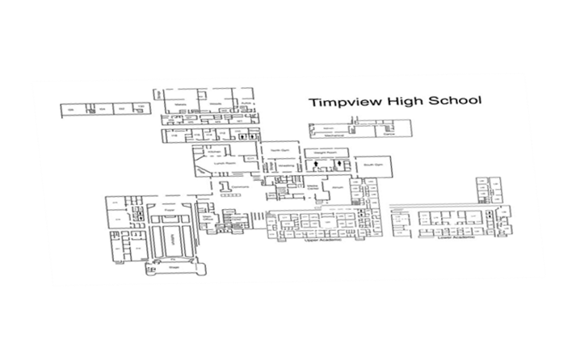
Facility Compliance (2 of 3)
What is a facility
Title II of the ADA
“all or any portion of buildings, structures, sites, complexes, equipment … roads, walks, passageways, parking lots, or other personal property”
Section 504
“all or any portion of buildings, structures, equipment, roads, walks, parking lots, or other real or personal property”

Slide 37
Facility Compliance (3 of 3)
Several factors to consider
When did construction start (ground breaking date, not Certificate of Occupancy received date)
Readily Accessible: Before 6/1977
ANSI: From 6/1977-12/1990
UFAS: From 1/1991-12/1991
ADA 1991: After 1/1992
ADA 2010: After 3/15/2011
Has there been a substantial alteration to a room, wing, and/or the building? (Use above dates and standards for altered portion)

Slide 38
Frequent Areas of Accessibility Noncompliance (1 of 6)
Signage: Accessible entrance, restrooms and stairwells
Note: indoor signage is required to have raised characters and Braille

Slide 39
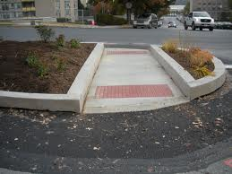
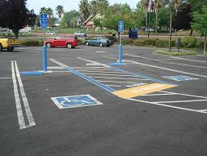
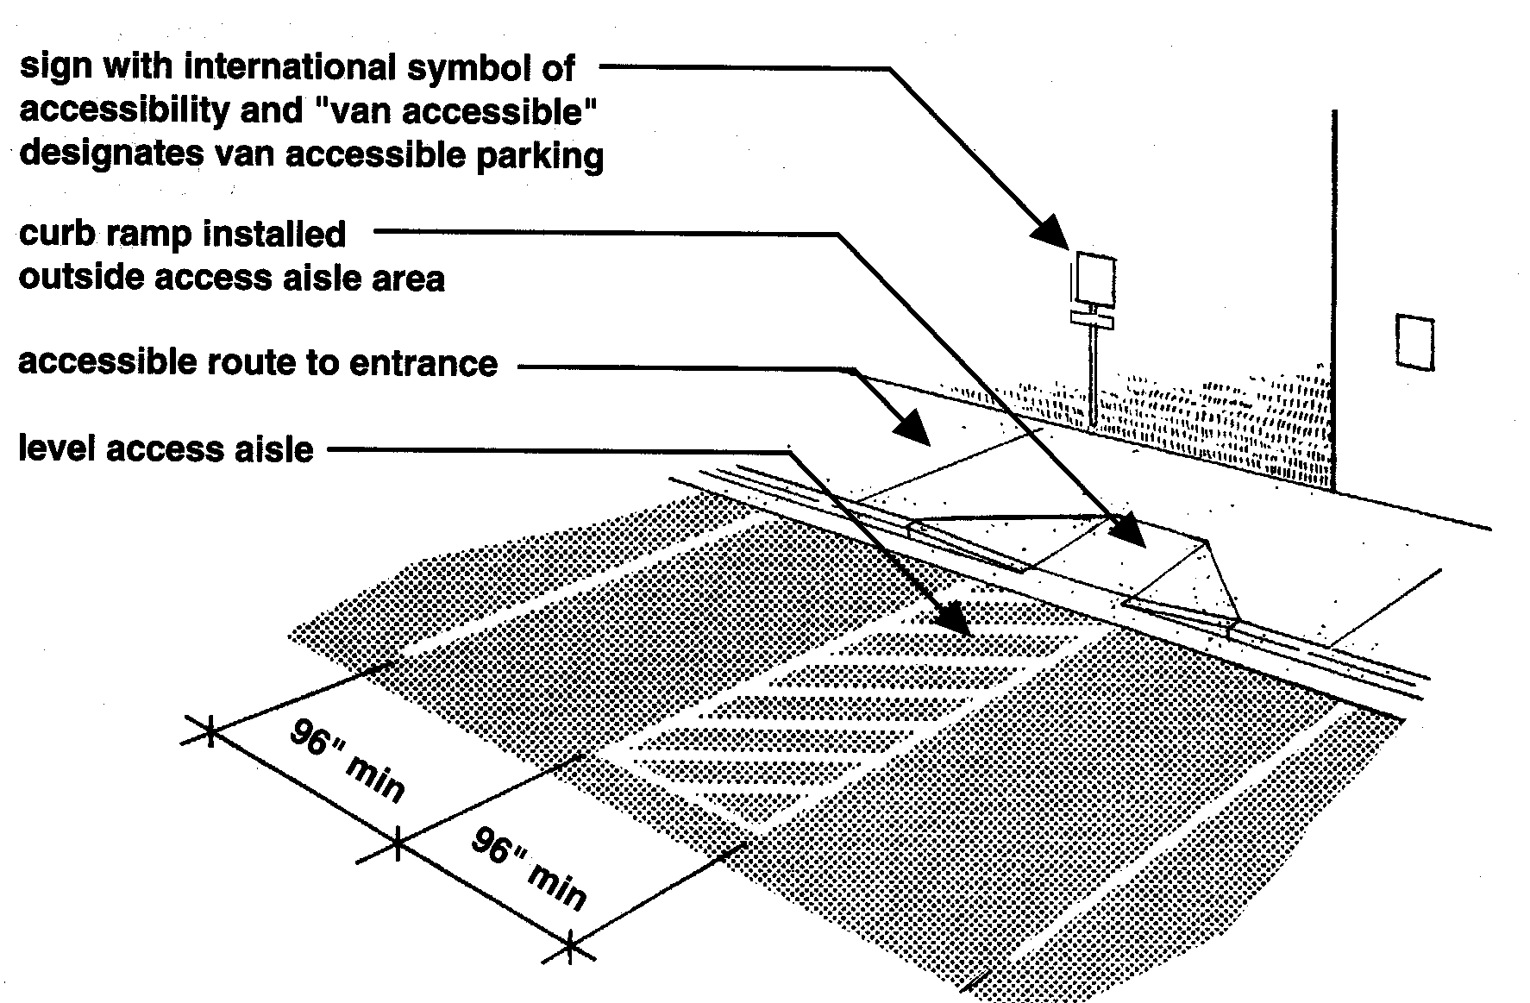
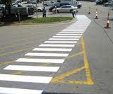
Frequent Areas of Accessibility Noncompliance (2 of 6)
Parking: Required spaces and paths of travel to entrances

Slide 40
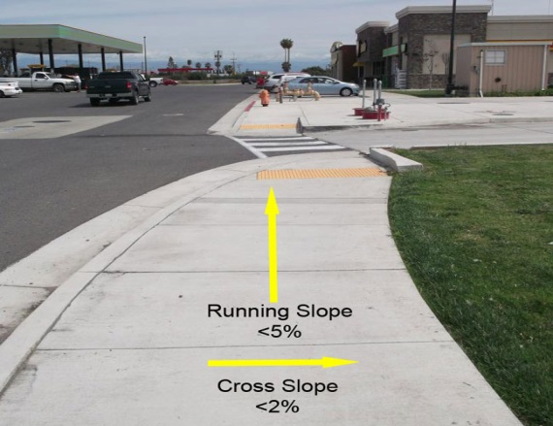
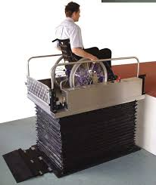
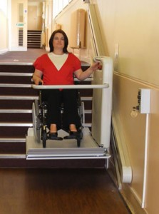
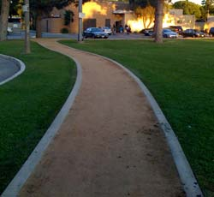
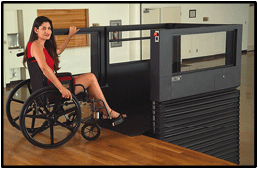
Frequent Areas of Accessibility Noncompliance (3 of 6)
Paths of travel in compliance: Walkways, ramps, and lifts

Slide 41
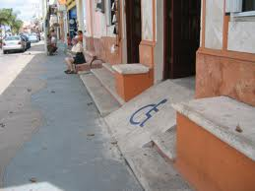
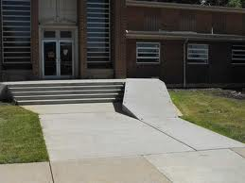
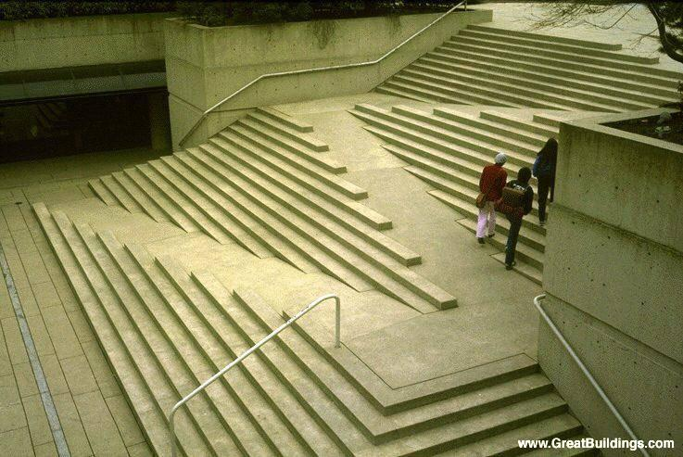
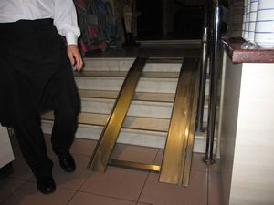
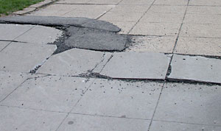
Frequent Areas of Accessibility Noncompliance (4 of 6)
Paths of travel not in compliance: Walkways and ramps

Slide 42
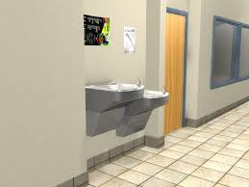
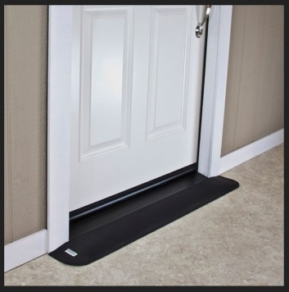
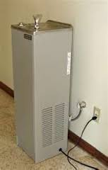
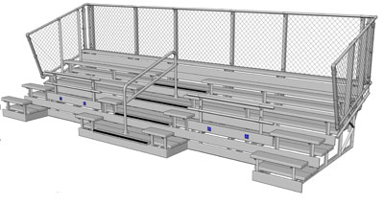
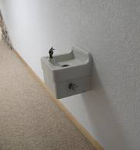
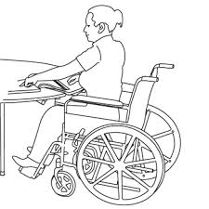
Frequent Areas of Accessibility Noncompliance (5 of 6)
Drinking fountains, thresholds, seating, and door hardware

Slide 43
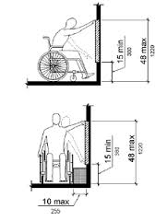
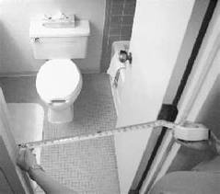
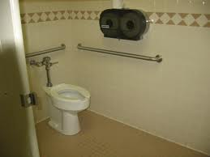
Frequent Areas of Accessibility Noncompliance (6 of 6)
Restrooms: Stalls, grab bars, and dispenser height

Slide 44
Comparable Facilities
Separate facilities provided for students who are male/female or with/without disabilities should be similar in quality and convenience
Separate facilities should also be located in similar proximity to associated restrooms, classrooms, cafeteria, gymnasium, or labs

Slide 45
Overview Civil Rights Review Process (1 of 2)
Targeting Plan/School Division Ranking
Selection Letters- Four school divisions per year
Orientation for Division (if requested)
Requested Information- Information needed prior to on-site visit (not inclusive):
Site map and floor plan with date(s) of original construction and area(s) of subsequent renovation/alteration
Grievance procedures
Samples of major division publications
On-Site Visit

Slide 46
Overview Civil Rights Review Process (2 of 2)
Letter of Findings (LOF) - Report detailing noncompliance issues provided to the school division within 45 days of the conclusion of the on-site visit
Voluntary Compliance Plan (VCP) - Plan detailing school division’s proposed actions to remedy noncompliance issues and finalized within 30 days of division’s receipt of LOF
Monitor - State-level follow-up with school division to ensure completion of VCP
Letter of Closure - Sent to superintendent upon evidence of completion approved by VDOE

Slide 47
Office of Career, Technical, and
Adult Education
William Hatch, J.D.
Planning, Administration and Accountability Coordinator
804.225.3077
William.Hatch@doe.virginia.gov

