Slide 1
Title II, Part A
Federal Program Monitoring Webinar
January 13, 2022

Slide 2
Purpose
To ensure compliance with the law
To offer technical assistance
To identify effective practices

Slide 3
Types of Monitoring
The 2021-2022 Federal Program monitoring will be conducted on-site or virtually as decided by the VDOE and COVID-19 protocols.

Slide 4
Ongoing “Desk Checks”
Application review
Reimbursement review
Licensure/Endorsement data
Equitable distribution of teachers
Private school participation

Slide 5
On-site Monitoring Procedures
Coordinate date, start time, location, and any other necessary details with specialists
Provide telephone number and address for location
Email protocol with division’s response to each indicator at least 2 weeks prior to visit
Plan for half to full day for review of protocol and documentation

Slide 6
Virtual Monitoring Procedures
Coordinate date and time with specialists
Send documentation along with completed protocol at least 2 weeks prior to date
Use Zoom link provided by VDOE specialist
2-3 hours for review of protocol and documentation

Slide 7
2021-2022 Monitoring
Accomack
Alexandria City
Alleghany
Amherst
Arlington
Buchanan
Buena Vista
Clarke
Colonial Heights
Colonial Beach
Dickenson
Dinwiddie
Essex
Falls Church
Galax
Giles
Goochland
Greensville
King George
Lee
Lexington
Madison
Manassas
Nottoway
Poquoson
Prince Edward
Prince George
Rockbridge
Salem City
Southampton
Stafford

Slide 8
Preparation
Review and complete the entire Title II, Part A, Monitoring Protocol.
  All requirements on the protocol will be monitored
Collect evidence
  One document may support multiple requirements
Organize evidence in a notebook, file folders, or electronically. Include:
  3 years of IPAL reports
  2 years of program/fiscal documentation
Notes:
Include the most current IPAL report even if revisions are still being made.

Slide 9
Division Personnel
Title II, Part A Coordinator
Human Resource liaison
Title I Coordinator
Professional Development staff
OMEGA/Finance contact

Slide 10
Monitoring Protocol
Guiding Questions
Acceptable Evidence
Local Agency Response
State Educational Agency Response
Sufficient Documentation
  Yes, No, or N/A

Slide 11
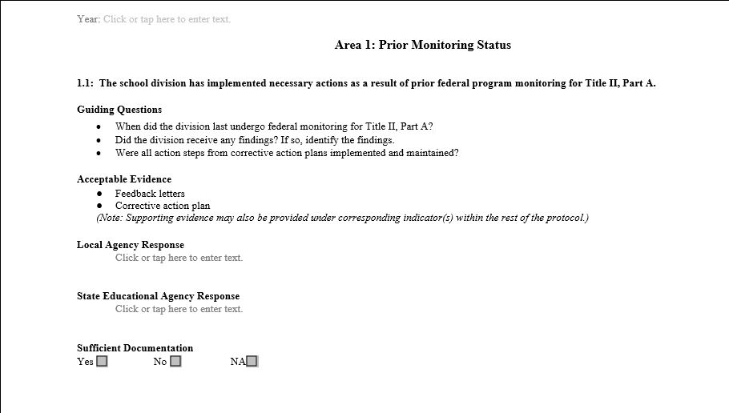
Protocol Layout

Slide 12
Monitoring Protocol Changes
Removal of Public Reporting section
New item: 3.8 – Progress on measurable objectives

Slide 13
Protocol Focus Areas
Prior Monitoring Status
Teacher Quality
Consultation and Professional Development Plan
Allowable Uses of Funds
Fiscal Requirements
Private School Participation

Slide 14
Prior Monitoring
(1.1)The school division has implemented necessary actions as a result of prior federal program monitoring for Title II, Part A.

Slide 15
Teacher Quality
(2.1) Progress toward 100 percent fully licensed/endorsed teachers
(2.2) Licensure status of class-size reduction teachers
(2.3) Equitable distribution of qualified, experienced, and effective teachers
(2.4) Teacher evaluations
(2.5) Principal evaluations

Slide 16
Consultation and PD Plan, slide 1 of 2
(3.1) Plan is developed in consultation with division stakeholders annually
(3.2) Activities align with state standards
(3.3) Plan describes the school system division’s system of professional growth
(3.4) Schools with the highest need are prioritized for services

Slide 17
Consultation and PD Plan, slide 2 of 2
(3.5) Activities are coordinated with other funding sources
(3.6) Division uses a process for selecting evidence-based activities
(3.7) Data and ongoing consultation are used to refine plan
(3.8) Division has made progress on measurable objectives outlined in application
(3.9) Activities address the needs of all learners

Slide 18
Allowable Uses of Funding
(4.1) Activities are allowable
  A full listing of allowable activities is provided in the protocol

Slide 19
Fiscal Requirements, slide 1 of 2
(5.1) Maintenance of effort
(5.2) Supplement not supplant
  Activities must not have been funded from a different source in the previous year; or
  Activities must not be a primary function of the school division or mandated by statute
(5.3) Implemented activities correlate to the plan submitted to VDOE

Slide 20
Fiscal Requirements, slide 2 of 2
(5.4) Applications, revisions, and amendments are submitted in a timely manner to ensure timely spend down of funds
(5.5) Funds are encumbered and drawn down in a timely manner
(5.6) Proper accounting of time is maintained for staff positions funded by grant

Slide 21
Private School Participation, slide 1 of 2
(6.1) Timely and meaningful consultation with private school personnel
  Intent to Participate submitted to VDOE
(6.2) Evidence of planning with private school personnel
  Agreement of Services submitted to VDOE

Slide 22
Private School Participation, slide 2 of 2
(6.3) Equitable services are provided
(6.4) Funds are properly administered
(6.5) Division maintains inventory of fixed assets

Slide 23
Common Findings
Teacher Qualifications
Needs Assessment/Stakeholder Involvement
Accounting of Time for Employees
Draw Down of Funds
Timely Submission of Applications/Revisions/Amendments

Slide 24
Next Steps
Email notification will be sent by Dr. Randall Johnson requesting dates
  Send at least 3-4 possible dates by February 11, 2022
  Virtual monitoring to be conducted between March 15, 2022 - May 26, 2022
Specialists will confirm dates with division coordinators

Slide 25
After Monitoring
Additional documentation to be submitted within 10 business days
Official letter sent to division superintendent indicating full compliance or outlining areas of improvement
  Corrective action plan is required for any requirements found not in compliance

Slide 26

QUESTIONS

Slide 27
References
ESSA Legislation, Public Law 115-64
Building Systems of Support for Excellent Teaching and Leading: Non-Regulatory Guidance
Revised Private School Children Non-Regulatory Guidance

Slide 28
Contact Information
Dr. Randall Johnson
Aaron Monroe
Title II, Part A Coordinator
Randall.Johnson@doe.virginia.gov
804-225-2122
Title II, Part A Specialist
Aaron.Monroe@doe.virginia.gov
804-509-0552
Welcome to the team!!!
Dr. Cora Coefield
Title II, Part A Specialist

