Slide 1
“Looking Closer”
Examining PALS data to ensure the value and investment of early screening in Virginia

Slide 2
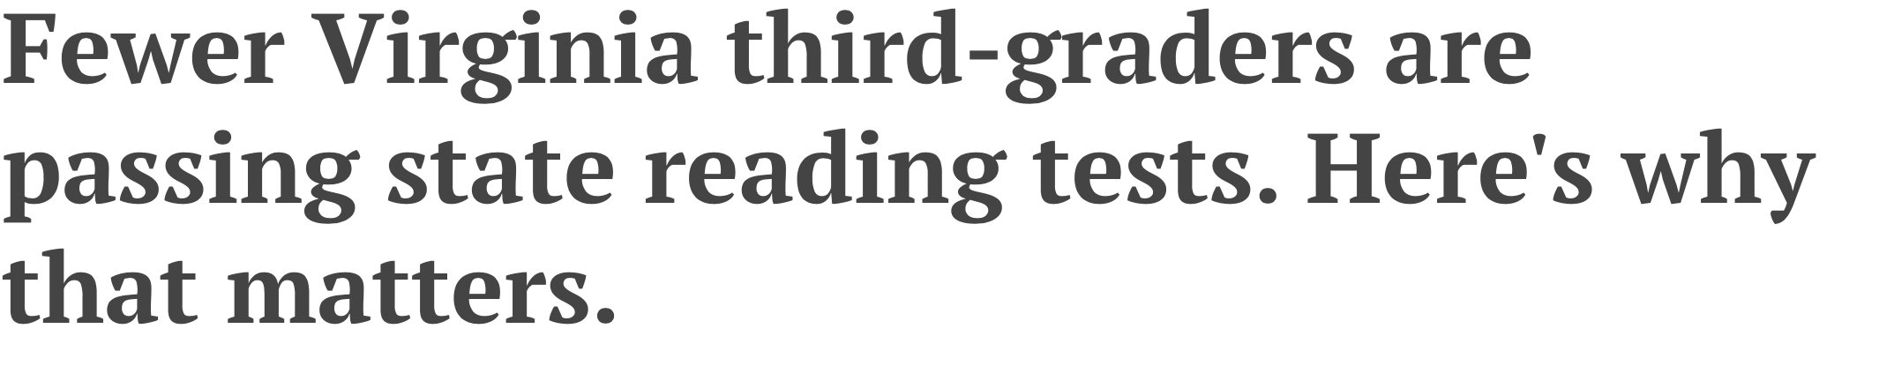
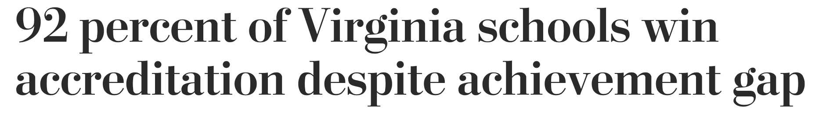
Virginia on the National Stage
V
Notes:
Virginia has been on a national stage in the last two years.
Virginia’s problems are not unique.
But they are getting attention.

Slide 3
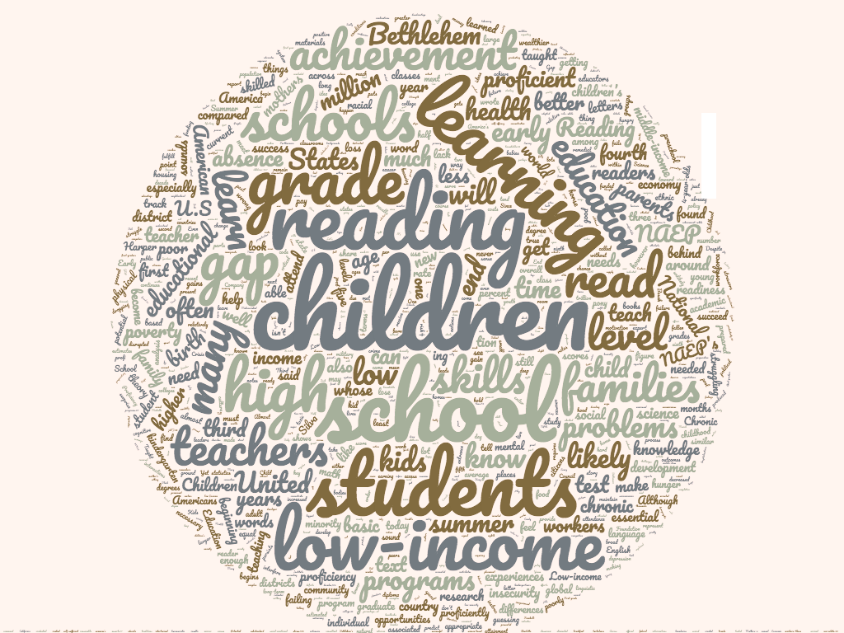
What about…..
What about the fact that half the kids come into my class so far behind I don’t even know where to begin?
What about more prek?
What about all the technology? Kids don’t even pick up a book anymore.
What about these kids’ behavior issues? This group of boys is so wild- I can barely teach anything!
What about families? If we could just get every family to read with their kids…
What about my own learning? Nobody knows this stuff at my school. I was never taught how to teach reading.
What about these kids’ home lives? How can kids learn to read when they are showing up hungry?
Notes:
Many factors and many questions come up when trying to answer the question of “What is the key problem to fix?”
It is complicated to everyone- from the parent to the teacher- we can all reflect on the complexity.
This sense of complexity can make it hard to find a space to take action.

Slide 4
What Role Can We Play? (1 of 2)
What role can we play?
Notes:
But its important we find a space for action.
What pieces of this story do I have the ability to change?
For PALS – our ability to use data to make children’s needs more visible to you is our area of action. Within that, I suggest that your area for action is considering how to use the PALS data to help make children and their needs more visible.

Slide 5
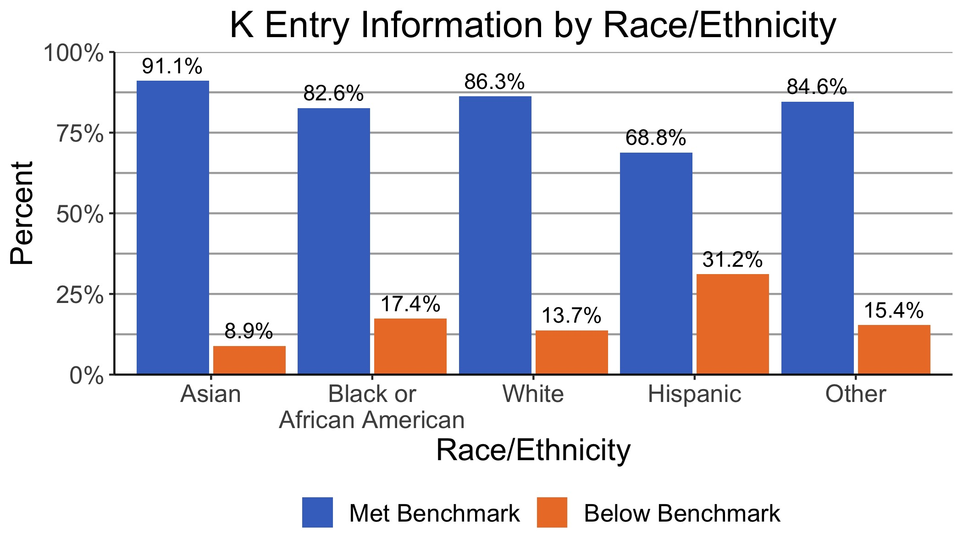
Inequity in 3rd grade reading achievement is evident much earlier than 3rd grade.
Notes:
The challenges that make the headlines- around reading outcomes and inequality- start far before the headlines.
Blue is above benchmark.
Orange below benchmark.
Above benchmark does not mean a child enters kindergarten reading. It means some minimal amount of literacy foundational development. Knowing some letters. Hearing/distinguishing some rhymes. Attempting to apply letter sound knowledge to ‘developmental spelling’ efforts. Knowing what books are and what text is and following along, to a degree.
The data show that the risk of coming in with minimal early literacy foundational skills is not equally distributed. It is worth noting different things may drive different reasons for this. For example, in VA, we do not measure children’s literacy skills in their home language- only in English. This is part of the reason for the high numbers of Hispanic children incoming below benchmark.
What research will say- and what our data also show- is that when there are unequal patterns of readiness- its generally largely explained by unequal opportunities.

Slide 6
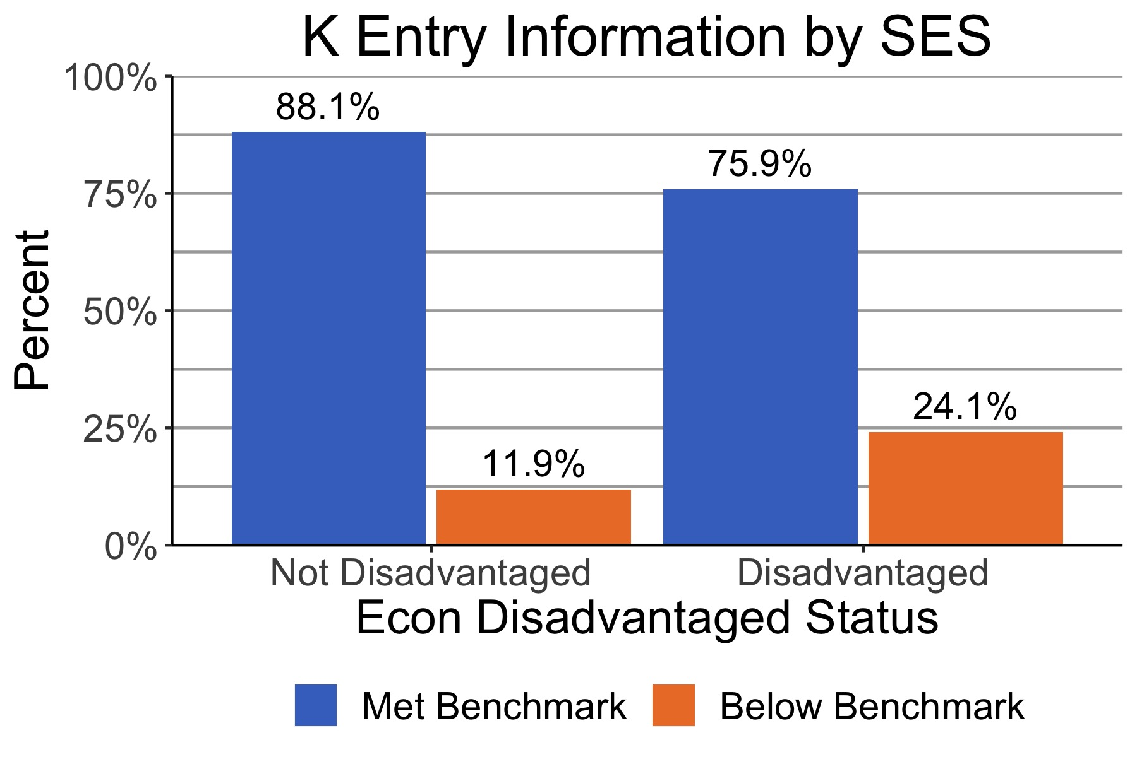
Inequity in 3rd grade reading achievement is evident much earlier than 3rd grade
Notes:
Its easier to see this when we look by income. The disparity by race evens out- to a degree, not completely- when we look by income and race. So I will focus on income gaps.
What these data show are the group of children who bear the greatest burden of risk for being behind in their skills are the same group of children who lack access to consistent opportunities for learning and early learning and for access to safe and nurturing environments.
When we look by poverty, we see that almost 1 in 4 children who are labelled as disadvantaged lack adequate development in early literacy foundations. This is in contrast to just over 1 in 10 children who are not labelled as disadvantaged.
Disadvantaged is a state flag meaning eligible for Medicaid, TANF, free and reduced lunch, or being designated homeless or migrant.

Slide 7
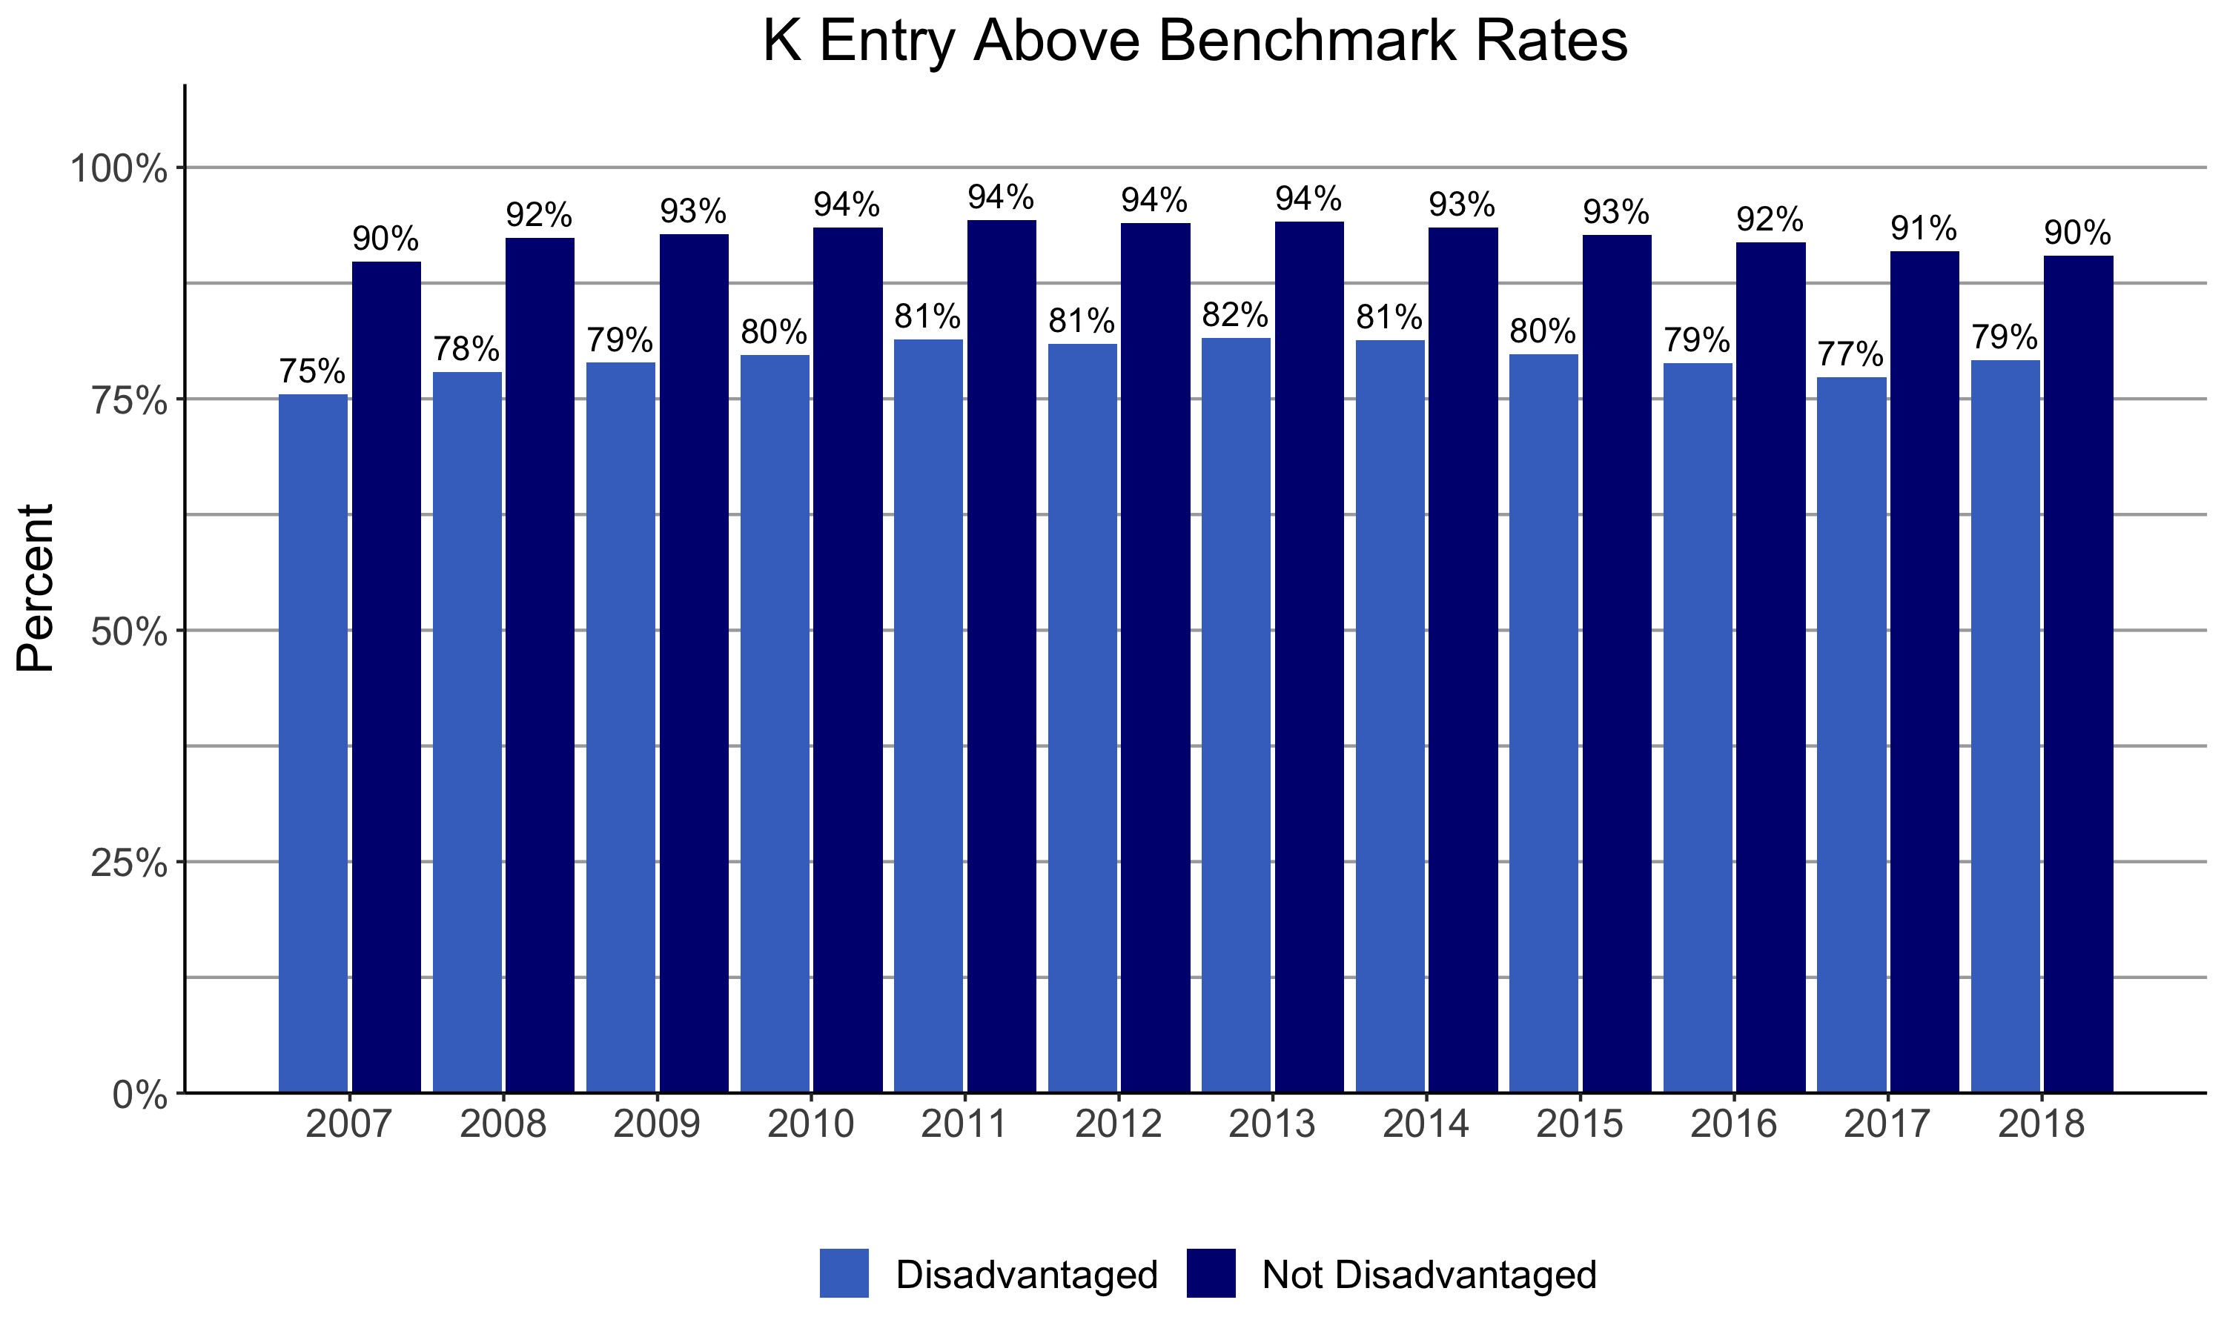
Gaps at K entry have been evident for the past 10 years (or more)
Notes:
This graph shows percentage above benchmark. Light blue is for disadvantaged. See 20% or so ‘gap’ in number of children who are coming in with the minimal threshold of literacy foundations by income.
And often we ask about prek. We see without prek, percentage of children who come in below benchmark is actually 40%. So this reflects a merging of children with and without prek.

Slide 8
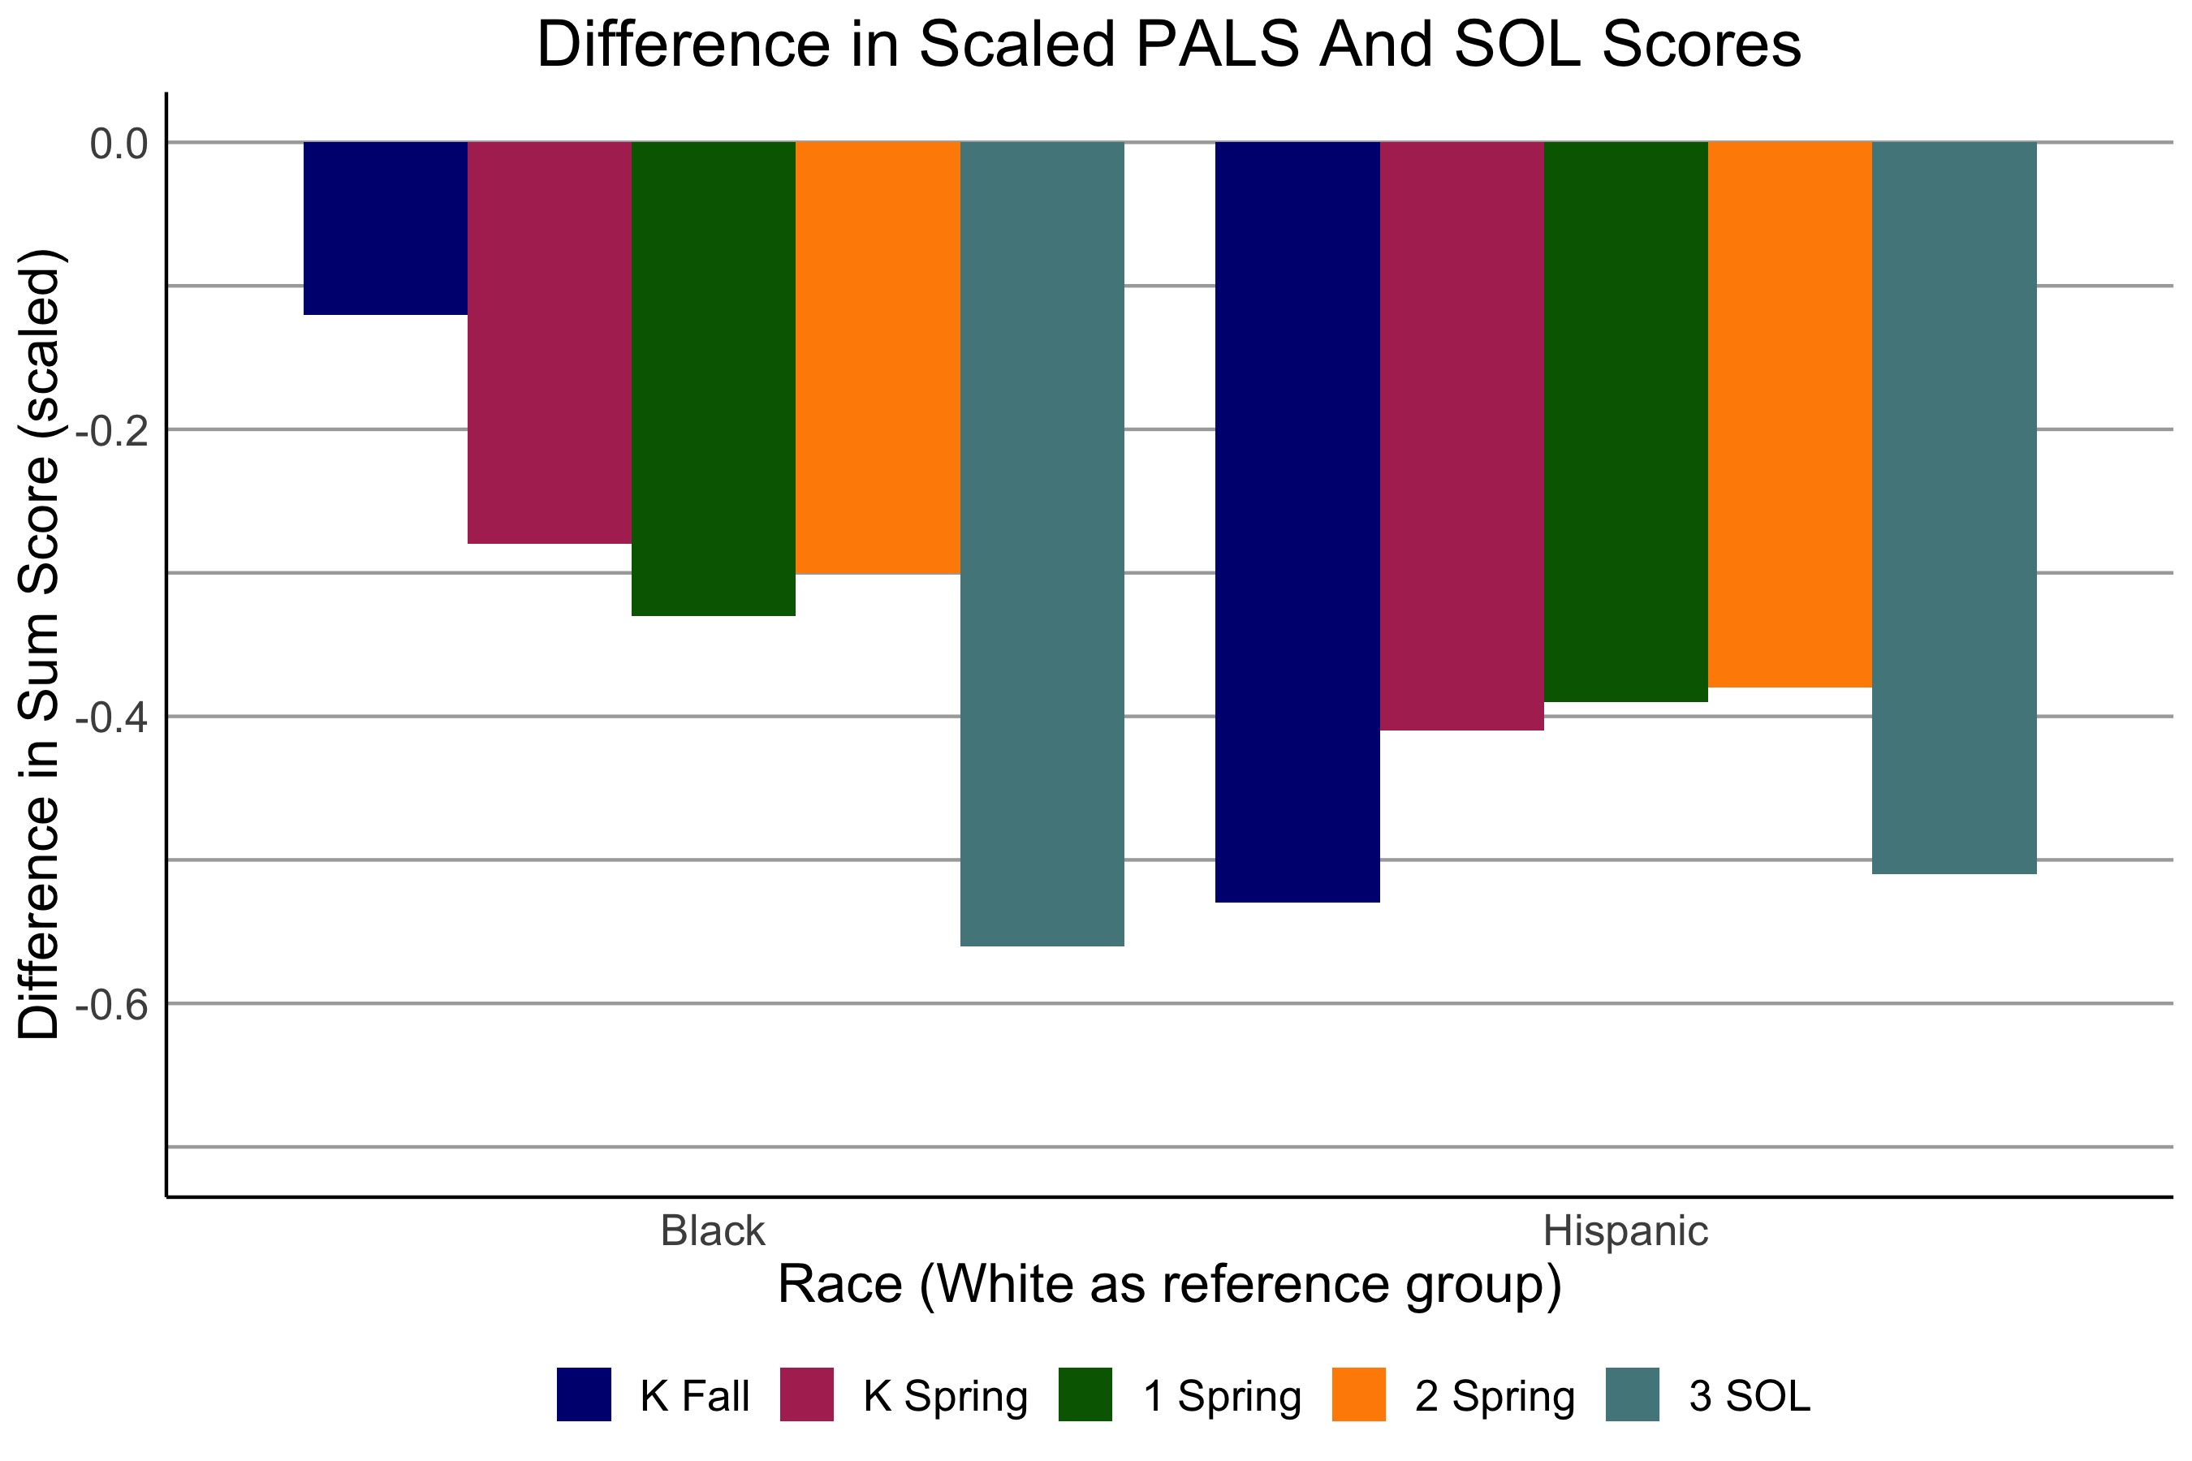
And gaps at K entry appear to increase or sustain across the K-3 time period
Bassock, Herring, McGinty, Miller, & Wyckoff, in progress
Children who begin the same have different chances of success as a function of race and socio-economic status.
Patterns of inequity are evident within schools (and cannot be fully explained by differences between schools or divisions)
Children starting the same, end differently within the same school as a function of race or disadvantage.
Notes:
Also what is important to consider is that gaps seen at K entry tend to continue or increase across the first few years of school when looked at by race.
What you see here is a standardized difference. So the zero line would suggest the difference between the average scores for incoming kindergarteners who are black and white is zero (again here we aren’t distinguishing by economics). What we see is a small difference- a tenth of a standard deviation. But it grows significantly across the grades.
We looked at this deeper with expertise of colleagues in Ed Policy and this is a paper we are preparing for submission for publication.
What we found, and the trend you see here, is one which occurs within schools. This doesn’t mean there may not be issues between schools or about sorting children in schools. But it does mean a piece of the story that cannot be ignored is that children are having different experiences and opportunities when you follow them within schools.
To contextualize:
Two children, showing up to school behind in literacy- below benchmark, with the same exact PALS score. But one is black and one is white. The white child is 1.5 times more likely to pass the SOL than the black child.
Similarly, two children showing up to school fairy advanced in their early literacy development. Top quintile of the population. One is from a economically disadvantaged home and the other is not. The child with economic disadvantage is 2 times less likely to score advanced on the 3rd grade SOL than the more advantaged child.

Slide 9
What Role Can We Play? (2 of 2)
What role can we play?
Notes:
So- we return to the question.

Slide 10
Look Closer
Look closer
Notes:
My message- to my team at PALS, and my message to you, is that data are underutilized. What I just presented came from my continuing to look closer. To lean into the patterns we saw and work to understand them is what I see as an action we can take that could help. And there are three key ways I want to suggest that you look closer at your PALS data.

Slide 11
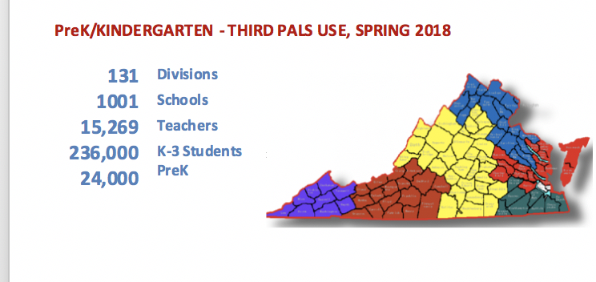
PALS K-3: Part of a Policy Initiative in Virginia: EIRI
Use of PALS K and PALS 1-3 in Virginia is part of the Early Intervention Reading Initiative (EIRI, 1997, Virginia Acts of Assembly, Chapter 924, Item 140).
The intent is to use assessment and data-guided intervention across K-3 to catch reading difficulties early.
4 mandatory assessment points
across K-3
Intervention dollars to divisions
(with a local match) for 2.5 added
instructional hours
per week for any child found
significantly behind in development
Reflects approximately an $18M annual
investment by the state (with matching
local dollars)
PreK
Approximately 36,000 children per year over the past 10 years have received intervention under EIRI
Notes:
Before we launch into those practices, however, its worth just recapping- in case anyone is new to this context.
This is what PALS was designed for.

Slide 12
The Design of PALS
PALS K-3 was created in phases of funding 1997-2000. K, then grade 1, followed by adding grades 2/3 and PreK in 2004
PALS was designed to examine key early literacy indicators predictive of early reading success in coordination with EIRI mandatory windows
PALS was designed to provide instructionally transparent information to teachers but with a developmental focus
PALS was designed to be given 1:1 by the teacher to support data to instructional links
PreK

Slide 13
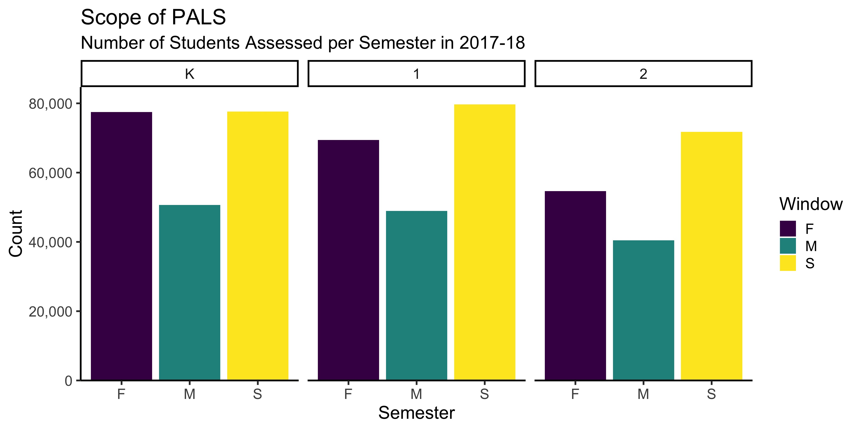
PALS K-3: Non-mandatory usage
Notes:
We see it has evolved to be used in ways that push the limits of its design. It’s used more often and frequently than just 4 snapshots over 4 years. This is good because it means you have the data to look at. But it also means that you may not know how to make the most of this information.

Slide 14
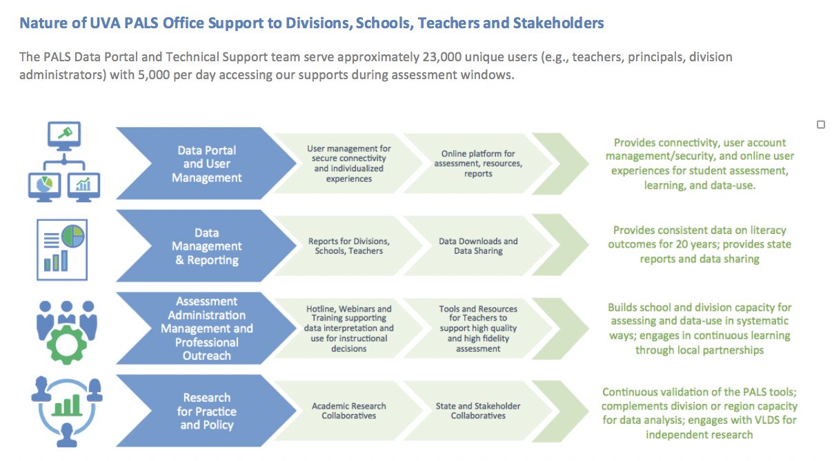
How to take a “closer look” with PAL
Recognize the difference between screening and success
Redefine risk: Watching progress across time
Put PALS in a developmental context when planning instruction
Notes:
These are three ways I want to suggest we look closer. It’s a joint responsibility.

Slide 15
Looking Close Practice 1: Recognize the difference between screening and success
Notes:
Big idea
What does that mean is a system
Moving growing

Slide 16
Recognize the difference between screening and success
Know that the PALS benchmark is not proficiency.
Understanding patterns of performance on subskills and subcomponents offers a much more valuable lens.
PALS Benchmark
Notes:
The PALS benchmark is not proficiency.
On bottom of graph, you see that a child with a very low PALS score- 10 or 15- has a low probability of passing the SOL. And at the top of the peak of the graph, a child with a very high PALS score, such as in the 50 or 60 point range, has a high probability of passing the SOL.
The benchmark is no where near a guarantee of success. And this is, again, because the benchmark is not a proficiency benchmark . It is a screener for significant risk. Risk so significant state dollars are allocated.
And so, in this context, we realize that the benchmark is not the most useful piece of information for understanding needs. Because children- above the benchmark- also have significant needs.
What we know is that the best way to consider PALS is through the subskills. Not the benchmark.

Slide 17
The summed score can mask difficulty in any one particular area
PALS was designed to glean the most information right around the benchmark.
  Items are designed to emphasize acquisition of skills to a minimum threshold within each subskill.
The benchmark takes these individual patterns and ‘puts them together’
  Children can have very different specific skills but show up ‘above the benchmark’ and have the same sum score (despite having a pocket of weakness)
Less than 3% of users are accessing reports that looks at data with a lens on subskill or subskill comparison (e.g., alphabet knowledge/Phonological awareness vs. COW; spelling vs. word reading).
Notes:
We are doing some new research now on actual item level difficulty. We are finding that the items do not span a wide range of ability. In other words, there isn’t a particularly hard or easy item within a subtest. It’s more like a lot of repetition of a narrow band within each subskill so that we can really understand- do they have minimal proficiency in this particular area of literacy?
This test design means that two very different types of children can have the same summed score.
(e.g., general challenge across areas or one area of significant weakness….they may end up with the same score).
From our analytics on our reports we now know that the most relevant information- on subskill performance and comparison of subskills- isn’t being used. Only 2.9% of teachers- out of 15,000 across the state- access the individual child reports for every child in the class.
Also less than 3% are looking at these subskill reports.

Slide 18

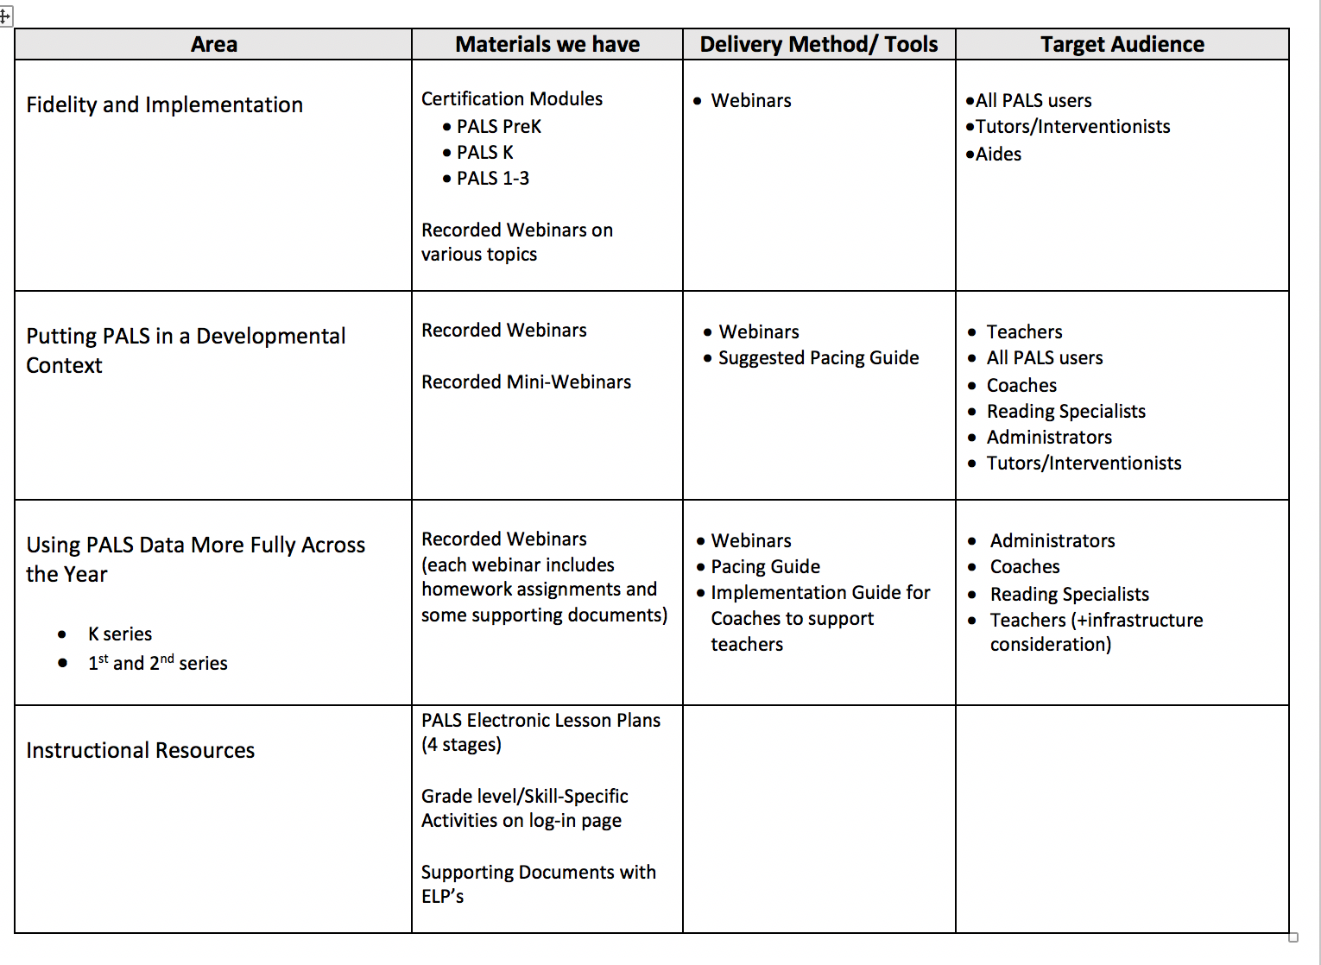
What tools are available to go beyond the benchmark?
Enhancing knowledge of development and the PALS assessment
Administrative Certification
Notes:
At PALS we are working to offer a few tools to address this and help teachers and instructional leaders use more of the data and data reports.
One line of supports we are developing is a series on data-use modules for K-2. It provides supports for various ways to use PALS data more effectively across the year.
We worked to develop this with Alleghany and Covington City under a Spencer grant last year; we are trying it out with more divisions this year and are hoping to offer this state wide next year.
We also have a newly released set of certifications to ensure there is background on how to use the measure.

Slide 19
Looking Close Practice 2: Redefine Risk
The power of following children across time

Slide 20
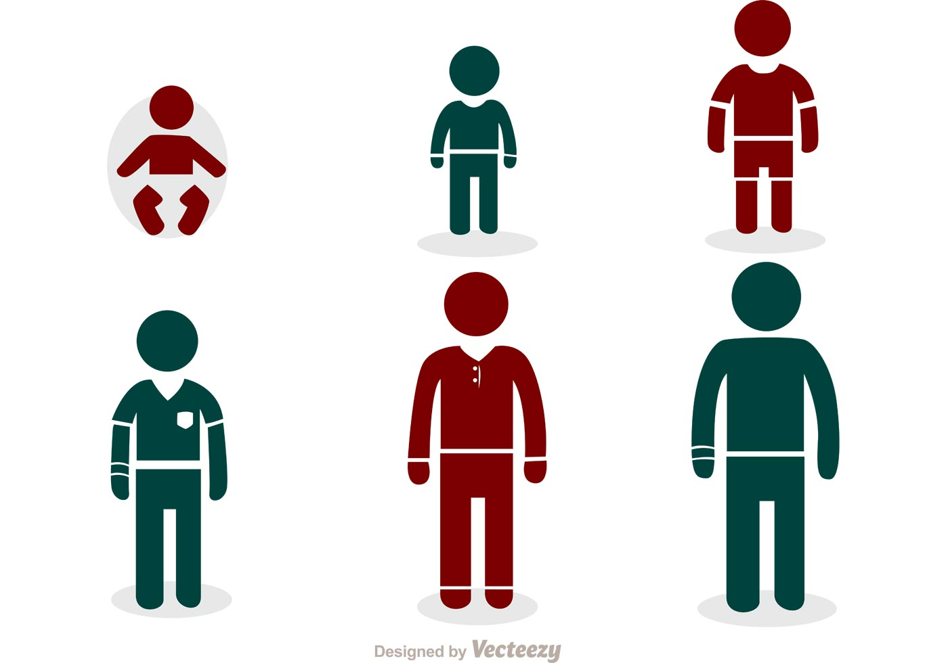
Children move in and out of risk across time (1 of 2)
Patterns of Risk Across time
Persistent Risk
Inconsistent Risk
Isolated Risk
K Fall
K Spring
1st Spring
Notes:
We engaged in some research around risk and sought to better understand whether patterns across time would be more telling than just thinking “who is below benchmark” at any one particular window of screening (which is how most schools and teachers are considering the risk of children).
We found three key patterns.
The persistent risk category are those children who were always below benchmark across all mandatory windows. This is the smallest group.
The inconsistent risk category was the largest and it’s the group of children who appear to flow ‘in and out’ of being above and below benchmark across windows.
And the isolated risk profile- are two different groups – but they did not differ in their long term outcomes. One comes in below benchmark and appears to then stay above benchmark going forward. The other comes in above benchmark but then falls below benchmark at some point subsequently (but only in one window).

Slide 21
Children move in and out of risk across time (2 of 2)
Risk | Percent Fail SOL
No Risk | 18.5%
Isolated Risk | 53.4%
Inconsistent Risk | 66%
Persistent Risk | 73.8%
K Fall
K Spring
1st Spring
Notes:
We found that looking at risk across time is really important for making children’s needs and risk more visible.
We found that a child who had isolated risk- meaning they only were below benchmark once at any time K-2- was still ‘at risk’ from the perspective that 50% of those children fail the SOL’s.
This suggests the value of using trends across time for a ‘watch and see’ group or for working intentionally in the classroom. Even if these children cannot get true EIRI intervention- or at least cannot be eligible for state dollars for intervention- their needs must be something that teachers and the school are aware of.

Slide 22
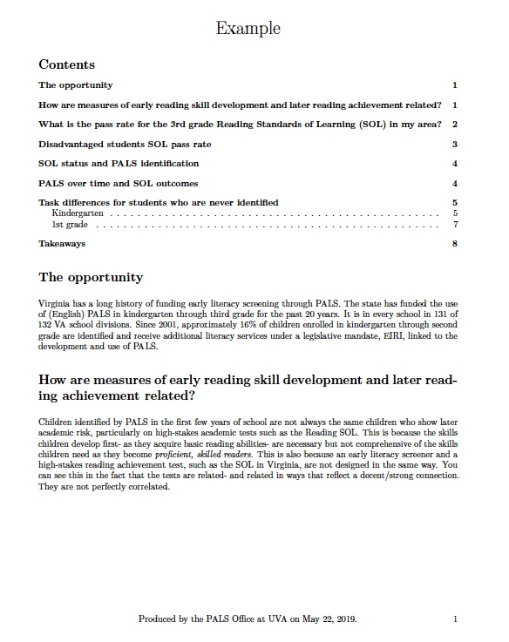
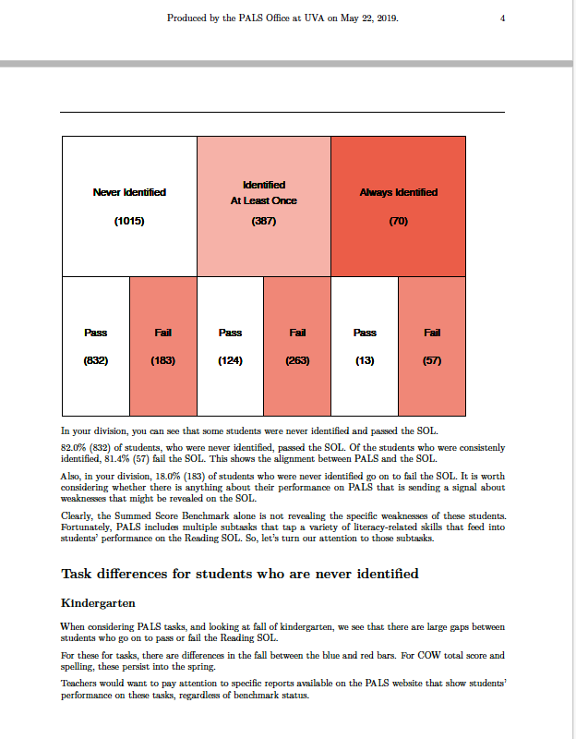
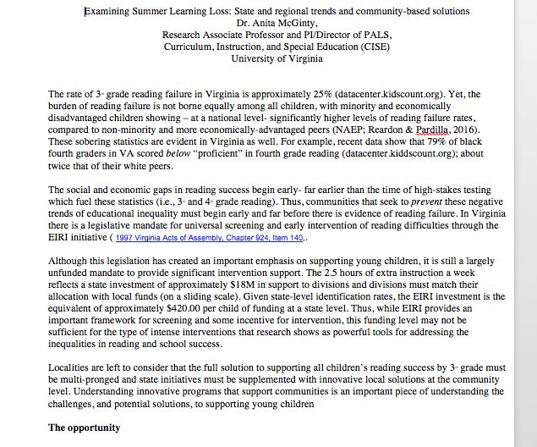
What tools are available to help consider performance across time?
Use reports and new data outreach tools.
Data downloads and reports for div reps.
Division history reports
Division history of identified students
Division disaggregated data
Cohort reports
Teacher reports.
Back to school reports
PALS Data Outreach. Last year we provided a snapshot report for about 15 divisions that traced their K-3 patterns. We can provide these and build a few others this year.
Research: Current study on central VA summer learning loss from an equity lens
Notes:
There are reports and resources, as well as projects our office continues to engage in, to better understand historical trends of children to support you.
Again these are underutilized.

Slide 23
Looking Close Practice 3: Put PALS in a developmental context
Interpreting data from PALS from a developmental perspective for instructional planning

Slide 24
Early reading and later reading are not the same.
PALS Summed Score Correlated with Grade 3 SOL
PALS Summed Score
Notes:
This graph is a correlation. The steeper the line the stronger the relationship.
What we see is the relationship of PALS is not perfect to SOL’s. But it is relatively moderate – which is actually surprising when you consider the two measures have a different purpose and the fact that a child’s literacy in kindergarten is not the same thing as their literacy in 3rd grade.

Slide 25
Reading requires two key areas of skills. This equation reflects the cognitive trade-offs that occur as children learn to read.
D X LC = RC
Decoding/Encoding
Word Level Skills
Language
Comprehension
And PALS represents a ‘proxy’ or pieces of early reading, but is not a measure of the full equation
Notes:
To understand the disconnect- and to use PALS data so that you know what it does tell you and what it doesn’t tell you- its important to think developmentally.
The end goal is in green. Its reading comprehension.
Children get to that by putting two fairly independent cognitive areas together. One is the capacity to decode (or make meaning of symbols on a page). The second is language. Once you translate print into something meaningful, you are using language skills. Reading a book or hearing a book requires largely the same language skills for meaning-making. The difference is simply the nature of the information (print translation or auditory signal translated).
In the first few years of school, children need to develop both. You need to instruct the whole equation.
But when we want to screen for risk, we don’t need to screen for the whole equation. Because in the first few years of school- children’s cognitive energy is going into decoding. And so when we try to measure reading comprehension, we largely only measure decoding. As children are learning to read, decoding is the bottleneck. Even if they have amazing vocabulary and language, much of this won’t come into play until their decoding becomes more automatic and they have cognitive ‘space’ to bring these skills into reading.
PALS was designed as a screener. It was not designed to assess all that is needed to build strong readers. It focuses on some proxies or indicators of the most important predictors of early reading, which reside with decoding. But PALS is not a template for the full range of your instruction.

Slide 26
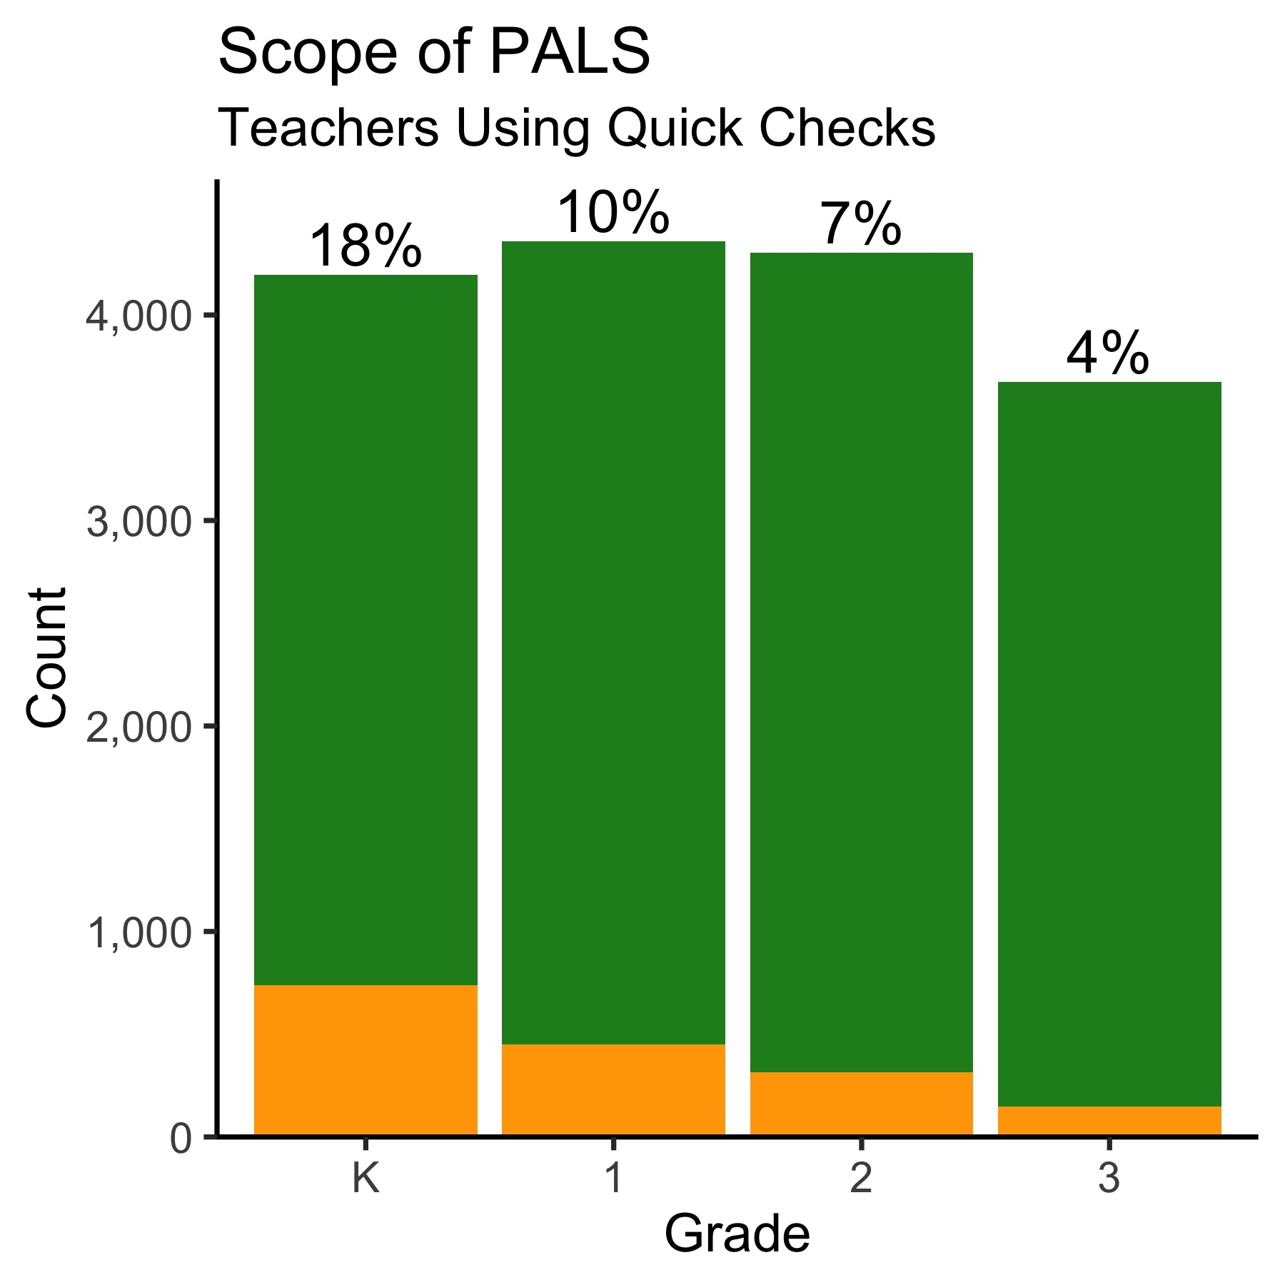
What can we do?
Distinguish developmental ‘indicators’ (PALS) from areas of development that need instruction.
Use consistent measurement- PALS and/or others- across the year, but also know your students need more than this.
Consider quick checks or other progress monitoring approaches.
Make the translation from developmental indicators to aligned areas of development for instruction.
Notes:
So- we suggest using PALS data to its fullest and better understanding what other information you need on children.
Also we suggest that you remember that the measures on PALS are just ‘proxies’ for skills related to decoding and automatic decoding. For example, COW subtests are one that many consider in kindergarten or even first grade (as an optional subtest to probe risk). COW is an indicator, but the skill to develop is how children merge and integrate phonological and alphabet skills.
If children are weak in COW, you want to consider a full range of instructional activities that build this capacity. For example, decoding CVC words or spelling CVC words. Quick checks offer non-words and word decoding checks as another source of information.

Slide 27
Questions?

Slide 28
Thank you!
Anita McGinty: as2g@virginia.edu

