Slide 1
Moving in the “Write” Direction for the SOLs
By Jennifer Haws, Annette Conley, and Sheila Sousa-Lintecum

Slide 2
Presenters
Sheila Sousa
Email: slsousa@ccpsd.k12.va.us
Annette Conley -
Email: amconley@vbschools.com
Twitter @Amconley49
Jennifer Haws
Email: Jennifer.Haws@vbschools.com
Twitter @jehaws

Slide 3
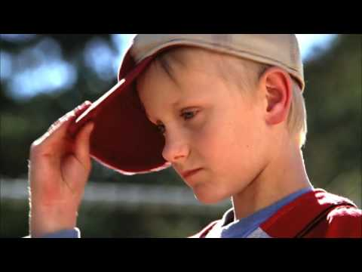
Change is good!

Slide 4
Let the SOLs Be Your Guide
Find resources from the Virginia Department of Education on their website
Curriculum Framework and Testing blueprint documents for 2017 are on the English SOL page
Writing blueprints and a draft rubric are found on the local assessments page.

Slide 5
Let the SOLs Be Your Guide
3rd Grade Writing Standards
3.8 The student will write in a variety of forms to include narrative, descriptive, opinion, and expository.
3.8 d) Use organizational strategies to structure writing according to type.
Formerly 3.9e. Revised from “Use strategies for organization of information and elaboration according to the type of writing”
3.8 h) Express an opinion about a topic and provide fact-based reasons for support.
New Content

Slide 6
Let the SOLs Be Your Guide
3rd Grade Writing Standards - Cont’d
3.10 The student will demonstrate comprehension of information resources to research a topic and complete a research product.
Formerly 3.7 and 3.11. Revised from “The student will write a short report”
3.10 e) Avoid plagiarism and use own words.
Revised from “Understand the difference between plagiarism and using own words”
3.10 f) Demonstrate ethical use of the internet
New content

Slide 7
3rd Grade Reading Blueprint Fiction
3.3 The student will read and demonstrate comprehension of fictional texts, literary nonfiction, and poetry.
d) Compare and contrast settings, characters, and plot events.
e) Summarize plot events.
f) Identify the narrator of a story.
g) Ask and answer questions about what is read.
i) Identify the conflict and resolution.

Slide 8
3rd Grade Reading Blueprint Nonfiction
3.6 The student will read and demonstrate comprehension of nonfiction texts.
a) Identify the author’s purpose.
d) Ask and answer questions about what is read using the text for support.
e) Draw conclusions using the text for support.
f) Summarize information found in nonfiction texts.
g) Identify the main idea.
h) Identify supporting details.

Slide 9
Let the SOLs Be Your Guide
4th Grade Writing Standards
4.7 The student will write in a variety of forms to include narrative, descriptive, opinion, and expository.
Revised from “The student will write cohesively for a variety of purposes”
4.7 j) Express an opinion about a topic and provide fact-based reasons for support.
New content

Slide 10
Let the SOLs Be Your Guide
4th Grade Writing Standards - Cont’d
4.8 The student will self-and peer edit writing for capitalization, spelling, punctuation, sentence structure, paragraphing, and Standard English.
Revised from “The student will edit writing for correct grammar, capitalization, spelling, punctuation, sentence structure, and paragraphing”
4.9 The student will demonstrate comprehension of information resources to create a research product.
Removed “research a topic” and added “create a research product”

Slide 11
Grade 4 Reading Blueprint: Fiction
4.5 The student will read and demonstrate comprehension of fictional texts, literary nonfiction, and poetry.
a) Describe how the choice of language, setting, and characters contributes to the development of plot.
c) Summarize events in the plot.
d) Identify genres.
e) Identify the narrator of a story and the speaker of a poem.
f) Identify the conflict and resolution.
g) Identify sensory words.
i) Compare/contrast details in literary and informational nonfiction texts.

Slide 12
Grade 4 Reading Blueprint: Nonfiction
4.6 The student will read and demonstrate comprehension of nonfiction texts.
a) Use text features, such as type, headings, and graphics, to predict and categorize information.
b) Explain the author’s purpose.
c) Identify the main idea.
d) Summarize supporting details.
e) Draw conclusions and make inferences using textual information as support.
g) Distinguish between fact and opinion.

Slide 13
Let the SOLs Be Your Guide
5th Grade Writing Standards
5.7 The student will write in a variety of forms to include narrative, descriptive, expository, and persuasive.
Revised from “The student will write for a variety of purposes: describe, to inform, to entertain, to explain, and to persuade”
5.7 f) Recognize different modes of writing have different patterns of organization including story structure for narrative writing.
New content
5.7 h) Clearly state a position including supporting reasons and evidence to persuade the intended audience.
New content

Slide 14
Let the SOLs Be Your Guide
5th Grade Writing Standards - Cont’d
5.9 The student will find, evaluate, and select appropriate resources to create a research product.
Added “to create” and removed “for”
5.9 c) Evaluate the relevance, reliability, and credibility of information.
Revised from “Use technology as a tool to research, organize, evaluate, and communicate information”
5.9 f) Demonstrate ethical use of the Internet.
New content

Slide 15
5th Grade Reading Blueprint: Fiction
5.5 The student will read and demonstrate comprehension of fictional texts, literary nonfiction, and poetry.
a) Summarize plot events using details from text.
c) Describe character development.
e) Explain the resolution of conflict(s).
f) Identify genres.
g) Differentiate between first- and third-person point of view.
i) Explain how an author’s choice of vocabulary contributes to the author’s style.
l) Compare/contrast details in literary and informational nonfiction texts.

Slide 16
5th Grade Reading Blueprint: Nonfiction
5.6 The student will read and demonstrate comprehension of nonfiction texts.
b) Skim materials to develop a general overview of content and to locate specific information.
c) Identify the main idea d) Summarize supporting details.
e) Identify organizational pattern(s) & phrases that signal an organizational pattern.
g) Locate information from the text to support opinions, inferences, & conclusions.
i) Differentiate between fact and opinion.
j) Compare and contrast details and ideas within and between texts.

Slide 17
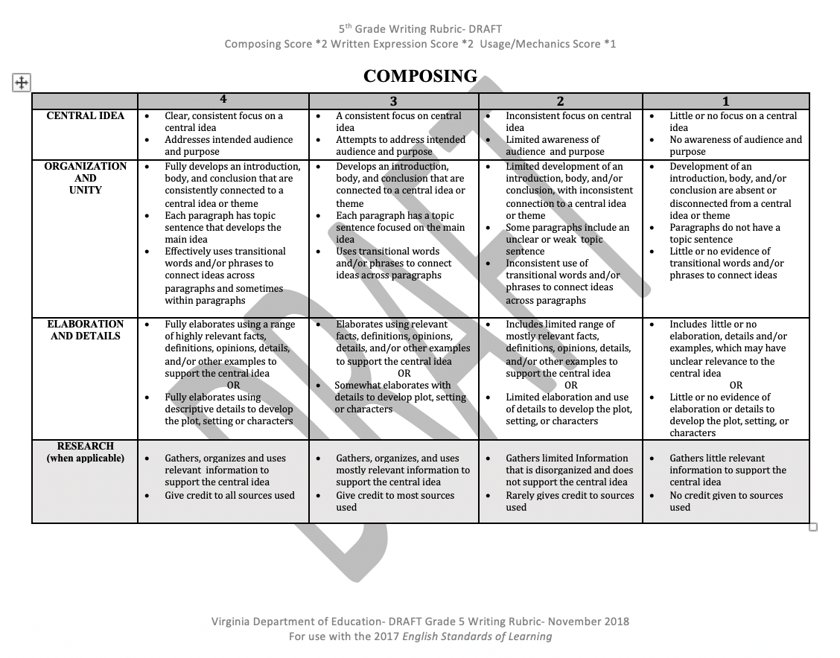
The Writing Rubric is your compass
You can find this draft under the Local Assessments page on the VDOE website.

Slide 18
Creating a Writing Community
The SOL Essential Understandings set the stage.
Essential Understandings: All students should:
understand that writers communicate ideas for a variety of purposes
understand that writers plan, write, revise, and share their writing with others
understand that writers use the writing process including planning, drafting, revising, editing, and publishing
understand that written communication should be well-planned and clear to the reader.
the reader.

Slide 19
Best Practices in Writing Instruction
Authentic writing should be happening at all grades.
Writing is about instructing, not assigning.
Choice should be given in writing - choice of how to publish, choice of topic, choice of prewriting strategies, etc.
The steps of the writing process need to be modeled and practiced.
Reading and writing should be reciprocal processes.

Slide 20
Which way do we go now?
The changes to the SOLS are guiding us to change our writing instruction and products.
3rd grade - Research a topic and complete a research product.
4th grade - Demonstrate comprehension of information resources to create a research product.
5th grade - Find, evaluate, and select appropriate resources to create a research product.
What do these changes mean for instruction?
What do these changes mean for assessment?

Slide 21
Performance Task Framework - Path
*Multi-step process over several days
Step 1 - Introduce the task
Step 2 - Notetaking - multimodal literacy
Step 3 - Drafting
Step 4 - Drafting, editing, and revising
Step 5 - Publishing - multimodal options with choice

Slide 22
Performance Task: Step 1
Hook (multimodal - videos, images, interviews, commercials…)
Introduce the task and establish purpose
Ask questions
Gathering ideas
Focus topic
Identify a genre

Slide 23
A Great Idea for Step One
One option for Step One is: The QFT - Question Formulation Technique created by Right Question Institute
“Students are more successful when they learn to ask their own questions.” - Link to Right Question website

Slide 24
Rules for Producing Questions
Ask as many questions as you can.
Do not stop to answer, judge, or discuss.
Write down every question exactly as it was stated.
Change any statements into questions.

Slide 25
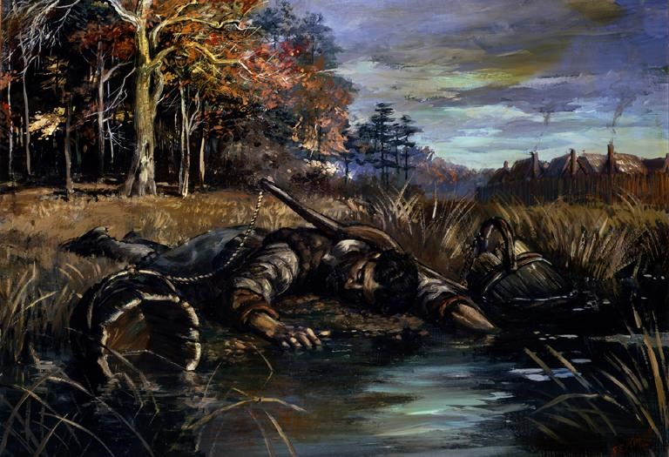
Start with a Questions Focus

Slide 26
Categorize Questions: Closed/Open
Definitions:
Closed-ended questions can be answered with a “yes” or “no” or with a one-word answer.
Open-ended questions require more explanation.
Directions: Identify your questions as closed-ended or open-ended by marking them with a “C” or an “O”.

Slide 27
Modify Questions
Directions:
Take one open-ended question and change it into an closed question.
Take one closed-ended question and change it into an open-ended question.

Slide 28
Prioritize Questions
Review your list of questions
Choose the three questions you consider most important.
While prioritizing, think about your QFocus
Reflect: Why did you choose those three questions as the most important? Where are your priority questions in the sequence of your entire list of questions?

Slide 29
Share
Questions you changed from closed to open
Your three priority questions and their numbers in your original sequence
Rationale for choosing priority questions

Slide 30
Reflection
What did you learn?
How did you learn it?
What do you understand differently now about asking questions?

Slide 31
Components of the QFT
Start with A Question Focus (image/video)
Review Rules for Producing Questions
Small Group Work: Producing Questions
Categorize Questions-Open/Closed
Change 2 Questions (Open to Closed, Closed to Open)
Prioritize Questions
Sharing
Reflection

Slide 32
Performance Task Step 1 Reminders
Introduce the task and establish purpose
Consider what role are students being asked to take?
Get them hooked! Use images/videos (Values.com)
Remember it may take time to focus the topic. Preliminary research may be needed.
Identify the specific genre to be used.

Slide 33
Performance Task Step 2
Building background knowledge - Students will have more to write when they have background
Note-taking / Collecting information
Organization is key!
Teach students to organize information by source to help them credit the source later
Consider using graphic organizers/colors

Slide 34
Performance Task Step 3
Prewriting
Organizing ideas based on genre
Considerations:
Graphic organizers to support genre
Sharing ideas orally helps to solidify focus

Slide 35
Performance Task Step 4
Drafting
Editing
Revising
Considerations:
Writing should occur over multiple days
Checklists to support editing
Oral check-ins

Slide 36
Performance Task Step 5
Publishing
Revisit the task and purpose
Consider student voice and choice
Extend the writing with presentations, videos, commercials, pamphlets….

Slide 37
For Example
Step 1 - Introduce the task - Take on the role of environmental awareness activist. First, you will be asked to research and write an expository piece about the effects of pollution. This paper will be shared with individuals in the community to spread awareness. Second, you’ll need to find a way to share the main idea of your message. You may choose to decorate paper garbage bags to pass out at a local grocery store, create a video for the morning announcements, or “your choice.”
Step 2 - Note-taking from multiple sources (Research pollution/videos)
Step 3 - Pre-writing/Organizing facts about pollution
Step 4 - Drafting, editing, and revising
Step 5 - Publishing - multimodal options with choice

Slide 38
K-5 Writing Roadmap
Emphasis on ethical use of the Internet when gathering and using information (Grades 3-12)
Writing process increases in complexity and rigor as students progress through K-12
Kindergarten = narrative and descriptive
Grade 1 = narrative, descriptive, and opinion
Grade 2 = narrative, descriptive, opinion, and expository
Grade 3 = narrative, descriptive, opinion, and expository
Grade 4 = narrative, descriptive, opinion, and expository
Grade 5 = narrative, descriptive, expository, and persuasive

Slide 39
What is the “write” direction in 3rd Grade?
Narrative, descriptive, opinion, and expository
Social Studies - Ancient Civilizations
Narrative - Imagine you are living in Ancient Greece and you have a friend/pen pal who lives in Ancient Rome. Write a letter, post card, or email to your pen pal telling them what your life is like there. Describe a typical day: Where do you live? What do you do all day? What is the environment like? What things do you see around you? How do you get food and water? How you feel about your life there?

Slide 40
What is the “write” direction in 3rd Grade?
Narrative, descriptive, opinion, and expository
Science - Ecosystems
Opinion - A travel agency offers trips around the world, and needs a way to help travelers choose their destinations. You have been hired to design something (brochure, webpage, poster, commercial, podcast) to help the travel agency advertise and explain the ecosystem that you select. Your presentation needs to give information about the ecosystem as well as encourage people to come and visit. Why should they visit? What will they see there? What animals? What plants? What makes your ecosystem unique?

Slide 41
What is the “write” direction in 4th Grade?
Here is an example of colliding Reading and Writing standards together through the use of novels. In 4th grade, we read Blood on the River: James Town 1607. After finishing the novel the teacher can:
Discuss the different types of writing (Author’s Purpose)
Students are given a writing task:
At the beginning of Chapter 23, Samuel and Richard are stunned that the Virginia Company has sent families with women and children to live in Jamestown. Richard suggests that the reason was because “No one is allowed to say anything bad about Jamestown in their letters back home.”
Task: Write a truthful letter to a family member about your experiences and opinions of the New World and persuade them to stay in England.

Slide 42
What is the “write” direction in 4th Grade?
Another option using the novel:
In chapters 17-18 we read about a disease that is affecting the colonists.
3. You are a scientist who has been asked to identify what diseases could have been the “summer sickness”. Research diseases borne by different insects such as flies, mosquitoes, ticks, etc.
Students are to find and give facts to support their theory of the “summer sickness”
Prepare slides to present their findings and share with the class

Slide 43
What is the “write” direction in 5th Grade?
Persuasive Writing:
Your school librarian is helping our class find resources to learn about the Revolutionary War. However, he is struggling on which resources to use: historical fiction books or movies (historical documentaries). After viewing both these resources closely, which would you recommend as a resource to use in our Revolutionary War lessons, and why?
Personal Narrative Writing:
Try to remember how you felt at the end of your 4th grade year. Were you nervous about starting 5th? How did you feel about switching classes? Having more responsibilities as a 5th grader (ex. Homework, projects, etc)? To help calm their nerves, you will write a letter to rising 5th graders and share your favorite experience(s) from this year. Write about a special day or favorite memory you had in fifth grade to help ease their concerns.

Slide 44
Maintaining the Course
It is important to teach students to avoid plagiarism with images and videos.
When using Google Images, click on “Tools” at the top. Then click on “usage.”
You can then choose the level of “usage” you desire
Typically we use “Labeled for noncommercial Reuse”
This will ensure all searched images are sharable.

Slide 45
Your turn! - Digital Citizenship Objectives:
3.10 The student will demonstrate comprehension of informational resources to research a topic and complete a research product.
d) Evaluate the relevance of the information.
e) Avoid plagiarism and use own words.
f) Demonstrate ethical use of the Internet.
4.9 The student will demonstrate comprehension of information resources to create a research product.
c) Evaluate the relevance and reliability of information.
d) Give credit to sources used in research.
e) Avoid plagiarism and use own words.
f) Demonstrate ethical use of the Internet.
5.10 The student will find, evaluate, and select appropriate resources to create a research product.
c) Evaluate the relevance, reliability, and credibility of information
d) Give credit to sources used in research
e) Avoid plagiarism and use own words
f) Demonstrate ethical use of the internet

Slide 46
Other Resources:
Authentic Ways to Develop Performance-Based Activities by ThoughtCo.
Website for developing Performance Based activities
What Does a Performance Assessment Look Like? Here Are Six Examples from the Center for Collaborative Education
Link to examples of Performance Assessments
Reading and Writing Performance Assessments from Columbia University Reading and Writing Project
Performance Assessments from the Reading and Writing Project

Slide 47
Go forth in the “write” direction!

Slide 48
Presenters
Sheila Sousa
Email: slsousa@ccpsd.k12.va.us
Annette Conley -
Email: amconley@vbschools.com
Twitter @Amconley49
Jennifer Haws
Email: Jennifer.Haws@vbschools.com
Twitter @jehaws

Slide 49
Disclaimer
Reference within this presentation to any specific commercial or non-commercial product, process, or service by trade name, trademark, manufacturer or otherwise does not constitute or imply an endorsement, recommendation, or favoring by the Virginia Department of Education.

