Slide 1
Writing is a Journey: Writing and Evaluating Metaphors to Increase Student Understanding
Dr. Jen McConnel, Longwood University
mcconneljm@longwood.edu

Slide 2
Presentation Overview
Theory
Metaphors from Students
Integrating the Lessons of These Metaphors
Wrapping Up

Slide 3
Presentation Objectives
Together, we will explore ways to:
• Guide students to develop strategies for revision through metaphor.
• Provide students with tools to explore complicated or confusing topics.
• Model reflective, recursive practices.

Slide 4
What Do I Mean By “Metaphor”?

Slide 5
According to Lakoff and Johnson,
“The heart of metaphor is inference. Conceptual metaphor allows inferences in sensory-motor domains (e.g., domains of space and objects) to be used to draw inferences about other domains (e.g., domains of subjective judgment), with concepts like intimacy, emotions, justice, and so on. Because we reason in terms of metaphor, the metaphors we use determine a great deal about how we live our lives.”
Metaphors We Live By, p. 244

Slide 6
Recent Research
Bauer, L. B. (2018). A Necessary Addiction: Student Conceptualizations of Technology and Its Impact on Teaching and Learning. Journal of College Reading and Learning, 48(1), 67–81.
Everett, S. (2016). “I Just Started Writing”: Toward Addressing Invisibility, Silence, and Mortality among Academically High-Achieving Black Male Secondary Students. Literacy Research: Theory, Method, and Practice, 65(1), 316–331.
Paulson, E. J., & Armstrong, S. L. (2011). Mountains and Pit Bulls: Students’ Metaphors for College Transitional Reading and Writing. Journal of Adolescent & Adult Literacy, 54(7), 494–503.

Slide 7
Metaphors for Teaching
“Academic work is like travelling. You may find yourself in new places and situations, where you don't know the people or speak the language. Over time, you come to feel more comfortable as you learn to navigate this new environment.”
College instructor, 2019

Slide 8
Metaphors are Everywhere

Slide 9
Metaphors for Argument
Your claims are indefensible.
He attacked every point in my argument.
I’ve never won an argument with her.
She shot down all of my arguments
Each of these statement makes a comparison between argument and war.

Slide 10
How I Came to This Work
“My article is totally a sphinx, goulash, or one of those university building where old and new meet unharmoniously: the blending isn’t clear.”
My metaphors, 2018

Slide 11
Considering Metaphors in the Classroom

Slide 12
Metaphors for Literacy
“Academic literacy is like a boardwalk on the first morning of spring because of the long journey before the final destination. At first, the walk may seem cold and pointless with maybe too many obstacles in your way. It is important instead to see it as another journey you can accomplish if you believe in yourself and all the strengths you have!”
First-year college student during her first semester after high school

Slide 13
Metaphors for Literacy: Vulnerability
“Academic literacy is like high school because you are constantly being peer-reviewed with majorly negative remarks. It takes lots of blood, sweat, and tears over a long period of time to come out with nothing but a sheet of paper. You will probably get covered in red marks, and are almost guaranteed to be drawn on with pen at some point.”
First-year college student after a gap between HS and college

Slide 14
Revised Metaphors
“What else can I compare academic literacy to? Is it like trying to impress someone you can’t? Is it…is it like stand-up comedy? Academic literacy is like stand-up because it is subjective to whoever’s experiencing it but there are elements that can be agreed upon to reflect general quality. And because there are lots of unspoken small rules that you learn once you get the main part down, I guess? And it’s a never-ending process of trying to get better.”
The same student, two months later

Slide 15
Supporting Students through Vulnerability
“the emotion that we experience during times of uncertainty, risk, and emotional exposure”
Brené Brown, 2018

Slide 16
Metaphors and Transfer
“I think part of it is I have a culinary background, I’m very passionate about food and cooking and a lot of areas around that, so I think I relate to it a lot, it’s kind of like second nature. So any time I’m like, ‘how can I make something I don’t understand into something I understand?’ it’s by relating it to something I’m good at.”
First-year mature college student, returning to school for a career change

Slide 17
Metaphors and Transformation
“Academic work is like pottery sculpting because developing one's understanding about a subject is like learning how to shape clay on a spinning wheel…Metaphorically, the difficulty of developing new academic skills would compare to the spin of the wheel; its the constant force that you have to fight strategically to reach your goal (completing an assignment or properly developing the curves to the pot.) Just like how you need to spend the time studying to complete academic assignments, you need to spend time sculpting to create the pot--neither will happen without effort--similarly you need to treat assignments with patience just as you would with making a pot; if you rush either an assignment or a sculpture, the end result will be messy and poor…”
First-year college student the semester after high school

Slide 18
Integrating the Lessons of These Metaphors

Slide 19
Teaching With Metaphors
Primary SOL:
11.6a Apply components of a recursive writing process for multiple purposes to create a focused, organized, and coherent piece of writing to address a specific audience and purpose.
Reinforced (Related Standard) SOL:
11.2a and b Create media messages with a specific point of view; Analyze the impact of selected media formats on meaning.
11.3c Discriminate between connotative and denotative meanings and interpret the connotation.

Slide 20
Embracing the Potential of Metaphor in the Classroom
This activity can be done with any pair of items.
Learning | Running
Life-long Community Teachers Support Books | Exhausting Community at races Coaches Training The right gear

Slide 21
“Ten Ways to Think About Writing: Metaphoric Musings for College Writing Students” by E. Shelley Reid
https://wac.colostate.edu/docs/books/writingspaces2/reid--ten-ways-to-think.pdf

Slide 22
What Will Students Do?
Read and reflect
Write and discuss
Examine and analyze

Slide 23
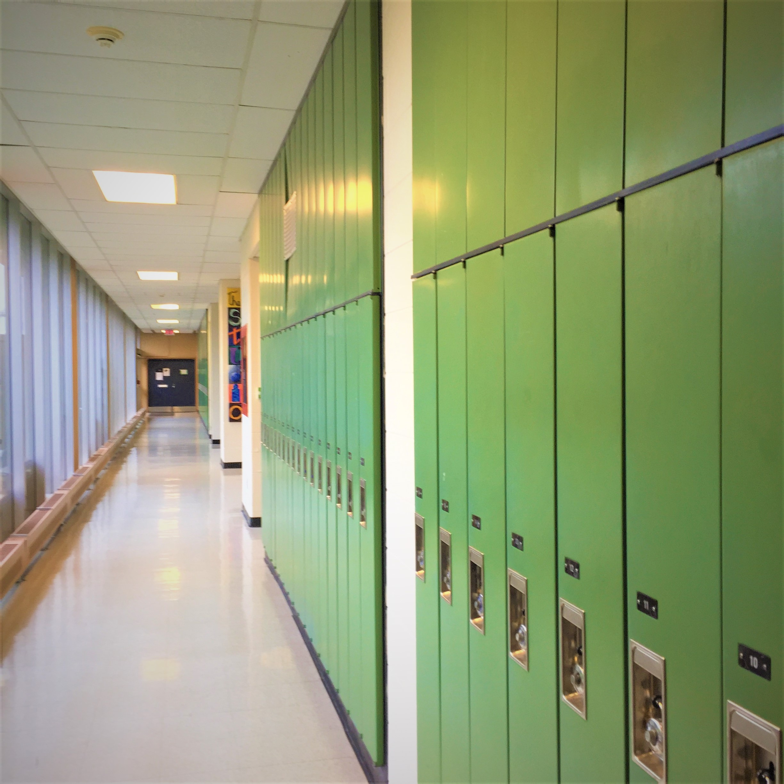
Integrating Metaphors and Art

Slide 24
Questions to Consider when Reading Metaphors
How does this student consider their own learning in relation to others? (presence of teacher, peer, in metaphor?)
What does this metaphor reveal about the student’s goals for the future?
What emotions are present, either explicitly or implicitly, in this student’s response?
What do these responses mean for classroom practice?

Slide 25
(Re)Considering Metaphors in the Classroom

Slide 26
How Can We Use Metaphor in Our Classrooms?
Help students develop strategies for revision through metaphor
Provide students with tools to explore complicated or confusing topics
Model reflective, recursive practices
Develop connections among students and between students and teachers through shared metaphors

Slide 27
The Power of Paradox
“Every metaphor is a force-fit, a mistake, a putting together of things that don't normally or literally belong together. A good metaphor in poetry or any kind of writing is also somehow graceful and just right.”
Peter Elbow, Writing With Power, p. 79

Slide 28
Key Takeaways
Bringing metaphors into our classrooms can…
Guide students to develop strategies for revision.
Provide students with tools to explore complicated or confusing topics.
Model reflective, recursive practices.

Slide 29
Thank you!
Jen McConnel, Longwood University
Please stay in touch: mcconneljm@longwood.edu
Twitter: @Jen_McConnel

Slide 30
References
Brown, B. (2018). Dare to lead: Brave work. Tough conversations. Whole hearts. New York, NY: Random House.
Bauer, L. B. (2018). A Necessary Addiction: Student Conceptualizations of Technology and Its Impact on Teaching and Learning. Journal of College Reading and Learning, 48(1), 67–81.
Dennihy, M. (2015). ‘Forget What You Learned in High School!’: Bridging the Space between High School and College. Teaching English in the Two-Year College, vol. 43, no. 2, pp. 156-169.
Everett, S. (2016). “I Just Started Writing”: Toward Addressing Invisibility, Silence, and Mortality among Academically High-Achieving Black Male Secondary Students. Literacy Research: Theory, Method, and Practice, 65(1), 316–331.
Elbow, P. (1998). Writing with power: Techniques for mastering the writing process (Second ed.). New York: Oxford University Press.
Lakoff, G., & Johnson, M. (1980). Metaphors we live by. Chicago: University of Chicago Press.
Paulson, E. J., & Armstrong, S. L. (2011). Mountains and pit bulls: Students’ metaphors for college transitional reading and writing. Journal of Adolescent & Adult Literacy, 54(7), 494–503. https://doi.org/10.1598/JAAL.54.7.3
Shaw, D. M., & Mahlios, M. (2011). Literacy metaphors of pre-service teachers: Do they change after instruction? Which metaphors are stable? How do they connect to theories? Journal of Education for Teaching: International Research and Pedagogy, 37(1), 77-92.
Shaw, D., & Mahlios, M. (2015). Researching academic literacy metaphors: Development and use of the modified “What was school like?” elicitation instrument. In W. Wan & G. Low (Eds.), Elicited metaphor analysis in educational discourse (189-212). Amsterdam: John Benjamins Publishing Company.
Theado, C. K. (2013). Metaphors we teach by: Examining teacher conceptualizations of literacy in the English language arts classroom. Language & Literacy: A Canadian Educational E-Journal, 15(2), 20–39. https://doi.org/10.20360/G2B01Z
Wan, W., & Low, G. (Eds.) (2015). Elicited metaphor analysis in educational discourse. Amsterdam: John Benjamins Publishing Company.
Zoss, M., Holbrook, T., McGrail, E., & Albers, P. (2014). Knotty Articulations: Professors and Preservice Teachers on Teaching Literacy in Urban Schools. English Education, 47(1), 38–79.

Slide 31
Disclaimer
Reference within this presentation to any specific commercial or non-commercial product, process, or service by trade name, trademark, manufacturer or otherwise does not constitute or imply an endorsement, recommendation, or favoring by the Virginia Department of Education.

