Slide 1
INTERSECTIONAL LITERATURE
Balancing Academic Rigor
and Cultural Relevance
Kavetta Anderson -Varina High School (HCPS)
JaNeé Boston - Varina High School (HCPS)

Slide 2
overview
OVERVIEW:
PURPOSE:
Our classrooms are microcosms reflecting the reality of our complex world. As systems evolve and diversify the Honors and Advanced Placement tracks, it is important to address both engagement and retention by guiding students through authentic texts.
This session will examine research on the impact of rigor and culturally relevant literature; in addition to exploring instructional strategies, backwards designed assessments, and student work samples.

Slide 3
Essential Question
How do we balance instructional rigor and cultural relevance?

Slide 4
Enduring Understanding
Culturally relevant literature does not limit “Black students to Black books and White students to the Classics;” nor is it a removal of the “Classics” as a whole.

Slide 5
What is Intersectional Literature?
Literature that transcends traditional notions of classic texts through inquiry and critical thought of global society.
Boston and Anderson, 2021

Slide 6
Key Terms
Culture: the customary beliefs, social forms, and material traits of a racial, religious, or social group; the set of shared attitudes, values, goals, and practices that characterizes an institution or organization
Relevant: having significant and demonstrable bearing on the matter at hand
Cultural Relevance Education:the practice of including students’ cultural backgrounds, interests, and lived experiences in all aspects of teaching and learning within the classroom
Reality Pedagogy: Chris Emdin → “connecting academic content to what’s happening in the world that affects students” and “making sure that their lives and backgrounds are reflected in the curriculum and in classroom conversations.”

Slide 7
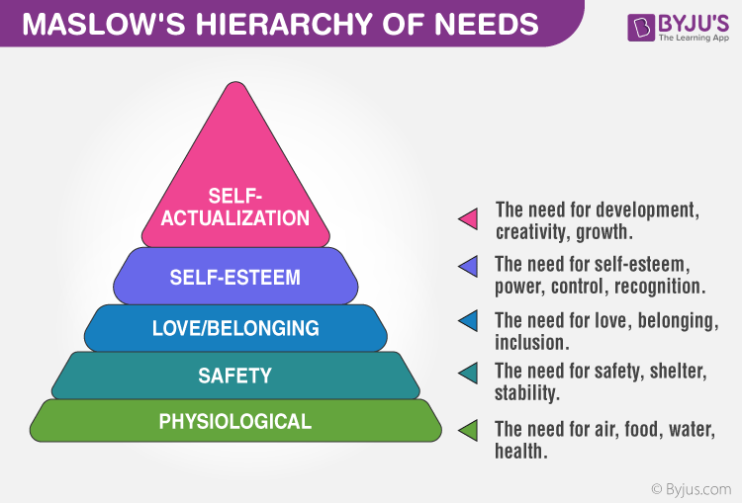
Belonging and Cultural Relevance
Teachers help students navigate the different levels.
Authentic instructional texts help students attain the need for belonging and inclusion.

Slide 8
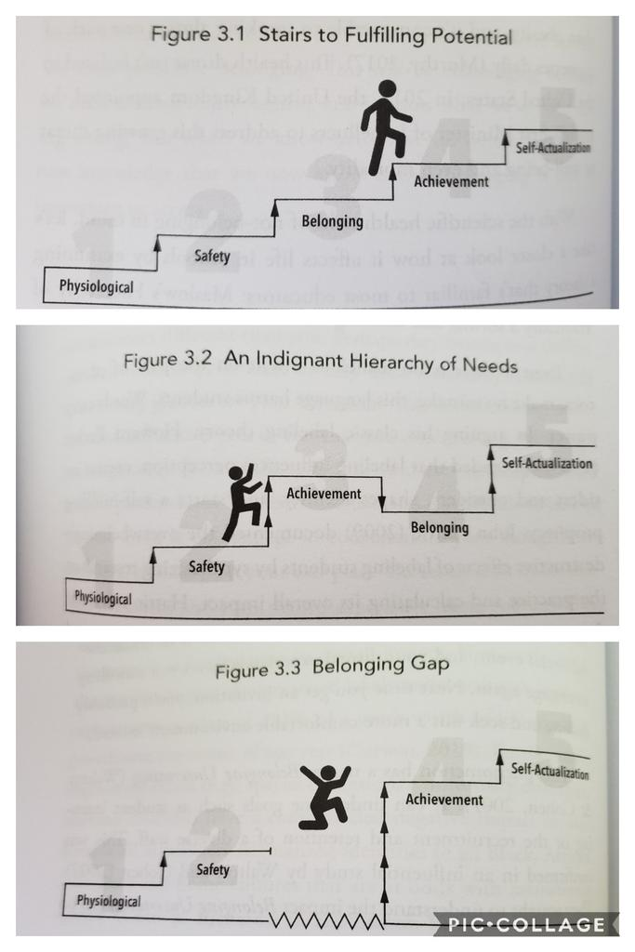
Belonging and Cultural Relevance - 2
What messages are being sent by the texts taught in our classrooms?
Does being “smart” align with who they are?
Students that experience the belonging gap need a “BRIDGE” to the achievement level.

Slide 9
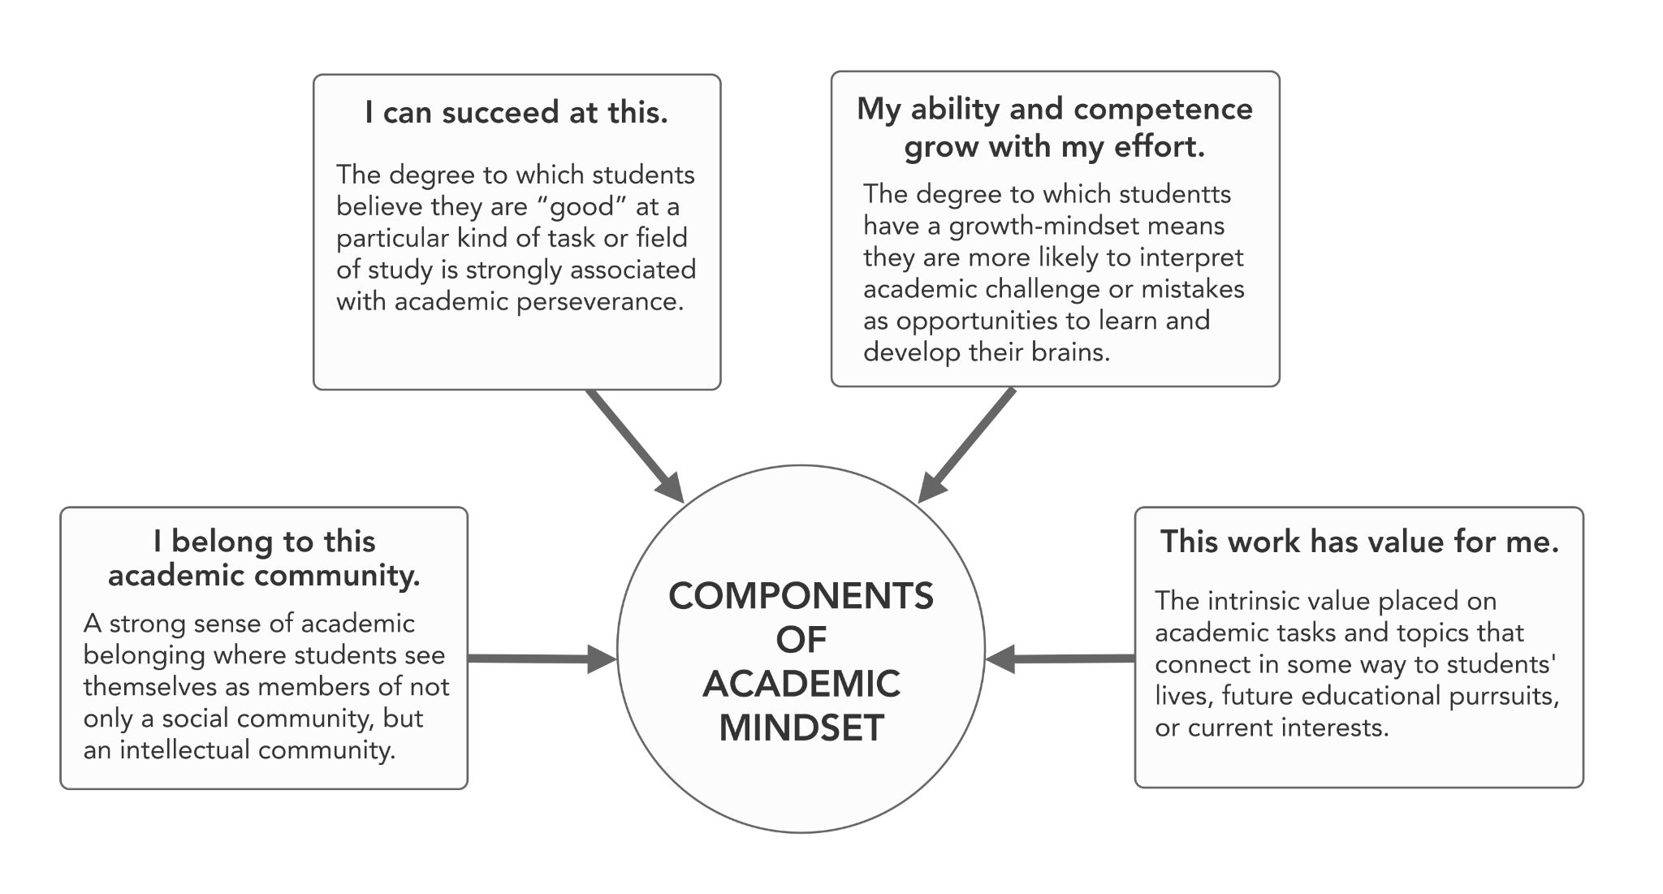
The Components of Academic Mindset

Slide 10
Instructional Strategies & Cultural Styles- Banks and Emdin
“Harmony refers to an ability to read the environment well and to read nonverbal behaviors proficiently. Thus, students who feel unwelcome in their classes may become unmotivated and
uninterested in learning.”
“Communalism refers to a cooperative, interdependent style of living and learning in which competition—especially with friends—is devalued. Students with this learning preference may be unmotivated in highly individualistic and competitive classrooms, preferring instead to learn in groups.”
Co-teaching with students is creating a space for voice and choice in the classroom. Teachers “become students of their students.” It creates agency and dialogue.

Slide 11
Layers of Culture & Background Knowledge - Zaretta Hammond
Layers of Culture
Surface - Observable & Concrete → food, dress/appearance, music
Shallow/Intermediate - Unspoken rules that govern social interactions and norms → concepts of time, nonverbal communication, touch
Deep - Implicit knowledge and unconscious assumptions that shape our worldview → concept of self, higher power, fairness

Slide 12
Layers of Culture & Background Knowledge - Zaretta Hammond - 2
Why do we need to know the layers of culture in our classrooms?
Accessibility: How do I activate prior knowledge to support my students’ access to the text? How do we make connections between the text and current events?
Teacher Reflection: What are my own cultural layers?
Student Reflection: What are the students’ cultural layers?
The best tool is relationship building!

Slide 13
What are authentic texts?
“A culturally authentic text is a piece of fiction or nonfiction that illuminates the authentic cultural experiences of a particular group--whether it addresses religion, socioeconomic status, gender, ethnicity, nationality, sexual orientation, or geographic location. The language, situations, and illustrations must depict culture in an authentic manner.”
- Sharroky Hollie
The check box method is NOT enough for our students.
Diverse Characters
Female Protagonist
Social and Civil plot content
Supplemental to the anchor

Slide 14
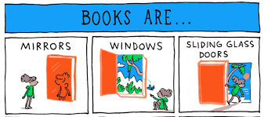
Authentic Texts
All students at ALL levels have a RIGHT to CORE and supplemental texts that reflect who they are culturally.
As teachers we can:
Mirror: Validate/Affirm
Window: Build
Sliding Glass Door: Bridge

Slide 15
Rigorous and Authentic Texts
What makes a work complex?
Variety of themes
Character development
Variety of plot structures
Use of literary elements and techniques to create multiple layers of meaning
So why read it?
Critical and Creative Thinking
Communicator and Collaborator
Quality Character and Global Citizen

Slide 16
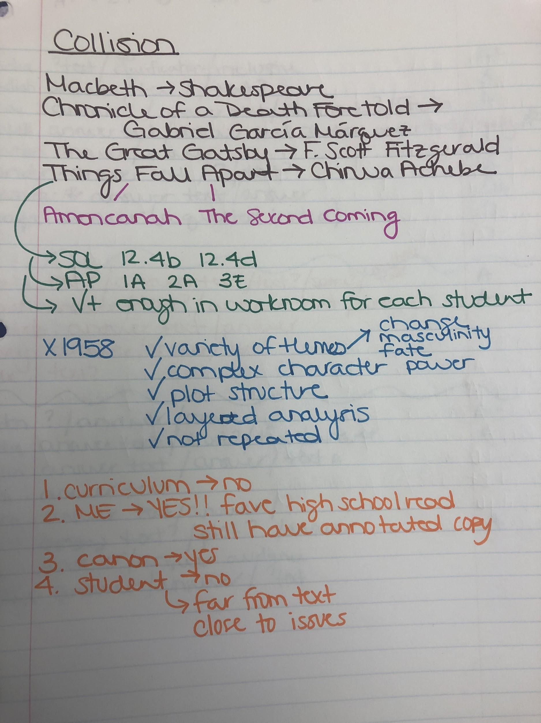
The Teacher Text Audit
Task 1: Collect the Data
List texts currently taught (Anchor and Supplementary)
Research text
Author demographics
Topics/themes/etc.
Publication date
Provide rationale
SOL/AP strands
Availability
Genre
Connect to vertical team
Is the book/author repeated?
Student Survey
What texts/authors/themes are they reading?
What is their favorite/least favorite text taught that year?

Slide 17
The Teacher Text Audit -2
Task 2: Reflection and Analysis
What is guiding the selection of the texts?
Curriculum?
Teacher preference?
Canon?
STUDENT?
Whose voices, histories, & priorities are represented? (Level? Vertical? School-wide?)
How close are the students to the texts?
What can I change?

Slide 18
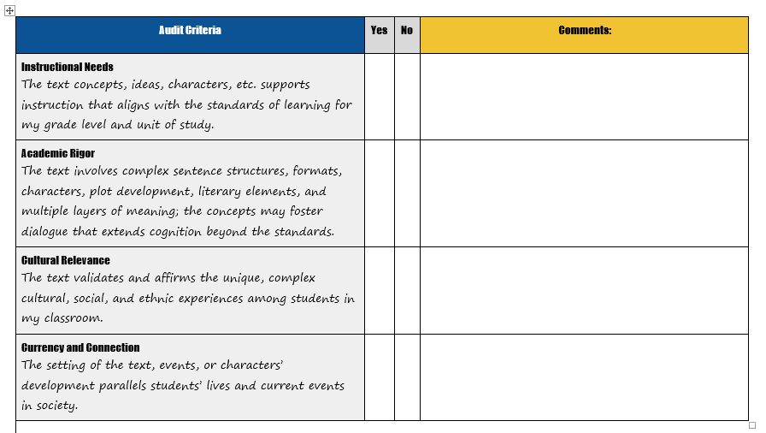
Culturally Responsive Text Audit Rubric

Slide 19
Directions for the Identity and Character Bullseye
Directions
Bullseye Levels
Task 1- Students create “social” labels for the identity bullseye either collectively or individually.
Task 2 - Students reflect on their individual identities by placing the circles on the bullseye.
Task 3 - Students can share.
* This is a great beginning of the year activity to build relationships and culture.
Green- Your identity in this area matches the dominant culture in society.
Yellow- You are marginalized in this area as compared to the dominant culture.
Red- Your identity in this area, combined with another aspect of your identity leads to you being multiply marginalized in this area.

Slide 20
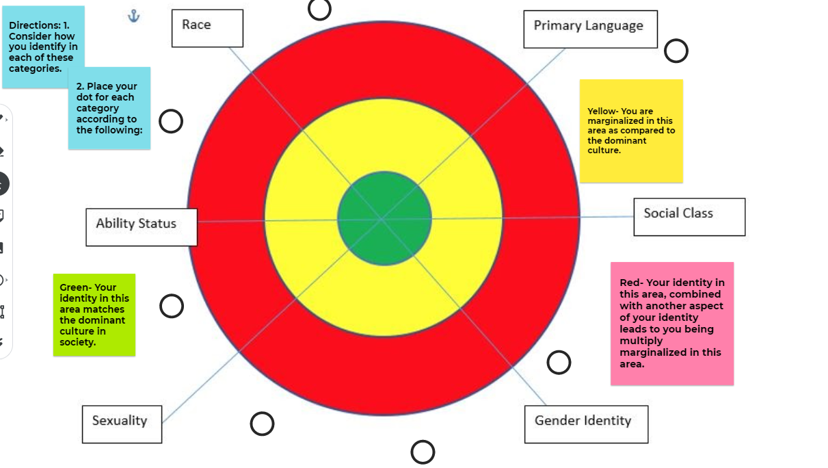
Bullseye Template

Slide 21
Directions for the Identity and Character Bullseye Level 2
Option 1 - How close am I to this character?
Option 2 - Character analysis
The template is now their individual identity bullseye.
Task 1 - Students mark the template with a different shape/color for a specific character.
Task 2 - Students can share and compare.
* This is a great reflection for teachers to see how the students connect to the characters.
Task 1- Students create “social” labels for the identity bullseye either collectively or individually.
Task 2 - Students reflect on specific characters and provide textual support for their target location.
Task 3 - Students can share.

Slide 22
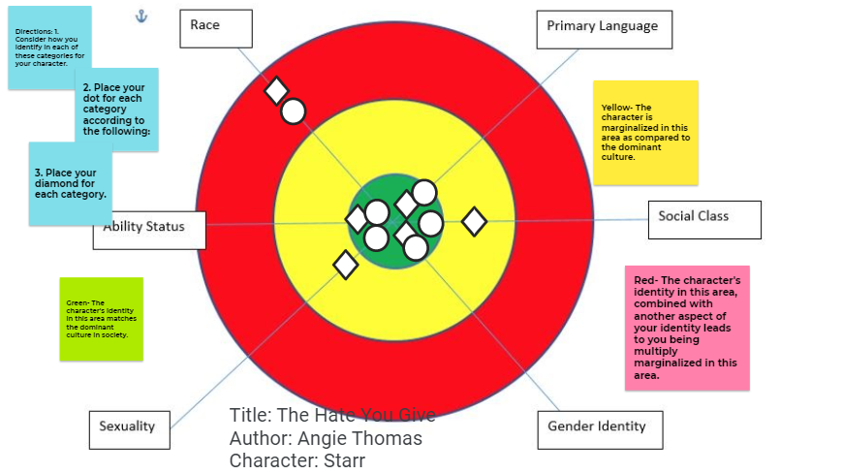
The Hate U Give, by Angie Thomas

Slide 23
Othello Character Complexity Charts
1,2.15-25
“The services I have done for
the Venetian government will count for more than
his complaints will. (...) I’m as noble as the woman I’ve married.”

Slide 24
Building the Bridge Between Honors and AP
Design and implement mirrored instructional strategies that foster deeper literary analysis with culturally relevant literature.

Slide 25
Honors English 9: Unit Performance Task
The Standards of Learning
The Learning Targets
9.4i Specific word choice, syntax & purpose
9.5d Author’s intended purpose & main idea
9.5e Summarize, paraphrase, and synthesize
9.6e Purpose & thesis statement
I am learning how words impact the purpose and audience of a text.
Understanding word choice will also help me understand an author’s goal in writing.
I will analyze “The Hill We Climb” by Amanda Gorman for its impact on the audience.

Slide 26
Guided Analysis of “The Hill We Climb”
Good writers use a variety of vocabulary, techniques, syntax, and purposes to create messages targeted to a specific audience. Take a look at Amanda Gorman’s inaugural poem, “The Hill We Climb.” Why do you think people are so impressed by her delivery? What words or phrases made this piece so ideal for the occasion?

Slide 27
Examine the Text
Rigor
Relevance
✔ Incorporates the use of multiple literary elements and techniques.
✔ Several layers of meaning demonstrated through word choice.
✔ Varied sentence lengths and text structures.
✔ Promotes inquiry of current events.
✔ Delivered by the youngest inaugural poet in US history.
✔ The speaker’s identity is intersectional--Black, (formerly) speech impaired, and female.
✔ Alludes to issues, ideas, and situations unique to US current events.

Slide 28
How do we “guide” literary analysis?
Designate specific skills to address the text and provide structured support for each skill.

Slide 29
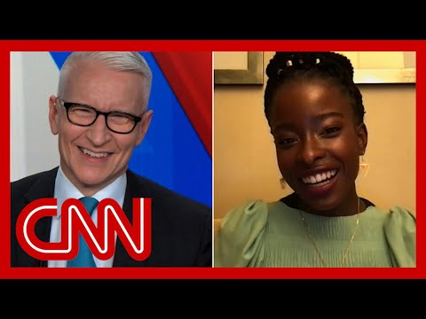
Accessing the Text
Build students’ background knowledge using real people, authentic conversations, and current events.
Show evidence of background knowledge through writing prior to reading.

Slide 30
Instructional Strategy #1: Frontloading Academic Vocabulary

Slide 31
Instructional Strategy #2: Sentence Frames

Slide 32
Instructional Strategy #3: Identifying Keywords

Slide 33
Instructional Strategy #4: Prompted Support for Textual Evidence

Slide 34
Instructional Strategy #5: Annotation

Slide 35
Extend Student Inquiry
Write a paragraph explaining the significance of the “caged bird” ring Oprah Winfrey gifted to Amanda Gorman.

Slide 36
Crossing the Bridge to AP English 12
AP students drive their own knowledge of texts through application of strategies mirrored by Honors English 9.

Slide 37
The Standards Cycle
English 9 | English 12 | Advanced Placement
9.4i → Specific word choice, syntax & purpose | 12.4b → Analyze how authors use key literary elements to contribute to meaning and interpret how themes are connected across texts. | AP: Explain the function of specific words and phrases in a text.
9.6e → Purpose & thesis statement | 12.6b → Produce arguments in writing that develop a thesis to demonstrate knowledgeable judgments, and provide effective conclusions. | AP: A Develop a paragraph that includes 1) a claim that requires defense with evidence from the text and 2) the evidence itself

Slide 38
English 12AP: End of Unit Task
Do we experience (BLANK) the same?
The Standards of Learning
The Learning Targets
12.4b→Analyze how authors use key literary elements to contribute to meaning and interpret how themes are connected across texts.
12.4f→Compare and contrast traditional and contemporary poems from many cultures.
12.6b→Produce arguments in writing that develop a thesis to demonstrate knowledgeable judgments, and provide effective conclusions.
I am analyzing text to build connections between literary elements and themes.
I am analyzing an AMERICA text set to compare and contrast elements and how authors address the same subject.
I am exploring how poetry reveals individual, social, and cultural commentary.
I am writing about poetry with textual evidence.

Slide 39
Examine the Texts
“I Hear America Singing” Walt Whitman → “I, too” Langston Hughes → “This is America” Childish Gambino → “America” Claude McKay → Sonnet 130 Shakespeare
Rigor
Relevance
✔ Incorporates the use of multiple literary elements and techniques.
✔ Several layers of meaning demonstrated through word choice.
✔ Varied sentence lengths and text structures.
✔ Promotes inquiry of current events and multiple thematic views
✔ Alludes to issues, ideas, and situations unique to US past and current events.
X Limited to White and African American male voices (minus Shakespeare)

Slide 40
Examine the Texts - 2
“I Hear America Singing” Walt Whitman → “I, too” Langston Hughes → “This is America” Childish Gambino → “America” Claude McKay → Sonnet 130 Shakespeare
So why teach the set?
12.4f→ Compare and contrast traditional and contemporary poems from many cultures.
The pathway is important too! We had to get to pre-20th century works and sonnet structure.
There is always the question - Who is missing? What does this say about the piece? Author? Time?
Students still need access and exposure to works that are different to create empathy and questions.

Slide 41
Text Set Order Rational
Bookend harder texts
Students receive more supports and scaffolds at the beginning of the set and a refresher at the end.
What makes them hard? What strategies do I need in place to support students?
Pop culture in the middle
Students are engaged and closer to the texts.
Students are able to use their strategies to build confidence.
NOT SUPPLEMENTAL! These are still addressed the same as the harder texts.
Transitions
Entry connects to previous unit texts.(YA novels with social justice theme)
Exit connects to next unit texts. (Shakespeare)
Students have a logical progression through the entire class.

Slide 42
Poetry Unit
Instructional Activities
Instructional Strategies
Literature Circle
Students TPCASTT all poems then become experts in one.
3 Levels of reading
Students are able to demonstrate connections through visuals.
Socratic Seminar
Students dialogue their findings through textual support and questioning.
Close Reading - TPCASTT
Bridged from English 9 Honors
Graphic Organizers
Visual Representations
Effective Questioning
Scaffolded Frames and Outlines
Vocabulary Access

Slide 43
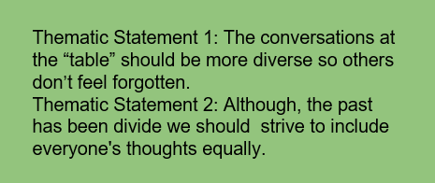
3 Circles - Student sample
Level 1 - On the line - Literal/Direct quotes - Denotation → Connotation
Level 2 - Between the lines → symbolism/imagery connections
Level 3 - Beyond the lines → thematic meanings

Slide 44
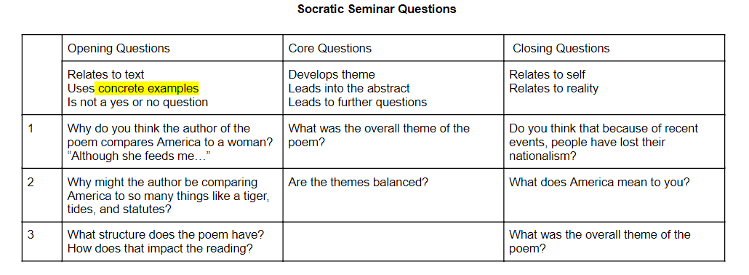
Socratic Seminar Question Planner
Socratic Seminars connect their voices!

Slide 45
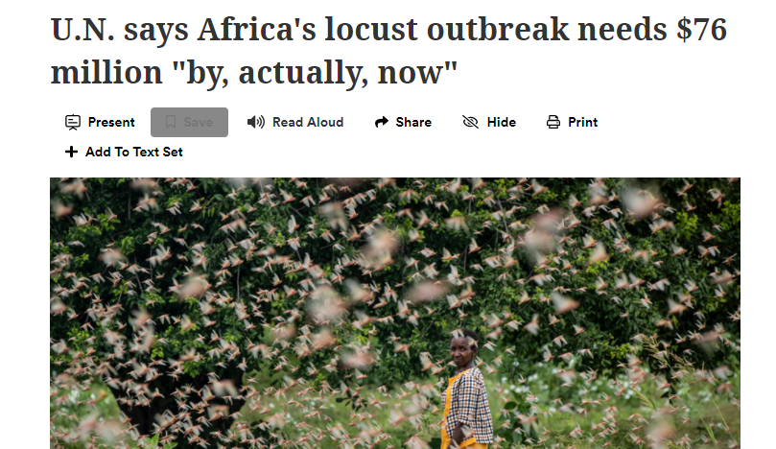
Instructional Activity #1: Close Reading for Things Fall Apart
Instructional Strategies to Activate Prior Knowledge:
Metaphors
Sensory Experiences
Paired informational texts (current events)
Frontloading vocabulary
“And at last the locusts did descend. They settled on every tree and on every blade of grass; they settled on the roofs and covered the bare ground. Mighty tree branches broke away under them, and the whole country became the brown-earth color of the vast, hungry swarm.” Things Fall Apart Achebe

Slide 46
Acknowledgements
Darin Thompson Janis Jones Cara-Jean O’Neal
Emily Stains Tiffany Lewis Ashley Walker
Erica Basnight-Johnson

Slide 47
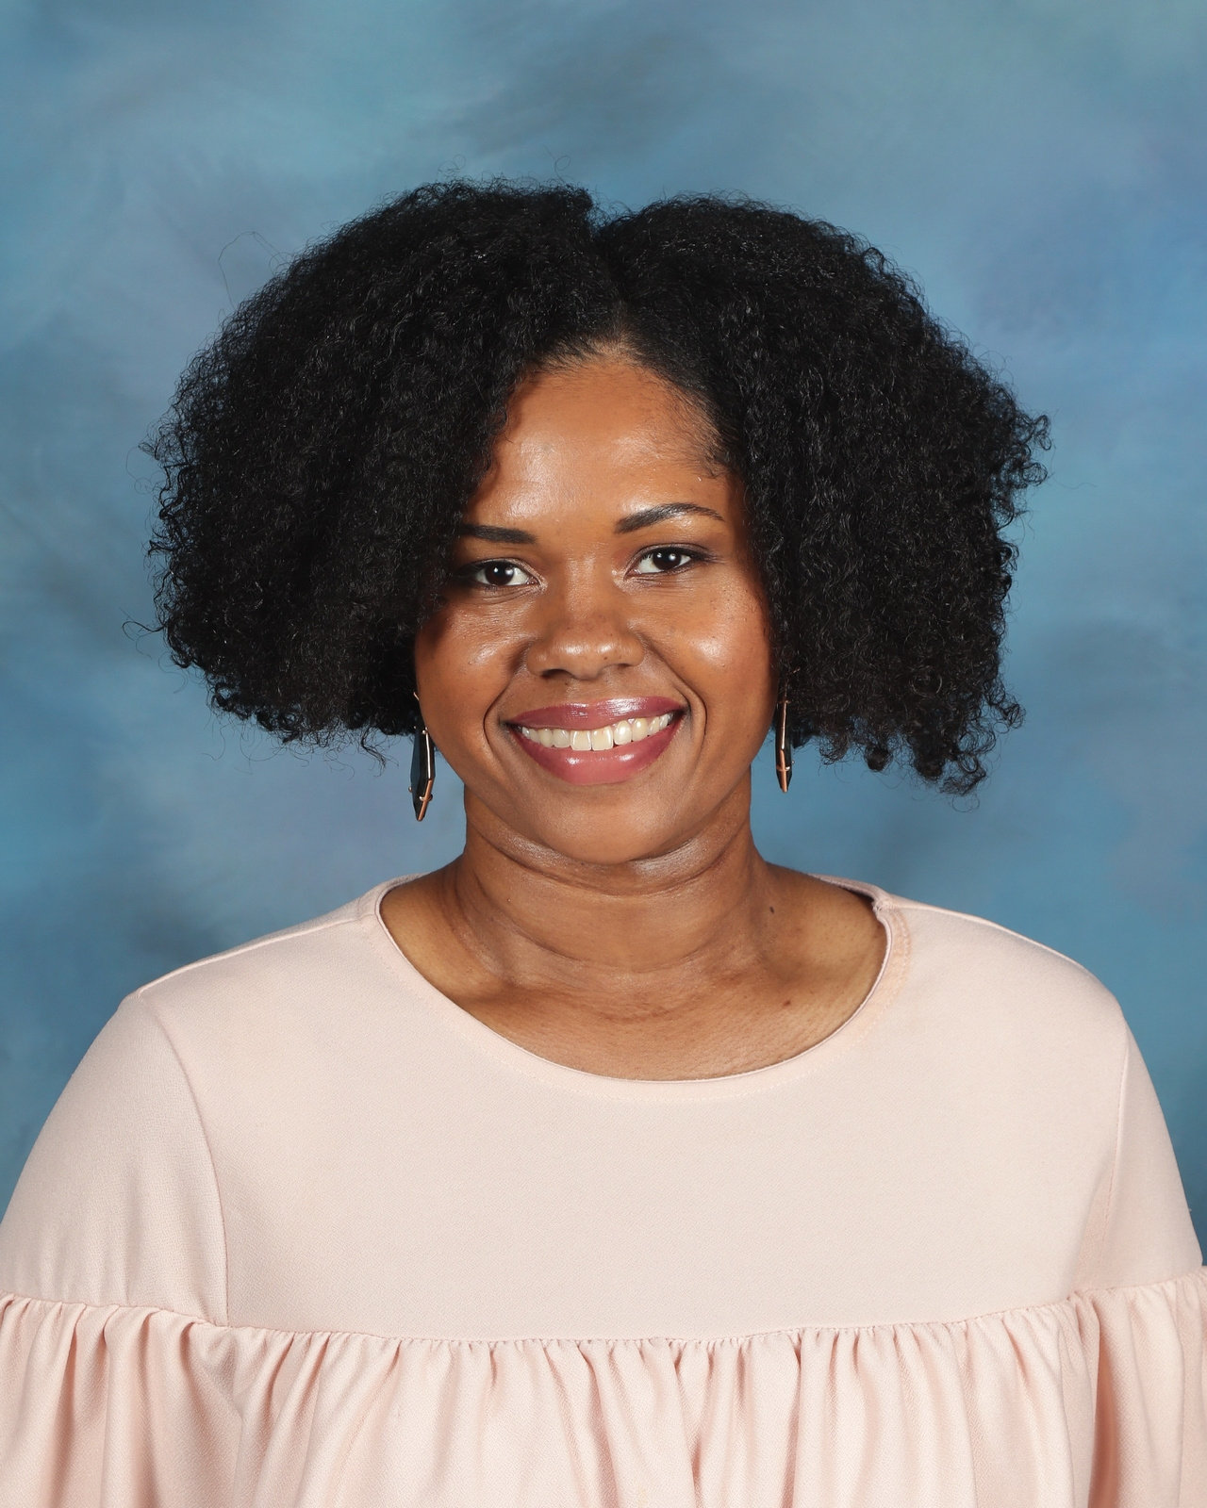
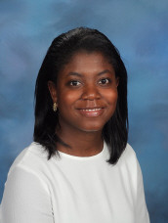
Thank you!
Kavetta Anderson
JaNeé J. Boston
Contact me!
knanderson@henrico.k12.va.us
In addition to teaching English 9 Honors, my passions include PLC facilitation and curriculum design. I also co-lead our campus Equity efforts. Ask me more about curriculum design and equity on your campus as well!
I am a graduate of University of Virginia and University of South Carolina.
Contact me!
jmjones3@henrico.k12.va.us
In addition to teaching English 10 and English 12 AP Literature and composition, my passion is student leadership. Ask me more about culture and climate on your campus as well!
I’m a graduate of Henrico County Public Schools and Wake Forest University.

Slide 48
Disclaimer for VDOE
Reference within this presentation to any specific commercial or non-commercial product, process, or service by trade name, trademark, manufacturer or otherwise does not constitute or imply an endorsement, recommendation, or favoring by the Virginia Department of Education.

Slide 49
Works Cited
Works Cited
Achebe, Chinua. Things Fall Apart. Penguin, 2013.
Anne, Kelia. Amanda Gorman. 18 Jan. 2021. NPR, 19 Jan. 2021, media.npr.org/assets/img/2021/01/18/ap_21015056094041-f5395818eca77840579cd04cf102ee10037d58a6-s800-c85.webp. Accessed 9 June 2021.
"AP English Literature and Composition Course and Exam Description, Effective Fall 2020." AP College Board, apcentral.collegeboard.org/pdf/ap-english-literature-and-composition-course-and-exam-description.pdf. Accessed 9 June 2021.
Banks, Cherry A. McGee, and James A. Banks. Multicultural Education: Issues and Perspectives. Hoboken (NJ), Wiley, 2012.
Barmann, Jay. "Here's the Full Inaugural Poem 'The Hill We Climb,' by California Poet Amanda Gorman." SFist, 20 Jan. 2021, sfist.com/2021/01/20/heres-the-full-inaugural-poem-the-hill-we-climb-by-california-poet-amanda-gorman/. Accessed 1 June 2021.
Books Are... 2018. Katy Tessman Blog, katytessmanhome.files.wordpress.com/2018/11/image3.png?w=264&h=366. Accessed 24 May 2021.
"A Call for Reality Pedagogy." Teachers College Columbia University, 24 July 2020, www.tc.columbia.edu/articles/2020/july/a-call-for-reality-pedagogy/. Accessed 9 June 2021.
"Components of Academic Mindset." Culturally Responsive Teachingn and The Brain, Transformative Learning Solutions, crtandthebrain.com/wp-content/uploads/Figure-7.1-Components-of-Academic-Mindset.jpg. Accessed 9 June 2021.
Curtis, Ben. Africa Locust Outbreak. 2020. Newsela, nails.newsela.com/s3/newsela-media/article_media/2020/01/africa-locust-outbreak-8295d75f.jpg?crop=0%2C192%2C2500%2C1600&height=498&horizontal_focal_point=center&vertical_focal_point=center&width=885. Accessed 26 May 2021.
Davies, Larissa McLean. "Auditing Subject English: A Review of Text Selection Practices Inspired by the National Year of Reading." Australian Association for the Teaching of English (AATE), 2 Nov. 2012, www.aate.org.au/documents/item/609. Accessed 27 May 2021.
Dickens, Charles, et al. Dombey and Son. New ed., Ware, Wordsworth Editions, 2002.
Gerber, Rachel. "AP Literature Open-Ended Prompts (1970 -2019)." Rachel Gerber, www.gerbersite.com/gerber/APLit/AP%20Literature%20Open%20End%20Prompts%20_1970%20-2019.pdf. Accessed 24 May 2021. AP ENGLISH LITERATURE AND COMPOSITION COURSE
Hammond, Zaretta L. Culturally Responsive Teaching and the Brain: Promoting Authentic Engagement and Rigor among Culturally and Linguistically Diverse Students. Canada, Corwin Press, 2014.
Hollie, Sharroky. "Steps to Authenticity." International Literacy Association, 22 May 2019, www.literacyworldwide.org/blog%2Fliteracy-now%2F2019%2F05%2F22%2Fsteps-to-authenticity. Accessed 24 May 2021.
"Langston Hughes: I, Too." Poets.org, Academy of American Poets, poets.org/poem/i-too. Accessed 9 June 2021.

Slide 50
Works Cited Continued
Macbeth Fate Free Will. Shmoop, media1.shmoop.com/images/module_images/Themes/macbeth-fate-free-will.png. Accessed 26 May 2021.
"Maslows Hierarchy of Needs." 2018. Byju's, cdn1.byjus.com/wp-content/uploads/2018/11/Maslows-Hierarchy-of-Needs.png. Accessed 26 May 2021.
McDonald, Kecia. Belonging. 2020. Twitter, pbs.twimg.com/media/EccuoEYUMAANO2f.jpg. Accessed 26 May 2021.
Mitchell, Stephanie. Amanda Gorman. Sept. 2018. The Harvard Gazette, 4 Oct. 2018, news.harvard.edu/wp-content/uploads/2018/09/090718_Gorman_Amanda_026_2500-768x512.jpg. Accessed 9 June 2021.
Navy Petty Officer 1st Class Carlos M. Vazquez II. Amanda Gorman Recites Her Inaugural Poem. 20 Jan. 2021. Wikipedia Commons, upload.wikimedia.org/wikipedia/commons/thumb/a/a6/210120-D-WD757-2466_%2850861321057%29.jpg/220px-210120-D-WD757-2466_%2850861321057%29.jpg. Accessed 9 June 2021.
"'Overjoyed': Hear from Poet Who Stole the Show at Inauguration." YouTube, uploaded by CNN, 20 Jan. 2021, www.youtube.com/watch?v=qHhut5nhI8g. Accessed 9 June 2021.
"Ready for Rigor." Culturally Responsive Teaching and The Brain, Transformative Learning Solutions, 2013, crtandthebrain.com/wp-content/uploads/READY-FOR-RIGOR_Final1.pdf. Accessed 9 June 2021.
"Standards of Learning (SOL) and Testing: English." Virginia Department of Education, Commonwealth of Virginia, www.doe.virginia.gov/testing/sol/standards_docs/english/index.shtml. Accessed 9 June 2021.
Thomas, Angie. The Hate U Give. New York, Balzer + Bray, 2017.
"U.N. Says Africa's Locust Outbreak Needs $76 Million 'by, actually, now.'" Associated Press, 10 Feb. 2020. Newsela, newsela.com/read/africa-locust-outbreak/id/2001005005/?search_id=4fc969c8-73da-4ea8-bd29-4e9e18ab392e. Accessed 31 May 2021.
Virginia's 5 C's. 2019. Virginia Is for Learners, Virginia Department of Education, www.virginiaisforlearners.virginia.gov/wp-content/uploads/2019/08/fivecs-vdoe-1.jpg. Accessed 28 May 2021.
Youth Poet Laureate Amanda Gorman. News 9, Griffins Communications, 17 Apr. 2020, cdn.field59.com/KWTV/1587158110-1cf0487d334ae0301f15a670812b616fbecf7a12.jpg. Accessed 9 June 2021.
Zhang, Anna. Amanda Gorman. Oct. 2017. The Project for Women, Women's Project 2021, 4 Oct. 2017, www.theprojectforwomen.com/wp-content/uploads/2017/10/Amanda-Gorman-TPFG-Web_Anna-Zhang-14-412x618.jpg. Accessed 9 June 2021.

Slide 51
INTERSECTIONAL LITERATURE Balancing Academic Rigor
and Cultural Relevance
Kavetta Anderson -Varina High School (HCPS)
JaNeé Boston - Varina High School (HCPS)

Slide 52
VDOE Disclaimer
Reference within this presentation to any specific commercial or non-commercial product, process, or service by trade name, trademark, manufacturer or otherwise does not constitute or imply an endorsement, recommendation, or favoring by the Virginia Department of Education.

