Slide 1
Student Voice & Choice to Support Authenticity in Interdisciplinary Literacy
Notes:
Welcome to our session today called “Student Voice & Choice to Support Authenticity in Interdisciplinary Literacy”

Slide 2
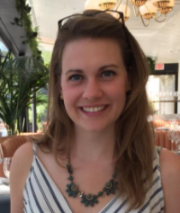
Contact Information
Victoria Begg
Former English Teacher
Instructional Coach
Fairfax County
VGBegg@fcps.edu
Meg Dombro
Former Civics Teacher
Advanced Academic Resource Teacher
Fairfax County
MDDombro@fcps.edu

Slide 3
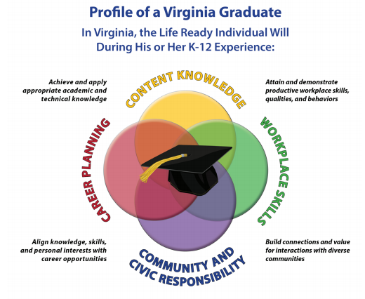
How can you, as a concerned citizen, identify a challenge for yourself, your family, or your community and advocate for a public policy solution?
Critical thinking
Creative thinking
Communication
Collaboration
Citizenship
Notes:
Victoria
Our presentation today offers a variety of ideas for how to design instruction to support the profile of a Virginia graduate. What makes our project a little unique for an English SOL conference is its use of interdisciplinary, project-based learning to support student growth with the 5C’s. The driving question that grounded our work with students was “How can you, as a concerned citizen, identify a challenge for yourself, your family or your community and advocate for a public policy solution?” We wanted to provide students an opportunity to align new knowledge and skills with their personal passions and interests, so that what we were doing in our classrooms was more relevant to students lives.
As a cross-curricular team, my colleagues in civics and science partnered with me in English to shift away from traditional assessment in order to move towards student-driven, authentic learning experiences. We believe that now, more than ever, it is important to invite discussion about the societal challenges our world faces into our classrooms to help students process some of the chaos and take ownership of what matters most to them.

Slide 4
Standards and Skills
Interdisciplinary Standards
Civics
Civics and Economics 1- The student will demonstrate skills for historical thinking, geographical analysis, economic decision making, and responsible citizenship
Civics and Economics 10- The student will apply social science skills to understand how public policy is made at the local, state, and national levels of government
Science
Physical Science.1 - The student will demonstrate an understanding of scientific and engineering practices by:
a) asking questions and defining problems
c) interpreting, analyzing, and evaluating data
f) obtaining, evaluating, and communicating information
*PS.1.c. - Construct, analyze, and interpret graphical displays of data and consider limitations of data analysis.
English Standards
Primary SOL:
6.9, 7.9, 8.9, 9.8 Find, evaluate, select, and synthesize appropriate resources to produce a research product.
Reinforced SOL:
6.2, 7.2, 8.2, 9.1 Develop and deliver multimodal, interactive presentations collaboratively and individually.
6.6, 7.6, 8.6, 9.5 Read, comprehend, and analyze a variety of nonfiction texts.
Notes:
Victoria
Our project is primarily a research project that also has students exploring a variety of non-fiction texts to prepare a presentation of their learning.
As a secondary English teacher it was eye-opening to see how the goals in my content overlapped with the goals in my teammates content as well. Secondary teachers are often siloed and feel a great burden to teach so many higher-level critical thinking skills, so it was nice to realize that the work could be shared with my teammates if we were more intentional about how our objectives aligned.
(Loop back to this more throughout the presentation)

Slide 5
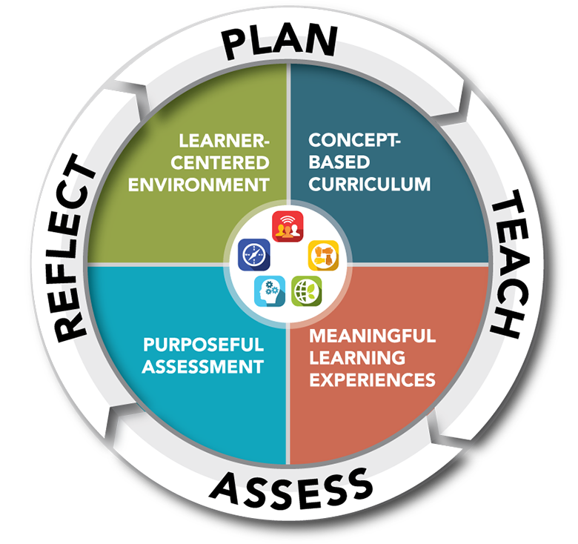
Project Planning Process (1 of 2)
Cross Curricular Standards
Divide and Conquer
Assessing student progress
“To Do” Lists
Notes:
Meg
Cross curricular projects can pose many logistical challenges and we were fortunate in that there were a lot of conditions in place that year that enabled us to be successful.
Supportive structures/Planning Phase: Our district and school site were focussing on Project Based Learning and we had a lot of professional development about that and the four Cs of Portrait of a Graduate: Communication, Collaboration, Critical and Creative Thinking. Our principal provided an additional motivation in that our evaluation (SMARTR) goals had to be related to Portrait of a Graduate. There were also structures in place that helped facilitate teacher collaboration such as common planning time and a loosely structured homeroom, that we call Panther Time, that provided additional time for teachers to conference with students.
Vision: But, the bottom line for us was that we wanted students to explore something they were passionate about, generate their own thinking, and share that learning. We decided we were willing to put in the work because it was learner centered, concept based, and a meaningful learning experience for our students.
Reflection: That being said, the project was far from perfect. There was a huge learning curve for us as educators, collaborators, and logistically. We were so used to planning independently that we had to learn to navigate conflict with each other. As with most middle schools we had crossed-teamed students that we had to adjust the project for. We hadn’t done anything like it before so we were learning as we went.
X-tremely Responsive Teaching: We can’t give you an exact roadmap because it will be different depending on your students and their needs (lots of checklists at the end of each day to inform the next day) By continuing to work the cycle of planning, teaching, assessing what the students needed, reflecting, and basing our lessons on the student needs, we were able to continue to work toward our vision.

Slide 6
Project Planning Process (2 of 2)
Cross Curricular Standards
Divide and Conquer
Assessing student progress
“To Do” Lists
Team Calendar
Notes:
Meg
Cross curricular projects can pose many logistical challenges and we were fortunate in that there were a lot of conditions in place that year that enabled us to be successful.
Supportive structures/Planning Phase: Our district and school site were focussing on Project Based Learning and we had a lot of professional development about that and the four Cs of Portrait of a Graduate: Communication, Collaboration, Critical and Creative Thinking. Our principal provided an additional motivation in that our evaluation (SMARTR) goals had to be related to Portrait of a Graduate. There were also structures in place that helped facilitate teacher collaboration such as common planning time and a loosely structured homeroom, that we call Panther Time, that provided additional time for teachers to conference with students.
Vision: But, the bottom line for us was that we wanted students to explore something they were passionate about, generate their own thinking, and share that learning. We decided we were willing to put in the work because it was learner centered, concept based, and a meaningful learning experience for our students.
Reflection: That being said, the project was far from perfect. There was a huge learning curve for us as educators, collaborators, and logistically. We were so used to planning independently that we had to learn to navigate conflict with each other. As with most middle schools we had crossed-teamed students that we had to adjust the project for. We hadn’t done anything like it before so we were learning as we went.
X-tremely Responsive Teaching: We can’t give you an exact roadmap because it will be different depending on your students and their needs (lots of checklists at the end of each day to inform the next day) By continuing to work the cycle of planning, teaching, assessing what the students needed, reflecting, and basing our lessons on the student needs, we were able to continue to work toward our vision.

Slide 7
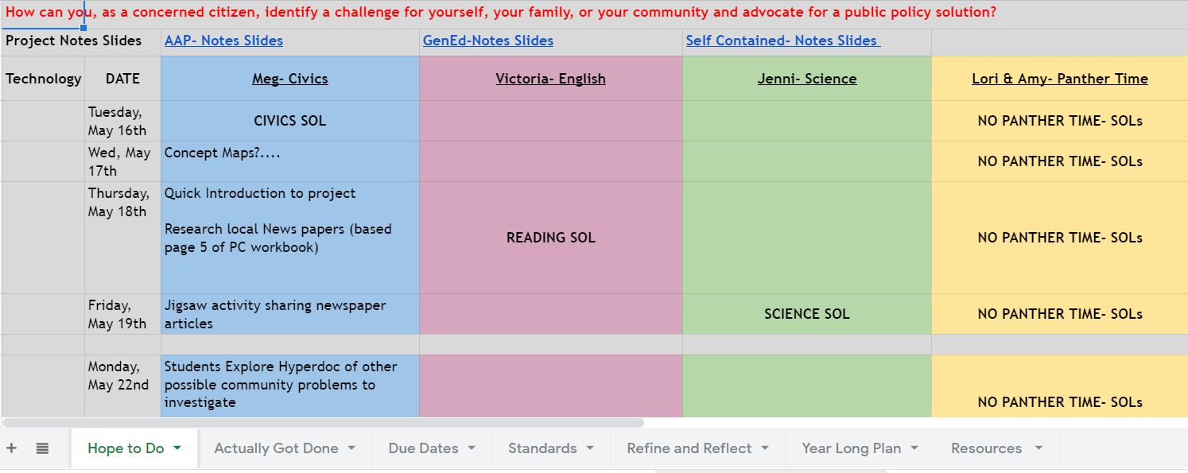
Supportive Structures
Aligned with District and School Strategic Goals
Common Planning Time
Homeroom
Notes:
Meg
Cross curricular projects can pose many logistical challenges and we were fortunate in that there were a lot of conditions in place that year that enabled us to be successful.
Supportive structures/Planning Phase: Our district and school site were focussing on Project Based Learning and we had a lot of professional development about that and the four Cs of Portrait of a Graduate: Communication, Collaboration, Critical and Creative Thinking. Our principal provided an additional motivation in that our evaluation (SMARTR) goals had to be related to Portrait of a Graduate. There were also structures in place that helped facilitate teacher collaboration such as common planning time and a loosely structured homeroom, that we call Panther Time, that provided additional time for teachers to conference with students.
Link to team calendar: https://www.google.com/url?q=https://docs.google.com/spreadsheets/d/1HH50-B4NeedY-_y-QcLVVURMf2ohajMWmnKhpyF5dN0/edit%23gid%3D1657090611&sa=D&source=editors&ust=1621817797403000&usg=AFQjCNHIYCbQ00_gNwW8KlJ-gxDFLRocpg

Slide 8
Continuous Improvement
Teachers as Learners
Navigate Conflict
Cross-teamed students
Notes:
Continuous Improvement: That being said, the project was far from perfect. There was a huge learning curve for us as educators, collaborators, and logistically. We were so used to planning independently that we had to learn to navigate conflict with each other. As with most middle schools we had crossed-teamed students that we had to adjust the project for. We hadn’t done anything like it before so we were learning as we went.

Slide 9
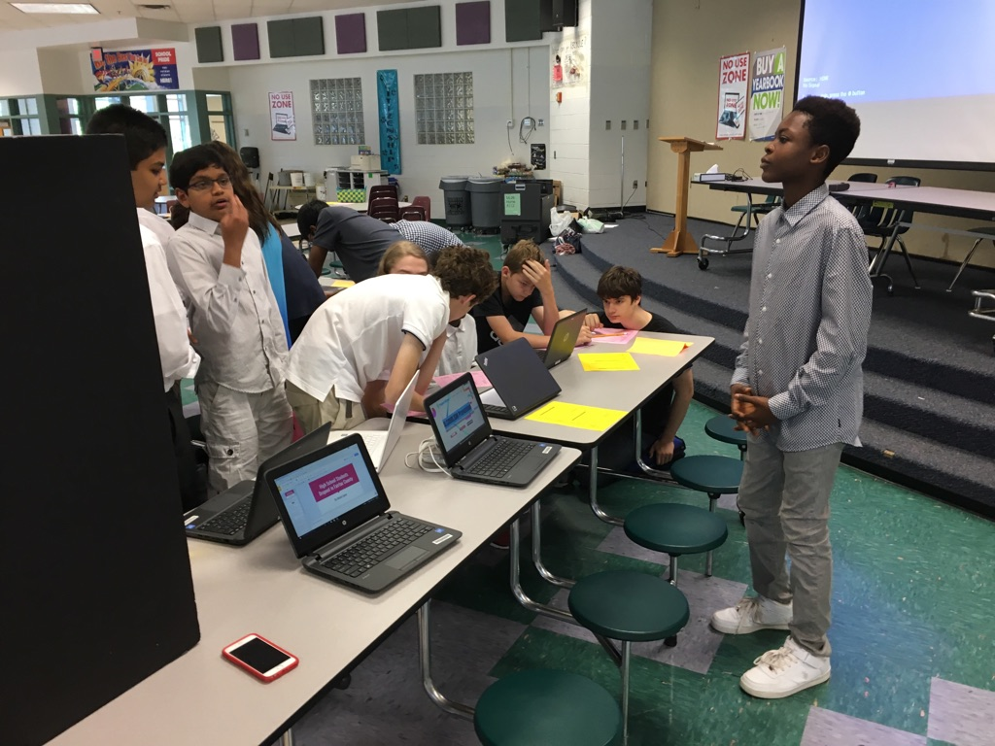
X-tremely Responsive Teaching
No roadmap
Student Interests & Needs
Notes:
Meg
X-tremely Responsive Teaching: We can’t give you an exact roadmap because it will be different depending on your students and their needs (lots of checklists at the end of each day to inform the next day) By continuing to work the cycle of planning, teaching, assessing what the students needed, reflecting, and basing our lessons on the student needs, we were able to continue to work toward our vision.

Slide 10
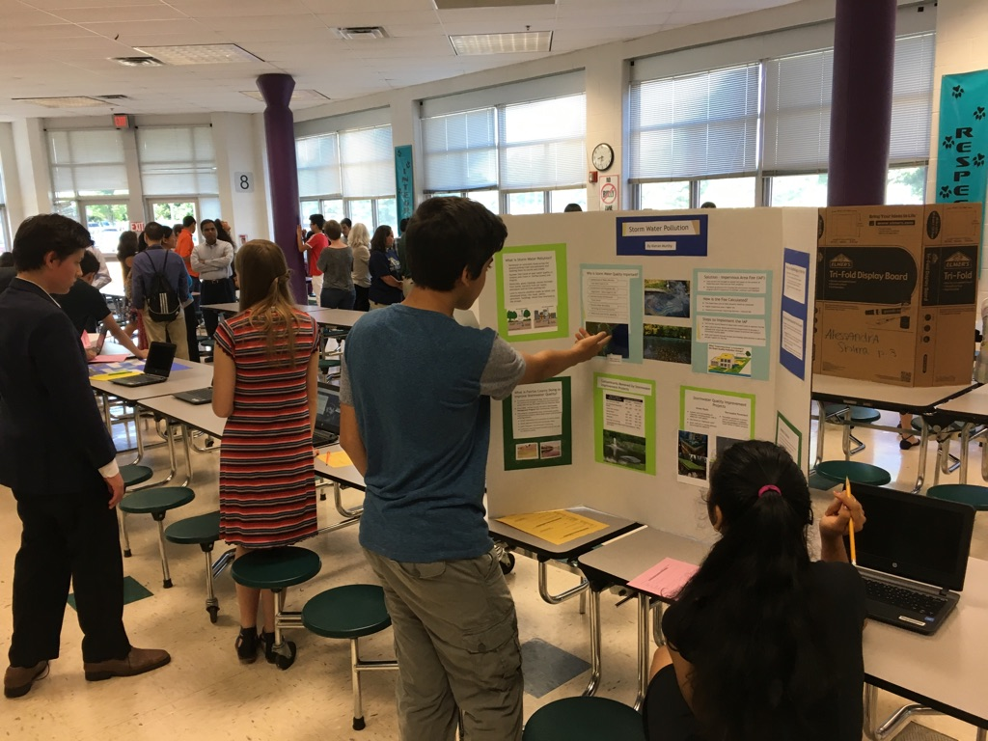
Vision
Student engagement
Student Voice & Choice
Meaningful Learning Experiences
Notes:
Meg
Vision: But, the bottom line for us was that we wanted students to explore something they were passionate about, generate their own thinking, and share that learning. We decided we were willing to put in the work because it was learner centered, concept based, and a meaningful learning experience for our students.

Slide 11
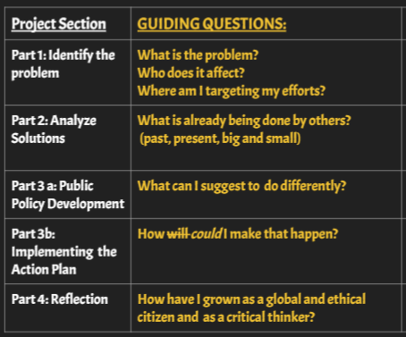
Project Framework
Inquiry-Based, Project-Based Learning
Formative assessments along the way
Support student executive functioning
Color- Coded Student Slide Deck
Green= Identify Problem
Yellow= Analyze and Evaluate Solutions
Blue= Develop a Policy and Action Plan
Purple= Reflection
Notes:
Victoria
We realized we needed a structure that would guide our students through this inquiry-based experience, and we decided upon four formative pieces of the learning that we could chunk the project into. Those were 1. identify the problem 2. analyze and evaluate solutions 3. public policy development and 4. Implementing an action plan.
We wanted to have one place where all student work could be captured and tracked, so that students weren’t unsure whose Google Classroom to go to or what document to click on. As a result, we developed one Google Classroom page where we were all monitors and a student notes slide deck that would have all the research and brainstorming parts of the project in one place. We color-coded the slides so that it was easy to tell students where to start and stop each class (just the yellow slides this week or just slides 10 and 11 today), and it was easy to see what students were working on as we circulated the room during work time.
We quickly noticed that not all students would be able to enact their plans in the short period of time we had at the end of the year, but we could still ask students to plan how they WOULD implement it if they had had more time. That meant developing the policy and action plan got combined, and we placed greater emphasis on reflection. Ultimately, this was a benefit because we were able to gather valuable student feedback about the project to help us improve and students were able to notice their growth as engaged citizens and critical thinkers.

Slide 12
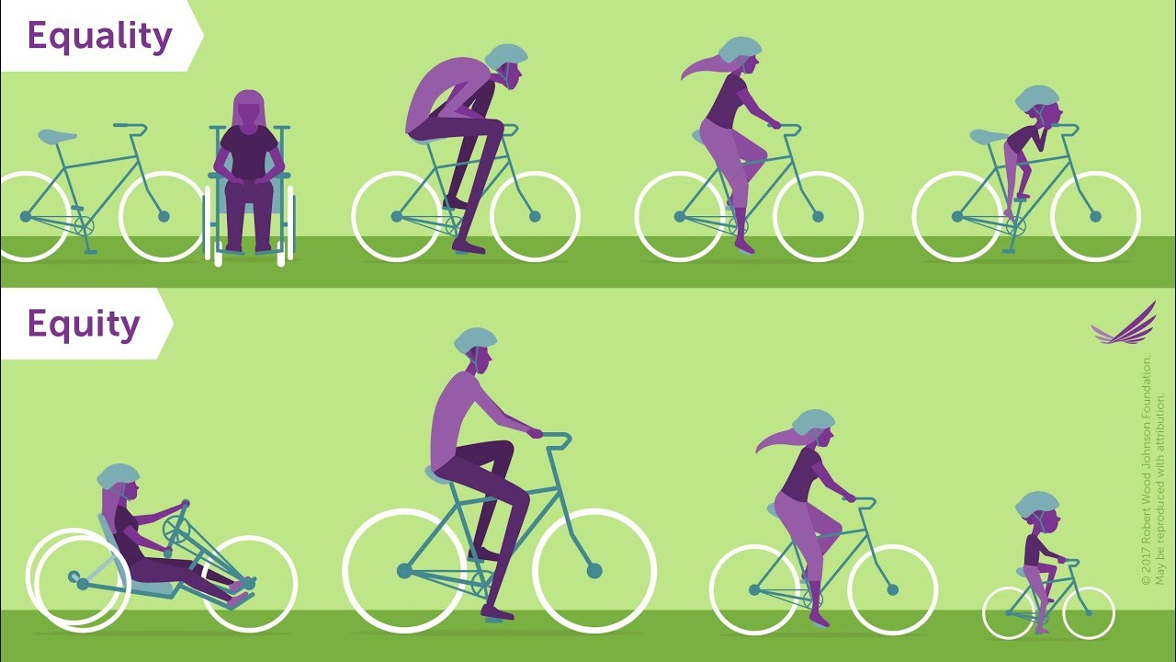
Strategies for Differentiation
Maintain rigor for all students while providing support for students who need it:
student voice and choice with topics
conferencing
graphic organizers
sentence frames
modified number of sources
Notes:
Victoria
It was very important to us that this project was accessible to ALL of our students because was a common experience every student on our team would have. That year our team was assigned 1 section of team-taught special education students, 1 section of general education students, and 3 sections of advanced academics students. We had a large range of abilities to consider, and we wanted to make sure we maintained the same level of rigor while also scaffolding and supporting those students who needed it.
One of the first ways we approached differentiation was in providing students choice for their topics. This was extremely important to the process because it allowed students to enter the project with a deeper level of background knowledge we couldn’t have provided if we’d chosen the topics for them. That gave them a head start on the research component from the beginning.
The next thing we made sure we did was set up time for one-on-one student conferences. This allowed us to formatively assess student progress and identify individual student needs to point them in the right direction. Conferencing with students one-on-one also allowed us to identify trends in the needs of the class that would inform our whole-group instruction the next day as well.
Additionally, we collaborated with our special education team teacher to adapt the notes slides we’d created to include more graphic organizers and sentence frames. Depending on the student’s academic level, we modified the number of required sources they needed during the research phase to be mindful of students who needed extended time to read and comprehend the material. That being said, we kept our focus on helping students select highly relevant and reliable sources, so every student could gather enough information for their project.
Self Contained Notes Slides
Gen Ed Notes Slides

Slide 13
Identity the Problem
Notes:
Meg

Slide 14
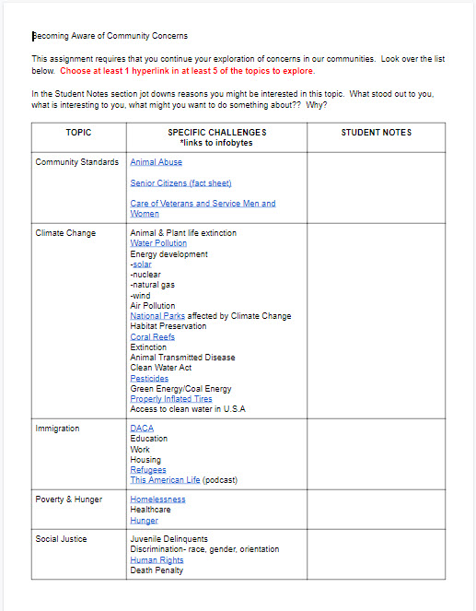
Expanding Student Thinking: Hyperdoc
What tools or structures do students need in order to identify issues in the community meaningful to them?
Expand on surface level topics
Guided Choice
Honors Student Experiences
Notes:
Meg
https://docs.google.com/document/d/1egDa_Va8fYx-DLkaZfaAXz4wEZWJ1WYXTUgTgprV5pE/edit?usp=sharing
One of the first challenges we needed to address was to expand the student’s thinking about problems to address. We knew that the more specific they could get about a topic, the more actionable their project would be. We also wanted them to think a little deeper than typical projects of this nature. The best way we found to do this was by creating a hyperdoc and give them choice within this structure.
On the left hand side of the chart are the broad categories that students originally identified. As part of the “need to know” phase of the project. Then the teachers, with some student volunteers, found links to articles and videos that got more specific within each topic.
Within this framework, we could guide student choice toward items we might have wanted to see represented. But, it’s important to not to be too restrictive about student choice. The fact that they can pick a topic they are passionate about is integral to this project.
This project offers a way for students to learn more about their own life experiences, and honors those experiences. If we were to do this today, I’m certain that students would identify topics about the pandemic.

Slide 15
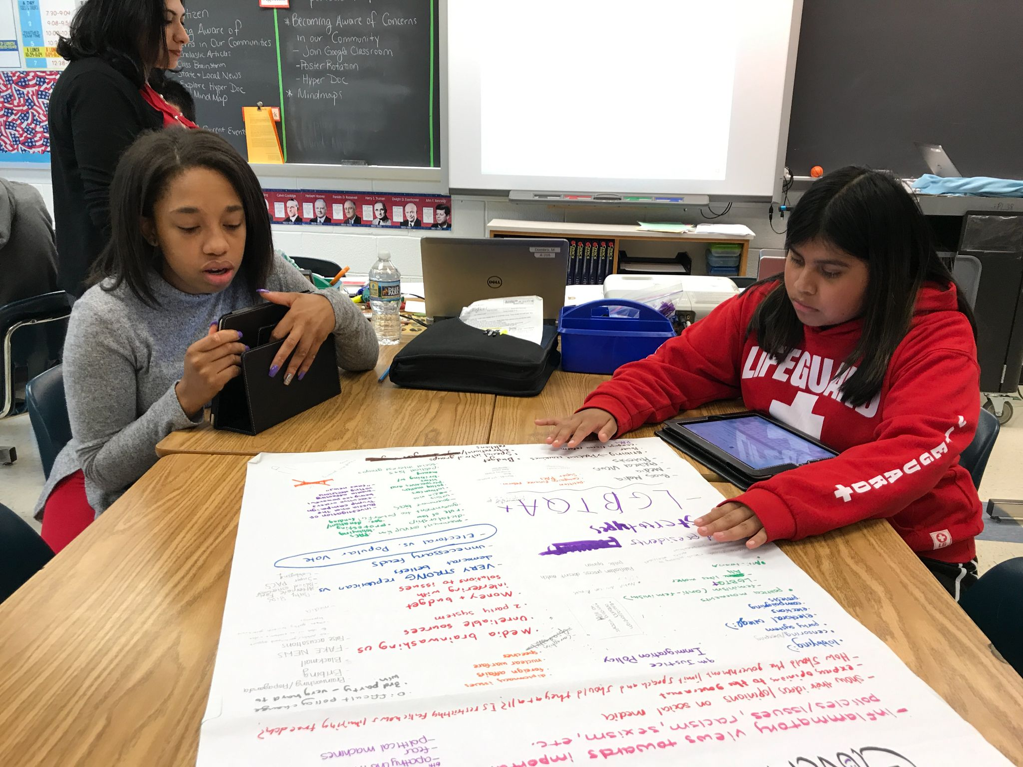
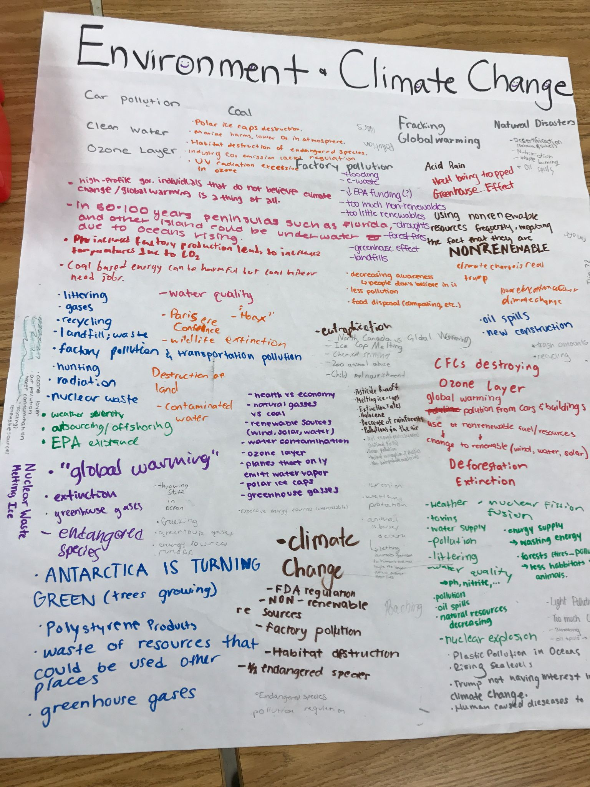
Getting Specific: Chalk Talk
What tools or structures do students need in order to narrow down a topic for research?
Share thoughts with classmates
Making Thinking Visible
Narrow Topics
Notes:
Meg
Once we expanded their thinking about each topic through the hyperdoc and other reading assignments, we needed them to narrow it down to something that could be researched within the time frame available.
We created posters with the heading from the hyper doc on them, and students moved from station to station with their partners, adding their thinking about the topic. This also made the thinking of their classmates visible.
In the example here, you can see that the students narrowed the topic of “Environment and Climate Change” to much more specific topics like fracking, endangered species, and polyurethane products.

Slide 16
Analyze and Evaluate Solutions
Notes:
Victoria

Slide 17
#1) Examining Alternatives- What is already being done by others?
Policy Title (add hyperlink to website): | Time Period (choose one) : past, present | Type of Policy (choose one) : local, state, national, international
Explain the Policy: What is being done?
Advantages of this policy=Do they have good intentions? How are they trying to make those happen? Is any of it working even a little bit? | Disadvantages of this policy=What isn’t working about this plan so far? Why is it not as effective as they might have hoped? Who/what is standing in the way?
Controversies / Disagreements about this policy=
Notes:
Victoria
For this part of the project, our end goal was to have students gain an understanding of the variety of policies that already existed around their topic to inform a new policy that they could design. This slide is the graphic organizer we included in their notes slide deck to complete as they read from their internet sources. We taught students how to hyperlink their websites in the policy box of this slide and then summarize what they read using the categories below (overview, advantages, disadvantages, controversies/disagreements) . Students had to examine at least two existing policies, but some students wanted to take notes on three to five policies to help them gather ideas from each that they might want to include in the policy they would propose.

Slide 18
Model- What is already being done by others?
Policy Title: Fairdon Pool Policy | Time Period (choose one) : past, present | Type of Policy (choose one) : local, state, national, international
Explain the Policy: What is being done? All users must wear proper swim attire when entering the pool area. No street clothes can be worn in the water. Infants and toddlers must wear swim diapers or swim pants that are form-fitting. Shoes are not allowed on the pool deck. Children 8 years old and under must have an adult in the pool with them at all times.
Advantages of this policy=Do they have good intentions? How are they trying to make those happen? Is any of it working even a little bit? The pool is trying to make sure there is a safe and welcoming environment for all people to enjoy the pool. They are good policies, | Disadvantages of this policy=What isn’t working about this plan so far? Why is it not as effective as they might have hoped? Who/what is standing in the way? The policies are not being followed. Most pool members are not aware of the pool rules. They are not displayed in an area that is visible to all pool goers.
Controversies / Disagreements about this policy= Some people feel that the rules are too restrictive. They are unclear about the definition of “proper attire.” Some feel that the rules should be more strict and children under the age of 12 should be supervised at all times.
Notes:
Victoria
We made sure to model detailed note taking using an example of a familiar policy like a neighborhood pool policy from a local Homeowners association.

Slide 19
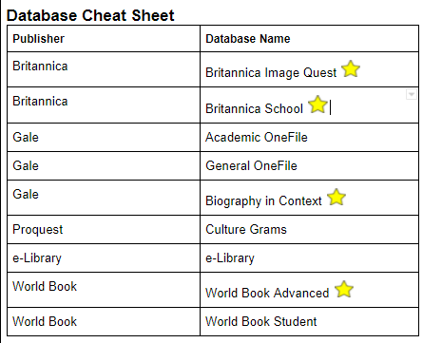
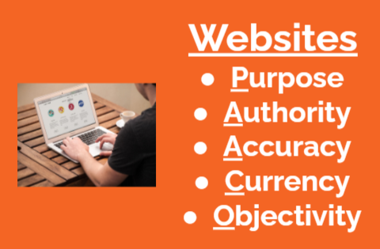
PAACO Lesson Slides & Notes
What else do students need to know in order to take effective notes and gather useful information about current policies?
Collaboration with librarians
Understand the definition of a reliable source
Evaluate internet sources (websites)
Cite internet sources (websites and databases)
Notes:
Victoria
Before we released students to explore the vastness of the internet, we had to ask ourselves, “What else do students need to know in order to take effective notes and gather useful information about current policies?” If we just gave students the graphic organizer, they might select unreliable websites or sites that didn’t have the information they needed. We had to ensure they were going to choose helpful sources, so we didn’t waste any time during the research process.
We knew that our librarians had worked with students on finding and citing reliable sources, so during English class we had them come in to do some review lessons about the tools and resources students had heard about before as well as how those tools and resources applied to this project.
For example, students had learned the acronym PAACO in 7th grade, which stood for purpose, authority, accuracy, currency, and objectivity, and the librarians created a google form to test if a source fit all of this criteria for a reliable source. We also knew that students had learned how to use noodletools in 7th grade, so we reviewed how to set up a works cited page for this project. Finally, we knew they had learned about how to use database in the library, and added a review demonstration to the lesson about how to access the databases and which databases would be most helpful for this particular project.
Lesson Slides
Notes Doc
PAACO Form

Slide 20
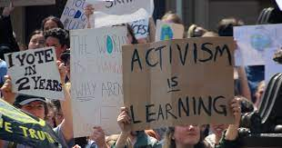
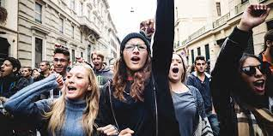
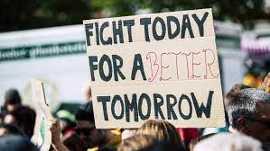
Famous Advocates and Activists
What do students need to know in order to generate creative, meaningful proposal ideas?
Notice real world examples of proposals and action plans
Notice real world examples of community influence on policy
Practice answering research questions
Practice summarizing main idea and supporting details
Practice citing sources
Notes:
Victoria
Once students had reviewed what a reliable source was, how to cite it, and how to access the databases, it was time to practice those skills with a formative task before they started research on current policies. We figured we could kill two birds with one stone if we had them practicing the skills on a mini-research task that allowed them to explore other examples of real world activism and policy change. This would not only reinforce the research skills, but further bolster their ideas about different ways THEY could take action in their own communities. That was the Analyze Solutions part of the project not only had students looking at creative solutions people had found for their topic, but also creative solutions to other topics as well. The emphasis was on getting students to think outside of the box and be inspired by a variety of ideas.
For this assignment, students were asked to choose one name from a list of 30 people who have influenced a variety of policies in the U.S. Most of the names are names students had never heard of before which even further reinforced the idea that real change starts with normal, everyday people like them. Students had to answer three research questions about their person 1.What are they known for? 2.Why did they advocate for this issues?/ What was their personal connection to it? 3. What are two ways they advocated for their cause? and 4. What was the final outcome of their work? Students had to cite at least 2 reliable sources where they found the answers to these questions.
Assignment: https://docs.google.com/document/d/1ixuP-GgXBArTKEq5au831-o2XBWHq17R6ZTi4GCt0j4/edit

Slide 21
Create Proposal for Action Plan

Slide 22
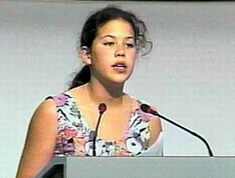
Model Texts
What do students need to know in order to actually write a proposal?
Notice the features of proposal writing in real letters, speeches, and policies.
Author’s craft- what can we imitate?
Severn Cullis Persuasive Speech
HOA Pool Regulations
FCPS Service Learning Policy
Reflection - more examples and explicit lessons to help students analyze these documents.
Notes:
Victoria
Once it was time for students to start compiling their own proposal ideas for the topics they had chosen, we as teachers wondered, “What do student need to know in order to actually write a proposal?” In the Analyzing Solutions portion of the project, students had opportunities to look at real world examples of actions and summarize what they learned about existing policies. In this phase of the project, students had the opportunity to analyze proposal documents themselves. Similar to the idea in Jeff Anderson’s book Everyday Editing where we invite students to notice grammar patterns in authentic texts, we expanded the idea to inviting students to notice features of proposal writing in the real world.
Students watched a speech by 12 year old Severn Cullis who presented at the 1992 United Nations Rio Earth Summit about global warming. I also provided them copies of the speech transcript. Students were asked to notice the “moves” she made as a writer like how she introduced herself, how she used her position as a child to her advantage and other details she chose to include that made her persuasive. We also considered things she could have added to be even more persuasive like a call for specific action steps. My role was to list the things students were noticing, so we could return to it during the writing process.
In retrospect, we wish we had used more examples of mentor texts from a variety of genres like letters to congress, speeches at protests, or local policy documents for students to analyze, so they could see beyond one example and actually notice trends in the proposals to apply them to their own work.

Slide 23
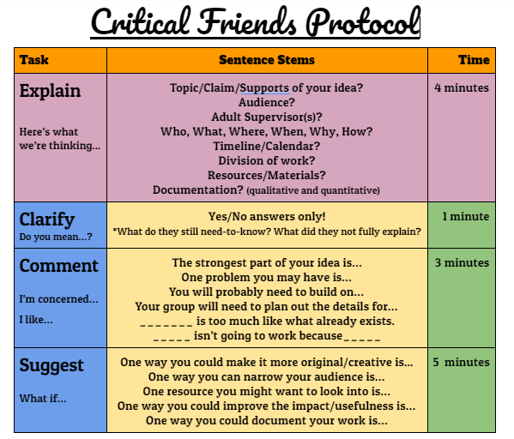
Peer Review
What do students need to know in order to refine and improve their ideas?
Critical Friends Protocol
Collaboration
Growth mindset
Audience
Revision
Mixed Academic Level Peer Review
Specific, individualized feedback
Metacognitive awareness of the skills used for the project
Models and examples from peers
Increased motivation and efficacy
Notes:
Victoria
Another concern we had during the proposal creation portion was how to make sure their proposals were detailed, creative and fully developed. The thought of providing 150 students with individualized feedback on 150 different topics was overwhelming until we realized that we could provide a structure that would allow students to review each other's work using specific “look fors” we, as teachers, explicitly identified. We used a protocol called Critical Friends in groups of 3. The process begins with a timer where Student A has 4 uninterrupted minutes to explain their idea using the checklist in purple to ensure they don’t forget any details. Then, student A stops talking and Students B and C, in timed intervals, ask clarifying yes/no questions for 2 minutes, comment on strengths and growth areas of the idea for 3 minutes, and finally, offer suggestions to fine tune the growth areas for 4 minutes. Sentence frames are provided to help students engage in these academic conversations. In 15 minutes or less, the student comes away with a variety of specific ideas for how to revise their proposal to be even more effective. The process is repeated for the two other students in the group, and the rest of the period is time for students to make their revisions.
We also had students engage in a mixed academic level peer review in which the science teacher and I shared students during each period of the day from both Advanced Academics classes and team-taught special education classes. Half of my roster went to her room and half of her roster went to my room. Once there, students were put into pre-selected partner pairs where they did a “dress rehearsal” of their presentations. Students were given a checklist to listen and look for certain items in the presentation and completed a 3-2-1 feedback protocol about 1 thing they liked, 2 questions they still had, and 3 suggestions for how to improve it even more. Students were able to see models of the project from their own peers which increased motivation that someone their age was capable of having a big idea and coming up with a proposal. Having to explain their thinking or provide suggestions resulted in an increased metacognitive awareness about the skills they used in the project and helped them reflect on their own learning processes in this experience.
We would recommend using these types of protocols many times throughout the year on tasks that are both big and small. Our students had done this at least 5 or 6 other time that year, so they had gotten used to being honest with their peers and themselves about their work. It took a few attempts, but eventually they began to realize that the more specific and thoughtful they were for their friends, the more likely their friends would be specific and thoughtful for them. They developed more realistic suggestions that would be more relevant to the target audience. They became less nervous about starting with a perfect idea and more curious about different perspectives on how to make it better.

Slide 24
Presentation, Feedback, and Reflection

Slide 25
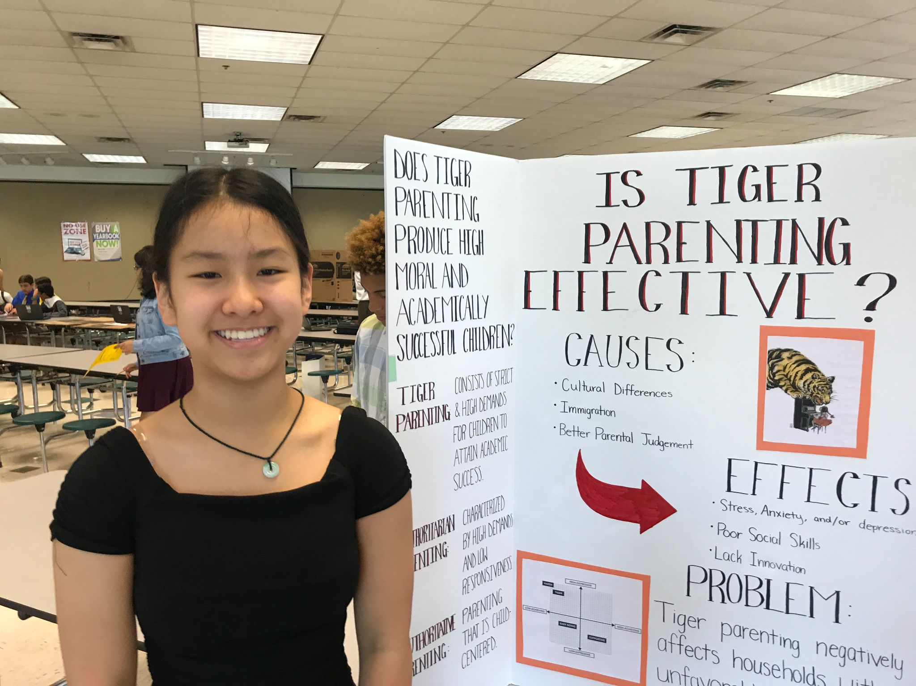
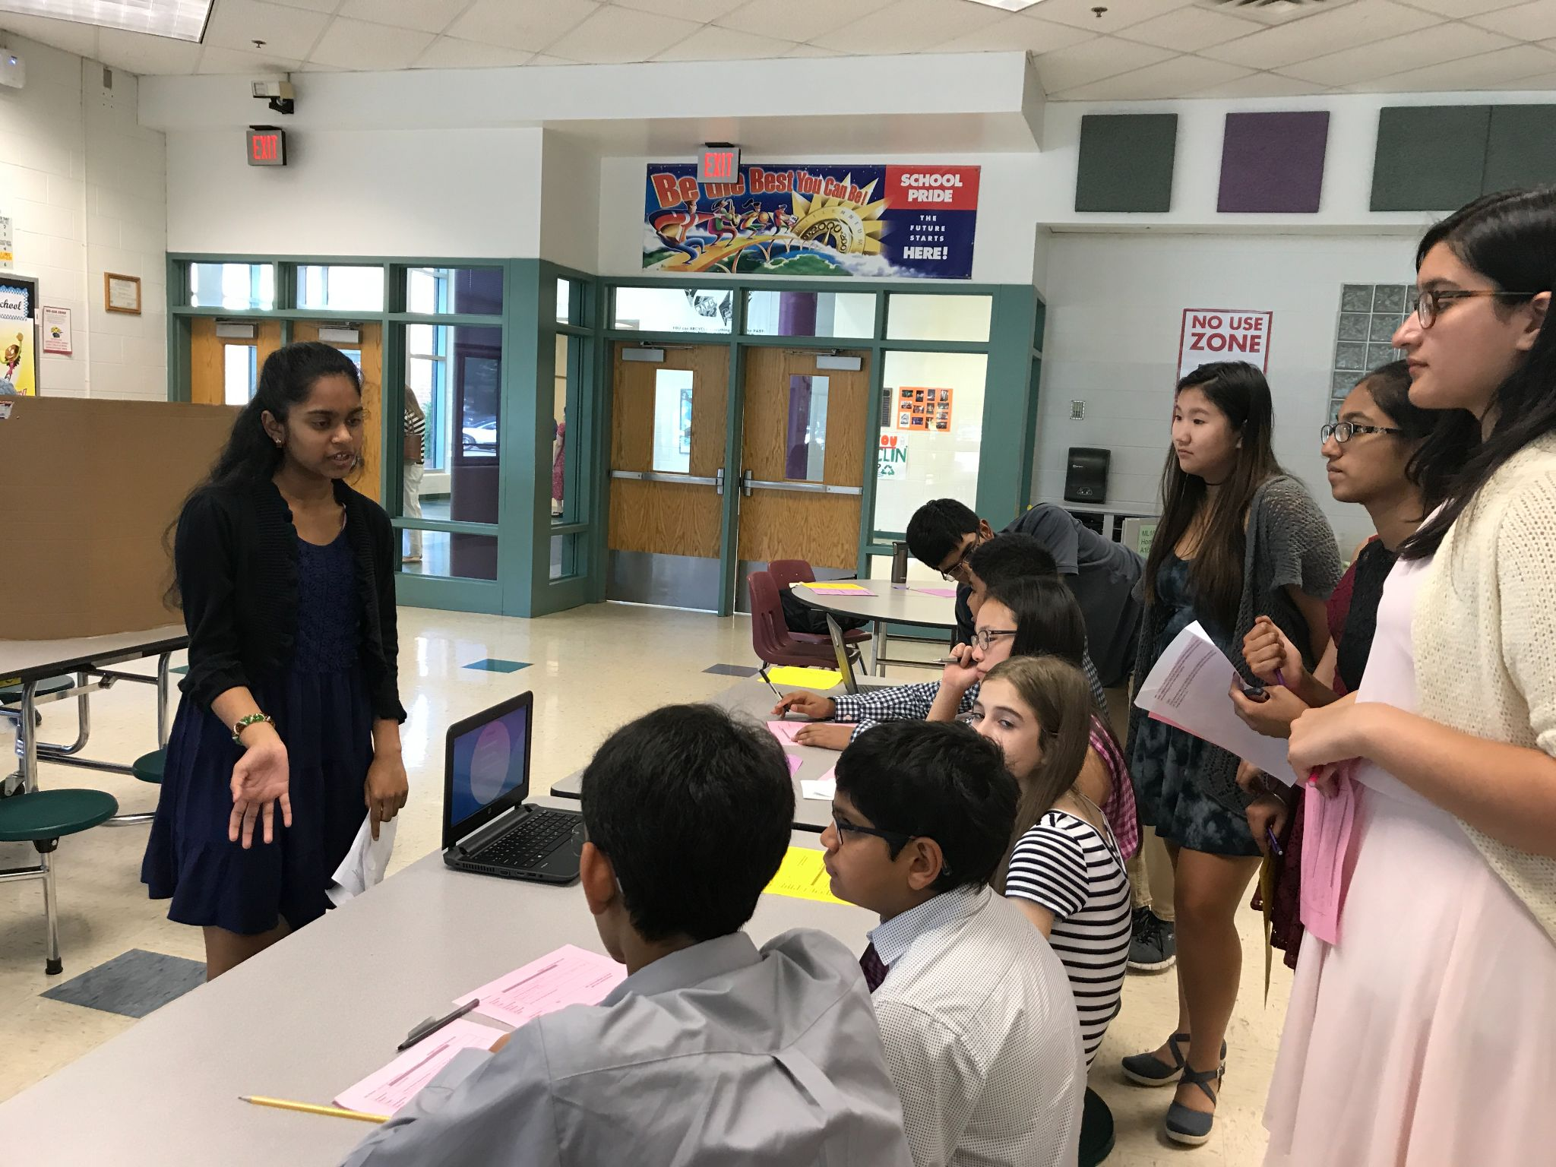
Presentations
Authentic Audience
Logistics
Peer Feedback
Feedback vs. Assessments
Notes:
Meg
For us, a key piece to this project was the way that students presented their learning. In lieu of a traditional awards ceremony at the end of the year, students had a share fair. This worked well with our focus on equity, in that every child had a project to share, and every parent was invited to see their child shine. This also created an authentic audience that increased student motivation.
We held the share fair in the cafeteria. Students were broken up into three groups, yellow, purple, and blue. When the blue group was presenting, the yellow and purple group were observing presentations and giving feedback on the “Share Fair Peer Feedback Form”.
During this project we were challenged to define the differences between feedback and assessment. We gave a lot of feedback along the way, so by the end of the project, it was very easy to assess the student achievement on the project.

Slide 26
Student and Teacher Reflection
Student Reflection
Reflection Slides 33-36
Student Feedback
Student Feedback about the Project - see question 4
Teachers as Learners- Leading by Example
Teacher PBL
Notes:
Victoria

Slide 27
Writing Connections
Identify The Problem
Expository Essay
Concept/Definition Mind Map
Chronological Newspaper Article
Analyze Solutions
Compare/Contrast Newspaper Article
Cause/Effect Infographic
Policy Proposal
Persuasive Essay
OpEd in Newspaper
Problem/Solution
Process
Notes:
Victoria
This project, or parts of this project, could have been used for a variety of tasks that apply to English standards like text structure or different purposes for writing. In “Identify the Problem” students could have been asked to write formal expository essays explaining their topics. You could also break down an essay into more creative projects like a concept/definition mind map or a chronological newspaper article giving a history of the topic. During the analyze solutions phase, students could have written a compare/contrast article for two existing policies or created a cause and effect infographic to show the flaws in some of the policies they researched. Finally, during the proposal phase, students could have been asked to write formal persuasive essays to present their idea. This could have been re-framed as an OpEd in a newspaper highlighting a problem and possible solution along with the process to enact the solution.

Slide 28
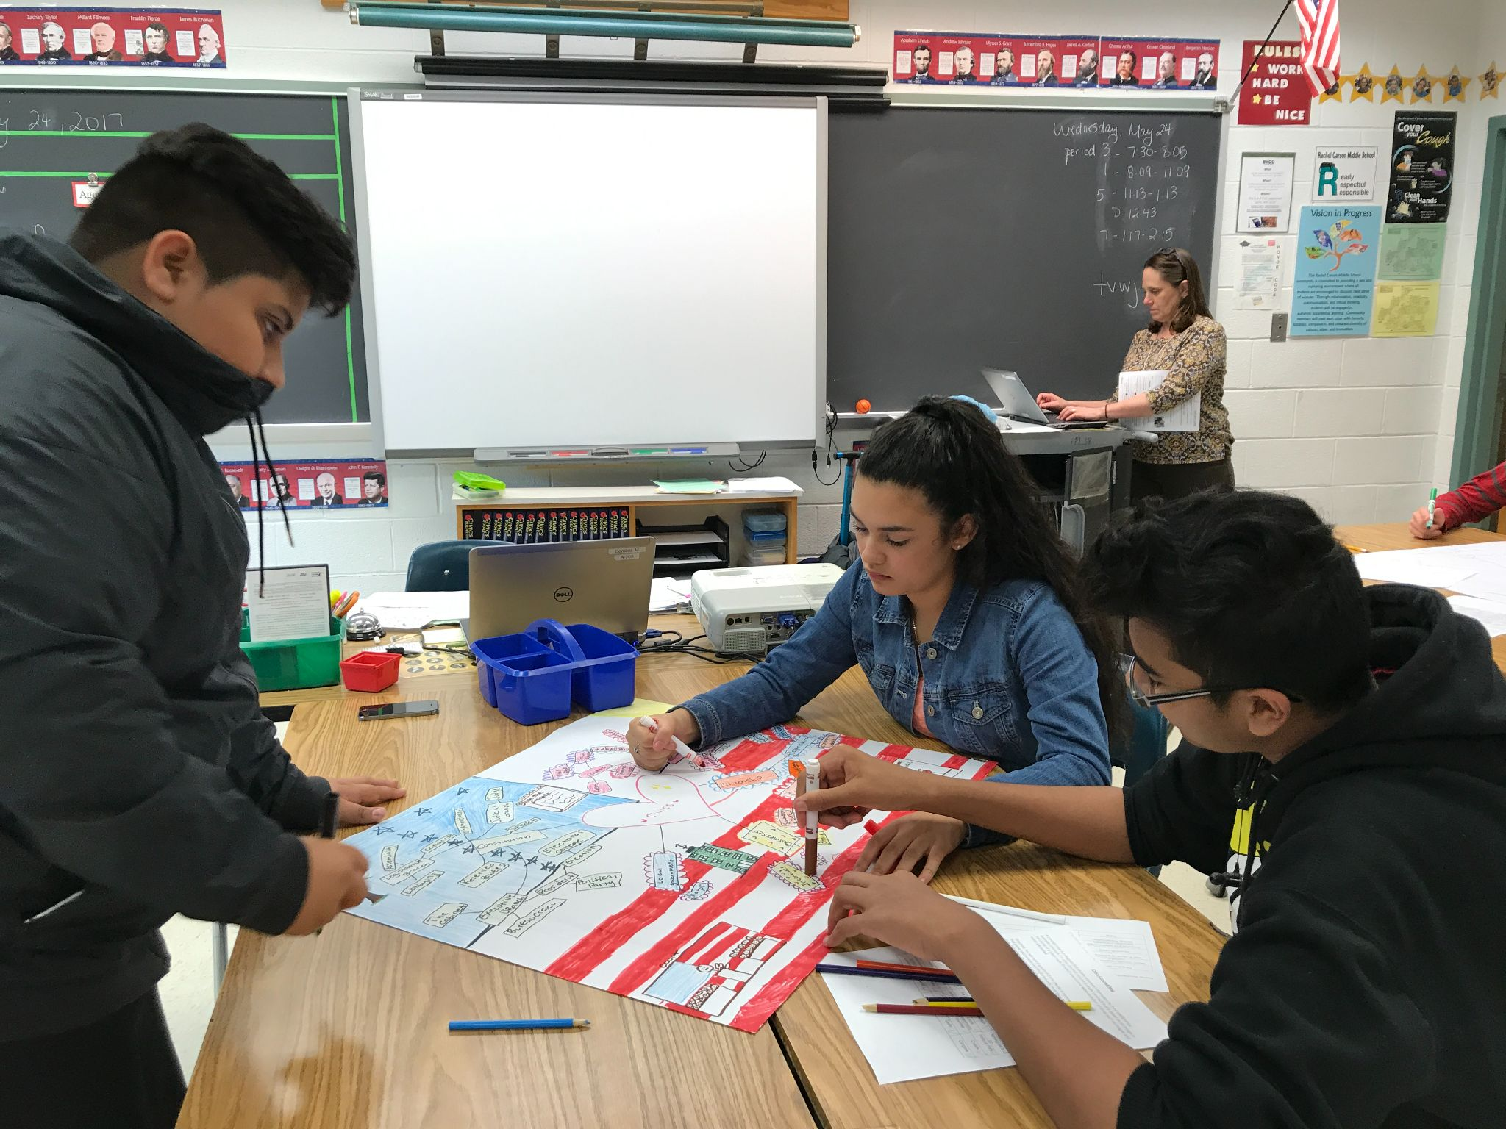
Extensions For All Students
Interdisciplinary Connections
Civics
Write Letter to elected representative
English
Audience, tone, grammar, and mechanics
Science
include graph or chart
Notes:
Meg
Civics interdisciplinary connections- standards overlap with English. Mutually beneficial. As part of the proposal- Civics teacher assigns letter writing assignment. English teacher conducts mini lesson on audience, tone, and revising grammar and mechanics. → Service hours opportunity.
Service Hours
Science- use of visual data/graphs

Slide 29
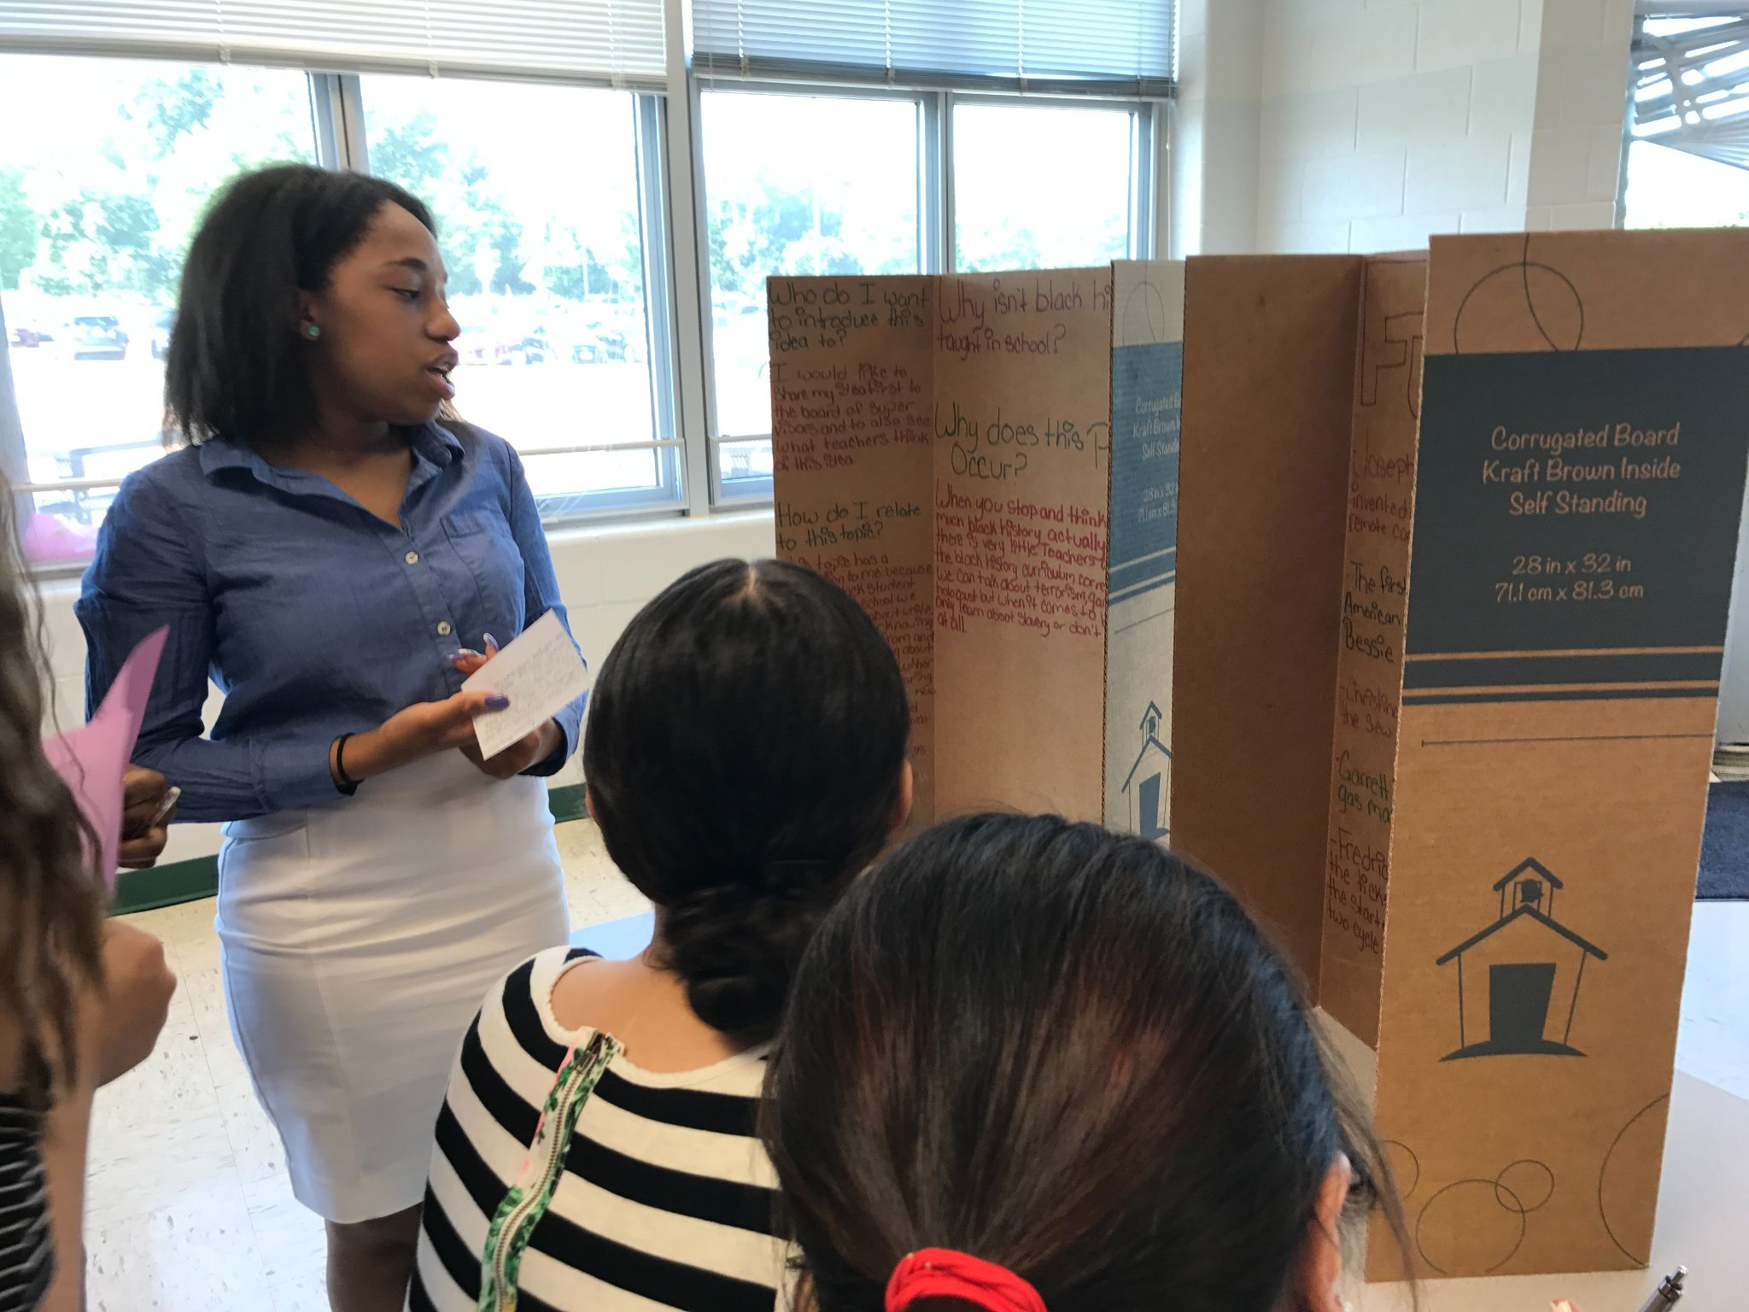
Thank You!
What questions might you have about inquiry-based or interdisciplinary projects?
Notes:
Meg
This is the way that this PBA worked for us, but as you can see, each time a PBA is done, it looks different depending on where your students interests take you.

Slide 30
VDOE Disclaimer
Reference within this presentation to any specific commercial or non-commercial product, process, or service by trade name, trademark, manufacturer or otherwise does not constitute or imply an endorsement, recommendation, or favoring by the Virginia Department of Education.

